Slide 1

Substance Misuse & Overdose Response
Protecting Our People, Strengthening Our Future

Slide 2
What Is Substance Misuse?
Excessively using substances in ways that harm your health or well-being
Examples of different substances:
  Prescription medications
  Alcohol
  Marijuana
  Commercial tobacco/vapes
  Illicit drugs

Slide 3
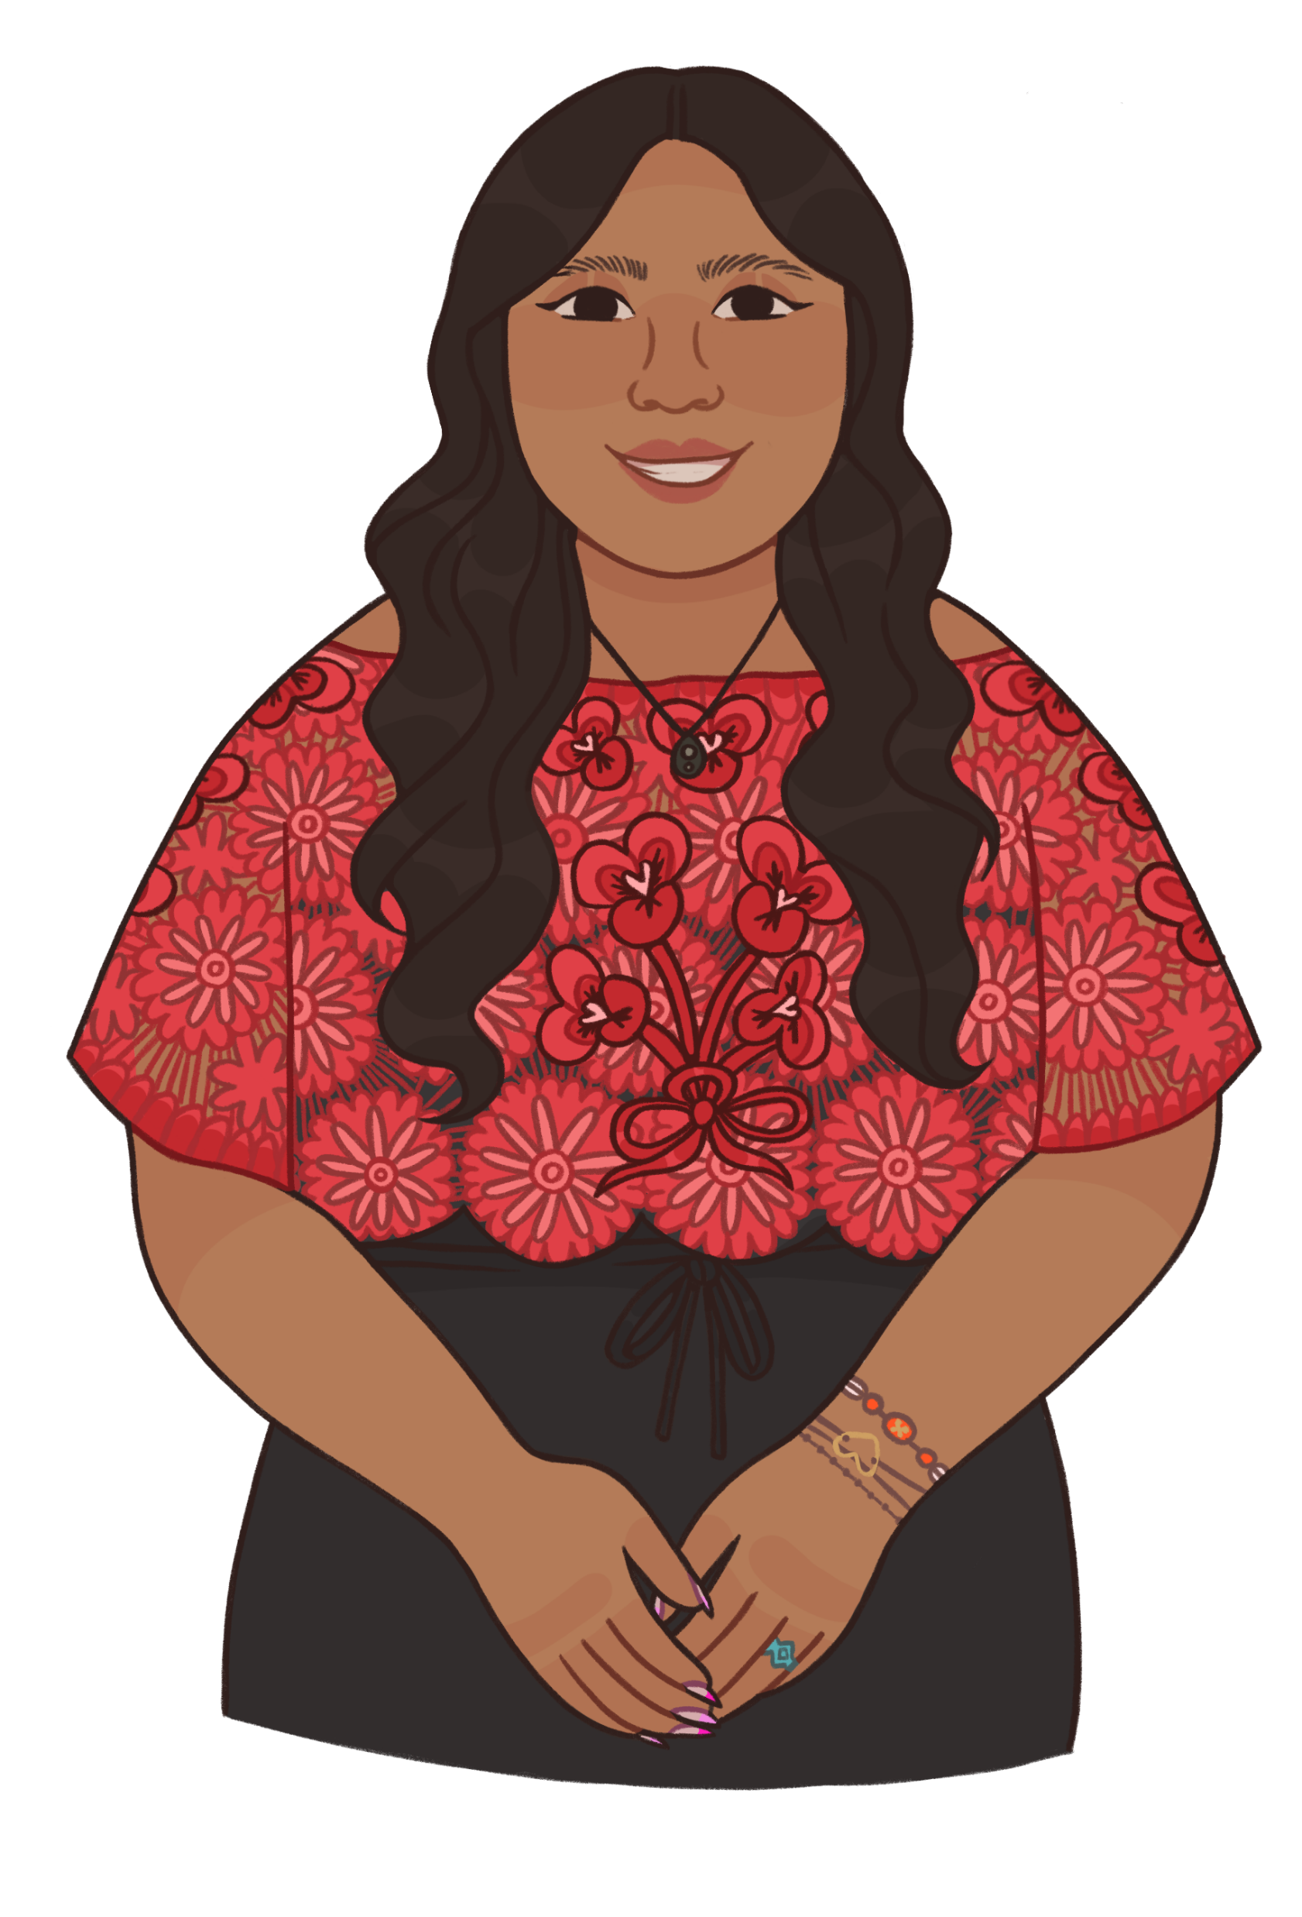
Why Youth Are Vulnerable
Peer pressure and wanting to fit in
Stress from school, family, or community challenges
Lack of accurate information about substances
Generational trauma
You carry your ancestor's resiliency within you!
Notes:
Seeing it as a “norm” in the media, on TV shows or in movies, etc.

Slide 4
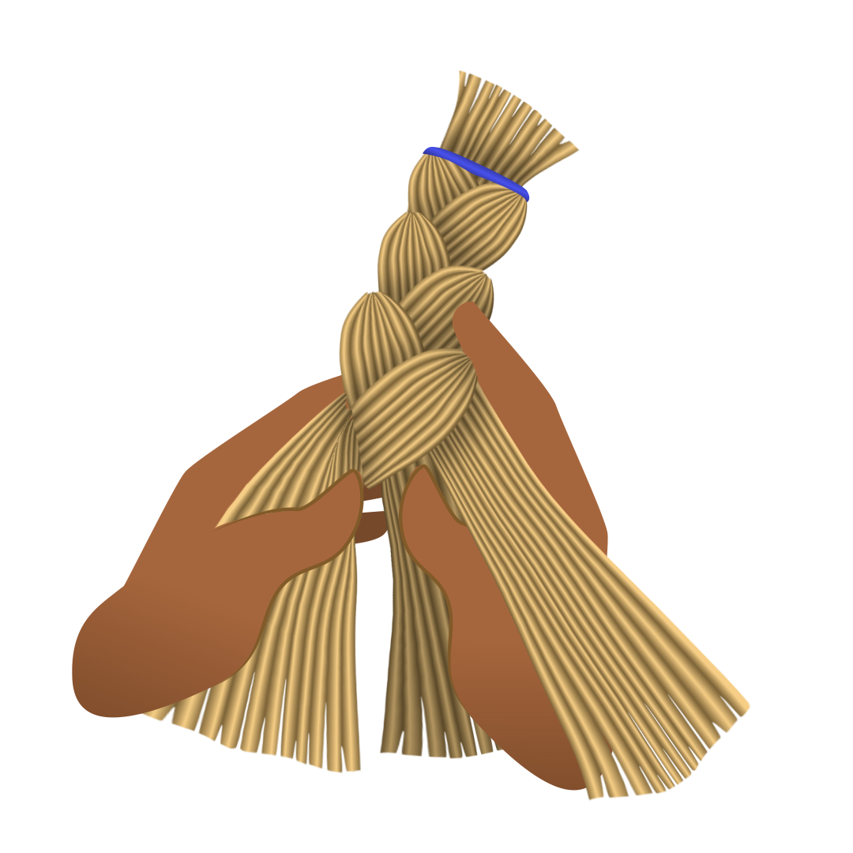
The Impact of Substance Misuse
Short-term effects:
  Poor decision-making
  Accidents
  Overdose
Long-term effects:
  Addiction
  Health issues
  Strained relationships
Community impacts:
  Family harm
  Disconnection from traditions and culture

Slide 5
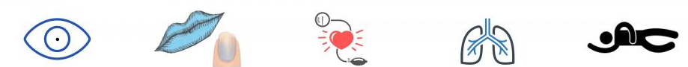
Recognizing an Overdose
Common signs:
  Slow or no breathing
  Unresponsive or unconscious
  Bluish lips or fingertips
  Vomiting or gurgling sounds
  Pale skin
  Small pupils

Slide 6
What to Do If Someone Is Overdosing
Call 911 immediately
Try to wake them: shake gently, shout their name
Administer Naloxone (Narcan): follow instructions if available
Perform CPR if trained
Stay with them: until help arrives or at least 90min after they wake up from the Naloxone

Slide 7
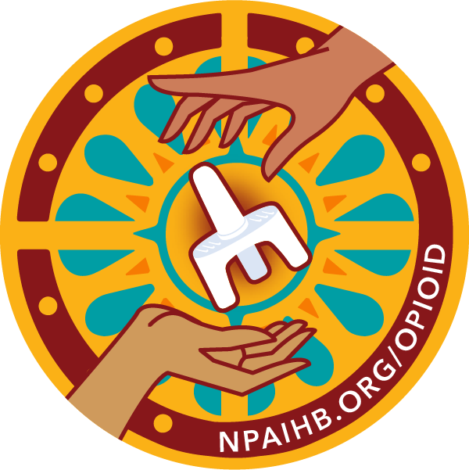
The Power of Naloxone
What it is: a medication that reverses opioid overdoses. AKA Narcan
How to get it: pharmacies, over the counter, community organizations, some Tribal clinics
Carrying Naloxone is like carrying a medicine bag – it’s a tool for healing and protecting life

Slide 8
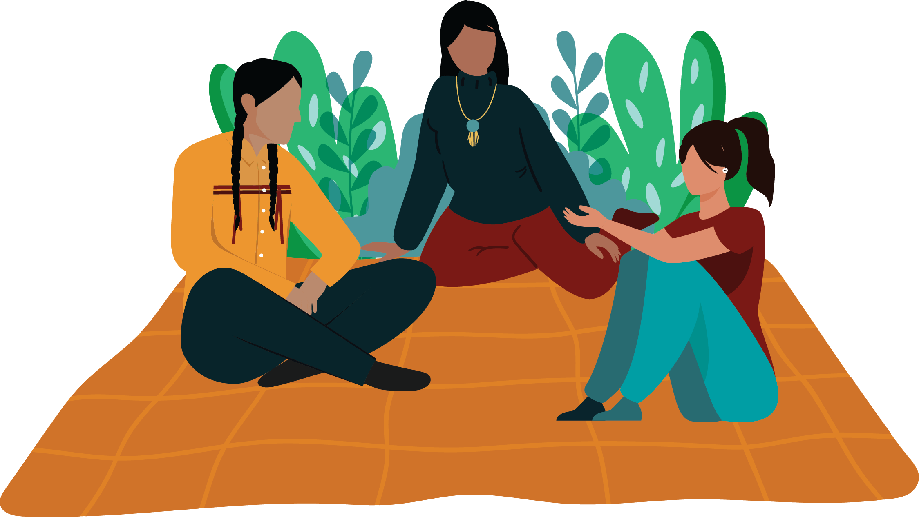
Protecting Yourself & Others
Set boundaries: Avoid situations with substance misuse
Know your resources: reach out to family, friends, elders, or counselors if you need help
Be an advocate: share what you’ve learned within your circle and community

Slide 9
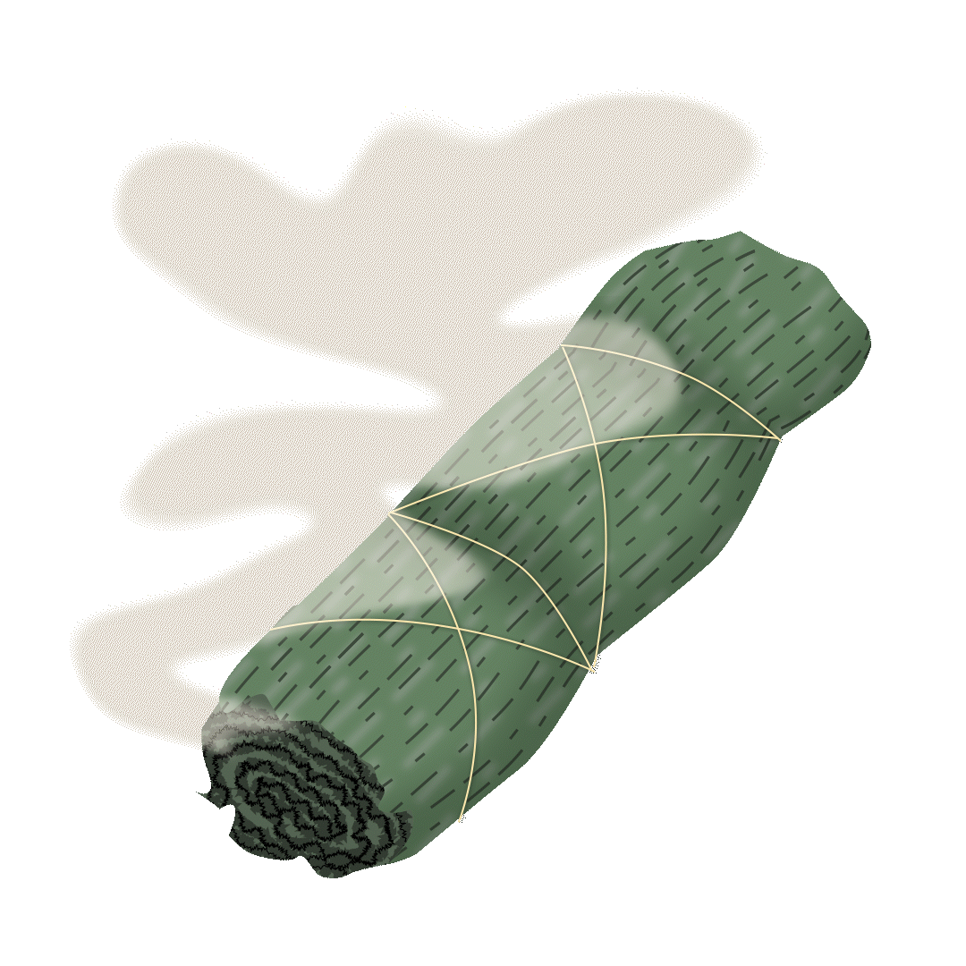
Staying Connected to Culture
Our traditions, ceremonies, and teachings guide us toward balance and health
Examples:
  Smudging for clarity and healing
  Participating in drum circles, Powwow’s, or beading groups
  Spending time in nature to reconnect with the land

Slide 10
Together, we can honor our traditions and keep our communities safe.
For more information, you can visit: www.npaihb.org/opioid

