Slide 1
Northwest Dental Health Aide Program
Portland Area Dental Meeting-2023
Miranda Davis, Dental Health Aide Program Director
Pam Ready, Dental Health Aide Program Manager
Kari Ann Kuntzelman, Dental Health Aide Specialist
Notes:
1

Slide 2
Objectives
History of the Northwest Dental Health Aide Program: Following Alaska's lead
Organizational Infrastructure
Learn the settings Dental Health Aides are authorized to work in
Adapting to the Pacific Northwest
Program updates
Notes:
2

Slide 3
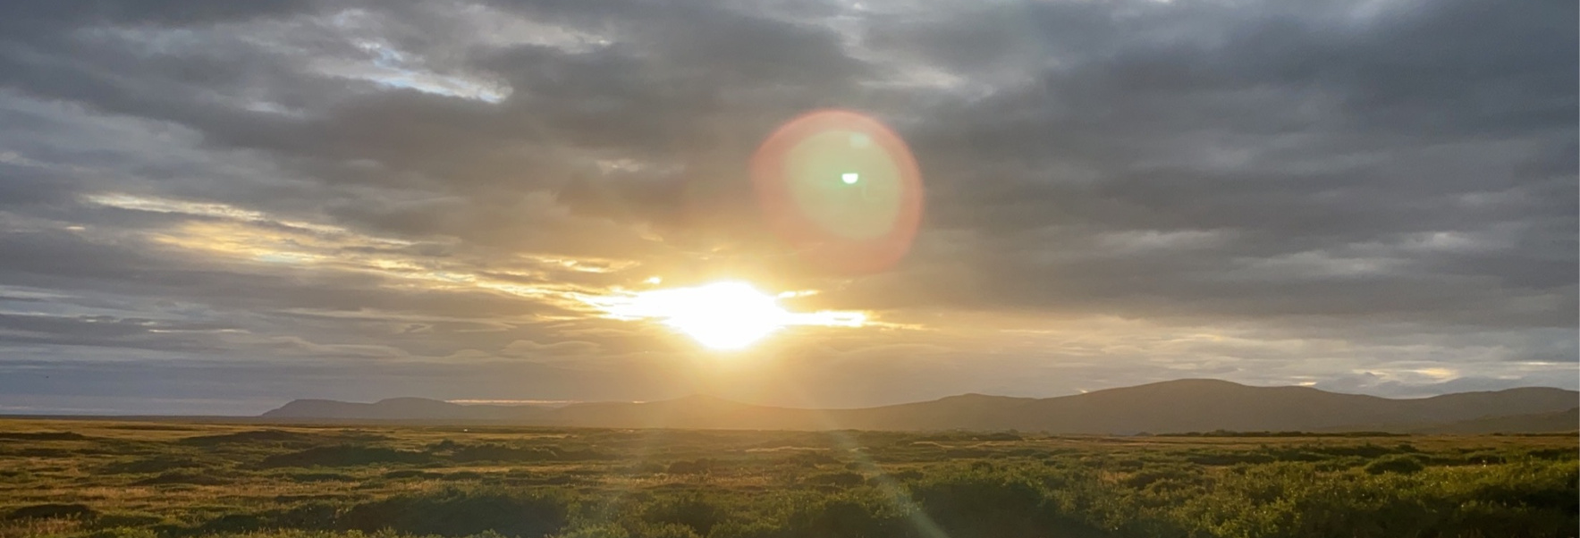
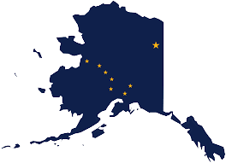
ALASKA
CHAP ORIGINS
Nome, AK Aug 2022
1950'S ORGINATED IN RESPONSE TO TB EPIDEMIC
1990'S ALASKA COMMUNITY HEALTH AIDE PROGRAM CERTIFICATION BOARD FORMALIZED
https://akchap.org/
1960'S INDIAN HEALTH SERVICE (IHS) ESTABLISHES THE COMMUNITY HEALTH AIDE PROGRAM (CHAP) IN ALASKA (THIS ONLY INCLUDED MID-LEVEL MEDICAL PROVIDERS WHO WERE COMMUNITY HEALTH AIDES).
2000'S DENTAL HEALTH AIDE AND BEHAVIORAL HEALTH AIDE PROGRAMS CREATED AND CERTIFIED
2010 : IN REAUTHORIZATION OF IHCIA, CONGRESS AUTHORIZES NATIONALIZATION OF CHAP
1970'S CONGRESS AMENDS THE INDIAN HEALTH CARE IMPROVEMENT ACT (IHCIA) TO AUTHORIZE THE Alaska CHAP (PL 94-437).
2020 IHS releases policy outlining nationalization of CHAP (Circular 20-06)
https://www.ihs.gov/chap/backgroun/

Slide 4
History of the NW DHAP
Began in 2015 as the Native Dental Therapy Initiative (NDTI)
Because Dental Health Aide Therapist (DHAT) is the only profession within CHAP that is noted in IHCIA as requiring authorization from the state
NDTI focused on assessment and developing infrastructure for the profession of dental therapy in Portland Area
Advisory Committees
Oregon Dental Pilot Project #100 (2016-2023)
Legislation in WA (2017, 2023), ID (2019), and OR (2021)
State Plan Amendments
Development of dental therapy education program
Began work to plan and implement other DHA types in 2021
Added title: Dental Health Aide Program, which oversees NDTI
Notes:
2

Slide 5
Dental Therapy Timeline in WA, OR, ID
2016
First Dental Therapist hired by Swinomish Tribe
Oregon Dental Pilot Project #100 approved
2017
Washington State passes Dental Therapy Legislation
2018
Dental Therapy Education Program Feasibility Study and Advisory Committee
2019
Idaho passes Dental Therapy Legislation
2021
Oregon passes Dental Therapy Legislation
2022
dəxʷx̌ayəbus DT Education Program receives CODA Accreditation, enrolls first class
Washington State passes state wide legislation
2023

Slide 6
Dental Health Aide Program Infrastructure
5
4
Dental Health Aide Program Advisory Workgroup- 3.2023
Integrate your branding into your business.
3
Dental Accademic Review Committee-3.2022
2
Portland Area CHAP Certification Board- 2021
1
Resolution-all 43 tribes agree on CHAP-7.15.2020
Tribes- 43 Federally Recognized tribes in OR, WA and ID
Standards and Procedures

Slide 7
DHAs Increase Access and Efficiency
PDHA
OHI, motivational interviewing
Polish, antimicrobials, fluoride
Dental Assisting
EFDHA
Place Restorations
PDHA services
DHAH
RDH procedures including local anesthesia
PDHA, EFDHA services
DHAT
Exam, diagnose
Prep, restore and finish
Non-surgical extractions
Kari Kuntzelman, DHAT, LDT, Oregon, 2020
Dentist
Complex services (RCT, crowns, surgery)
Supervising Dental Health Aides

Slide 8
For more information please contact:
pready@npaihb.org
kkuntzelman@npaihb.org
mdavis@npaihb.org
Dental Health Aide Program
https://www.tchpp.org/about-dhas
Primary Dental Health Aide I PDHA I | Primary Dental Health Aide II PDHA II | Expanded Functions Dental Health Aide I EFDHA I | Expanded Function Dental Health Aide II EFDHA II | Dental Health Aide Hygienist DHAH | Dental Health Aide Therapist DHAT
Required Courses | Required Courses | Required Courses | Required Courses | Required training & education | Required training & education
 | PDHA I and: | PDHA II and: | EFDHA I and:
Core Curriculum | Advanced Dental Procedures | Basic Restorative Functions | Advanced Restorative Functions | Accredited DH Program or Board approved DHAH Program | Accredited DT Program or Board Approved DHAT Program
Primary Oral Health Promotion and Disease Prevention | Community Based Dental Practice | Prefabricated Crown Placement | Preceptorship - 6 months or 800 hrs | Accredited DH Program or Board approved DHAH Program | Accredited DT Program or Board Approved DHAT Program
 | One or more of the following: Dental Assistant Functions Sealants Dental Prophylaxis Radiology Atraumatic Restorative Treatment | Preceptorship - 6 months or 800 hrs | Preceptorship - 6 months or 800 hrs | Accredited DH Program or Board approved DHAH Program | Accredited DT Program or Board Approved DHAT Program
Preceptorship - specific # of procedures | Preceptorship (s) - specific # of procedures | Preceptorship - 6 months or 800 hrs | Preceptorship - 6 months or 800 hrs | Accredited DH Program or Board approved DHAH Program | Accredited DT Program or Board Approved DHAT Program
Preceptorship - specific # of procedures | Preceptorship (s) - specific # of procedures | Preceptorship - 6 months or 800 hrs | Preceptorship - 6 months or 800 hrs | Accredited DH Program or Board approved DHAH Program | Accredited DT Program or Board Approved DHAT Program

Slide 9
NW Tribes Guiding the Dental Health Aide Progam
DHA CHAP Analysis:
Outreach conducted with Area Tribes and clinics to explore familiarity with CHAP, offer information, and ensure that DHA Program development is meeting their needs
Dental clinics interested in DHA program to enhance exiting DAs skills and train new DAs
DHA Program Advisory Workgroup
All tribes and staff welcome to participate
Guiding development of DHA Program
Next meeting: September 13, 12pm-1pm Pacific Time
Notes:
2

Slide 10
Outreach: Tribal Schools
Nixya’awii Community School - CTUIR Charter School
June 2022: Educational dental unit to capture interest in the core curriculum course
August - November 2023: Core Curriculum course
Chief Leschi Schools - Puyallup Tribe
Dental careers information
High School Career and Technical Ed
Elementary STEM Enrichment
2022 and 2023
***Please contact the DHAP if you are interested in adding these programs to your community.
Notes:
2

Slide 11
MENTORSHIP
Elders recruitment
Communication
Portland Area CHAP CertificationCertification assistance
Recruitment for AWG's/ARC's
Notes:
2

Slide 12
PROGRAM UPDATE
https://www.tchpp.org/-academic-review-committees
Notes:
2

Slide 13
dəxʷxayəbus (Place of Smiles) Dental Therapy Program
Skagit Valley College, 2019
2022: CODA Accreditation and enrolled first cohort
Currently recruiting for 3rd cohort beginning September 2024
5 students accepted for the 2023 cohort
NPAIHB continues to coordinate advisory committee
Notes:
2

Slide 15
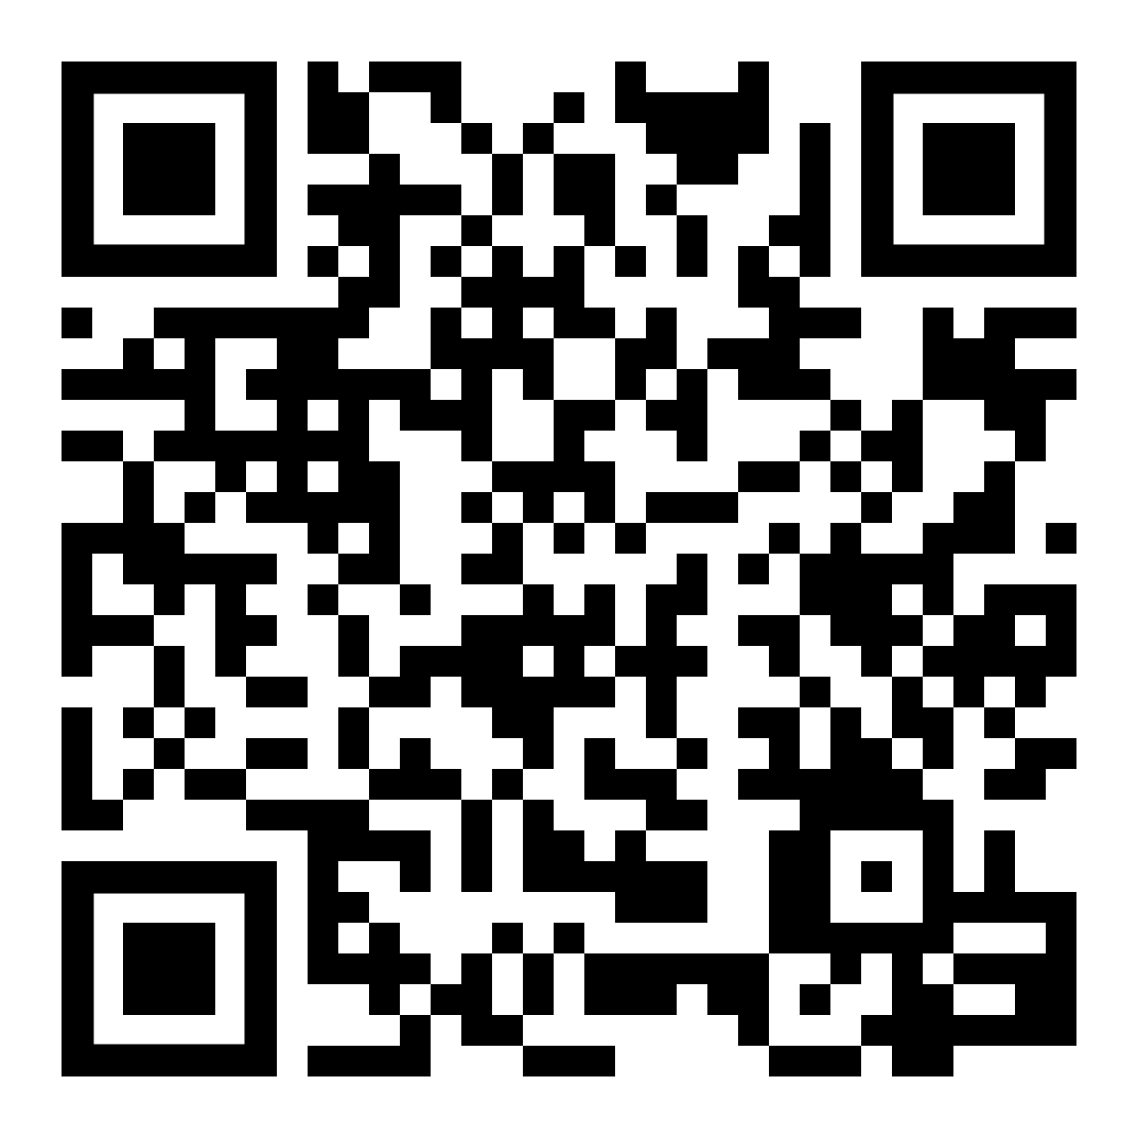

Slide 16
THANK YOU
www.tchpp.org
pready@npaihb.org
mdavis@npaihb.org
kkuntzelman@npaihb.org

