Slide 1
The dental team:
Our important role in HPV prevention
Presented to Northwest Tribal Dental Support Center - Portland Area Dental Meeting
August 16, 2023
by Lisa Bozzetti DDS, Dental Director
Knight Cancer Institute Grantee
Funding for this project was provided in part by the OHSU Knight Cancer Institute Community Partnership Program, a grant program that supports communities across Oregon in addressing local cancer-related needs.

Slide 2
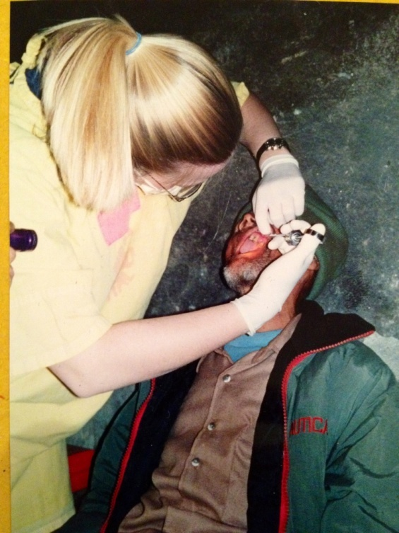
About Me
Lisa Bozzetti DDS
DDS – Loma Linda University, CA 2002
Experiences in Mexico and Nepal
First job–CHC in Hood River, OR
Corporate Group Practice for 5 years
Dentist and Dental Director, Virginia Garcia Memorial Health Center - 15 years
Board of Directors NNOHA
Member of the Oregon HPV Dental Task force (part of the Oregon HPV Prevention Alliance) 2021-2022
Organization is recipient of Knight Cancer Institute funding to support some of our work around HPV prevention
Nepal 2001

Slide 3
Our Mission
The Mission of Virginia Garcia Memorial Health Center is to provide high quality, comprehensive, and culturally appropriate health care to the communities of Washington and Yamhill counties with a special emphasis on migrant and seasonal farmworkers and others with barriers to receiving health care.

Slide 4
About Virginia Garcia
We serve more than 52,000 individuals in
Washington and Yamhill counties at:
five primary care clinics
six dental clinics
five school-based health centers
a women’s clinic
a mobile outreach clinic (soon to be 2!)
a centralized administration office
Today we serve 1 in every 14 residents of Washington and Yamhill counties.

Slide 5
Objectives
Describe the relationship between HPV and oral cancer
List two benefits of promoting HPV vaccination in the dental clinic
Outline the age range that benefits most from HPV vaccination

Slide 6
What is HPV (Human Papilloma Virus)?
Human papillomavirus (HPV) is the most common sexually transmitted infection (STI) in the U.S. with nearly every sexually active person having an HPV infection in their lifetime (National Cancer Institute, 2021).
Estimated 79 million Americans currently infected
14 million new infections/year in the US
HPV infection is most common in people in their teens and early 20s
Most people will never know that they have been infected
HPV-related oropharyngeal cancer cases are rising, with an estimated 3,500 new cases per year in women and 16,200 per year in men (CDC, 2021).
Dentists participate in detection of oral and oropharyngeal cancer by performing oral cancer screenings. Dentists do not routinely participate in primary HPV-related oropharyngeal cancer prevention, including counselling, referrals for vaccination, and/or direct vaccination (Daley EM, 2018; Griner SB, 2019; Harris KL, 2020).
Sources: Megan Cloidt DDS MPH
CareQuest presentation to Oregon HPV Dental Task Force & You are the Key HPV Dental presentation
Notes:
HPV is from a common family of viruses that infect epithelial tissue
Women will sometimes find out due to an abnormal pap or genital warts and men typically find out due to a genital wart diagnosis
Some will clear the virus whereas others will not, no way to tell if you are at risk for cancer

Slide 7
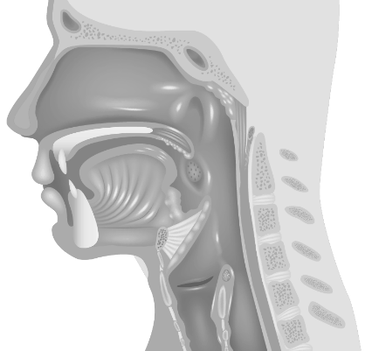
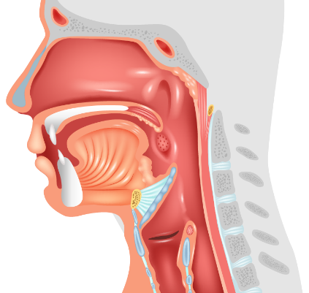
HPV DNA Detection by Anatomic Location of Certain Head and Neck Cancers^{1,2}
Oropharynx
~
70
%
HPV-positive
Oral Cavity
~
32
Larynx
%
HPV-positive
~
21
%
HPV-positive
The CDC partnered with 7 United States population-based cancer registries to obtain archival tissue for cancers diagnosed from 1993-2005, before the introduction of HPV vaccination. HPV testing was performed on 2670 case patients who were fairly representative of all participating cancer registry cases by age and sex. HPV type-specific detection percentages were determined by anatomic site and demographic characteristics.¹ Not all oropharyngeal, laryngeal, and oral cavity cancers are caused by HPV.¹ Detection of HPV DNA in an HPV study is insufficient to indicate a causal relation with the tumor.¹
CDC=Centers for Disease Control and Prevention; DNA=deoxyribonucleic acid; HPV=human papillomavirus.
Saraiya M, et al. J Natl Cancer Inst. 2015;107(6):djv086.
NCI website. https://www.cancer.gov/types/head-and-neck/patient/adult/oropharyngeal-treatment-pdq. Last updated November 21, 2019. Accessed February 25, 2020.
(slide used with permission from Shanta Chelliah, MD, FAAP, Regional Medical Director, West – Merck & CO.)

Slide 8
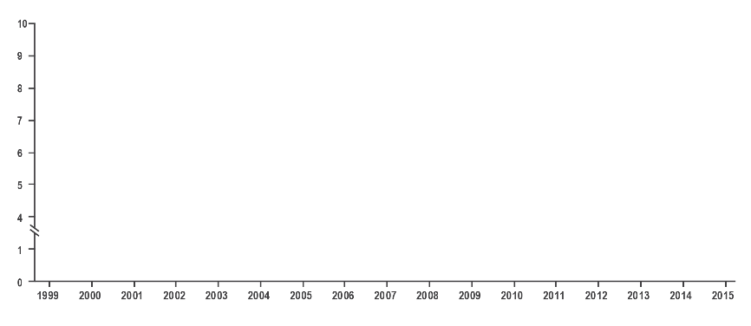
HPV-Associated Oropharyngeal Cancer Rates in Males Surpassed Cervical Cancer Rates in Females¹
Oropharyngeal SCC (male); AAPC: 2.7
Cervical carcinoma (female); AAPC: -1.6
Rate (no. of cases per 100,000)
During 1999-2015, oropharyngeal SCC rates increased 2.7% per year among men
Year of Diagnosis
Trends in age-adjusted incidence of cervical carcinoma among females and oropharyngeal SCC among men in the United States, 1999-2015. The CDC analyzed data from population-based cancer registries that participate in the CDC’s National Program of Cancer Registries and the NCI’s SEER program that met the criteria for high data quality for all years from 1999 to 2015. These data cover approximately 97.8% of the US population. Cancer registries’ incidence data met the following 5 United States Cancer Statistics criteria: 1) ≤5% of cases ascertained solely on the basis of death certificate; 2) ≤3% of cases missing information on sex; 3) ≤3% of cases missing information on age; 4) ≤5% of cases missing information on race; and 5) ≥97% of registry’s records passed a set of single-field and interfiled computerized edits that test the validity and logic of data components. HPV-associated cancers were defined as cancers at specific anatomic sites with specific cell types in which HPV DNA is frequently found. All cancers were microscopically confirmed.
AAPC=average annual percent change; CDC=Centers for Disease Control and Prevention; DNA=deoxyribonucleic acid; HPV=human papillomavirus; NCI=National Cancer Institute; SCC=squamous cell carcinoma; SEER=Surveillance, Epidemiology, and End Results.
1. Van Dyne EA, et al. MMWR Morb Mortal Wkly Rep. 2018;67(33):918-924.
(slide used with permission from Shanta Chelliah, MD, FAAP, Regional Medical Director, West – Merck & CO.)

Slide 9
Oropharyngeal Cancer Is the Most Prevalent Type of HPV-Attributed Cancer in the United States (2012-2016)
According to a model of the CDC’s estimated 2012-2016 US incidence of cancer cases attributed to 7 HPV types (16, 18, 31, 33, 45, 52, and 58)¹:
9
7
0
0
1
2
6
0
0
~
~
~
~
cases of cervical cancer annually¹
cases of oropharyngeal cancer annually¹
For most people, HPV clears on its own. But, for those who don’t clear the virus, it could cause certain cancers and diseases.²⁻⁴ There is no way to know which patients who have HPV will develop cancer.⁵
The CDC analyzed data from the United States Cancer Statistics (USCS) to assess the incidence of HPV-associated cancers and to estimate the annual number of cancers caused by HPV, overall and by state, during 2012-2016. The estimated number of cancers attributable to HPV was calculated by multiplying the average number of HPV-associated cancers by the percentage of cancers diagnosed from 1993-2005 that were attributable to HPV.^{1,6} Not all cervical and oropharyngeal cancers are caused by HPV.¹ Detection of HPV DNA in an HPV study is insufficient to indicate a causal relation with the tumor.⁶
CDC=Centers for Disease Control and Prevention; DNA=deoxyribonucleic acid; HPV=human papillomavirus.
Senkomago V, et al. MMWR Morb Mortal Wkly Rep. 2019;68(33):724-728. 2. CDC. 2015 sexually transmitted diseases treatment guidelines: human papillomavirus (HPV) infection. https://www.cdc.gov/std/tg2015/hpv.htm. Last reviewed June 4, 2015. Accessed February 3, 2020. 3. CDC. Human papillomavirus. In: Hamborsky J, et al, eds. Epidemiology and Prevention of Vaccine-Preventable Diseases. 13th ed. 2015:175-186. 4. CDC. HPV and oropharyngeal cancer. https://www.cdc.gov/cancer/hpv/basic_info/hpv_oropharyngeal.htm. Last reviewed March 14, 2018. Accessed January 21, 2020. 5. CDC. Types of cancer caused by HPV. CDC website. https://www.cdc.gov/hpv/parents/cancer.html. Last reviewed April 29, 2019. Accessed March 9, 2020. 6. Saraiya M, et al. J Natl Cancer Inst. 2015;107(6):1-12.
(slide used with permission from Shanta Chelliah, MD, FAAP, Regional Medical Director, West – Merck & CO.)

Slide 10
The Majority of HPV-Attributed Oropharyngeal Cancer Occurs in Males (2012-2016)
Model of the CDC’s estimated 2012-2016 United States incidence of cancer cases attributed to 7 HPV types (16, 18, 31, 33, 45, 52, and 58)¹:
~2100
female cases annually
Males affected
~5X
more than females
~10,500
male cases annually
(slide used with permission from Shanta Chelliah, MD, FAAP, Regional Medical Director, West – Merck & CO.)

Slide 11
Why Discuss HPV vaccine in Dental?
70% of Head and Neck Cancers are HPV+
AND we regularly see children in the 9-12 age range for dental care
Prior to the pandemic over 84% of children, ages 2-17, had an annual preventive exam.
In 2020 the number dropped to 80% and is increasing slowly
DID YOU KNOW WE HAVE A VACCINE THAT PREVENTS CANCER??
The dental team can be extension of the team recommending the vaccine – patients/parents hear similar messaging from multiple sources

Slide 12
Dental providers see a large number of adolescents and young adults who are unvaccinated for HPV in a given year and we can serve as an access point for HPV vaccine messaging and delivery
Notes:
Consider that around this age many children don’t regularly see a doctor unless they are sick, so chances are pretty good that you will see a child more frequently in the dental chair

Slide 13
Messaging Dental Patients
Focus on cancer prevention: HPV vaccination prevents cancer-causing infections & pre-cancers
Review vaccine history much like you do a health history
Add sections to your patient questionnaire about HPV vaccine history
Recommend vaccines much like you’d recommend dental needs
Reinforce HPV vaccination as the norm, just like parents chose to vaccinate their child as infants
Important that we all use clear, consistent messages about the HPV vaccine
Talk to your medical teams about their recommendations
Educate staff about HPV vaccine recommendations
Notes:
Dental teams don’t like to talk about STDs and sex, so turn the conversation to one of prevention

Slide 14
Focus on Cancer Prevention When Discussing the HPV Vaccine With Patients
Vaginal ~600
Model of the CDC’s estimated 2012-2016 United States incidence of cancer cases attributed to 7 HPV types (16, 18, 31, 33, 45, 52, and 58)¹
Vulvar ~2500
Anal ~6000
FEMALES ~4100
MALES ~1900
~31,400 total cases each year
Cervical ~9700
FEMALES ~2100
Oropharyngeal ~12,600
MALES ~10,500
For most people, HPV clears on its own. But, for those who don’t clear the virus, it could cause certain cancers and diseases.²⁻⁴ There is no way to know which patients who have HPV will develop cancer.⁵
The CDC analyzed data from the United States Cancer Statistics (USCS) to assess the incidence of HPV-associated cancers and to estimate the annual number of cancers caused by HPV, overall and by state, during 2012-2016. The estimated number of cancers attributable to HPV was calculated by multiplying the average number of HPV-associated cancers by the percentage of cancers diagnosed from 1993-2005 that were attributable to HPV.^{1,6} Not all cervical, vulvar, vaginal, anal, and oropharyngeal cancers are caused by HPV.¹
Detection of HPV DNA in an HPV study is insufficient to indicate a causal relation with the tumor.⁶
CDC=Centers for Disease Control and Prevention; DNA=deoxyribonucleic acid; HPV=human papillomavirus.
1. Senkomago V, et al. MMWR Morb Mortal Wkly Rep. 2019;68(33):724-728. 2. CDC. 2015 sexually transmitted diseases treatment guidelines: human papillomavirus (HPV) infection. https://www.cdc.gov/std/tg2015/hpv.htm. Last reviewed June 4, 2015. Accessed February 3, 2020. 3. CDC. Human papillomavirus. In: Hamborsky J, et al, eds. Epidemiology and Prevention of Vaccine-Preventable Diseases. 13th ed. 2015:175-186. 4. CDC. HPV and oropharyngeal cancer. https://www.cdc.gov/cancer/hpv/basic_info/hpv_oropharyngeal.htm. Last reviewed March 14, 2018. Accessed January 21, 2020. 5. CDC. Types of cancer caused by HPV. CDC website. https://www.cdc.gov/hpv/parents/cancer.html. Last reviewed April 29, 2019. Accessed March 9, 2020. 6. Saraiya M, et al. J Natl Cancer Inst. 2015;107(6):1-12.
(slide used with permission from Shanta Chelliah, MD, FAAP, Regional Medical Director, West – Merck & CO.)
14

Slide 16
CDC Recommendation for HPV Vaccination¹
2 doses if completed before age 15
3 doses if completed after age 15
CDC=Centers for Disease Control and Prevention; HPV=human papillomavirus.
1. Meites E, et al. MMWR Morb Mortal Wkly Rep. 2019;68(32):698-702.
Notes:
AAP recommends HPV vaccine starting at 9 years of age. Pre-teens produce more antibodies after HPV vaccination than older teens. Vaccinating at a younger age can protect kids before they are exposed to the virus.
Forecasting is simple

Slide 17
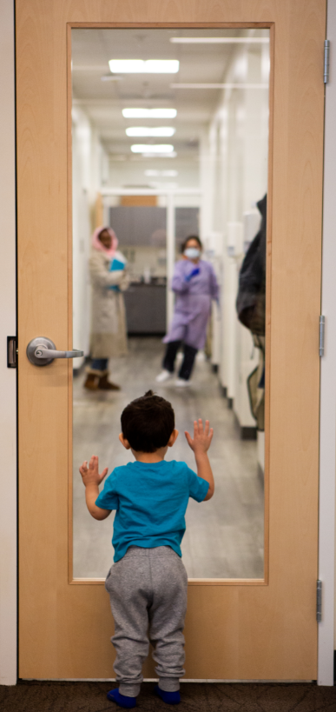
Educating Teams about HPV
Education of Staff and Parents/Patients
(1) Train clinical dental staff to feel comfortable having conversations with parents and introducing the concept of HPV vaccine
(2) Use existing educational materials designed specifically for dental use (ex: from the Oregon HPV Dental Task force) to:
Educate parents of patients 9-12 years of age - to encourage consideration of vaccination for HPV for their child.
Recommend vaccine in primary care

Slide 18
Oregon HPV Alliance Dental Task Force & Toolkit
Oregon HPV Dental Task Force:
Convened dental professionals in 2021 from private and public sector for 16 months to:
Provide continuing education and discussion on HPV prevention strategies within the dental field
Encourage dental providers to prevent HPV infection through counseling, referral or direct vaccine administration
Collaboratively create a customizable educational toolkit to guide providers in having conversations about HPV infection and prevention with patients

Slide 19
Patient facing educational materials in English & Spanish –
can add your organization’s log to any of these materials
Oregon HPV Alliance Dental Task Force Toolkit
Also includes provider facing materials

Slide 20
Additional Resources
HPV Prevention Alliance
CDC How I recommend HPV vaccine series
American Dental Association (ADA) recommendations for HPV vaccine
American Academy of Pediatrics (AAP) – HPV recommendations and Toolkit

Slide 21
Lessons Learned
Providers were much more receptive to learning about HPV and learning to message patients. DAs needed a bit more time to warm to the idea and additional education.
Yet providers struggled to start the conversation about HPV
Have a DA leader prepare a presentation about HPV to share with DAs
Concerns addressed:
When to bring up the conversation with a parent/patient
Messaging and examples of scripting were very helpful
What if a parent or patient asks a question you don’t know the answer to?

Slide 22
HPV Project Timeline and Next Steps
Patient/Staff Education
Presentation about HPV and vaccine from Dr. Shanta Chelliah
All Dental Staff presentation 4/5/22
Provider Meeting 6/7/22
Standing topic of discussion at provider meetings
Informational session for Dental Assistants ONLY:
11/4/22
Distributed patient and provider facing materials to all clinics and provided scripting for conversations with patients
Work out billing/coding issues
Currently being worked on:
Administer HPV Vaccines
August 30, 2023 – HPV vaccine training for dentists and DAs
Working with our clinical training teams and clinics to create a workflow
Begin administering HPV vaccines at co-located dental clinics in September 2023
Challenges so far:
Uninsured patients require challenging paperwork trail for use of vaccines for children (VFC) vaccine supply
Looming Question
Will patients be amenable to receiving the HPV vaccine from the dentist?
Medical Credentialing of Dentists? To bill medical plans directly?
Though in the same EHR – worked to created a split encounter – so dental and medical codes can go in the same encounter and be billed to dental and medical plans respectively – dental vaccine code gets “flipped” to a CPT code for medical billing
Commercial plans look different from Medicaid plans
Dental Plans not likely to cover vaccines even in our CCO world
Determine IF this model can work

Slide 23
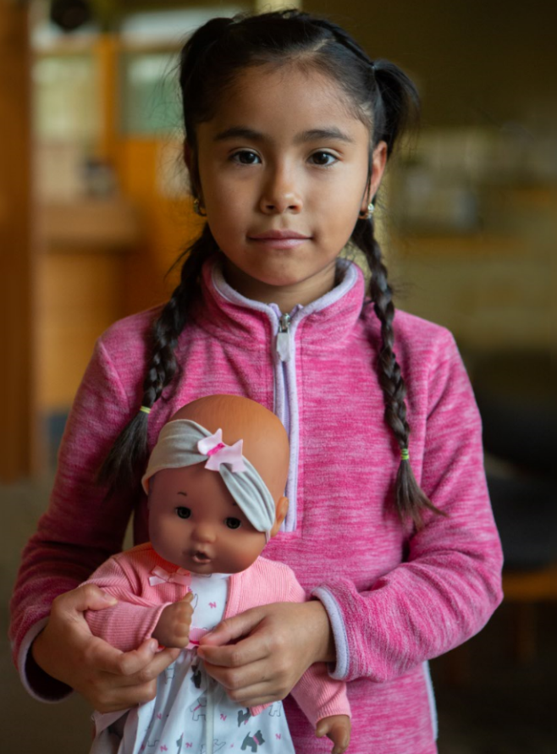
Advantages of doing this work in an FQHC setting
Advantages:
Our dentists and hygienists administered Covid vaccines AND flu vaccines with our medical colleagues for over 2 years now. Is an accepted part of our dental workflows.
We use an integrated electronic record (Epic)
Our dental teams query Alert/review and reconcile vaccines and recommend overdue vaccines already.
Pilot sites for administering HPV vaccine: 2 dental clinics that are co-located with medical
Intentional:
Vaccine fridges already on-site and managed by primary care
If we are unsuccessful in untangling the billing side, we can still bill through the physician on-site (even though our dentists CAN order vaccines)

Slide 24
Key Take Aways
Dental Teams should be part of messaging parents and patients about HPV
Key message – cancer prevention
You all have a big role in helping decrease our HPV related cancer rates through vaccination!

Slide 25
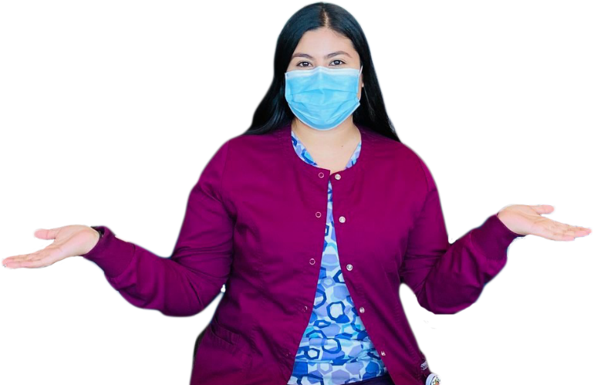
THANK YOU!
@VGMHC
Lisa Bozzetti, DDS
Dental Director
lbozzetti@vgmhc.org
@ClinicaVirginiaGarcia (Spanish-only page)
@VGMHC
@VirginiaGarcia
Virginia Garcia Memorial Health Center and Foundation
Virginia Garcia Memorial Health Center

