Slide 1
Infection Control for Dental Healthcare Professionals

Slide 2
Eve Cuny, MS
Executive Associate Dean and Professor
University of the Pacific
Dugoni School of Dentistry

Slide 3
Infection Prevention and Control Guidelines
CDC
Interim infection prevention guidelines for COVID-19
Core practices for infection prevention and control
Transmission-based precautions
Additional guidelines exist in areas such as
Sterilization and disinfection
Hand hygiene
Healthcare personnel (vaccine, post-exposure management, etc.)
Healthcare worker vaccinations
Disease-specific guidelines (TB, hepatitis B, HIV, etc)
Summary of Infection Prevention Practices in Dental Settings (not a guideline)
mmary of Infection Prevention Practices in Dental Settings

Slide 4
Additional Regulations and Guidelines
OSHA
Bloodborne Pathogens Rule
Hazard Communication
Respiratory Protection Program
Injury and Illness Prevention
State Boards of Dentistry
Infection control
EPA
Surface disinfectant registration
State Health Departments
Regulated Medical Waste
AAMI/ANSI
Sterilization
FDA
Manufacturer labeling, and instructions for use
High level disinfectant registration
Notes:
In addition to accreditation/certification of outpatient clinics, eg; AAAHC, CMS, etc.

Slide 5
Precautions to prevent transmission in healthcare
Standard
Used in the care of all patients as foundational precautions
Transmission-based
in addition to standard precautions to interrupt the spread of certain pathogens
Contact
Droplet
Airborne
Currently under review by HICPAC
Possibly combining droplet and airborne
May reduce emphasis on AGP’s since patients are always expelling aerosols regardless of the procedure
Nothing has been finalized—stay tuned

Slide 6
Vaccinations
Hepatitis B
Measles/Mumps/Rubella
Varicella
Tdap
Polio
Influenza
COVID-19
Other vaccines recommended for locations where diseases not common in US are prevalent (e.g., yellow fever, typhoid), or during outbreaks.

Slide 7
Standard Precautions
Standard Precautions are a set of infection control practices that healthcare personnel use to reduce transmission of microorganisms in healthcare settings.
Standard Precautions protect both healthcare personnel and patients from contact with infectious agents.

Slide 8
Standard precautions
Elements include:
Hand hygiene.
Using personal protective equipment (PPE).
Respiratory hygiene/cough etiquette.
Sharps safety, including engineering and work practice controls.
Safe injection practices.
Sterilization and disinfection of instruments and devices.
Cleaning and disinfecting environmental surfaces.

Slide 9
Personal protective equipment
Preventing contact with blood and body fluids

Slide 10
Personal Protective Equipment (PPE)
Worn whenever there is a potential for:
Contact with patients’ body fluids
Blood
Saliva
Wound exudate

Slide 11
Cal/OSHA requirements
Employer must provide appropriate PPE
1
Employer must replace PPE when needed
2
Employer must ensure its use by employees
3

Slide 12
Masks and Protective Eyewear
Surgical facemasks in combination with face shields or protective eyewear
Change masks between patients
Clean and disinfect reusable face/eye protection between patients

Slide 13
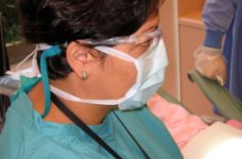
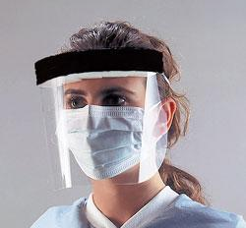
Protective Eyewear
Glasses with solid side shield
Goggles
Chin-length face shield
Required in situations where spray or spatter of patient body fluids may be possible (e.g.; handpiece use, air/water syringe, ultrasonic scaler)
Evidence indicates eye protection is effective in preventing the transmission of SARS-CoV-2

Slide 14
Face Shields—the protector of the protection
During testing of an influenza-laden cough aerosol with a volume median diameter (VMD) of 8.5 μm, wearing a face shield reduced the inhalational exposure of the worker by 96% in the period immediately after a cough. The face shield also reduced the surface contamination of a respirator by 97%
https://oeh.tandfonline.com/doi/full/10.1080/15459624.2013.877591
Notes:
This ability to protect our masks and respirators becomes even more important as we move into talking about reuse and decontamination strategies.
A face shield that extends from your forehead to just below your chin will help protect your eyes as well as your mask
Face shields are being 3d printed at many places across the country, and can also be easily made with craft items you can probably source. See the information at the end of the webinar in the resources section

Slide 15
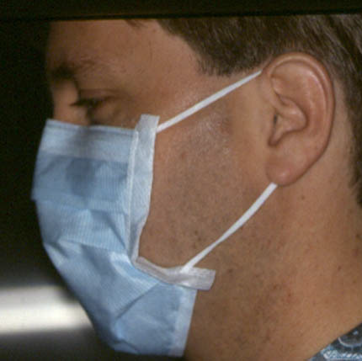
Face Mask
To protect mucous membranes from splash, spray and spatter
Changed between patients or more often if soiled or wet
Worn in combination with eye protection
Does not provide respiratory protection against aerosolized particles

Slide 16
Attire
Reusable or disposable gown or lab coat
Under same conditions as other PPE and for disinfection, sterilization and housekeeping procedures involving germicides or contamination
Changed daily or between patients if moist or soiled
Remove before leaving patient care or laboratory areas
Discarded or laundered as per OSHA

Slide 17
Contaminated Laundry
“Laundry which has been soiled with blood or other potentially infectious materials or may contain sharps.”
OSHA Bloodborne Pathogens Rule

Slide 18
OSHA Laundry Requirement
The employer shall clean, launder, and dispose of personal protective equipment at no cost to the employee
Placed in containers that are labeled or color-coded
Transported in containers that are labeled or color-coded
May be done onsite (by trained employees) or by a professional service (ensure the use of Standard Precautions)

Slide 19
Exam Gloves
For contact with mucous membranes, blood, OPIM
Appropriate for most dental procedures
Sterile gloves for surgical procedures

Slide 20
Heavy-duty utility Gloves
Heavy-duty utility gloves
When handling contaminated sharp instruments and devices during reprocessing

Slide 21
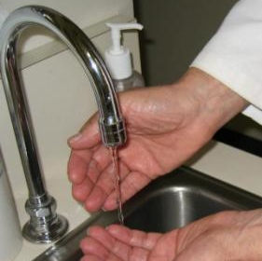
Hand Hygiene – Soap and Water
At the start and end of each workday
If hands are contaminated or visibly soiled
Before placing and after removing gloves (may use ABHR in place of soap and water if no visible soil)

Slide 22
Alcohol-based Hand Sanitizers
Alternative to soap and water
For hands free of debris
Good antimicrobial
Not a cleaning agent

Slide 23
Patient Care Restrictions
Refrain from direct patient care and handling patient care equipment if:
Weeping dermatitis
Exudative lesions

Slide 24
Needle and Sharp Safety
Accident prevention and exposure follow-up

Slide 25
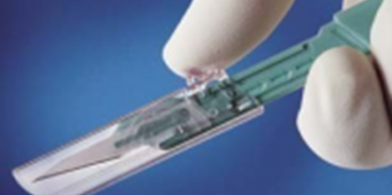
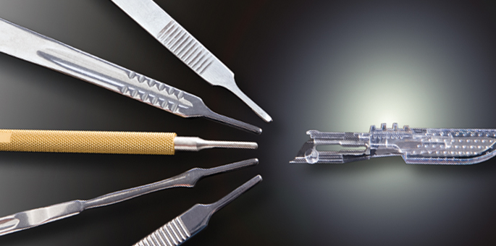
Safety Devices (ESIP)
Required if available
Not limited to safety needles/syringes
Need to be sought out and evaluated
Exceptions
Not available on the market
Not safer than traditional devices
Interferes with delivery of patient care

Slide 26
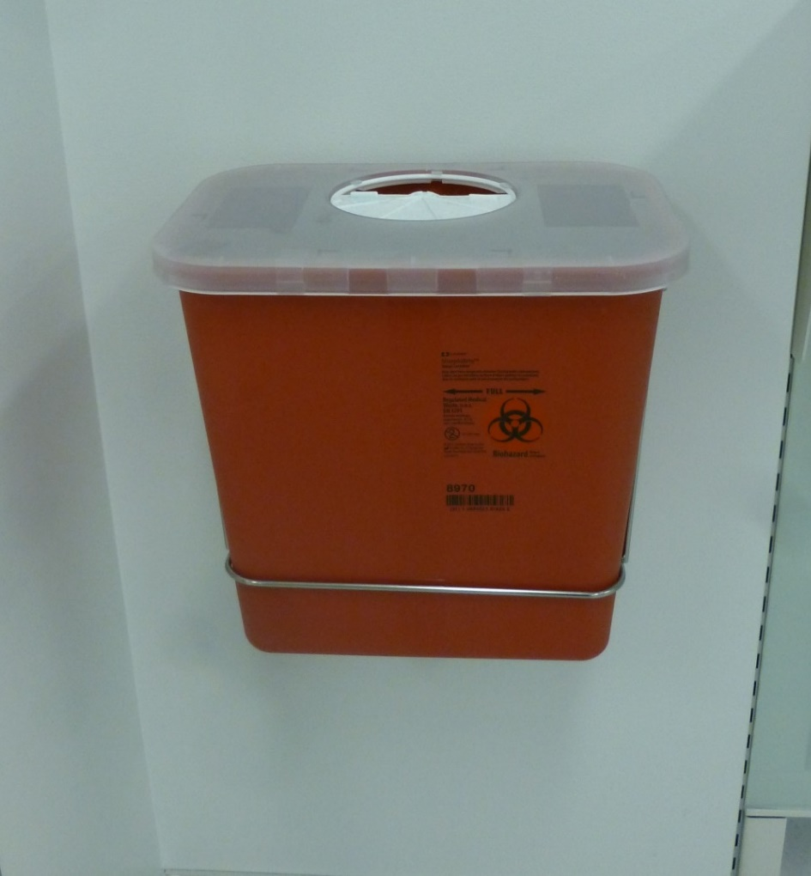
Sharps Containers
Disposable needles, syringes, scalpels, ends of orthodontic wires, broken glass, etc.
Discard as soon as feasible after use
Close as possible to point of use
Do not bend or break needles for disposal

Slide 27
Evaluate Work Practices
Seek safer ways of doing things

Slide 28
Ergonomics
Designing and arranging things people use so that the people and things interact most efficiently and safely

Slide 29
Ergonomics – Risky Behaviors

Slide 30
Instrument transfers
Develop a system, train everyone and use the same method consistently.

Slide 31
One-handed recapping or recapping device

Slide 32
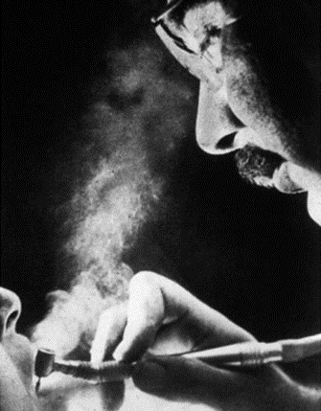
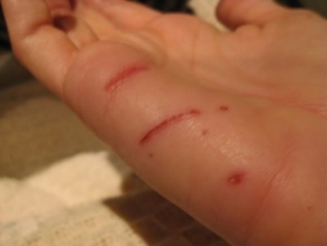
Exposure Incident
Percutaneous injury
Splash to mucous membranes
Contact with nonintact skin

Slide 33
Post-exposure Management
Prompt reporting of injuries
Interview of patient
Testing of patient and exposed worker
Referral for medical counseling
Written report documenting details of incident, including whether or not a safety device was involved

Slide 34
Clinical Surface Disinfection

Slide 35
Why worry about surface disinfection?
HIV
Hours
HSV
Hours
Rhinovirus
14 Hours
Staph
5 Days
HBV
7 Days
TB
6 to 8 Months
HCV
6 Weeks

Slide 36
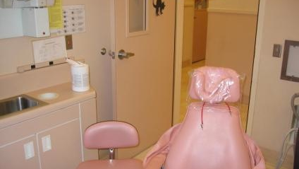
Environmental Surface Disinfection

Slide 37
Resistance to Chemical Germicides
Bacterial spores
Mycobacterium
Nonlipid or small virus
Fungi
Vegetative bacteria
Lipid or medium size virus

Slide 38
Classification of disinfectants
Low-level | Kill most vegetative bacteria, some fungi, and some viruses in a practical period of time (≤10 minutes). Do not kill mycobacteria.
Intermediate-level | Kill mycobacteria, vegetative bacteria, most viruses, and most fungi but do not necessarily kill bacterial spores.
High-level* | Will kill all microorganisms except large numbers of bacterial spores.
* Some high-level disinfectants will kill spores with prolonged exposure times (3–12 hours); these are called high level disinfectants/sterilants

Slide 39
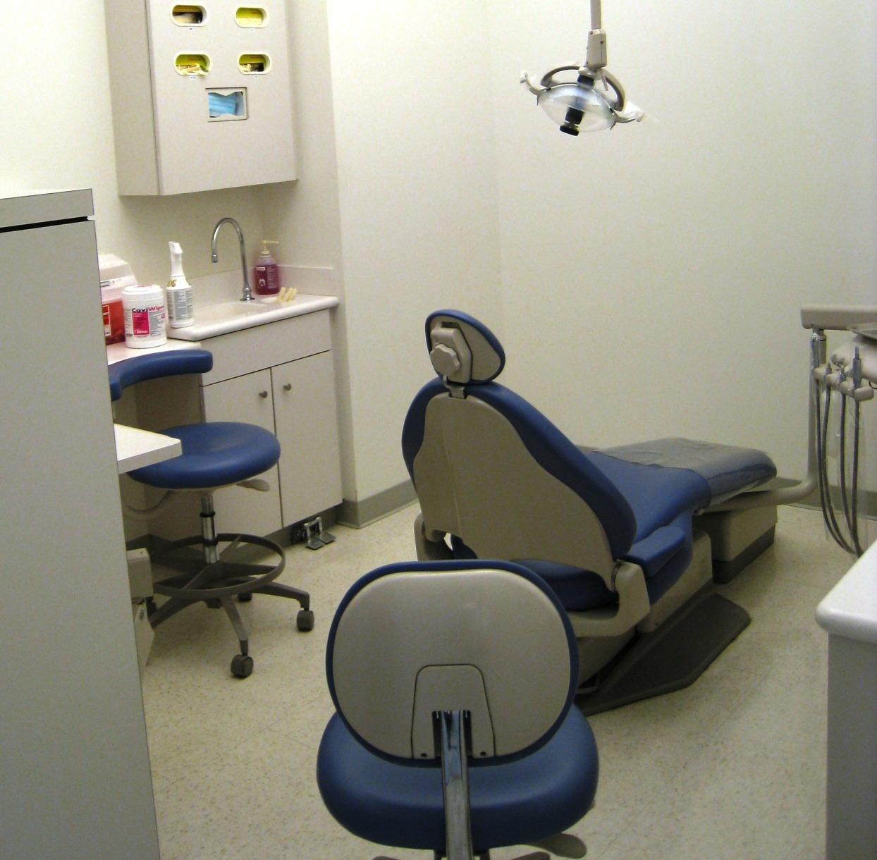
Housekeeping Surfaces

Slide 40
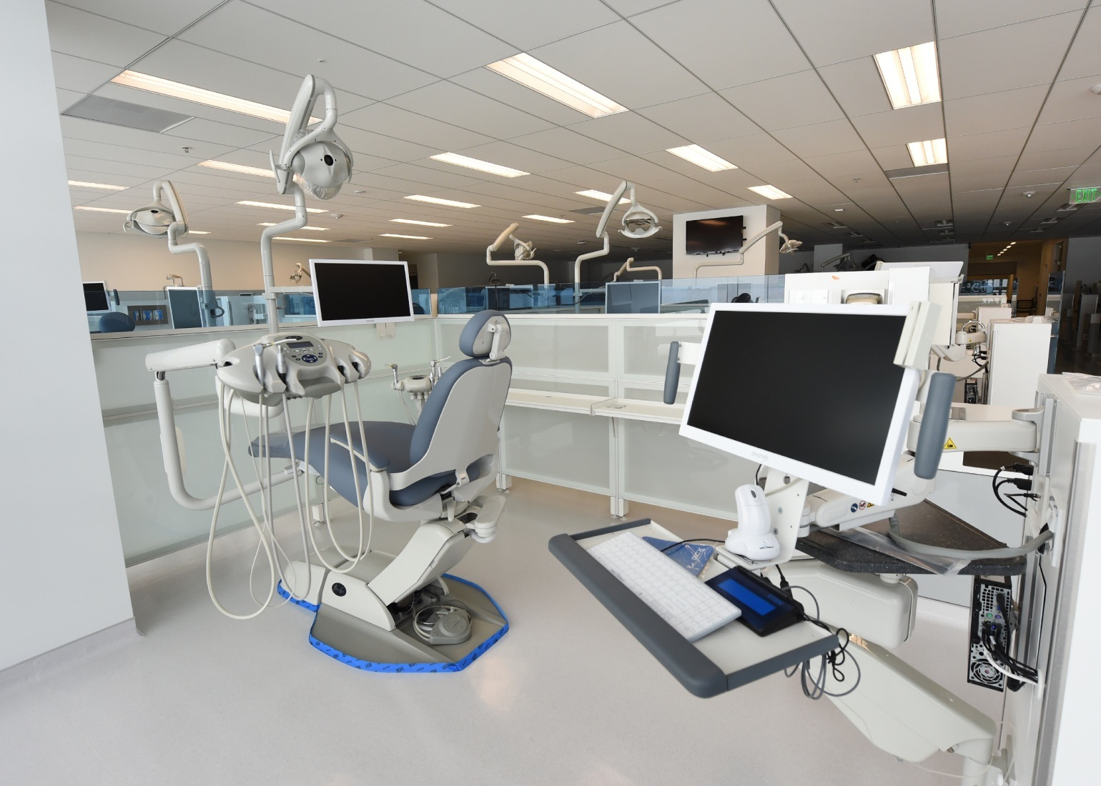
Clinical Contact Surfaces

Slide 41
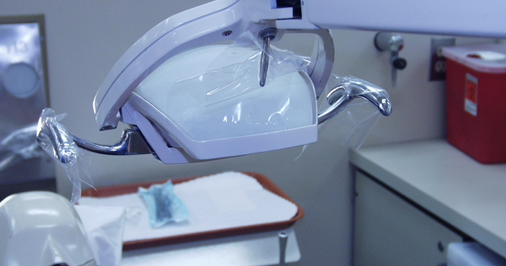
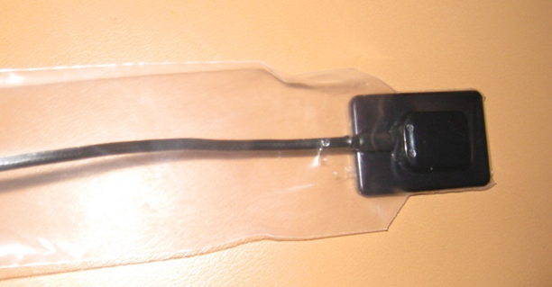
Equipment Barriers
Use surface barriers to protect clinical contact surfaces, particularly those that are difficult to clean
Change between patients
Disinfect underlying surface if it is inadvertently contaminated when removing barrier

Slide 42
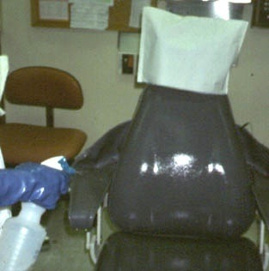
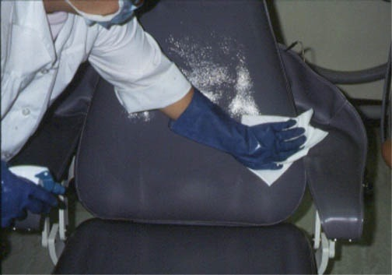
Spray – Wipe - Spray
Spray on cleaner (or cleaner disinfectant)
Wipe to clean
Spray on disinfectant and then WAIT – follow label directions for contact time

Slide 43
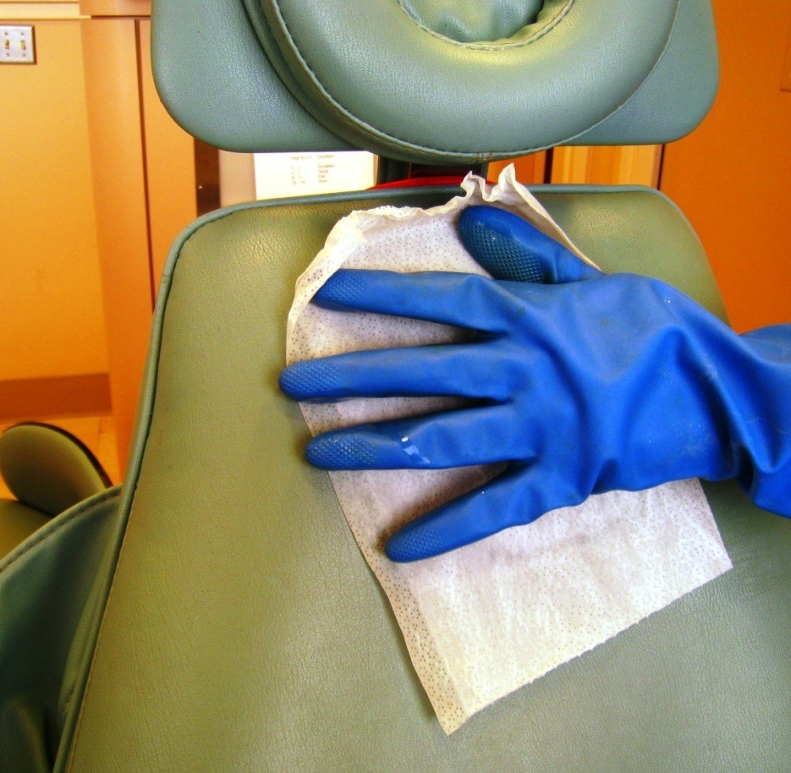
Wipe – Throw - Wipe
Wipe on cleaner (or cleaner/disinfectant) with premoistened towelette
Throw away wipe (multiple surfaces will require multiple towelettes)
Wipe with fresh towelette(s) and WAIT – allow surface to remain wet for time indicated on the label

Slide 44
Effective Decontamination
The most effective method to remove contamination is wipe – toss – wipe
Contamination can be spread from surface-to-surface by using one wipe to apply disinfectant to multiple surfaces

Slide 45
Instrument Processing
Transporting, cleaning, sterilizing and storing

Slide 46
The instrument processing cycle

Slide 47
Spaulding's Classification of Instruments
Category | Definition | Reprocessing | Examples
Critical | Penetrate soft tissue or bone | Sterilization | Surgical instruments, periodontal scalers
Semicritical | Contact mucous membranes or non-intact skin | Sterilization or high-level disinfection | dental mouth mirrors, amalgam condenser, Handpieces and handpiece components
Noncritical | Contact intact (unbroken) skin | low- to intermediate-level disinfection | X-ray head/cone, facebow

Slide 48
Sterilization of Instruments
Critical and semicritical instruments
Cleaned
Heat sterilize
High level disinfect or sterilize using chemical germicides only if item cannot be heat sterilized
Discard if disposable
Heat sterilize all high-speed handpieces, low-speed handpieces, rotary components and all other attachments (e.g.: reusable air/water syringe tips, ultrasonic scaler tips, etc.)

Slide 49
Heat-Based Sterilization
Steam under pressure (autoclaving)
Gravity displacement
Dynamic air removal
Steam-flush pressure pulse
prevacuum
Dry heat
Static air (convection, oven-type)
Forced air (rapid heat transfer)
Unsaturated chemical vapor
Proprietary formula of alcohol/formaldehyde

Slide 50
Comparison of Gravity and Dynamic Air Removal Autoclaves
 | Gravity | Dynamic Air Removal
Mechanism | Steam injects into chamber, forms a stratified layer, and its mass displaces air via drain vent | Cycles of steam flush, pressure pulse removes air from chamber and packaged materials
Temperature | 121⁰ C | 132 – 135⁰ C
Sterilization time | ~ 30 mins | 3-5 mins
Drying time | 30 mins | 30 mins
Type of instrument sets | Unwrapped and lightly wrapped | All types, including devices with lumens

Slide 51
Consider Work Flow When Planning

Slide 52
Proper Work Flow Prevents Errors

Slide 53
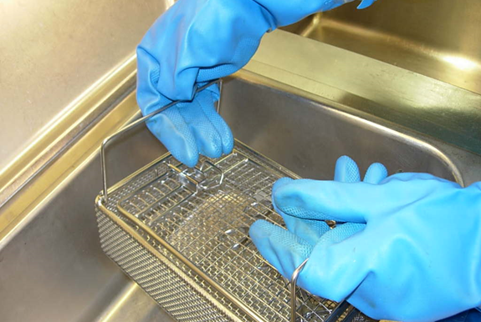
Cleaning Before Sterilization -- Ultrasonic

Slide 54
Hand Scrubbing
For instruments that cannot be submerged in liquids
For instruments with debris that remains after mechanical cleaning
Instruments with lumens may require cleaning with a brush

Slide 55
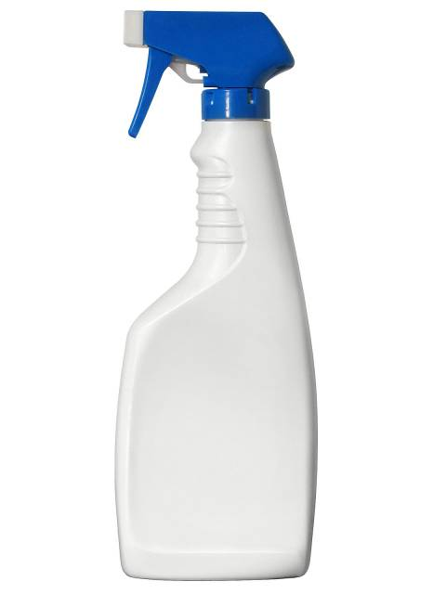
Presoak/Prespray
May be used to hold instruments until cleaning can be done
Some solutions may help loosen stubborn debris
Not required prior to cleaning
Useful if instruments cannot be cleaned immediately and for heavily soiled items, such as surgical instruments
Enzyme Spray

Slide 56
Drying Instruments
Dry instruments carefully
Remove debris that was not cleaned mechanically
Wear heavy-duty gloves to process instruments

Slide 57
Packaging Instruments
Carefully place instruments in pouch or wrap
Use materials compatible with type of sterilizer

Slide 58
Loading the Sterilizer
Light items on top
Heavy items on the bottom
Peel pouches (on edge)
Perforated wrapped trays (flat)
Solid wrapped trays (on edge)

Slide 59
Chemical Indicators
Measure key parameters of the sterilization process (e.g. time, temperature)
Visual change when the desired parameter has been achieved
Single parameter indicators, multi-parameter indicators and integrators
Recommended by CDC and AAMI
One inside each pack and one on the outside if the inside one is not visible

Slide 60
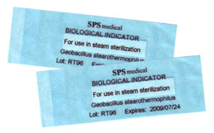
Biologic Monitoring (Spore Test)
Contain bacterial spores resistant to heat sterilization
Highest level of confirmation for sterilization
Weekly spore testing recommended (requirements vary by state)

Slide 61
Issues in Sterilization
CDC Health Advisory October 2015
CDC/FDA Health Update about the Immediate Need for Healthcare Facilities to Review Procedures for Cleaning, Disinfecting, and Sterilizing Reusable Medical Devices
Numerous reports of breaches in reprocessing of instruments and devices in health care settings
Leading to notification of thousands of patients regarding potential exposure to bloodborne diseases

Slide 62
Liquid Chemical Sterilant/Disinfectants
Heat tolerant or disposable alternative available for most items
The use of high-level disinfectants is discouraged by CDC

Slide 63
Use of High-Level Disinfectants
Ventilation
OSHA recommendations/best practices
Disposal
May be hazardous waste
Risks
Skin irritation
Asthma potential
Items are not packaged and there is no process validation, such as chemical indicators and spore tests

Slide 64
What if I open a sterile pack but don’t use the instruments?
All instruments opened in the operating or procedure room should be considered contaminated whether or not they have been used.
Rationale: Scrubbed persons might touch instruments without being aware of it. Used instruments also might come in contact with other instruments.
AAMI/ANSI

Slide 65
How can I protect instruments from damage?
place instruments into their respective containers, tray, instrument pans for transport
have a process in place to identify instruments in need of repair/maintenance and removal from service (e.g; a tag)
protect delicate instruments from damage (cassettes)
segregate reusable sharp instruments inside the container
place heavy instrumentation on the bottom and lighter, delicate instruments on top.

Slide 66
If sterilization is good—sterilization combined with disinfection is better – right?
Instruments and devices should not be treated with any additional chemical (e.g., alcohol, disinfectant wipes) unless such treatment is specifically recommended in the manufacturer’s written IFU.
AAMI/ANSI

Slide 67
Single-use Items
Used for one patient and discarded appropriately
Disposable prophy angles, prophy cups and brushes, plastic high speed evacuator tips, saliva ejectors, disposable a/w syringe tips, gloves

Slide 68
Dental Waterline Contamination

Slide 69
How do waterlines become contaminated?
Biofilm forms on the inner lining of tubes delivering water to dental devices
Biofilm provides a nutrient-rich environment for the colonization of certain bacteria
Over time, if untreated, the biofilm becomes laden with enough bacteria to result in water that would not be considered suitable for drinking
Studies have shown untreated lines produce 100,000 - >1,000,000 cfu/mL of bacteria*
*Szymanska J, Sitkowska J.Bacterial contamination of dental unit waterlines. Environ Monit Assess. 2013 May; 185(5): 3603–3611.

Slide 70
Dental Waterline Management
CDC guidelines establish 500 CFU of heterotrophic bacteria as the goal for maintaining water quality
Use products designed to control biofilm in water lines
Do not use surface disinfectants or other products that have not been tested as safe and effective for water lines
Test water for heterotrophic bacteria on a regular basis and retreat with initial treatment if bacteria is increasing
Initial treatment with a product to remove biofilm is usually needed

Slide 71
Mycobacterium abcessus infections among children
2015
20 children admitted to local hospitals near Atlanta, GA, USA
All children had severe illness, 17 required surgery
The CDC determined the source of infections were from dental treatment water in a single clinic with untreated waterlines
All children had pulpotomies performed in the days before onset of illness
2016
A second cluster of infected children emerged in California, USA
At least 58 children became ill after receiving pulpotomies at a dental clinic
Health officials linked infections to contamination of dental treatment water with Mycobacterium abcessus

Slide 72
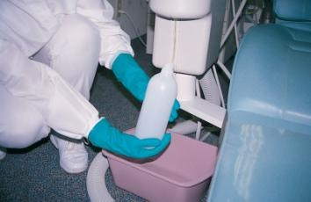
Independent reservoirs
Tablets or liquids added to treatment water
Follow instructions for use provided by the treatment product manufacturer
Do not use surface disinfectants
Diluted bleach has been used but may cause damage to internal components of dental unit
Water testing may be needed to ensure water quality is maintained

Slide 73
CDC Guidelines 2003 Dental Unit Waterlines and Water Quality
For non-surgical treatment use water that meets EPA drinking water standards (< 500 CFU/mL of HPC bacteria)
Consult with dental unit manufacturer for appropriate methods to maintain dental water quality
Follow manufacturer recommendations for monitoring water quality
In July 2023 a working group was formed within HICPAC to develop guidelines for dental waterline biofilm control.

Slide 74
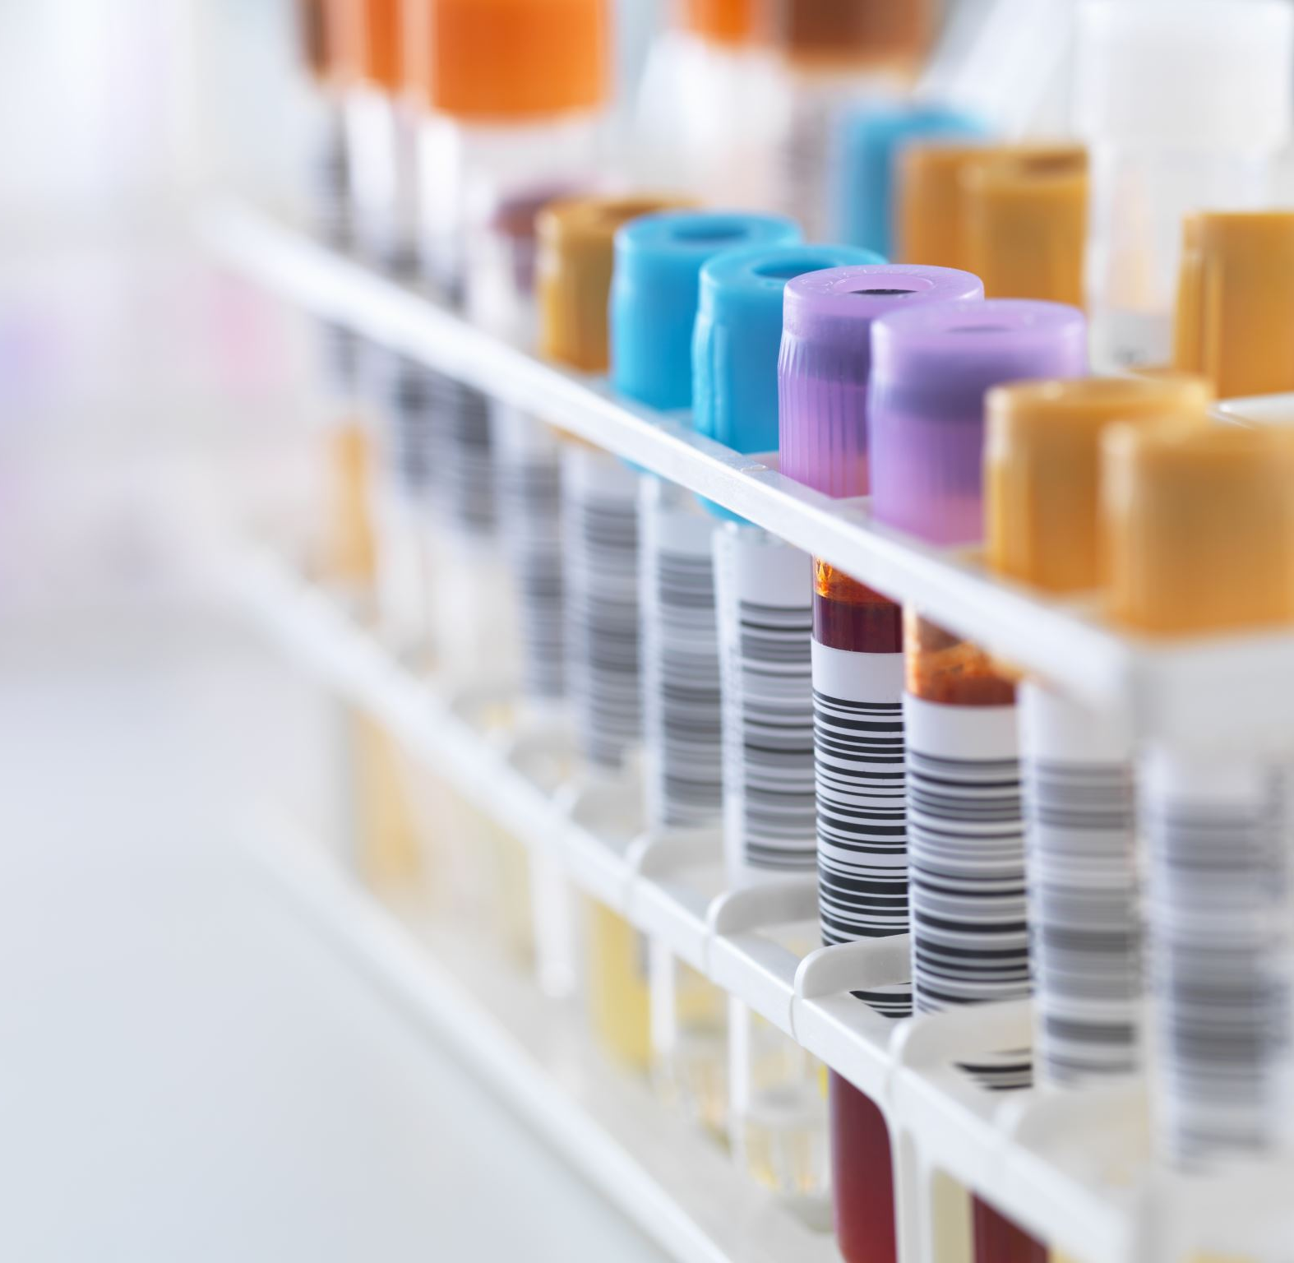
Transmission-based Precautions
Modes of transmission for which standard precautions may not provide enough protection

Slide 75
2007 Guideline for Isolation Precautions: Preventing Transmission of Infectious Agents in Healthcare Settings
CDC: Jane D. Siegel, MD; Emily Rhinehart, RN MPH CIC; Marguerite Jackson, PhD; Linda Chiarello, RN MS; the Healthcare Infection Control Practices Advisory Committee

Slide 76
Transmission-based precautions
For patients who are known or suspected to be infected or colonized with infectious agents, including certain epidemiologically important pathogens, which require additional control measures to effectively prevent transmission.
Implemented in addition to standard precautions

Slide 77
Three principal routes of transmission in healthcare settings requiring precautions beyond standard precautions
Contact
Droplet
Airborne

Slide 78
Managing patients requiring airborne precautions
Always screen patients for respiratory symptoms, and whether they are confirmed or under investigation for infection with airborne transmissible disease
Delay routine dental treatment
If they present to the office, place a mask on patients with a cough and reschedule appointment
Emergency care
Determine if treatment can be delayed with providing supportive care (pain medication, antibiotics, home care)
If treatment must be provided, refer to a facility equipped for airborne precautions

Slide 79
Thank you

