Slide 1
Motivational Interviewing in Dentistry
Carrie Bader, MPH, MOT
Training Director, Boost Oregon
Member, Motivational Interviewing Network of Trainers
training@boostoregon.org
www.boostoregon.org
Notes:
I am Carrie Bader ….
Today, I am providing an overview of Motivational Interviewing and how it can be used in vaccine discussions

Slide 2
Boost Oregon . . .
is a parent-led, independent nonprofit organization
empowers people to make science-based vaccine decisions for themselves, their families, and the community
envisions a world where people’s health decisions are rooted in science

Slide 3
Boost Oregon’s Approach
We support vaccination education by:
Educating people;
Supporting medical providers; and
Encouraging peer advocates.

Slide 5
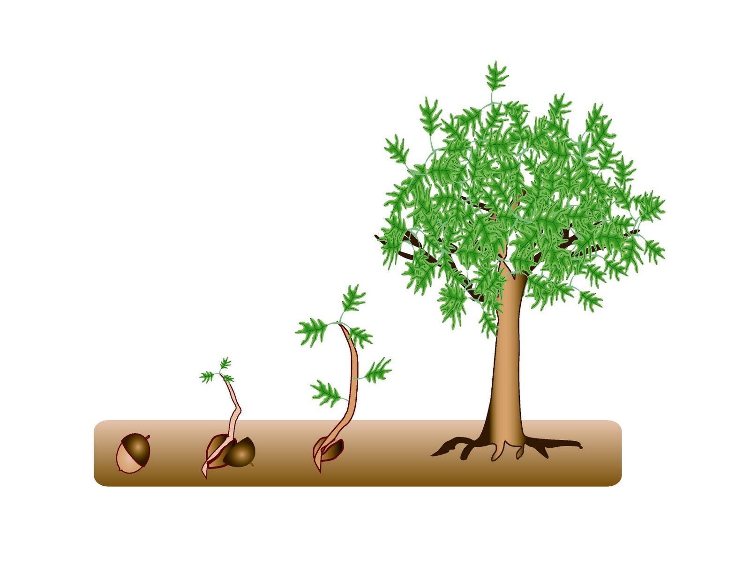
How familiar are you with motivational interviewing (MI)?
This is my first MI training ever
I am fully proficient in MI
Notes:
5

Slide 6
How confident are you in having effective conversations about change with clients/patients?
Not at all confident
Fully confident
Notes:
6

Slide 7
“Motivational interviewing is a particular way of talking with people about change to strengthen their own motivation and commitment.”
-Miller & Rollnick, 2023
Notes:
For those of you not familiar with Motivational Interviewing or MI, I’d like to provide a brief definition.

Slide 8
Spirit of MI
Partnership
Acceptance
Compassion
Empowerment
Context

Slide 9
In Motivational Interviewing, we avoid:
Debating
Judging
Dumping information
Dismissing
Pouncing
Confronting
Notes:
What was the practitioner doing that left you feeling unheard?
How would you feel if you were the client?
How would you describe the practitioner’s approach?

Slide 10
Think about a health care provider that you like and trust.
How would you describe this provider? What do they do in your interactions?

Slide 11
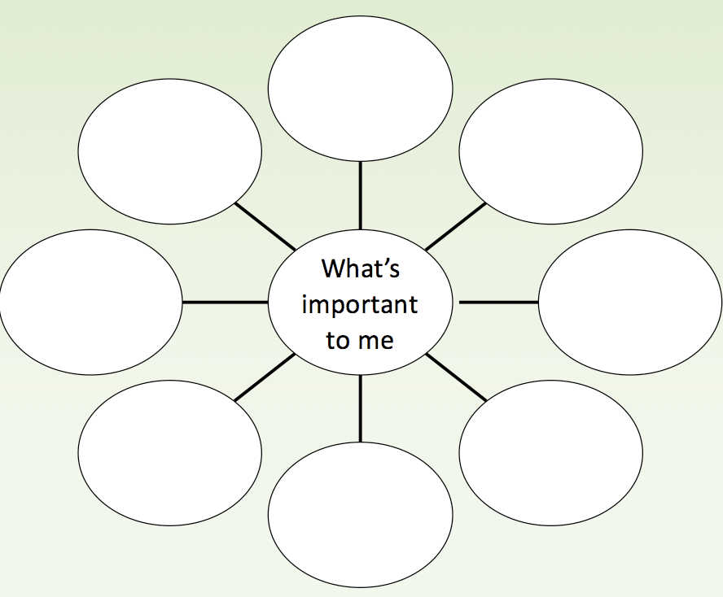
physical activity
family well-being
sleep
screen time
other
eating habits
stress management
community connections

Slide 12
A Taste of MI (Step 1)
Interviewer: Listen and give no advice.
Ask the following:
What change are you thinking about?
What are your reasons for wanting to _____?
How important is it for you to _______?
Notes:
12

Slide 13
Listen with:
Presence
Undivided attention
Acceptance
Curiosity
Silence
Encouragers (e.g., mm-hmm, I see, really. . .)

Slide 14
A Taste of MI (Step 2)
Reflect back one or two of their reasons for change:
“So you’re thinking of making this change because . . .”
[Listen]
Then ask:
“What do you think you might do next?”
[Listen]
Notes:
14

Slide 15
In Motivational Interviewing, we aim to:
Listen, listen, listen
Show openness, respect, and understanding
Offer information with permission
Notes:
Permission is crucially important; if you’re doing a puzzle and I put in a piece for you, that would probably upset you if you didn’t ask for help. The more I do MI, the less information I give and the more I listen and reflect.

Slide 16
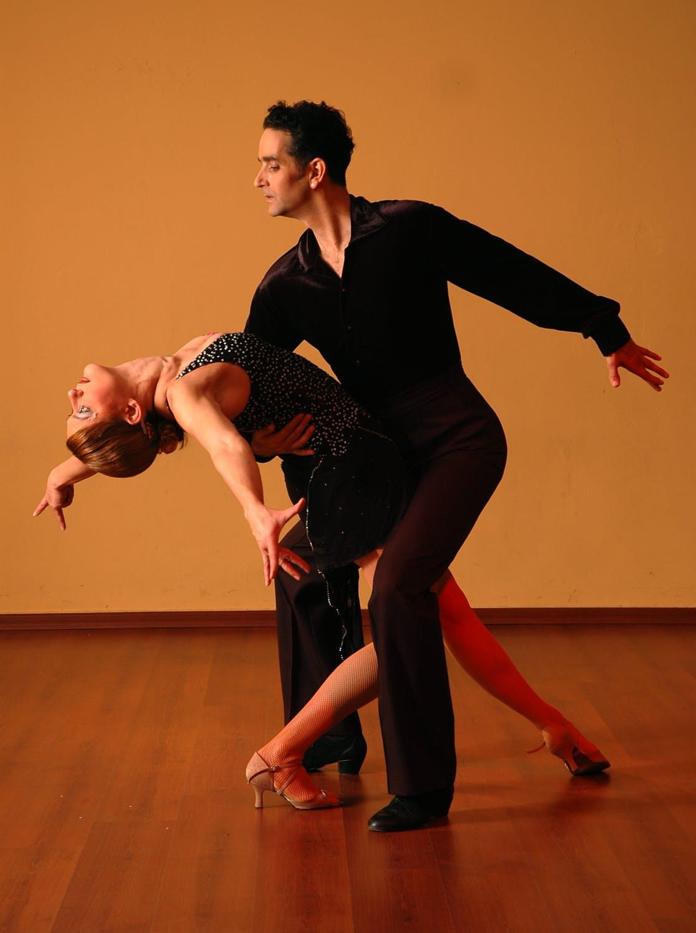
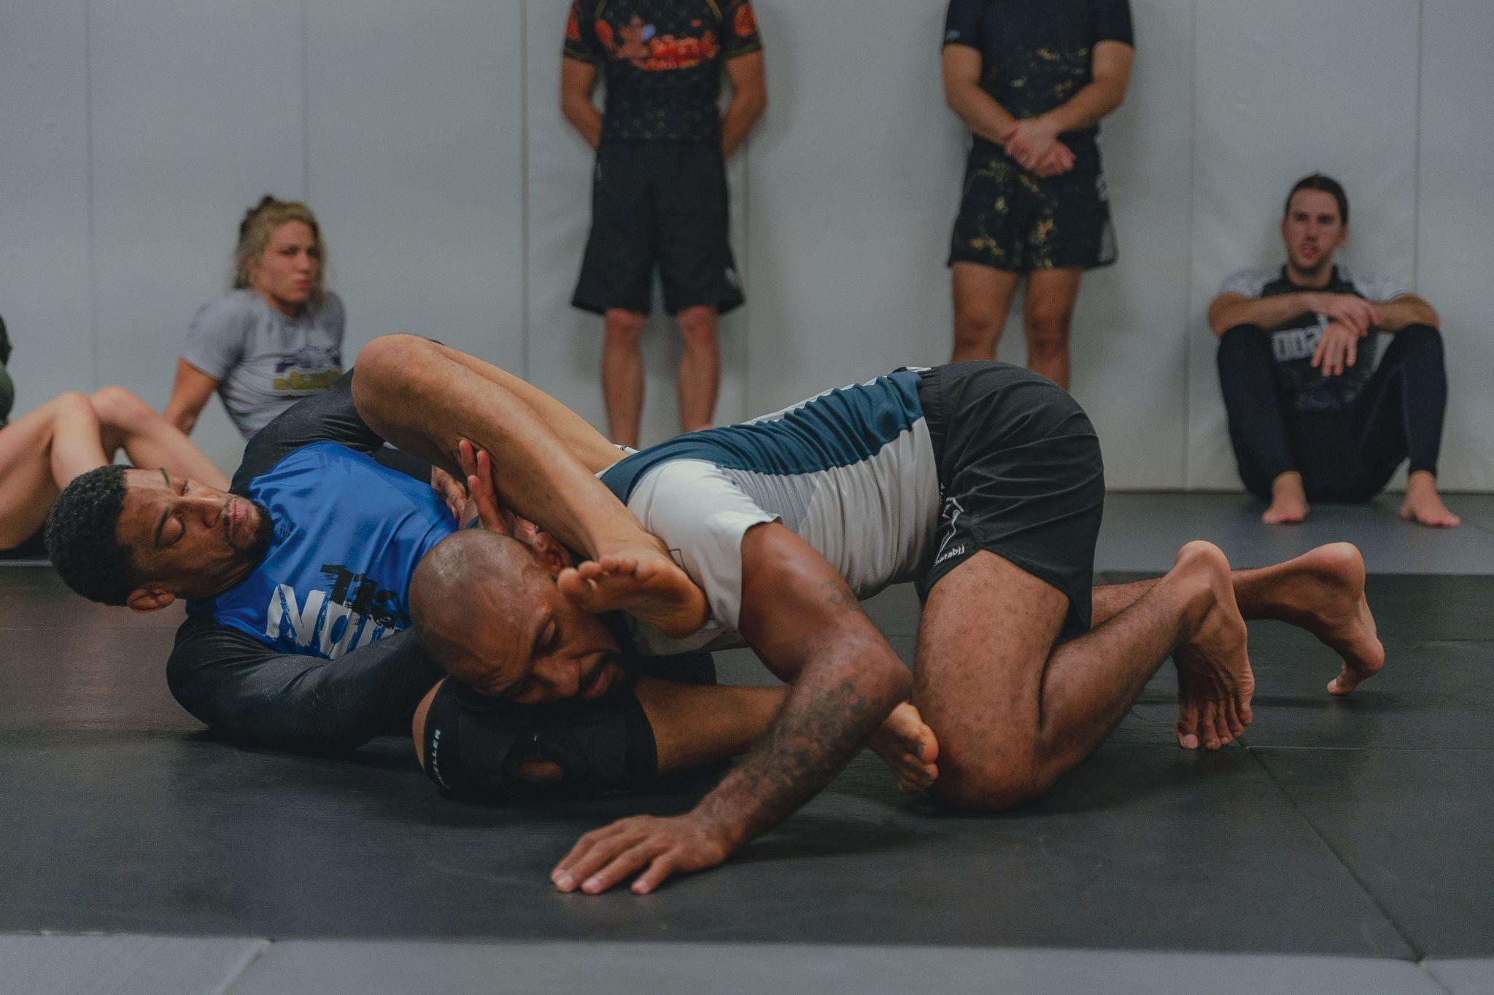
Notes:
16

Slide 17
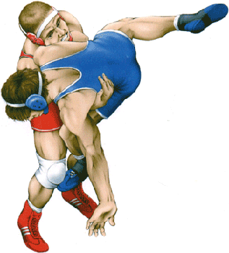
Traditional Approach
Authoritarian
Confrontational
Educational
Notes:
17

Slide 18
Notes:
18

Slide 19
Spirit of MI
Partnership
Acceptance
Compassion
Empowerment
Context

Slide 20
Partnership
MI is done “with” another.
Notes:
And how to do we lose trust?

Slide 21
Acceptance
When people are accepted as they are, they feel freed to change.
Notes:
And how to do we lose trust?

Slide 22
Compassion
MI is done for the benefit of the other person.
Notes:
And how to do we lose trust?

Slide 23
Empowerment
MI honors patient’s autonomy and ability to change.
Notes:
And how to do we lose trust?

Slide 24
Context
Structural inequities and policies impact people’s situations and potential solutions.
Notes:
And how to do we lose trust?

Slide 25
“MI Yoga”
Partnership
Acceptance
Compassion
Empowerment
Context
Notes:
Partnership: hands together
acceptance: open
compassion: hands at heart, slight chair
empowerment: lifting the burden
context: twist side to side

Slide 26
Core Skills of Motivational Interviewing
“Open-Minded” Questions
Reflective Listening
Affirming Statements
Summarizing
|
Notes:
Let’s look at the core skills of Motivational Interviewing or MI.
Open Ended Questions
Affirming Statements
Reflective Listening
Summarizing
This is what I think of when I want to decide how to say something
We will look at one last example of this interaction that demonstrates MI. Look for the OARS!

Slide 27
Questions be careful with “why” questions
What does your brushing and flossing routine look like?
What’s important to you when it comes to your teeth and gums?
Is there anything that could make this appointment more comfortable for you?

Slide 28
Affirmations
I can see it took courage for you to come in for this appointment.
You’ve clearly been doing a lot to take care of your teeth and gums.
I appreciate how you’re open to learning as much as you can about this.
Notes:
Acknowledging qualities that make us feel proud makes us more likely to be willing to change our minds about deeply held beliefs.
Think about affirming values like wanting to learn, rather than actions like having done a lot of “research”, since often times that “research” is mostly comprised of being funnelled through disinformation networks.

Slide 29
Reflections
Coming in for this appointment wasn’t easy.
You want to keep your teeth for as long as possible.
On one hand you don’t like needles, and on the other hand you want to be done with this pain.
Notes:
End double-sided reflections with change talk.
As I have more MI convos, I am replacing more education with reflections, and more questions with reflections. Ie to “We’re not getting the vaccine”, instead of “how’d you come to that decision?” (Q), might try “you’ve made up your mind” ®

Slide 30
Autonomy-
Emphasizing Statements
This really is up to you.
You know best what will work for you.
It’s completely your choice - no one can make you do this.
Notes:
Especially important with marginalized/targeted communities – have often had experiences of not being treated respectfully, autonomy supported. Also have gotten in trouble for not doing what people in power tell them they should do.

Slide 31
How do I provide information or recommendations when using motivational interviewing?
Notes:
Ryan

Slide 32
“Doing Motivational Interviewing with someone is like entering their home. One should enter with respect, interest, and kindness, affirm what is good, and refrain from providing unsolicited advice about how to arrange the furniture.”
-Kamilla Venner
Notes:
For those of you not familiar with Motivational Interviewing or MI, I’d like to provide a brief definition.

Slide 33
Explore what they already know, then:
ASK - OFFER - ASK
ASK permission to offer information
OFFER relevant, tailored information
ASK what they think of what you said
Notes:
A Framework for Providing Information/Recommendations/Ideas
Reflect/Explore
Ask permission
Offer
Explore/Emphasize Autonomy
Let’s look at this framework with a couple of examples.

Slide 34
HPV Vaccination
There’s a vaccine we like to make sure everyone knows about that can prevent several types of cancers - the HPV vaccine. Have you heard about it?
EXPLORE
Is it okay if I share some information about it with you?
ASK
The HPV vaccine protects against mouth and throat cancers, along with several other types of cancers, and it is recommended at your age.
OFFER
What do you think about that? Does it sound like something you might want to get?
ASK
Notes:
Here is an example of the Explore – Offer – Explore approach in action.
patient asked a question here, so you already have permission to answer

Slide 35
“I don’t know if I want to get a deep cleaning, that sounds painful.”
Notes:
Here is an example of the Explore – Offer – Explore approach in action.
patient asked a question here, so you already have permission to answer

Slide 36
Impact of MI in Action: Parent-focused MI for dental care of children in rural Mexico
100 schoolchildren 6-10 years old at high risk of caries randomized into two groups
6 MI counseling sessions for parents following oral health informational session
Statistically significant decrease in dental plaque in experimental group
González-Del-Castillo-McGrath M, Guizar-Mendoza JM, Madrigal-Orozco C, Anguiano-Flores L, Amador-Licona N. A parent motivational interviewing program for dental care in children of a rural population. J Clin Exp Dent. 2014 Dec 1;6(5):e524-9. doi: 10.4317/jced.51662. PMID: 25674320; PMCID: PMC4312680.

Slide 37
“An intervention based on the principles of MI was more effective in reducing the number of surfaces affected by early childhood caries compared with convention oral health education intervention.”
Notes:
southern Brasil - ~320 children through age 3
providers received 8 hours of training plus annual followup reinforcement (coaching?)

Slide 38
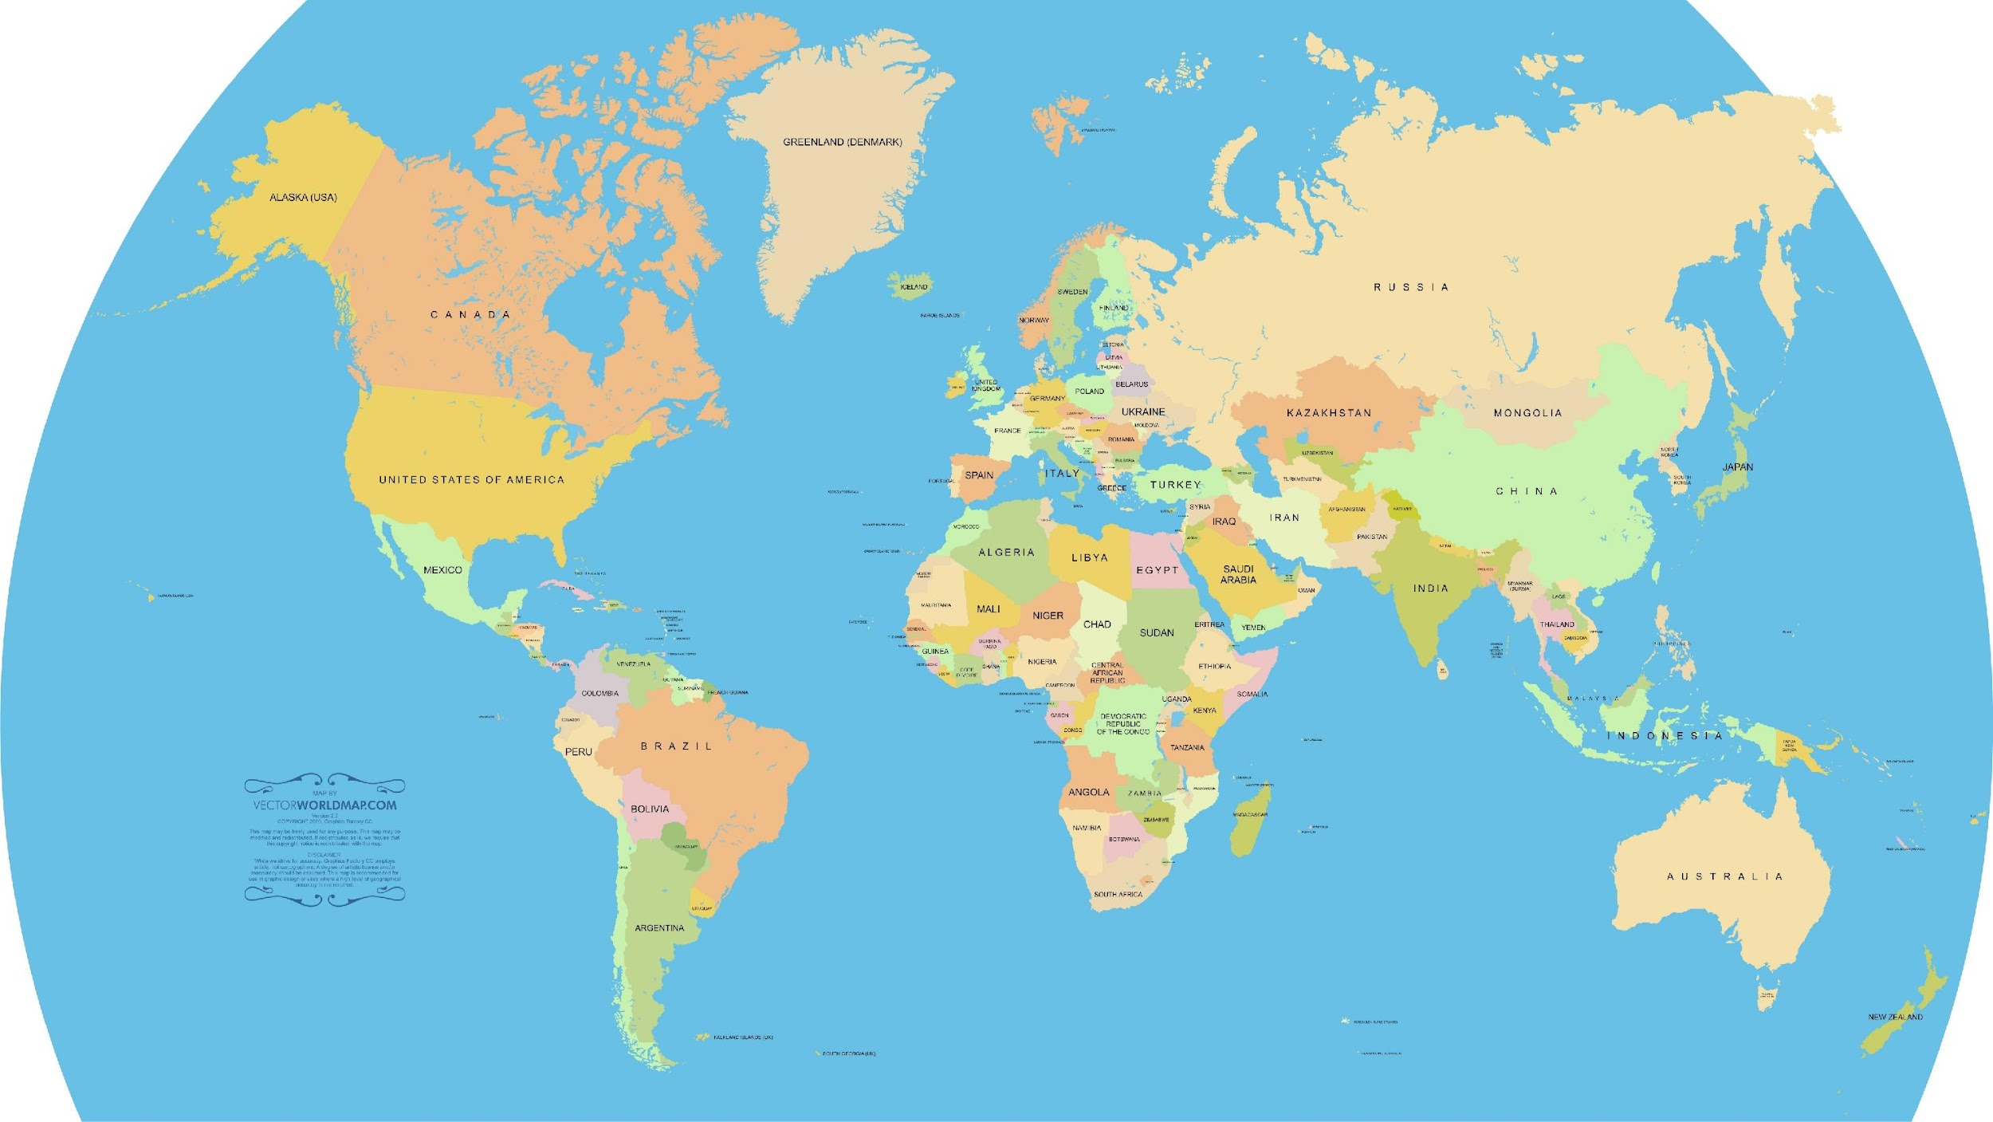
MI Research Around the World
Notes:
MI research has been conducted around the world. Each heart identifies a country that is using MI. The US has two showing using in the tribal communities as well as in hospitals.
Oceania: Australia, New Zealand,
Europe: Netherlands, Norway, Sweden, Switzerland, United Kingdom
North America: Canada, Cherokee*, Chicksaw*, United States, Zuni* *Tribal Nations
Africa: Egypt, Kenya, Nigeria, South Africa, Uganda, Zambia
Asia: China, India, Iran, Malaysia, Marshall Islands, Turkey, Bangladesh
Central & South America: Brazil, Chile, Mexico,

Slide 39
If you would like to learn more
Boost Oregon virtual and in-person offerings:
Free 1-hour Virtual Monthly Sessions
Introductory and Comprehensive Trainings
MI Skills
“Tune-Up” (Individual Feedback)
3-6 months of Organizational MI Support
|
https://www.boostoregon.org/motivational-interviewing

Slide 40
Motivational Interviewing in Dentistry
Carrie Bader, MPH, MOT
Training Director, Boost Oregon
Member, Motivational Interviewing Network of Trainers
training@boostoregon.org
www.boostoregon.org
Notes:
We’ve talked today about what MI is, what it looks like in practice, the skills, and the types of questions and statements that are used. If this is something that you’d like to get more information about, please reach out. We’d love to work with you. Sign up for our newsletter . . .

