Slide 1


Promoting adolescent health and wellbeing UpDATE
NPAIHB QBM - Oct 2019

Slide 2
Disseminating Effective Adolescent Health Interventions in Native Communities
Healthy Native Youth

Slide 3
Communication Strategies
Online Sexual Health Portal
Partner:
NIEA, BIE, B&G Clubs
Teachers and Educators
Social Media
Partner: UNITY, GEN-I, CNAY
Teens and Young Adults
Radio, Articles
Talking Points
Parents

Slide 4

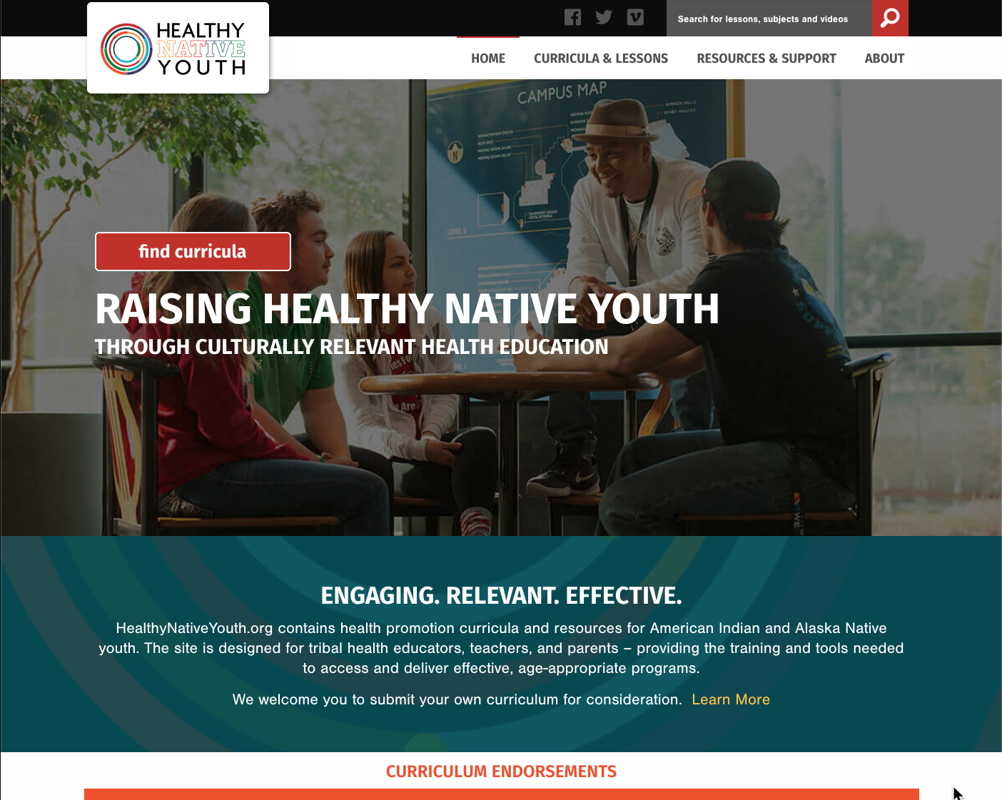
Healthy Native Youth
Notes:
The HNY portal allows you to filter and compare curricula on several dimensions, including by: age, delivery setting, duration, cost, and evidence of effectiveness.
The website includes direct links to all materials needed for implementation, such as facilitator training tools, lesson plans, marketing materials, information about how each program was designed, evaluation tools and findings, and references to related publications and reports.
The site also allows users to upload and submit their own health curricula for national distribution

Slide 5
sharE the site with your community networks: www.HealthyNativeYouth.org
Sign up to receive A monthly newsletter!
Text HEALTHY to 97779
Like us on Facebook, Instagram & You Tube!
JOIN THE MOVEMENT!

Slide 7
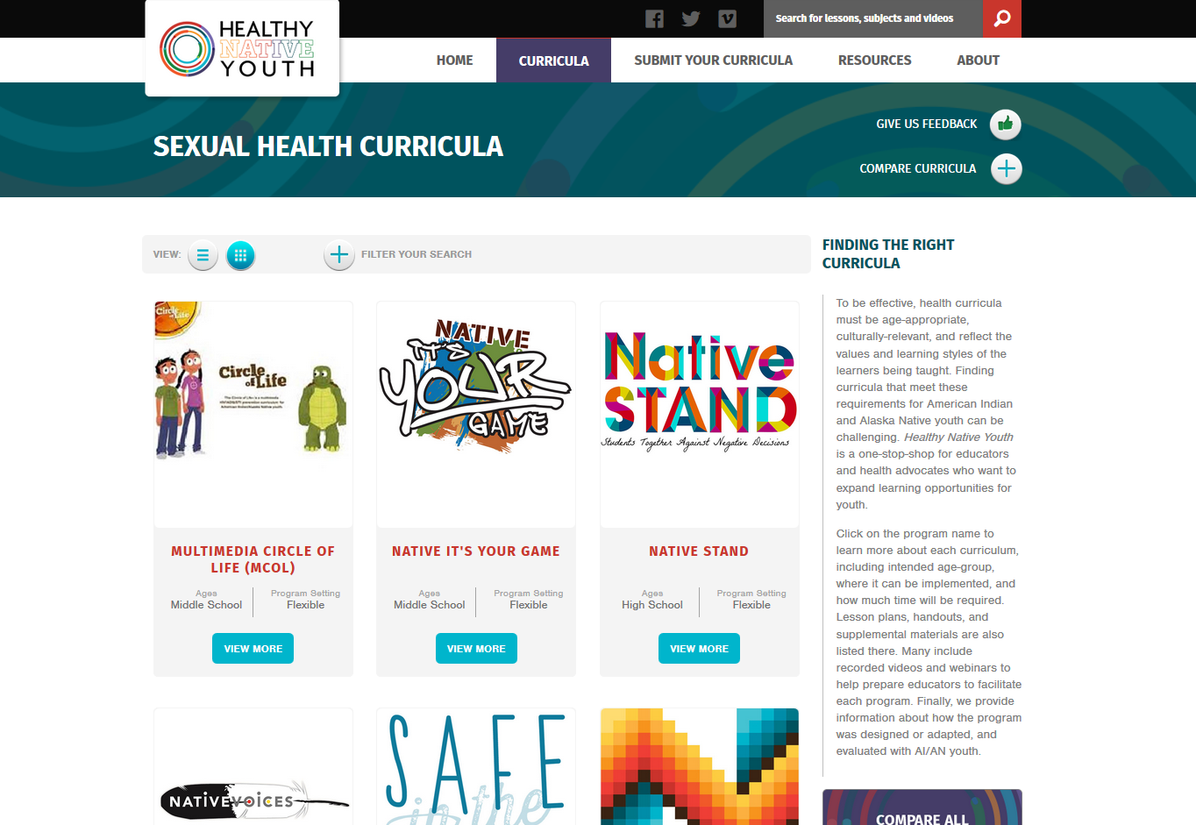
Healthy Native Youth Website
Notes:
There are currently 9 curricula available on the site. You can click on the program name to learn more about each one, including intended age-group, where it can be implemented, and how much time will be required.

Slide 8
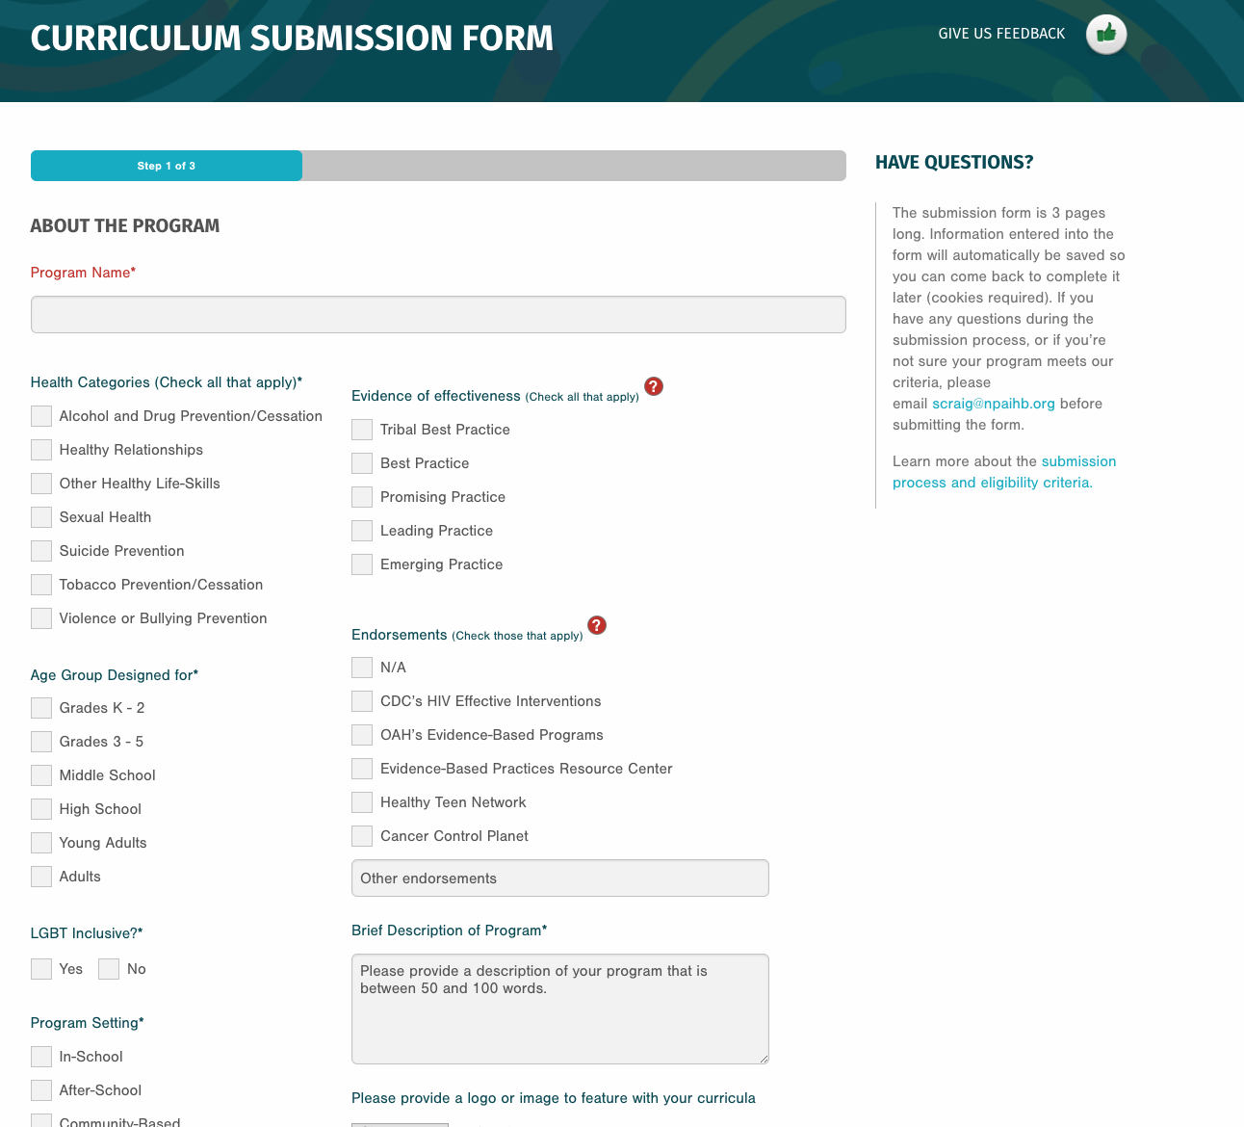

Slide 9
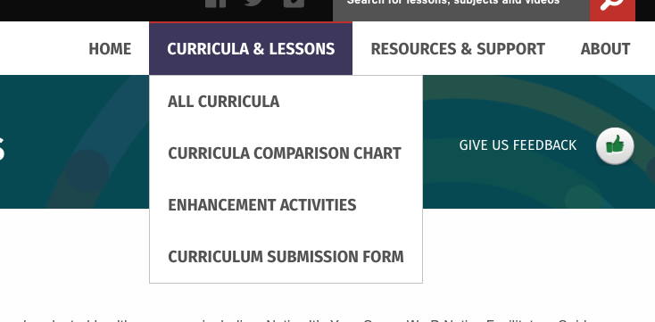
Enhancement Activities
Notes:
Amanda

Slide 10
Curriculum Enhancement Activities:
Health Topics Include
    Anatomy and Physiology
    Bullying
    Concerning Posts on Social Media
    Condom Demonstration
    Consent
    Cultural Identity
    Dating Violence
    Drugs and Alcohol
    Healthy Friendships
    Help Seeking
    Ice Breakers
    LGBT, Two-Spirit and Sexual Diversity
    Media Literacy
    Opioid Prevention
    Personal Rule Setting
    Sex Trafficking Safety and MMIR

Slide 11
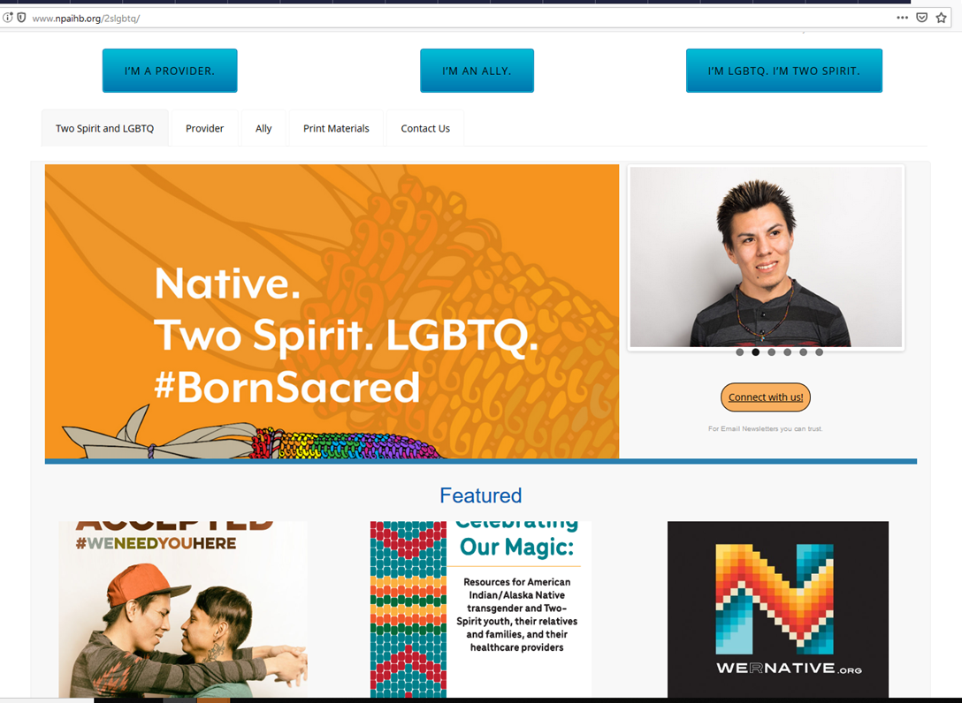
Native. Two Spirit. LGBTQ #BornSacred
Notes:
www.npaihb.org/2slgbtq

Slide 12
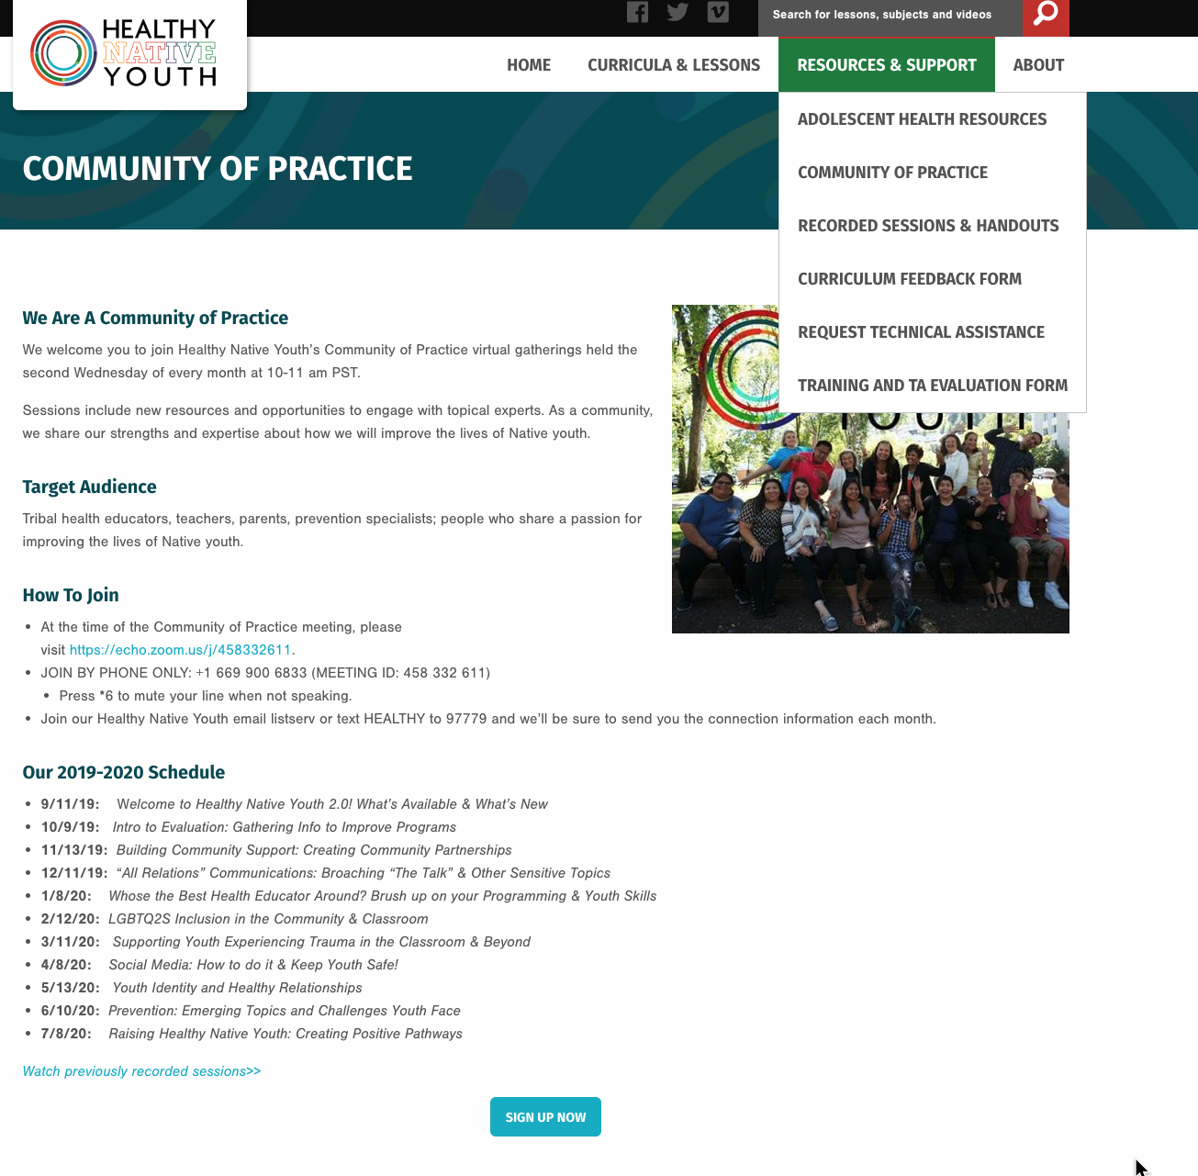

Slide 13
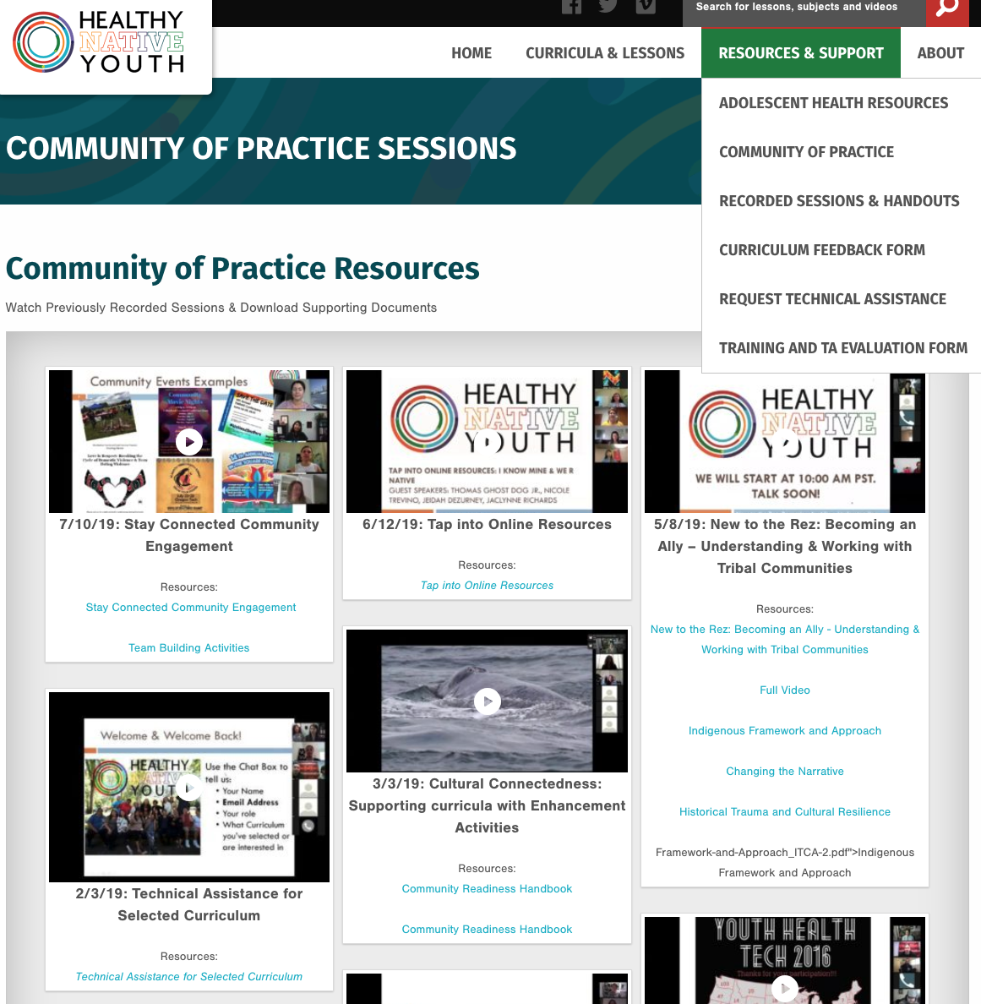

Slide 14
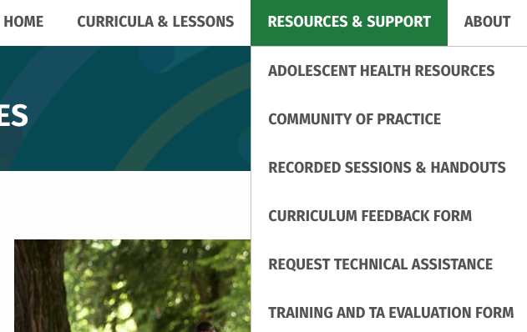
Feedback, Training & TA Requests
Notes:
Stephanie

Slide 15
support for Parents and Caregivers…
Tools & Resources
Notes:
Adolescent sexual health is a subject that parents and caregivers have difficulties in trying to answer sensitive questions from their child or youth. Is this your observation and if yes, what tools do you think could be helpful to provide?

Slide 16



Center for Healthy Communities
Oregon Prevention Research Center

Slide 17
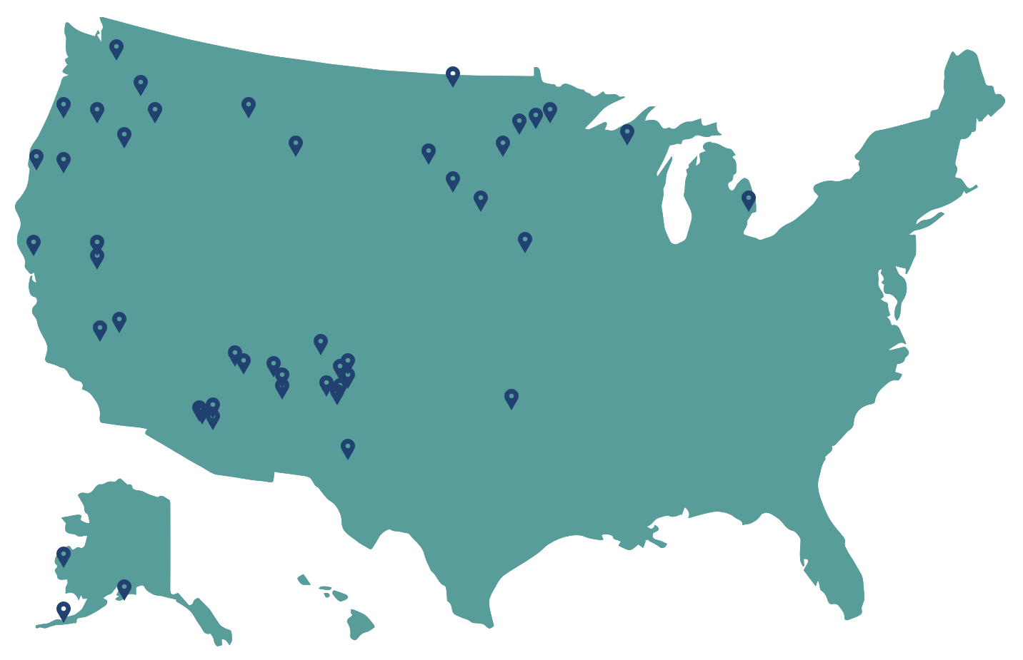
Center for Healthy Communities
Oregon Prevention Research Center
Geographical Reach of Native STAND

Slide 18
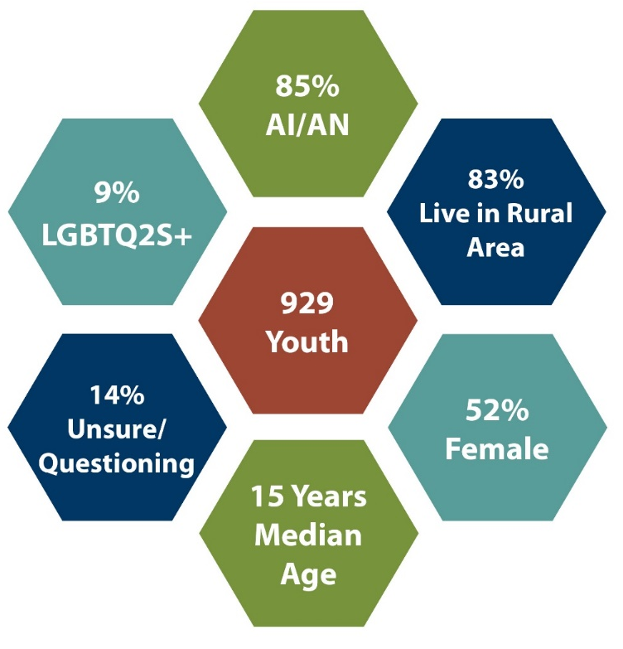
Center for Healthy Communities
Oregon Prevention Research Center
Reach – Youth Participant Characteristics
*929 youth completed both pre- and post- questionnaires
1,203 youth completed the pre- questionnaire only

Slide 19
Center for Healthy Communities
Oregon Prevention Research Center
Quotes from Educators
“I got feedback from a young man’s parents, and the dad was indicating that [Native STAND] made it easier to talk to him about the different STDs, and about relationships, because of what we’ve been implementing.” – Nichole Gonzales
“[Native STAND youth] are even being role models and mentors for their younger siblings and cousins -- they look up to them.” – Donna Quintana
“It’s just amazing, the conversations that these youth are having...they’re really not scared to talk about it. They just need a place to do it.” – Robby Bill

Slide 20

Coming Soon:
Parent/Child Text Messaging
“The Talk”: a text messaging program for parents of middle and high school students to get guidance on how to begin a conversation with youth
Weekly Message sequence
Topics include:
  Dating
  Sexual health
  Relationships
  Communication
  Consent
  LGBTQ2S+

Slide 21

Notes:
To promote sexual health, we designed and evaluated a 12-week text message sequence (text SEX to 97779)
Text SEX…
Frequent condom use increased from 30% to 42% and was retained by participants at least 3 months post-intervention.
The intervention improved participants’ intention to get tested for STI/ HIV after changing sexual partners, increasing from 46% to 58% post-intervention.
Given the widespread use of cell phones by youth, text-based interventions may offer a feasible and effective tool to promote condom use and STI/HIV testing.

Slide 22
Possible Parent-Child Communication
Tools and Resources
Instagram & YouTube
One-pagers for Parents (Promoting the text message service)
Incorporate links to videos:
  Parent-child conversation examples
  Tips for starting conversations on a topic
  Q&A addressing Sensitive Questions
  Topical experts
Resource page on HNY website

Slide 23
Adolescent health resources
For Native youth by Native youth
We R Native

Slide 24
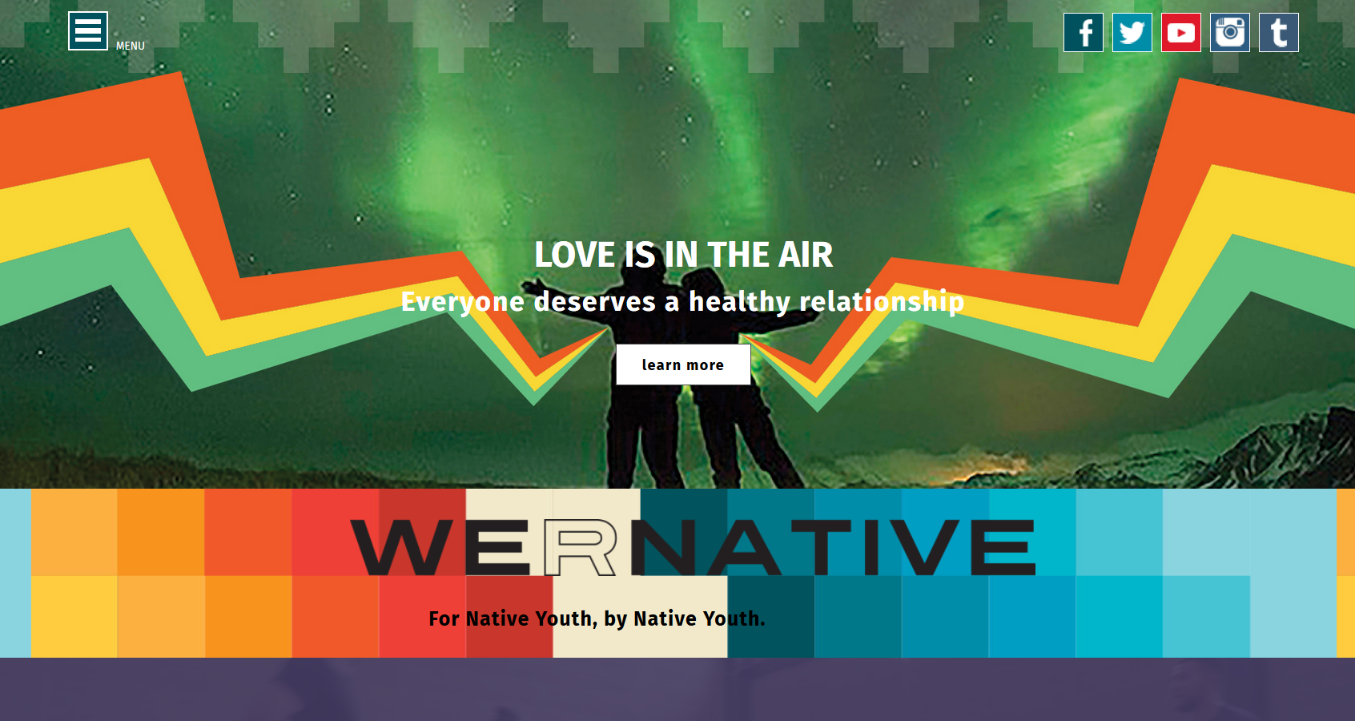
Notes:
We R Native, a multimedia health resource for Native youth, by Native youth, run by the Northwest Portland Area Indian Health Board.

Slide 25
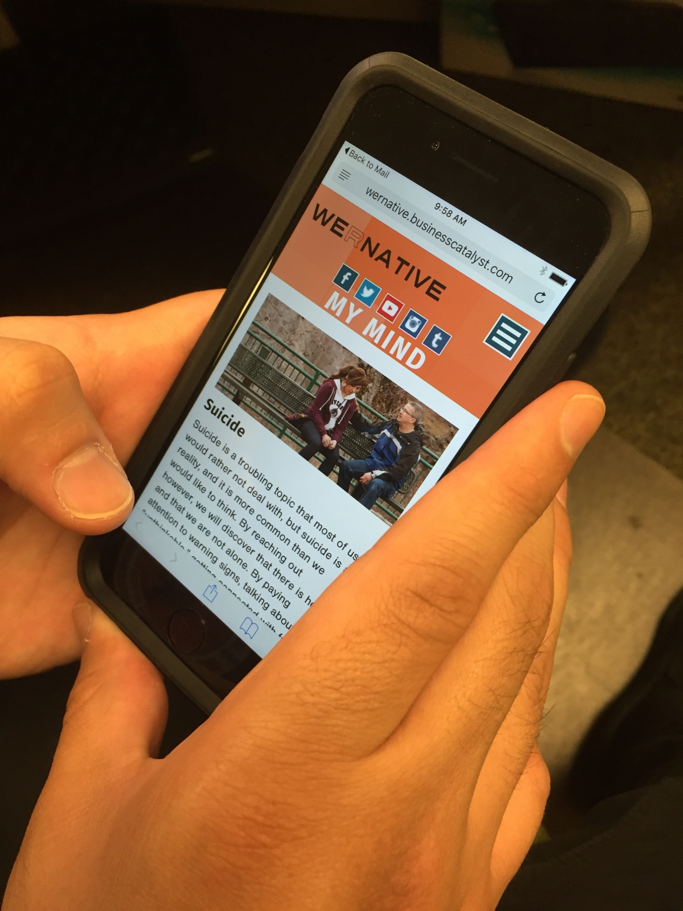
Notes:
The site includes life advice on a wide variety of topics, with over 400 health and wellness pages written and reviewed by Native youth and topical experts.

Slide 26
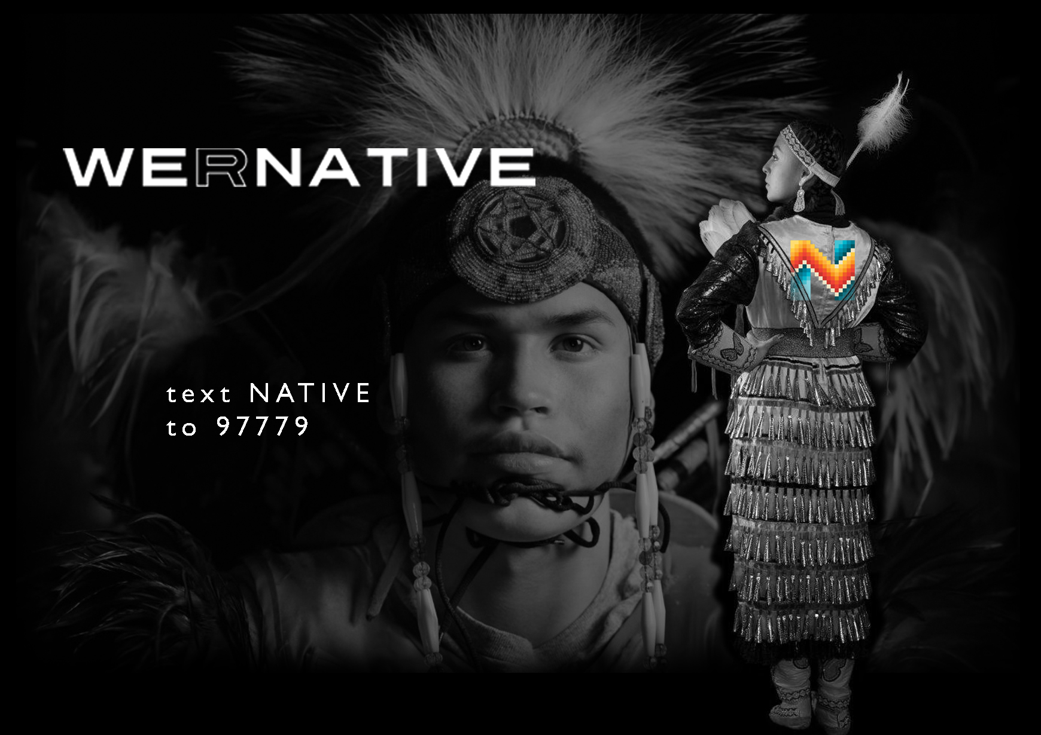
Notes:
Given the widespread use of cell phones by youth, we are increasingly using text messaging to help disseminate our messages. Nearly 6,000 youth have signed up to receive our weekly health tips and life advice.

Slide 27
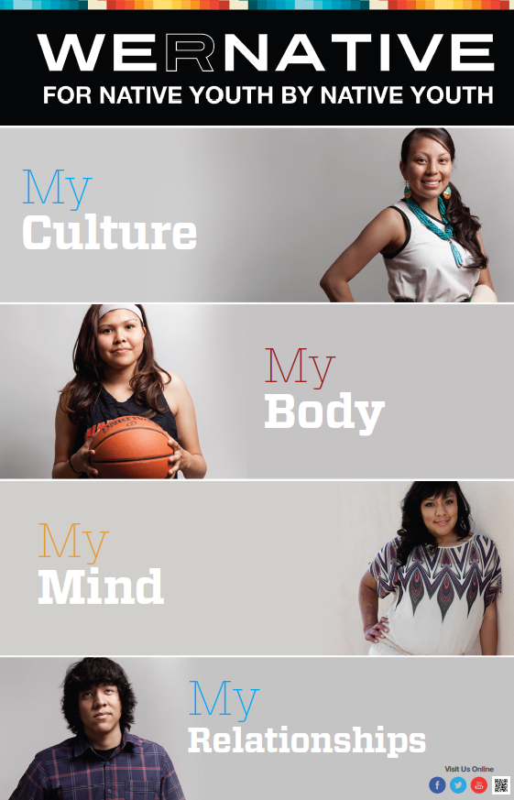
Website launched October 1, 2012 – WRN is 7 Years Old!
REACH: 1. 7 million viewers
Across all media channels, the service reaches on average 31,000 users per week
Over 400 health/wellness pages, reviewed by AI/AN youth and topical experts.
Special features include:
  Contests
  Videos
  Free gear & Promo Kits
  Mini Community Service Grants
  Student Testimonials

Slide 28

Get at us on social media
@wernative
Healthy Relationships
o them.

Slide 29
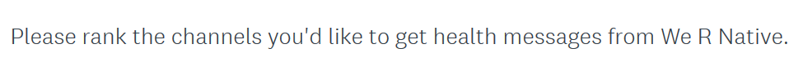
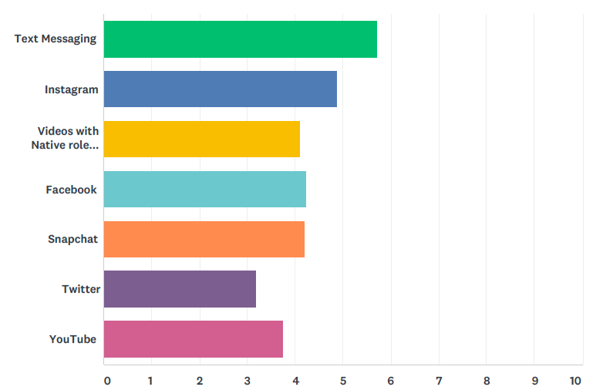


Slide 30
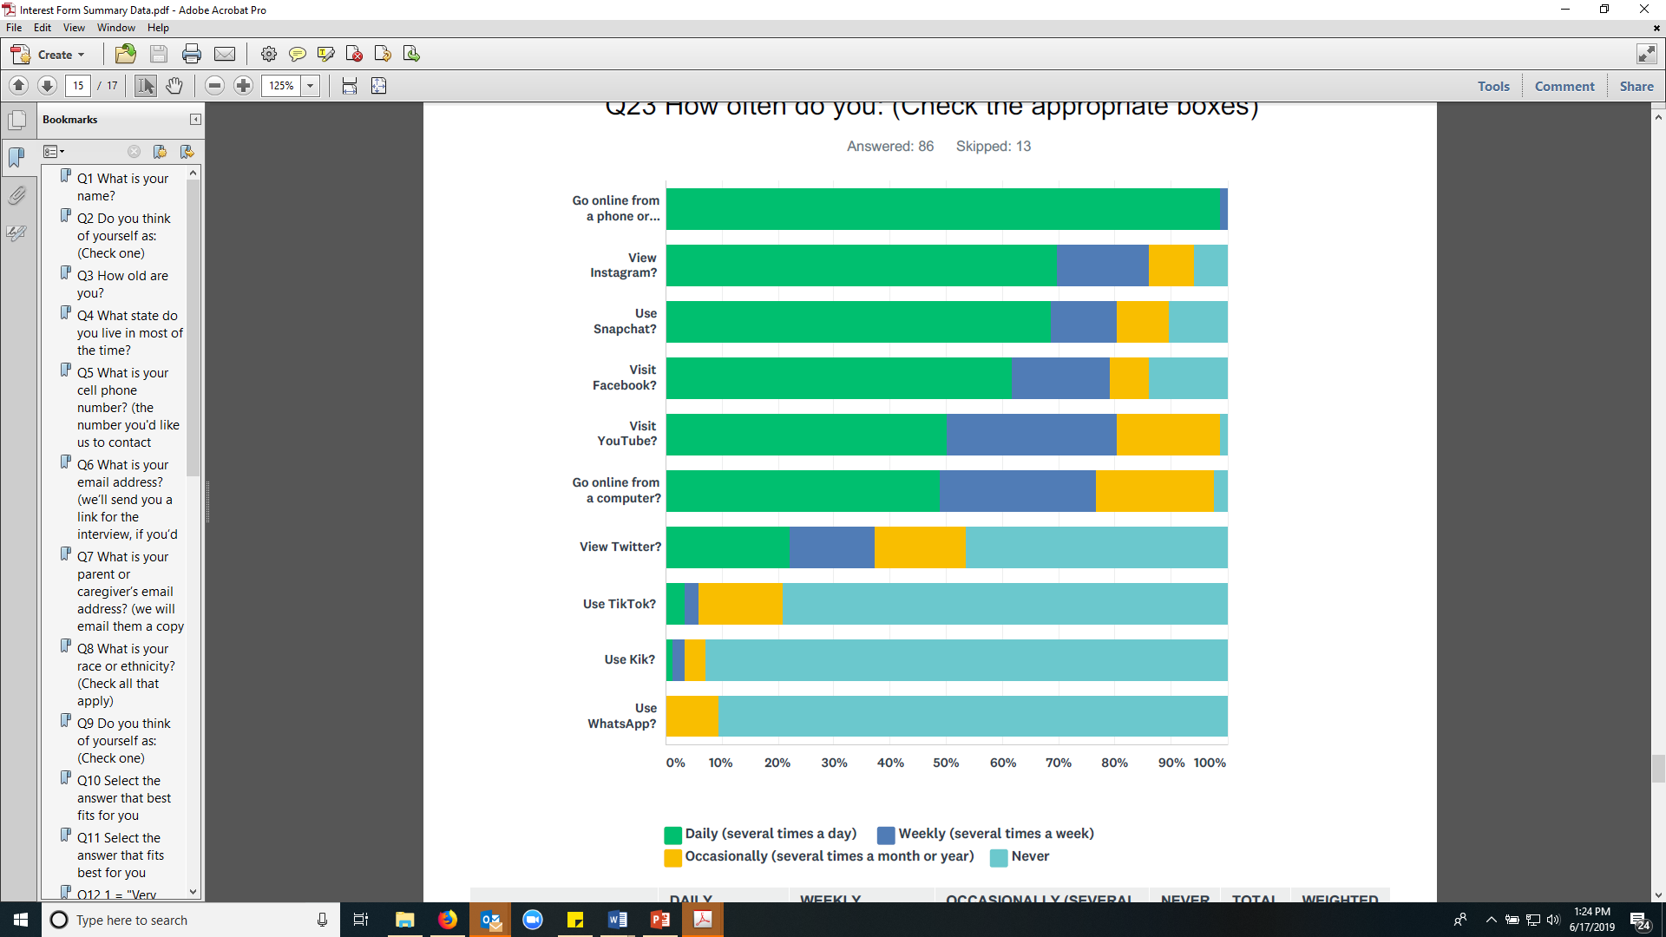
Notes:
How often do you…?

Slide 31
Notes:
Our key informant interviews added context to these data, discussing trauma, grief, and other life stressors.
In the age group of 15-17, the most important mental health topics are stress and then depression and anxiety. In the 18-24 age group, the top three most important mental health topics were suicide prevention, depression, and unhealthy relationships. Overall, grief or depression were the most important mental health topics; stress and mental wellness skills (e.g. coping mechanisms) were the second most important mental health topics.

Slide 34
Quotes from We R Native Interviews
“It makes me feel more connected to my culture - just know that I’m with a community of people who are like me. Just having the little reminders and posts… really helps me.”
For a lot of kids, We R Native is a really good way to connect with their culture, and they're also there to listen to you… if you have any issues with mental illness or feeling different. Everyone's different in their own way. I think they do a really good job of addressing stigma through the articles and Ask Auntie – [the] videos really help too.

Slide 35
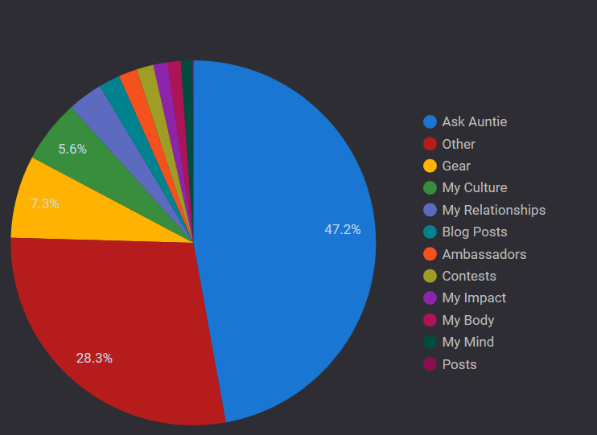

Slide 36
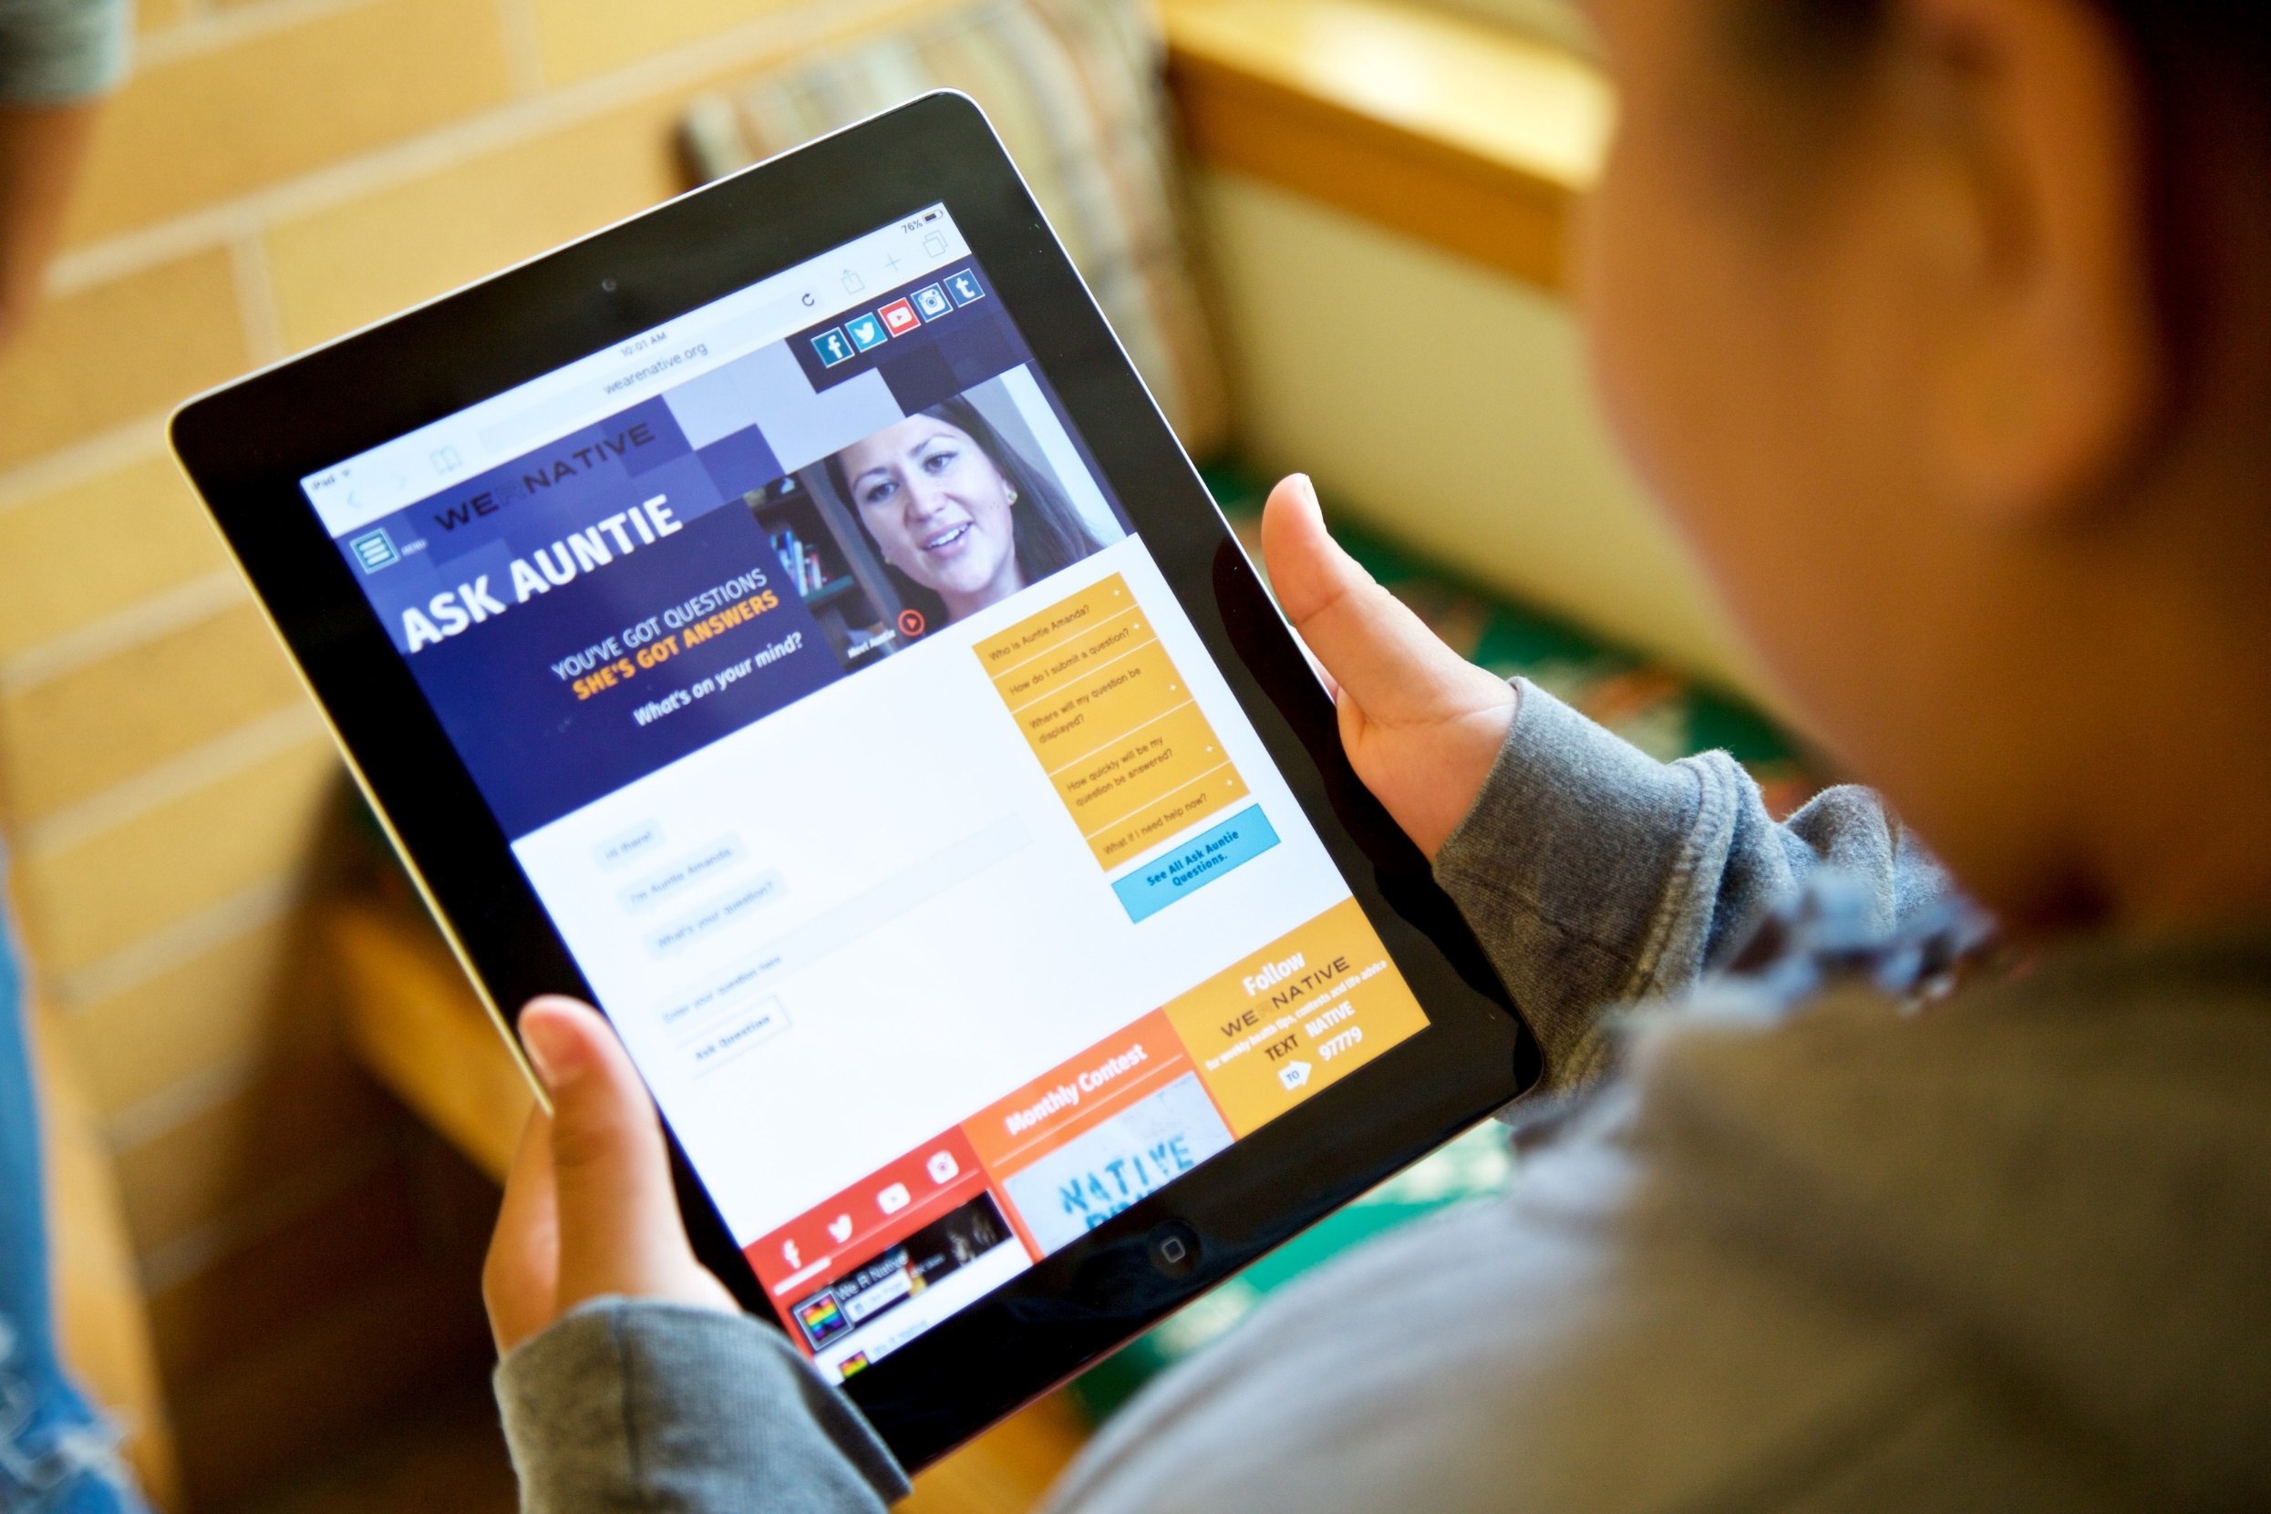
Notes:
1.15-1.30
One of the most popular sections of the website is an Ask Auntie service. Auntie has answered over 300 questions, many addressing sensitive topics that youth might not have felt comfortable asking a parent or clinician.

Slide 37
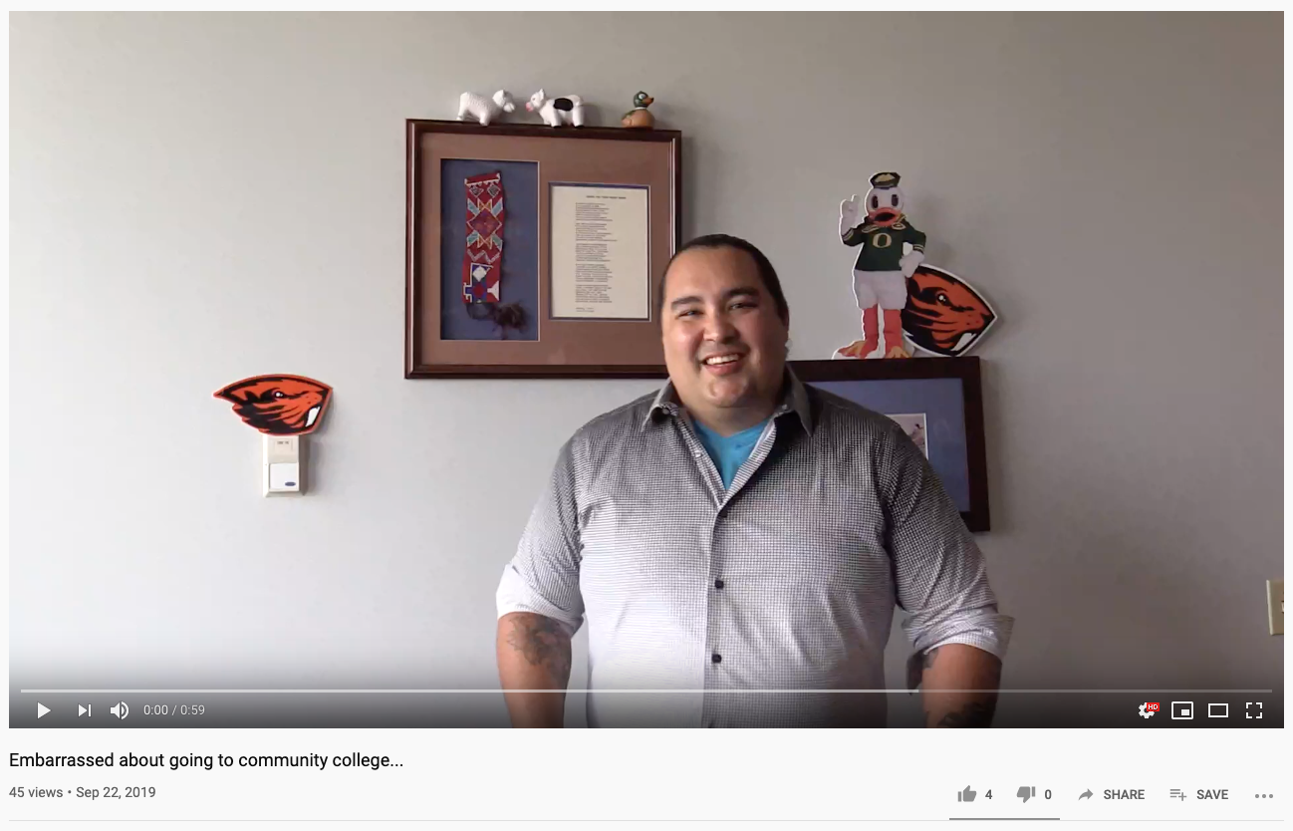
https://www.youtube.com/watch?v=esgoJigRaM4

Slide 38
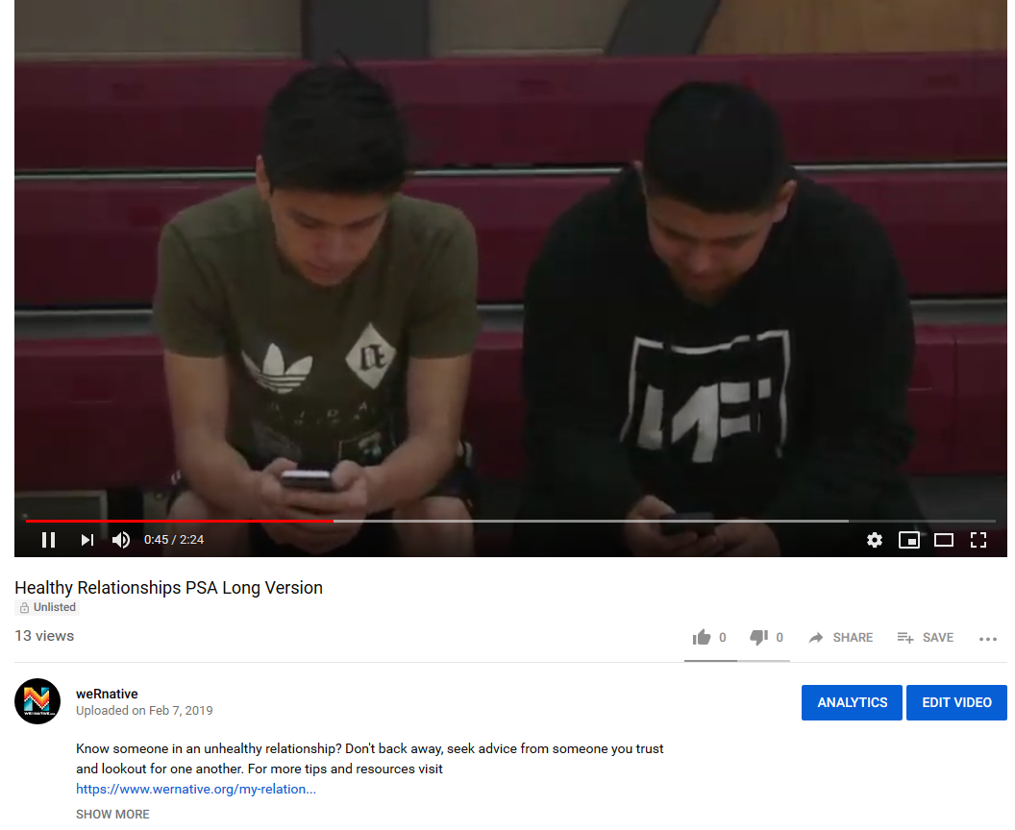
Healthy Relationships Video: https://www.youtube.com/watch?v=5jy-jVMi2zY&feature=youtu.be
Notes:
https://www.youtube.com/watch?v=5jy-jVMi2zY&feature=youtu.be

Slide 39


Notes:
Over 400 participants

Slide 40
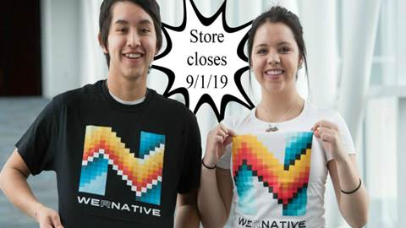
Text “Gear” to 97779

Slide 41
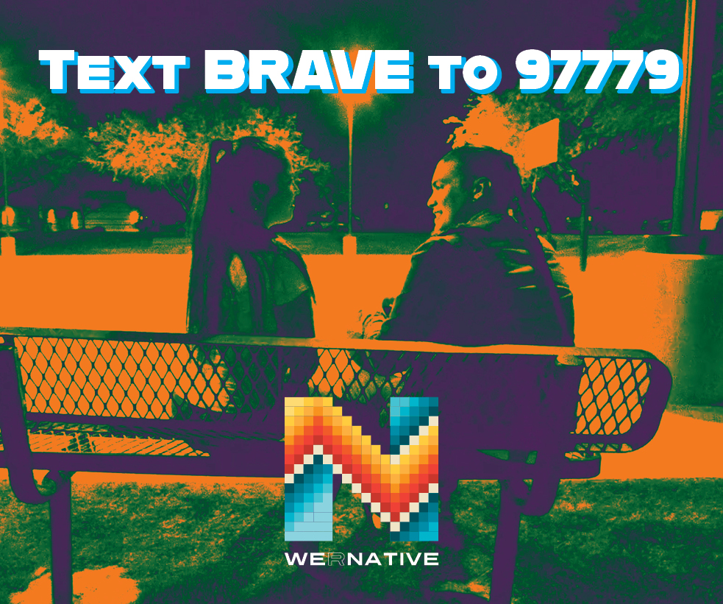
It takes courage to change. It takes courage to step up and help a friend.
Text BRAVE to 97779.
You’ll receive videos, tips, and resources to fill your wellness toolbox.
Eligibility:
American Indian or Alaska Native
Age: 15-24 years old
Able to receive text messages on your phone
To enroll, text BRAVE to 97779.
Participants will receive $40.00 for completing 4 surveys over 9 months.

Slide 42
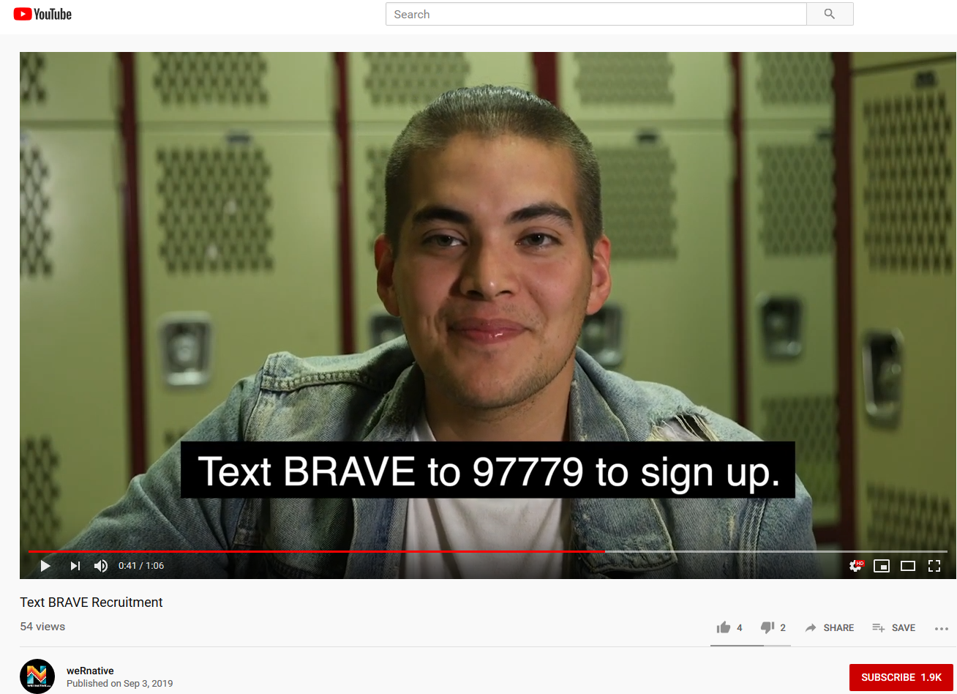
https://www.youtube.com/watch?v=hSAnVwlT7uk&feature=youtu.be

Slide 43
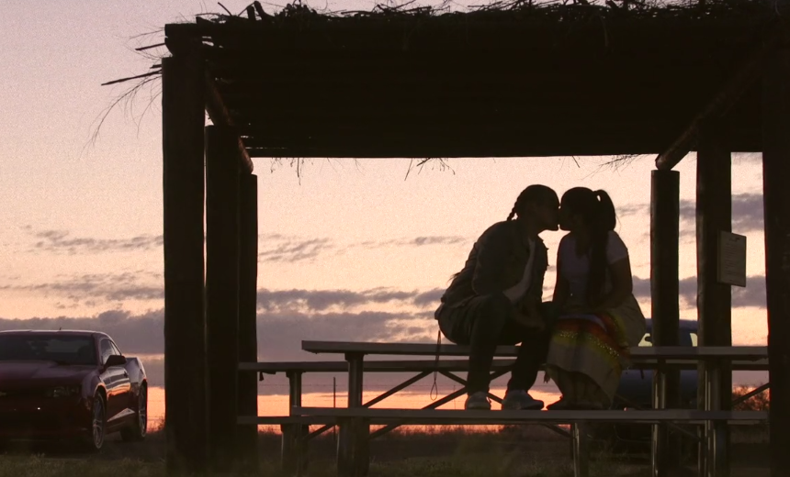
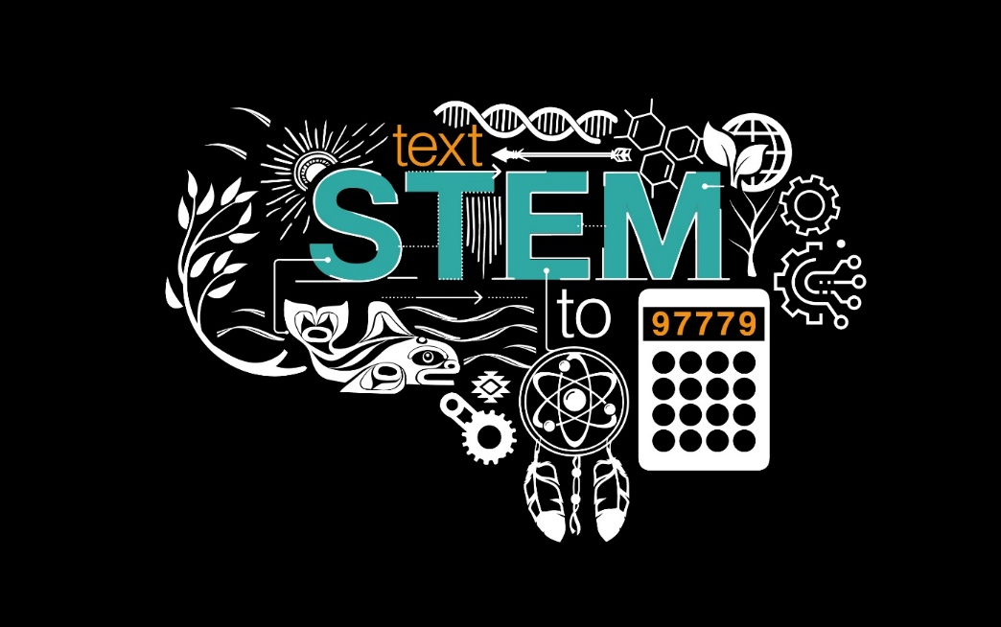
Study Arms (n = 1,500 Native youth
Age range: 15-24 yrs old)
Text BRAVE to 97779
Text STEM to 97779

Slide 44
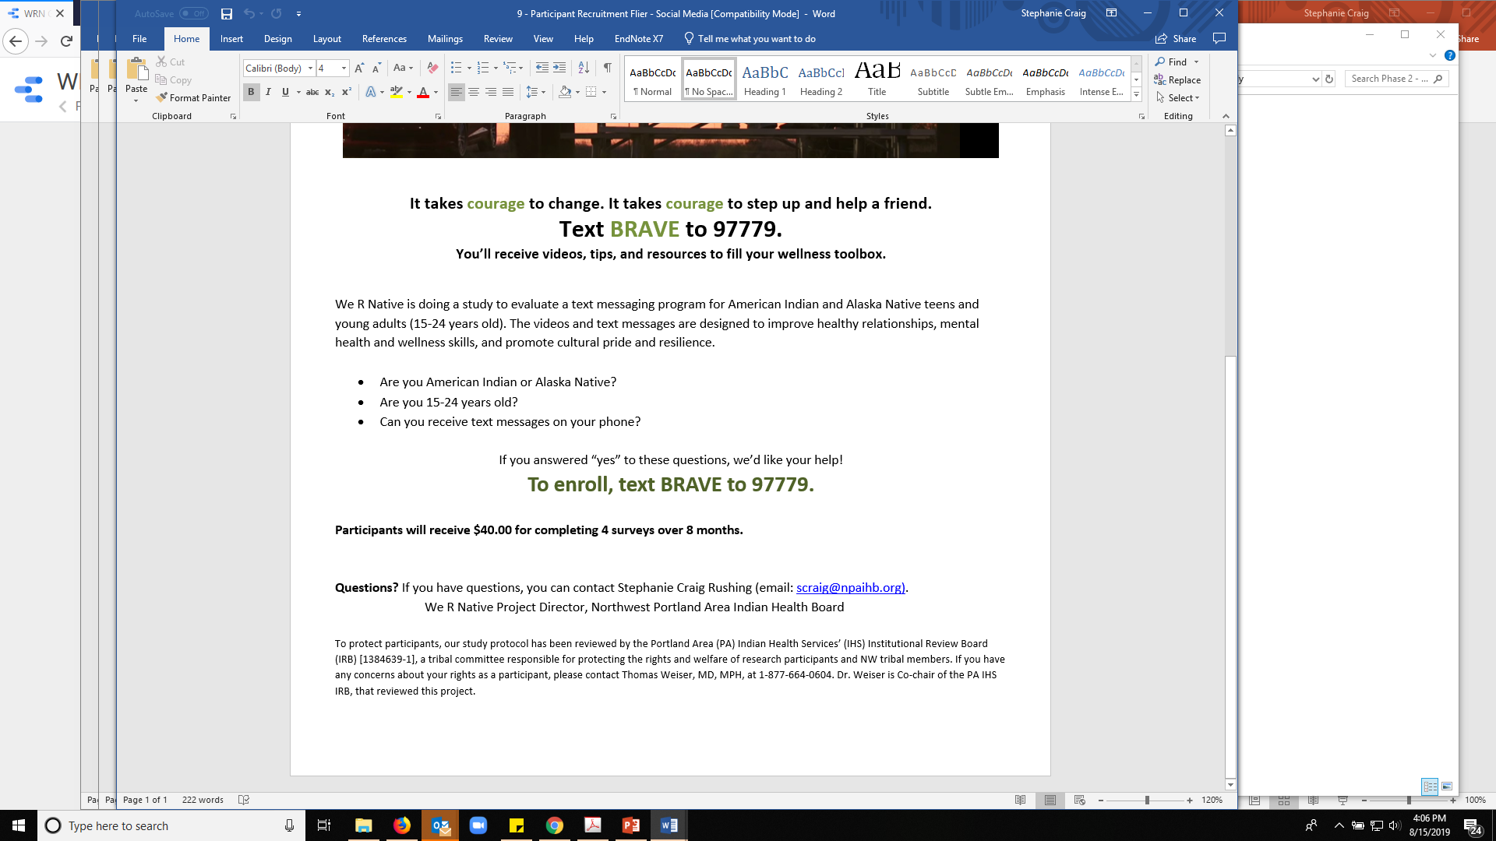
Enrollment > Pre-survey > Randomize

Slide 45
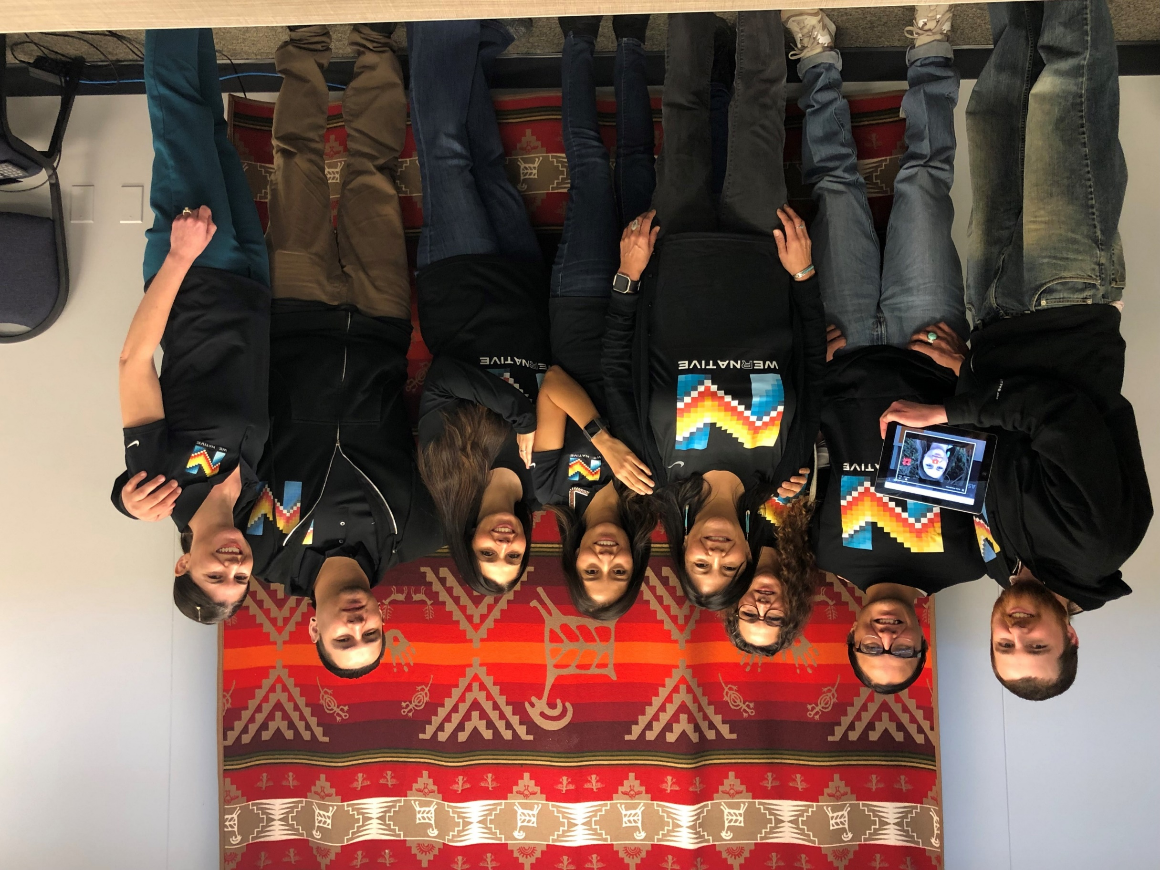
Notes:
3.30-3.45
This work is done by a small but mighty team, who is deeply committed to our shared mission.
Every day we lovingly nudge each other to do our best work.
Everybody give ‘em a quick silent wave…

Slide 46
Northwest Portland Area Indian Health Board (NPAIHB)
Stephanie Craig Rushing, PhD, MPH
Principal Investigator
scraig@npaihb.org
Jessica Leston, MPH
STD/HIV Clinical Services Director
jleston@npaihb.org
Colbie Caughlan, MPH
THRIVE Project Director
ccaughlan@npaihb.org
Celena McCray
THRIVE Coordinator
cmccray@npaihb.org
Danica Brown, PhD, MSW
Behavioral Health Manager
dbrown@npaihb.org
Amanda Gaston, MAT
Ask Auntie
agaston@npaihb.org
David Stephens, RN
ECHO Director
dstephens@npaihb.org
Tommy Ghost Dog
We R Native Coordinator
tghostdog@npaihb.org
Michelle Singer
Healthy Native Youth Manager
msinger@npaihb.org
Tana Atchley-Culbertson
Youth Engagement Coordinator
tatchley@npaihb.org
Paige Smith
THRIVE Project Coordinator
psmith@npaihb.org
Corey Begay
Multimedia Specialist
cbegay@npaihb.org

Slide 47


Healthy Native Youth and We R Native are funded by the Indian Health Service HIV and behavioral health programs. This work is also supported with funds from the Secretary’s Minority AIDS Initiative Fund.

