Slide 1
NPAIHB Tribal Opioid Response – Taking care of each other

Slide 2
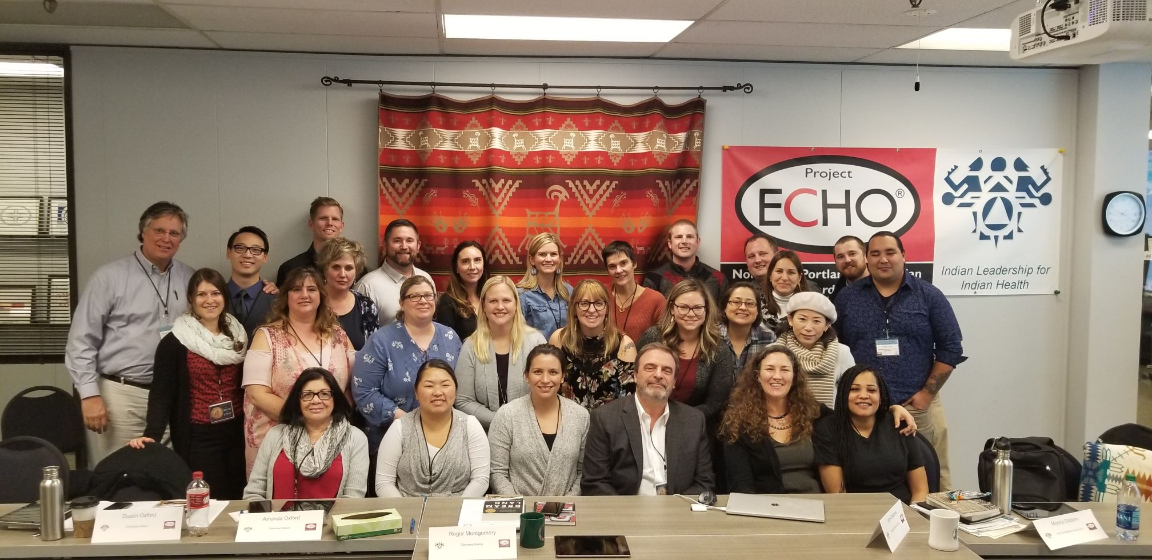
How are we responding?

Slide 3




NPAIHB Opioid Projects
Tribal Opioid Response (TOR) – SAMHSA
  Consortium of 28 Tribes (42 Total)
Strategic Planning (CDC)
  Regional and National Work
  49 Days of Ceremony
Opioid Overdose Data and Surveillance (CDC)
  Improve accuracy and access to data on drug and opioid overdoses for Northwest Tribes
Indian Country Substance Use Disorder ECHO clinic (SAMHSA + OMH)
  Integrating Medications for Addictions Treatment in Primary Care
MCH Opioid Study
Notes:
“To deal with structural disaggregation of necessary OUD treatment components in the Indian Healthcare system, and provide tribes and clinicians with comprehensive information to do more for our patients and system, the Northwest Portland Area Indian Health Board aims to address the opioid crisis in tribal communities by increasing capacity to address the complex factors associated with a comprehensive opioid response, including:”

Slide 4
NPAIHB Tribal Opioid Response Consortium
The overarching goal of the NPAIHB TOR Consortium is to develop a comprehensive and strategic approach to assist Tribes in developing capacity to address the complex factors associated with a comprehensive opioid response. This includes:
Developing a framework for an Opioid Response Strategy,
Increasing awareness of opioid use disorder,
Preventing opioid use disorder,
Increasing access to treatment and recovery services and overdose reversal capacity
Reducing the health consequences of opioid use disorder in tribal communities.
Notes:
“To deal with structural disaggregation of necessary OUD treatment components in the Indian Healthcare system, and provide tribes and clinicians with comprehensive information to do more for our patients and system, the Northwest Portland Area Indian Health Board aims to address the opioid crisis in tribal communities by increasing capacity to address the complex factors associated with a comprehensive opioid response, including:”

Slide 5
Year 1 TOR Consortium
16 Tribes developed public awareness campaigns and 9 Tribes reached the point of implementing their campaigns.
Extensive work to disseminate and educate about opioid reversal medications.
At least 12 Tribes used funds to make MAT available to tribal members.
5 Tribes developed MAT policies in preparation to offer MAT through the clinic.
Notes:
Education and Public Awareness
-Many Tribal stakeholders explained the need for community education to increase awareness and acceptance of naloxone, due to a general resistance to many harm reduction approaches.
-Several Tribal stakeholders underscored the need for education about MAT to support its acceptance by medical care providers, Tribal elders, and the community.
Naloxone
-Nearly 2,000 naloxone kits were purchased across 15 Tribes.
-By the end of Year 1, nearly 500 naloxone kits had been distributed by 12 Tribes.
-8 Tribes developed naloxone policies.
Staff Support and Workforce Development
-14 Tribes used TOR funds to hire and support staff. A total of 29 permanent and temporary staff positions were funded in whole or in part by TOR funds, including peer mentors, counselors, clinicians, and care coordinators.
-14 Tribes used TOR funds to offer workforce development opportunities to their staff, thereby increasing their local capacity for opioid prevention, treatment, and recovery services.
-16 medical professionals from 6 Tribes were trained and became DATA 2000-waivered.

Slide 6
Year 1 TOR Consortium
11 Tribes reached more than 300 people with recovery services, including recovery coaching, recovery housing, and other cultural programs.
8 Tribes reached more than 3,000 people with prevention services and messages.
14 Tribes offered wraparound services to support individuals in treatment or recovery from OUD. Services included outreach, transportation, assistance with housing, education regarding OUD and mental health, legal services, and family services.
Notes:
READ FIRST: Prevention and Recovery Programs
Tribes used TOR funds to provide important prevention and recovery services in their communities and they placed an emphasis on the provision of culturally based programs.
--Then move on to the slide bullet points

Slide 7
A Trickster Tale
Notes:
TOR Funds

Slide 8
Fact Sheets
Notes:
We have 6

Slide 9
Communication
Newsletter
Listserv

Slide 10
Tribal Opioid Response Agenda
7 Key Areas
Preventing New Cases of Opioid Use Disorder
Offering Evidence-based Treatment and Recovery Services
Protecting Mothers and Babies Affected by Opioids
Incorporating Harm Reduction into Tribal Treatment, and Recovery Services
Gathering Critical Information to Mount an Effective Community Response
Growing the Evidence-Base for Effective Tribal Opioid Interventions
Developing our Tribal organizations and workforce

Slide 11
49 Days of Ceremony Overview
To“develop and examine efficacy of culturally appropriate prevention and intervention strategies to reduce opioid misuse and support OUD treatment” – mentioned as a reoccurring theme in 2018-2019 strategic planning listening and learning sessions.
We will focus on developing innovative AI/AN community-based intervention to prevent or mitigate the effects of early adversity as a result of intergenerational/historical trauma and adverse childhood experiences (ACES) which includes opioid misuse and other health disparities with a focus on wellness.
Target Population - AI/AN communities in Alaska, Idaho, Oregon and Washington.

Slide 12

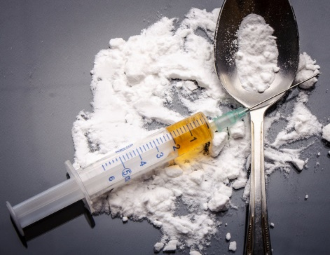

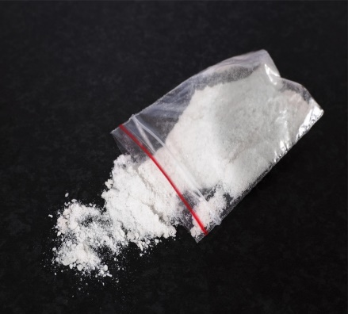
Opioid Data & Surveillance Project

Slide 13


Opioid Data & Surveillance Project
Overview
3-Year grant through the CDC (Centers for Disease Control and Prevention)
Add-on to the TEC-PHI grant
Goal is to improve opioid & drug surveillance among Northwest tribes, and improve tribal access to drug/opioid data

Slide 14
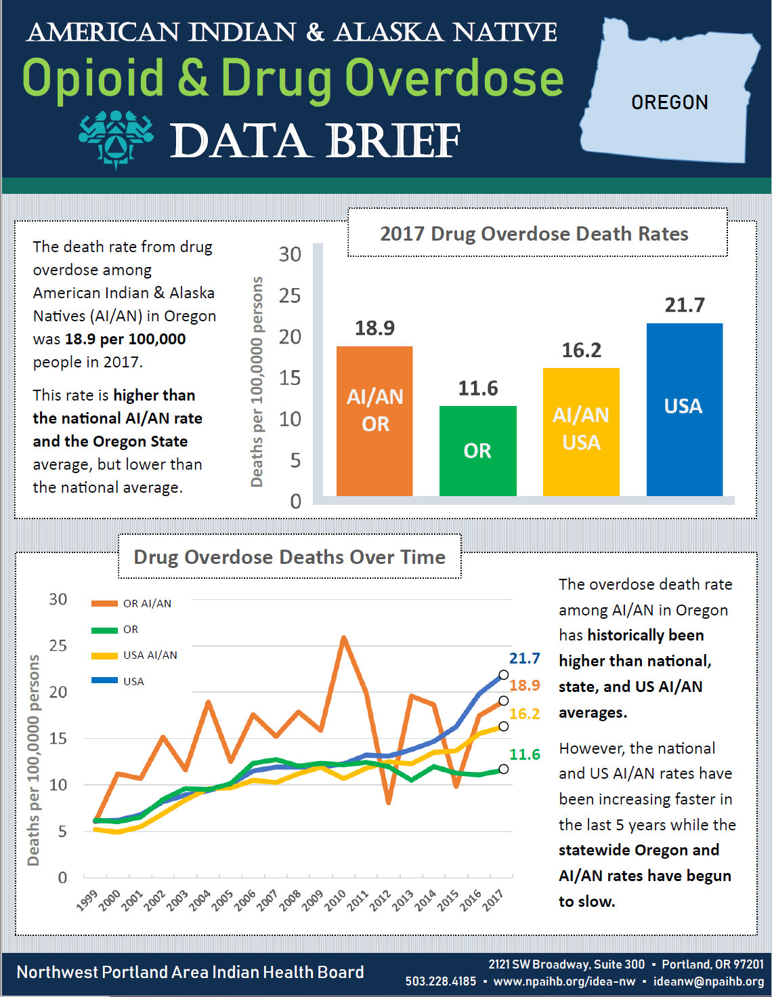
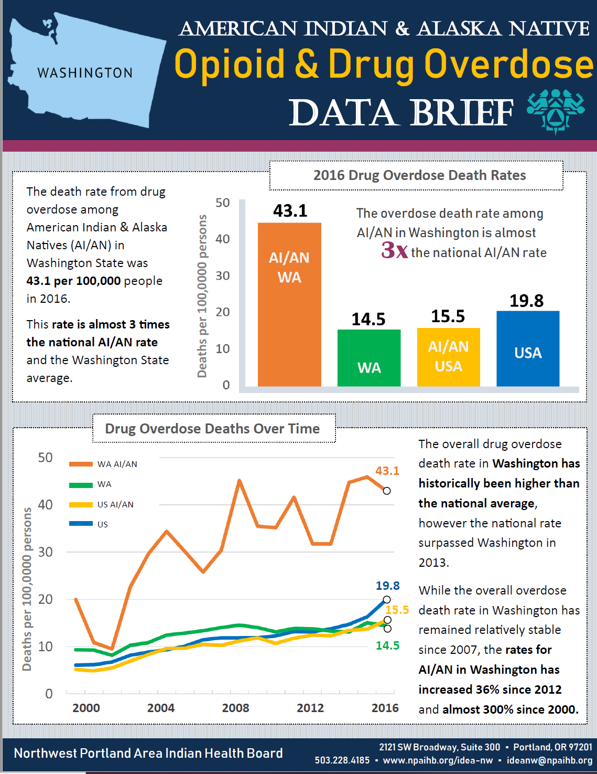
Opioid Data & Surveillance Project
Goals
Produce opioid/substance data reports for AI/AN
Assist NW tribes with opioid/substance data needs
Gain access to additional opioid/substance data sources
Work with partners to address racial misclassification in data systems
Notes:
Mortality related to opioid, other substances, alcohol, poly

Slide 15

Need Opioid/Drug Data?
Contact me!
Overdose deaths in your county/area
Emergency department visits for overdose in your county/area
Other opioid/drug-related data
Heidi Lovejoy, MSc
Substance Use Epidemiologist
HLovejoy@npaihb.org
(503) 416-3251
Notes:
Call me. It is literally my job. ☺

Slide 16
Indian Country Substance Use Disorder ECHO
The Indian Country Substance Use Disorder ECHO provides an opportunity to promote expansion of access to treatment for opioid use disorder and other SUDs. Specialists in substance use disorder and behavioral health treatment at NPAIHB offer in-person trainings and a twice monthly teleECHO clinic for Indian Country healthcare staff. The program offers:
In-person trainings with MAT Waiver
Telehealth sessions
Providers support to improve or integrate best-practice care where opioid use disorder and other substance use disorder treatment may have been previously unavailable.
Notes:
Overall objectives include expanding MAT services to at least 60 clinics, providing DATA 2000 training to at least 75 clinicians, and to provide consultation to at least 175 AI/AN patients.

Slide 17
Best Practice – Indian Country ECHO
Notes:
Project ECHO (Extension for Community Healthcare Outcomes) is a collaborative model of medical education and care management that enables clinicians (regardless of where they live) to provide better care to more people, right where they live.
The ECHO model™ does not actually “provide” care to patients. Instead, it increases access to specialty treatment in rural and underserved areas by providing front-line clinicians with the knowledge and support they need to manage patients with complex conditions such as: hepatitis C, HIV, tuberculosis, chronic pain, endocrinology, behavioral health disorders, and many others. It does this by engaging clinicians in a continuous learning system and partnering them with specialist mentors and colleagues.

Slide 18
DATA 2000 Waiver Training + ECHO Onboarding
Opioid Use Disorder Training + ECHO Onboarding
Upcoming Trainings:
Swinomish, WA – Feb 19-20 & March 16-17
Portland, ME – March 24-26
Billings, MT – April 29-30
Host a Training:
Contact the ECHO team
David Stephens, dstephens@npaihb.org

Slide 19
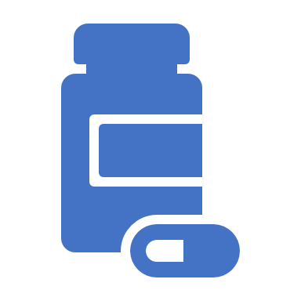
Online Opioid Learning Models for Dentistis

Slide 20



|
INVESTIGATING MATERNAL OPIOID USE, NEONATAL ABSTINENCE SYNDROME AND RESPONSE IN NW TRIBAL COMMUNITIES
MCH-OPIOID STUDY
Tam Lutz/Jodi Lapidus Co-PIs
Chiao-Wen Lan Co-Inv/Biostat
Jenine Dankovchik Biostatistician
Candice Jimenez Research Manager
Project Period August 2019 to July 2021
Grant No. R21DA047940
Funder. National Institute on Drug Abuse

Slide 21
In Oregon and Washington, the NAS incidence rate for AI/AN babies was more than three times higher than Non-Hispanic White babies
Notes:
The risk of AI/AN maternal substance use (MSU)-related delivery hospitalizations was 3 times that of NHW during 2012—2013
The overall incidence rate of NAS in both states combined was 26.8 per 1,000 live births (95% CI: 23.1, 31.1) for AI/AN, and 7.9 per 1,000 live births (7.4, 8.3) for NHW.

Slide 22

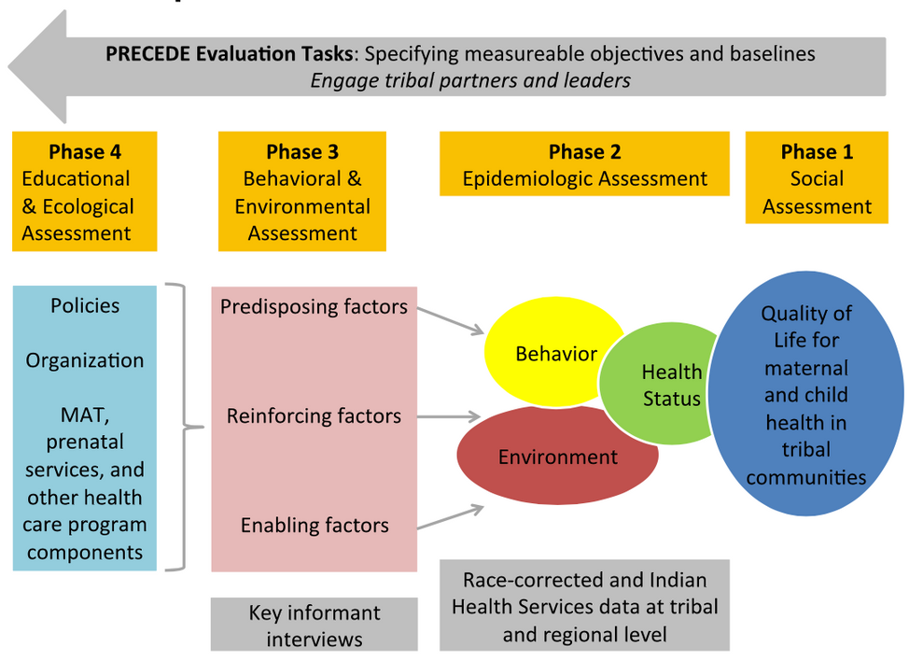
SPECIFIC AIMS
Aim 1
Perform an epidemiologic assessment to determine the magnitude and impact of maternal substance use during pregnancy and NAS among AI in the Northwest
Aim 2
Describe the environmental, social and organizational structures, processes and policies, as well as individual behaviors that influence access to, or use of, MAT in NW Tribes
Contact Us:
cjimenez@npaihb.org
503 416 3264

Slide 23
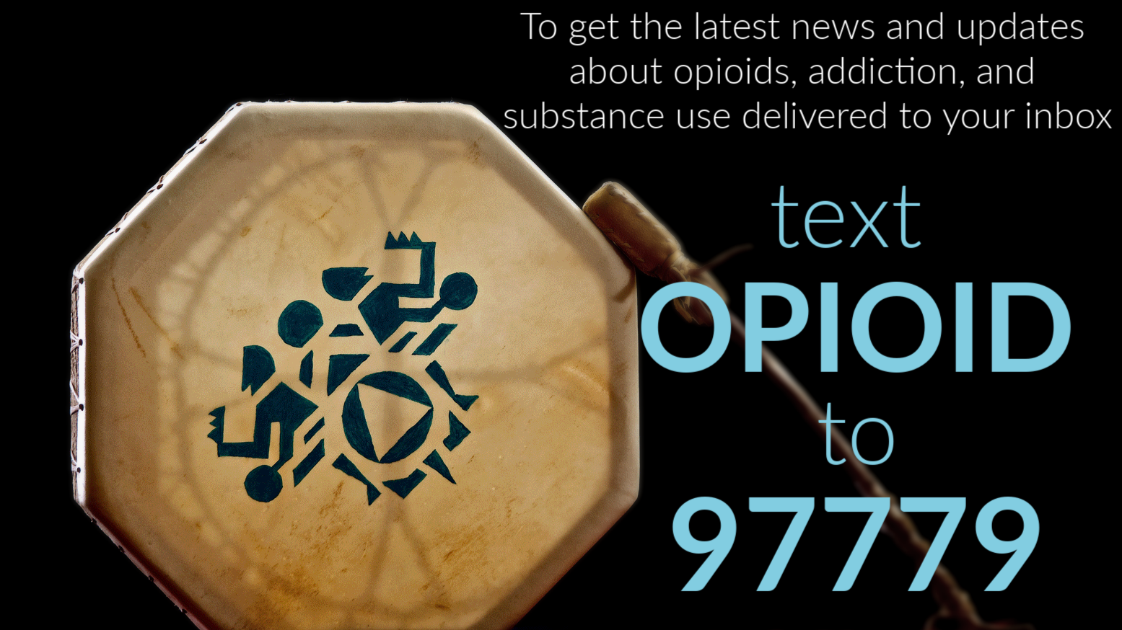
Notes:
Stay Connected! To get custom resources and tailored content for you and your area, you can join our text message service by texting HCV to 97779. We’ll also be sending out today’s slides via text.

