Slide 1
Peer Support in Tribal Communities
Jessica Carroll (Osage) MA-PMHCA, PWS
Lead Project Coordinator - Peerlink NTAC
Program Manager - Oregon Peer Training Innovation Center
Mental Health & Addictions Association of Oregon

Slide 2
What is Peer Support?
Peer Support is a profession, where people with lived experience of mental health and/or substance abuse issues who have found recovery, are employed to support others in finding there own path to recovery
Peer workers help others to advocate for themselves and navigate systems, and accessing resources.
Having experience navigating systems and accessing resources from a consumer point of view is essential to Peer Support
Peer workers support others without judgment, understanding that we all have different paths to recovery
Peer workers know that recovery is more than possible, it is probable, when individuals have appropriate resources and support.

Slide 3
Peerlink – About the Program
Peerlink is a Peer-Run National Technical Assistance Center funded by SAMHSA.
Focus area’s are: employment, financial self-sufficiency, and organizational development.

Slide 4
Peerlink – About the Program
Peerlink is assigned SAMHSA Regions 9 & 10 which include the following States and Territories:
  Alaska
  Arizona
  California
  Idaho
  Hawaii
  Nevada
  Oregon
  Washington
  American Samoa
  Commonwealth of Northern Mariana Islands
  Federated States of Micronesia
  Guam
  Palau
  Marshall Islands

Slide 5
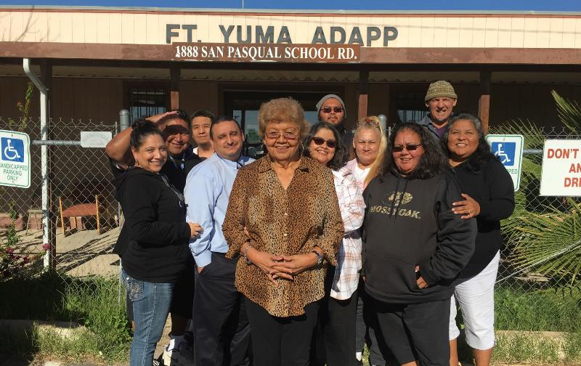
Quechan Peer Training

Slide 6
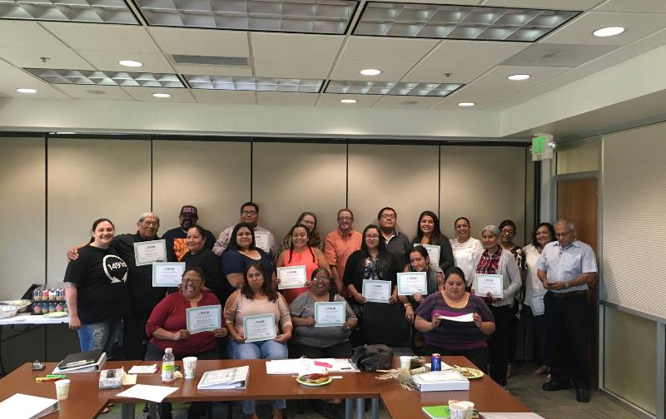
Tucson Peer Training

Slide 7
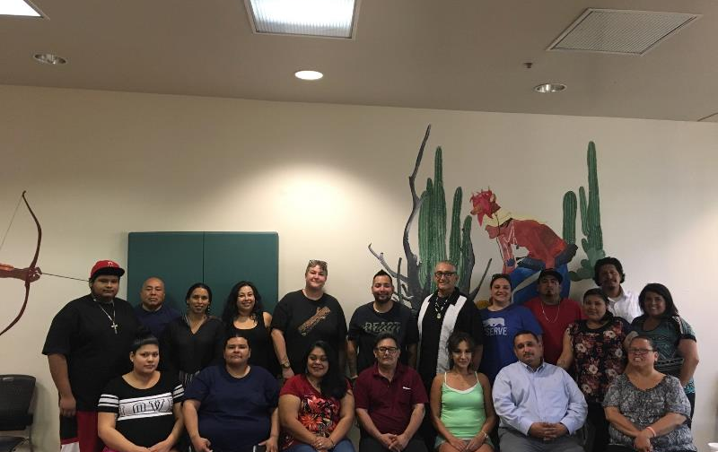
Pascua Yaqui Peer Training

