Slide 1
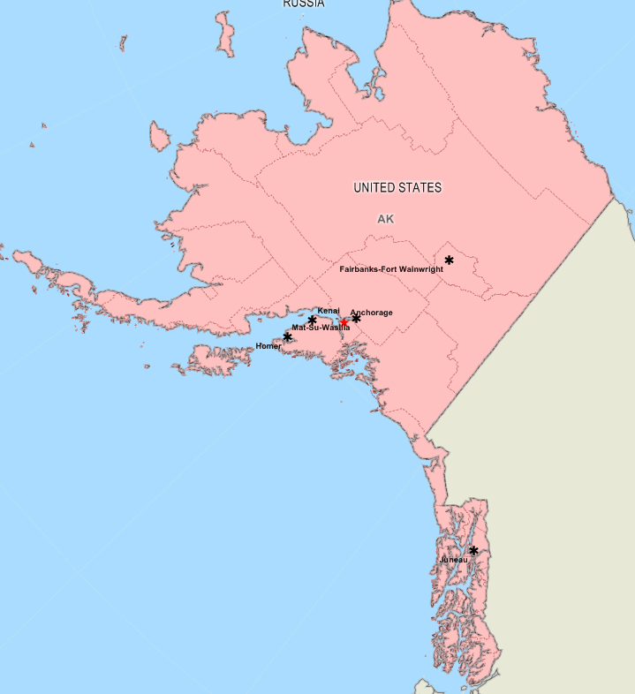
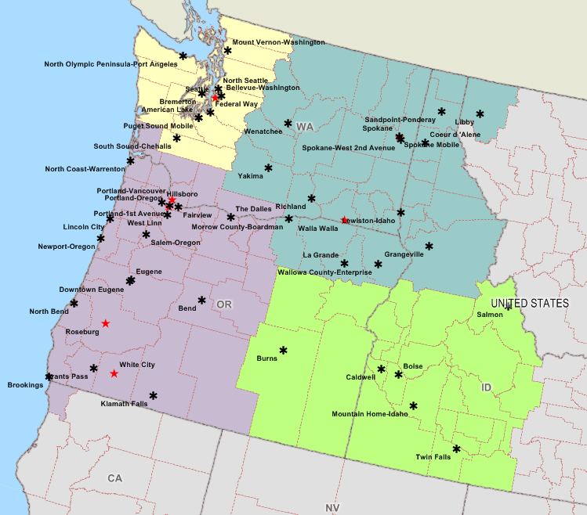
Veterans Integrated Service Network 20
VISN 20 Office
Notes:
Introduce the Audience to VISN 20 geographically.
8 Healthcare Systems: Alaska, Boise, Portland, Puget Sound, Roseburg, Spokane, Walla Walla, White City
10 VA Campuses: Anchorage, Boise, Portland, Vancouver, Roseburg, Seattle, American Lake, Spokane, Walla Walla, White City
45 Community Clinics:
VSSC Bed Cube
Hospital Beds: Operating 472, Authorized 580
Dom Beds: Operating 591, Authorized 591
CLC Beds: Operating 305, Auth 338

Slide 2
VISN 20 Footprint 8 VA Health Care Systems Serving 200 tribes in Alaska and 43 tribes in Idaho, Oregon, & Washington 26 Reimbursement Agreements in Alaska totaling $32M disbursed and 1869 Unique Veterans 20 Reimbursement Agreements in Idaho, Oregon, & Washington totaling $1.4M disbursed and 321 Unique Veterans 2 MOUs for sweat lodges in Walla Walla and American Lake 1 MOU for Biomedical services for 2 IHS clinics in Oregon Yakama Nation and VA Annual Camp Chaparral
Notes:
Majority of reimbursement agreements are with Tribal health programs
Biomed services from VAPORHCS to Warm Springs Health and Wellness Center and Chemawa Indian Health center.
Event Dates
Aug 14th-19th
Veterans Camp Chaparral PTSD Drug and Alcohol Awareness
Memorial Day, Veterans Day, PTSD Camp Chaparral - third weekend of August.
Camp Chaparral is a week-long cultural immersion experience designed to improve understanding and sensitivity of all ethnic backgrounds. The training is located on restricted grounds of the Yakama Indian Nation, in the foothills of Mount Adams in Washington State. The venue and methodology used in the Camp Chaparral experience provides an ideal opportunity for participants to focus on the way veterans' care or benefits are provided, not just how to provide it.
The Veterans Affairs Program coordinates various activities throughout the year with the Yakama Warriors Association such as funeral details, setting of headstones, and flag raising ceremonies.

Slide 3
VISN 20 Growth
As of 2nd Quarter FY19: 3% increase
Ranking 4th in VHA
compared to national average of 1.5%
Have ranked in the top 5 for the last 3 years
Notes:
Source: https://bioffice.pa.cdw.va.gov/default.aspx?bookid=288ea276-8515-4701-9ca7-b48a656c7a4a|ispasFalse|report9621c349-b84c-4e22-b6f3-4c092411e3f8|ws1|wsb0|isDisabledAnalyticsFalse|isDashboardPanelOnTrue

Slide 4
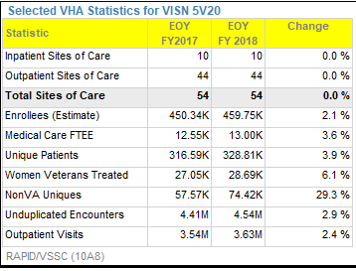
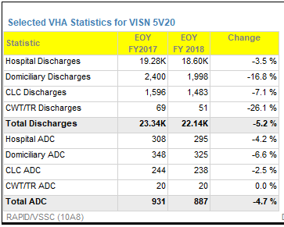
WORKLOAD
Notes:
Sources: https://reports.vssc.med.va.gov/ReportServer/Pages/ReportViewer.aspx?%2fMgmtReports%2fPocketCard%2fPocketCard&rs:Command=Render

Slide 5
MISSION ACT 4 Main Pillars
1
2
Expanding the Program of Comprehensive Assistance for Family Caregivers to eligible Veterans of all eras
Providing VA the necessary flexibility to align its infrastructure footprint with the needs of our Nation’s Veterans
4
Strengthening VA’s ability to recruit and retain quality healthcare professionals
3
Consolidating VA’s community care programs
Notes:
Source
https://vaww.vashare.vha.va.gov/sites/LIT/MISSION_Act/SitePages/Homepage.aspx
What is the 2018 VA MISSION Act?
The VA MISSION Act of 2018 was signed into law by the
President on June 6, 2018. The Act will fundamentally
transform elements of VA’s healthcare system, fulfill the
President’s commitment to provide Veterans with more
choice in their healthcare providers, and prevent a
funding shortfall in the current Veterans Choice Program.
What are the immediate impacts to Veterans
for community care due to the VA MISSION
Act?
In the near term, the VA MISSION Act of 2018
appropriates $5.2 billion in mandatory funding
for the Veterans Choice Program to continue to
provide care to Veterans until the new,
consolidated Veterans Community Care
Program is operational—approximately one
year after the enactment of this Act.

Slide 6
Under the MISSION Act, eligibility criteria for community care:
Services unavailable
Residence in a State without a full-service VA medical facility
40-mile legacy/grandfathered from the Choice program
Access standards
Best medical interest
Needing care from a VA medical service line that VA determines is not providing care that complies with VA’s standards for quality
ACCESS STANDARDS
Access standards will be based on average drive time and appointment wait times.
For primary care, mental health, and non-institutional extended care services, VA is proposing a 30-minute average drive time standard.
For specialty care, VA is proposing a 60-minute average drive time standard.
VA is proposing appointment wait-time standards of 20 days for primary care, mental health care, and non-institutional extended care services, and 28 days for specialty care from the date of request with certain exceptions.
Eligible Veterans who cannot access care within those standards would be able to choose between eligible community providers and care at a VA medical facility.
Notes:
Source: https://www.va.gov/opa/pressrel/pressrelease.cfm?id=5187

Slide 7
Community Care Network (CCN)
=More choices and robust care coordination for Veterans using one consolidated program instead of multiple programs and eligibility requirements that can be confusing to veterans.
Notes:
Source
https://www.va.gov/COMMUNITYCARE/docs/pubfiles/factsheets/FactSheet_26-01.pdf
Key Features
The CCN has several features that will improve care coordination and make it easier for community providers, VA staff, and TPAs to deliver care to Veterans.
Expanded Health Care Services: The CCN will administer regional networks of high-performing licensed health care providers who will work together with VA physicians and practitioners to provide medical, surgical, Complementary and Integrative Health Services (CIHS), Durable Medical Equipment (DME), pharmacy, and dental services to eligible Veterans who are unable to receive care at local VA medical centers.
• Improved Customer Service: The CCN will allow VA staff to directly manage Veteran touchpoints for customer service while the TPAs will support VA staff and community provider inquiries.
• Improved Accountability: Performance will be measured at the local VAMC level to help ensure TPAs build provider networks that meet the needs of Veterans and VAMCs. The CCN will also enable the designation of high performing preferred providers by identifying providers that meet specific quality and performance metrics.
• Improved Health Information Exchange: The CCN will have direct health information sharing capability between VA and community providers to ensure proper care coordination.
• Improved Referrals and Scheduling: Under the new CCN, VA staff will refer Veterans directly to community providers and will directly schedule community care appointments for Veterans through the local VAMC. Veterans can also choose to schedule their own appointment with support from local VA staff.
Improved Provider Payments: The TPAs will pay claims submitted by community providers within the network they administer and the TPAs will send invoices directly to VA for reimbursement.

Slide 8
CCN Key Features
Improved Health Information Exchange
Improved Referrals and Scheduling
Improved Provider Payments
Expanded Health Care Services
Improved customer service
Improved accountability
Notes:
Source
https://www.va.gov/COMMUNITYCARE/docs/pubfiles/factsheets/FactSheet_26-01.pdf
Key Features
The CCN has several features that will improve care coordination and make it easier for community providers, VA staff, and TPAs to deliver care to Veterans.
Expanded Health Care Services: The CCN will administer regional networks of high-performing licensed health care providers who will work together with VA physicians and practitioners to provide medical, surgical, Complementary and Integrative Health Services (CIHS), Durable Medical Equipment (DME), pharmacy, and dental services to eligible Veterans who are unable to receive care at local VA medical centers.
• Improved Customer Service: The CCN will allow VA staff to directly manage Veteran touchpoints for customer service while the TPAs will support VA staff and community provider inquiries.
• Improved Accountability: Performance will be measured at the local VAMC level to help ensure TPAs build provider networks that meet the needs of Veterans and VAMCs. The CCN will also enable the designation of high performing preferred providers by identifying providers that meet specific quality and performance metrics.
• Improved Health Information Exchange: The CCN will have direct health information sharing capability between VA and community providers to ensure proper care coordination.
• Improved Referrals and Scheduling: Under the new CCN, VA staff will refer Veterans directly to community providers and will directly schedule community care appointments for Veterans through the local VAMC. Veterans can also choose to schedule their own appointment with support from local VA staff.
Improved Provider Payments: The TPAs will pay claims submitted by community providers within the network they administer and the TPAs will send invoices directly to VA for reimbursement.

Slide 9
Electronic Health Record
Contract with Cerner to purchase a new Electronic Health Record (EHR) was awarded May 17, 2018:
$10 billion contract award will replace VA’s VistA over 10 years
Goal is to seamlessly share VA patient records with DoD and many community healthcare providers
Pilot sites for Initial Operating Capability (IOC); both expected to go live in 2020:
VA Puget Sound HCS (w/ Madigan Army Medical Center)
Mann-Grandstaff VAMC in Spokane (w/ Fairchild AFB Clinic)

Slide 10
SUICIDE PREVENTION COORDINATORS
Moghadam, Monireh
3710 SW U.S. Veterans Hospital Road Portland, OR 97239 P: 503-402-2857 F: 503-402-2830 vhapor-mhdspc@va.gov
Rossbach, Kurt
913 NW Garden Valley Blvd. Roseburg, OR 97471-6513 P: 541-440-1000 x40322 F: 541-677-3010 kurt.rossbach@va.gov
Barnes, Kendra
8495 Crater Lake Hwy. White City, OR 97503 P: 541-826-2111 x3943 F: 541-830-3516 wcospcteam@va.gov
Wojcik, Rafal
1660 S. Columbian Way Seattle, WA 98108-1597 P: 206-277-4965 F: 253-589-4067 pugsuicidepreventionteam@va.gov
Souder, Kelly
4815 N. Assembly Street Spokane, WA 99205 P: 509-434-7288 F: 509-434-7113 kelly.souder@va.gov
Veverka, Celena
77 Wainwright Drive Walla Walla, WA 99362 P: 509-525-5200 x26969 F: 509-526-6236 celena.veverka@va.gov;
Notes:
Specific request from Terry Bentley

Slide 11
Q&A
CONTACTS
Margaux Macchiaverna, VISN20 Strategic Planner
Margaux.Macchiaverna@va.gov
360-567-4684
John Mendoza, VISN 20 Deputy Network Director
John.Mendoza3@va.gov
360-619-5929

