Slide 1
Human Trafficking: The Pivotal Role of Healthcare
Jeri Moomaw, Executive Director of
Innovations Human Trafficking Collaborative
January 22nd 2019
Notes:
Michele

Slide 2
Approach to Trafficking
Criminal Justice
Public health
Notes:
Narration: In the past, human trafficking was typically viewed through a criminal justice point of view, which influenced our response to it. A criminal justice response to trafficking provides identified victims with services that are often of short duration and focused on services victims need to be able to become witnesses against their traffickers. While this perspective is important, we now realize that human trafficking is also a public health issue that affects individuals, families, and communities across generations.

Slide 3
Public Health Approach to Violence Prevention
Identify the Problem
Trafficking
Risk/Protective Factors
What’s causing trafficking?
What are the risk and protective factors?
Prevention Strategies
How can trafficking be prevented by considering social and economic determinants involved?
Implementation
How can we implement identified interventions and determine their effectiveness?
Step 1
Step 2
Step 3
Step 4
Notes:
Narration: One of the primary benefits of looking at human trafficking as a public health issue is the emphasis on prevention: that is, looking at the systemic issues that cause people to be vulnerable to human trafficking in the first place. A public health approach begins by identifying the problem. In this case, the problem is human trafficking. The second step of a public health approach is to ask what’s causing human trafficking and to identify risk factors that make certain populations more vulnerable to it.
There are many social and economic determinants of health that lead to human trafficking. Awareness of these determinants allows us to create interventions aimed at preventing and reducing trafficking. The final step in a public health approach is to determine how to implement these interventions and determine their effectiveness. This training is intended to focus more specifically on how together we can apply a public health approach to Native communities that are impacted by human trafficking, not just to respond but to help prevent it from occurring.

Slide 4
What do we mean by human trafficking?
Human trafficking is a crime involving the exploitation of someone for the purpose of compelled labor or a commercial sex act through the use of force, fraud, or coercion. Where a person younger than 18 is induced to perform a commercial sex act, it is a crime regardless of whether there is any force, fraud, or coercion.
—The Trafficking Victims Protection Act
Notes:
Narration:
So, what is human trafficking? According to the Trafficking Victims Protection Act of 2000, or TVPA, human trafficking is a crime involving the exploitation of someone for the purpose of compelled labor or a commercial sex act through the use of force, fraud, or coercion. According to federal law, “a commercial sex act means any sex act on account of which anything of value is given to or received by any person. Where a person younger than 18 is induced to perform a commercial sex act, it is a crime regardless of whether there is any force, fraud, or coercion.

Slide 5
Trafficking Victims Protection Act of 2000 (TVPA)
ACTION
BY
MEANS
FOR
PURPOSE
Victims of Trafficking and Violence Protection Act of 2000 (TVPA), Pub. L. No.106-386, 8 U.S.C. §1101, §7101, 114 STAT 1464 (2000)
Notes:
The TVPA identifies three elements of human trafficking: Action, Means, and Purpose. In order to successfully prosecute an incident of human trafficking, each of these elements must be proven in a court of law. There is one exception, but we’ll look at that later.

Slide 6
Action
Recruiting
Harboring (or housing)
Transporting
Providing
Obtaining
In the case of sex trafficking
Patronizing
Soliciting
Advertising
* Sex trafficking only
Notes:
Action includes recruiting, harboring, transporting, providing, and/or obtaining. For sex trafficking, it also includes patronizing, soliciting, and advertising. The action focuses on what the trafficker does, which is considered a crime.
Housing is tight in many Native communities and minors are often housed by their adult traffickers. This brings home the reality that family members traffic family members in Native communities, including intimate partner relationships. This level of control, loss of trust, is very important in understanding trafficking in Native Communities

Slide 7
Means
Force—Physical assault, sexual assault, physical confinement, or isolation
Fraud—False promises about work and living conditions,
false pretenses for interpersonal relationships, use of fraudulent travel documents, fraudulent employment offers, withholding wages
Coercion—Threats of serious harm or psychological manipulation such as holding someone at gunpoint, threating the life and safety of a person or their family and friends, withholding legal documents, debt bondage
Notes:
Means is how a trafficker accomplishes the eventual exploitation. He or she may use force, fraud, or coercion.
Force can involve the use of physical restraint or serious physical harm. Physical violence, including rape, beatings, and physical confinement, is often employed as a means to control victims, especially during the early stages of victimization, when the trafficker breaks down the victim’s resistance.
Fraud involves luring individuals with false promises regarding employment, wages, working conditions, or other matters. Once away from home and support, they are forced into labor or sex trafficking. This happens frequently to Native Americans who leave or are lured away from the reservation with promises of a better life. They may wind up in a vulnerable situation because things are so different from where they came from.
Coercion can involve threats of serious harm to or physical restraint against any person, threatening harm to family members and/or loved ones, mental health or substance use coercion, confiscating personal identification such as driver’s license. It often involves manipulating victims through fear. We’ll talk more about the historical context of human trafficking in Tribal communities shortly, but for now you should know that Native people and other indigenous populations may be particularly susceptible to coercion in part because of historical trauma..

Slide 8
Sex Trafficking of Minors
Minors induced into commercial sex are trafficking victims regardless of whether force, fraud, or coercion have been used.
Notes:
There is an exception to the rule that Action, Means and Purpose must be proven to successfully prosecute human trafficking, and that is that when a minor (anyone under 18 years of age) is involved in commercial sex. In this case, it is considered human trafficking regardless of the means, and means does not need to be proven.

Slide 9
Purpose
Forced Labor
Commercial Sexual Exploitation
Notes:
Purpose: This is either forced labor or commercial sexual exploitation.
Many individuals who are trafficked, particularly women and children, are exploited for purposes of prostitution and pornography.
Trafficking also takes place in diverse labor contexts, such as domestic servitude, small businesses, factories, and agricultural work.

Slide 10
Labor traffickers often make false promises of a high-paying job, exciting education or travel opportunities to lure people into horrendous working conditions. Yet, victims find that the reality of their jobs proves to be far different than promised and must frequently work long hours for little to no pay.
https://polarisproject.org/labor-trafficking

Slide 11
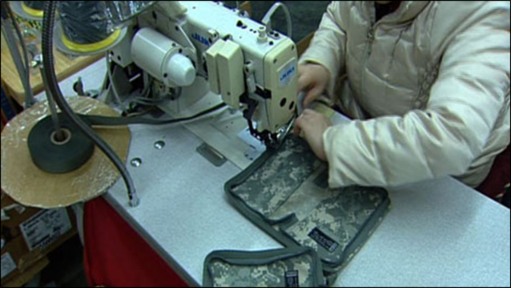
Labor Trafficking Hidden in Plain Sight
Domestic labor
Agriculture
Landscaping
Day labor sites
Panhandling/Begging
Garment factories
Meat-packing plants
Door-to-door sales
Nail salons
Massage parlors
Chain and fast-food restaurants
Bars
Fishing Industry

Slide 12
Sex and Labor Trafficking May Co-Occur Although state and federal law divides human trafficking into the categories of sex trafficking or labor trafficking, in many cases a survivor has experienced both forms of exploitation. When working with victims, it is important to ask about potential sex and labor exploitation to identify the full range of services they may need.

Slide 13
Sex Trafficking—Hidden in Plain Sight
Prostitution
Pornography
Strip clubs
Commercial/Residential Brothels
Illicit massage parlors
Escort services
Truck stops

Slide 14
Relationships Between Trafficker and Trafficked Individual
Covenant House New York and Fordham University’s Applied Developmental Psychology Department. Homelessness, survival sex, and human trafficking as experienced by the youth of Covenant House New York. May 2013. https://traffickingresourcecenter.org.
Notes:
The relationship between the trafficker and the person being trafficked may also make it difficult to identify a trafficker. A 2013 study by Covenant House New York revealed that was that 36% of the children being trafficked were being trafficked by their parents or immediate family members. It’s also important to note that while the term boyfriend can mean a romantic partner, it’s also a euphemism used for the trafficker. Don’t discount someone as being a potential victim just because they appear to be presenting with a “relative” or a romantic partner. This study also helped to debunk the myth that traffickers are most often strangers to their victims.

Slide 15
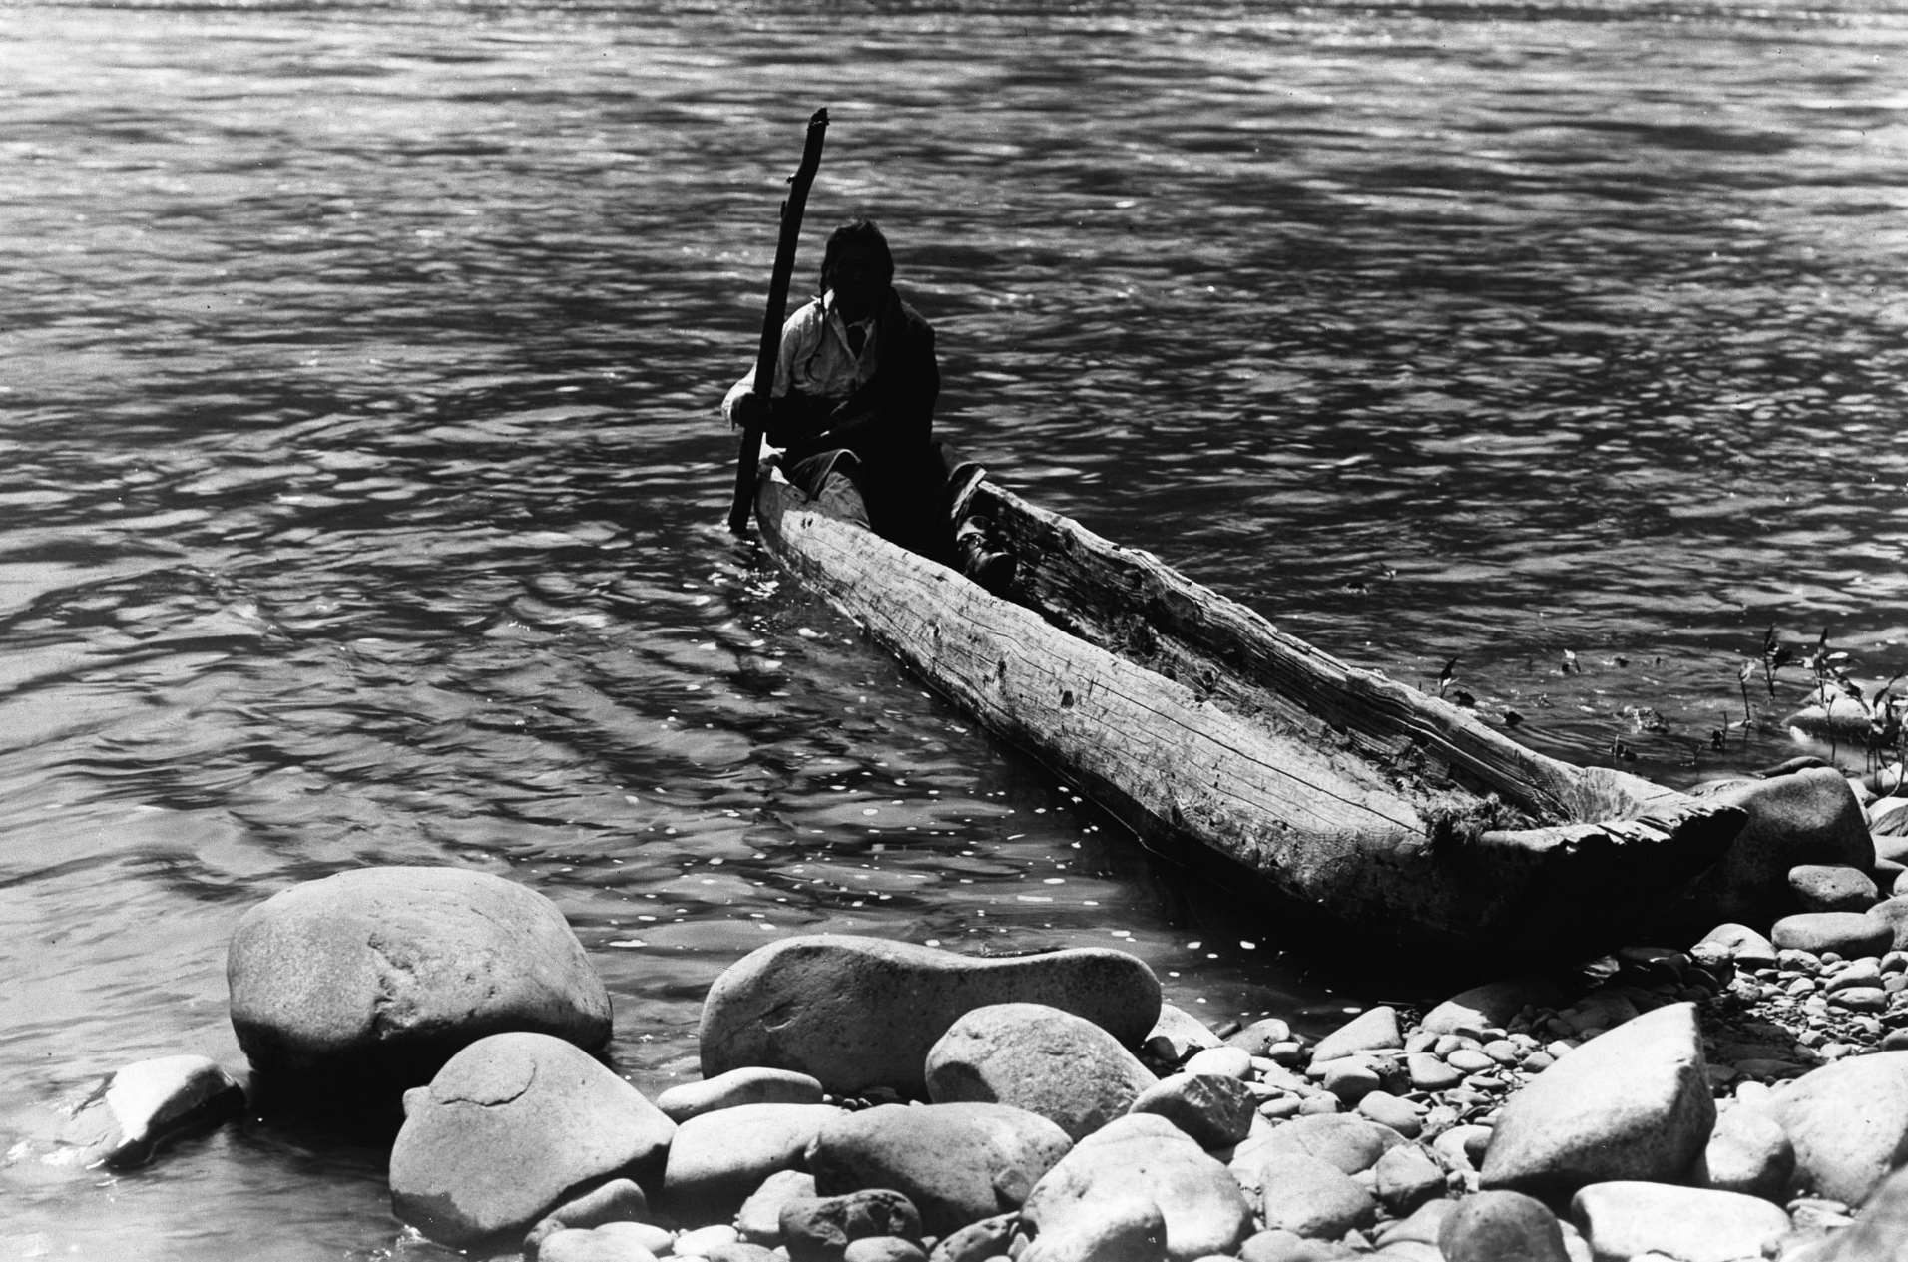
To understand how to move forward, we must first talk about what has happened.
Notes:
In order to move forward, we must first talk about what has happened. Although trafficking occurs within Native communities now, it is important to recognize that it was not always so.

Slide 16
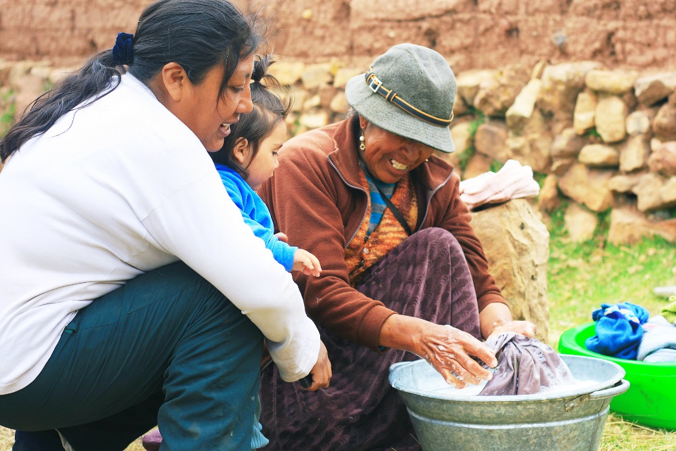
Traditional View of Women and Children
No words for rape or prostitution
Violence against women was a capital offense
Women were viewed as sacred
Children were seen as a gift from the Creator
Notes:
In traditional Native culture, there were no words for rape or prostitution.
Women were viewed as sacred and violence against them was a capital offence.
Children were valued as gifts from the Creator.
Unfortunately, with the arrival of Europeans came genocide, violence against women and children, forced removal, boarding schools, separation of children, sterilization, reservations, and the loss of traditional laws and ways of dealing with such offences. All of these contributed to historical trauma.

Slide 17
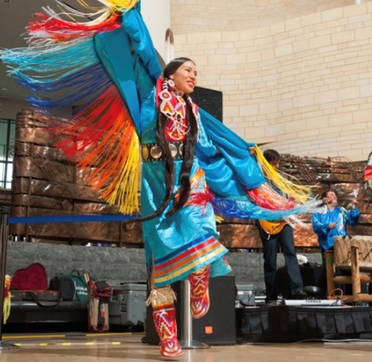
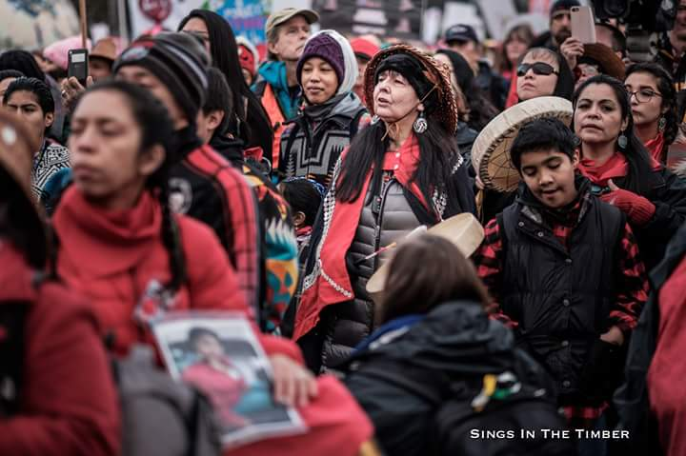
American Indian / Alaska Native Statistics
Native Americans are the most raped, assaulted, stalked, and murdered of all ethnicities.
U.S. Department of Justice. Violence Against American Indian and Alaska Native Women and the Criminal Justice Response: What is known. 2008:7
Native American women experience domestic violence at a rate that is 50% higher than the national average.
U.S. Department of Justice. Violence Against American Indian and Alaska Native Women and the Criminal Justice Response: What is known. 2008:7

Slide 18
“Perfect Population”
"If you're a trafficker looking for the perfect population of people to violate, Native [American] women would be a prime target. You have poverty. You have a people who have been traumatized. And you have a legal system that doesn't step in to stop it."
Source: Sarah Deer, attorney & author of “The Beginning and End of Rape: Confronting Sexual Violence in Native America.”

Slide 19
Historical Trauma
Historical trauma is the cumulative, multigenerational, collective experience of emotional and psychological injury in communities and in descendants.
Brave Heart,
M.Y.H. (2003)
Results of Historical Trauma
Defense mechanisms
Developmental malfunctions
Behavioral issues
Depression
Anger
Isolation
Violence
Suicide
Shame
Substance use
Anxiety
Notes:
Historical trauma is the cumulative, multigenerational, collective experience of emotional and psychological injury in communities and in descendants. When working with and among Tribal communities, its vital that we understand and recognize the legacy of colonization, forced relocation away from their historic land, separation of parents and families and placement of children in boarding schools and other historic trauma continues to impact Tribal people today.
It results in defense mechanisms, developmental malfunctions, and behavioral issues as well as depression, anger, isolation, violence and suicide, shame, substance use, and anxiety.
Mohatt, Thompson, Thai, Kraemer Tebes. (2014). Social Science and Medicine. 106: 128-136. Retrieved: https://www.ncbi.nlm.nih.gov/pmc/articles/PMC4001826/#

Slide 20
Adverse Childhood Experiences (ACEs)
Traumatic Event
Childhood
Traumatic Event
Traumatic Event
Mechanisms by Which Adverse Childhood Experiences Influence Health and Well-Being Throughout the Lifespan
https://www.cdc.gov/violenceprevention/acestudy/about.html
Adulthood
Notes:
Adverse childhood experiences, or ACEs, are stressful or traumatic events that occur during a child’s formative years. ACEs include a wide variety of issues, including abuse and neglect, and household dysfunction, and are strongly related to the development and prevalence of a wide range of health problems throughout a person’s lifespan, including human trafficking.
When looking to prevent human trafficking, understanding these risk factors is a critical step to be able to assess individual risk for your patients or clients, and ACEs gives us one invaluable tool to do so.

Slide 21
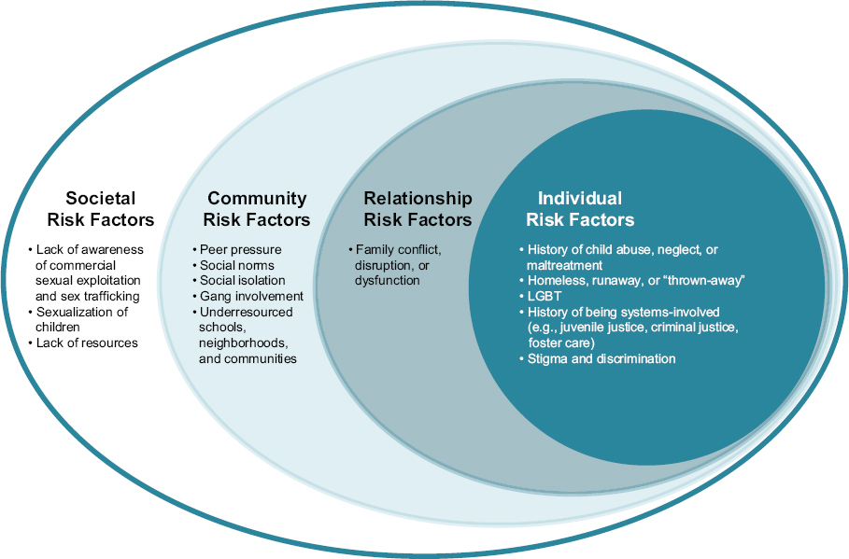
Risk Factors
Notes:
Jeri

Slide 22
Signs of Trauma
Physical
Behavioral
Social/Environmental
Frequent sexually transmitted infections
Multiple pregnancies/abortions
Dental issues
Bruising and burns
Signs of self-harm
Weight loss or malnourishment
Respiratory issues
Suicide attempts
Physical and sexual abuse
Confusing or contradicting stories
Inability to focus
Unaware of current date, location, or time
Minimizes abuse
Extreme timidity
Aggressive or defensive
Heightened stress response
Withdrawn or depressed
Frequent school absences/failing grades
Increase in substance use
Change in dress
Age-inappropriate romantic partner
Change in friends
Repeat runaway
Doesn’t share information
Evidence of being controlled
Crowded living conditions
No address
Notes:
There are a variety of “red flags” that may indicate either sex or labor trafficking. These red flags may be physical, behavioral, or social/environmental. The list here provides some examples, but it is not definitive and not every individual will present the same red flags.
Also, individuals at risk, and those who have been trafficked, typically do not experience their first victimization when they are exploited as victims of trafficking. Many of them experience multiple traumas, at various phases of their lives, including traumatic events that began during their formative childhood years and continue into adulthood. The issues they present when you work with them may be related to trauma they experienced prior to being trafficked.

Slide 23
Barriers That Prevent Identification
Patient/Client-Related
Provider-Related
Notes:
Narration: The reality is that individuals who are at risk, or who have been trafficked, are not being recognized. This is often due to various barriers that hinder identification. These barriers fall into two categories, patient or client-related and provider-related barriers. What I would like to do now. .
Patient/Client-Related
Lacks awareness of victimization
Lacks understanding of victim and legal rights
Lacks identification and other records
Has a language barrier
Fears deportation or law enforcement
Fears that reporting could lead to being returned to an abusive home, jail, or foster care placement
Feels complicit in an illegal act
Fears that traffickers will cause harm to self, family, or loved ones
Has limited literacy and education that hinders the ability to communicate
Has experienced trauma bonding with the trafficker or other victims
Distrusts the provider or those in authority
Feels hopeless and helpless
Feels shame or guilt
Provider-Related
Lacks knowledge about human trafficking
Inadequate understanding of federal, state, and local human trafficking laws
Fears violating Health Insurance Portability and Accountability Act (HIPAA rules)
Lacks trauma-informed care training
Has preconceived notions of how an individual who has been trafficked will present
Doesn’t believe it is his or her role to get involved
Lacks access to neutral, professional interpreters
“Checks off boxes” without seeing the full patient or client situation
Thinks that asking will be time consuming or too complex
Feels the patient/client is unresponsive or hostile to questioning or tells a rehearsed story
Lacks information on good referral options
Attributes behavior(s) to harmful cultural stereotypes
Misidentifies the case

Slide 24
Reasons Why Individuals May Not Self-Identify
Lack of awareness of victimization
Lack of understanding of victim and legal rights
Fear of law enforcement or social services
Fear that reporting could lead to being returned to an abusive home, jail, or foster care placement
Distrust of provider or those in authority
Feels hopeless and helpless
Feels isolation, shame, or guilt
Feels complicit in an illegal act
Fear that traffickers will cause harm to self, family, or loved ones
Trauma bonding with trafficker or other victims
Dependence on trafficker for drugs or emotional support
Notes:
Individuals who are at risk, or who have been trafficked, are often not recognized due to various barriers that hinder identification.
A person being trafficked may not self-identify or admit to it either because they don’t realize that they are being trafficked or for many other reasons.

Slide 25
Reasons Why Professionals May Not Identify
Lacks knowledge about human trafficking
Inadequate understanding of federal, state, local and tribal human trafficking laws
Fears violating Health Insurance Portability and Accountability Act (HIPAA rules)
Lacks trauma-informed care training
Has preconceived notions of how an individual who has been trafficked will present
Doesn’t believe it is his or her role to get involved
Mistrust of law enforcement
Lacks access to neutral, professional interpreters
“Checks off boxes” without seeing the full patient or client situation
Thinks that asking will be time consuming or too complex
Feels the patient/client is unresponsive or hostile to questioning or tells a rehearsed story
Lacks information on good referral options
Attributes behavior(s) to harmful cultural stereotypes
Misidentifies the case
Notes:
Its vital when responding to human trafficking that professionals understand their own limitations, preconceptions and other barriers that can prevent us from identifying individuals at risk as well as those being trafficked.

Slide 26
Mandated Reporting
Human Trafficking
When to Report?
During the screening process for any of these crimes, if you are a mandated reporter, you are required to report suspected abuse. Many federal laws have expanded mandatory reporting requirements related to human trafficking.
Child Abuse or Neglect
Domestic Violence
Health Insurance Portability and Accountability Act (HIPAA)
Notes:
Narration: Mandatory reporting requirements vary from state to state, and within states, and where tribal law has jurisdiction, so it is important to know the requirements in your area and continue to work within HIPAA guidelines.
If your screening of a patient leads to the disclosure of traumatization, such as child abuse or domestic violence, state and federal laws may require that you disclose that information to the proper authorities. Many federal laws, such as the Trafficking Victims Protection Act (TVAP) and the Preventing Sex Trafficking and Strengthening Families Act may also require you to report certain information to varying entities in order to further protect those who have experienced trafficking or are at risk of being trafficked.
Mandatory reporting requirements vary from state to state, and within states, or where Tribal Law has jurisdiction, so it is important to know the requirements in your area and continue to work within the HIPAA guidelines. Mandatory laws might include informing law enforcement or child protection agencies of suspected child abuse, domestic violence, and laws requiring reports of knife or gunshot wounds. State laws on suspected child abuse, domestic violence, and vulnerable populations’ abuse may apply even if you are not sure this is a trafficking case. As part of your protocol, include specific guidance on the mandatory reporting requirements related to human trafficking. Remember that you are not likely to have a patient seeking treatment for human trafficking. They’ll be seeking care for other health concerns that may need to be reported.
Reporting can be a tricky topic for several reasons:
The traumatic physical and psychological impacts for victims are extensive; necessitating that health care providers and social workers must be able to respond to these needs.
Persons being trafficked may interface with health care providers on several occasions before human trafficking is suspected.
Whenever possible, keep visits positive to encourage a relationship and extend an invitation to return as needed. The goal for any provider during interactions should not be disclosure. Our role is to assist our patients and clients and that should be the focus.
Select each button to learn more.
Programming Notes:
Human Trafficking
Trafficking Victims Protection Act (https://www.congress.gov/bill/114th-congress/senate-bill/178)
Requires Federal, State, or local officials to notify HHS within 24 hours of discovering a child who may be a foreign victim of trafficking. If you are a federal, state, or local official, notify an HHS Child Protection Specialist at ChildTrafficking@acf.hhs.gov or call 202.205.4582.
Polaris Policy & Legislation
Child Abuse or Neglect
Justice for Victims of Trafficking Act of 2015(https://www.congress.gov/bill/114th-congress/senate-bill/178)
Mandated reporters should report suspected trafficking of a minor as they would abuse and neglect in accordance with the protocols in their state.
Preventing Sex Trafficking and Strengthening Families Act(https://www.congress.gov/bill/113th-congress/house-bill/4980)
This federal law requires public child welfare agencies to identify and serve minors who have been, or are at risk of being victims of sex trafficking. Additionally, state child welfare agencies must report any missing children to law enforcement and the National Center for Missing & Exploited Children (NCMEC) within 24 hours. If you work for a state child welfare agency, you can report a missing child to NCMEC by calling 1-800-843-5678.
Mandatory Reporters of Child Abuse and Neglect
Domestic Violence
Compendium of State Statutes and Policies on Domestic Violence and Health Care
Health Insurance Portability and Accountability Act
Department of Health and Human Services: HIPAA for Professionals

Slide 27
HHS Screening Tools
Screening tool to identify minors who are being trafficked
Screening tool for adults who may be trafficked
Notes:
Narration: The National Human Trafficking Training and Technical Assistance Center, or NHTTAC, has developed a human trafficking screening tool to be used to screen potential adult victims of human trafficking to complement the screening tool created by the Office of the Assistant Secretary for Planning and Evaluation (ASPE) to identify minor victims of trafficking. Through use of the NHTTAC and ASPE human trafficking screening tools, professionals in social services, behavioral health, public health, and health care will apply trauma-informed principles to identify individuals who have been trafficked and provide appropriate referrals to supportive and culturally competent services.

Slide 28
Creating a Safe Environment
Notes:
Narration: Creating a safe environment and building rapport with individuals who have been trafficked are foundational elements of trauma informed care. There are several practical ways to enhance feelings of safety and security when screening a client. Select the button to learn more.
Programming Notes:
Practical ways to enhance feelings of safety and security when screening a client:
Ask for permission to speak to a survivor before screening them
Ensure that meeting space is private, neutral and comfortable
Begin with a warm welcome. For example, it can be helpful to meet new referrals outside of the building or in the lobby to avoid confusion about where they are going and to send the message that the meeting is important.
Provide a brief tour of the building, particularly is this is the first time the victim has been there. This will help familiarize them with a new environment. Note what services are offered on site and offer coffee, tea, or water (if possible).
Explain your role and that of other service providers who may be involved
If needed, secure a safe and appropriate interpreter in the language the survivor identified as preferred.
Review the concept of confidentiality and the specific policy where you work, outlining the commitment to not share any information with any outsider (including law enforcement or other providers associated with the case) without specific, written permission
Be sure to have all documents outlining available services, confidentiality, and victims’ rights on hand; have them printed in the victim’s preferred language.
Avoid discussions about clients in public spaces
Be aware of nonverbal cues and body language that you’re displaying. Maintain openness in your posture, avoid crossing your arms, sit at the same level as the person you are screening, and avoid displaying emotional reactions or judgments to things that are said in the course of the discussion, including your judgments of the trafficker

Slide 29
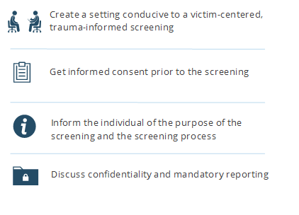
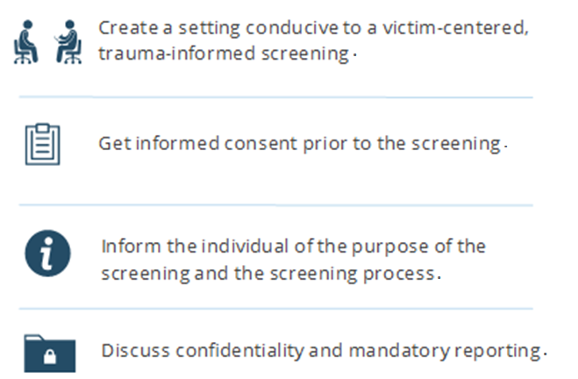
Survivor-Centered Screening Techniques
Notes:
Narration: When screening a client who may have been trafficked, it’s important to first create a setting that supports a victim-centered, trauma-informed screening. Get informed consent prior to screening a person who has been trafficked. Be sure to let them know the purpose of the screening, and provide information about the screening process, including potential uses of the information they provide. Individuals being screened should also be informed about confidentiality and any limitations in the context of your screening, particularly any mandated reporting obligations you may have.

Slide 30
Trauma-Informed Screening
Notes:
Narration: When screening a person who has been trafficked, remember the goal is not to obtain a disclosure about trafficking, but rather to obtain enough information that helps you best respond to the needs of your client. When applying a trauma-informed lens to screening, it is highly invasive and triggering to ask individuals who may have been trafficked to share a detailed history of their exploitation to secure access to support services. Many individuals who have been trafficked are distrusting of service providers and may be hesitant to respond. Such in-depth questioning may lead them to become unresponsive, defensive, and distrusting of the screener.

Slide 31
What Do We Mean by “Trauma”?
“Individual trauma results from an event, series of events or set of circumstances that is experienced by an individual as physically or emotionally harmful or life threatening and that has lasting adverse effects on the individual’s functioning and mental, physical, social, emotional or spiritual well-being.”
Substance Abuse and Mental Health Services Administration https://www.samhsa.gov/trauma-violence
Notes:
Let’s take a moment to be sure you understand what we mean by a trauma-informed, culturally and linguistically appropriate approach to trafficking.
The Substance Abuse and Mental Health Services Administration, or SAMHSA, defines trauma as the results from an event, series of events or set of circumstances that is experienced by an individual as physically or emotionally harmful or life threatening and that has lasting adverse effects on the individual’s functioning and mental, physical, social, emotional or spiritual well-being. In short, trauma is any experience, such as child abuse or domestic violence, that overwhelms one’s ability to cope. Individuals who have been trafficked may have experienced trauma not only from their actual trafficking exploitation, but also from some of the upstream determinants that made them at risk to trafficking.

Slide 32
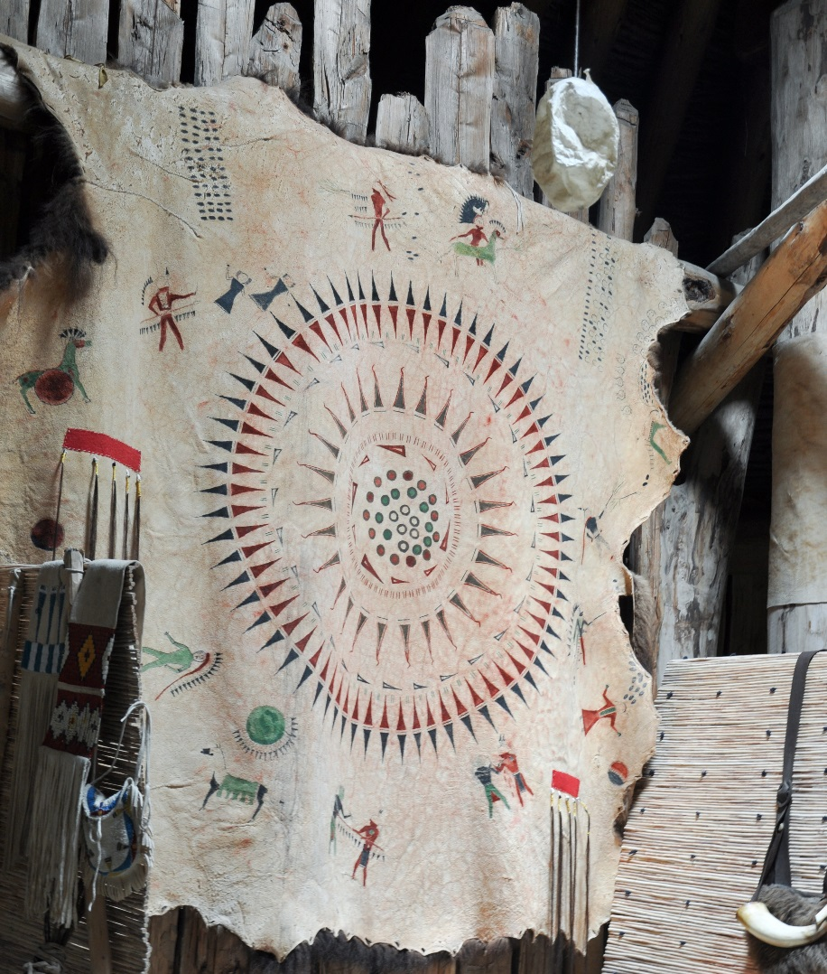
Trauma-Informed Services
Incorporate knowledge about trauma in all aspects of service delivery
Minimize traumatization or re-traumatization
Facilitate healing, connection, and empowerment
Notes:
Trauma-informed services
Recognize that we are spiritual beings on a human journey, not human beings on a spiritual journey.
When victimized by violence, often a westernized approach does not acknowledge the spiritual wound of our whole being. A holistic approach is necessary to help heal individuals who have been trafficked.

Slide 33
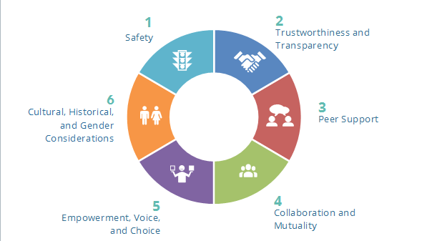
Trauma Informed Care
Notes:
Narration: You have the opportunity to help support individuals at risk, and those who have been trafficked, in a variety of ways. While your role may vary, depending on where you work, the types of services your organization provides, and the populations you serve, it’s important to use a trauma-informed, culturally and linguistically appropriate response with everyone you work with. Select each button to learn more.
Programming Notes:
Safety
Throughout the organization, staff and the people they serve feel physically and psychologically safe.
Recognize what it means when someone leaves their tribal community, especially when someone is traditionally a tribal person. Suggesting they leave the community for safety or shelter may be traumatizing.
In rural communities, it may take a long time to reach services. Safety planning will look different in rural vs urban vs reservations vs island communities.
Provide a welcoming environment.
Be sensitive to potential triggers that might remind a patient of past trauma.
Be kind. Individuals who have been trafficked may be belligerent or hostile. Try to remember that their life experiences and past traumatizations make it difficult to trust care providers or people in authority.
Incorporate regular safety planning within your organization, including how to strategize safety concerns with your patient
Conduct screenings in a confidential setting
Trustworthiness and Transparency
Organizational operations and decisions are conducted with transparency and the goal of building and maintaining trust among staff, patients, and family members of those receiving services.
Explain your role and that of other medical or service providers who may work with the patient
Involve the patient in decision making, when possible, and respect their decisions even when you disagree with them.
Provide qualified interpreters and translated materials as needed
Peer Support
Peer support provides a way for survivors of human trafficking to meet together and share their strengths and weaknesses as they recover from the trauma of trafficking. Seek out opportunities for peer support.
Identify and work with survivor leaders. Know elders in the community who have an understanding of trafficking.
Coordinate peer-to-peer counseling and mentoring from survivors who are now serving in a direct services or life coach capacity
Collaboration and Mutuality
There should be true partnering and leveling of power differences between staff and patients and among organizational staff from direct care staff to administrators. The organization recognizes that everyone has a role to play in a trauma-informed approach.
Advocate for trauma-informed training for all staff to ensure the whole organization is aware of trauma and its impact both on patients and on staff
Collaborate with other medical professionals and network across different departments
Create a resource and referral protocol for use with outside service providers
Empowerment, Voice, and Choice
Throughout the organization and among the patients served, individuals’ strengths and experiences are recognized and built upon.
Be transparent in explaining patient options and your role in working with them
Respect the decisions patients make, even if you disagree
Provide interpreters and translated materials, as needed, to insure that all patients feel equally empowered and have a voice in the services they receive
Cultural, Historical, and Gender Considerations
The organization actively moves past cultural stereotypes and biases (e.g., based on race, ethnicity, sexual orientation, age, geography), offers gender responsive services, leverages the healing value of traditional cultural connections, and recognizes and addresses historical trauma.
Avoid letting stereotypes and biases prevent you from identifying a person who has been trafficked
Respect a patient’s decision to follow traditional practices and treatment. Consider learning more about these approaches
Seek training and collaboration opportunities from community-based organizations who represent diverse cultural, religious, and ethnic communities

Slide 34
Spiritual Healing
Notes:
We are emotional, mental, physical, and spiritual.
We are spiritual beings on a human journey, not human beings on a spiritual journey.
When victimized by violence, often a westernized approach does not acknowledge the spiritual wound of our whole being.
A holistic approach is necessary to help heal individuals who have been trafficked.
Both traditional and Western approaches can be utilized at the same time.

Slide 35
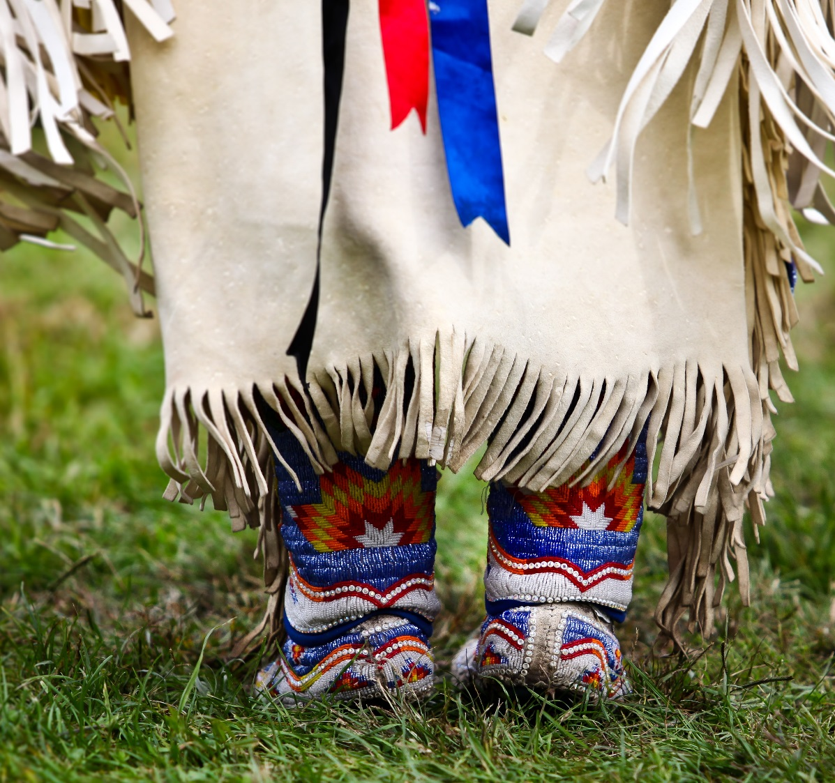
Honoring Culture and Tradition
Modeling of traditional behavior
Offering sage, sweet grass, or something to drink in a warm, caring environment
Traditional healing, sacred medicines, ceremonies
Welcome home ceremonies
Wiping Away the Tears (Lakota)
Naming ceremony
Making relatives
Connect to Elders
Notes:
When working with Native survivors of human trafficking, especially women and girls who have been sex trafficked, look for ways to connect them back to their culture.
[Facilitator may offer examples or elaborate from her own knowledge and experience]

Slide 36
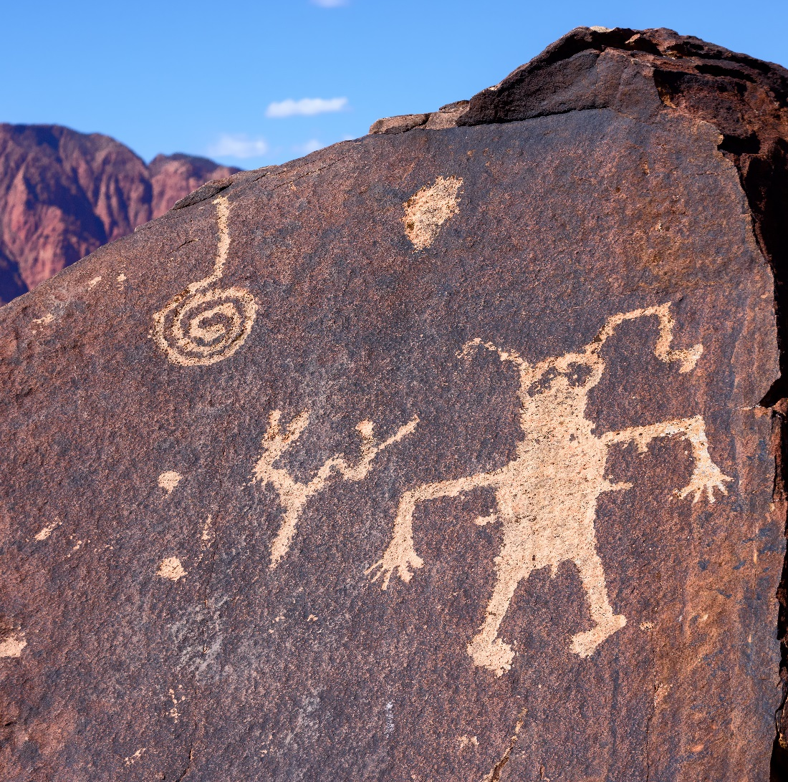
Building a Response to Trafficking in Native Communities
Notes:
[No audio]

Slide 37
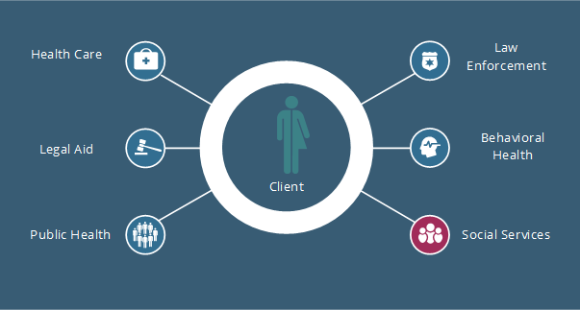
Collaborating Across the Public Health Sectors
Notes:
Narration: Every person who has been trafficked is unique, and will require a different mix of services. A vital component of responding to human trafficking is collaborating across the public health sectors with experts who can provide services such as legal aid, housing, medical care, and behavioral health services. Select each button to learn more.
Programming Notes:
Partner with organizations in the community:
Many urban and reservation sites have Boys & Girls Clubs – they should be linked and staff should have training. All JDCs (juvenile detention centers) have routine visit with healthcare for a variety of reasons including sexual exploitation. My only experience for this is reservation based and we are linked to our JDC.
Build a relationship with Residential Recovery Programs. There is a connection between human trafficking and substance use. These programs are highly likely to be serving people who may have been or are being trafficked. It’s a great place to screen for potential trafficking as well as raise awareness.
Health Care Providers
For help in finding health care providers who have worked with individuals who were trafficked, contact HEAL Trafficking, an independent, interdisciplinary network of health professionals across the country. IHS/Tribal/Urban Indian healthcare centers could be encouraged to develop foster care clinics to touch base with all Native children in the foster care system as this is a high risk group.
Client health care needs will vary, but may include:
Dental care
Broken bones
Sexual assault forensic examination
Substance use treatment
Malnutrition and/or dehydration
Short- and long-term medical treatment, depending on the seriousness of the injury or infection
Long-term physical impact of trauma
Legal Aid
As with health care, behavioral health, and social service needs, your client’s legal needs will vary. Legal aid professionals can provide services such as:
Applying for “T” visas, for victims and their families
Helping with orders of protection
Representing victims who testify against their traffickers
Assisting with eviction and housing issues
Obtaining proper legal documentation, including proof of age and name at birth
Vacatur and expungement relief for victims with a criminal history as a result of their trafficking
Public Health Professionals
As a field, public health professionals provide a variety of services in many different settings. Depending on the role they play, they may contribute to preventing and identifying human trafficking in a variety of ways, some more obvious than others, including:
Health safety inspectors identifying potential indicators of trafficking in businesses or homes
Community health workers noticing the spread of disease and infection amongst vulnerable populations
Researchers identifying methods for preventing trafficking that have worked in other communities
Law Enforcement
Human trafficking is a crime in all 50 states and 16 territories. To learn more about the laws in your state or territory, visit the Polaris’s State Ratings web page. As a mandatory reporter, you likely already have members of law enforcement in your referral network. In addition to services within the criminal justice system, law enforcement can also:
Refer you to victim service providers in the area
Provide a network of resources through a human trafficking task force, where available
Provide certification to help patients apply for immigration relief
Behavioral Health Providers
Many individuals who have been trafficked have experienced multiple traumas over the course of their lives. They develop unique responses to these events, as well as coping mechanisms. Develop an internal protocol for referring your patients to behavioral health specialists within your organization, as well as one for outside referrals.
Behavioral health providers can help survivors address their trauma through:
Counseling services
Treatment for addiction
Sexual assault trauma services
Short and long-term therapy
Referrals for more specialized care
School based counselors

Slide 38
Engaging Survivor Leaders
“A survivor-informed practice acknowledges the unique perspectives of survivors with relevant expertise based on knowledge of their trafficking experiences and challenges they have faced in their efforts to regain and rebuild their lives. A survivor-informed practice includes meaningful input from a diverse community of survivors at all stages of a program or project, including development, implementation, and evaluation.” Human Trafficking Leadership Academy, 2017
Promising Practices
Notes:
Narration: Survivor engagement allows organizations to better serve clients, craft programs, identify challenges and opportunities, and achieve agency missions and mandates. As a primary stakeholder in the anti-trafficking field, survivor leaders offer invaluable insight and expertise. Anti-trafficking efforts can only be successful with comprehensive inclusion of diverse professionals, including survivor leaders. It offers insight into the anti-trafficking field that, through application, adaptation and validation, will contribute to the development of evidence-based practices. Consider ways that your organization can collaborate with professionals who have a history of human trafficking to further inform your response.
Understanding the degree to which your organization is survivor-informed is a critical first step. You can assess your organization by eliciting feedback from staff, consultants, and clients through surveys, focus groups, or exit interviews. Regularly assess across the entire organization, including mission, vision, and culture; approach to program development, implementation, and evaluation; referral networks and partnerships; outreach and awareness-raising activities; fundraising strategies; and human resource and staffing development.
Programming: pop up text box
Solicit survivor expertise throughout program development, implementation, and evaluation. Include diverse human trafficking survivor perspectives (i.e., sex and labor trafficking survivors, adult and minor survivors, LGBTQ survivors, and foreign-national and domestic survivors).
Integrate promising practices from other related fields (i.e., intimate partner violence, sexual assault, and labor exploitation), when appropriate.
Leverage survivor strengths and expertise to determine the most appropriate activities and level of engagement.
Be mindful of survivor’s length of time out of their trafficking situation and support survivors in managing their triggers.
Train everyone within the organization on trauma-informed and person-centered practices.
For guiding principles, assessments tools, resources, and practical tips for implementing survivor-informed policies and procedures as well as information on how to support survivor leaders as staff, volunteers, and consultants, download this toolkit: Survivor Toolkit for Building Survivor-Informed Organizations (https://www.acf.hhs.gov/otip/resource/nhttacorgtoolkit).

Slide 39
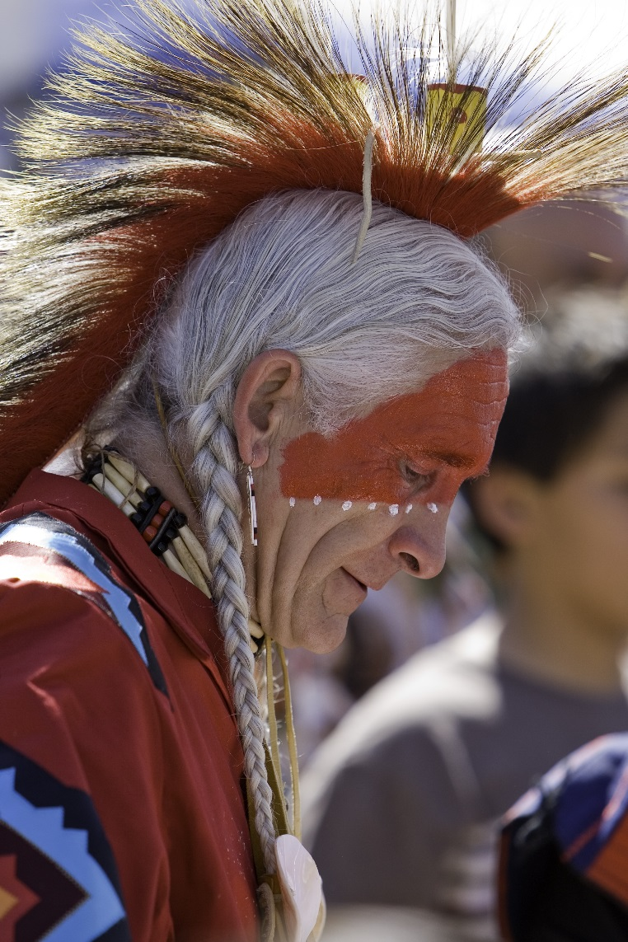
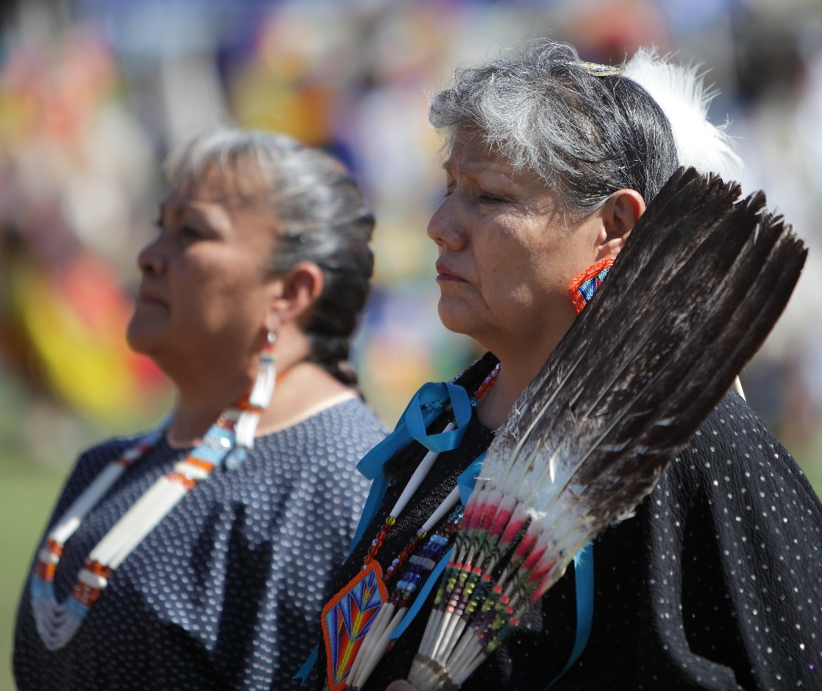
Involving Elders/Leaders
Notes:
Wherever possible, solutions should involve Elders and leaders.
[Facilitator share example of MOU partnership with a Native direct service organization in Washington State. Through this partnership, she works with Elders from different tribes to provide insight and oversight – they are part of the mobile response team to help survivors regain their culture.]

Slide 40
Protocol Components
Protocol development for human trafficking should include these elements:
1. Staff Training
2. Screening and Identification
3. Multidisciplinary Response
4. Mandated Reporting
5. Follow-up/Follow-through Procedures
HealTrafficking and Hope for Justice’s Protocol Toolkit
Notes:
Narration: To be able to apply SOAR within your workplace, you’ll need a protocol for working with individuals who have been trafficked. Protocols are guidelines created for an organization to help guide care providers in the appropriate response to trafficking. The components of a human trafficking protocol within the public health system should include many of the things we have discussed in this module, such as identification, screening, and separation procedures. At a minimum, protocol components should also include guidance for multidisciplinary treatment, mandatory reporting, a referral process, and follow-up or follow-through procedures. Select each component to learn more.
Programing Notes:
Staff Training: In order to identify patients or clients who have been trafficked, all staff in an organization, including administrative and support staff, should be trained in the basic indicators of human trafficking and red flags based on local trends in trafficking.
As you learned in the Ask lesson, screening tools for people who may have been trafficked should focus on collecting information about the individual’s emergency, medium, and long-term needs. In addition to the screening tool, organizations also need to have a plan in place that considers screening procedures and how to plan for safety
As we just discussed, a person who has been trafficked will require the services of a multidisciplinary team of experts. Each individual will have a unique set of needs, which you can prepare to meet by creating a referral network that includes providers from law enforcement, health care, tribal elders, behavioral health, social services, legal aid and peer support, just to name a few.
As we discussed in the Ask section, understanding and knowing how and when mandatory reporting applies is vital.
After you have properly identified a person who is being trafficked, it’s important you use trauma-informed care to gain their trust. For example, include them in decisions that are made about their future, both with creating a safety plan and when identifying the services they will receive. Once your trust has been established, use a warm handoff when it’s time for the individual to meet their next provider. As you introduce them, explain what will happen next, and answer any questions they have. Maintain a high level of confidentiality while continuing to develop their after-care plan. Enabling individuals who have been trafficked to take back control of their life will help them to feel empowered by the process and avoid abandonment or re-exploitive situations or feelings.

Slide 41
Suspicion or Disclosure: Now what?
Ask & Deny
Ask & Disclose
Police, SANE, Resources
Report
Do not Report
Resources & Safety
Resources & Referrals
MINOR
Notes:
Michele:
And improving health!
Again, if the person was a minor or in imminent danger, this would look different.

Slide 42
Prevention
Engage schools
Educate youth about healthy relationships
Strengthen cultural identity through traditional dance clubs, drum groups and craft classes
Address poverty
Establish programs that provide employment opportunities, especially for youth and women
Work toward economic equality
Provide access to higher education
Prevent and reduce ACEs
ACEs includes abuse, neglect, and household dysfunction; reducing the number of ACEs will reduce negative health outcomes, including trafficking
4. Awareness
Hold talking circles and support groups to raise awareness and provide safety and support
Notes:
There are many issues that could be addressed in order to bring about meaningful change in Native communities and reduce the incidence of human trafficking through early and proactive intervention. Three that could have a big impact are:
Address poverty
Prevent ACEs
Education
Poverty
Establish programs that provide employment opportunities, especially for youth and women
Work towards economic equality
Provide access to higher education
Education
Education is critical, and the schools can be key players in preventing and identifying incidents of human trafficking. Although not ‘traditional’ to go into the schools, children are there all day and it is a good venue for education/awareness efforts. Also, schools are often considered a ‘safe’ place, and teachers are often someone that students turn to in times of stress.
Education must begin young (elementary age). Although both sexes should be addressed, it is particularly important to instill a sense of self-worth in girls. There are womanhood ceremonies that could be leveraged to educate young women about human trafficking and how to avoid becoming a victim.
Other ways to involve schools include:
Encourage schools to have “open gym” after school hours with well-informed adult staff to interact with the community, role model healthy relationships, which may help kids come forward with someone they trust. The open gym also gives alternative activities (although transportation to get kids home can be an issue).
Native schools also have traditional dance clubs, drum groups, and craft classes to link kids to traditional ways and the teachers for those classes are in a good position to talk about traditional ways.
Prevent ACEs
Preventing adverse childhood experiences (ACEs), which include abuse, neglect, and household dysfunction. Reducing the number of ACEs will reduce negative health outcomes, including human trafficking.

Slide 43
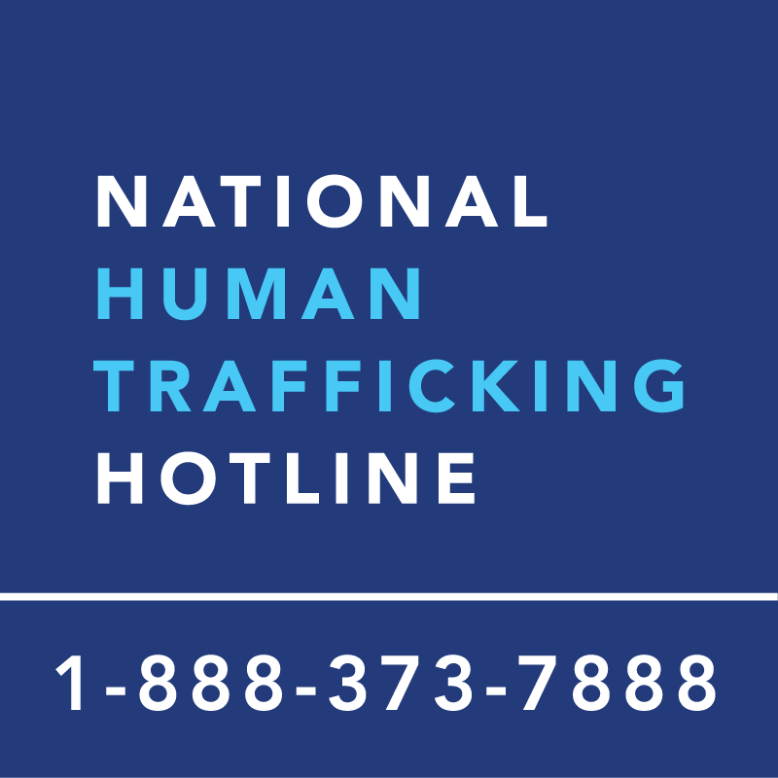
National Human Trafficking Hotline
Comprehensive service referrals for potential victims of human trafficking
Tip reporting to trained law enforcement
Data and trends on human trafficking in the United States
Text HELP to 233733 (BEFREE) to get help for potential victims of human trafficking or to connect with local services.
Notes:
Narration: The National Human Trafficking Hotline (NHTH) is another resource available to you. It’s a national anti-trafficking hotline and resource center serving people who are being trafficked and the anti-trafficking community in the United States. Anyone can call the hotline at any time, be it provider or patient or client. It’s open 24 hours a day, 7 days a week, every day of the year. Select the button to learn more about the information you should have when calling the NHTH.

Slide 44
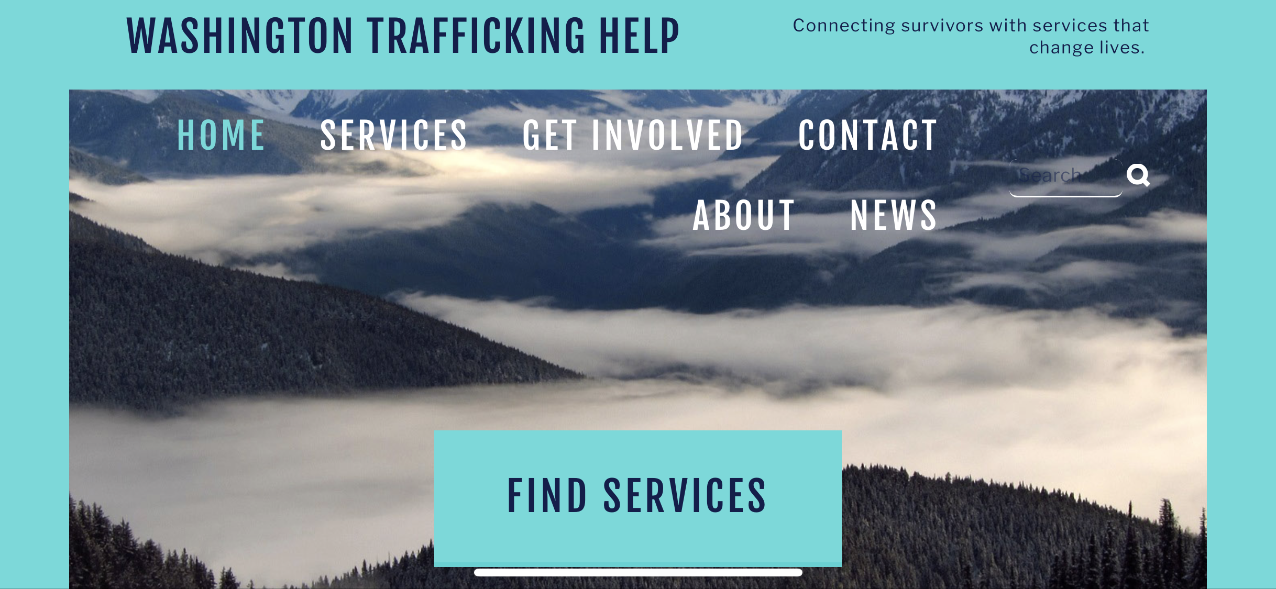
https://www.watraffickinghelp.org/

Slide 45
Monday through Friday, from 9 a.m. to 5:30 p.m. CST.

Slide 47
CONTACT US
www.innovationshtc.com
info@innovationshtc.org
360-705-8575

