Slide 1
NW Tribal Juvenile Justice Alliance
Danica Love Brown, MSW, CACIII, PhD
Stephanie Craig Rushing, PhD, MPH

Slide 2
Tribal-Researcher Capacity Building Grant
U.S. Department of Justice (DOJ)
Office of Justice Programs (OJP)
National Institute of Justice (NIJ)
Northwest Portland Area Indian Health Board
Planning Grant: Will form a new inter-tribal workgroup
NW Tribal Juvenile Justice Alliance (NW TJJA)
Dates: 01/01/19 - 06/30/2020
Notes:
In response to the Tribal-Researcher Capacity Building Grant opportunity issued by the U.S. Department of Justice (DOJ), Office of Justice Programs (OJP), National Institute of Justice (NIJ), the Northwest Portland Area Indian Health Board will form a new inter-tribal workgroup – the NW Tribal Juvenile Justice Alliance (NW TJJA) – that will meet over 18 months to collaboratively design a research study to evaluate and disseminate juvenile justice best practices for AI/AN youth in the Pacific Northwest, aligning with DOJ research priorities.

Slide 3
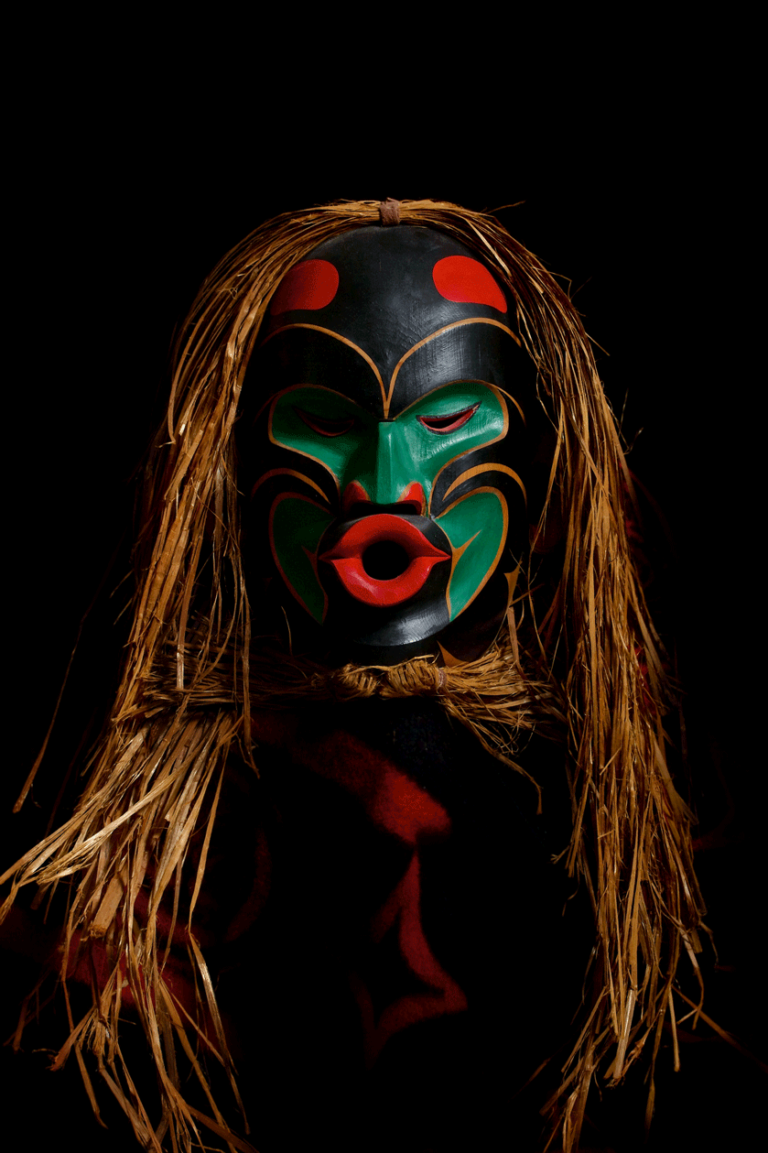
Aim: Facilitate a strategic planning process
While AI/AN youth in the region experience disproportionate rates of juvenile justice involvement, no planning body is presently convening decision-makers to elevate these important health and safety research questions in AI/AN communities.

Slide 4
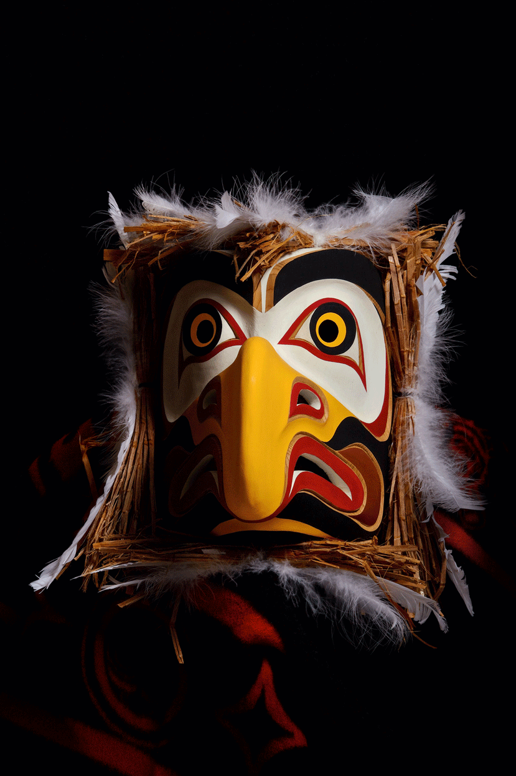
Juvenile Justice: A Public Health Issue
Risk Factors:
Historical trauma
Poverty
Victimization and violence
Mental health and suicide
Substance abuse and dependency
HepC and HIV
Notes:
Risk Factors – Numerous risk factors have been shown to impact AI/AN delinquency rates: including .

Slide 5
Table 1. Selected demographic and socio-economic characteristics for AI/AN and the total population in Idaho, Oregon, and Washington.
 | AI/AN | Total population
Median Age (years) | 29.8 | 37.0
Percent of population between 10 and 24 years of age ^{b} | 26.0 | 20.6
Percent of adults with less than a high school degree | 15.6 | 10.2
Unemployment rate among people 16 years and older | 10.8 | 6.6
Median per capita Income (dollars) | $16,155 | $25,925
Poverty rate | 27.1 | 15.5
Childhood poverty rate | 31.4 | 20.5
Percent of households receiving Food Stamp benefits | 32.3 | 15.5
Percent of population without health insurance | 23.8 | 15.6
All data from U.S. Census Bureau 2010-2012 American Community Survey 3-year estimates except: b. 2010 Census American Indian and Alaska Native Summary File.

Slide 6
Establish Tribal-Researcher Partnerships to:
Identify, test and expand best practices that improve Juvenile Justice systems for Tribes in the Pacific Northwest,
Ensure that non-Native justice systems are improving life outcomes for AI/AN youth who interact with their services, and
Build tribal capacity to access and utilize data that support quality improvement at the community-level.
Notes:
To address research needs identified by Tribes in our region, the NPAIHB will guide a multi-stakeholder planning process to collaboratively design a study that aligns with DOJ research priorities, to:
identify, test and expand best practices that improve Juvenile Justice systems for Tribes in the Pacific Northwest,
ensure that non-Native justice systems are improving life outcomes for AI/AN youth who interact with their services, and
build tribal capacity to access and utilize data that support quality improvement at the community-level.

Slide 7
Aims for the NW Tribal Juvenile Justice Alliance:
AIM 1: Convene, monitor, and support collaborative research and surveillance activities carried out by a network of research partners and community experts, by planning and facilitating 6 regional planning meetings and quarterly NPAIHB Board Meetings.
AIM 2: Support bi-directional communication between research partners, NW Tribes, local tribal governments, OJJDP grantees, topical experts and other regional stakeholders.
AIM 3: Design and submit a DOJ study, aimed to improve Juvenile Justice systems for Tribes and AI/AN youth in the Pacific Northwest.
Notes:
During the 18-month planning phase, our aims are to:
Convene, monitor, and support collaborative research and surveillance activities carried out by a network of research partners and community experts, by planning and facilitating 6 regional planning meetings and quarterly NPAIHB Board Meetings.
AIM 1: Convene, monitor, and support collaborative research and surveillance activities carried out by a network of research partners and community experts, by planning and facilitating 6 regional planning meetings and quarterly NPAIHB Board Meetings.
Hypothesis 1: Joint timelines and data collection tools will improve inter-agency coordination, ensuring that each partner’s research and surveillance activities are successfully carried out.
Hypothesis 2: The collaborative planning process will inform the identification of best practices that improve Juvenile Justice systems for Tribes in the Pacific Northwest.
Hypothesis 3: Collaborative planning activities will improve the coordination and rigor of our resultant DOJ study.
AIM 2: Support bi-directional communication between research partners, NW Tribes, local tribal governments, OJJDP grantees, topical experts and other regional stakeholders.
Hypothesis 1: Open, bi-directional communication will improve adherence to community-based participatory research (CBPR) principles, building tribal capacity to carryout rigorous research and evaluation (including tribal capacity to access and utilize data that supports quality improvement at the community-level).
AIM 3: Design and submit a DOJ study, aimed to improve Juvenile Justice systems for Tribes and AI/AN youth in the Pacific Northwest.
Hypothesis 1: The study will improve the uptake and utilization of evidence-based, culturally-relevant juvenile justice policies and programs by Tribes in the Pacific NW.

Slide 8
Partners
The Northwest Portland Area Indian Health Board (lead)
Tribes in the Pacific Northwest (Oregon, Washington, and Idaho)
Confederated Tribes of the Colville Reservation, WA
Confederated Tribes of the Umatilla Indian Reservation, OR
Cowlitz Indian Tribe, WA
Kooteni Tribe of Idaho, ID
Confederated Tribes of Warm Springs, OR
Shoalwater Bay Indian Tribe, WA
Spokane Tribe of Indians, WA
Lower Elwha Klallam Tribe, WA
Confederated Tribes of Coos, Lower Umpqua and Siuslaw Indians, OR
Other member-Tribes of the NPAIHB, during QBM updates
NPC Research (Topical Expert)
State Juvenile Justice Departments in the Pacific Northwest

Slide 9
Timeline: 01/01/19 - 06/30/2020
 | 2019 |  |  |  | 2020
Milestones (Lead Organization) | 1 | 2 | 3 | 4 | 1 | 2 | 3 | 4
NPC MOA and Contract (NPAIHB and NPC)
Project Kick off – January QBM (NPAIHB Host)
Identify Juvenile Justice Best Practices (NPAIHB and Tribes) Best Practices Research Priorities
Create and Administer Data Collection Tools (NPC) Identify Data Sources Lit. Review, Stakeholder Survey, Key Informant Interviews
Collaborative Planning Process (NPAIHB) NW Tribal Juvenile Justice Alliance meetings (N = 6) NPAIHB Quarterly Board Meetings (N = 4) NW Native Adolescent Health Alliance meeting (N = 2) Youth Input: NPAIHB Youth Delegates (N = 2)
Brainstorm: Study Aims and Study Design (NPAIHB)
Draft, Review, Finalize and Submit DOJ Study (NPAIHB) Identify Study: Aims, Methods, Sites, Participants
Create and Implement Dissemination Plans for Effective Strategies (NPAIHB)
Report milestones in annual reports (NPAIHB)
Publications and Presentations (All Partners)

Slide 10
Create and Administer Data Collection Tools (with NPC) to:
Identify Data Sources that could inform our understanding of Juvenile justice disparities or concerns for our NW Tribes
Identify Best Practices & Research Priorities:
Literature Review
Stakeholder Surveys
Key Informant Interviews

Slide 11
Planning Deliverables
Final Research Proposal
Special Report: Lessons learned, reflections on the process
Required Data Sets and Associated Files and Documentation
Publications
Notes:
Final Research Report: The NPAIHB will prepare and submit a final research proposal that complies with the instructions provided in Section D, based on the funding criteria provided in Section E.
Special Report: The NPAIHB will also prepare and submit a special report detailing the tribal-research partnership. The report will thoroughly capture the process and substance of the collaboration, including: lessons learned, challenges and successes experienced, and overall reflections. The special report will map out key issues that can help inform existing or future partnerships of a similar nature.
Required Data Sets and Associated Files and Documentation: The NPAIHB will submit to the National Archive of Criminal Justice Data (NACJD) all data sets that result in whole or in part from the work funded by the award, and will enter into data-sharing agreements with the DOJ that protect the rights and welfare of NW Tribal data.
Publications: The team will disseminate research findings to the DOJ and the scientific community, through scholarly publications.

Slide 12
Danica Love Brown, MSW, PhD
Choctaw Nation of Oklahoma
Northwest Portland Area Indian Health Board
Behavioral Health Manger
503-416-3291
dbrown@npaihb.org

