Slide 1
Introducing Community and Behavioral Health Aide Services in Washington State: A Gap Analysis
Assessing mid-level provider staffing needs in tribal and urban Indian health and behavioral health clinics in Washington State

Slide 2
JBA contributors: Tess Abrahamson-Richards, M.P.H. Amy Stiffarm, M.P.H. Erin Geary, Ph.D. In Consultation with: Susan Steward, NPAIHB CHAP Project Director
This presentation and the accompanying crosswalk document were prepared for the Northwest Portland Area Indian Health Board by James Bell Associates, Inc.

Slide 3
Background

Slide 4
Why a Gap Analysis?
Describing the existing landscape of Washington tribal medical and behavioral health services
Understanding the need for additional training and licensing pathways for mid-level providers in tribal communities
Getting from where we are to where we want to be
Notes:
As it says on slide 4, a gap analysis was asked for in order to further understand the need for these new provider types.

Slide 5
Overview of Gap Analysis Methodology
Determining where there is a need, deficit, or breakdown (i.e. a gap) between the current and ideal situation
Determine the root causes of the gap
Analyze proposed solutions; And/Or,
Identify root causes that are more versus less subject to influence based on things like: character of the issue, time and monetary parameters, available solutions
Notes:
We don’t need to talk about gap analysis methodology too much today, but you can take a look at the summary on slide 5 if you’re interested. But let’s look at the aims on slide 6.

Slide 6
Goals of this Gap Analysis
Understand what underlying factors contribute to the need for mid-level medical and behavioral health providers in Washington Tribal and urban Indian communities
Describe specific data points and qualitative information characterizing this regional demand, meaning how do we know there’s a shortage and what does it look like on the ground?
Analyze the potential of the Community and Behavioral Health Aide program to address the provider shortage
Notes:
[read]

Slide 7
A quick footnote
What do the terms “mid-level” and “paraprofessional” refer to?
Both terms can be used to refer to positions in the medical and behavioral health field that do not require graduate degrees, such as nurses, nurse assistants, mental health counselors, chemical dependency professionals, etc. We use “mid-level” in this analysis and presentation.
“Mid-level provider” has in the past been used by some in the medical field to refer to Nurse Practitioner and Physician Assistant providers, but those professionals are now commonly referred to as “Advance Practice Providers.”
Notes:
The next few slides just explain that we use the term mid-level to refer to (read 2nd bullet)

Slide 8
A quick footnote
What do the terms “mid-level” and “paraprofessional” refer to?
Both terms can be used to refer to positions in the medical and behavioral health field that do not require graduate degrees, such as nurses, nurse assistants, mental health counselors, chemical dependency professionals, etc. We use “mid-level” in this analysis and presentation.
“Mid-level provider” has in the past been used by some in the medical field to refer to Nurse Practitioner and Physician Assistant providers, but those professionals are now commonly referred to as “Advance Practice Providers.”
Notes:
Note: does not indicate that a high degree of professionalism and professional expertise is not needed for these jobs

Slide 9
A quick footnote
What do the terms “mid-level” and “paraprofessional” refer to?
Both terms can be used to refer to positions in the medical and behavioral health field that do not require graduate degrees, such as nurses, nurse assistants, mental health counselors, chemical dependency professionals, etc. We use “mid-level” in this analysis and presentation.
“Mid-level provider” has in the past been used by some in the medical field to refer to Nurse Practitioner and Physician Assistant providers, but those professionals are now commonly referred to as “Advance Practice Providers.”
Notes:
Note: does not indicate that a high degree of professionalism and professional expertise is not needed for these jobs

Slide 10
Gap Analysis Overview
Community Health Aides (CHA/Ps)
Behavioral Health Aides (BHA/Ps)

Slide 11
Methods
Tiered data collection strategy
Review of existing data
Tribal and urban clinic outreach
Key informant inquiries
Notes:
So, if we skip ahead to slide 11, we get to our methods section. We used a tiered data collection strategy to start with available data and build on it to get more nuanced answers to our study questions.

Slide 12
Existing Data Sources
Health Provider Shortage data
BHA Program Roll Out Feasibility Report conducted by Cumming
AIHC Health Profiles
Data from the Alaska CHA/P & BHA/P Programs

Slide 13
Tribal and Urban Clinic Outreach
Clinics/programs were sampled in order to reflect a diversity of: geography, proximity to urban area; service population size; IHS vs. tribally-run
We asked program personnel about: Current staffing levels; Turnover; Ease of filling open positions; Capacity to meet service demands; Factors influencing overall capacity to provide services

Slide 14
Key Informant Interviews
Clinic/Program Managers
Consultants
Advisory Committee Members

Slide 15
Findings

Slide 16
Aim 1
Understand what underlying factors contribute to the need for mid-level medical and behavioral health providers in Washington Tribal and urban Indian communities

Slide 17
Aim 1 Overview
Background Aim
Establishing considerations underpinning Aims 2 & 3
Drawing on existing data from key informants closely involved in CHAP implementation

Slide 18
Identifying Underlying Issues
We will present information related to current provider shortages; however, identifying the underlying factors contributing to these shortages is key to understanding how the addition of Community and Behavioral Health Aide providers and the associated training and funding infrastructure can address these shortages.
Notes:
Because it involves not only licensing but also establishing a training program and community infrastructure (and funding) it will address some of the root causes of the existing provider shortage and is more than just adding another provider license type.

Slide 19
These issues include
A Trained Workforce
Position Funding
Community/ Clinic Infrastructure
Notes:
The next few slides explain how the CHA/P and BHA/P programs can address these.

Slide 20
A Trained Workforce
Training that is affordable, culturally and contextually specific, and accessible for tribal students can be very challenging
The CHA/P and BHA/P program implementation is working towards an accompanying community-partnered education training program through a local tribal college and/or community college partnership

Slide 21
Community/Clinic Infrastructure
It is critical that infrastructure to support new providers is developed alongside the positions themselves in order for providers and programs to benefit
Programs will be developed in partnership and support NPAIHB, and funding structures will be in place for program implementation as well as ongoing services and administration.
Notes:
In WA we don’t have federal $ earmarked for CHAP. We’ll look to congress for allocations, get state plan amendments in place so that chaps are billable so that funding comes from 3rd party revenue, and seek private foundation funding.
In Alaska, they have a lot of financial support from village built clinic program which is federal $. They’re all compacted tribes and chap money is part of it. Sue had budget of 1.45 million for 4 clinics and 10-12 staff. Money was for equipment, supplies, health aide salary and training. Backfill for itinerant staff when someone is out used 3rd part revenue. Found other $ for big purchases or use 3rd party revenue.

Slide 22
Position Funding
New positions must be able to bill against existing funding sources or access new revenue streams
Exact billing details have not been finalized for the CHA/P and BHA/P programs, but they will be an essential component of implementation
Notes:
Mention that it’s expected they will be able to bill following state certification process

Slide 23
Aim 2
Describe specific data points and qualitative information characterizing this regional demand

Slide 24
Aim 2 Overview
Central component of this gap analysis
Examining concrete metrics and on-the-ground expertise
Triangulating quantitative and qualitative data sources to gather a richer picture of regional provider demand

Slide 25
Health Provider Shortage Areas
A Health Provider Shortage Area (HPSA) is a regional designation that indicates practitioner shortages in dental health, behavioral health, or primary care.
The National Health Service Corps developed a HPSA scoring system to determine regional-level health provider shortages and to thereby prioritize areas of greatest need.
Scores range from 1 to 26, with 26 being the highest priority.
A such, we categorized programs into low (1-9), moderate (10-16), and severe (17+) HPSA score groups, indicated by light, medium, and dark blue dots on the following maps

Slide 26
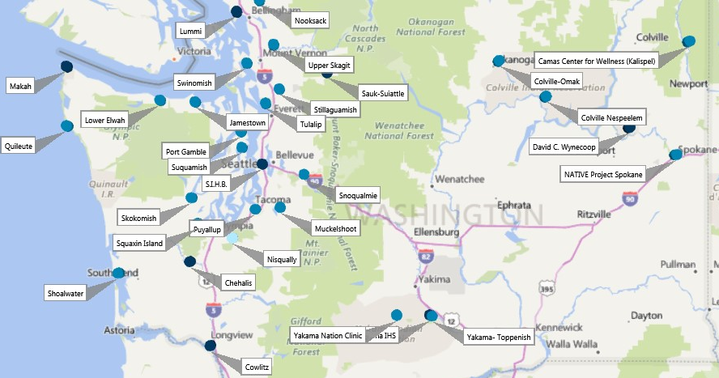
WA Tribal and UIHP Clinic Medical Provider HPSA Designations
Key:
Low
Moderate
Severe
Notes:
1-9 low
10-16 med
17+ high

Slide 27
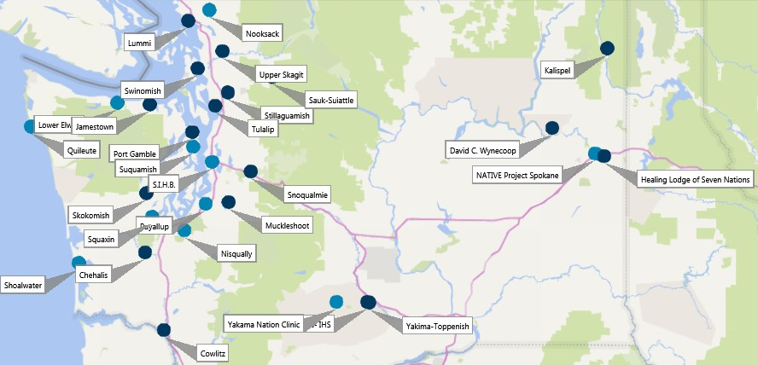
WA Tribal and UIHP Clinic Mental Health Provider HPSA Designations
Key:
Low
Moderate
Severe

Slide 28
Notable Findings from the Cumming Report on BHA rollout
AIAN individuals and communities experience a large unmet need for providers and access to providers
“Of those with a mental [health] disorder, only 32 percent had received mental health or substance abuse services.”
Nationally, AIAN individuals have access to 42% fewer providers per 100,000 population than whites
Demand projections suggest that most tribes in WA could use 1 BHA provider initially, with larger communities eventually adding a 2nd BHA provider

Slide 29
Continuing Beyond the Cumming Report on BHA rollout
List of BHA training and program needs in the Cumming Report offer a starting point, but will need to be further updated for Washington’s program
The forthcoming demonstration project with 3-6 students starting later this year will provide key insights for continued planning and roll-out activities

Slide 30
American Indian Health Commission Data
Data on current behavioral health staffing was a starting point for sampling and outreach to programs (CHAP-comparable provider data not available)
Service population data provides greater specificity than census or other sources
Most programs serve a broader population than solely their tribal members

Slide 31
American Indian Health Commission Data
Overview of range of services provided
Primary and emergency care
Obstetrics
Youth and elder specific programs
Physical therapy
Community health services
Case management, home-based, and care coordination services
Outpatient and Inpatient treatment
Individual, family, and group counseling
Psychiatric care
Suicide prevention

Slide 32
Qualitative Interview Findings
Behavioral health integration is a key contextual issue when thinking about existing and new providers’ roles and capacity
There is interest in CHA/Ps and BHA/Ps at some facilities because these providers can meet a wide range of service needs whereas other providers may need to be more honed in on a certain scope of practice
Similarly, there are many instances where current providers are practicing beyond the scope of their core duties (e.g. offering transportation, conducting community or home-based outreach, etc.) and that limits their ability to fully do their assigned job or serve more patients

Slide 33
Qualitative Interview Findings
Varies from agency-to-agency, but both finding and retaining qualified providers at the mid-level is an issue for many agencies
Other related issues tribal and urban medical and behavioral health programs face include working to offer attractive/competitive salaries, infrastructure barriers to adding providers (e.g. space, funding, equipment),
Connection to community and service orientation helps retention
Patient and community outreach benefit health outcomes; asks more of providers and other staff, but is effective for getting patients through the door

Slide 34
Aim 3
Analyze the potential of the Community and Behavioral Health Aide program to address the provider shortage

Slide 35
Aim 3 Overview
Understanding how the CHAP program may be able to address the underlying issues established in Aim 1 and the shortage described in Aim 2
Drawing on data from the Alaska program and Key Informant consultation with those closely involved with CHAP implementation

Slide 36
Advantages of CHA/P and BHA/P staffing in tribal clinics
Growing our own
Training/educational investment promotes retention
Filling a needed service gap
Notes:
Add icons

Slide 37
Successes in Alaska
Increased access to care and provision of services: 550 CHAs in over 170 villages
CHA/Ps offer consistent local access to primary care and local emergency response
Health outcomes have improved in a variety of metrics since CHAP introduction (access to care, infant mortality, life expectancy, hospitalization rates)
Patients and providers report very favorably about their experiences with CHA/Ps and the impact of their work
Cost savings related to transport and contract care
Notes:
Sources:
Akchap.org
https://www.ncbi.nlm.nih.gov/pmc/articles/PMC3417638/
https://www.uaa.alaska.edu/academics/college-of-health/departments/ACRHHW/dataandreportspages/_documents/2004%20The%20Alaska%20Community%20Health%20Aide%20Program_An%20Integrative%20Literature%20Review%20and%20Visions%20for%20Future%20Research.pdf

Slide 38
Resources and Partnerships to Support the Programs’ Success
Training and education program structure
NPAIHB CHAP Project
Alaska program resources, AK CHAP staff, and the Alaska CHAP certification board
Washington Dental Health Aide Therapy Program

Slide 39
Outstanding Areas to Address
Certification
Funding and billing
Training program curriculum

Slide 40
Final Thoughts

Slide 41
Limitations
Staffing data more limited at the mid-level
Employment numbers and service gaps are in a state of constant flux
Staffing need is more complicated than vacancies; funding and billing specifics also play an important role

Slide 42
Conclusions
The need for mid-level medical and behavioral health providers in tribal and UIH programs is well supported by available data
The broader structure of the Community and Behavioral Health Programs will be critical to their success and merits uniquely focused attention alongside the tasks of recruiting, training, placing, and supporting individual providers

