Slide 1
CHAP Board Advisory Work Group
NPAIHB QBM
Suquamish Casino & Hotel
January 22, 2019

Slide 2
Work Group Purpose
Purpose:
To inform and support the strategic direction and development of a Portland Area CHAP Federal Certification Board in accordance with IHS policy (yet to be finalized) as referenced in IHCIA title 25 section 1616L that provides DHAT’s, BHA/P’s and CHA/P’s aka Tribal Health Providers (THP) individual certification as well as review and certification of training centers, curricula, continuing education and manuals that dictate patient care.
Notes:
Today we want to share the progress of the workgroup and where we are in the process of establishing a Portland Area CHAP Certification Board.

Slide 3
CHAP Board Advisory Work Group
Membership
Jim Steinruck | WA | Tulalip Health
Andrew Shogren, Chair | WA | Suquamish Tribe
Lori Hartelius | WA | Stillaguamish Tribe
John Stephens | WA | Swinomish Indian Tribal Community
Cheryl Rasar | WA | Swinomish Indian Tribal Community
Rachel Hogan | WA | Swinomish Indian Tribal Community
Cheryl Sanders | WA | Lummi Nation
Regina Miller | WA | Lummi Nation
Veronica Smith | WA | Lummi Nation
Maureen Kinley | WA | Lummi Nation
Tara Olsen | WA | Lummi Nation
Vicki Lowe | WA | American Indian Health Commission
Cindy Gamble | WA | American Indian Health Commission
Candice Wilson | WA | NorthSound ACH
Kay Culbertson, Secretary | WA | Cowlitz Tribe
Cassandra Sellards Reck | WA | Cowlitz Tribe
Libby Cope (IHS), Co-Chair | WA | Makah Tribe
Matthew Whitacre | WA | Lower Elwha
Marilyn Scott | WA | Upper Skagit Tribe
Andy Joseph Jr | WA | Colville Tribes
Barbara Juarez | WA | Northwest Washington Indian Health Board
Wilbert James | WA | Sauk Suiattle
Aren Sparck | WA | Seattle Indian Health Board
Sharon Stanphill | OR | Cow Creek Tribe
Kelle Little | OR | Coquille Indian Tribe
Lisa Guzman | OR | Umatilla (Yellow Hawk)
Jon McConville | ID | Nimiipuu
Chantel Eastman | ID | Nez Perce
Carolyn Craig | AK | Alaska Native Tribal Health Consortium
Crystal Stordahl | AK | Tanana Chiefs Conference
Christina Peters | - | NPAIHB
Sue Steward | - | NPAIHB
Cheryl Sixkiller (IHS) | - | PAO-IHS
Tess Abrahamson-Richardson | - | NPAIHB consultant
Geoffrey D. Strommer |  | HOBBS STRAUS DEAN & WALKER, LLP
Starla K. Roels |  | HOBBS STRAUS DEAN & WALKER, LLP
Notes:
Currently we have 36 members but we welcome all interested persons. Voting is limited to one vote per tribe or partner organization.

Slide 4
Project Funding
Washington tribes provided a percentage of their Medicaid Transformation Funds as detailed in Resolution 18-03-09 for CHAP Area Certification Board project start up.
$548,228

Slide 5
CHAP TAG
Circular 18-01
IHS
To provide subject matter expertise, program information, innovative solutions, and advice to the I.H.S. to establish a National CHAP.
Meetings
  August 17 in Seattle
    Version IV
  October 10 at HQ
    Version V
The good news is that the I.H.S. draft now includes tribal participation and has language including ACCB’s. Honest conversation was held about what responsibilities a National CB could reasonably execute.

Slide 6
CHAP TAG
11/5/18 CHAP TAG requested that IHS provide an updated policy for discussion. IHS agreed to submit that by the next Friday and reschedule teleconference. That did not happen.
12/20/18 Version VI of draft policy was sent out to CHAP TAG with letter that it would be announced at the January 3, 2019 Tribal Leaders and Urban teleconference and a DTLL would be forth coming.
12/21/18 Partial Government shut down.
1/3/19 No announcement at Tribal and Urban Leaders Teleconference.
1/4/19 A letter was prepared by CHAP TAG and sent to IHS under signature of chairperson Dr. Segay’s signature expressing CHAP TAGs concern that they did not approve the current draft being sent out for tribal consultation.
Notes:
NPAIHB is preparing a separate letter to IHS to discuss the consultation process and specific concerns for our tribes.
We are working on draft comments to share with our member Tribes if they want some assistance responding to the DTLL.

Slide 7
Analysis of AK Standards & Procedures
Our focus is on those sections that relate to DHATs;
We have completed review and legal analysis of the first 5 chapters;
Our next face to face meeting is Thursday Noon to 4 PM to review the remainder of the AK S&P for DHATs needing certification to practice in June.
Notes:
CHAP work group is going through the Alaska CHAP standards to adapt them to Washington as a basis for our CHAP Certification Board.
The Exo team is intimately involved with the intricate review of the Alaska S & P’s.
There is legal work that is being done to understand how to integrate CHAP into Washington. If anyone is interested we can share the legal analysis.

Slide 8
Analysis of AK Standards & Procedures
June 2019 we celebrate the return of 7 graduating DHATs
  (1) Coeur d’Alene (Idaho)
  (1) NARA (Oregon)
  (1) Colville (Washington)
  (2) Lummi (Washington)
  (2) Swinomish (Washington)
Notes:
Here are the sites and states that our new DHATs will soon be providing care. Since we have 7 DHATs returning in June, the plan is to complete all the overall and general sections and the DHAT relevant sections. Once that is complete, we will turn our attention to the BHA section and then the CHA section.

Slide 9
Analysis of AK Standards & Procedures
The Alaska standards and procedures were develop for Alaskans by Alaskans after many years of CHA training and education.
Notes:
This is a detailed work that is informed by the actual demonstration of the process. A chicken or egg, which comes first scenario. After we have launched the BHA I students and they have completed a full cycle of education we will start on those sections that pertain to them and eventually we will use the same process for CHAs.

Slide 10
Plan B
The partial shut down of the U.S. Government may delay the release of an IHS Interim CHAP Policy;
Temporary Solutions
  Swinomish Licensing
  Alaska CHAP Certification Board
Notes:
PLAN B: Fall back plan if we do not have a PACCB in place – 1) Swinomish is licensing their DHATs and have licensed some other tribes DHATs, 2) AACCB could enter into an agreement with tribes to temporarily certify their DHATs

Slide 11
Costs
A Portland Area feasibility study will need to be completed, but we know this about the AK CB costs;
  Current certification is about 600;
  This amounts to about 150K annually;
  Certification costs $500.00 q 2 years
Notes:
COST: Cost to operate a PACCB – feasibility study needed for PACCB but we do know what it costs AK.
The CHAP CB in Alaska is self sustained through certification fees and the main expense of the board is the travel for board members to come to the three meetings annually and staff. It will take several years for a new board to become sustainable since it is dependent on workforce.

Slide 12
Draft PACCB Resolution
We are targeting April QBM to introduce a Resolution to create and seat Portland Area Federal Certification Board
Copies of the draft are located in packets.
Notes:
We would like to walk you through the draft.

Slide 13
Next Steps
-
Finalize the draft Resolution;
Submit it to the Policy Committee;
Suggest membership
Notes:
An early version of suggested membership was created in the first draft of the IHS Interim policy that includes representation for Title I, Title V and Direct Service tribes as well as representation for tribes in each State.

Slide 14
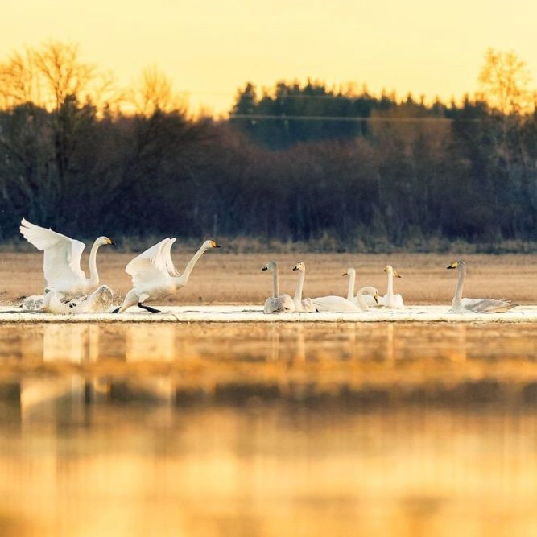
Questions?
CHAP Board Advisory Work Group meets here on Thursday after QBM
Safe Travels

