Slide 1
Legislative & Policy Update
NW Portland Area Indian Health Board
Quarterly Board Meeting
Hosed by Confederated Tribes of the Umatilla
October 23, 2015

Slide 2
Report Overview
Appropriations Update & Continuing Resolution
Contract Support Cost Updates
Indian Health Legislation in 114th Congress
100% FMAP & TTAG Updates
HRSA 340(b) Regulation

Slide 3
FY 2016 Continuing Resolution
FY 2016 President Request $460 million increase
House bill is $315 less than President’s Request – 3.1%
Senate bill is $324 million less than President’s Request – 2.9%
$8.6 million difference with House mark higher
Senate provides $17 million increase for H&C accounts while House provides $78 million
Senate provides $61 million for Facilities accounts, while House provides $6 million
Congress passed CR through 12/11/2015 for twelve regular appropriation bills
CR funds @ 2015 levels; less a .2018% across the board decrease

Slide 4
FY 2017 Budget Requst
Discussion at TSGAC Meeting with IHS Deputy Director
Positive developments for the FY 2017 budget
Full funding for current services and contract support costs may be possible
HHS Secretary Burwell took “took our proposals to heart”
Emphasis on behavioral health and suicide prevention

Slide 5
Indian Legislative Bills in 114th Congress
S. 286 – Department of Interior Tribal Self-Governance Act of 2015
Introduced by Sen. John Barasso; Co-sponsors include Senators Tester, Murkowski, Crapo, Schatz, Franken
Amends Title IV of of ISDEAA to make it consistent with Title VI, the Self-Governance Program for HHS
Creates the same administrative efficiencies for DOI that have been in place for HHS programs.
Sen. McCain Amendments cause alarm going to mark-up but were withdrawn and had to do with “OIG Alert to Tribes on the use of ISDEAA and 3rd Party Funds”
S. 286 passed Senate by Unanimous Consent and has now been sent to the House for consideration
Title IV Task Force is trying to find a primary sponsor in the House

Slide 6
Indian Legislative Bills in 114th Congress
Senate bill Exempts Tribal Programs from Sequestration
S. 1497 would exempt IHS, BIA, HUD and other Indian programs from sequestration required under the Budget Control Act of 2011
Introduced by Sen. Tester (MT); only one cosponsor Sen. Udall (NM)
House bill Exempts Tribal Programs from Sequestration
H.R. 3063 same companion bill to S. 1497
Introduced by Rep. Young (AK); Co-sponsors include Representatives Cole (OK), Ruiz (CA), McCollum (MN)
Both bills referred to Budget Committees
Likely to die in Committee
Likely best chance to avoid sequester for Indian programs is language in specific appropriations (Interior, HUD, Labor-HHS)

Slide 7
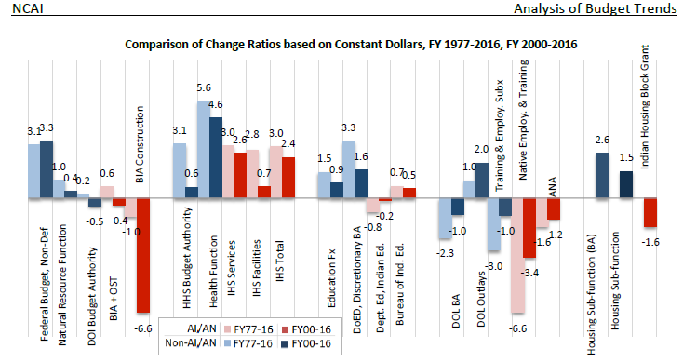
NCAI Analysis of Budget Trends

Slide 8
Indian Legislative Bills in 114th Congress
Exemption from ACA Employer Mandate (Shared Responsibility)
Tribal Jobs Employment and Protection Act
S. 1771 Introduced by Sen. Daines (MT); Co-sponsors Senators Crapo (ID) and Thune (SD)
H.R. 3080 introduced by Rep. Noem (SD); Co-sponsors Representatives Cole (OK) and Zinke (SD)
Senate bill referred to Finance; House bill referred to Ways & Means
Cadillac Tax amendment?
If passed what will the President do?

Slide 9
Indian Legislative Bills in 114th Congress
S. 1964 Family Stability and Family Kinship Act of 2015
Introduced by Sen. Wyden; Co-sponsors Sen. Bennett, Brown, Cantwell, Casey, Gillbrand, Menendez, Schumer, Stabenow, Warner
Reforms the federal finance system supporting state and child welfare services
Funds preventive services and kinship placements for children at risk of foster placement
Current law creates incentives to place Indian children outside of families in order to receive federal funding
Encourages child welfare system to forego alternatives to prevent breakup of families like parent training, mental health counseling, trauma recovery, etc.

Slide 10
Legislative Issues in the 114th Congress
Employer Mandate
Advance Appropriations
SDPI Reauthorization
IHCIA Technical Amendments
Medicare-like Rates for outpatient services
Contract Support Costs mandatory funding and reconciliation language

Slide 11
Contract Support Cost Update
IHS Continues to revisit CSC negotiated amounts using a cost incurred approach more than a year or more later
BIA does not follow the same method – why does IHS?
IHS advises that it must verify that CSC is being paid on the correct amount and cost-incurred (audit) is the only way to do this
IHS Past Year’s Claims – Agency want to settle by end of this year
Revised CSC Policies: BIA has completed a revised policy; IHS should have a draft available soon for reivew
Fixed Rates
OMB should bring IHS and BIA CSC Workgroups together to align the issues and resulting policies

Slide 12
Contract Support Cost Update
CSC Appropriations in FY 2016 and potential sequester
Congress and Administration have established a policy to fully fund CSC requirements
In event of FY 2016 year long CR; or sequester if CSC is not adequate IHS will likely reprogram funds
FY 2016 CR is approximately $55 million short of fully funding CSC requirements
A potential 2% sequester and across the board cut will result in not enough CSC funds
Administration could request an anomaly for additional funding in the appropriation
Mandatory CSC proposal

Slide 13
IHS Dear Tribal Leader letters
DTLL on IHS implementation of a new Integrated Data Collection System Data Mart (IDCS DM)
Intended to improve GPRA/GPRAMA national clinical measures
RPMS has decreased as tribes opt to utilize commercial health information systems and the IDCS-DM is intended to address this
An opt-out feature will be available to tribal programs that do not want their data included in GPRA and GPRAMA reporting
Tribal consultation closes on October 31, 2015
Session during QBM with IHS Deputy Director and OIT

Slide 14
CMS 100% FMAP Policy Change
NEW CMS WHITE PAPER COMMENTS DUE NOVEMBER 17TH
AK & SD Medicaid Expansion proposals to CMS
AK 100% FMAP request for emergency and non-emergency medical transportation and services provided through CHS/PRC referrals
SD requests 100% FMAP for telehealth services, specialty services provided through collaborative arrangements, and services provided by community health representatives
CMS has conducted Tribal consultation and expected to issue a decision soon
NPAIHB has submitted recommendations
100% FMAP for CHS referrals or
100% FMAP for services under contract with I/T/U
Without link to I/T there is not incentive for States to work w/Tribes

Slide 15
CMS-Tribal Technical Advisory Group Issues
Summary of Benefit Documents for zero and limited cost sharing variations
Referrals for cost-sharing and proper payments
Marketplace Call Center Tribal Scripts
Network Adequacy for I/T/Us – contract issues
Simplify Family Plan Provisions for Indians
Enrollment data for Indians
Transition from Marketplace Coverage to Medicaid coverage (AK) – Could effect Idaho
New Medicaid eligibles can not cancel Marketplace coverage
NACs and CCIIO have invested much time in this process
Results in enrollee not having coverage for some time which has resulted in bills to individual s
Complicates Indian cost-sharing for QHP & Medicaid

Slide 16
VA Dear Tribal Leader Letter
Veterans Budget and Choice Improvement Act
Act requires a report to Congress on how the VA will streamline all non-VA programs into single program called Veterans Choice Program
VA is seeking consultation regarding inclusion of I/T as part of the VA’s core provider network including efforts to streamline provision of non-VA care to veterans
Comment on existing VA reimbursement agreements
Comments due October 26, 2015
Additional tribal consultation on November 1, 2015

Slide 17
HRSA 340B Proposed Guidance
HRSA has proposed 340B Drug Pricing Program Omnibus Guidance, August 28, 2015, makes significant changes regarding individuals eligible for 340B drug pricing
Guidance redefines the required relationship between a provider and a patient & will effect Tribal access 340B drug pricing:
require that the relationship between a patient and a provider be evaluated on a prescription-by-prescription basis; and
that the prescription be issued at a tribal facility.
Will make PRx issued by providers serving tribal health program patients outside of tribal clinic facilities ineligible for 340B pricing
NPAIHB Comments clarify standards that should be applicable to Tribal health programs to “permit covered entities” and not focus on facilities ; and defining patient eligibility under the ISDEAA

Slide 18
Discussion?

