Slide 1
Using interviews with PWID to understand perspective and plan our public health interventions
Jessica Leston, Tsimshian, DrPH (c), MPH
Northwest Portland Area Indian Health Board
Notes:
Every day, more than 90 Americans die after overdosing on opioids.¹ The misuse of and addiction to opioids—including prescription pain relievers, heroin and synthetic opioids such as fentanyl—is a serious national crisis that affects public health as well as social and economic welfare. The Centers for Disease Control and Prevention estimates that the total "economic burden" of prescription opioid misuse alone in the United States is $78.5 billion a year, including the costs of healthcare, lost productivity, addiction treatment, and criminal justice involvement.²
But what does it mean to us as sisters, as fathers, as uncles and aunts? I am sure everyone in this room has been effected at some level by the opioid crisis directly. Maybe more than once. The reason I started working on opioids 4 years ago is because a close family member had to tell us that she was addicted to drugs. It started with prescription opioids and moved on from there. And I have watched her struggle every single day of her life to deal with that.
So, at the same the opioid crisis is absolutely a national epidemic and deserving of the highest level response from our leadership, it is also in almost everyone's direct context, and impacts mothers, fathers, daughters, sons.

Slide 2
How did this happen?
Notes:
In the late 1990s, pharmaceutical companies reassured the medical community that patients would not become addicted to prescription opioid pain relievers, and healthcare providers began to prescribe them at greater rates. This subsequently led to widespread diversion and misuse of these medications before it became clear that these medications could indeed be highly addictive.³⁻⁴ Opioid overdose rates began to increase. In 2015, more than 33,000 Americans died as a result of an opioid overdose, including prescription opioids, heroin, and illicitly manufactured fentanyl, a powerful synthetic opioid.⁵ Here is what we know about the opioid crisis:
Roughly 21 to 29 percent of patients prescribed opioids for chronic pain misuse them.⁶
Between 8 and 12 percent develop an opioid use disorder.⁷⁻⁹
An estimated 4 to 6 percent who misuse prescription opioids transition to heroin.⁷⁻⁹
About 80 percent of people who use heroin first misused prescription opioids.⁷
This issue has become a public health, community and family crisis with devastating consequences including increases in opioid misuse and related overdoses, as well as the rising incidence of neonatal abstinence syndrome due to opioid use and misuse during pregnancy. The increase in injection drug use has also contributed to the spread of infectious diseases including HIV and hepatitis C. As seen throughout the history of medicine, how public health respons can be an important part of the solution in resolving such a crisis.

Slide 3
Risk Taking Behavior

Slide 4
Negative Perception of Services

Slide 5
Barriers to Treatment

Slide 6
Overdosing

Slide 7
HCV and HIV Transmission

Slide 8
Achieved Recovery

Slide 9
Stigma

Slide 10
The words we use can support the path to recovery
Substance use disorder is a chronic brain disorder from which people can and do recover
Persistent stigma still creates barriers to treatment and recovery
The White House ONDCP prepared a document which draws attention to terminology related to substance use that may cause confusion or perpetuate stigma
Executive Branch agencies are encouraged to consider the importance of language in their communications related to substance use

Slide 11
Stigma
People with substance use disorders are viewed more negatively than people with physical or psychiatric disabilities
The terminology often used can suggest that substance use disorders are the result of a personal failing/choice
The term “abuse” is highly associated with negative judgments and punishment
Even trained clinicians are likely to assign blame when someone is called a “substance abuser” rather than a “person with a substance use disorder”
Negative attitudes among health professionals have been found to adversely affect quality of care and subsequent treatment outcomes

Slide 12
Language
American Society of Addiction Medicine has recommended adoption of clinical, non-stigmatizing language for substance use
“Person-first language” has been widely adopted by professional associations to replace negative terms that have been used to label people with other health conditions and disabilities
“Person with a mental health condition” or “person with a disability” distinguish the person from his/her diagnosis

Slide 13
Substance Use Disorder
The current Diagnostic and Statistical Manual of Mental Disorders replaced older categories of substance “abuse” and “dependence” with a single classification of “substance use disorder”
Terms such as “drug habit” inaccurately imply that a person is choosing to use substances or can choose to stop

Slide 14
Person with Substance Use Disorder
Person-first language is the accepted standard for discussing people with disabilities and/or chronic medical conditions
Use of the terms “abuse” and “abuser” negatively affects perceptions and judgments about people with substance use disorders
Terms such as “addict” and “alcoholic” can have similar effects

Slide 15
Person in Recovery
Various terms are used colloquially to label the substance using status of people including the terms “clean” and “dirty”
Instead of “clean”
“negative” (for a toxicology screen)
“not currently using substances” (for a person)
Instead of “dirty”
“positive” (for a toxicology screen)
“currently using substances” (for a person)
The term “person in recovery” refers to an individual who is stopping or at least reducing substance use to a safer level, and reflects a process of change

Slide 16
Medication Assisted Treatment
Terms “replacement” and “substitution” have been used to imply that medications merely “substitute” one drug or “one addiction” for another - this is a misconception
The dosage of medication used in treatment for opioid addiction does not result in a “high,” rather it helps to reduce opioid cravings and withdrawal
“Medication-assisted treatment” (MAT) is used to refer to the use of any medication approved to treat substance use disorders combined with psychosocial support services

Slide 17
Medication Assisted Treatment Services

Slide 18
Indian Country Opioid/Addiction ECHO
Lack of specialist availability limits access to HCV treatment
Learning from the best of what is working in Indian Country
Specialist Providers/ Treatment Centers
Patients with SUD

Slide 19
Best Practice -
Notes:
Project ECHO (Extension for Community Healthcare Outcomes) is a collaborative model of medical education and care management that enables clinicians (regardless of where they live) to provide better care to more people, right where they live.
The ECHO model™ does not actually “provide” care to patients. Instead, it increases access to specialty treatment in rural and underserved areas by providing front-line clinicians with the knowledge and support they need to manage patients with complex conditions such as: hepatitis C, HIV, tuberculosis, chronic pain, endocrinology, behavioral health disorders, and many others. It does this by engaging clinicians in a continuous learning system and partnering them with specialist mentors and colleagues.

Slide 20
What does participation look like?
The 1 hour long clinic includes an opportunity to present patient cases and receive recommendations from a specialist
Engage in a monthly didactic session
Become part of a learning community and network
Together, manage patient cases so that every patient gets the care they need

Slide 21
Indian Country Opioid Project ECHO Curriculum Design and Learning Objectives
Each teleECHO clinic will offer learners the opportunity to benefit from didactics presented by experts in the field supported by references and will contain at least three main learning objectives. The didactic curriculum will be inter-professional in scope and will provide:
Current practice guidelines pertaining to opioid use disorders, addiction and MAT management
Foundations of opioid use disorders to provide a baseline understanding of the topic, and will include epidemiology, diagnosis, and treatment/management approaches
Topics based on organizational, local and national trends in Indian Country, new findings in peer-reviewed medical literature, as well as participant feedback of interest
Notes:
At the conclusion of the curriculum activities and through the process of ECHO telementoring, participants will be able to demonstrate the following competencies:
Understand the basis for MAT and how it fits into addiction treatment
Describe options for opioid detoxification management with adjuvant therapies
Understand the unique properties of methadone, buprenorphine, and naltrexone for opioid use disorder treatment
Identify and understand the strengths and weaknesses of the medications indicated for alcohol and methamphetamine use disorders
Provide resources for providers to begin implementing these tools in their practices
To provide a neurobiological framework/explanatory model for our patients with chronic pain, addiction, and trauma
Understand new concepts in neurobiology of addiction and chronic pain
Understand neurobiology of trauma, and how it may exacerbate symptoms of pain and addiction
Discuss aligned treatment modalities (pharmacologic and behavioral) for this triad, including medication to avoid in this population
List symptoms and signs of opioid use disorder
Understand how to make the diagnosis of opioid use disorder
Understand how to safely and effectively prescribe opioid pain medications
Understand how to safely and effectively taper a patient off of opioid pain medications
Describe, understand and advocate for naloxone availability in AI/AN communities

Slide 22
Syringe Service Programs

Slide 23
STARTING A SYRINGE SERVICES PROGRAM – as a piece of overall harm reduction
Jessica Rienstra, RN
Hepatitis C Project Coordinator
JessicaR@Lummi-nsn.gov

Slide 24
Harm Reduction
Harm reduction incorporates a spectrum of strategies from safer use, to managed use to abstinence to meet people who inject “where they’re at,” addressing conditions of use along with the use itself. Because harm reduction demands that interventions and policies designed to serve users reflect specific individual and community needs, there is no universal definition of or formula for implementing harm reduction.
http://harmreduction.org/about-us/principles-of-harm-reduction/
Notes:
http://harmreduction.org/about-us/principles-of-harm-reduction/
Importance of meeting people where they are at as well as addressing the CONDITIONS of use along with the use itself.
Harm reduction will look different in each state, in each clinic and it looks different for each patient.

Slide 25
Basic Harm Reduction Principles
Accepts, for better and or worse, that licit and illicit drug use is part of our world and chooses to work to minimize its harmful effects rather than simply ignore or condemn them.
Understands drug use as a complex, multi-faceted phenomenon that encompasses a continuum of behaviors from severe abuse to total abstinence, and acknowledges that some ways of using drugs are clearly safer than others.
Establishes quality of individual and community life and well-being–not necessarily cessation of all drug use–as the criteria for successful interventions and policies.
Recognizes that the realities of poverty, class, racism, social isolation, past trauma, sex-based discrimination and other social inequalities affect both people’s vulnerability to and capacity for effectively dealing with drug-related harm.
Does not attempt to minimize or ignore the real and tragic harm and danger associated with licit and illicit drug use.
Notes:
Basic Harm Reduction Principles from harmreduction.org
For future reading. I have found that these basic principles have been helpful talking points with those around me who hold different views on syringe services. It has opened up discussion with co-workers, community members and patients.

Slide 26
Harm Reduction
Is a practical strategy that attempts to reduce negative consequences of drug use and other activities.
Accepts that some will engage in dangerous activities, but does not attempt to minimize the harm or dangers involved.
Focuses on the individual and their health and wellness needs.
Places individuals in the greater social context.
Places a value on drug users having a voice in the creation of programs and policies designed to serve them.

Slide 27
What else is Harm Reduction?
Prevention of injection-related wounds
Prevention of secondary infections (endocarditis, cotton fever)
Safer injection technique
Alternatives to injecting
Overdose prevention and response
Immunization
STI testing
Safer sex supplies
Case management
Addiction treatment
Allows patients access to Primary Care that they previously did not seek out
Connects patients to Recovery and Treatment options

Slide 28
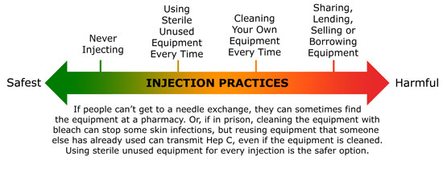
Lummi Tribal Health Center (LTHC) offers a Primary Integrated Care Syringe Service Program that allows patients to access harm reduction materials while maintaining anonymity.
Notes:
In the past we have had a needle exchange program that operated outside the clinic for one hour a week, and while initially there was success with this model, the patients expressed concern at the lack of privacy and the amount of onlookers and many patients stopped attending.
With the syringe program integrated into the primary care visits the patient has a chance to express their needs privately in a secure environment.
Not every patient will ask for supplies, but it is something that everyone here can offer. For the patient that comes in with repeated abcesses, do you need a sharps container, how many times are you injecting each day, do you use alone or with others?. Making a point to ask the uncomfortable questions to better meet the patients need.

Slide 29
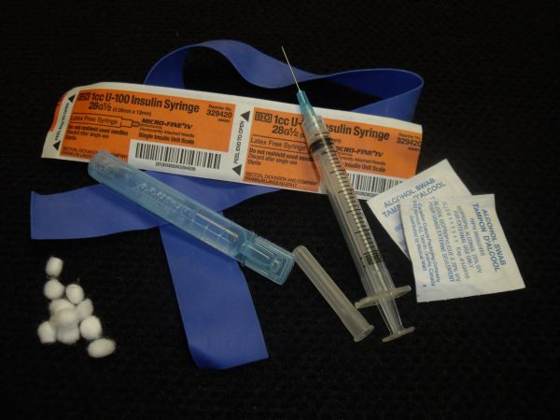
Supplies
-Sterile syringes
-Alcohol prep pads
-Cookers
-Cotton filters
-Sterile water
-Bandages
-Condoms
-Tourniquet
-Narcan
https://nasen.org/
Notes:
Vanish point, need based vs one to one
These may include but are not limited to the following prevention items:
Nasen.org

Slide 30
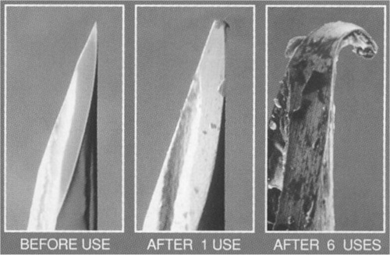
Notes:
A big part of the syringe program is education of our patients. Decreasing abscesses for patients who reuse their own needles. Preventing transmission in patients who previously shared needles.

Slide 31
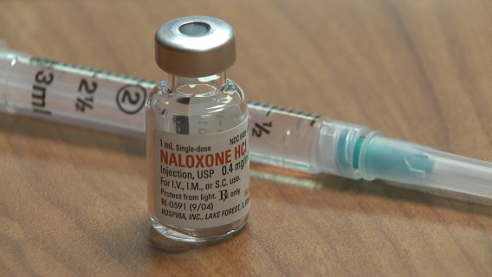
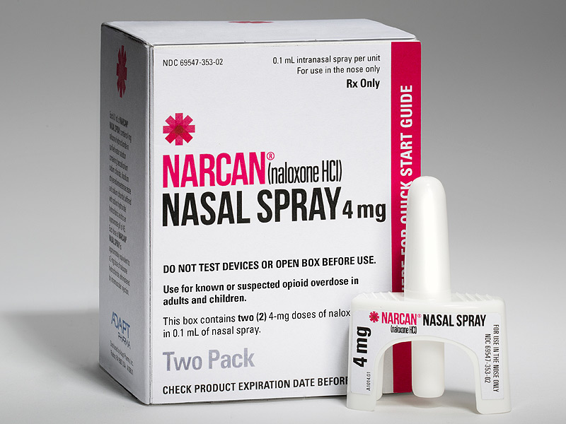
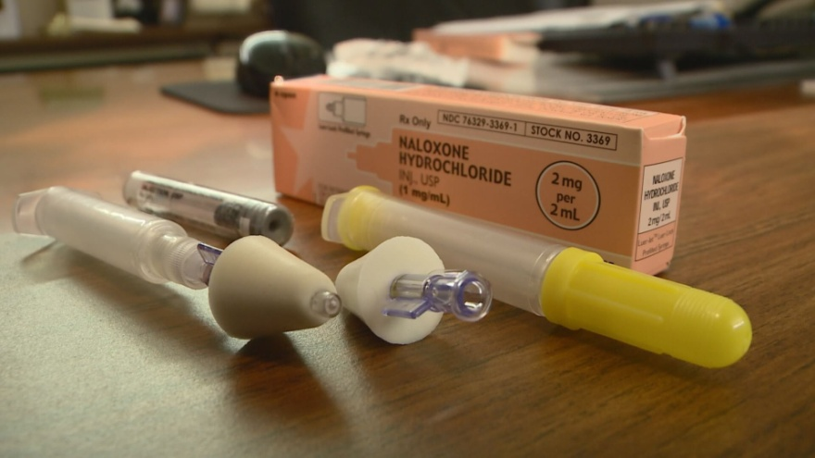
Easy and SAFE access to Narcan
Notes:
Another big focus is Narcan Distribution
Presently we only give our Narcan through MD prescription. However looking at the health departments methods and with WA states liberal rules surrounding Narcan distribution we are working on easier access to narcan through any trained clinic employee.
This must include Overdose prevention and Narcan training for each new patient.
Discuss Training Highlights. (reviewing s/sxs of overdose, both from stimulants and depressants. Identify risk factors. Disspell common myths.

Slide 32
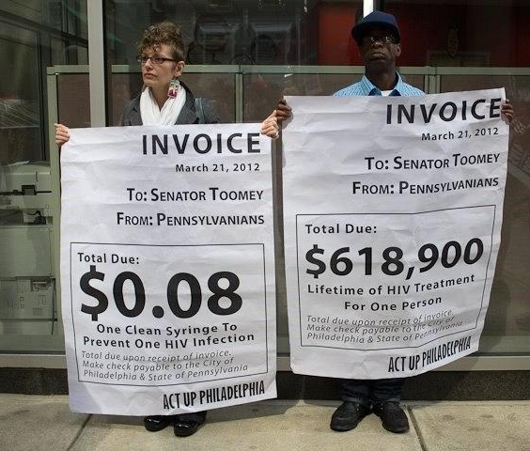
Harm Reduction is Cost Effective
Every dollar invested in SSPs results in
$7 in savings
just by preventing new HIV infections.¹
Notes:
¹Nguyen, T. Q., Weir, B. W., Pinkerton, S. D., Des Jarlais, D.C., & Holtgrave, D. (2014). Syringe Exchange in the United States: A National Level Economic Evaluation of Hypothetical Increases in Investment, AIDS and Behavior November 2014, Volume 18, Issue 11, pp 2144-2155; abstract: http://link.springer.com/article/10.1007/s10461-014-0789-9

Slide 33
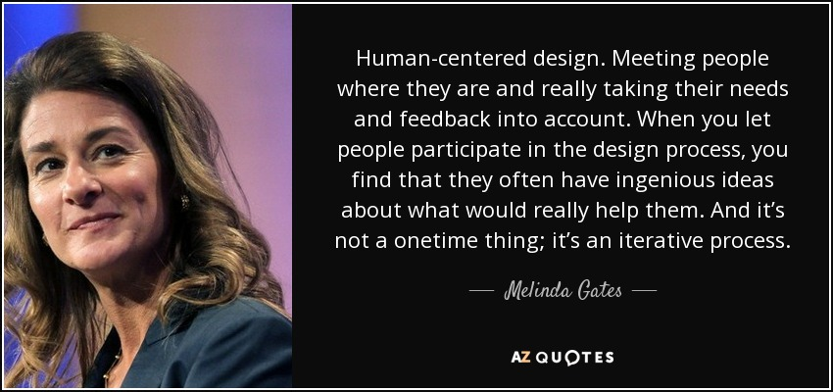
Notes:
This is key as we try to format a program with structure around HCV treatment. If it is not something that fits into the individuals life style or priority list, we will not be successful.

Slide 34
Nt’oyaxsn
“We are responsible for ourselves and each other” – Kodiak Aluttiiq Traditional Value
For more information, please contact Jessica Leston jleston@npaihb.org or 907-244-3888 (text works too)

Slide 35
References
Corrigan, P.W., Kuwabara, SA., O’Shaughnessy, J. (2009). The public stigma of mental illness and drug addiction: findings from a stratified random sample. Journal of Social Work. (9)(2): 139-147.
Barry, C.L., McGinty, E.E., Pescosolido, B.A., Goldman, H.H. (2014). Stigma, discrimination, treatment, effectiveness, and policy: public views about drug addiction and mental illness. Psychiatric Services. (65)(10): 1269-1272.
Kelly, J.F., Westerhoff, C.M. (2010). Does it matter how we refer to individuals with substance-related conditions? A randomized study of two commonly used terms. International Journal of Drug Policy. 21(3):202-7.
Kelly,J.F., Saitz, R.D., Wakeman, S. (2016). Language, substance use disorders, and policy: The need to reach consensus on an “addiction-ary”. Alcoholism Treatment Quarterly. (34)(1): 116-123.
van Boekel, L.C., Brouwers, E.P.M., van Weeghel, J., Garretsen, H.F.L. (2013). Stigma among health professionals towards patients with substance use disorders and its consequences for healthcare delivery: Systematic review. Drug and Alcohol Dependence. 131: 23-35.

