Slide 1
CHAP Project
NPAIHB Quarterly Board Meeting
July 17, 2018

Slide 2
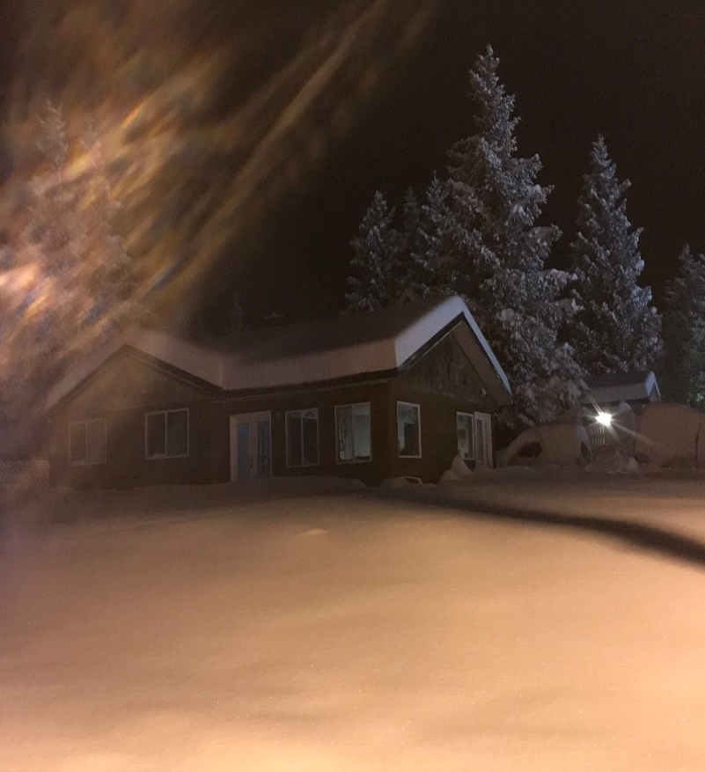
Motivated to Serve
Cow Creek Citizen
18 years in CHAP
Life Long Dream for CHAP
Happy to be Home

Slide 3
Goals
Brief history of CHAP in Alaska
CHAP TAG update
CHAP Board Advisory Committee
Tribal College Partnership
Behavioral Health Aide / Practitioner
BHA Advisory Committee
CHAP Community Readiness Surveys

Slide 4
What is CHAP?
Inception
Providers
Physician extenders
CHA/P, BHA/P and DHAT
TB epidemic
High rate of infant mortality
High rate of unintentional injury
Typically Tribal or Village Member
Often Generational
Role model for the village

Slide 5
AK CHAP Timeline

Slide 6
Provider Scope
BHA/P
CHA/P
Counselor
Alcohol, drug & tobacco abuse
Grief, depression & suicide
Health Educator
Advocate
Individuals
Families
Communities
Emergency
Acute
Chronic
Preventive

Slide 7
CHP vs CHR
CHA/P
CHR
Physician Extender
Medical Standing Orders
Telemedicine
EHR
Basic Training (year 1): Health Promotion/Disease Prevention
Advanced Training (year 2-3): Public health topics related to outreach for THS & IHS goals
Specialized Training: Motivational interviewing, case management, MCH, MH, HP/DP and CHR documentation training.

Slide 8
IHS Circular 18-01
To provide subject matter expertise, program information, innovative solutions, and advice to the Indian Health Service to establish a National CHAP.
1. Interim Policy – Critical
2. Orientation to CHAP
Next Meeting:
Henry M. Jackson Federal Building
Seattle, WA
August 17, 2018 9 AM to 4 PM

Slide 9
CHAP Board Advisory Committee
Andrew Shogren – Suquamish
Kelle Little – Coquille
Chantel Eastman – Nez Perce
Dr. SixKiller – IHS
Crystle Stordahl – AK ACCB
Need:
BH Clinician
Physician
DHAT
BHP
CHP
Meet and Greet – 7/18/18 Tower Room A & B
Committee Structure
Committee Mission

Slide 10
AK Training Centers
Where would BHA/P Training be Housed?

Slide 11
AK CHAP Certification Board
The federally authorized Community Health Aide Program Certification Board (CHAPCB) was created in 1998, and charged with formalizing the process for maintaining CHA/P training and practice standards and policies. The CHAPCB:
Certifies CHA/P Training Centers.
Certifies individual Community Health Aides/Practitioners, Behavioral Health Aides/Practitioners and Dental Health Aides at all levels of training. The term of the certificate is 2 years.
Approves the Alaska Community Health Aide/Practitioner Manual and Alaska Behavioral Health Aide/Practitioner Manual revision.
Copies of the Certification Board Standards and Procedures are available from the Alaska Native Tribal Health Consortium (ANTHC) Community Health Services CHAP/Rural Health Consultant, and at the web site: www.akchap.org
There are currently 12 members on the Board, one federal representative appointed by the Alaska Area Native Health Service Director, one State of Alaska appointed representative and the remaining Board positions are determined by a variety of tribal groups representing CHAP interests. A Dental Academic Review Committee Representative was added in 2003; a Behavioral Health Representative was added in 2008.
The Board is managed by the Alaska Native Tribal Health Consortium who employs a full-time support staff. Application process fees paid to the Board for the purpose of CHA/P, DHA, and BHA/P certification pay for all of the Board expenses. There are no recurring funds in the CHAPCB budget.

Slide 12
Certification
CHAP Certification Board
Federal Authority, 12 members
Standards and Procedures
Individuals, Training Centers, Curricula
488 individuals certified
387 CHA/Ps certified, 387 meet criteria for reimbursement for services to Medicaid eligible clients (June 2018)
49 Dental Health Aides certified
52 Behavioral Health Aides/Practitioners certified

Slide 13
Alaska Tribal Colleges

Slide 14
BHA/P Projected Roll Out
BHA Advisory Committee – September 30, 2018
Procure funding – 2 M
PACCB -
Identify Educational Partner -
First Class April 2020 -

Slide 15
BHA Advisory Committee
Andrew Shogren – Suquamish
Kristi Woodard – IHS
Need
Oregon Representative
Idaho Representative
Direct Care Representation
BHP

Slide 16
Community Readiness Survey
35 Questions to determine knowledge and infrastructure and community desire for CHAP
Tanya Firemoon will be assisting
Existing DHAT sites
Tribes interested in BHA/P
Please contact either Tanya or Sue

Slide 17
Questions?

Slide 18
Thank You

