Slide 1
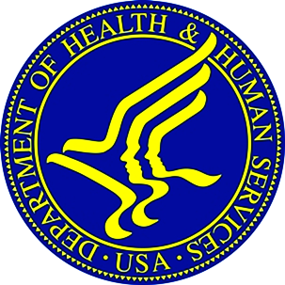
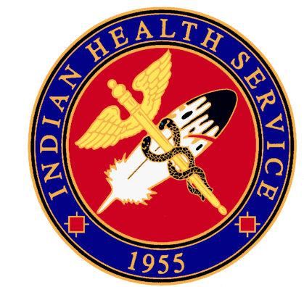
Indian Health Service Portland Area Director’s Update
Dean M Seyler - Area Director
July 17, 2018
Silver Reef Hotel – Lummi Nation
NPAIHB Quarterly Board Meeting

Slide 2
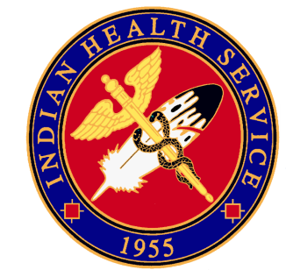
Indian Health Service Portland Area
Portland Area Staff Update
CDR Roney Won – Acting Director Office of Clinical Support
CAPT Marcus Martinez – Acting Director – Office of Environmental Health and Engineering
CAPT Laura Herbison – Acting CEO – Wellpinit Service Unit
Melvena Yazzie – Acting Area Property Management Officer
Intermittent Physician/NP Positions
Intermittent Pharmacist (soon)

Slide 3
Indian Health Service Portland Area
Portland Area Direct Service Tribes Meeting
Date - August 21, 2018
Location – Fort Hall, ID
2018 National Combined Councils Meeting
August 14 – 17 2018
Red Lion Hotel – Jantzen Beach
https://www.ihs.gov/forproviders/ncc/2018meeting/
Area CHSDA Expansion Pilot Project
Area CHSDA Expansion Pilot Project Update.

Slide 4
Indian Health Service Portland Area
SDPI Update
SDPI Tribal Consultation, FY19 Funding Distribution
Diabetes Trainings
Squaxin Island – American Association of Diabetes Educators (AADE) Lifestyle Coach Training | May 17-18
NARA NW – “Diabetes Care: The Whole Kit and Kaboodle” | July 26
Virtual Trainings/Services
Virtual Foodservice Training – Healing Lodge of the Seven Nations | July 24
Endocrinology ECHO Clinic, 6 month pilot project – NPAIHB and Shoshone-Bannock Tribal Diabetes Program
Tele-Nutrition Services – Makah Nation, Sophie Trettevick Indian Health Center

Slide 5
Indian Health Service Portland Area
Pharmacy & EHR Update
RPMS-EHR
Windows 10 Update
Future of IHS RPMS-EHR and VA-Cerner EHR
Washington I/T/U Pharmacist Round Table Meeting
IHS Adverse Event Reporting System Replacement
roney.won@ihs.gov

Slide 6
Indian Health Service Portland Area
Health Facilities Engineering Update
Small Ambulatory Program (SAP)
Port Gamble S’Klallam Tribe Selected to Receive SAP Funds for the Port Gamble Tribal Health & Wellness Center Project.
Backlog of Essential Maintenance, Alteration, and Repair (BEMAR)
Portland Area Received $2,388,000 For Tribal Program BEMAR.
18 Tribes Submitted Required Information for Funding Consideration.
PAFAC Will Meet on July 20th To Review and Prioritize Submitted BEMAR Deficiencies for Funding.
Funding Notices Expected in September.
Please Respond to IHS Requests to Update Supportable Space and Health Deficiency Information

Slide 7
Indian Health Service Portland Area
Division of Environmental Health Update
Spokane District Office: Risk-1 Facilities Inspections Completed Early.
Olympic District Office: Risk-1 Facilities Inspections Completed.
60% of Risk -1 completed
Interagency Agreements (IAs) with Region 10 EPA:
Integrated Pest Management & Pesticide Safety Program Ongoing
Children’s Environmental Health Waiting for Documents from EPA to Re-allocate Funds to the Project.

Slide 8
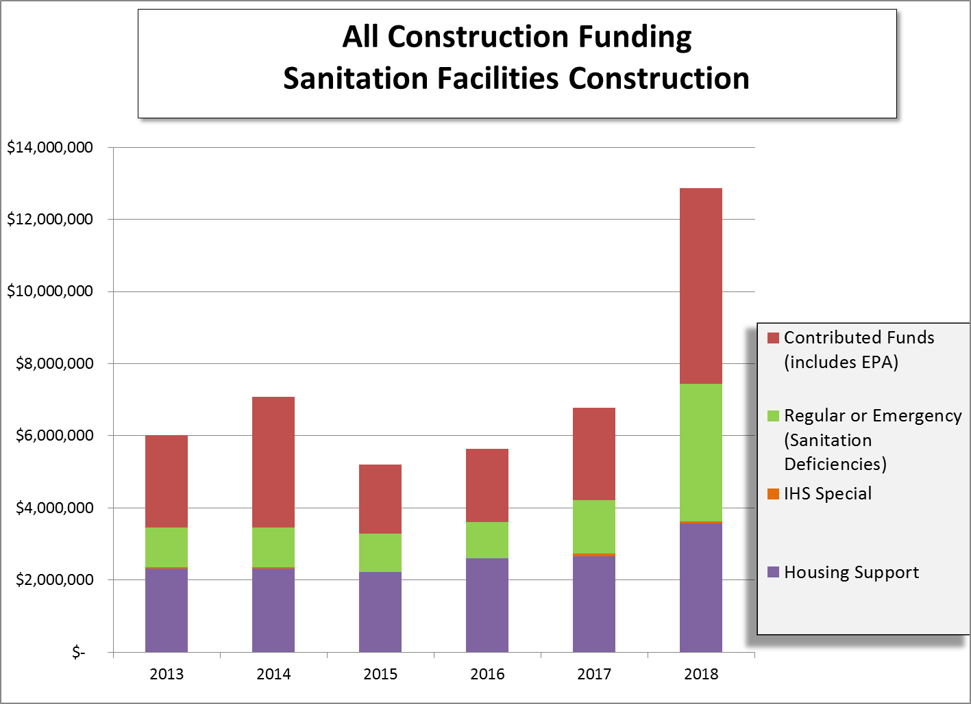
Indian Health Service Portland Area

Slide 9
Indian Health Service Portland Area
Sanitation Facilities Construction Program – Office Changes
Economic Boom in Seattle has Necessitated Moving the Seattle District Office From Downtown Seattle.
Services to the Tribes Currently Served by Seattle Will Not be Decreased as a Result of this Move Out of Seattle. IHS Staff Will Just be Serving You From a Base Other Than Downtown Seattle.
The Goal is to Eliminate Unnecessary Operating Cost Without Negatively Affecting Tribes Served by Seattle.
Transition Will Likely Begin in September 2018, and Will be Complete No Later Than April 1, 2019.

Slide 10
Indian Health Service Portland Area
Indian Health Care Improvement Fund
FY 2018 funding increase of $72 million
IHCIF Workgroup: Review existing IHCIF formula and make recommendations for potential formula revisions
PAO IHCIF Tribal Workgroup Members: Ms. Gail Hatcher, Vice-Chair, The Klamath Tribes and Mr. Steven Kutz, Tribal Council Member, Cowlitz Indian Tribe
IHCIF Workgroup’s recommendations: Update Benchmark, Population Factor and Alternate Resources Factor
Three – In-Person Tribal Consultations and Webinar
The deadline for submitting comments on the IHCIF Workgroup’s Recommendations on the IHCIF formula is Friday, July 13, 2018.
Notes:
-

Slide 11
Indian Health Service Portland Area
FY 2020 Portland Area Budget Formulation Meeting
Portland Area IHS is partnering with NPAIHB to plan the FY20 Portland Area Budget Formulation Meeting
Meeting Location: Portland, OR
Meeting Date: November or December 2018. Save the Date will be distributed via email upon finalization.
Instructions & Template: Areas will receive instructions and template from HQ in late August or early September.

Slide 12
Indian Health Service Portland Area
Fund Distribution Workgroup
Reconvene Portland Area Funds Distribution Workgroup
Purpose: Review Methodology
Challenges:
Currently based on FY1998 user pop
Doesn’t capture new program requirements, i.e. increased IT support
Residual may need to be reevaluated

Slide 13
Indian Health Service Portland Area
FY18 Catastrophic Health Emergency Fund
Total Number of Cases: 25
Total Number of Amendments: 19
Current Reimbursement Amount: $998,079.00
Current Pending Reimbursement Amount: $119,865.70
84% Reimbursed
CHEF Balances as of July 2, 2018 $47,270,541

Slide 14
Indian Health Service Portland Area
RPMS Third Party Billing & Accounts Receivable Training
RPMS Third Party Billing:
September 10, 2018 1:00pm – 4:00pm
September 11, 2018 8:30am – 4:00pm
September 12, 2018 8:30am – 12:00pm
RPMS Accounts Receivable:
September 12, 2018 1:00pm – 4:00pm
September 13, 2018 8:30am – 4:00pm
September 14, 2018 8:30am – 12:00pm
Location:
Northwest Portland Area Indian Health Board Broadway Plaza
2121 SW Broadway, Suite 300
Portland, OR 97201
To register for this training, please contact Nicole Massey at
salena.massey@ihs.gov
Please include your full name, title, facility, email and phone number

Slide 15
Questions or Comments
Our Mission... to raise the physical, mental, social, and spiritual health of American Indians and Alaska Natives to the highest level.
Our Goal... to assure that comprehensive, culturally acceptable personal and public health services are available and accessible to American Indian and Alaska Native people.
Our Foundation... to uphold the Federal Government's obligation to promote healthy American Indian and Alaska Native people, communities, and cultures and to honor and protect the inherent sovereign rights of Tribes.

