Slide 1
The Road to Resilience
Cow Creek Band of Umpqua Tribe of Indians
Notes:
Introduce yourself. w/ title
Follow up on some key points from Julies presentation

Slide 2
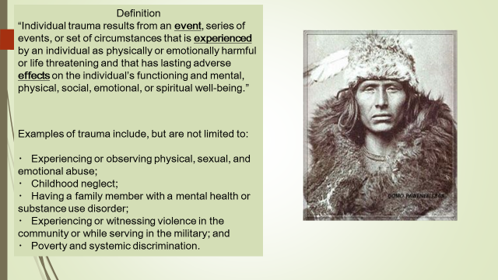
Notes:
Remember the three E’s of trauma
Event
Experience
Effects
The pervasive effect of long term exposure to low levels of trauma
Childhood neglect
Failure to provide needed age appropriate care. It is not incident based and is an ongoing pattern that’s easily observed. Babies with flat heads, kids chronically late, w/o lunch andin dirty clothes

Slide 3
Notes:
ACES – a screening tool that gives a score of Adverse Childhood experiences
Data from 2016 Oregon student Wellness Survey
Compares Tribal to State Available online for all counties.
Felt that they didn’t have enough to ear wore dirty clothes 5-15 point spread
Lived with drug Users, problem drinkers and mental illnesses

Slide 4
2016 Oregon Student Wellness Survey
Cow Creek Tribal Youth
12% higher than peers for feelings of hopelessness
29.2% higher rate of attempted suicides
30% binge drank in the last 30 days
50% reported illicit drug use
Notes:
Data specific to our tribe In this statistic describing the fatal combination of depression/hopelessness, substance use and attempts at self harm.

Slide 5
Notes:
Referring again to the 2016 Oregon Student wellness Survey
Data on 11th graders or 16/17 year old kids
Again comparing tribal to the state numbers
20 pt swing on alcohol consumption prescription drugs
Heroin use

Slide 6
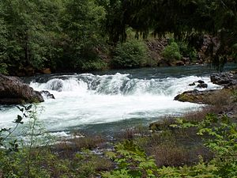
So now what…..?
Notes:
Share the Kit story

Slide 7
Resilience
“the process of adapting well in the face of adversity, trauma, tragedy, threats or significant sources of stress”
Notes:
Focus on the Adapting well

Slide 8
Developmental Assets
a set of skills, experiences, relationships, and behaviors that enable young people to develop into successful and contributing adults.
Support
Empowerment
Boundaries and Expectations
Constructive use of Time
Commitment to Learning
Positive values
Social Competencies
Positive Identity
Notes:
Vary from age group
Where you and I as parents, providers and members of our communities help support and empower our youth by Setting expectations and boundaries, giving kids the opportunity to constructively use their time. Where we make a commitment to educational equity so that our kids can grow up with a commitment to being a life long learners And by modeling positive values and social behaviros to help build kids positive identities.
.

Slide 9

Notes:
5 year grant program designed to help AI and Alaska Native Communities identify and address behavioral needs in our youth
Goal is to reduce suicidal behavior, substance abuse/misuse in youth easing the impact of trauma and its associated substance abuse and mental illness.
3 co-hort
Co-hort 2 70 tribes
2 in Oregon Yellow hawk
First steps assessing our Community for readiness to address trauma/suicide.
Survey group
And here are the results

Slide 10
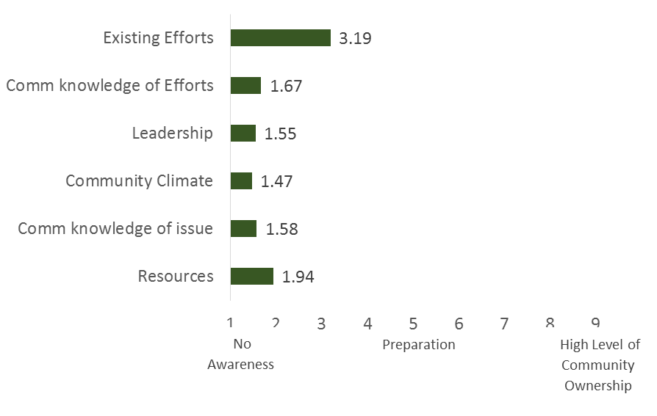
Community Readiness
Notes:
Clearly we have some work to do
Discuss
Formed BHAC/Native connections Advisory
Developed Mission and Vision statements

Slide 11
Vision Statement
After more than a century of intergenerational trauma Cow Creek Health &Wellness will utilize trauma informed practices to identify those Tribal youth in need, initiate new and relevant trauma informed programs, and strengthen the trauma awareness of our existing programs. All of these efforts will enhance the resiliency of our tribal youth; and promote a strong sense of cultural identity for all Tribal members.
Notes:
Define trauma informed
And then the development of the Strategic Action Plan

Slide 12
Trauma Informed Practices…..
…….is a strengths-based framework that is responsive to the impact of trauma, emphasizing physical, psychological, and emotional safety for both service providers and survivors; and creates opportunities for survivors to rebuild a sense of control and empowerment.
Notes:
Implementation of the Sanctuary Model
Explain CCR and it’s members
Cohort modle first flight

Slide 13
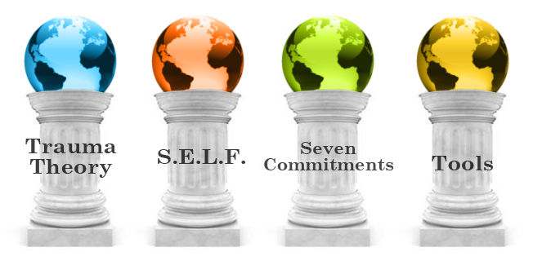
Sanctuary Model- Organizational Transformation
Notes:
Trauma Theory - the three e’s and traumas effects
Safety-physical Social Moral
Emotional Management
Loss- Acknowledge and grieving the loss and not getting stuck
Future-Building the capacity for choices and new behaviors
7 Commitments-non-violence, open communications, emotional intelligence, social learning, social responsibility, Democracy, growth and change
Tools-self governance, personal empowerment and the safety to say “hey wait a minute….”

Slide 14
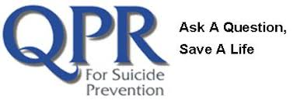
Question
Persuade
Refer
QPR (Question, Persuade, and Refer) Gatekeeper Training for Suicide Prevention is a 1-2 hour educational program designed to teach lay and professional "gatekeepers" the warning signs of a suicide crisis and how to respond.
Notes:
On boarding for new employees for the clinic, reaching into the Government Offices and Human Services
Empowering people to ask the question “Are you thinking about killing yourself?”

Slide 15

Notes:
Youth based QPR

Slide 16

HOPE Squad students are trained to be active listeners so they may help and respond to peers who are struggling with emotional issues such as depression and suicide. HOPE Squad members are trained to share concerns with an adult. The goals of the HOPE Squad Program are to: Prevent suicide and reduce suicidal behaviors.
Notes:
Youth lead with an onsite school professional as the contact point.

Slide 17
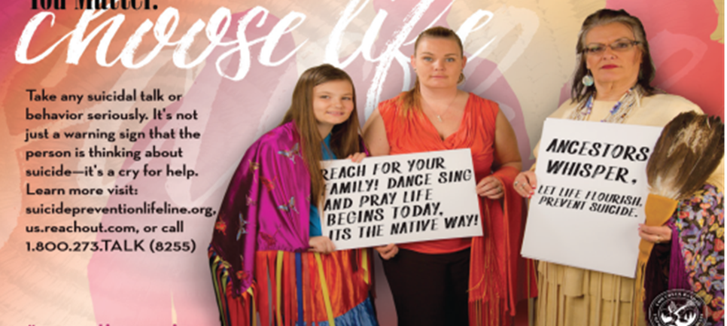
You matter. Choose Life
Notes:
Professionally produced focusing on Mental Health, suicide, substance abuse, tobacco prevention
Featuring tribal members

Slide 18
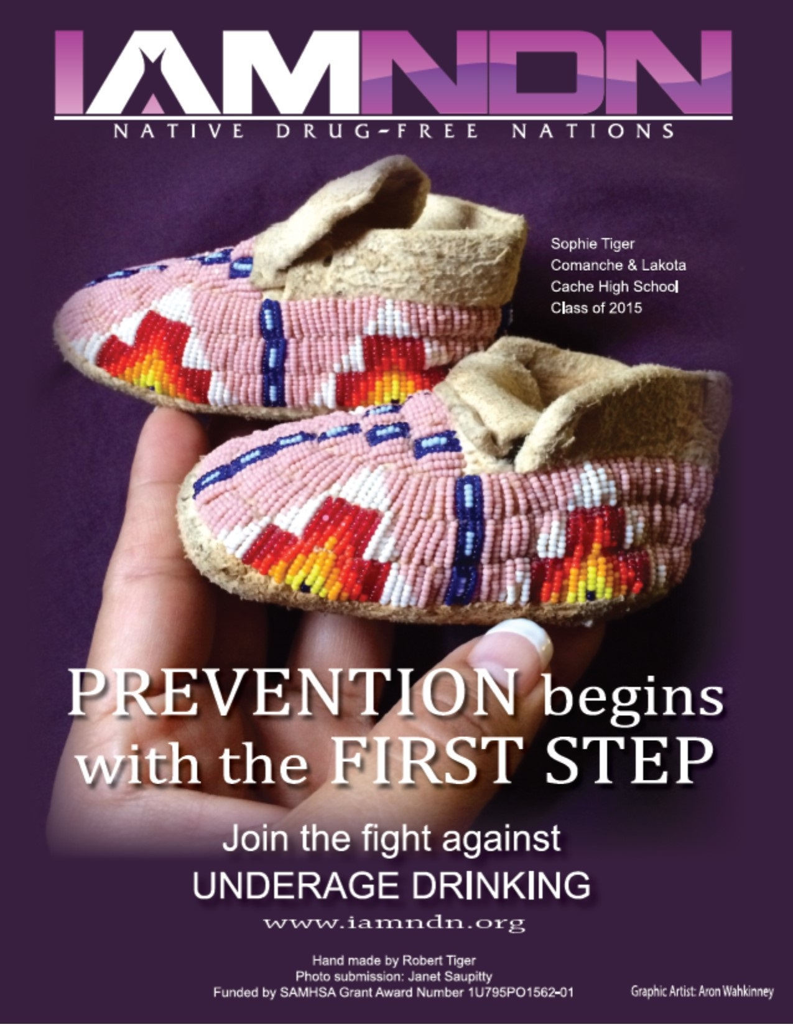
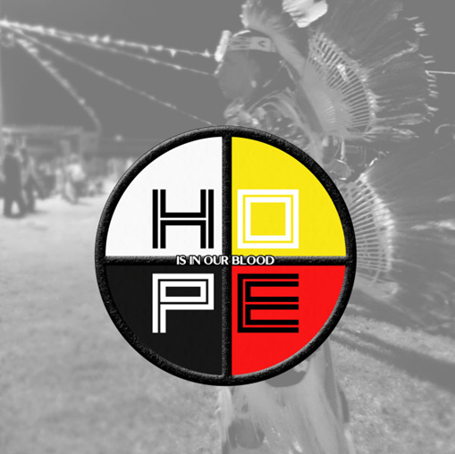
Social Media Campaign
Utilizing the Cow Creek Facebook page
Notes:
Official tribal page. Weekly update featuring you tube videos , links and inspirational messaging

Slide 19

Notes:
My favorite

Slide 20
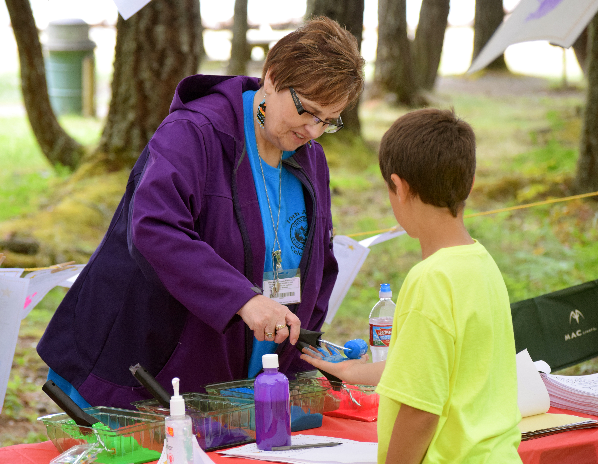
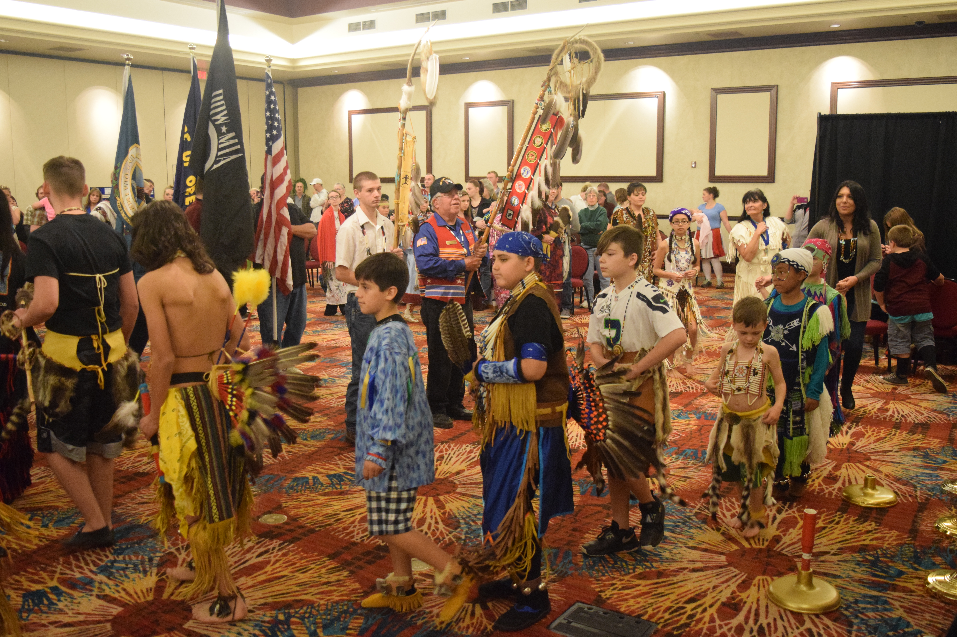
Strengthening the Elder/Youth Connection
Notes:
My vision for this

Slide 21
Developmental Assets
Support
Empowerment
Boundaries and Expectations
Constructive use of Time
Commitment to Learning
Positive values
Social Competencies
Positive Identity
Vision- a pairing of active Tribal Elders with Tribal Youth who are participating in activities together, making a connection.
Notes:
At risk youth/Active Elder social and cultural events
Foster the connections and building developmental Assests
Still in the relationship building stages

Slide 22
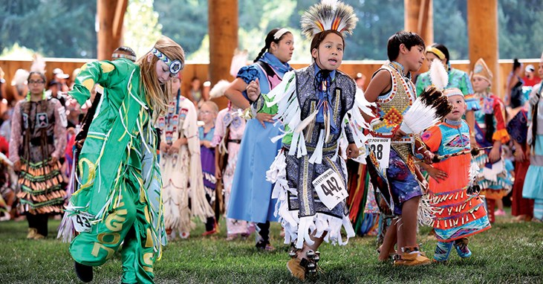
Culture is Prevention
Notes:
Closing comments
Trauma is real, its effects are real and we can be proactive about treating it.

