Slide 1
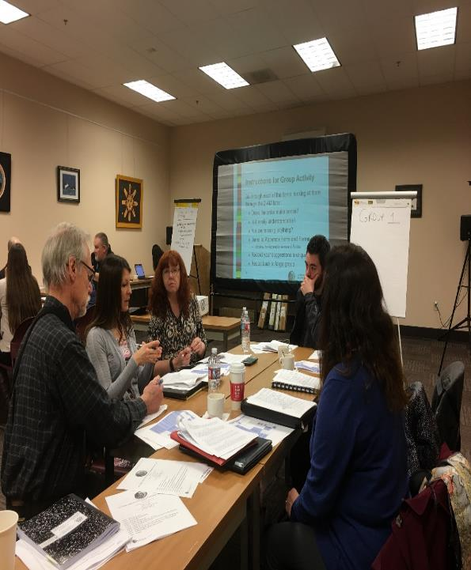
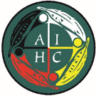
American Indian Health Commission
for Washington State
Cross Jurisdictional Collaboration Project
Distributing Medical Countermeasures Across Tribal and Non-Tribal Jurisdictions
January 17, 2018
NPAIHB Quarterly Board Meeting
Presenter:
Lou Schmitz, Consultant

Slide 2

Today’s Presentation
PART 1: Understanding Medical Countermeasures and Medical Materiel
PART 2: Protecting Your Community through Cross-Jurisdictional Collaboration
PART 3: Overview of 2017-2018 Cross-Jurisdictional Collaboration Project
PART 4: The Asks
American Indian Health Commission
for Washington State

Slide 3

American Indian Health Commission
for Washington State
About Us
Pulling Together for Wellness
We are a Tribally-driven, non-profit organization providing a forum for the twenty-nine tribal governments and two urban Indian health programs in Washington State to work together to improve health outcomes for American Indians and Alaska Natives.

Slide 4
Understanding Medical Countermeasures and Medical Materiel
Part 1
American Indian Health Commission
for Washington State

Slide 5
Public Health Threats
Chemical
Biological
Radiological
Nuclear
Pandemic
Influenza
Emerging
Diseases
American Indian Health Commission
for Washington State

Slide 6
Medical Countermeasures
Medical treatments or prophylaxes for public health threats
American Indian Health Commission
for Washington State

Slide 7
Medical Materiel
Supplies, equipment and other items needed to treat or protect against public health threats
American Indian Health Commission
for Washington State

Slide 8
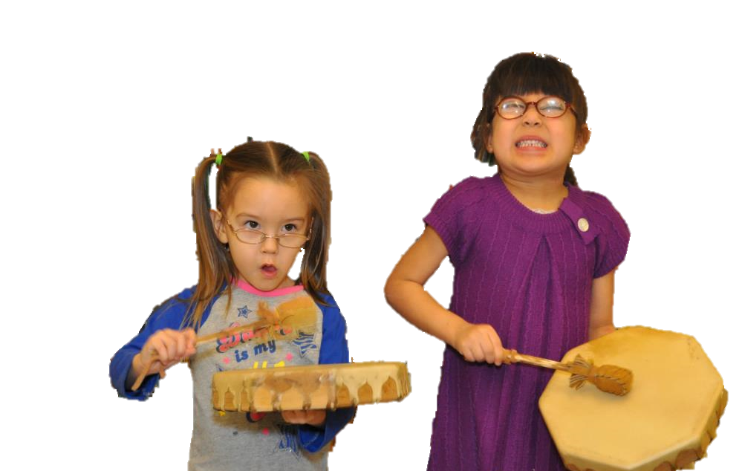
Our Mission
  We must assure that Tribes receive appropriate and sufficient medical countermeasures and materiel in a timely manner during public health emergencies
American Indian Health Commission
for Washington State

Slide 9
Protecting Your Community through Cross-jurisdictional Collaboration
Part 2
American Indian Health Commission
for Washington State

Slide 10
Why is collaboration
between Tribes,
Local Governments,
and the State vital to community health and safety?
American Indian Health Commission
for Washington State

Slide 11
Every emergency and public health incident is experienced first and is responded to first by local, tribal, and state personnel.
  See Homeland Security and Emergency Management, Abbott and Hetzel, p. 5
American Indian Health Commission
for Washington State

Slide 12
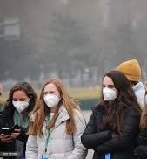
Public health issues, emergencies and disasters know no boundaries
American Indian Health Commission
for Washington State

Slide 13
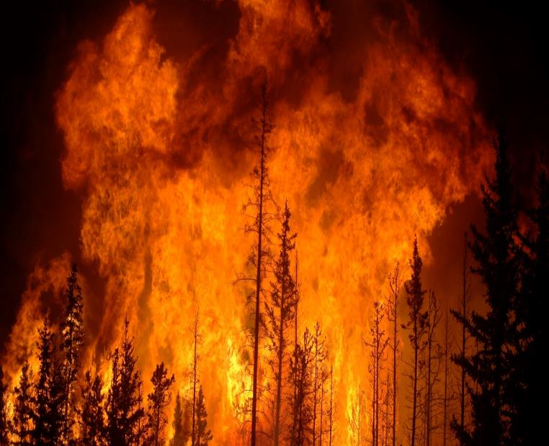
capacity
No federal, state, local, or tribal government has the capacity to respond to every public health incident or emergency that may occur within its jurisdiction without assistance

Slide 14
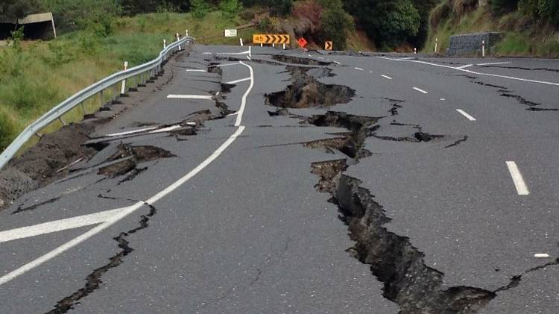
Cascadia Rising Exercise 2016
During a catastrophic event, some areas of Washington State may have to wait up to 7 days for state and/or federal assistance
American Indian Health Commission
for Washington State

Slide 15

Collaboration +
preparedness
The unfolding of a catastrophic event is a poor time to begin learning how to collaborate with neighboring jurisdictions and knowing their capabilities and available resources
American Indian Health Commission
for Washington State

Slide 16
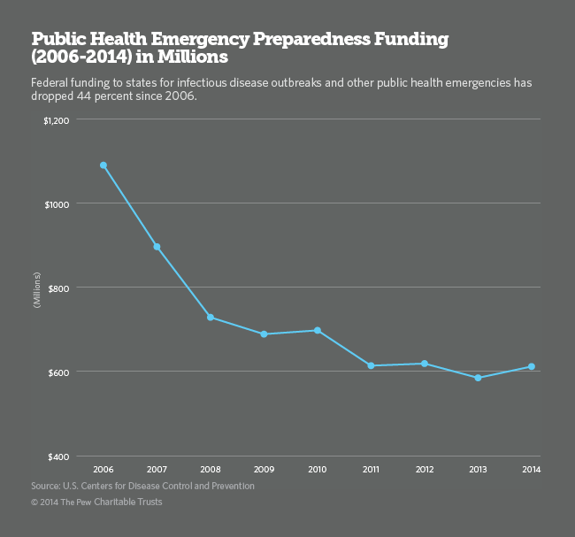
Diminishing
Federal
Funding

Slide 17
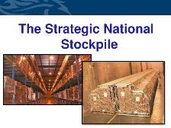


Options
What is best
for your Tribe?

Slide 18
Overview of 2017-2018 AIHC Cross-Jurisdictional Collaboration Project
Part 3
American Indian Health Commission
for Washington State

Slide 19
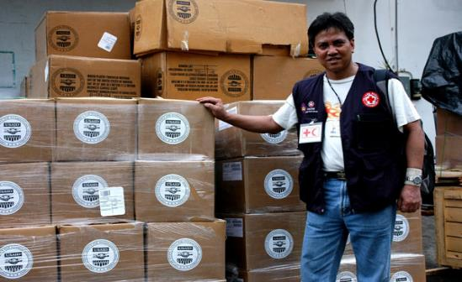
Project Goal
Assure the appropriate amount and type of medical countermeasures and materiel reach every Tribe quickly during public health emergencies
American Indian Health Commission
for Washington State

Slide 20
Project Objectives
Strengthen collaboration and mutual aid between Tribes and non-Tribal partners
Enhance each region’s ability to manage and distribute medical countermeasures and materiel
Prevent problems like those experienced during 2009-2010 H1N1 response
American Indian Health Commission
for Washington State

Slide 21

Important
Regional Meeting Dates
Mark Your Calendar
This Photo by Unknown Author is licensed under CC BY-SA

Slide 22
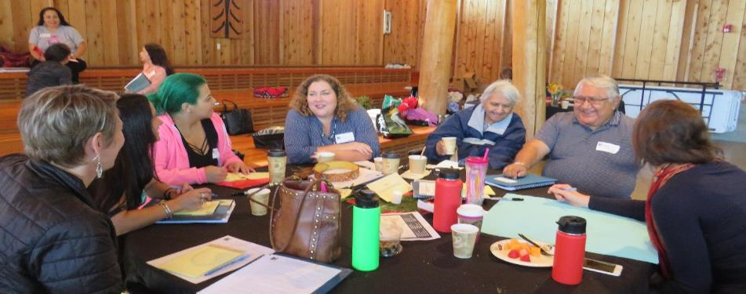
Meeting 1 – Desired Outcomes
Increase partners’ understanding of each others’ capacity, organization, resources, etc.
Plan a tabletop exercise

Slide 23
Meeting 2 – Desired Outcomes
Test each region’s ability to effectively distribute medical countermeasures and materiel across Tribal and non-Tribal jurisdictions
Identify potential legal issues/challenges
Document and provide actionable insight on strengths and areas for improvement
Test and compare performance in partners who are signatories to Mutual Aid Agreements versus partners who are not
American Indian Health Commission
for Washington State

Slide 24

Project Products
Partner profile template
Partner profiles
Tabletop exercise scenario
After-Action Reports
Final project report
Recommendations to address Tribal issues in the 2019 statewide full-scale exercise
American Indian Health Commission
for Washington State

Slide 25
The Asks
Part 4
American Indian Health Commission
for Washington State

Slide 26
The Asks
1. Please send tribal representatives to the two CJC meetings:
(Tribal Leaders, Tribal Health Directors, Medical Directors, CHRs, Clinic Managers, Emergency Managers, YOU)
If your jurisdiction has not yet signed the “Mutual Aid Agreement for Tribes and Local Health Jurisdictions in Washington State,” please consult with your legal counsel to finalize the agreement for your tribe
http://www.aihc-wa.com/aihc-health-projects/emergency-preparedness/mutual-aid-project/
American Indian Health Commission
for Washington State

Slide 27

Questions?
American Indian Health Commission
for Washington State

