Slide 1
Tribal Policy Guide: An Indigenous Perspective on Policy Development
Adam Becenti, Diné Nation
Community Development Specialist
Antoinette Aguirre, Diné Nation
Cancer Prevention Coordinator
Nora Frank-Buckner, Nez Perce
WEAVE-NW Project Coordinator
Ryan Ann Sealy, Chickasaw Nation
Tobacco Prevention Specialist
January 17th, 2018
Notes:
All
Welcome, general introductions, thank everyone for coming
Let everyone know our workshop doesn’t include to “build public health infrastructure

Slide 2
Presentation Objectives
Preview of the policy toolkit content, resources and tools
Discuss:
Purpose and use of the guide
Theory and methodologies used
Policy phases
Discussion Questions
Notes:
Adam

Slide 3
Tribal Customary Policy
Natural and customary law established by traditional beliefs & values
Tribal perspective:
Guided tribal people in maintaining traditions, surviving inconceivable events, and thriving
Notes:
Adam
NPAIHB/NICWA have tapped into these existing indigenous frameworks to create the Tribal Customary Policy Toolkit.
Tribal policy is a community lever with the ability to create sustainable change or maintain valuable resources.

Slide 4
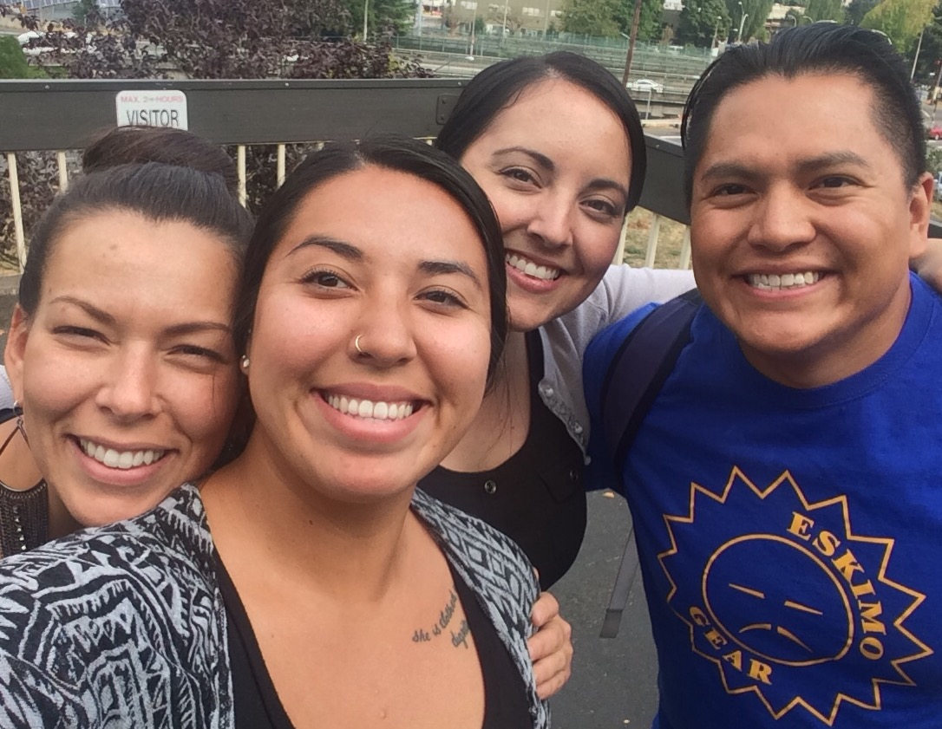
Policy Toolkit Team
Notes:
Netta
NICWA Adam
NPAIHB Health Board – Ryan, Nora, Netta

Slide 5
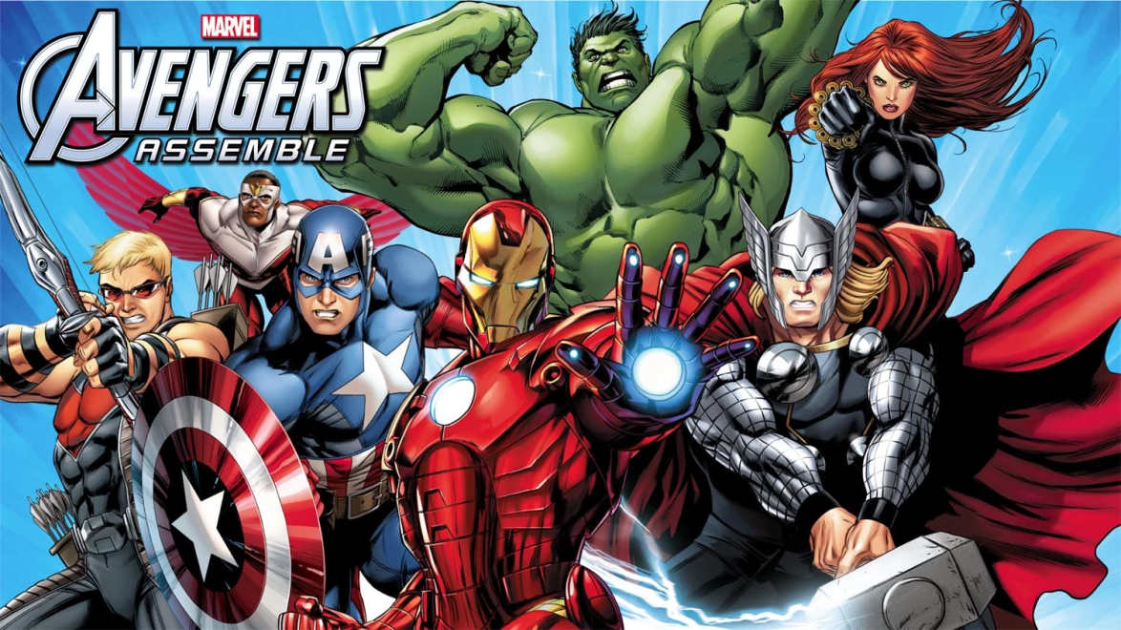
Team Origin Story
How our group came together
Why we came together
Importance
Notes:
Ryan
Started last summer when I attended a session Ryan/Netta/Nora were facilitating at health board – I approached them with this idea to work together
We all thought community norms were a form of policy – we wanted to dive deeper and identify ways to further support tribal advancement
A unified voice is stronger, collaboration needs to happen, we were all friends to begin with, we love the challenge, we were all doing similar work beforehand

Slide 6
Who NPAIHB Serves
Notes:
Ryan talk about service area

Slide 7
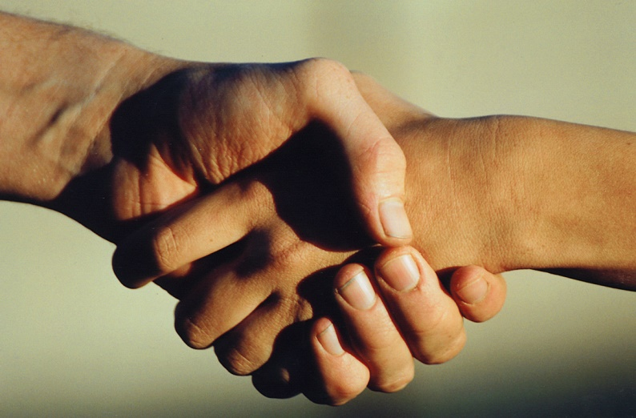
Community Introductions
Name
Tribal affiliation/current homestead
What is your experience with policy?
What does policy mean in your community?
Notes:
Quick introductions if we have large crowd and If a small crowd go into detailed intros
Experience with policy can be informal/formal experience
Policy meaning – can be a definition, philosophy, value, or a story

Slide 8
Purpose
Support tribal community driven policy
Provide a guide for tribal nations/communities in the policy making process
Offer ideas, concepts, and structure relating
to how tribal communities may approach policy
Highlight and honor tribal perspective for policy development
Notes:
Netta/Ryan
Conceptual guide
Develop understanding of policy through tribal lens
illustrate how tribal beliefs and values can help inform policy creation
Learn how policy may help support your tribal community

Slide 9
Utilization of Guide
Practical step-by-step guide
Course of action
Address community need
Advocacy/education for non-native partnership
Tribal framework
Tribal Sovereignty
Notes:
Ryan/Netta
Be guide for state a/county federal working with tribes.
Is policy best course of action
Describe for community level ect
Is policy needed?
Target Audience
Tribal community
Resource for State/County/Federal agencies
Based on need

Slide 10
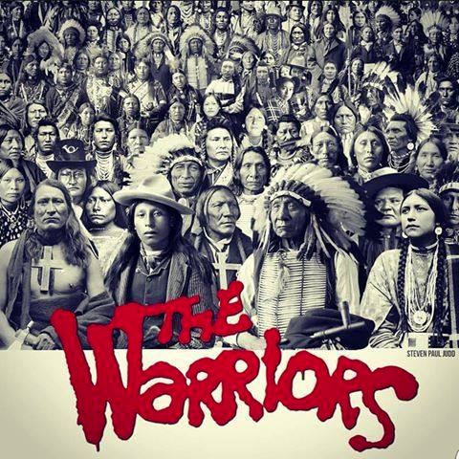
Audience
Tribal community
Resource for State/County/Federal agencies
Based on need
Notes:
Netta
Describe who tribal community is: tribal council, elders, tribal workers, youth
Could be used for non-native partners or state/county/federal agencies
Based on need where policy could be the solution

Slide 11
Traditional Forms of Policy
Customary law, tribal protocol, community norm
Philosophy/belief systems
Traditional roles
Application to modern day context
Notes:
Netta/Ryan

Slide 12
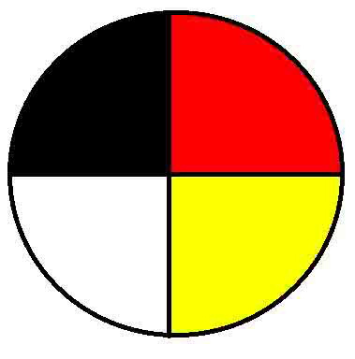
Theoretical Framework
Relational World View
Benefits
Application
Notes:
Adam

Slide 13
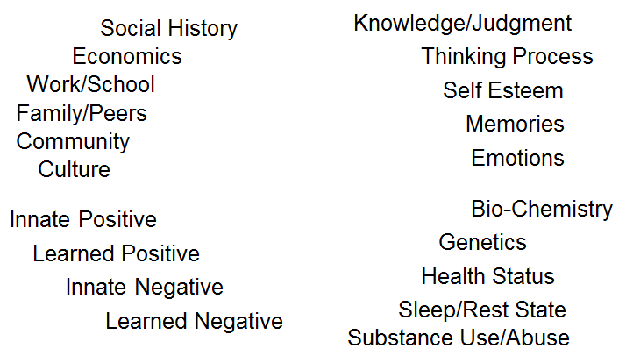
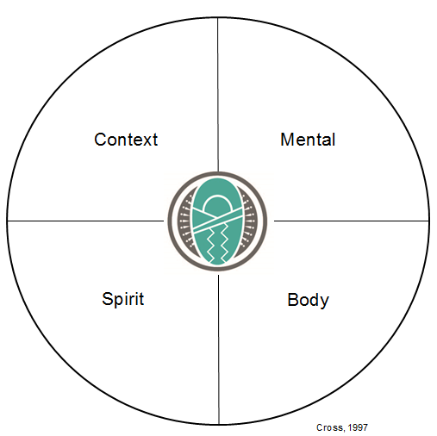
Relational Worldview Model Individual/Family Level
Notes:
Adam
Go through each of the points and examples of the four areas beginning with Context, then Mind, Body, and Spirit
Give examples of each of the points
Explain the inter-dependent nature of the circle
“ENERGIZER” EXERCISE DEMONSTRATING THE MODEL OF BALANCE (5 minutes)
“Right now after sitting so long, you’re are probably feeling at least a little out of balance… we are going to take a few minutes to actively demonstrate this model and the concept of balance”
“Let’s start with the body”
Have the audience get up and stretch and lead them in some physical movement
“Now let’s move into changing the context”
Have audience shake hands, hug and acknowledge those around them by offering compliments or words of encouragement
“Now we’re moving into the real of the mind”
Ask audience to think back and review their daily activities yesterday and today…what had each meal, etc. Or offer other short “brain-teaser”
“Now let’s finish off by taking care of our spirit”
Ask audience to quietly reflect or get in touch with their sense of spiritual connection, creator, or how ever they believe
Quickly review and talk about personal balance change that just happened

Slide 14
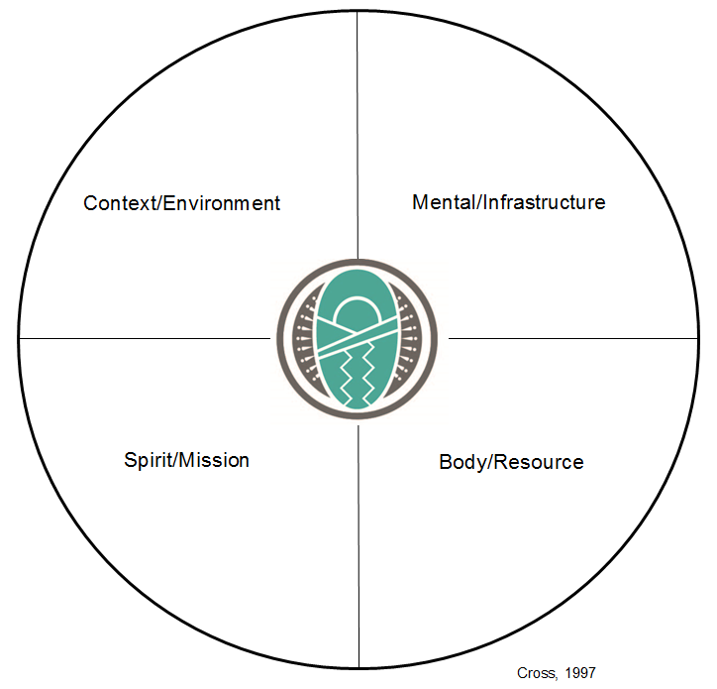
Relational Worldview Model Organizational Level
Physical
Policies/Procedures
Economic
Service Design
Political
Strategic Plans
Social
Mgmt Structure
Mission
People
Leadership
Org Spirit
Champions
Values
Funding
Purpose
Coalitions
Vision
Notes:
Adam
Ask the audience what else could go into these quadrants

Slide 15
Community Quadrants
Community Environment/Context: Social, political, economic, cultural, spiritual, community dynamics, relationships of community members to systems, institutions/organizations, or agencies. History of the community (e.g.. boarding schools, BIA, & federal Indian policy).
Community Infrastructure/Mind: System/services in community, formal/informal governing bodies, capacity of community organizing, community protocol/taboos, and community policies/procedures.
Community Resources/Physical: Formal/informal leaders within the community, expertise, education, & experience of community members, community readiness/capacity, identity of the community, elders, youth, medicine men/woman, cultural practices/traditions, community partnerships, and community space.
Community Mission/Spirit: Culture of community, tradition of community, community norms, roles of men/women in community, community practice, values of community, philosophy of the community, influences include both positive/negative learned teachings and practices, as well as positive/negative metaphysical or innate forces.
Notes:
Adam

Slide 16
Balance/Harmony
How will your policy holistically incorporate the community level quadrants (e.g. environment, infrastructure, mission, and resource)?
How does your policy consider the variables (e.g. quadrants) that may disturb the balance within the community?
What factors can come into harmony and allow the community to achieve its goals and perform with excellence?
Notes:
Adam

Slide 17
Tribal Example
Policy: Traditional Tobacco Program & Policy
Re-introduce the use of traditional tobacco through education on the difference between Traditional and Commercial Tobacco. In addition, this policy is aimed to reduce and prevent the use of commercial tobacco to improve the health of the community.
Environment: policy helps to balance the use of tobacco by the community
Infrastructure: policy balances the relationship between community protocol and the health standards
Resources: policy is community driven with the voice and experience of the people
Mission: policy honors cultural traditions and community norms
Notes:
Adam

Slide 18
Tribal Example
Policy: Incorporation of tribal customary, natural, and common law within tribal justice system.
Environment: Integrating tribal customary law into justice system strengthens tribal sovereignty.
Infrastructure: Utilizing natural and customary law informs protocol for justice system.
Resources: Elders can serve as cultural advisors to justice system while youth can learn traditions of justice system protocol.
Mission: Adherence to traditional customs and/or practice respects the spiritual realm.
Notes:
Adam (If there is time)

Slide 19
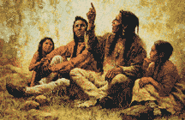
Policy Process
Thought behind our approach
Structure
Policy phases
Notes:
Nora
Why we used mainstream process in toolkit
Tribal perspective
Community-driven/community ownership
Many of these phases were from real examples in our communities
There is no cookie-cutter way of doing this, and our toolkit serves as a guide for policy work. Each tribe is different and every situation will vary.

Slide 20
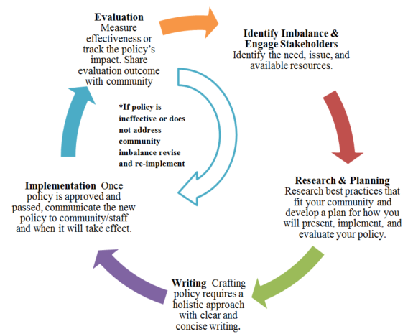
Phases of Policy
Notes:
Nora
Our version of policy process- if we think non-linear these phases don’t need to be in exact order
You may need to go back to previous phases
Maybe you have already done phase 1 & 2 and need guidance on writing or implementation

Slide 21
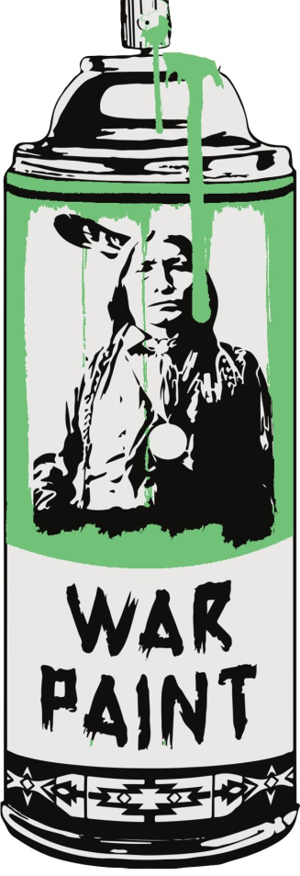
Tools for the Community
Environmental scan
Community readiness
Writing considerations
Policy templates/Resolutions
Policy checklist
Evaluation & research
Stakeholder engagement
Roles within the community
Notes:
Ryan/Netta
Discuss each tool and reference handout

Slide 22
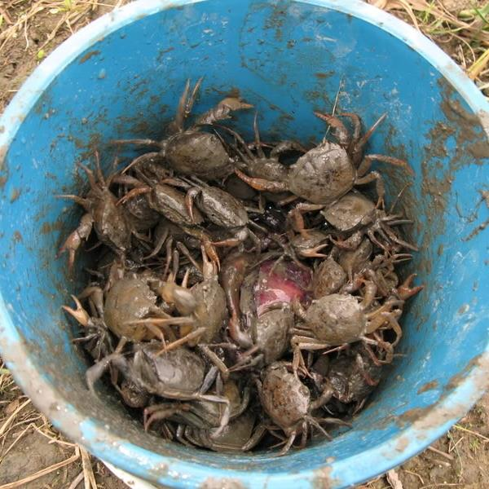
Challenges to Policy
Diverse tribal communities
Is policy the right approach
Collaboration/inclusion
Lack of resources/capacity
Conflicts with traditional values
Merging frameworks
Notes:
Talk about challenges to developing toolkit and to developing policy in general

Slide 23
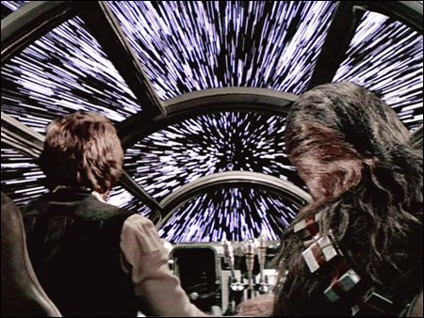
Moving Forward
Feedback
Revisions
Timeline
Pilot
Notes:
Netta
How are we moving forward:
Process of getting more feedback
Revise and incorporate the edits
Present to our Health Delegates at our Quarterly Board Meeting next month
Allow for community feedback and vetting by our tribal leaders
Incorporate feedback and finalize by Spring 2018
We would like to pilot the toolkit in 2-3 tribal communities through a hands-on workshop

Slide 24
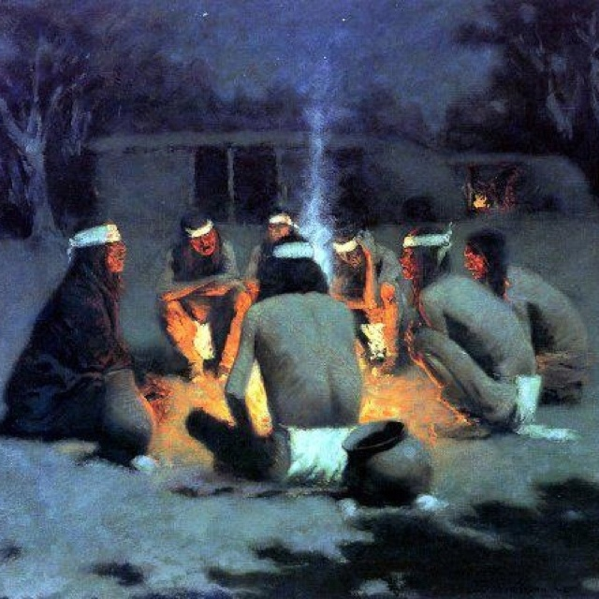
Discussion
Notes:
All

Slide 25
Thank You!
Adam Becenti abecenti@nicwa.org
Antoinette Aguirre aaguirre@npaihb.org
Nora Frank-Buckner nfrank@npaihb.org
Ryan Ann Sealy rsealy@npaihb.org
Notes:
All
Here’s how to connect with us if you want to offer more feedback or have a discussion

