Slide 1
Tribal Endocrinology ECHO
Sunny Stone, MPH, CHES
Diabetes Manager/Quality Improvement Coordinator
Shoshone-Bannock Tribes
Ethan Newcomb
WEAVE-NW Project Assistant/ECHO Clinic Coordinator
NPAIHB

Slide 2
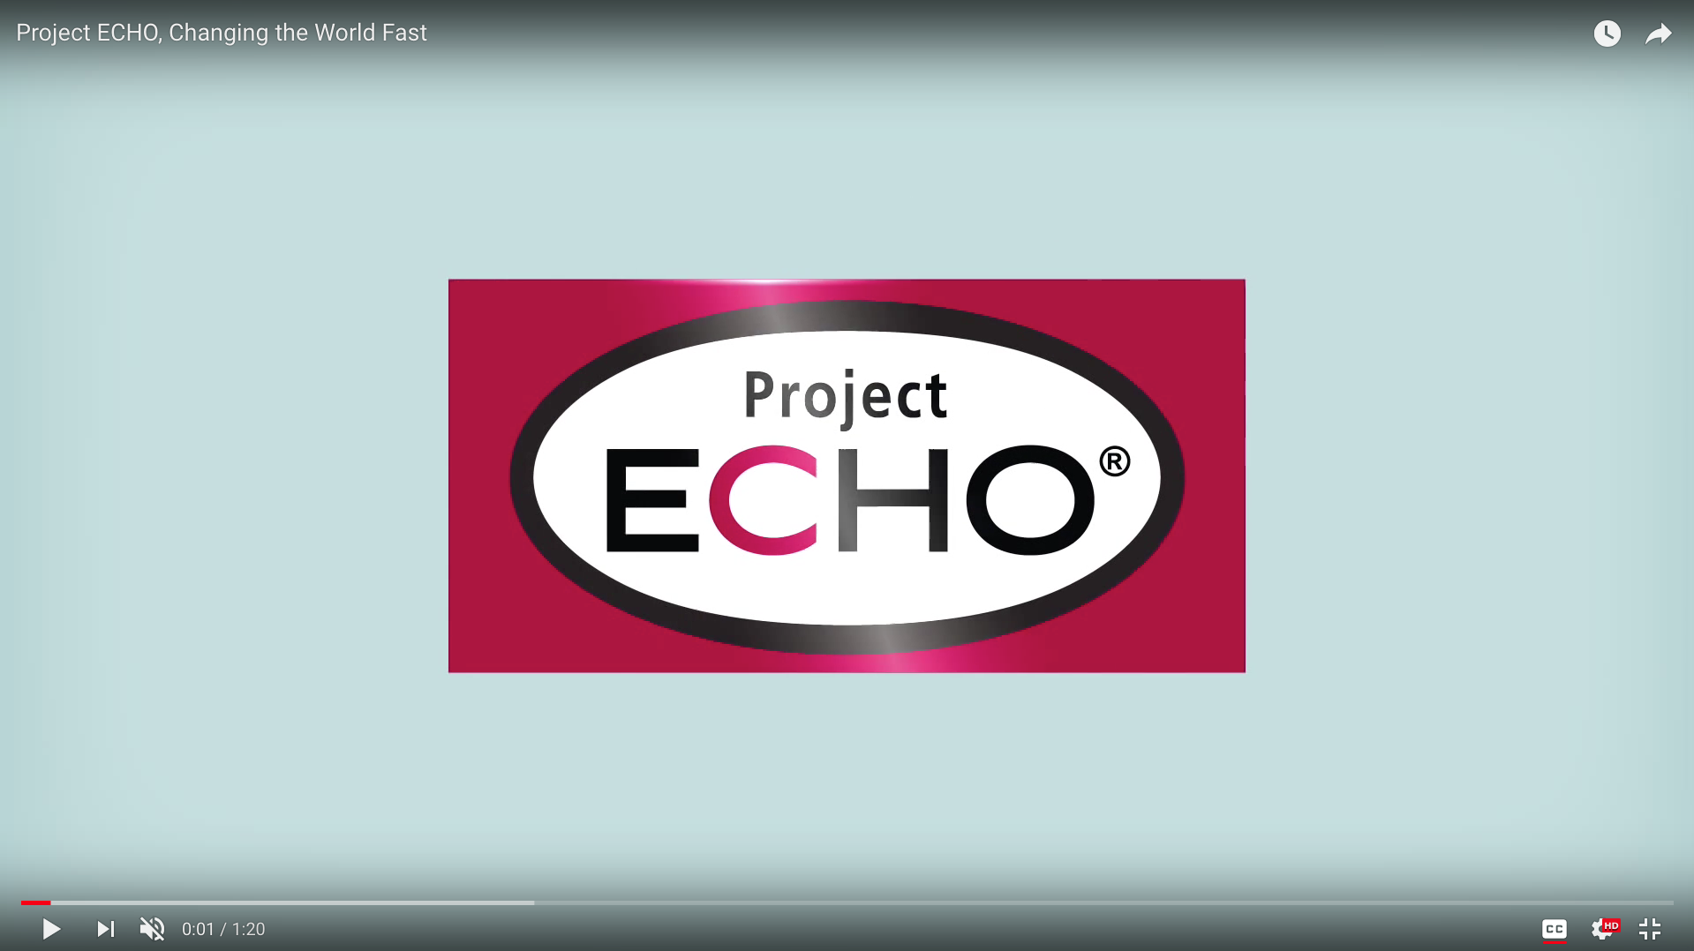
What is ECHO?

Slide 3
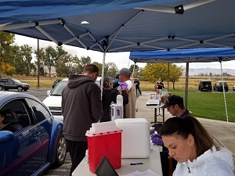
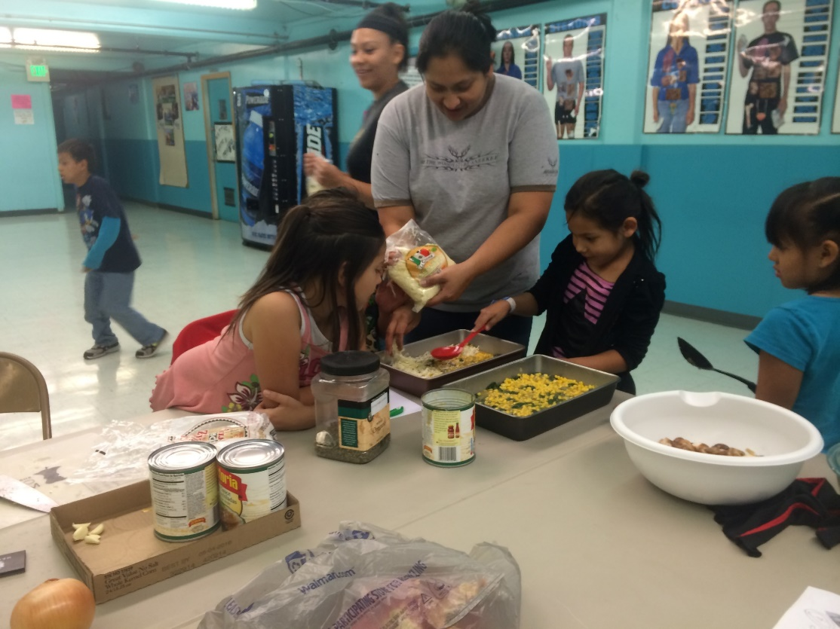
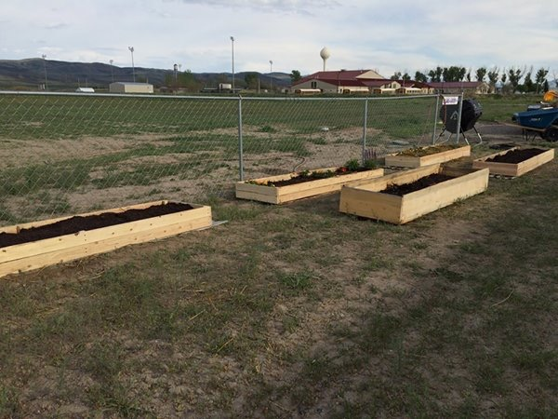
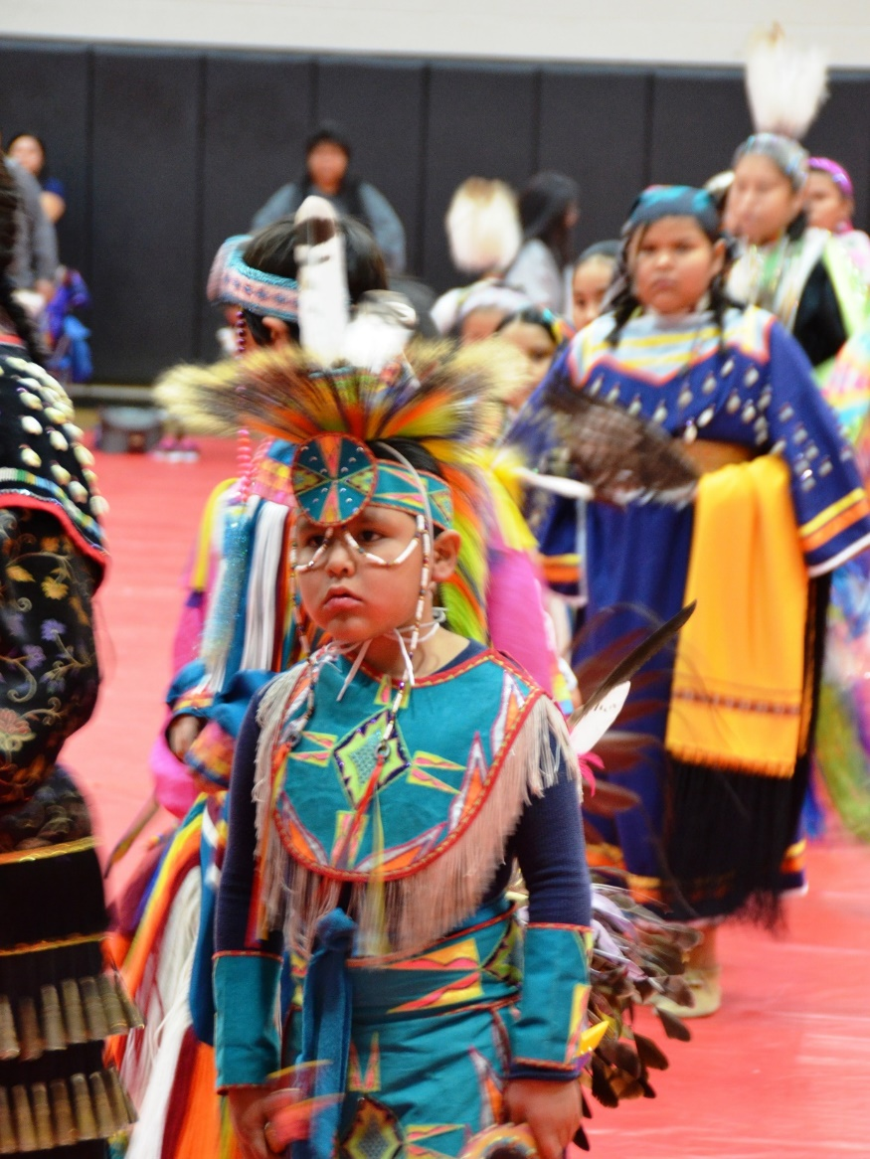
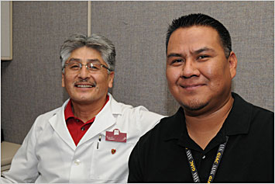
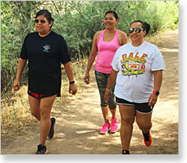
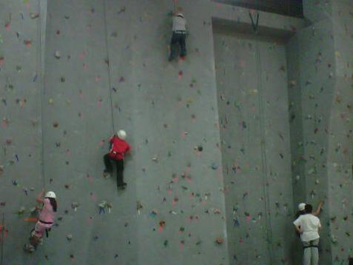
Diabetes Care in Indian Country

Slide 6
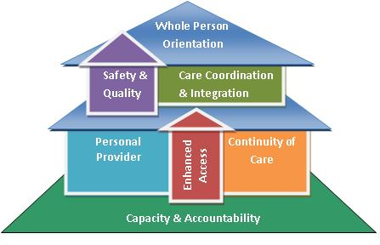
Patient-Centered Care

Slide 7


Who benefits?

Slide 8

The Endo-ECHO Webpage is now live!
NPAIHB.ORG/TRIBAL-ENDOCRINOLOGY-ECHO/

Slide 9
Questions?
Feel free to contact endoecho@npaihb.org with any questions, comments, or concerns.
To Join Our Listserv Text “ENDO” to 97779
Or
Visit www.npaihb.org/tribal-endocrinology-echo/

