Slide 1
IDEA-NW: Tribal Epidemiology Center – Public Health Infrastructure Project
Overview & Health data literacy trainings

Slide 2
Tribal Epidemiology Center – Public Health Infrastructure (TEC-PHI) Project
Overarching goal:
Increase Northwest Tribal public health capacity and infrastructure
Key Strategies:
1. Strengthen the core public health functions and services provided by the Tribal Epidemiology Center
2. Improve the effectiveness of health promotion and disease prevention activities
3. Engage in sustainability activities
Funding:
Five-year cooperative agreement from the Centers for Disease Control and Prevention (September 2017 – September 2022)

Slide 3
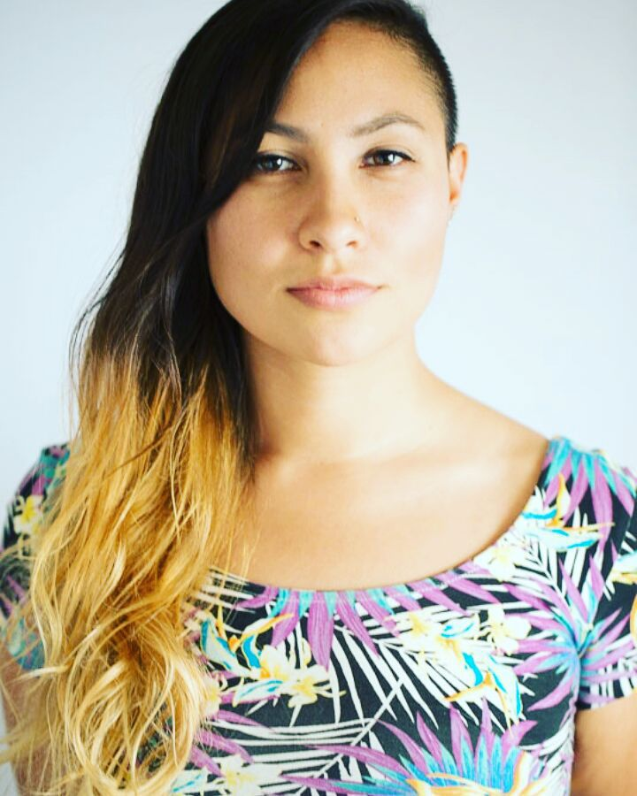
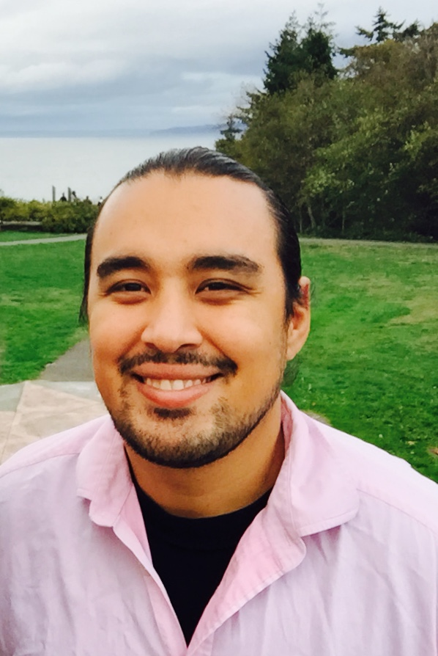
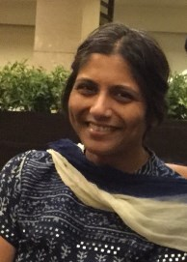
Chiao-Wen Lan, PhD, MPH
Epidemiologist
Sujata Joshi, MSPH
Project Director/ Epidemiologist
Monika Damron, BS
Hualapai/Navajo
Biostatistician
Joshua Smith, BS
Paiute/Modoc
Health Communications Specialist
Notes:
The team

Slide 4
Health Data Literacy & Applications for Tribal Health Workshops
Epidemiology 101
Descriptive Statistics
Sampling Methods
Sources of Bias in Data
Age-adjustment
Hypothesis Testing
Sources of health data for AI/AN communities
Common challenges in findings and using health data
Strategies for Effective Data Presentation
Introduction to Mapping and GIS Field Data Collection
Using data for grant writing and policy development

Slide 5
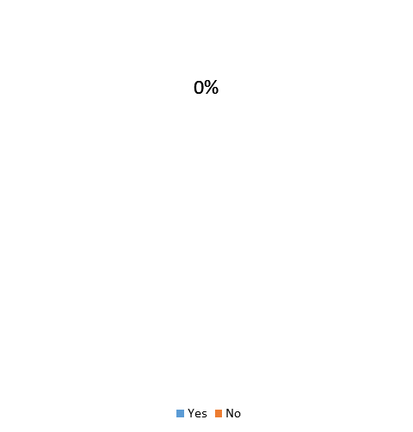
Before today, were you aware that NPAIHB offers Health Data Literacy workshops?
Yes
No

Slide 6
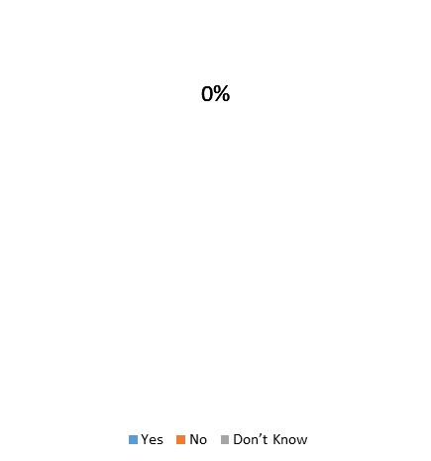
Have you or staff from your Tribe attended a Health Data Literacy workshop in the past?
Yes
No
Don’t Know

Slide 7
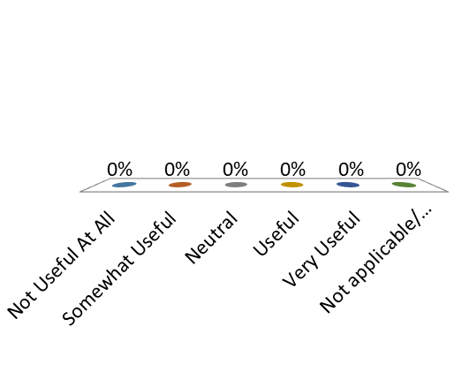
If you have attended a workshop, how useful has the information been in your work?
Not Useful At All
Somewhat Useful
Neutral
Useful
Very Useful
Not applicable/ Haven’t attended

Slide 8
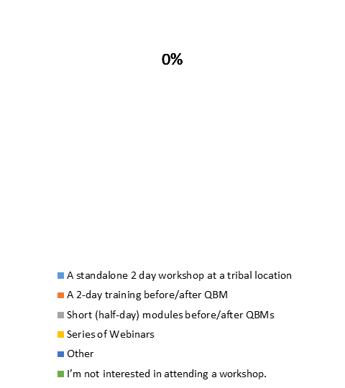
What would be your first preference for attending a Health Data Literacy Workshop?
A standalone 2 day workshop at a tribal location
A 2-day training before/after QBM
Short (half-day) modules before/after QBMs
Series of Webinars
Other
I’m not interested in attending a workshop.

Slide 9
What would be your second preference for attending a Health Data Literacy Workshop?
A standalone 2 day workshop at a tribal location
A 2-day training before/after QBM
Short (half-day) modules before/after QBMs
Series of Webinars
Other
I’m not interested in attending a workshop.

Slide 10
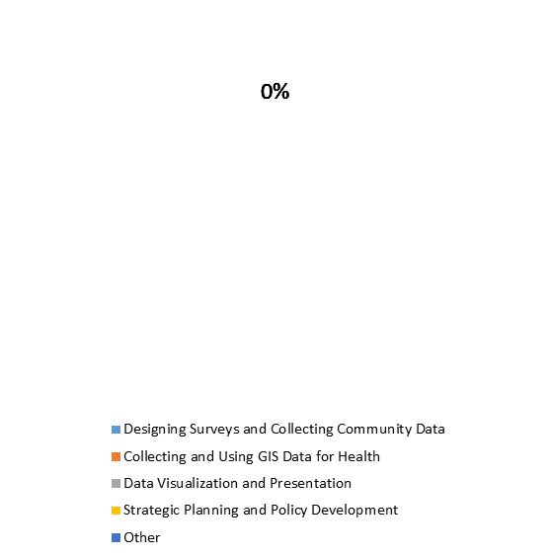
Which of the following training topics is most useful for your Tribe (1st choice)?
Designing Surveys and Collecting Community Data
Collecting and Using GIS Data for Health
Data Visualization and Presentation
Strategic Planning and Policy Development
Other

Slide 11
Which of the following training topics is most useful for your Tribe (2nd choice)?
Designing Surveys and Collecting Community Data
Collecting and Using GIS Data for Health
Data Visualization and Presentation
Strategic Planning and Policy Development
Other

Slide 12
Upcoming Health Data Literacy Workshop
When: May 2nd & 3rd, 2018
Where: Swinomish Casino & Lodge
Cost: Free and Travel Scholarships Available!
Register online at https://www.surveymonkey.com/r/HDLMay2018
by April 23rd

