Slide 1
Northwest Portland Area Indian Health Board
Quarterly Board Meeting
April 17, 2018

Slide 2






Regaining Our Future
2018 Farm Bill Report
  Commissioned by the Shakopee Mdewakanton Sioux Community
  Release at NCAI Mid Year Conference in June 2017
  Compendium on the Farm Bill, Indian Country’s involvement, Tribes’ and Tribal orgs’asks, and a review of potential opportunities in the 2018 reauthorization
  Available at: http://seedsofnativehealth.org/farm-bill-report-and-title-summaries/

Slide 3
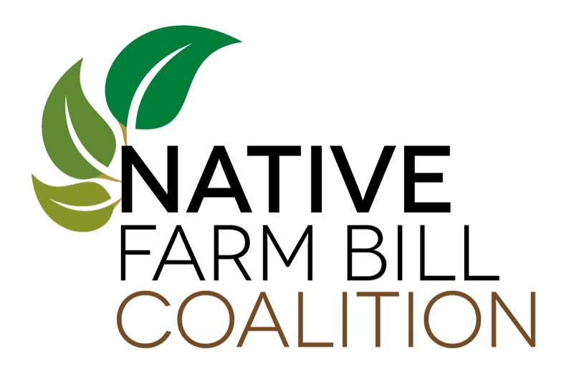
Building the
Native Farm Bill Coalition
Established in Oct. 2017 at the NCAI Annual Conf. in Milwaukee, WI
  Co-chaired by Keith B. Anderson, Vice-Chair of the Shakopee Mdewakanton Sioux Community, and Ross Racine, Executive Director of the Intertribal Agriculture Council
Founding Partners:
  Shakopee Mdewakanton Sioux Community
  Intertribal Agriculture Council
  National Congress of American Indians
  Indigenous Food and Agriculture Initiative (Research Partner)
Largest coordinated effort to defend/extend Indian Country’s interests in the Farm Bill
  Over 120 Tribes represented: 67 Native Nations passed resolutions/sent letters of support
  11 Intertribal/Native Organizations – including the Affiliated Tribes of Northwest Indians
  2 Ally Organizations – including MAZON: A Jewish Response to Hunger

Slide 4
Join the
Native Farm Bill Coalition
Need More Tribal Leadership and Tribal Organizations to get involved!
  Pass a resolution, send logo, and point of contact’s information
  Provide input, get latest updates, and receive information
  Coalition will provide talking points, one-pagers, and tailored data to support your advocacy; regular lawyer/lobbyist strategy calls; regular webinar and discussions
Website: www.nativefarmbillcoalition.org
Email: info@nativefarmbillcoalition.org

Slide 5
About the Farm Bill

Slide 6
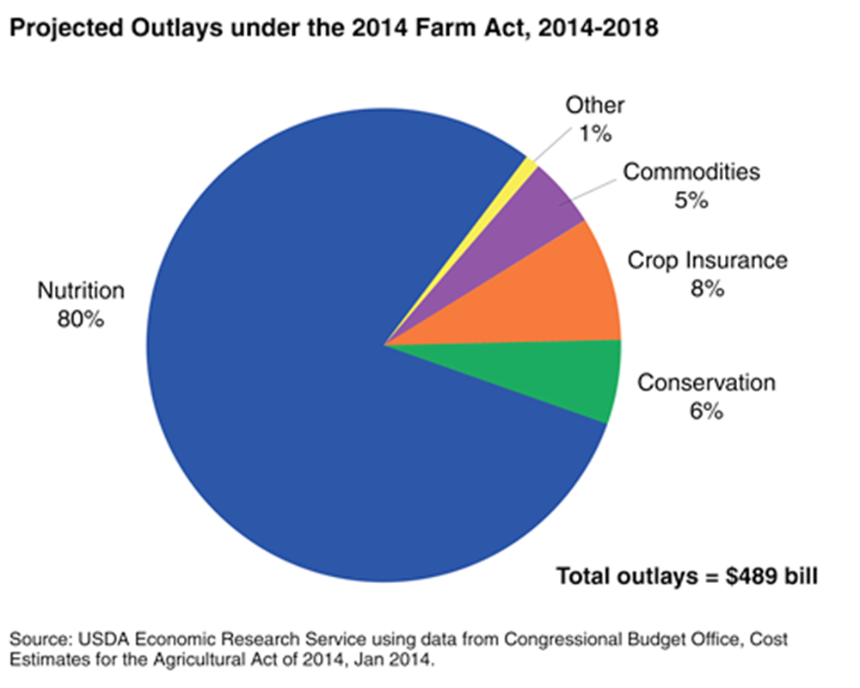
The 2014 Farm Bill
What’s in the Farm Bill?
  5 Year Bill -$489 billion Bill
  Expires September 2018
Includes Programs and Support for:
  Commodities, Crop Insurance, Conservation, Trade, Nutrition, Credit, Rural Development, Research, Forestry, Energy, Horticulture, etc.
Nutrition = 80 percent of the funding
  The most contentious title

Slide 7
Why the Farm Bill Matters
$956 Billion – 2014 Farm Bill CBO projected spending over 10 year period
  One of the only truly rural development focused pieces of legislation
  Food, agriculture, nutrition, infrastructure, housing, community buildings, research, education, broadband, and utilities
Represents rural and urban partnership that’s existed for over 40 years through the Nutrition Title and Farm Programs
  Nutrition Title acts as a “price support” for crops’ SNAP/Food Stamps helped secure votes of urban congressional representatives
  Now – 20 percent of rural households receive federal food assistance; over 25 percent in Indian Country with some communities reaching over 50 percent
The 2018 Farm Bill Could Mean—
$1 Trillion to Indian Country and Rural Areas

Slide 9
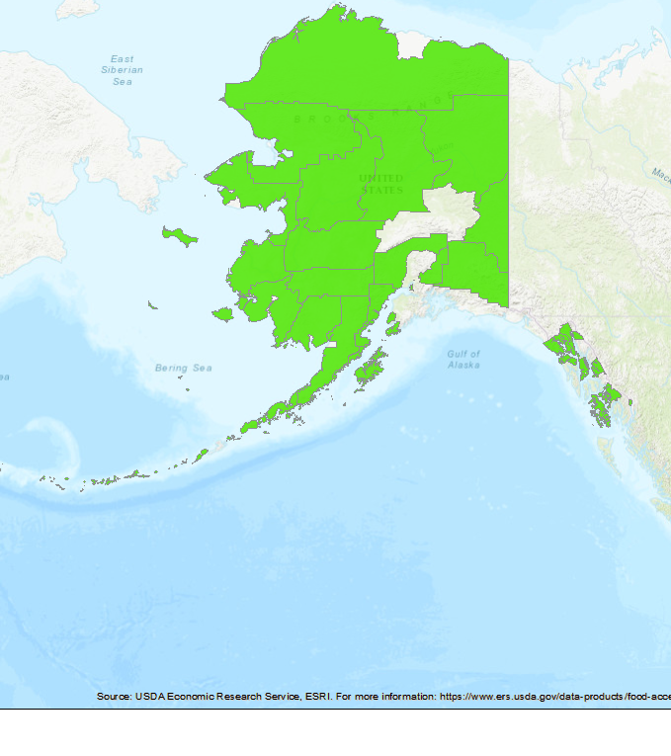

Slide 11
Current Scope of Ag in
Indian Country – People/Land
The Basics
71,947 Native Farm Operators
57 million acres of land in Indian Country are already engaged in food and agriculture (2012 USDA Census of Agriculture)
  Example: 20 million of the 26 million acres in Arizona involved in food and agriculture is under direct Tribal control
  One of the largest contiguous farms in the U.S. is Navajo owned (NAPI).
American Indian and Alaska Native Farm Operators and Farm lands
USDA Ag Census Year | 2007 | 2012
Total Native Farm Operators | 77,437 | 71,947
Acres Operated | 58.1 million | 57.2 million
Avg. Acres per Operation | 946 | 1,020

Slide 12
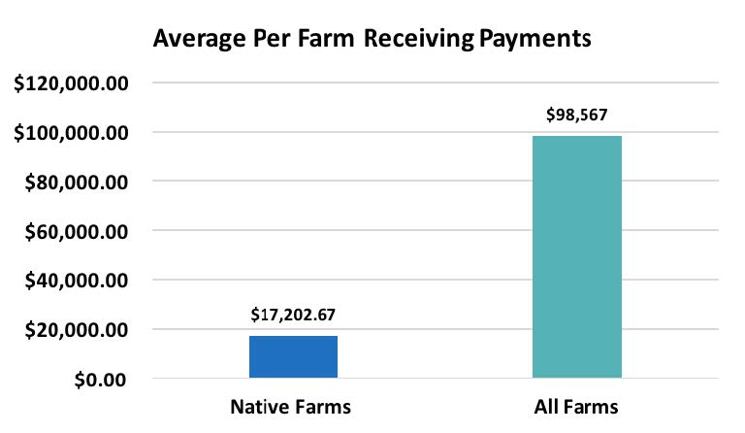
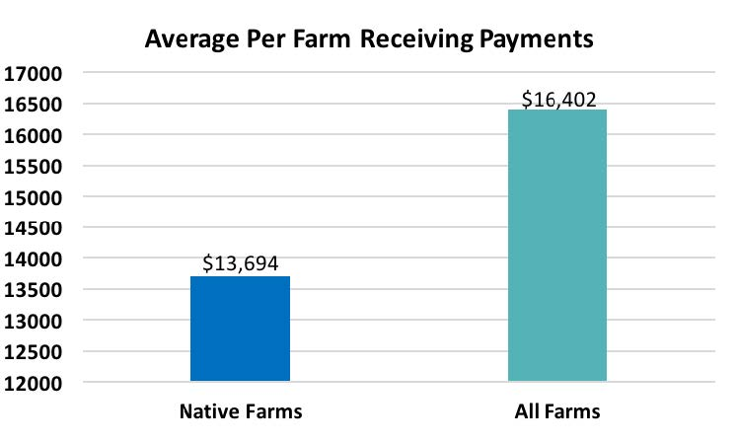
Average Farm Payments
Arizona, Nevada, and Utah
Oregon, Washington, Idaho, Montana

Slide 13
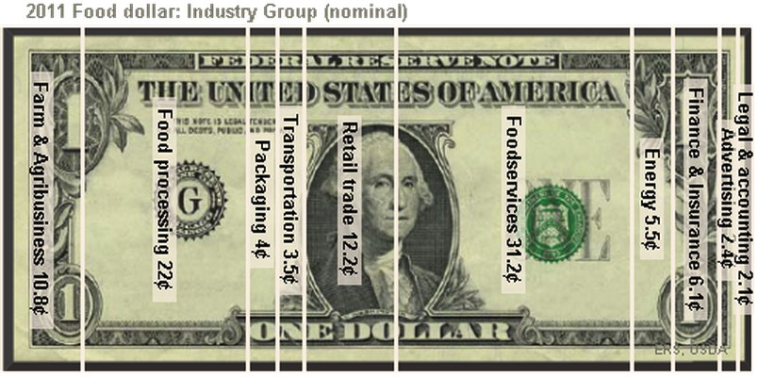
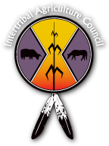
Importance of Value Added
Value added means more jobs, lower costs
3 steps would TRIPLE Reservation Economies

Slide 14
Current Farm Bill Titles
Commodities
Conservation
Trade
Nutrition
Credit
Rural Development
Research/Education
Forestry
Energy
Horticulture
Crop Insurance
Miscellaneous

Slide 15
2018 Farm Bill Opportunities for Indian Country
  Tribal administration of SNAP/federal food programs – “638”
  Food Distribution Program on Indian Reservations – Increased authority, regional model, traditional foods, no matching, etc.
  Tribal Parity, Sovereignty, and Self-Determination through out the Farm Bill and USDA Programs
    “638” Tribal contracting and compacting where appropriate
    Treatment as States/State Departments of Agriculture
    Conservation and Forestry
    Improved Access to Credit
  Rural Development: “SUTA” and Technical Assistance
  Increase Support and Access to healthy, traditional, local, and regionally produced food by Native Farmers and Ranchers
  FRTEP, Research, Education, and TCUs

Slide 16
Indian Country Opportunities in the Conservation Title
One of the Greatest Titles for Parity
  Tribal Parity throughout the Conservation Title, including tribal law parity
  Ensure equivalent status between USDA and BIA of Conservation Plans
  Ensure recognition of Traditional Ecological Knowledge-Based Conservation
  Tribal Lands Priority for enrollment in Conservation Reserve Program
  Conservation measures/protections for fisheries

Slide 17
Title VI – Rural Development
The Basics
  Only agency in the entire federal government that is solely focused on the needs of rural America
  Includes: rural business and community programs; housing; rural infrastructure, including electric and telecommunications services; rural water and sewer infrastructure; and rural hospitals and healthcare, among many other programs
Importance to Indian Country
  Last 5 years – $3 Billion from USDA Rural Development to Indian Country
  Tribes have an historic low usage of RD—but potential to be substantial partner in building strong rural economic development and community infrastructure in Indian Country and all of Rural America
  RD programs and funding can help build out much need infrastructure and infrastructure improvements in Indian Country and rural areas

Slide 18
Indian Country Opportunities in the Rural Development Title
Broader Application of Substantially Underserved Trust Area (SUTA) Provision
  Only applies to a small segment of infrastructure programs (RUS), change would provide equitable access to RD programs and authorities for Tribal governments and entities serving citizens in rural areas
Native CDFI Access to All Rural Economic Development Loan and Grant
  Support Native CDFIs and other CDFIs who struggle to secure loan funding become intermediary lenders
Permanent Tribal technical assistance office for all RD funding authorities
Clarify Eligibility Requirements for all RD Programs
  Ensures that Tribes are not inadvertently excluded from eligibility

Slide 19
Indian Country Opportunities in the Forestry Title
  Streamline the Tribal Forest Protection Act’s provisions to improve the timelines for review and implementation of forest restoration projects
  638 Authority under the TFPA to manage Forest Service and BLM lands Allow for greater Tribal Cooperative Management of Adjacent Federal Lands
  Add Tribes to Good Neighbor Authority
  Fix the wildfire funding issue; prioritize protection of tribal forest assets
  Change the name program to Tribal, State, and Private

Slide 20
The Nutrition Title Basics
The Basics
  The Most Contentious Title
  80 percent of total funding of the entire Farm Bill
  SNAP cut by $8.6 billion in 2014 - Survived a $20 billion cut & being removed from the Bill
  Represents rural and urban partnership that’s existed for over 40 years
  Must keep this partnership together to improve food access for everyone

Slide 21
The Nutrition Title Basics
Impacts the Largest Number of People
  15 federal food assistance programs – tribes can manage 3
25 percent of all American Indians and Alaska Natives receive some type of food assistance
  Supplemental Nutrition Assistance Program (SNAP) (Food Stamps)
  24 percent of AI/AN households– but in some communities that number is double or triple that percentage
Food Distribution Program on Indian Reservations (FDPIR) (Commodity Food Package)
  276 Tribes and 100 ITOs manage the program

Slide 22
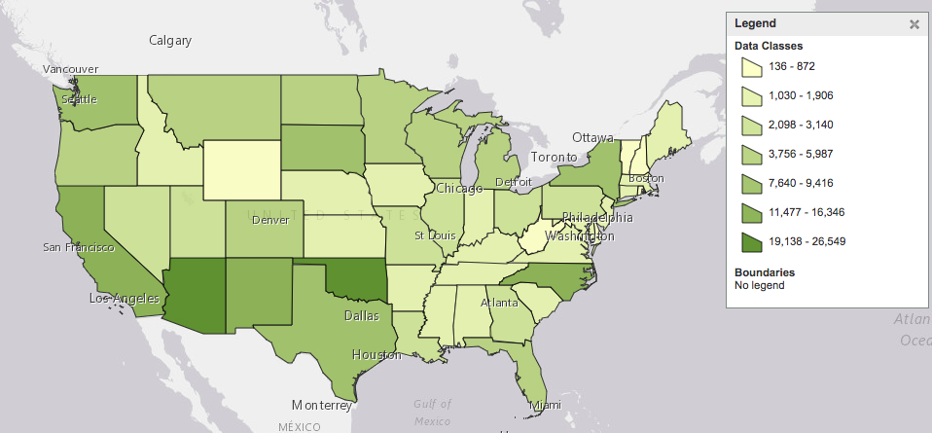
SNAP in Indian Country
Source: US Census Bureau (American Community Survey– SNAP Usage by Race: AIAN, state level) (2016 data).

Slide 23
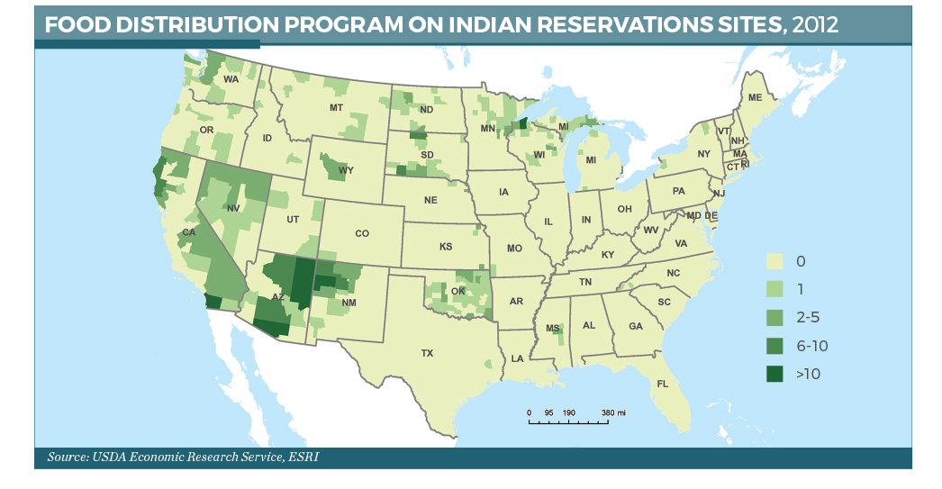

Slide 24
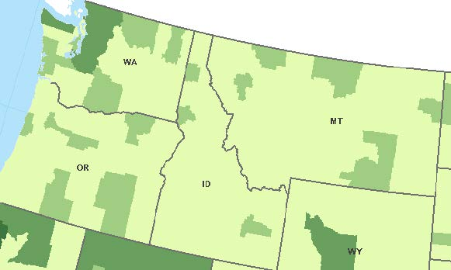

FDPIR Sites by County – PNW

Slide 25
Program Relationship:
FDPIR and SNAP
Participants may only use either FDPIR or SNAP in a given month. Policy changes– such as budget cuts and benefit reductions– to SNAP typically result in higher FDPIR usage without any additional funding, leaving ITO’s with more clients to assist but no additional resources to do it.
    Example: When the American Recovery and Reinvestment Act (ARRA) expired in October of 2013, the temporary increase the ARRA gave to SNAP benefits ended.
    The following month, in November 2013, participation data for selected Tribes in FDPIR showed an immediate rise in participation, sometimes by more than 100 new participants at an ITO site.
    ITO’s could not receive additional funds to support these new participants, and the government shutdown that occurred during those months resulted in a food shortage for FDPIR. The effects of the shortage persisted for nearly a year in some places.

Slide 26
Indian Country Opportunities in the Nutrition Title
Tribal administration of SNAP/federal food programs – 638 Authority
Food Distribution Program on Indian Reservations:
    A Tribal Leaders Consultation Working Group has been sitting in consultation with USDA for the past two years on this program, and has surfaced up a variety of opportunities in the FDPIR that could be addressed through the Farm Bill, including:
      Eliminate match require for program sites
      Allow for carryover funding
      Stop regulatory-approved “tailgating” practice
      Tribal consultation for contingency plans
      Food and Nutrition Service should hire a national tribal liaison and have regional liaisons
      At least $5 million increase for education funding
      All traditional food purchases should be included in FDPIR packages
      Distribution should be regionally based and include local, tribally produced foods
      Remove “Urban Place” definition and limitation

Slide 27
2018 Farm Bill Opportunities for Traditional Foods
  Commodities Title
    Protections for livestock/animals traditionally raised by Native producers
  Conservation Title
    Recognition of Traditional Ecological Knowledge in practices for traditional foods
    Leveraging programs to protect water ways and expand to fisheries
  Trade Title
    Promote commercialized Traditional Foods in international markets; protect from fraud in the marketplace
  Nutrition Title
    Increase inclusion in Food Distribution Program on Indian Reservations using a regional/local food sourcing model
  Forestry Title
    Protect from fires, infestation, and disease to promote health of traditional foods and medicines that grow in federal and tribal forests
  Horticulture Title
    Many Traditional crops are “produce” or “specialty crops” under federal law
    Protection of Native seeds and Traditional Foods

Slide 28
Indian Country Opportunities in the Credit Title
One of the Best Ways to Grow Agribusiness and Food Production
  Structure Loans to Suit the Business
    Include the first year’s operating expenses – incentivize operating from available funds, not annual borrowing
  Debt Restructuring for FSA Planning Prices
    Allow producers to restructure debt so that it will not count towards lifetime limits on loan servicing
  Socially Disadvantaged Interest Rate
    Set a specific, statutory rate for qualifying borrowers
  FSA Food Loan Authority for Value Added Products
  FSA Forgiveness for American Indians
    Producers with debt write-down, write-off or other forms debt servicing are barred from further participation in FSA loan programs; giving them literally nowhere to go for financing
  Remove the Graduation Requirement for FSA programs
  Remove the Requirement for Private Credit Denial
  GAO Study on Credit Access in Indian Country

Slide 29
Congressional Outlook
The 2018, 2019, 2020 Farm Bill??
House Ag Committee Released – April 12, 2018; mark-up Wednesday April 18th
  Further and restrictions on eligibility and work requirements on Abled-Bodied Adults Without Dependents (ABAWDs)
  FDPIR is funded from SNAP budget, leaves uncertainty in the program
  When SNAP benefits decline/lost, see a near direct proportional increase in FDPIR
    Estimated 25-40 percent increase to FDPIR based on ABAWDs/work require increases
  FDPIR 2-year carryover funding included; “regionally” available foods added to defn.
  Forestry:
    638 pilot program for TFPA and expedited review of applications;
    Allows Tribal management of federal forest lands;
    Tribes “private forest” owners for State and Private;
    Tribes added to Good Neighbor Authority
  Conservation – merges the CSP into the EQIP, cutting
The Senate? – Still Drafting and Waiting
Trade Issues

Slide 30
Discussion, Questions, and Input
What matters to you and your Tribe in the farm bill?

Slide 31
Native Farm Bill Coalition
Weekly Members’ Webinar
Native Farm Bill Coalition – Weekly Members’ Webinar
  Wednesday, April 18, 2018
  3 p.m. EDT/2 p.m. CDT/1 p.m. MDT/12 p.m. PDT/11 a.m. AKDT
  Register at: https://attendee.gotowebinar.com/register/7093352322089352451
.

Slide 32
Building the Native
Farm Bill Coalition
Colby D. Duren, J.D.
Indigenous Food and Agriculture Initiative
Policy Director and Staff Attorney
cduren@uark.edu
(860) 324-2391
Washington, DC Office
.
Website: www.nativefarmbillcoalition.org
Email: info@nativefarmbillcoalition.org

Slide 33
Model Tribal Food and
Agriculture Code Project
Native Food Safety Training Center
Our team of attorneys is hard at work on a model legal code, adoptable by Tribes, and that spans all of food and agricultural production
The Model Code will provide Tribes with a template for a full food & ag code, with as many possibilities for additional detail/specification as there are Tribes.
This is a FREE resource for Tribes.
Available in 2018!
IFAI is the Native American Tribal Center for Food Safety Outreach, Education, Training and Technical Assistance
Wide array of partners, including the Intertribal Agricultural Council
Series of webinars
Face-to-Face certification trainings tailored to Tribal producers and food businesses to fulfill requirements of FSMA.
www.nativefoodsafety.org

