Slide 1
SAMHSA Resources to Address the Opioid Epidemic
David Dickinson
Regional Administrator
Substance Abuse and Mental Health Services Administration
U.S. Department of Health and Human Services
NPAIHB Quarterly Meeting
April 18, 2018 North Bend, OR

Slide 2
HHS Five Strategic Priorities to Address the Opioid Epidemic
Strengthening public health surveillance
Advancing the practice of pain management
Improving access to treatment and recovery services
Targeting availability and distribution of overdose-reversing drugs
Supporting cutting-edge research

Slide 3
TRIBAL FUNDING OPPORTUNITIES
Tribes, Tribal organizations, and urban Indian organizations are eligible to apply for most of SAMHSA’s discretionary grant programs. Each grant program has its own application deadline and information is available at http://www.samhsa.gov/grants. SAMHSA’s grants address a range of issues including:
Behavioral health systems and workforce
Homelessness and housing for people with mental and/or substance use disorders
Issues related to behavioral health and the criminal justice system
Opioids and other substances of abuse (i.e., methamphetamines, alcohol, etc.)
Prevention, treatment, and recovery from mental and substance use disorders
Suicide Prevention

Slide 4
Youth and Family Tree Program
er
SAMHSA released a funding opportunity announcement (FOA) entitled “Enhancement and Expansion of Treatment and Recovery Services for Adolescents, Transitional Aged Youth, and their Families”—also referred to as Youth and Family TREE. This program includes a $5M set-aside for Tribes, Tribal organizations, urban Indian health programs, and consortia of Tribes or Tribal organizations. This amount is approximately 34% of the total anticipated $14.6M available for this program. The FOA was posted on February 9th and applications are due no later than April 10, 2018.

Slide 5
Statewide Consumer Network Program
SAMHSA released a FOA entitled “Statewide Consumer Network Program.” The intent of this program is to improve efforts to address the needs of adults with serious mental illness by developing and/or expanding peer support services, peer leadership, and peer engagement strategies. SAMHSA included criteria that would allow for at least three Tribes/Tribal organizations to receive awards out of the total anticipated nine grant awards that will be made. The FOA was posted on February 20th and applications are due no later than April 23, 2018.

Slide 6
Grants Application Process
In response to the concerns from Tribes regarding the complexity of SAMHSA’s grant application process, the Agency reduced the number of pages required in a grant application as well as reduced some content that is not required by the HHS grants policy. These actions will be particularly helpful to small Tribes who don’t have resources to develop complicated applications. SAMSHSA is also working to increase the number of American Indian and Alaska Native reviewers in its grant reviewer database and improving engagement with SAMHSA’s Office of Tribal Affairs and Policy on recommendations for reducing tribal reporting burden.

Slide 7
Financial Management Support
SAMHSA has focused on grants-related support for Tribal entities. An area identified for additional support is grants financial management. A team of SAMHSA staff developed a Financial Management Toolkit for Tribal entities which will be available during the spring of 2018.

Slide 8
The FY 2018 Omnibus Appropriations Bill
The legislation contains an extra $1 billion for the state response to opioid (STR) grants administered by the Substance Abuse and Mental Health Services Administration (SAMHSA). Within this funding there is a $50 million set-aside for Tribes and Tribal organizations.
The funding bill also provides $84 million for the Medication-Assisted Treatment for Prescription Drug and Opioid Addiction (MAT-PDOA) program, also administered by SAMHSA. Tribes and Tribal organizations will receive a $5 million set-aside in this funding.
Additionally the FY18 appropriations bill provides funding for other Tribally-focused health programs such the Tribal Behavioral Health Grants (Native Connections), and the Zero Suicide Prevention Initiative.

Slide 9
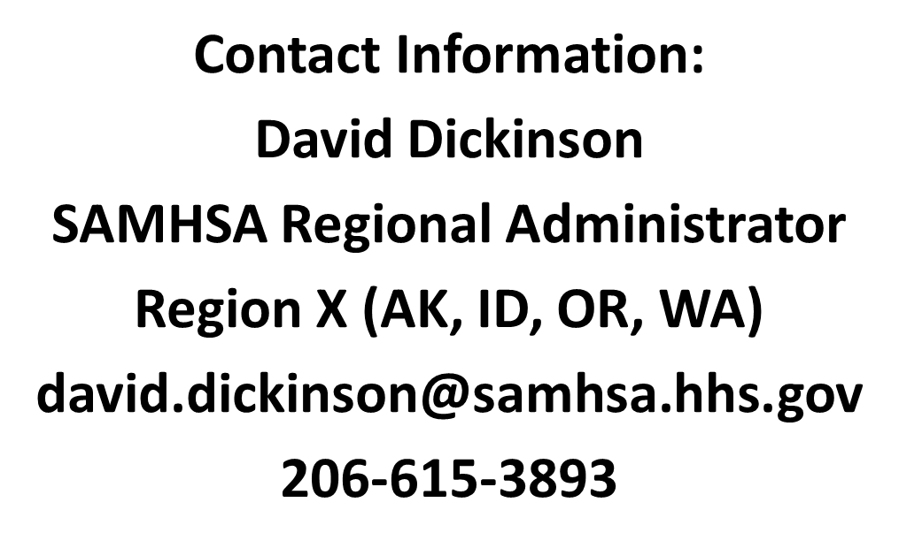
Thank You!

