Slide 1
Northwest Portland Area
Indian Health Board
Quarterly
Meeting

Slide 2
Swinomish didgʷálič Wellness
Center
John Stephens
EXECUTIVE DIRECTOR

Slide 3
Need Nationwide
Consensus among National Officials
Last October, we declared the opioid crisis a public health emergency. …Defeating this epidemic will require the commitment of every state, local, and federal agency.
At HHS and across this administration, we know that we need to treat addiction as a medical challenge, not as a moral failing.
…the
destigmatization of substance use disorder is critical.
Donald J. Trump,
President
Alex Azar,
HHS Secretary
Notes:
Substance use disorder is medical challenge, not moral failing
SAMHSA has reclassified it as a medical issue not a dependence

Slide 4
Need Across the States
Consensus among State Officials
[O]pioid use disorder is a devastating and life-threatening chronic medical condition, and we need to improve access to treatments that support recovery and lifesaving medications to reverse overdoses.
I have heard from families, local police chiefs, and community leaders across Washington state about the tragic impacts of the opioid epidemic.
Governor Jay Inslee’s Executive Order
Senator Patty Murray

Slide 5
Need within Our Community
Consensus among local public health providers
Community Health Needs Assessment:
“[S]ubstance abuse and mental health . . . are significant issues in our community.”
Community Health Assessment:
“Health issues identified . . . as important priorities for action included opioid use.”
Community Health Needs Assessment:
“Increase mental health and substance abuse access and treatment capacity within the service area.”
Notes:
Public health crisis
Consensus among local public health providers
Island hospital
Peacehealth United
Skagit County
All 3 conducted recent community health needs assessments
All 3 identified substance use as one of top issues

Slide 6
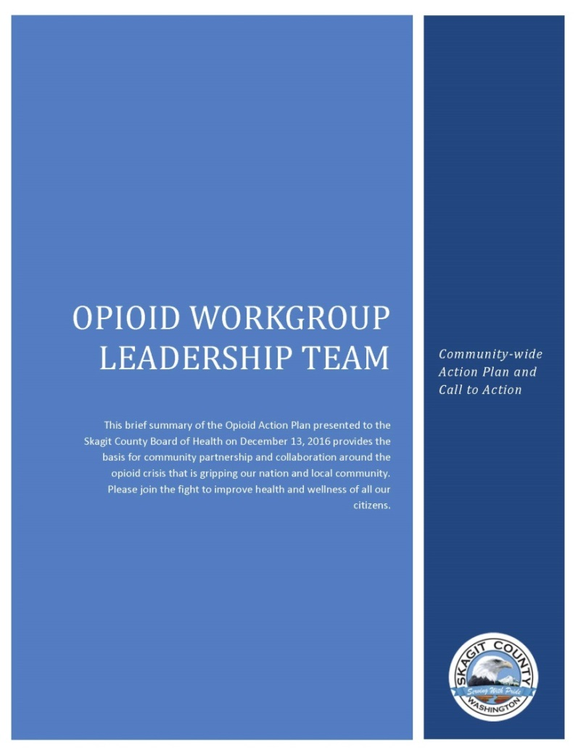
Skagit County Opioid Workgroup Leadership Team: Support Swinomish
http://www.skagitcounty.net
Notes:
Additional summary of local and state needs
Skagit County developed an action plan to mitigate the severe, negative public health impacts of opioid crisis
Swinomish program is part of their mitigation plan
Action plan states:
“Support the Swinomish Indian Tribe in the opening of their new Full Services Outpatient Treatment Program, which includes a full range of MAT”

Slide 7
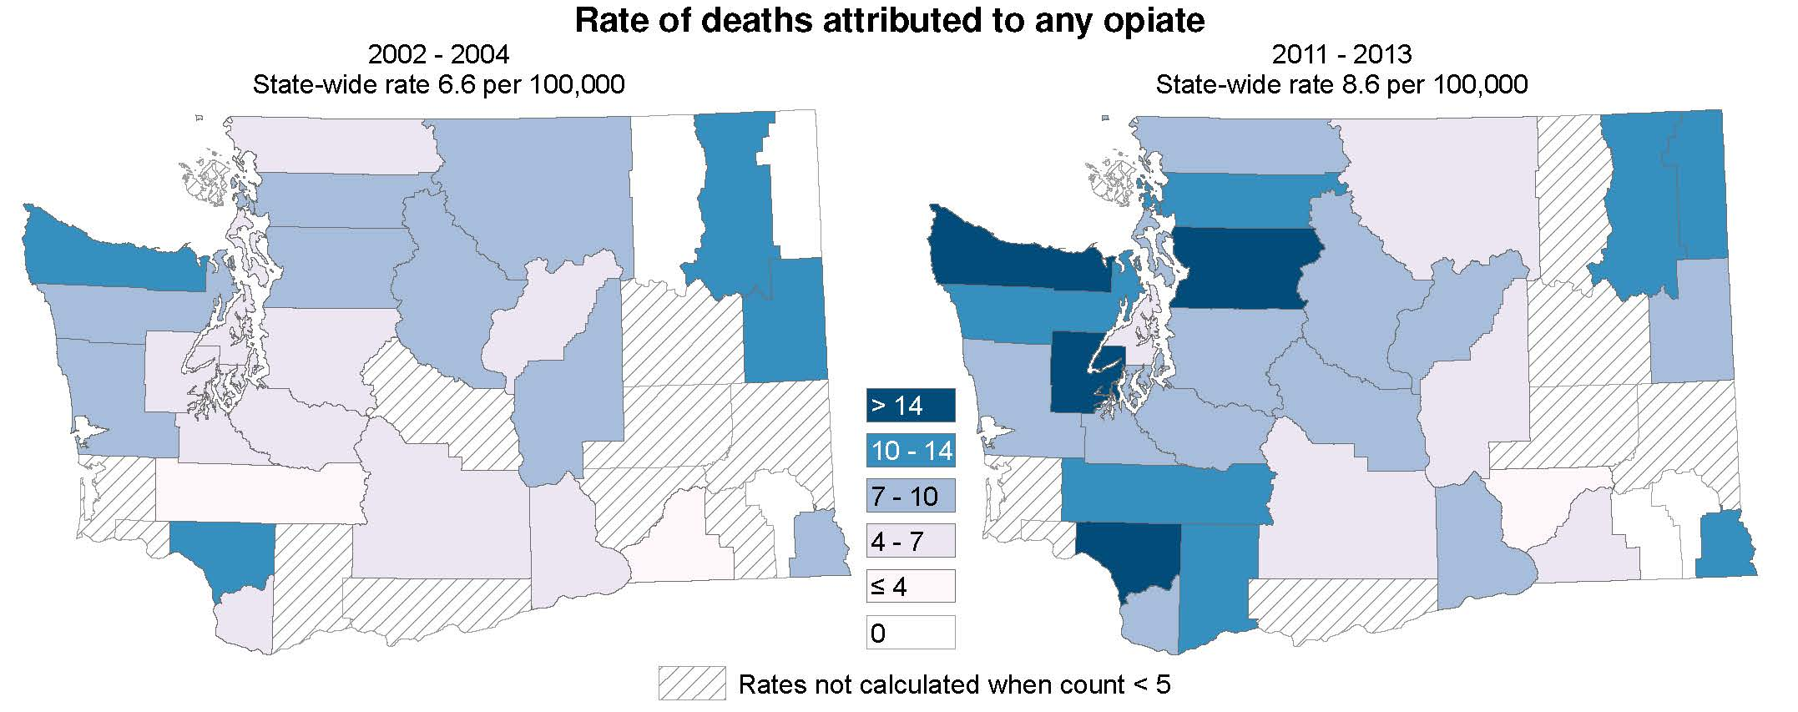
University of WA: Alcohol & Drug Abuse Institute
OPIOID TRENDS
http://adai.uw.edu
Notes:
Evolution of opioid crisis over the last decade
Statewide trend -more people are dying from opioid overdose
Skagit County - opioid overdose deaths increased by 42% in the last decade

Slide 8
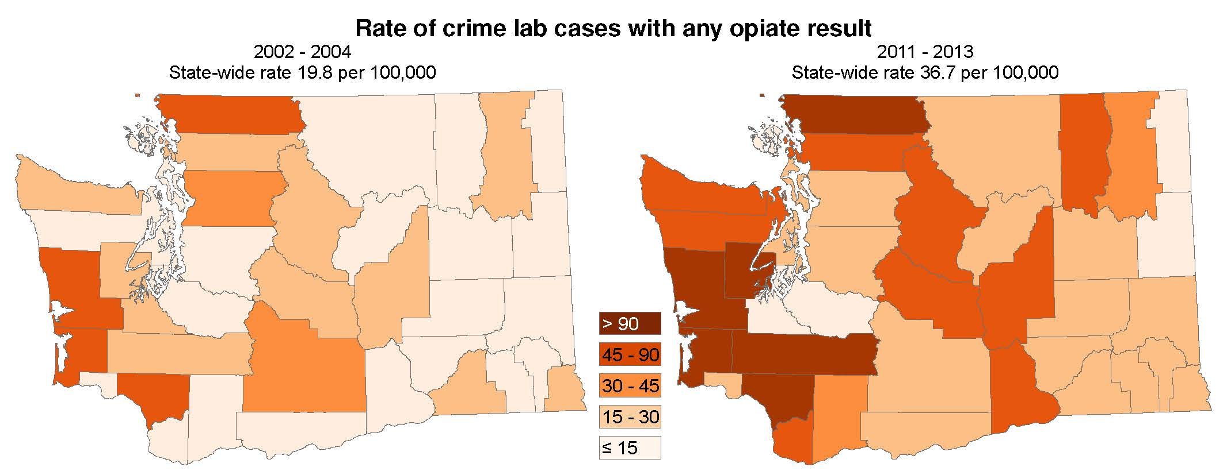
University of WA: Alcohol & Drug Abuse Institute
OPIOID TRENDS
Opioid evidence in crimes occurring in Skagit County has increased by 181%.
http://adai.uw.edu
Notes:
Rate of opiate results in crimes dramatically increasingly state wide
Skagit County: 181% increase over past decade
Opioid crisis is putting burdens on law enforcement services.

Slide 9
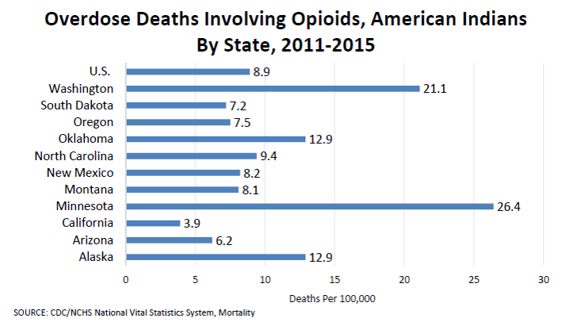
this
us all
affects

Slide 10
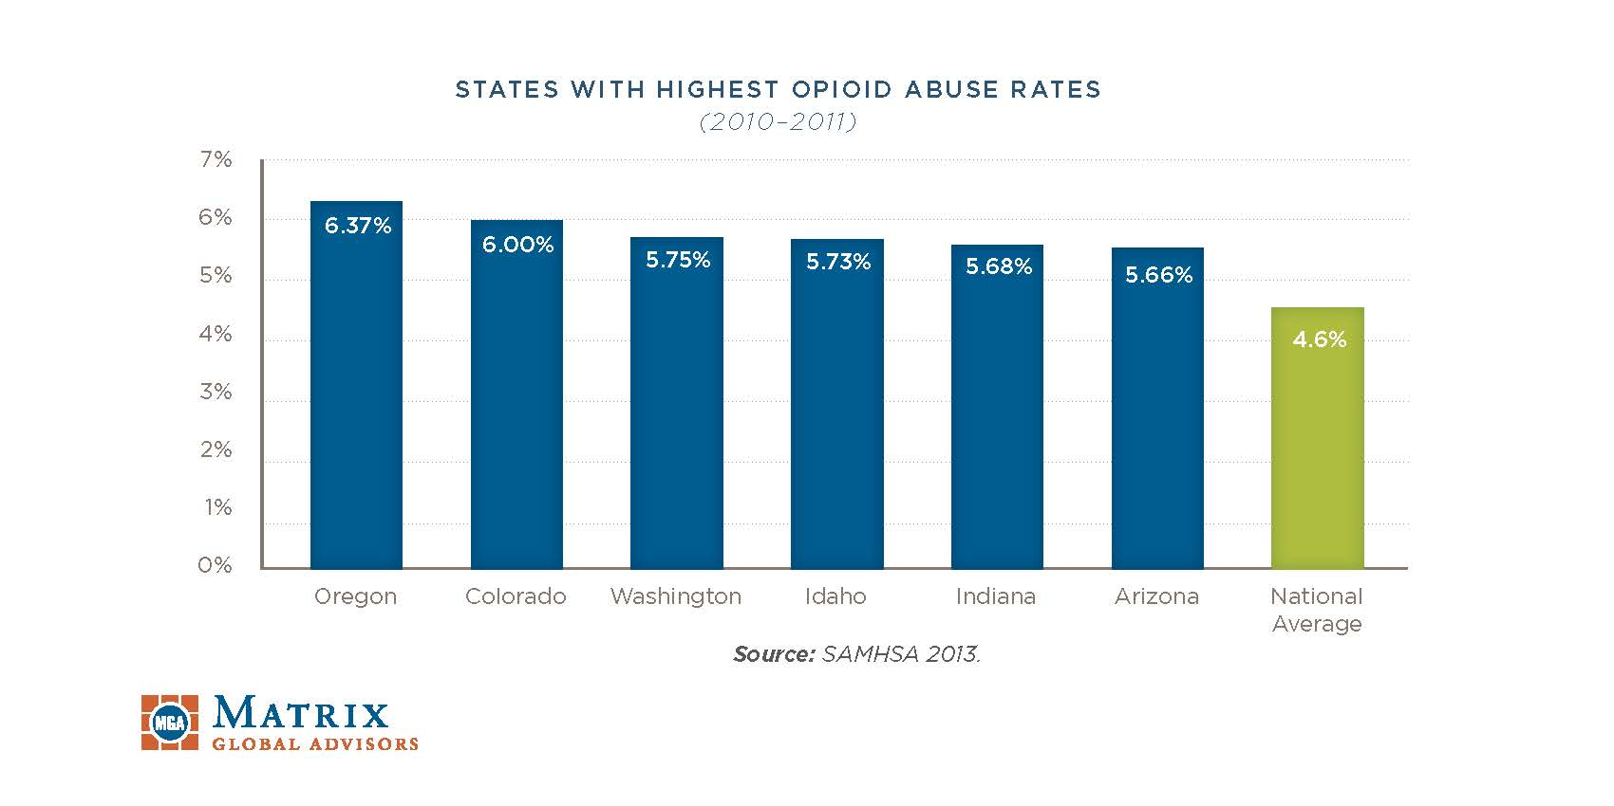
http://www.drugfree.org

Slide 11
Addressing the Need
The Swinomish Senate ambitiously decides to use their own funds and resources to combat opioid crisis.
Community understands that this is a local and national issue affecting Native and non-Native populations.
Notes:
Senate stated they want to help their friends & neighbors
Not a Tribal issue, or a state issue, or a national issue – this disorder affects each of those areas, and all of us must work together to bring sobriety back to our neighborhoods.

Slide 12
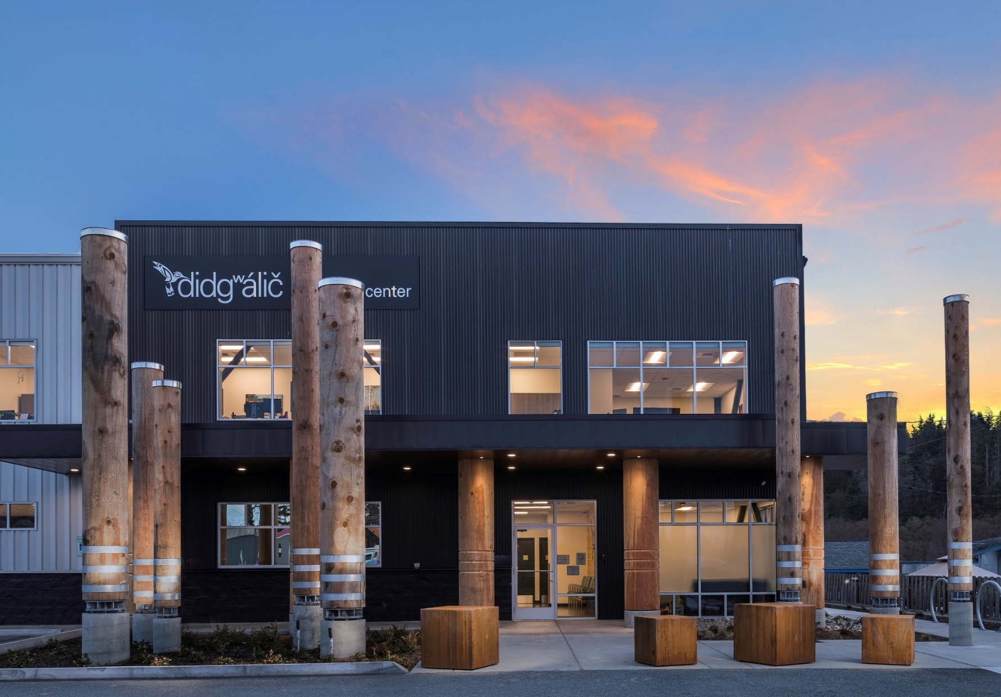
Addressing the Need
Property purchased:
September 28, 2016
Grand opening:
January 2, 2018
Notes:
Rapid response to opioid crisis
Typically takes years to launch and open new program/facility
In response to this public health need, Swinomish is building a new treatment program
Will provide services to all – both Native and non-Native residents
Why is the Tribe doing this?
Tribe started addressing opioid crisis about 3 ½ years ago
We developed treatment model for substance use disorders
It’s working – saving lives and helping Tribal members return to full participation in family, cultural and community life
Senate is very passionate about being able to help Tribal members
They said: “If we can do something to address the needs of our neighbors who are facing the same problems, we will make this model available to broader community”
Senate is sincere in its commitment.
Funding this program with Tribal governmental funds.
The Senate recognized that the opioid crisis a problem we face together and need to come together as a broader community
HOW is the Tribe doing this?
Tribe is fully funding investment in the program
Sustainable financial model - similar to a public health program, or akin to medical nonprofit
Fee for service - will take private insurance, Medicaid, and IHS coverage for Native American patients.
Will monitor the evolving political climate in Washington DC re: health care coverage

Slide 13
NEXT
STEPS
1
Initiate long and involved permitting/licensure process
2
Convert property to medical facility
3
Hire skilled staff
Notes:
Next steps
Large undertaking

Slide 14
1
2
3
4
5
6
7
CITY OF ANACORTES
WA DEPT OF BEHAVIORAL
HEALTH & RECOVERY
WA BOARD OF PHARMACY
Regulatory
Agencies
WA DEPT OF HEALTH
SUBSTANCE ABUSE & MENTAL
HEALTH SERVICES ADMIN
INDIAN HEALTH SERVICES
US DRUG ENFORCEMENT
ADMINISTRATION
Notes:
Compliance with multiple state and federal regulations.
Obtaining state and federal certification is a long winded process with many moving parts and interwoven stages.
Anacortes: Essential public facility, conditional use permit process through planning commission public hearing and city council public hearing
Certified Opiate Treatment Program (OTP)
Licensed and regulated by several state and federal agencies
Washington State Division of Behavior Health and Recovery (DBHR) and Indian Health Service (IHS)

Slide 15
Process Timeline
DHBR Application Submittal
October 21, 2016
Anacortes Zoning
DRG November 1, 2016
DBHR Provisional Approval (ADA Checklist Needed)
February 22, 2017
Building Permit Submittal
March 6, 2017
Conditional Use Permit Granted
March 27, 2017
Construction Begins
April 3, 2017
DBHR Community Hearings
June 15, 2017
DBHR Tour Certification Granted
November 1, 2017
SAMHSA/DEA/Board of Pharmacy Approval
November 10, 2017
Soft Opening Facility
November 15, 2017
A sneak peak into the

Slide 16
Hiring Timeline
Advertise for PA/ARNP
March 20 – April 27
Interviews PA/ARNP
June 12
Advertise for LPNs/MA
July 17 – August 19
Advertise for CDP Clinical Supervisor, MH Supervisor, CDPs, Office Manager, Billing Manager, Social Worker
July 24 – August 11
Interviews CDP Clinical Supervisor, MH Supervisor, CDPs, Office Manager, Billing Manager, Social Worker
August 10 – 18
Interviews LPNs, MA/RN
August 28 – 30
Advertise Daycare, Admin Assistant, Security, Transporters
August 28 – September 15
Interviews for Daycare, Admin Assistant, Security, Transporters
September 18 – 22

Slide 17
Washington’s Medicaid State Plan
Original
Amended
REIMBURSEMENT FOR INDIAN HEALTH SERVICE AND TRIBAL HEALTH FACILITIES
Payment for Services
Services provided by facilities of the Indian Health Service (IHS) which includes, at the option of the tribe, facilities operated by a tribe or tribal organization, and funded by Title I or III of the Indian Self Determination and Education Assistance Act (Public Law 93-638), are paid at the rates published in the Federal Register or Federal Register Notices.
The outpatient per visit rate also known as the IHS encounter rate is, "A face-to-face contact between a health care professional and a Medicaid beneficiary for the provision of Title XIX defined services through an IHS or Tribal 638 facility within a 24-hour period ending at midnight, as documented in the patient's record.
The services of the following providers are included in the encounter rate:
Physicians Physician Assistants
Nurse Midwives Advanced Nurse Practitioners
Speech-Language Pathologists Audiologists
Physical Therapists Occupational Therapists
Podiatrists Optometrists
Dentists Chemical Dependency Counselors
Psychiatrists Psychologists
Mental Health Professionals
Included in the outpatient per visit rate are laboratory and x-ray services provided on-site and medical supplies incidental to the services provided to the patient. Pharmaceuticals/drugs are outside the encounter rate and are reimbursed under the fee-for-service system at the applicable fee-for-service rate.
REIMBURSEMENT FOR INDIAN HEALTH SERVICE AND TRIBAL HEALTH FACILITIES
TN# 17-0042 Approval Date Effective Date 7/1/17 Supersedes TN# 00-006
Services provided by or through facilities of the Indian Health Service (IHS) which includes, at the option of the tribe, facilities operated by a tribe or tribal organization and funded by Title I or III of the Indian Self Determination and Education Assistance Act (also known as Tribal 638 facilities), are paid at the applicable rates published in the Federal Register or Federal Register Notices.
The applicable published outpatient per visit rate (also known as the outpatient all-inclusive rate) is paid for up to five (5) outpatient visits per Medicaid beneficiary per calendar day for professional services.
An outpatient visit is, "A face-to-face or telemedicine contact between any health care professional authorized to provide services under the State Plan and a Medicaid beneficiary for the provision of Title XIX defined services, as documented in the patient's record.”
Included in the outpatient per visit rate are laboratory and x-ray services provided on-site and medical supplies incidental to the services provided to the patient. Pharmaceuticals/drugs are outside the all-inclusive rate and are reimbursed under the fee-for-service system at the applicable fee-for-service rate.

Slide 18
Services to be Offered
didgʷálič provides patients with
all the tools necessary for success
Outpatient Treatment Services
Primary Medical Care
Mental Health Counseling
Medication-assisted Therapies
Shuttle Transportation
On-Site Childcare
Case management & referrals
Notes:
Unique “whole person” treatment model
Full – service approach
unlike what other clinics traditionally offered
Not dose and go clinic
EXPLAIN PATIENT FLOW BRIEFLY
Not a “detox” facility
Patients will come to our clinic when they are stable

Slide 19
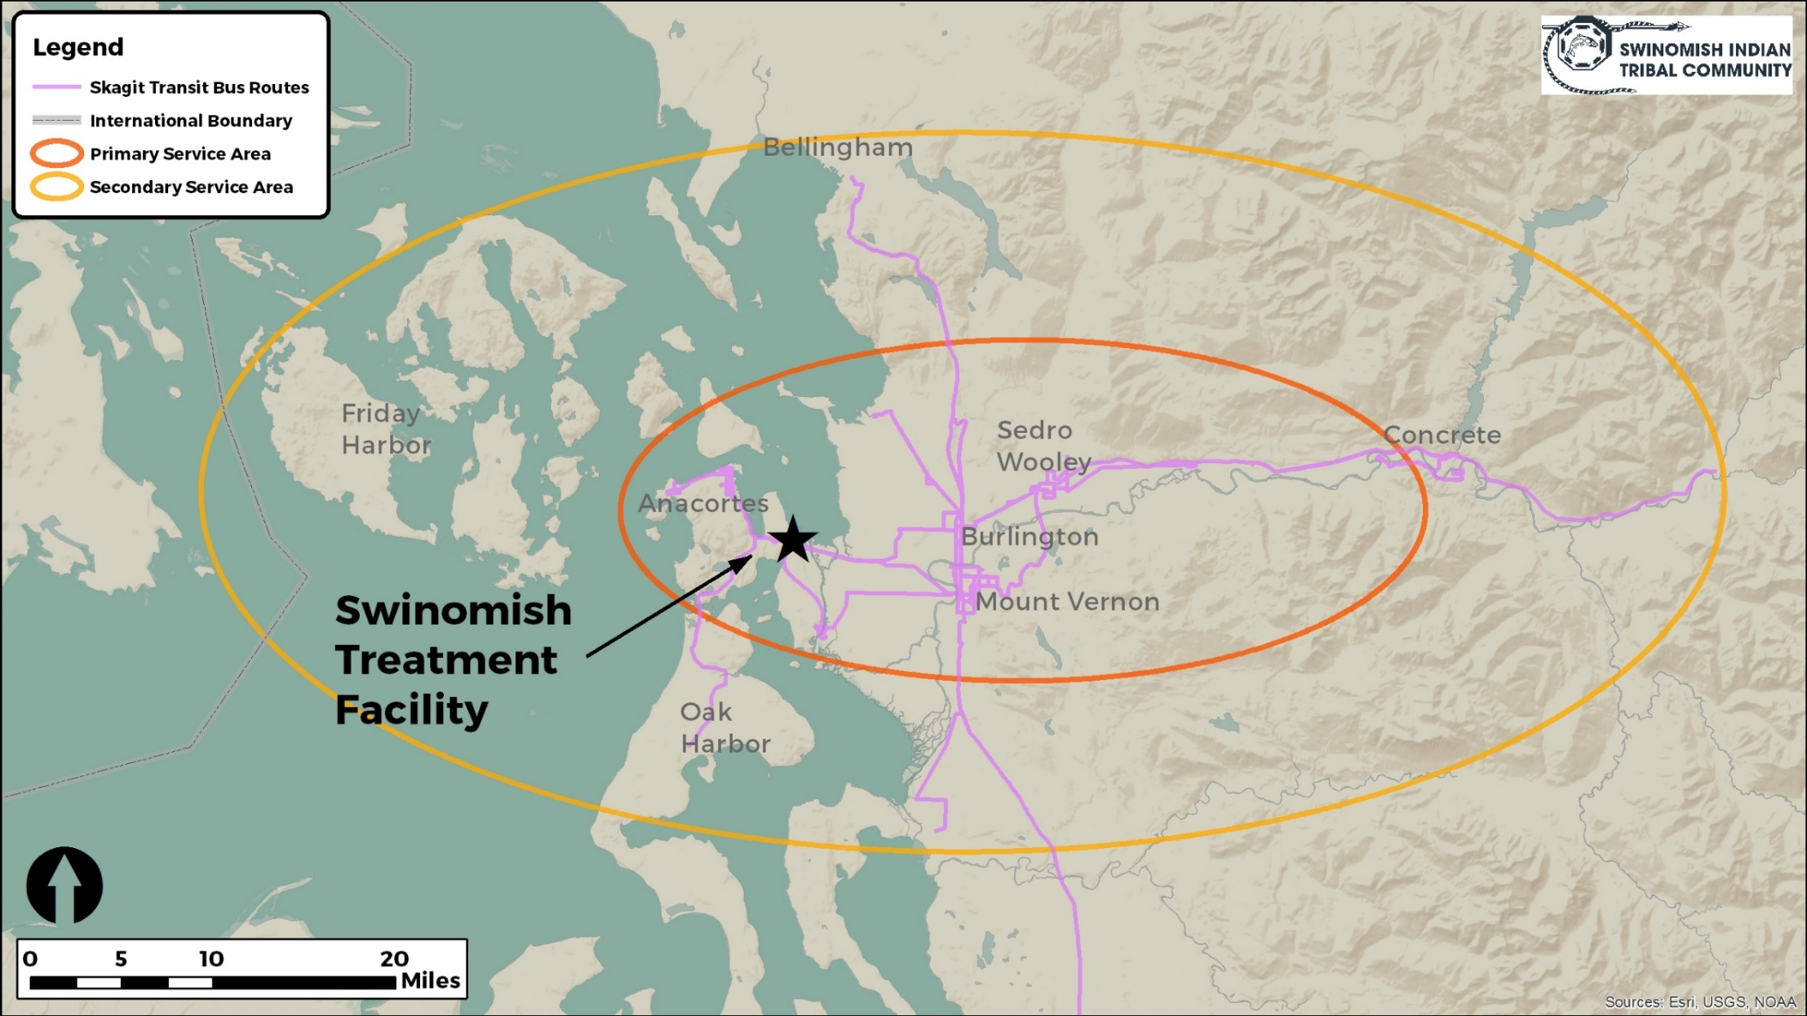
Service Area
Notes:
Graph is approximation – not exact
Primary = Anacortes – Fidalgo Island – Mount Vernon – Burlington – Sedro Woolley
Secondary = San Juan islands – Concrete – northern Skagit – northern Island County

Slide 20
Notes:
Location within state of washington

Slide 21
INVESTING IN
Safer Communities
“[M]edication-assisted therapy is associated with reduced general health care expenditures and utilization, such as inpatient hospital admissions and outpatient emergency department visits”
– Mohlman, et. al.
Swinomish Program will mitigate community impacts of the opioid crisis
Will alleviate burdens on first responders, public hospitals, law enforcement
http://www.journalofsubstanceabusetreatment.com
Notes:
No identified adverse impacts of program
Swinomish program will mitigate impacts of opioid epidemic in Skagit County
Will alleviate burdens on EMS, public hospitals, law enforcement
Research indicates medication assisted treatment lowers impacts on public health systems (Vermont study)

Slide 22
Personnel
based on 250 patients
.5 FTE
CEO
Program Sponsor/Director
Medical Director
Medical Staff
3 LPNs, RN, PA, ARNP
Chemical Dependency Professional
Clinical Supervisor, 3 CDP’s, 2 CDPT’s
1 FTE
.5 FTE
6 FTEs
6 FTEs
Notes:
Payroll projections are estimated at over $1 million per year
Directed back into local economy & job market

Slide 23
Social Worker
Licensed Mental Health Counselors
Clinical Supervisor, 1 LMHC/CDP
Administration
Office Manager, 2 Administrative Assistants, Child Watch Attendant
Billing
Security/Transportation
Manager, 2 Security Guards, 3 Transporters
1 FTE
2 FTEs
4 FTEs
2 FTEs
6 FTEs
Notes:
Payroll projections are estimated at over $1 million per year
Directed back into local economy & job market

Slide 24
didgʷálič Organizational Chart
Swinomish Senate
Swinomish Development Authority
John Stephens Executive Director
OTP Program Director/Sponsor Dawn Lee
Medical Director
CDP
Social Worker
Office Manager
Administrative Assistant
MH Counselor
MH Clinical Supervisor
LPN
LPN
Transporter
PA/ARNP
CDP
Security/Transport Manager
CD Clinical Supervisor
LPN
PA/ARNP
RN
CDP
CDPT
Administrative Assistant
Daycare Attendant
Transporter
Security
Security
Transporter
Billing Manager
Transporter
Security
Billing Specialist

Slide 25
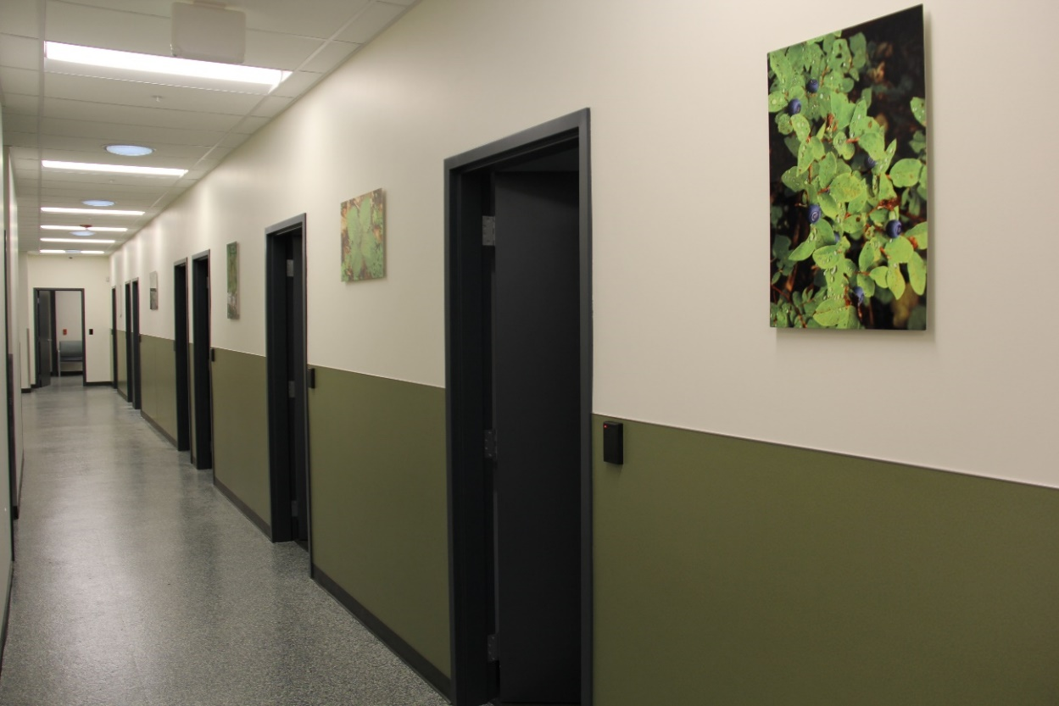
Individuals are treated for the physiological, psychological, and spiritual effects of
the disease of chemical dependency.
The holistic design of the building creates a natural flow and protects patient confidentiality and dignity
The “whole person” model treats substance use disorder in its entirety – a complete treatment plan is created to address the needs of each client
Notes:
Unique “whole person” treatment model
Full – service approach
unlike what other clinics traditionally offered
Not dose and go clinic
EXPLAIN PATIENT FLOW BRIEFLY
Not a “detox” facility
Patients will come to our clinic when they are stable

Slide 26
How does work?
MAT
medication assisted therapy
Our brains produce natural opiates
With a flood of external opiates our brain quits producing their own
Leaving the person core, sensitive to pain, depressed and fatigued
Medications help to stabilize users and give the brain a chance to heal
Notes:
Our brain produces natural opioids. But with the continued flooding of external opioids like heroin, the brain gradually stops producing its own. An internally depleted opioid system leaves us constantly sore, sensitive to pain, depressed, fatigued but unable to sleep. When I was still addicted but not using, I always felt a pang of doom impossible to relieve. These medications—which are synthetic and semi-synthetic opioids—help stabilize users and stanch these side effects while giving the brain a chance to heal. (Slaate Journal)

Slide 27
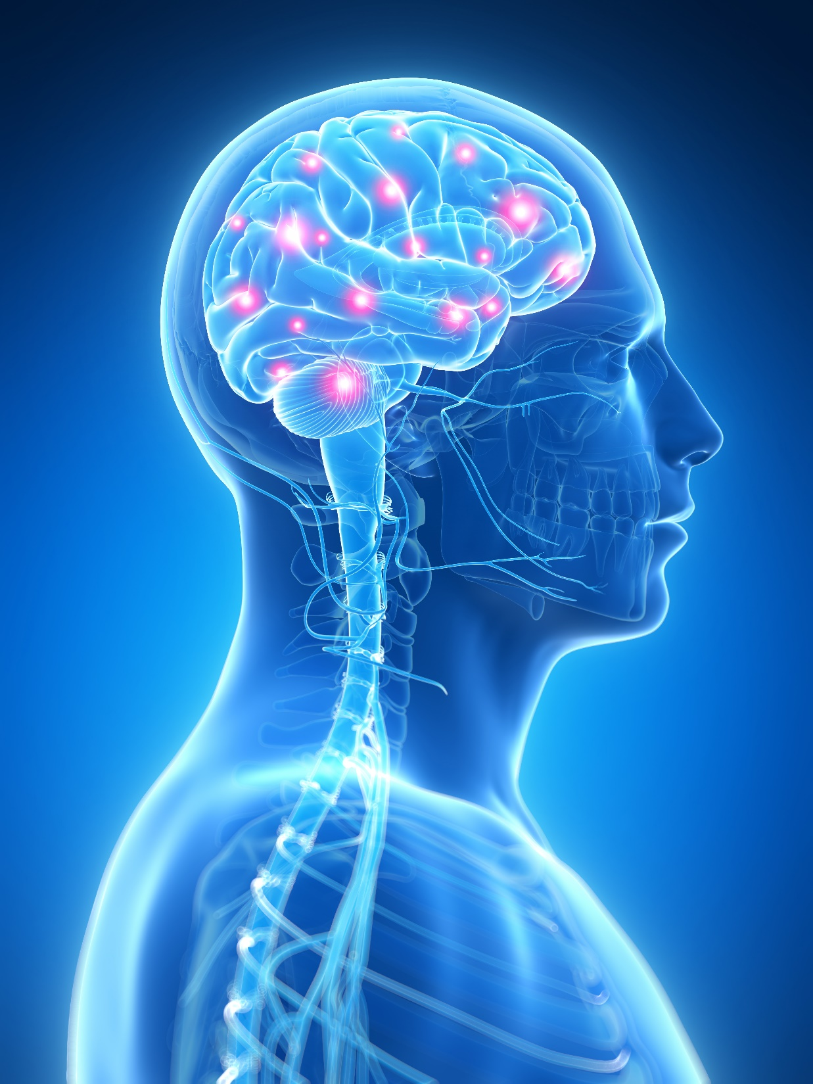
OPIOIDS IN THE BODY
Opioid receptors are located within the brain, the brain stem, spinal cord, intestines as well as other organs. When the bodies naturally made endorphins or opioids are released through taking medications or use of illicit drugs such as heroin they bind to receptors in the brain and in other areas of the body.
Brain: There are opioid receptors located throughout the brain and trigger the brain’s reward system generating feelings of pleasure and happiness. Opioid receptors are located in the cerebral cortex, cerebellum, nucleus accumens, ventral tegmental area, sustantia nigra as well as the hypothalamus.
Brain Stem: The brain stem controls the bodies autonomic system such as breathing. When opioids bind to the receptors in the brain stem, breathing is slowed, the person experiences the feeling of relaxation and pain relief.
Spinal Cord: The opioid receptors in the spinal cord reduce pain signals from a point of injury, surgical procedure or sickness. The interference in the pain perception is the intended function when opioids are prescribed.
Notes:
Brain: When opioids are used they attach to specific receptors which flood the brain with Dopamine; a neurotransmitter that regulates feelings of pleasure, emotion, motivation, and cognition. The overstimulation of the reward system by the use of opiates is what leads to the euphoric feelings or “high”. After the use of opiates the brain associates them with pleasure and “trick” the brain into thinking the drug is a life sustaining activity and this deception is what leads to the person taking the drug again and again. If used over a long period of time they change the way the nerve cells in the brain function and the user is no longer able to experience pleasure without the drug. This is what leads to addiction and without the opiate the user will experience unpleasant withdrawal symptoms.
Brain Stem: Overdose occurs when the persons breathing is slowed to the point of death.
Spinal Cord: Even though opioids are intended to reduce pain signals they also do affect the receptors in the brain as well as the brain stem and can play a role in the development of addiction.

Slide 28
Treatment Overview of Opioid Dependence
ABSTINENCE
Naltrexone/
Vivitrol
MEDICATION ASSISTED ABSTINENCE
Methadone
Buprenorphine
HARM REDUCTION
Needle Exchange
DEATH
Notes:
28
DWC provides a unique approach individualized to each patient. Our treatment team which consists of medical, chemical dependency professionals, MH counselors and social worker, meet the client where they are and work with them according to their treatment plan. Our OTP can provide higher level of outpatient care without referring them off site. Working on their OUD, then focusing on the other drugs of abuse.

Slide 29
Recovery is
good for the neighborhood.
The Swinomish Senate knows that a
healthy and sober community isn’t just important on Reservation –
It is important across our cities, counties, and state.
Notes:
Senate stated they want to help their friends & neighbors
Not a Tribal issue, or a state issue, or a national issue – this disorder affects each of those areas, and all of us must work together to bring sobriety back to our neighborhoods.

Slide 31
John Stephens, Executive Director
jstephens@swinomish.nsn.us
(360) 466-7307

