Slide 1
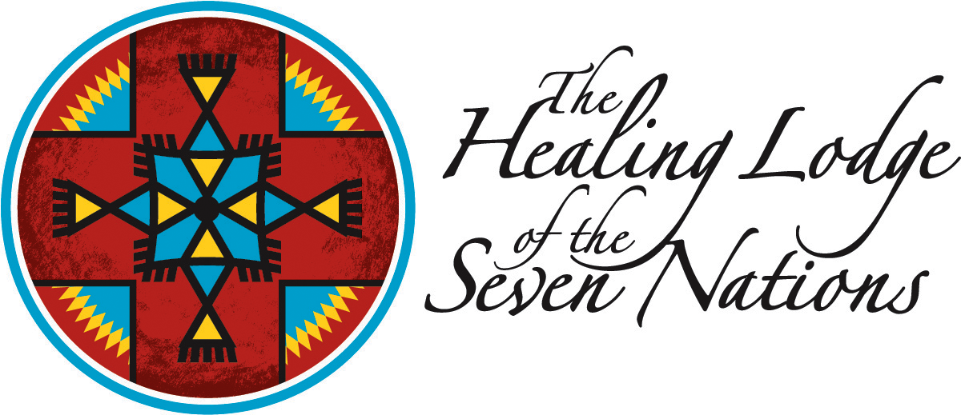
Residential Treatment for Addicted Youth
Notes:
The history of The Healing Lodge of the Seven Nations begins in 1986 when The Confederated Tribe of the Colville Reservation, The Spokane Tribe of Indians, The Kalispel Tribe of Indians, The Kootenai Tribe of Idaho, The Coeur d’Alene Tribe of Indians, The Nez Perce Tribe, and The Confederated Tribes of the Umatilla (the “Seven Nations”) banded together to talk about creating a chemical dependency treatment solution for youth.
The consortium of tribes knew that they would be the most successful if they combined their limited resources to develop one collective program rather than creating their own. With the help of Indian Health Services (IHS), they established a treatment program in 1988 named Inland Tribal Consortium (ITC) Youth Treatment. Because of its central location among the Seven Nations, the Spokane area was chosen as a location for the program. Once the program was established and services were expanded to all adolescents (Native or non-Native), additional funding was attracted from the State of Washington so that the program could serve youth covered by state-funded medical plans.
The Healing Lodge of the Seven Nations is one of twelve Indian Health Services Regional Youth Treatment Centers around the country.

Slide 2
Notes:
This picture depicts a lot our residents where they are seen but not heard. They sometimes feel like they don’t have a voice but they want help!

Slide 3
Seven tribal nations came together
Vision and Foresight of Tribal leaders.
Spokane, Kalispel, Colville, Nez Perce, Kootenai, Coeur D’Alene and Umatilla Tribe.
Addressed concern of sending “our children” to far away places for help.
Central site was selected (Spokane)
Created through Public Law 93.638.
Evolved, continued to grow and dream facility was opened in 1996.
Notes:
The Indian Self-Determination and Education Assistance Act of 1975 (Public Law 93-638) authorized the Secretary of the Interior, the Secretary of Health, Education, and Welfare, and some other government agencies to enter into contracts with, and make grants directly to, federally recognized Indian tribes. The tribes would have authority for how they administered the funds, which gave them greater control over their welfare. The ISDEAA is codified at Title 25, United States Code, beginning at section 450.

Slide 4
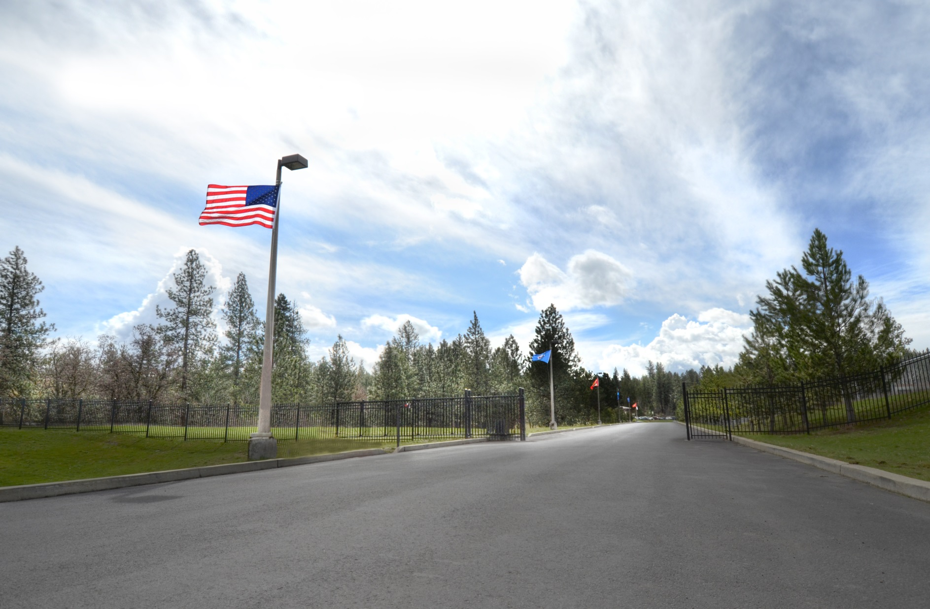

Slide 5
Our facility
Notes:
The Healing Lodge treats adolescents within a beautiful facility in Spokane Valley, Washington. The campus features 50 acres of rolling terrain, filled with beautiful timbered land and basalt rocks of the natural woods. The Healing Lodge moved to its current campus in 1996 to offer staff and residents a permanent place to call home.

Slide 6
Entrance

Slide 7
School and Cafeteria

Slide 8
The medicine wheel
Notes:
Medicine Wheel
In Native American spirituality, the Medicine Wheel represents harmony and connections and is considered a major symbol of peaceful interaction among all living beings on Earth. The medicine wheel is important to the healing lodge because we form our animal teachings around the medicine wheel East is for Coyote, South is for the Elk, West is for the Eagle and North is for the Salmon.

Slide 9
The talking circle

Slide 10
The inner circle and flags

Slide 12
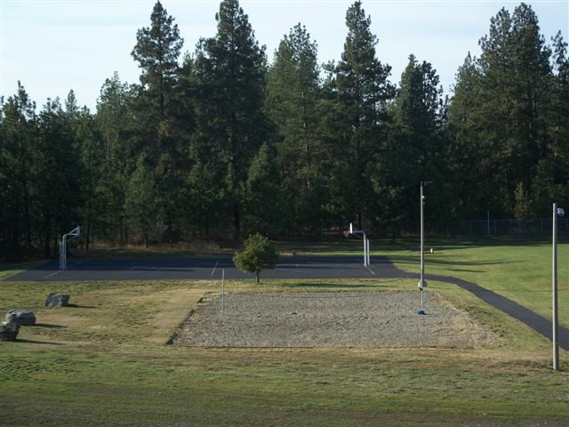
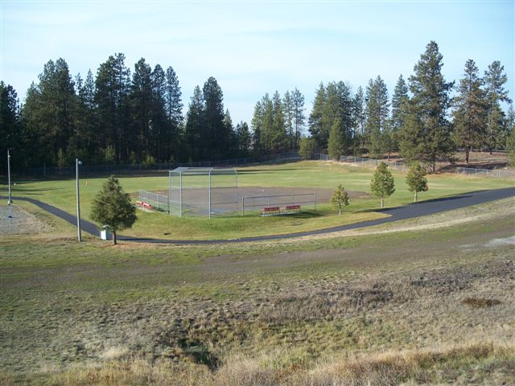
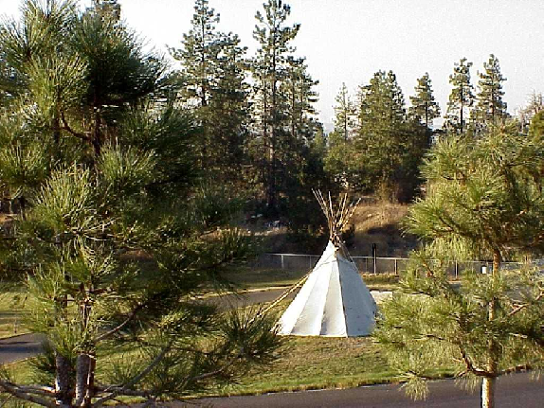
Outdoor recreation

Slide 13
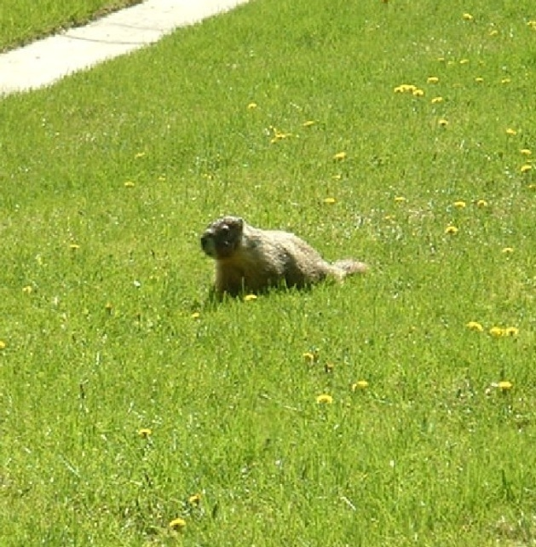
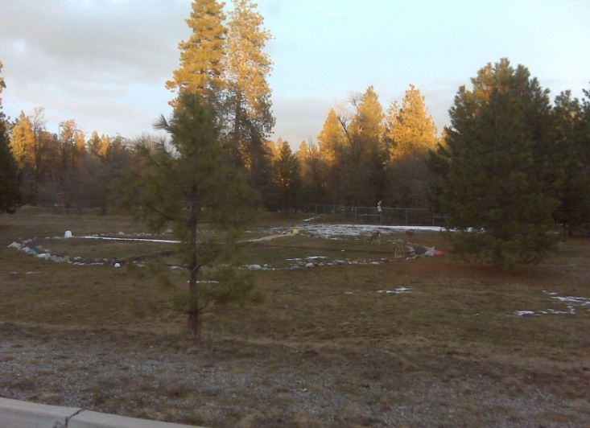
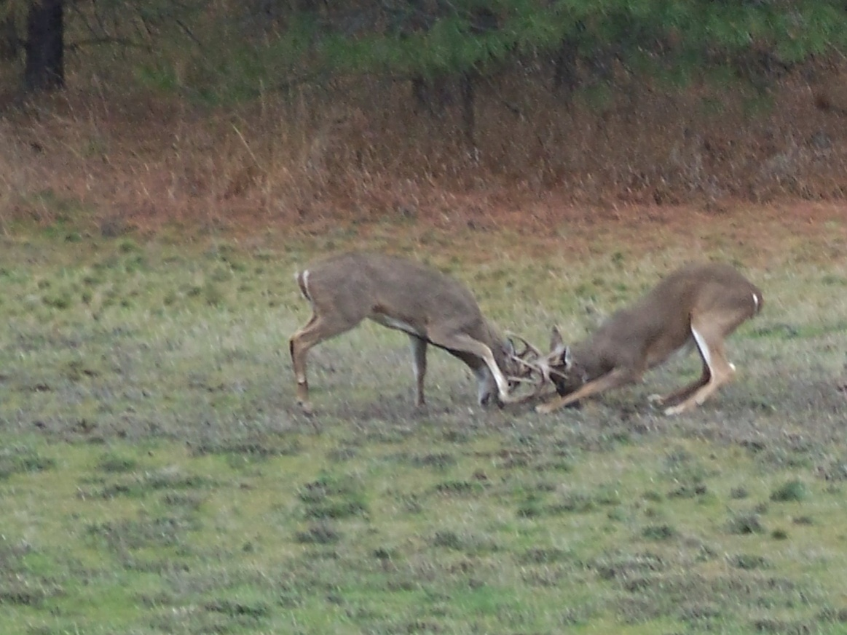
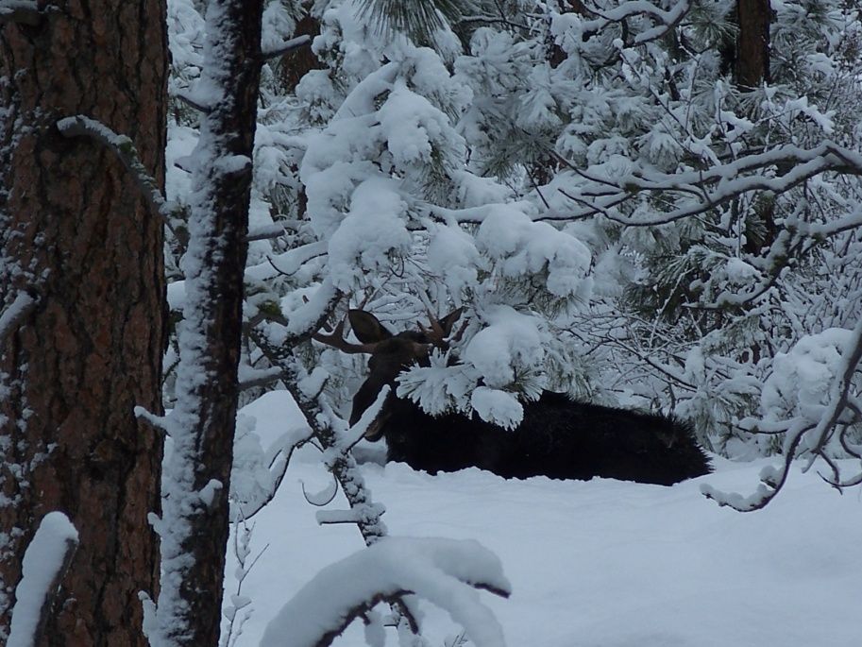
Wildlife at the lodge

Slide 14
Overall Compliance standards
Washington State Administrative Code (WAC): 203
Department of Health (DOH): 593
Indian Health Service (Food Service): 45
USDA (Food Service): 300 pages of standards
CARF International: 1200
FIRE MARSHALS (state and local)
FINANCIAL OMB A-133: Federal Single Audit Act
Spokane Public Schools Contract
Behavioral Health Organizations (BHO)
OSHA Audit

Slide 15
Resident profile
Average number of residents served/yr: 190+
Serve youth ages 13-17 years old
Serve approximately 70% native youth, serve all.
We serve more males than females
We have 45 beds: 29 male and 16 female
Top three drugs of choice: 1)Marijuana, 2)Alcohol, and 3) Amphetamines
Top three mental health diagnosis: 1)ADHD, 2)Depression/Anxiety and PTSD

Slide 16
Holistic and therapeutic community
Voluntary Program ( not lock down)
Hands-Off Facility
Multi-Disciplinary Team Approach
Treating Youth with Respect and Dignity at all times.
Create a Safe Place

Slide 17
Program components
Chemical Dependency Treatment
- Social Justice CD Curriculum
- CD Education (group/1:1)
- Expressive Arts/ Music
- Sports, Weight Lifting and Running
Cultural
Program
- Root Digging
- Rights of Passage
- Guest Speakers, Dancers, Drummers
- Sweat Lodge Ceremonies
- Cultural Projects
-Groups
Education
Program
- GEDs
- High school credit
- High school credit retrieval

Slide 18
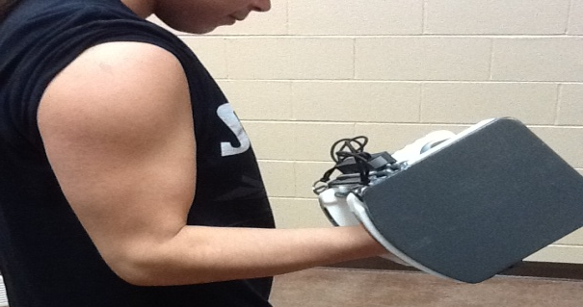
Program components (cont’d)
Mental Health
Mental Health Counselors
1 on 1’s
Groups
Food Service
3 meals per day with 3 snacks per day.
Sugar-free Diet
Caffeine-free Diet
Recreation
Basketball
Softball
Running
Hiking
Volley Ball
Weight lifting
Disc Golf

Slide 19
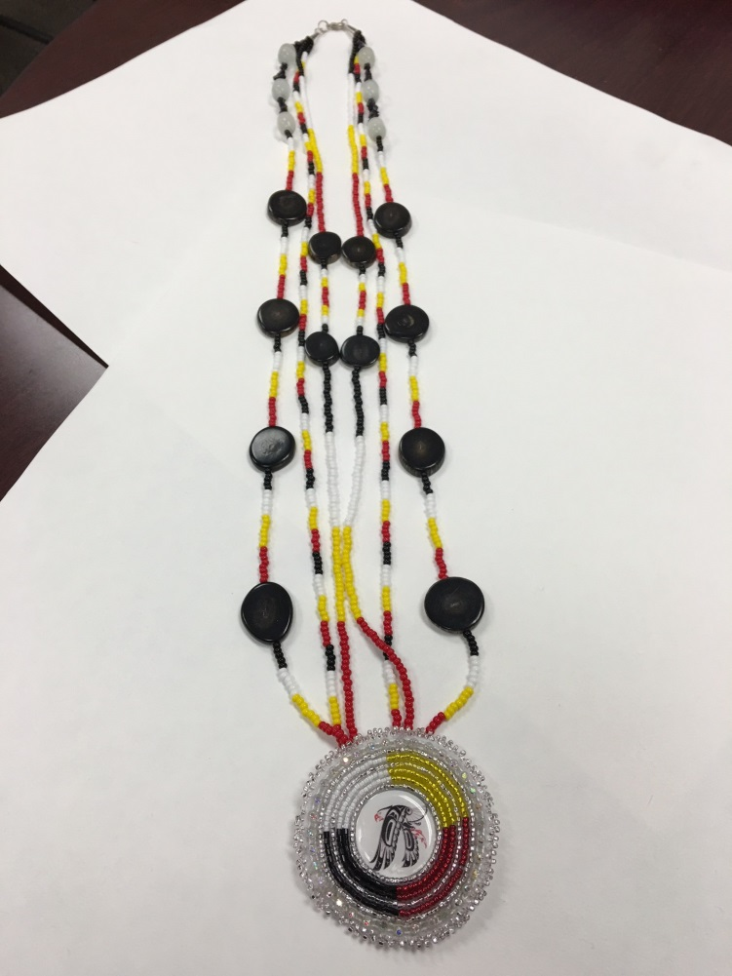
Cultural projects

Slide 20
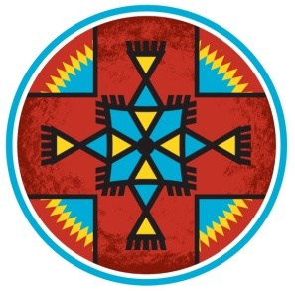
ANIMAL TEACHINGS
Salmon
COYOTE
ELK
Eagle
Teachings through stories
Teachings through skits
Discussing traits
Bring self-awareness

Slide 22
Rites of Passage

Slide 23
Music program
The Music Program records hundreds of songs by our young residents. Many of those songs have been selected to be on a featured album.
The Music Program has become a core therapeutic tool for the clinical team in addressing trauma and addiction.

Slide 24
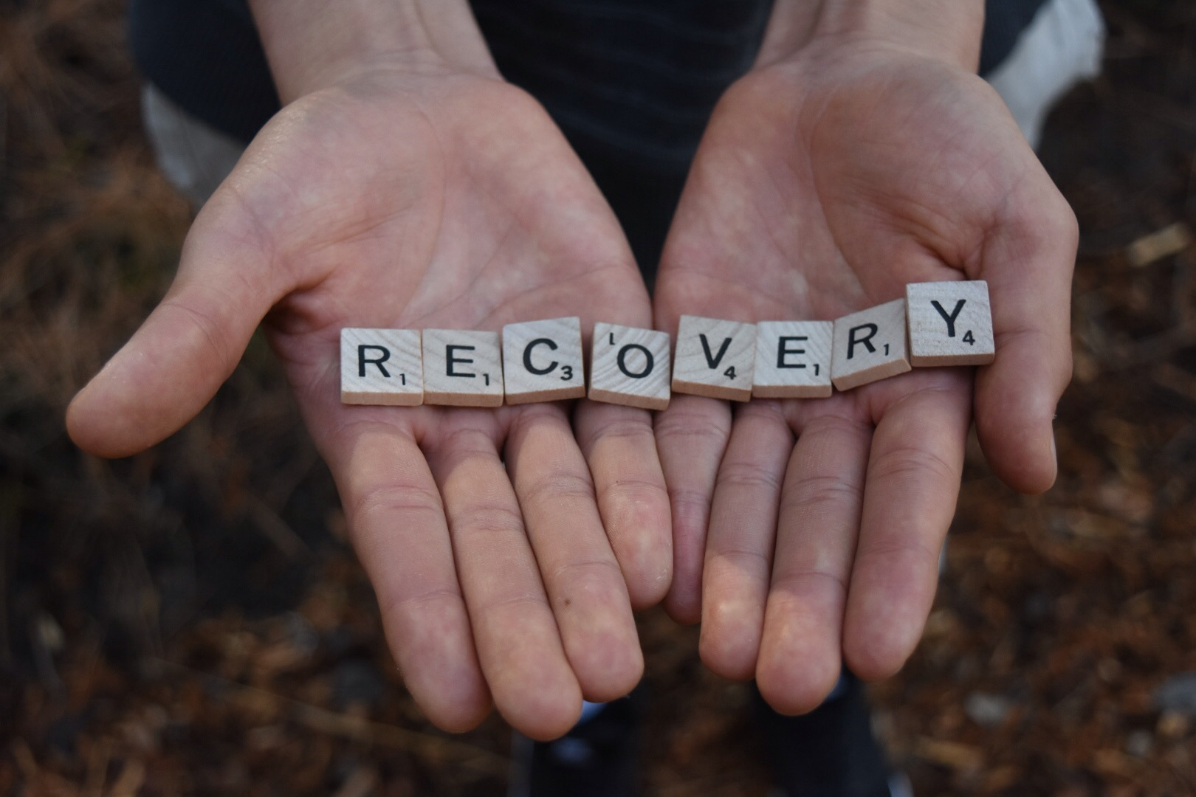
CALENDAR PROJECT

Slide 25
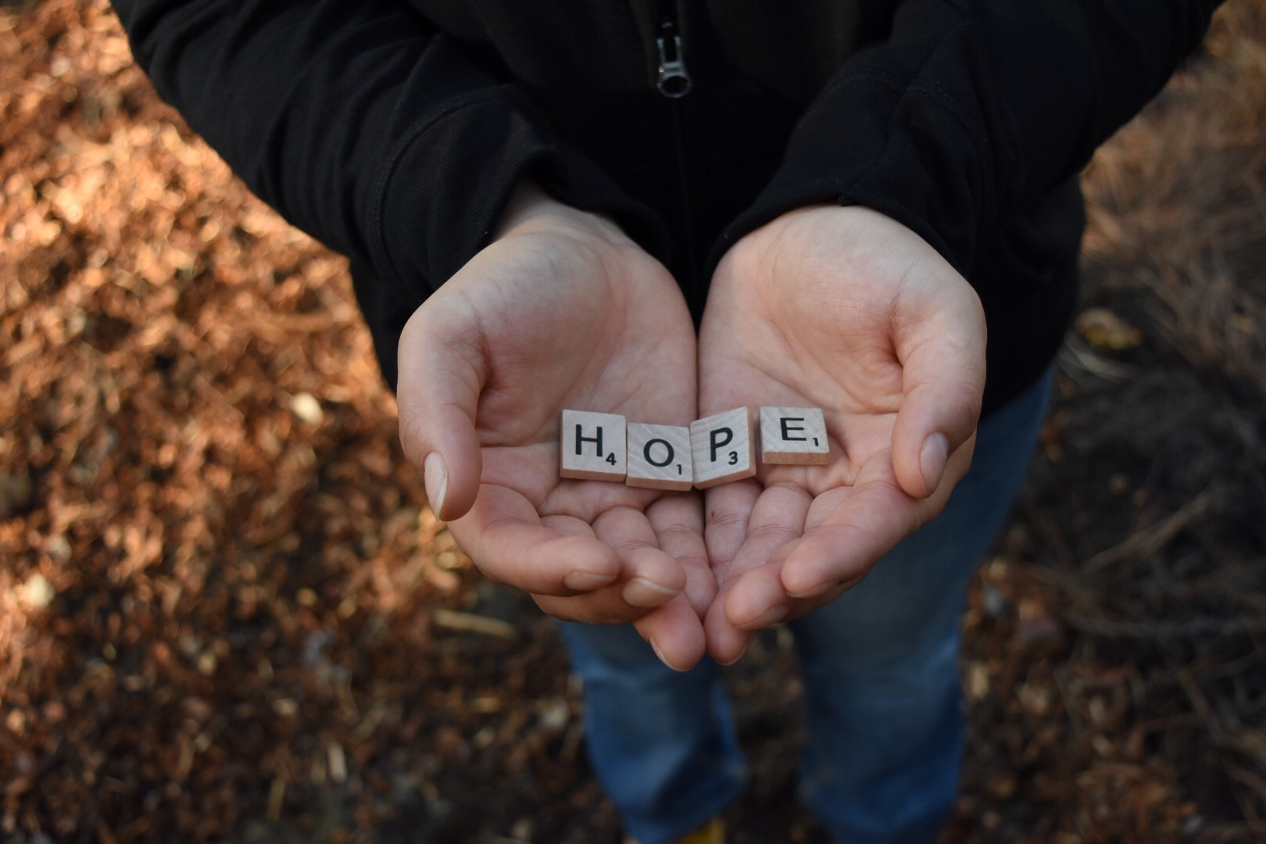
CALENDAR PROJECT

Slide 26
A rainbow of hope for our youth

