Slide 1
Heritage University Garrett Lee Smith Suicide Prevention grant
Principle Investigators (PI’s)
Maxine Janis, Associate Professor & President’s Liaison for Native American Affairs
Corey Hodge, Chair, Social Work
Interns: Sasha Longee, Social Work
Brenda Lewis, Business

Slide 2
Náx̱shsim Natash Wa (We Are One) Project
Náx̱shsim Natash Wa (pronounced like Nahhh-ka-shh-him Nahhh-Tahh-shh-Wa) is the Ichishkíin Sinwit language phrase that translates as
“We are one.”

Slide 3
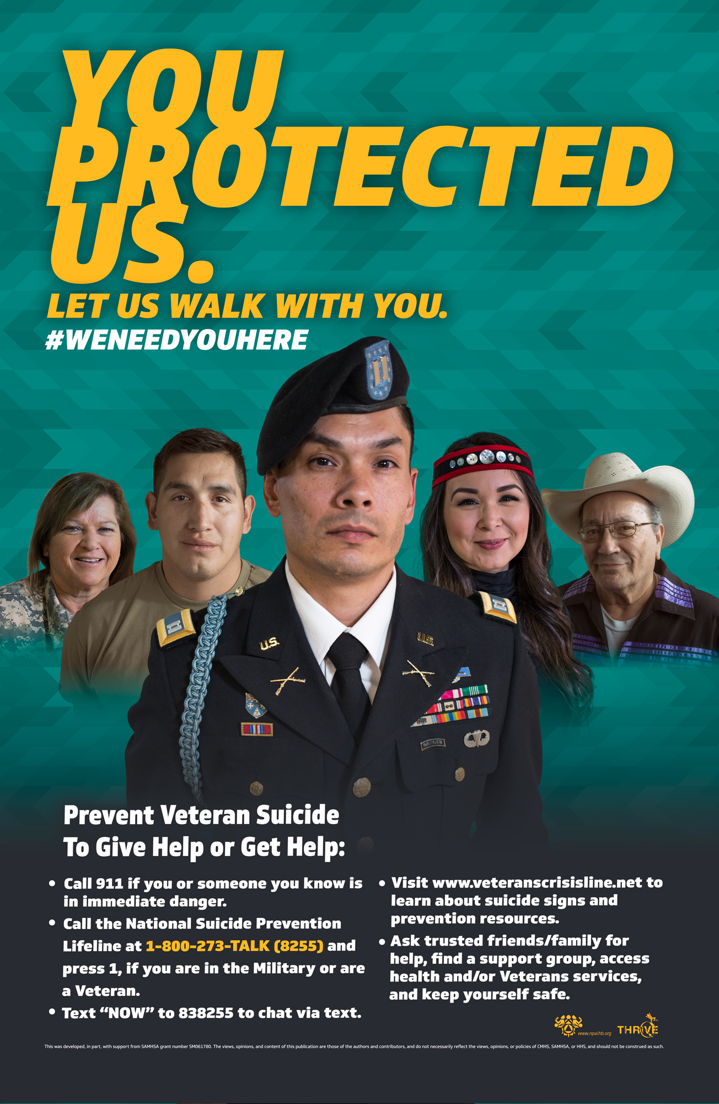
THRIVE Suicide Prevention Project
Through the GLS funding streams, THRIVE is able to provide funding each year for Heritage to coordinate and implement suicide early intervention and prevention strategies targeting their students, faculty, and AI/AN youth in their local community (Yakama Nation).
SP Training and Technical Assistance
SP Resources:
Educational Materials
Media Campaigns
Lived Experience Videos

Slide 4
Heritage University (HU)Suicide Prevention
Strength- based approaches
Cultural Protective Factors
Cultural Responsiveness
HU Initiatives

Slide 5
Strength-Based approaches

Slide 6
Cultural Protective Factors

Slide 7
HU- Culturally Responsive

Slide 8
Advisory Board

Slide 9
HU Suicide Prevention Initiatives
Question, Persuade, Refer (QPR) Gatekeeper Training
Applied Suicide Intervention Skills (ASIST) Training
Internships
Crisis Response Plan
Campus-Community Collaborations

Slide 10
HU Suicide Prevention Initiatives
Tepee/Lodge – Cross-Cultural Learning space, Talking Circle
Native American Heritage Month
All Nations Powwow – Stand Strong Special
Wellness Through Laughter Comedy Show
Gun Lock Safety event
Comfort Care packages

Slide 11
Questions

