Slide 1
Indian Health Service Portland Area Director’s Update
Dean M Seyler - Area Director
October 10, 2017
Yakama Legends Casino & Hotel
NPAIHB Quarterly Board Meeting

Slide 2
Indian Health Service
Portland Area
H.R. 601 Continuing Appropriations Act, 2018
H.R. 601, the “Continuing Appropriations Act, 2018” was signed into law by the President on September 8, 2017.
The continuing resolution provides fiscal year 2018 appropriations through December 8, 2017, for the continuing projects and activities of the Federal Government.

Slide 3
Indian Health Service
Portland Area
A.S.A.P Area Pool
Letter to Tribes seeking comments to discontinue; sent 10-06 with 30 day comment
The number of referrals have declined
Not all tribes who have retained shares with ASAP utilize the funding.
The Affordable Care Act has provided extensive funding for substance use disorder treatment that was not been available in prior years.
Difficulty in increasing the number of substance use disorder treatment facilities as recognized IHS vendors. Facilities would rather negotiate treatment fees per each tribe.

Slide 4
Indian Health Service
Portland Area
IHS Awards $16.5 Million in Grants to Support Behavioral Health Programs
Substance Abuse and Suicide Prevention (SASP)
Cow Creek Ban of Umpqua Tribe of Indians
Northwest Portland Area Indian Health Board
Port Gamble S’Klallam Tribe
Seattle Indian Health Board
Domestic Violence Prevention Program (DVPP)
Confederated Tribes of Siletz Indians
Nez Perce Tribe
Northwest Portland Indian Health Board
Behavioral Health Integration Initiative (BH2I)
Yellowhawk Tribal Health Center
Preventing Alcohol-Related Deaths (PARD)
Here is the link to the full release: https://www.ihs.gov/newsroom/pressreleases/2017pressreleases/ihs-awards-16-5-million-in-grants-to-support-behavioral-health-programs/

Slide 5
Indian Health Service
Portland Area
CDC-IHS Healthcare Infection Control Training
Date: Week of 1/22/18 (Dates TBD)
Portland, OR (Hotel TBD)
Open to all Portland Area IHS/Tribal/Urban
Register thru IHS Environmental Health Support Center
https://www.ihs.gov/ehsct/index.cfm?module=classes&catID=4
Who Should Attend:
Clinic Leaders
Clinic Medical Directors
Clinic Healthcare Providers
Infection Control Officers
Clinic Risk Management
Accreditation Managers
Facility Managers
POC: LCDR Matthew Ellis, MPH REHS
matthew.ellis@ihs.gov / (503) 414-7788

Slide 6
Indian Health Service Portland Area
Accelerated Model for improvement - Ami™ Waves
Colville Service Unit
September 25-27, 2017
Billing Errors
Procurement Process
PRC Referrals
PRC Payments
Wellpinit Service Unit
September 27-Oct 2, 2017
Infection Control Process
Optimizing access of patient care
Yakama Service Unit
October 3-5,2017
Referral process (Direct Care)
Patient access to follow-up care and patient scheduling
Phone access for patients

Slide 7
Indian Health Service Portland Area
Accelerated Model for improvement -Ami™ Waves
Warm Springs Service Unit
October 17-19, 2017
Increase Patient Satisfaction
Medical Supply Management
Fort Hall Service Unit
October 25-27 27-Oct 2, 2017
Increased Access to Care/Patient Satisfaction
Pharmacy Point of Sale (POS) Billing
Western Oregon Service Unit
FY17
Health Information Management (HIM) Scanning
Lab Draw/Operations
Lab Inventory

Slide 8
Indian Health Service
Portland Area
FY17 CHEF
$1,725,099 submitted for Portland Area
$650,606 has been returned
$24,484,022 current balance (as of September 25, 2017)

Slide 9
Indian Health Service
Portland Area
YRTC – NARA Update
24 bed license granted on 10-02-2017
Combining Services Under One Roof
Staffing of facility in process
Projected opening date – 10-16-2017
620 NE 2nd St. Gresham Oregon

Slide 10
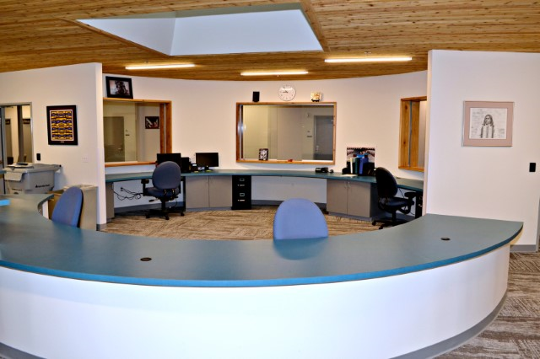
Indian Health Service
Portland Area

Slide 11
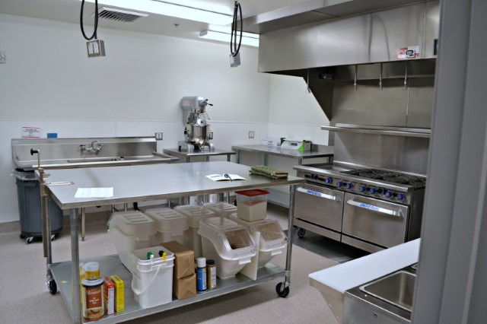
Indian Health Service
Portland Area

Slide 12
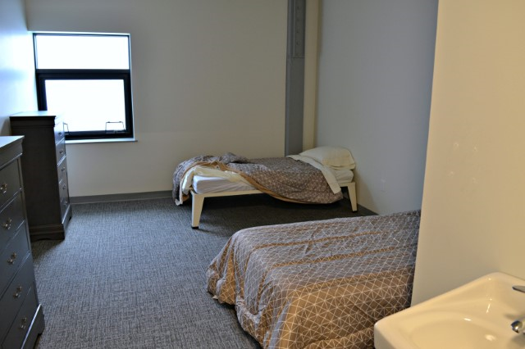
Indian Health Service
Portland Area

Slide 13
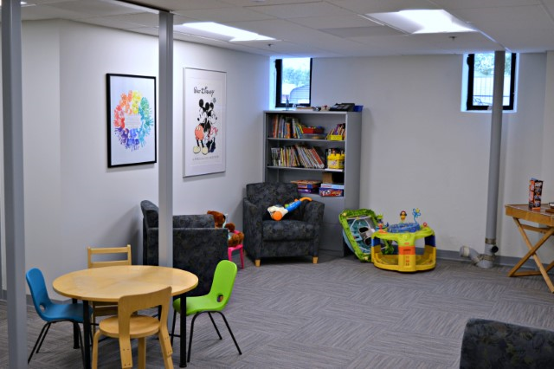
Indian Health Service
Portland Area

Slide 14
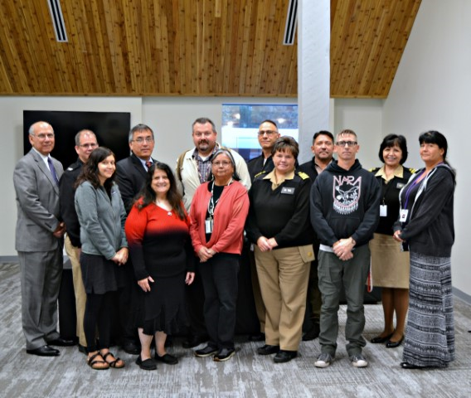
Indian Health Service
Portland Area

Slide 15
Indian Health Service Portland Area
Small Ambulatory Program (SAP)
IHS is Accepting Applications for this Health Facility Construction Funding Opportunity.
$5.0M Reserved / Max Award is $2.0M
3-5 Awards Anticipated (Highly Competitive)
Applications Due: December 1
Download Application Kit: https://www.ihs.gov/dfpc
Portland Area IHS Will Provide Two Webinars on Application Process
October 31st and November 7th
If You Plan to Apply, Please Contact
CAPT Jason Lovett - jason.lovett@ihs.gov OR
Gene Kompkoff - gene.kompkoff@ihs.gov
Available to Answer Questions, Provide Facilities Data, and Webinar Information

Slide 16
Indian Health Service Portland Area
Annual Combined Space Verification
Will Be Sent to Tribes in Early November
Verify the Amount and Location of Facility Space Used for IHS PSFA’s
Response Due Date: December 31, 2017
Please Review the Provided Data and Certify if is Accurate
Used to Calculate Share of Equipment and M&I Funds
Used to Update and Maintain the CMS Facilities List for Encounter Rate Billing
Used to Verify Facility Type and Other Statistical Items
If Data is Not Accurate, Please Follow Included Instructions to Update
Questions:
Jonathan McNamara – Health Facilities Engineering – jonathan.mcnamara.ihs.gov
Peggy Ollgaard – Business Office – peggy.ollgaard@ihs.gov
Mary Brickell – Statistics – mary.brickell@ihs.gov

Slide 17
Indian Health Service
Portland Area

Slide 18
Indian Health Service
Portland Area
A
J

Slide 19
Indian Health Service Portland Area
Portland Area IHS Multi-Conference Series
Nov. 13-17, 2017 at Spokane NATIVE Project.
AAAHC Achieving Accreditation Workshop
Nov. 13 (afternoon) - Nov. 14 (all day)
Currently all slots are filled
Pain Skills Intensive Seminar (HOPE Committee and UNM sponsored)
Nov. 15 (all day)
Medication Assisted Treatment (MAT) DATA waiver training Nov. 16 (morning)
Registration link- Access code psi11152017
Portland Area Fall Clinical Director’s Meeting
Nov 16 (afternoon) – Nov 17 (morning)

Slide 20
Indian Health Service Portland Area
Portland Area Opiate Procurement
4th year of data collection for 6 Federal and 11 Tribal sites utilizing the VA Pharmacy Prime Vendor (PPV)
Assesses procurement of 9 commonly prescribed opiates
Codeine/acetaminophen, hydrocodone/acetaminophen, oxycodone/acetaminophen, fentanyl, hydromorphone, methadone, morphine, oxycodone, tramadol
Also tracking procurement of associated drugs:
Naloxone- utilized to reverse opiate overdose
Naltrexone, buprenorphine/naloxone- used to treat opiate use disorders
Individualized reports with analysis and recommendations for best practices on appropriate and judicious opiate prescribing are provided to each included Federal and Tribal clinic.

Slide 21
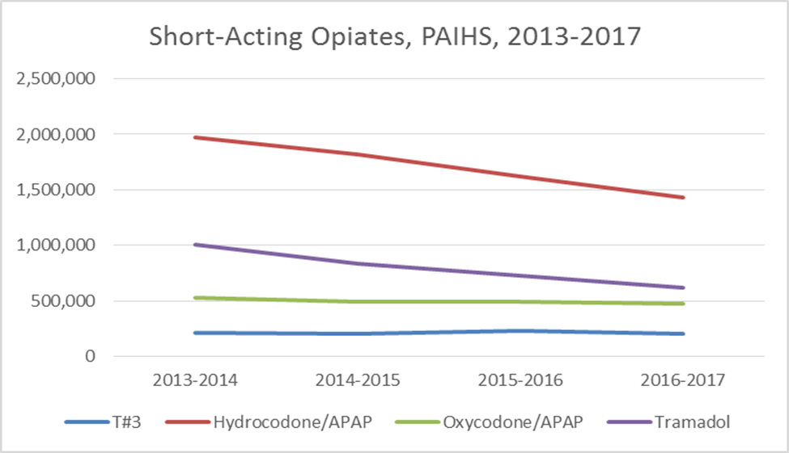
Indian Health Service Portland Area
Key trends:
Procurement of hydrocodone/APAP is down 27.3%

Slide 22
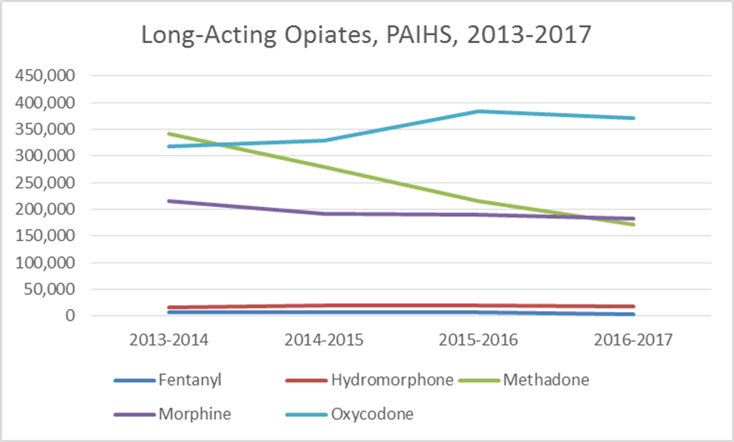
Indian Health Service Portland Area
Key trends:
Procurement of methadone is down 50.0%

Slide 23
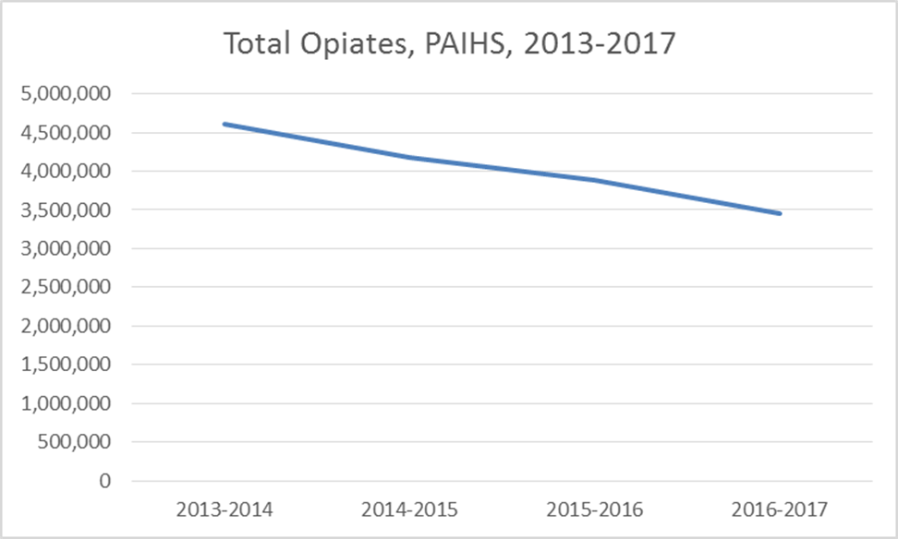
Indian Health Service Portland Area
Key trends:
Overall procurement is down 25.0%

Slide 24
Indian Health Service Portland Area
Key Recommendations:
Utilize a facility policy on chronic opioid therapy (COT)/chronic pain management.
Assure policies are congruent with the IHS Chronic Non-Cancer Pain Management policy.
Assure all prescribers of Controlled Substances have had training on appropriate pain management.
Conduct at least annual peer review among your prescribers to assure compliance with facility policies on COT.
Implement a First Responder and Take-Home Naloxone (co-prescribing) program, esp. for those prescribed methadone.
Transition as many patients as possible off of methadone.
Develop local capacity for Medication-Assisted Therapy for opioid dependence.
Follow CDC recommendations to limit acute opiate prescriptions to 3 days, rarely more than 7 days, of therapy.
Obtain a Prescription Drug Monitoring Program (PDMP) report on all new patients receiving controlled substances, all patients receiving more than 7 days of medication for acute pain, and at each visit for patients on chronic opioid therapy.

Slide 25
Questions or Comments
Our Mission... to raise the physical, mental, social, and spiritual health of American Indians and Alaska Natives to the highest level.
Our Goal... to assure that comprehensive, culturally acceptable personal and public health services are available and accessible to American Indian and Alaska Native people.
Our Foundation... to uphold the Federal Government's obligation to promote healthy American Indian and Alaska Native people, communities, and cultures and to honor and protect the inherent sovereign rights of Tribes.

