Slide 1
Wellness for Every American Indian to Achieve and View Health Equity
WEAVE-NW
October 10, 2017
Good Health & Wellness in Indian country initiative

Slide 2
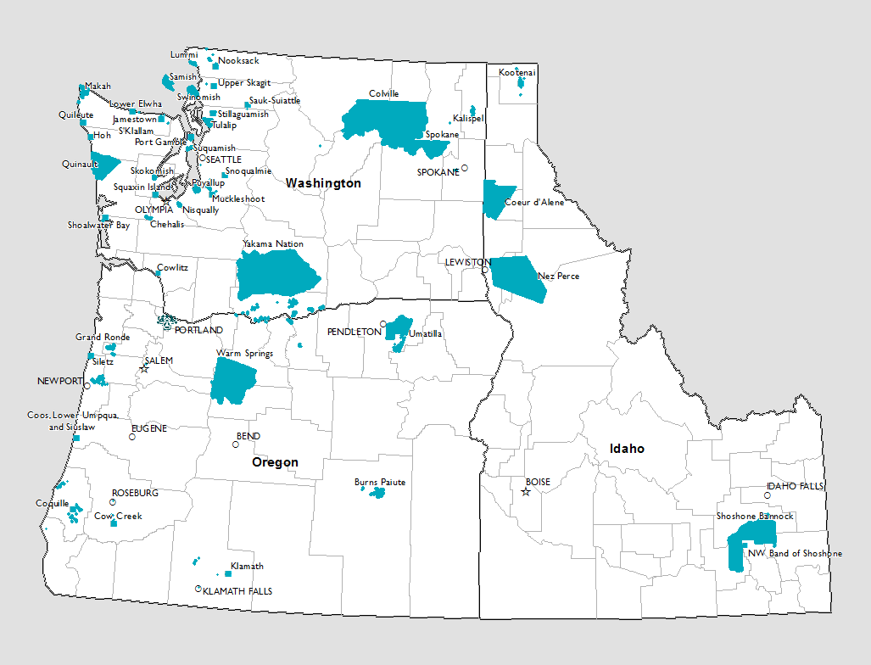
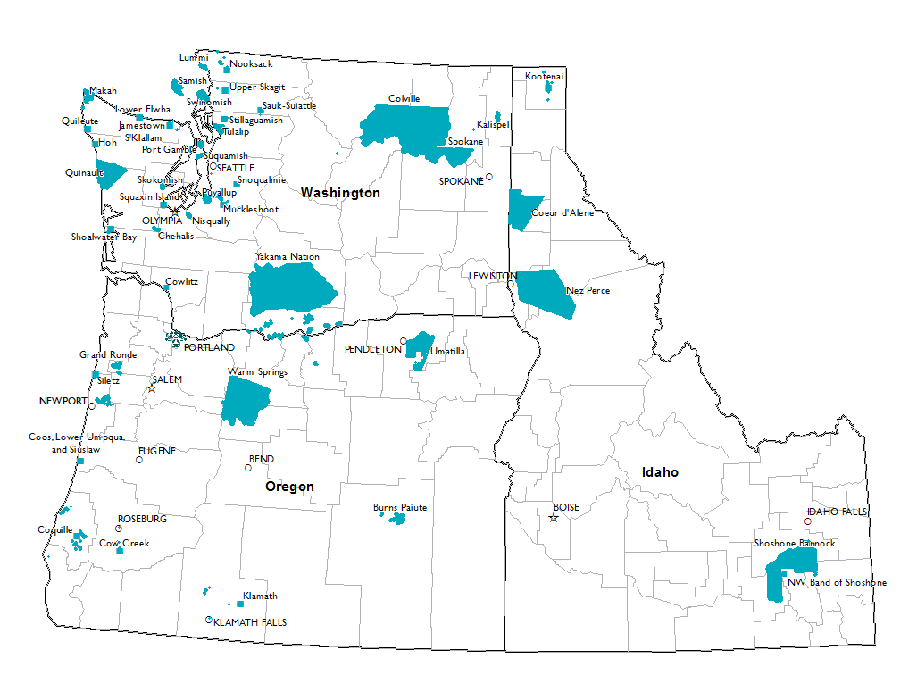
Notes:
43 Federally recognized Tribes across Idaho, Oregon, and Washington
First GHWIC YEAR = 5
YR 2,3 = 14 approximately 33% reach / 2 are already funded as Component 1 = 37%
YR 4, 5 = at least 5 new awards a year to bring the duration to a greater than 50% direct funding reach

Slide 3
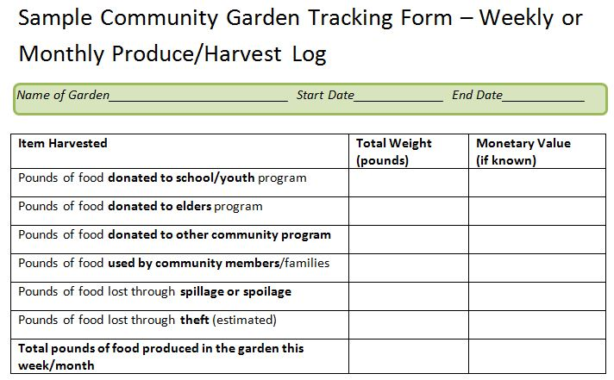
Technical Assistance for All Tribes
Data analysis
Strategic planning
Health systems change
Enhancing collaborations
Evaluations & assessments
Cultural adaptation of resources
Survey design, implementation, and analysis
Tobacco prevention & intervention activities
Policy development
Youth lead
Notes:
Site Visits: We have found that hearing about the strengths of our tribes when we visit has been the best way know what type of TA we can offer. People don’t always know what to ask for in terms of basic data analysis, creating culturally applicable health materials in their native languages, getting assistance retaining some of their public health material that might have been stuck from a different grant ending.

Slide 4

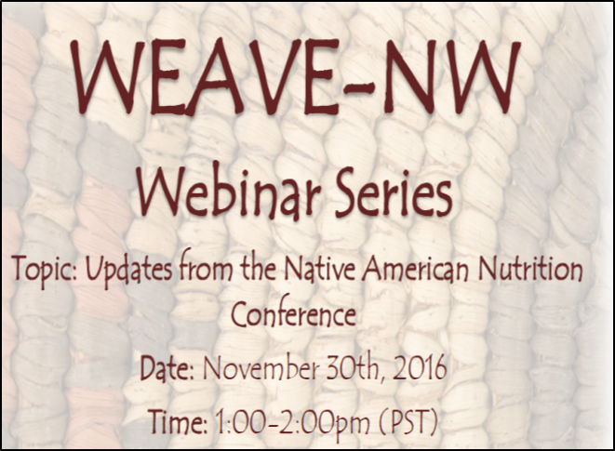

Webinars, Trainings, Workshops
Tribally Lead …
Notes:
Webinars
started out with some of our staff presenting. Now we ask our tribes to present and share very similar to GHWIC All Hands. This builds their relationship, increases resource sharing (not defined as monetary), and continues to foster new ideas and innovations.
Trainings
Are all a train-the-trainers model all materials, information, and details are provided to participants so that they can share and use in their communities and with others.
Workshops
Focus is on topics identified as a need by our tribes such as grant writing. Within our past few grant writing workshops we use our own RFA as example to help the particpants write a grant if they are interested. We have also collaborated with other projects including health data literacy to include APPLICATIONS to all teaching materials such as using open source mapping and grant writing with the health data literacy/epidemiology course material.

Slide 5
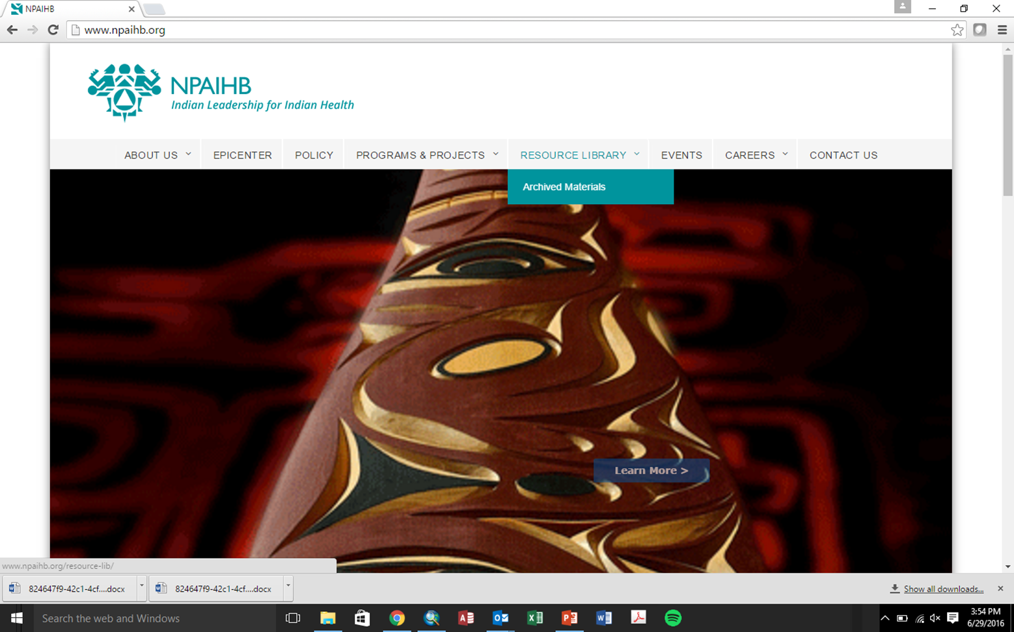
Resource Library
http://www.npaihb.org/
Notes:
What is it?
Repository for Policy, Systems, and Built Environment materials (still in the gathering of templates process. Some of our Delegates have received calls and follow-up requests to ensure permission before any publications.
Types of materials
Training manuals, policy templates (MOUs, proclamations, referendums, ordinances, resolutions, etc.), presentations, health tool kits, guidance documents for population health reporting, traditional food habitat restoration protocols, evaluation templates, process, EHR supported documents, built environment campaign materials (SRTS, walking path signage, etc.)
Embedded on tabs of our project webpage
Although parent is GHWIC. It is housed on NPAIHB so regardless of this particular project the keyword search and template material will be archived and available for all Tribes.

Slide 6
Communication Forum to increase collaboration across Tribes and provide an immediate digital platform for sharing resources.
Notes:
We realized that a lot of our daily emails and other communication is linking tribes with one another. We created this forum, specifically at the request and interest of our gardeners that stated they would love to have other gardeners to talk to but need to stay on their reservation working in the garden.
They can post pictures, videos, links, or just chat. This still needs some work to get going and build traffic. We expect it to be regularly used in the next few months. Our ED stated that he would pick it up as a Board cost in the future to make it accessible to our delegates and all our tribal communities.

Slide 7
Direct Funding NOW OPEN!
2015
5 Tribes
2016
9 Tribes
2017
14 Tribes
2018
Open
2019
Notes:
In the past 3 years WEAVE-NW has successfully reached 14 Tribes with direct funding and over XX Tribes with Technical Assistance.
We would like the reach of direct funding to be above %50 by 2019. This means, that we will continue to serve all tribes and would like direct funding to reach those that have not received GHWIC funding to date. We would be happy to come out and speak with whomever Program Directors or Projects Leads or Grant Writers you feel may be most appropriate for this funding.

Slide 8
Application Details
$1000. - $10,000.
Rolling basis based on available funding!
Funds utilized for Prevention (PSE) Activities ONLY:
  Cardiovascular disease
  Obesity
  Type 2 Diabetes
  All associated risks
Activities completed by September 30, 2018

Slide 9
WEAVE-NW Team
Principle Investigator
Victoria Warren-Mears
Project Director & Epidemiologist
Nanette Star
(Choctaw Oklahoma Nation)
Project Coordinator
Nora Frank-Buckner
(Nez Perce)
Project Evaluator
Jenine Dankovchik
Tobacco Project Specialist
Ryan Sealy
(Chickasaw)
WEAVE-NW Email: weave@npaihb.org
Phone: 503-228-4185

