Slide 3
Long Version:
https://vimeo.com/233006812
Short Version (One Minute):
https://vimeo.com/233006446
30 Second Spot:
https://vimeo.com/233006264

Slide 4
Healthy Native Youth Website
Notes:
We recognized that, to be effective, health curricula must be age-appropriate, culturally-relevant, and reflect the values and learning styles of the learners being taught. Finding curricula that meet these requirements for American Indian and Alaska Native youth can be really challenging.
Designed a website that could help teachers/educators do just that…
www.HealthyNativeYouth.org is a one-stop-shop for tribal health educators, teachers, and parents.

Slide 5
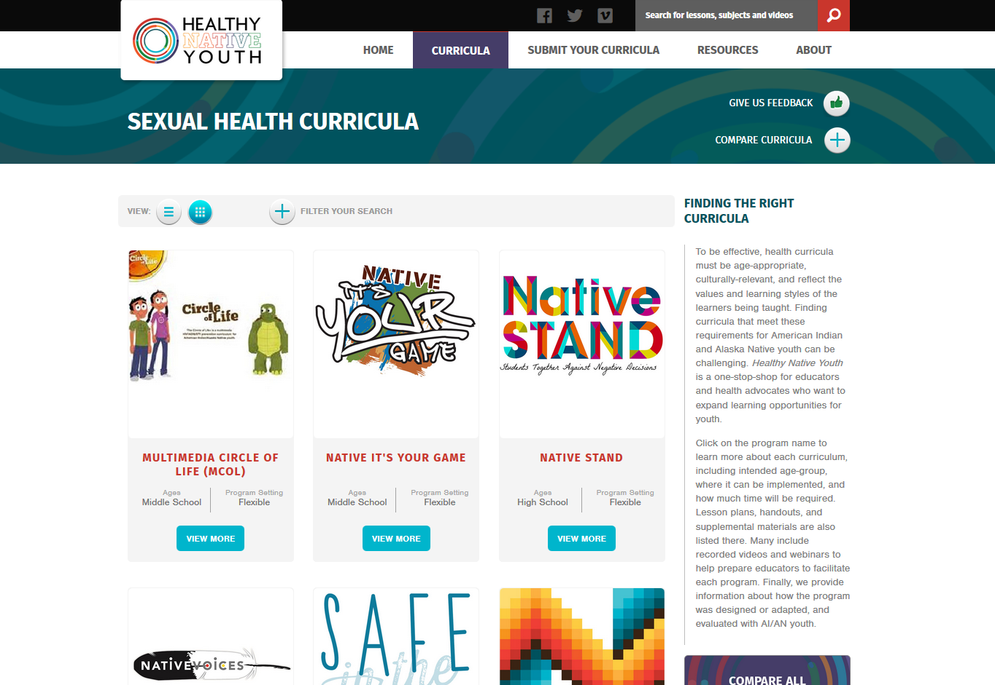
Healthy Native Youth Website
Notes:
From the Curricula tab…
You can click on the program name to learn more about each curriculum, including intended age-group, where it can be implemented, and how much time will be required.

Slide 6
Notes:
You can filter your search by age, lgbt inclusivity, program setting, and evidence of effectiveness.

Slide 7
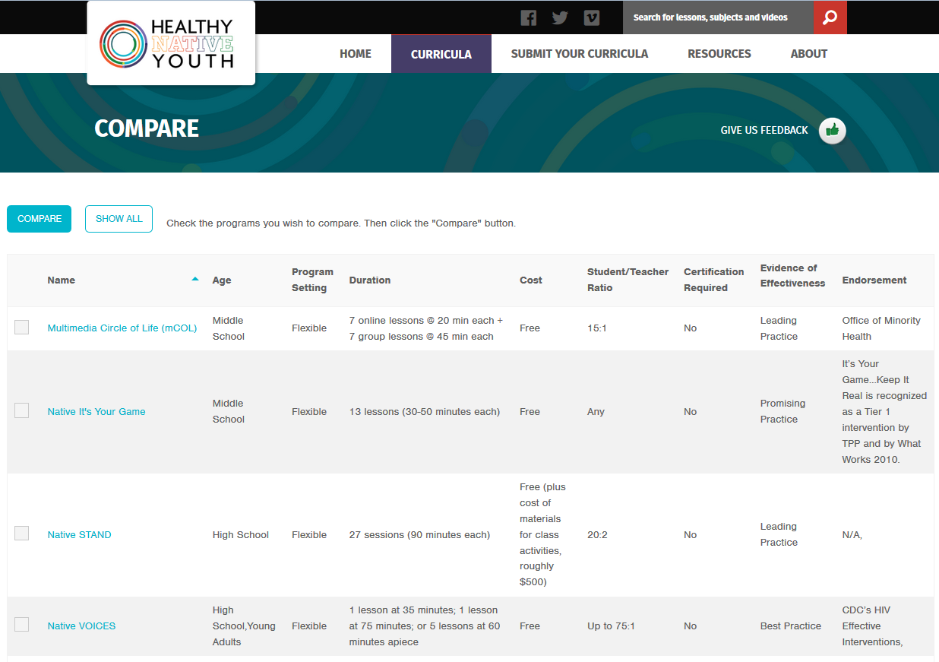
Notes:
You can also compare two or more programs to each other… by class size, cost, or program duration.

Slide 8
Notes:
Once you’ve selected a program, each has folder tabs that contain lesson plans, handouts, and supplemental materials. Many include recorded videos and webinars to help prepare you to facilitate the program.
We also provide information about how the program was designed or adapted, and evaluated with AI/AN youth.

Slide 9
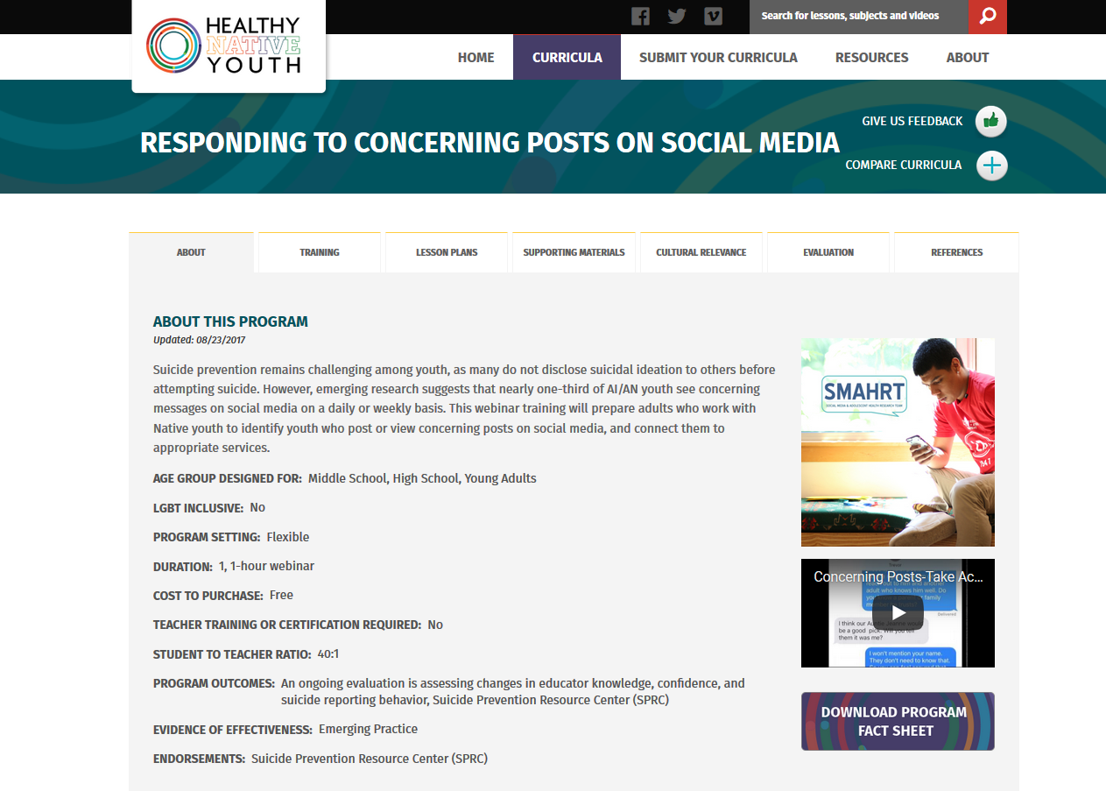
Notes:
The new 1-hour webinar training will prepare adults who work with Native youth to help youth who post or view concerning posts on social media, and connect them to appropriate services.
The training is designed for adults who work with Native youth, including: parents, mentors, teachers, coaches, health educators.

Slide 10
What are “Concerning Posts”?
Concerning posts include those that express depression or intent to hurt one’s self or others, that have been posted on a social media site, such as Facebook, Instagram, Twitter, or Snapchat.
Notes:
Emerging research suggests that nearly one-third of AI/AN youth see concerning messages on social media on a daily or weekly basis.
These include posts that express depression, grief, intent to hurt one’s self, or intent to hurt others, that have been posted on a social media site, such as Facebook, Instagram, Twitter, or Snapchat.

Slide 11
1. Watch the video training (30 min.)
Please click here to watch the training video.
Notes:
The one-hour training includes a 30-minute video, that you can share with adults in your community to better understand the issue.

Slide 12
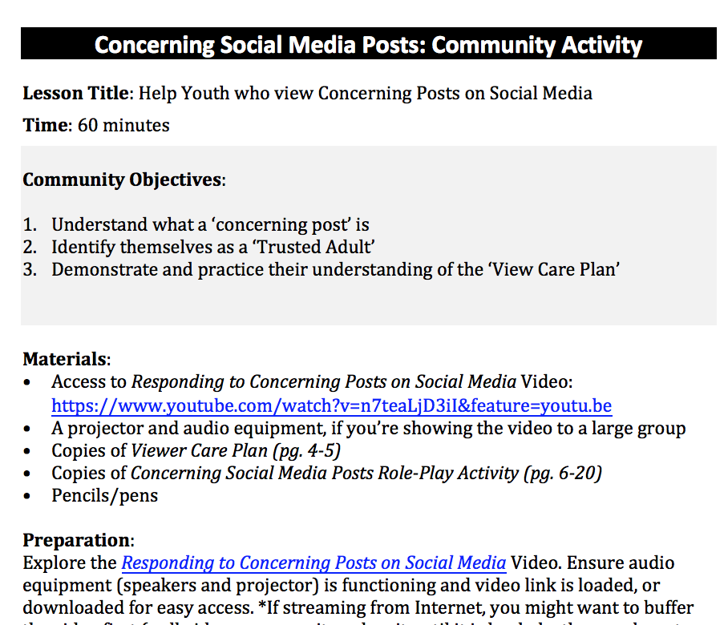
Community Awareness Activity
Notes:
In the “Resource” tab, we’ve also created two Community Awareness activity guides that you can use to raise awareness about this topic: one for youth and one for adults.
It can be used just about anywhere: at school events, at a staff meeting, a tribal council meeting, or at tribal gatherings.

Slide 13
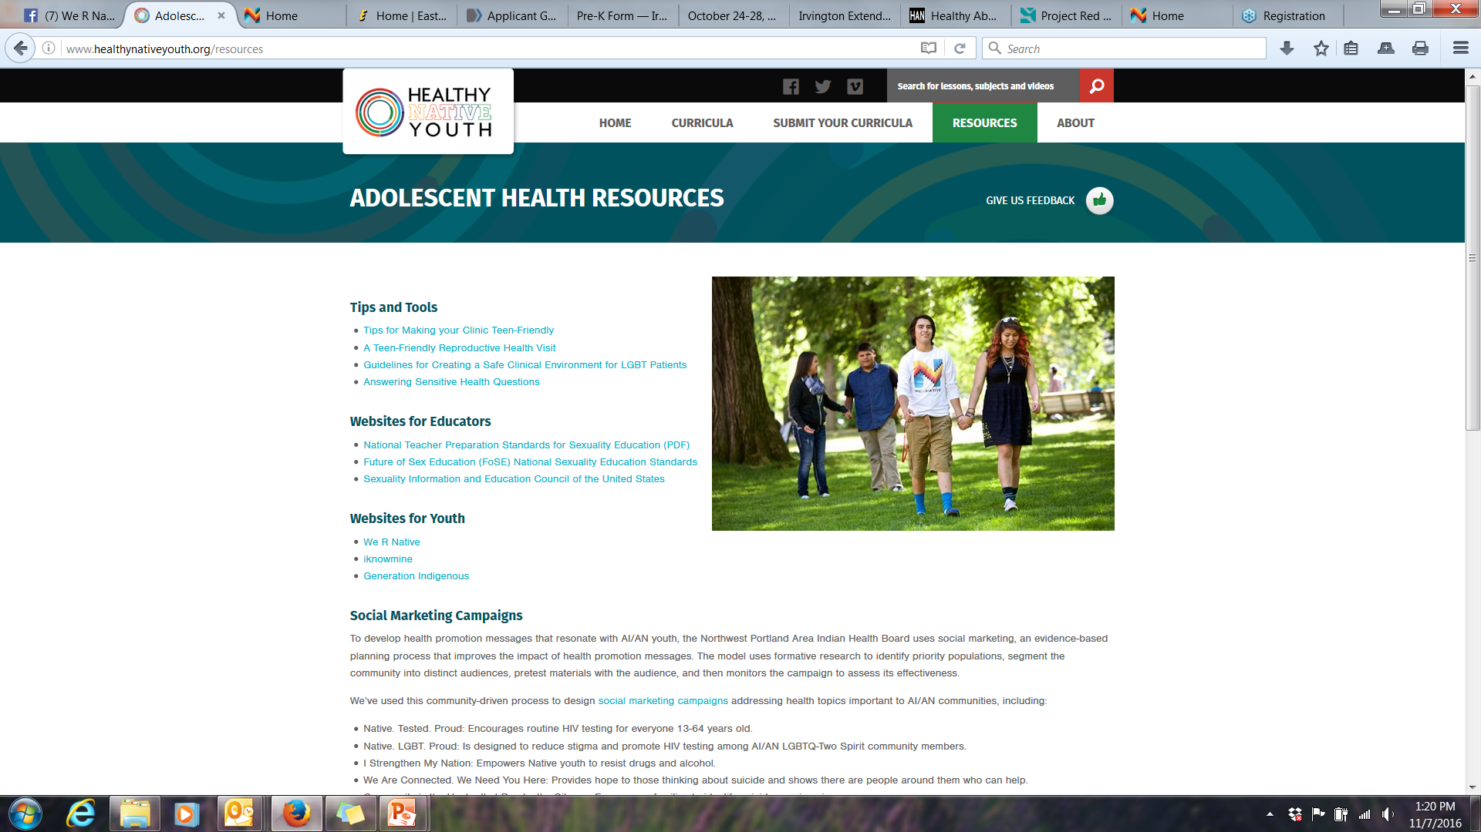

Slide 14
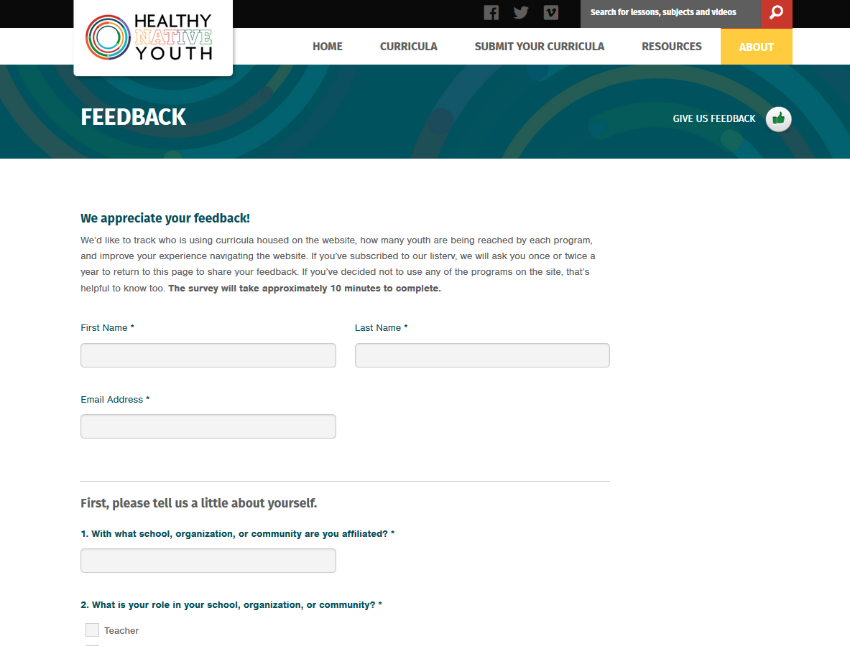
Notes:
Please let us know if you select or use a program on the site. (10 minutes!)
This is what we use to show the reach of the programs available on the site – who is using them and how many youth have been taught.

Slide 15
Notes:
Also, help us grow.
If you have a health program that you’d like to share… Consider housing it here! It will be made available to educators across Indian Country, and you’ll receive feedback on program uptake and reach, with the ability to update training materials and lesson plans as needed.

Slide 16
Back-To-School Challenge

Slide 17
Take the Back-to-School Challenge
A 3-month challenge to help students grades 6-12 develop skills for healthy relationships. Earn your class free school supplies!
Step 1: Select a curriculum from HNY.
Step 2: Implement it with a group of students
Step 3: Complete the Feedback Form by Dec 1st: https://www.healthynativeyouth.org/about/feedback

Slide 18
Win Prizes!!!
First 10 entries = $250 in School Supplies
All Participants = We R Native
Promo Kits

Slide 19
Notes:
Share the site with your community networks: www.HealthyNativeYouth.org Sign up to receive updates about curricula available on the site (in the red bar at the bottom of the homepage) Follow the site on Facebook (www.facebook.com/HealthyNativeYouth)

Slide 20
This project is funded by the Indian Health Service HIV and behavioral health programs. This work is also supported with funds from the Secretary’s Minority AIDS Initiative Fund.

