Slide 1
Executive Director Report
Seven Feathers Casino Resort
Canyonville, OR
July 18, 2017
Joe Finkbonner, RPh, MHA

Slide 2
Personnel
Temps & Interns
Ashely Swetzof
Kauna Tirumala
Alyssa Bosold
Separation of Employment
Rosetta Minthorn

Slide 3
Meetings
APRIL
4/24-4/27 - 2017 Annual Tribal Self-Governance Spokane, WA
MAY
5/17- Legislative Commission on Indian Services, Salem, OR
5/23-5/26 - ATNI Mid-Year Conference, Portland OR

Slide 4
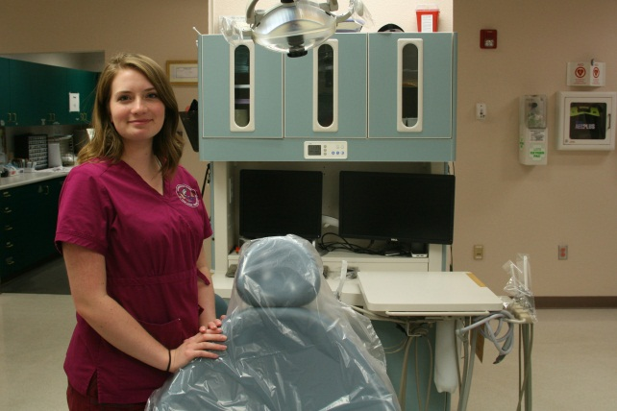
Meetings
JUNE
6/2 - DHAT Graduation, Anchorage, AK
6/5-6/8 - NIHB National Tribal Public Health Summit, Anchorage, AK
6/19-6/22 - PHAB, Washington, DC
Naomi Petri, CTCLUSI

Slide 5
Upcoming Events
AUGUST
8/2 – 8/3 - 14th Annual Direct Service Tribes Meeting, Danvers, MA
8/2 – 8/3 - Portland Area 93-638 Orientation, Portland, OR
8/2 – 8/3 - Idaho Tribes/State Meeting, Ft. Hall, ID
8/8 - 8/10 - Portland Area Dental Meeting

Slide 6
Upcoming Events
AUGUST
8/30-8/31- Native Fitness XIV, Nike World HQ
SEPTEMBER
9/8 - NWIC Quarterly Board Meeting
9/12-9/12 - PHAB 2017 Accreditation Committee Meeting, Washington, DC
9/14-9/16 - WDSF Board Retreat, Suncadia

Slide 7
Upcoming Events
SEPTEMBER
9/18-9/21 – ATNI Fall Convention, Spokane, WA
9/25-9/28 – NIHB Annual Consumer Conference, Bellevue, WA
OCTOBER
10/5-10/6 - NPAIHB Staff Retreat, Suquamish Casino Resort

Slide 8
Other Events
6/12 - 6/30 - Summer Institute
8/18 - NPAIHB Staff Picnic, Oak Park, Portland, OR
8/25-8/26 - Hood to Coast Running & Walking Team
9/22 12th Annual Dancing In the Square Indian Day Celebration
Office Remodel underway….

Slide 9
Questions…..

