Slide 1
Notes:
Stay Connected! To get custom resources and tailored content for you and your area, you can join our text message service by texting HCV to 97779. We’ll also be sending out today’s slides via text.

Slide 2
Using the ECHO model to treat and cure HCV in Indian Country
David Stephens, BSN, RN
Jessica Leston, DrPH (c), MPH
Joint CRIHB NPAIHB Board Meeting

Slide 3
Why is HCV a problem? What are the solutions? What is our BIG GOAL?
Outline

Slide 4
Goal of treatment
“The goal of treatment of HCV-infected persons is to reduce all-cause mortality and liver-related health adverse consequences, including end-stage liver disease and hepatocellular carcinoma, by the achievement of virologic cure as evidenced by an SVR”
SVR: sustained virological response hcvguidelines.org

Slide 5
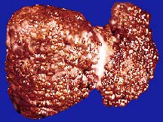
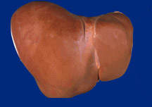
Why do we need to treat HCV?
SVR (cure) of HCV is associated with:
70% Reduction of Liver Cancer
50% Reduction in All-cause Mortality
90% Reduction in Liver Failure
Lok A. NEJM 2012; Ghany M. Hepatol 2009; Van der Meer AJ. JAMA 2012
Notes:
With the availability of DAAs, the disease burden would further reduce. For instance, 260,000 deaths would be averted because of the availability of DAAs (in comparison with pre DAA era).
60-70% reduction in the advanced HCV outcomes

Slide 6
HCV Deaths and Deaths from Other Nationally Notifiable Infectious Diseases,* 2003- 2013
* TB, HIV, Hepatitis B and 57 other infectious conditions reported to CDC
Holmberg, S. D., Ly, K., Xing, J., Hughes, E., Moorman, A. C., & Jiles, R. (2015). Continued Rising Mortality From Hepatitis C Virus in the United States, 2003–2013. Open Forum Infectious Diseases, 2(Suppl_1). doi:10.1093/ofid/ofv131.177
Notes:
This slide from CDC shows that HCV related deaths now outnumber deaths from all other notifiable infectious diseases combined and continues to trend upward. The HCV-related mortality rate among AI/AN is the highest of any race, and is 2.6 times that of Whites.
Estimated 3.5 million Americans with chronic infection
I/T/U diagnose over 2,000 new patients per yea
Current NPIRS data has found 34,000 unique patients in I/T/U facilities with an HCV ICD code. Of these, about half are ‘baby boomers’ born 1945-1965. Many Boomers have had asymptomatic infection for decades and now have late stage liver disease from HCV. These data lead us to estimate between 4 to 5 thousand HCV patients in our system have late stage disease and need to be cured as soon as possible. Curing a patient of HCV is associated with significantly lower rates of cirrhosis, liver cancer, and all-cause mortality. We can help your facility panel and prioritize your HCV patients.

Slide 7
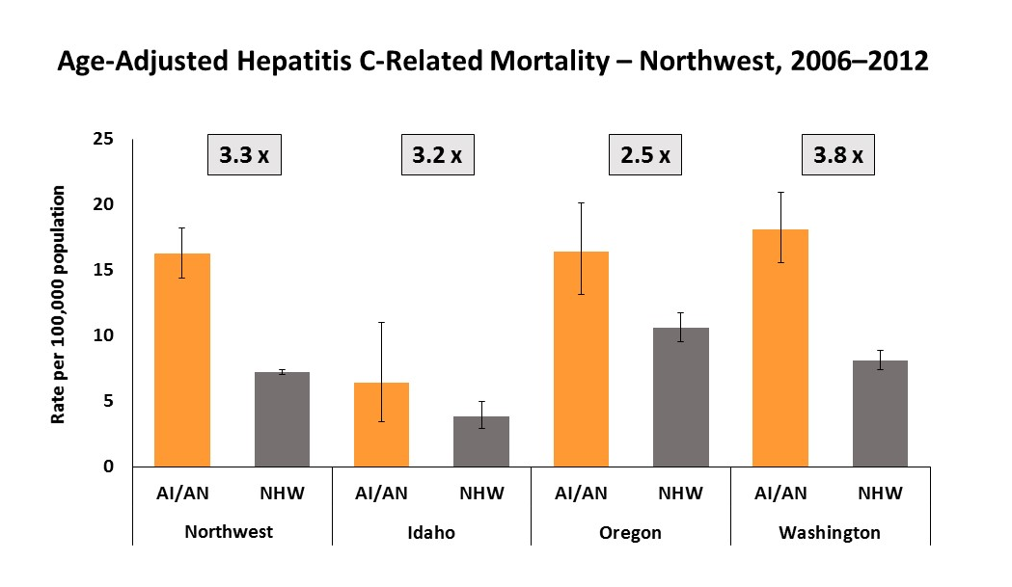
Mortality
Notes:
About 20,000 persons die from HCV each year. Hepatitis C is a preventable and curable disease.
The most recent national data show AI/ANs with both the highest rate of acute HCV infection and the highest HCV-related mortality rate of any US racial/ethnic group. In the Northwest from 2006–2012, the AI/AN HCV-related mortality rate was over three times that of non-Hispanic whites. This disparity has persisted over time, demonstrating the need for access to treatment.

Slide 8
The Problem - Lack of specialist availability limits access to HCV treatment
Specialist Providers
3,500,000
Patients with Chronic
HCV
20,000
Notes:
A significant limitation to access is the lack of capacity for care amongst specialty providers. Given prior IFN based treatments were complicated, with significant monitoring requirements, the standard of care was to receive HCV treatment by a liver or ID specialist. However, in the US, there exist only 20,000 HCV specialty providers, for almost 3 million chronically infected Americans. With the expanding ease of therapy, and minimal contraindications to care, this number of providers is no longer sufficient.
Lack of access to specialty care is particularly stark in community-based health centers, where patients are often uninsured, or underinsured. As a result, patients face multiple barriers to accessing HCV care, including extended wait times, scheduling inflexibility, and lengthy travel to appointments.

Slide 9
The Problem
HCV is just one problem of many
Backlog of hepatitis C positive patients that now have to be systematically managed.
“The Indian Health Service (IHS), an agency within the Department of Health and Human Services, is responsible for providing federal health services to American Indians and Alaska Natives. The provision of health services to members of federally-recognized Tribes grew out of the special government-to-government relationship between the federal government and Indian Tribes. This relationship, established in 1787, is based on Article I, Section 8 of the Constitution, and has been given form and substance by numerous treaties, laws, Supreme Court decisions, and Executive Orders. The IHS is the principal federal health care provider and health advocate for Indian people, and its goal is to raise their health status to the highest possible level. The IHS provides a comprehensive health service delivery system for American Indians and Alaska Natives.”

Slide 10
Why is HCV a problem? What are the solutions? What is our BIG GOAL?
Outline

Slide 11
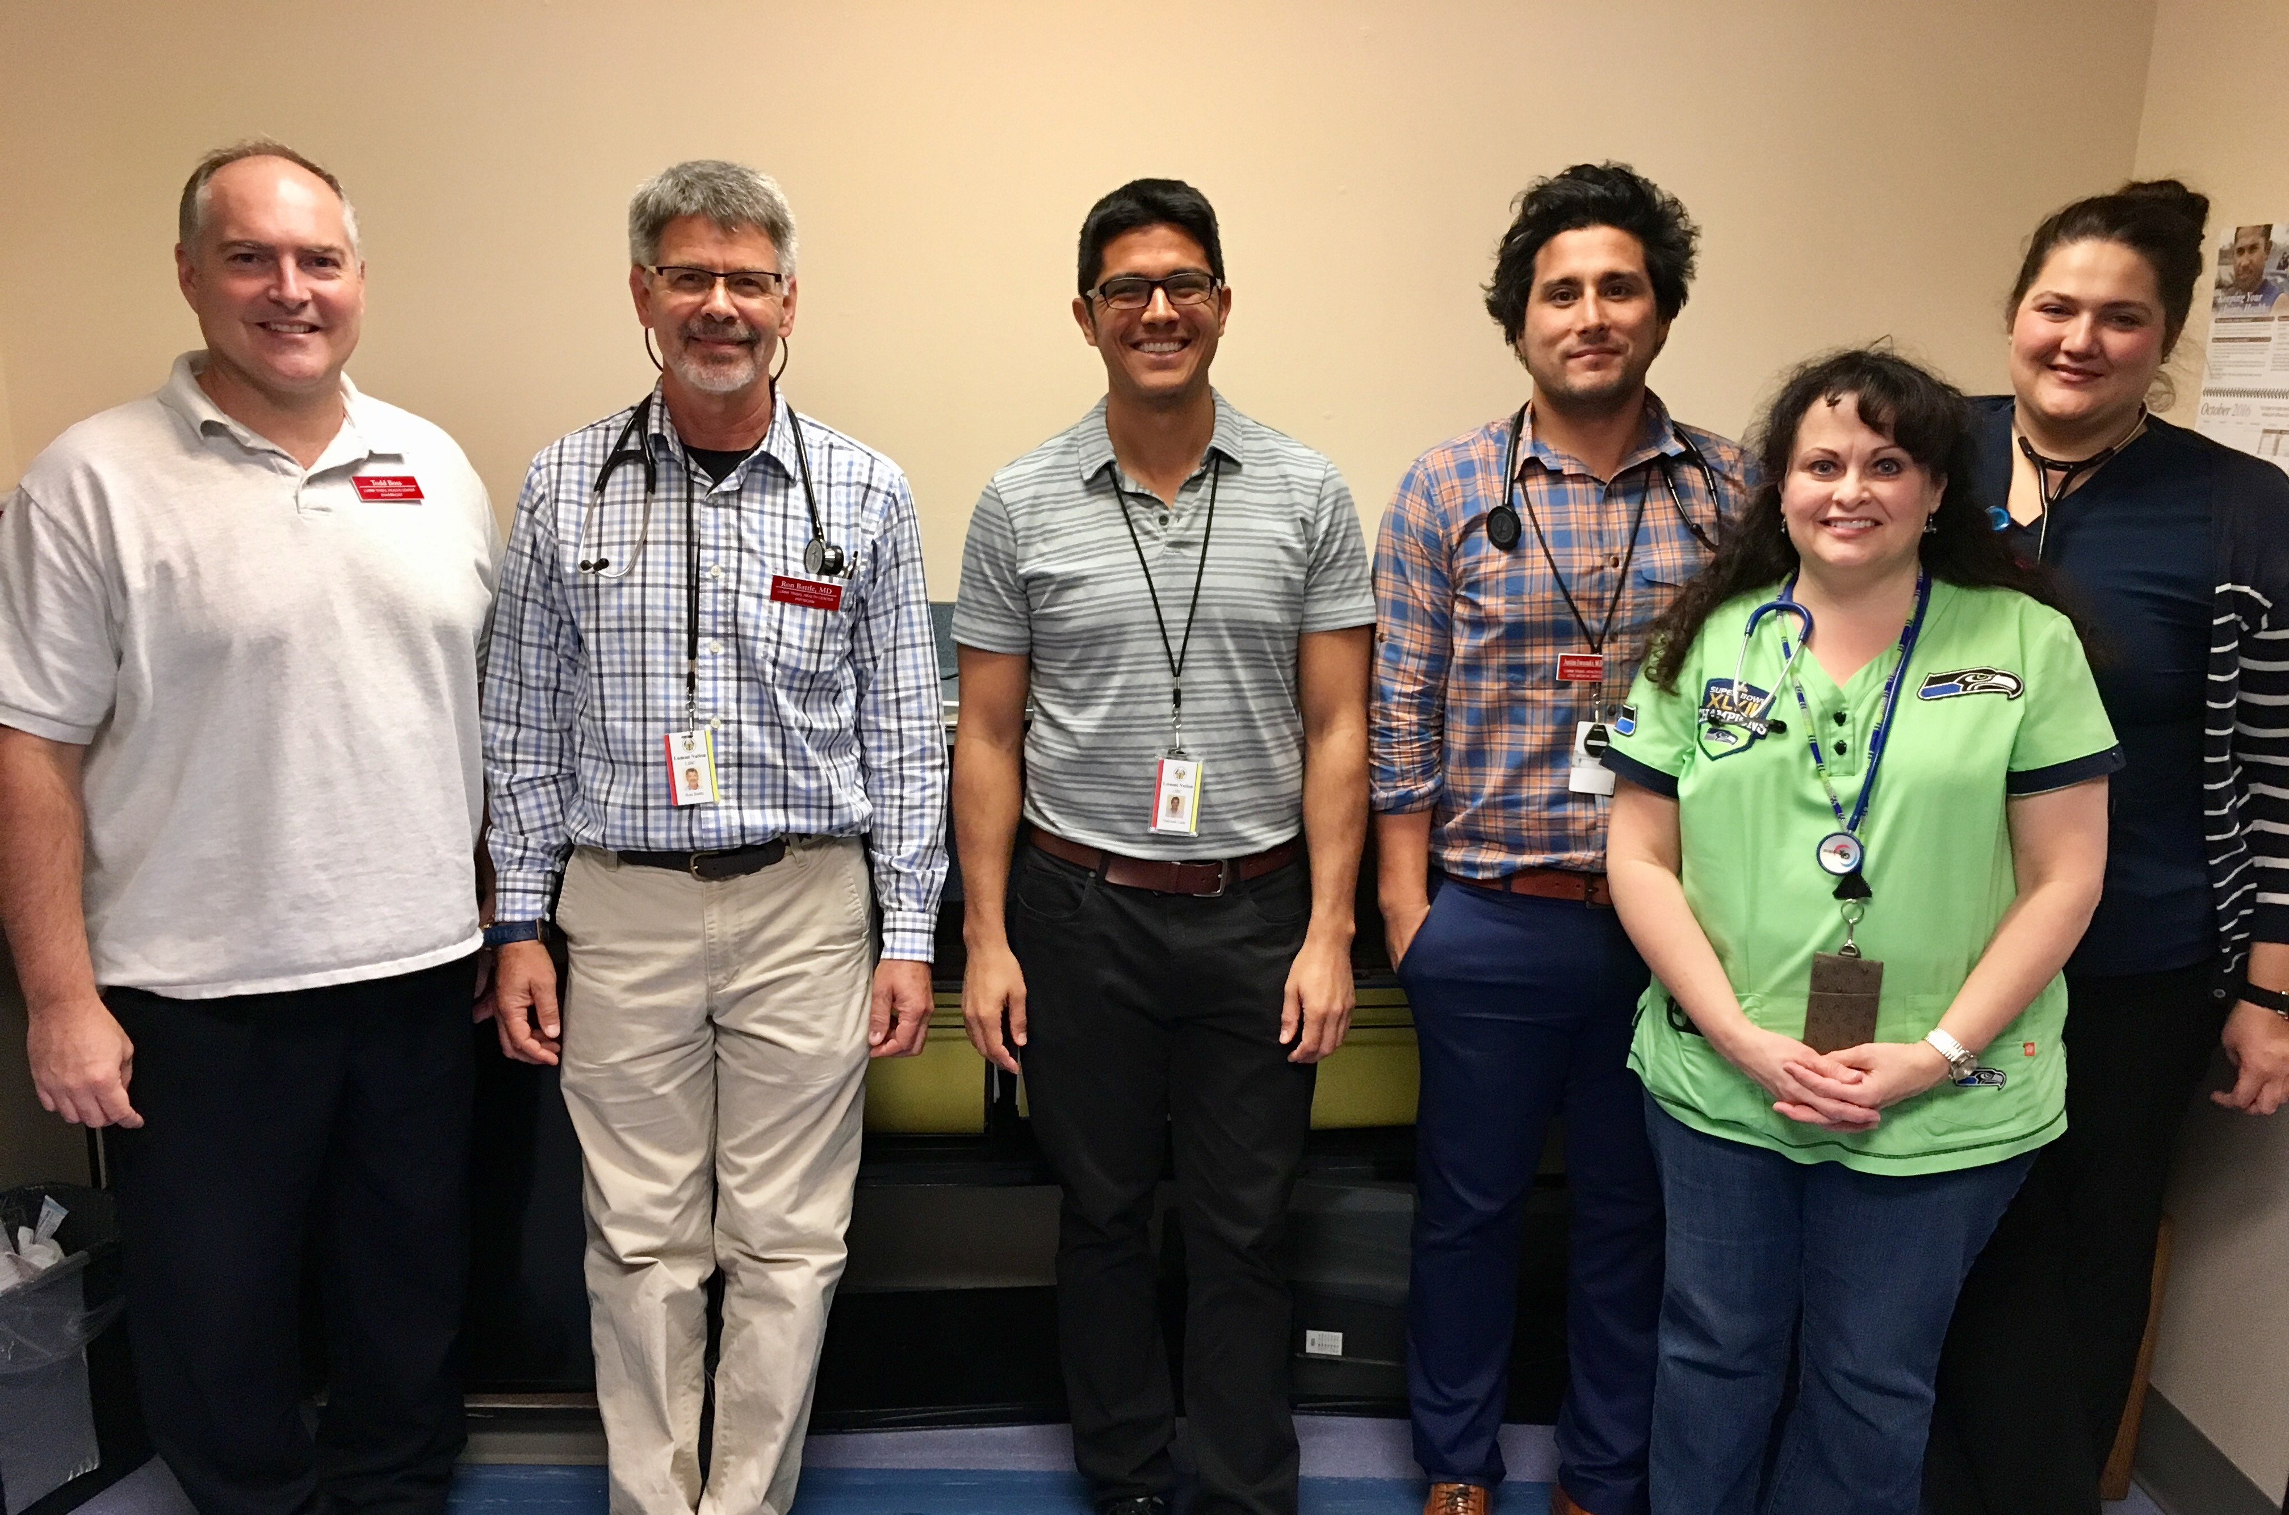
The Solutions
Notes:
Expand Clinical Capacity
The primary barrier mentioned by some of our clinics to implementing their Hepatitis C programs has been provider knowledge and comfort in prescribing the new DAA medications. So, some of our clinics have elected to send their physicians to the University of New Mexico, which is an opportunity offered to all IHS, tribal and urban providers, for a two-day HCV training.

Slide 12
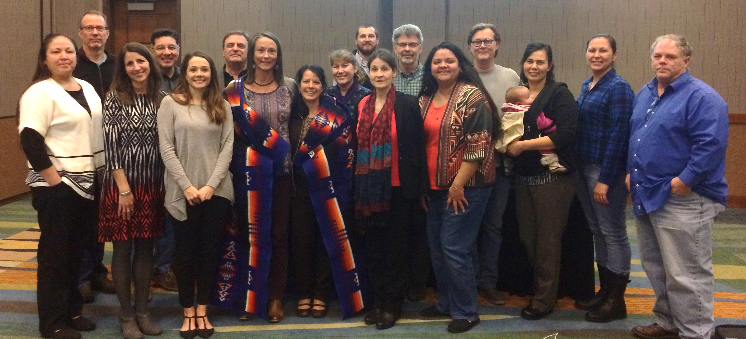
The Solutions
Notes:
Expand Screening
We hosted a free clinical training for I/T/U facilities. To make the training more real and palpable, MDs, NPs, RNs and pharmacists presented actual patients of theirs and tx recommendations were provided by Dr. Jorge Mera, who is an infectious disease doctor at Cherokee Nation. He and his team have treated over XX pts. Additionally, providers have been completing the University of Washington Hepatitis C Online course hepatitisc.uw.edu which is free to the public and provides continuing education for clinicians.
This training took place at Swinomish, WA where they have now expanded their age targeted screening to 20-69 years old and expanded screening to their dental clinic.

Slide 13
The Solutions
Notes:
Project ECHO (Extension for Community Healthcare Outcomes) is a collaborative model of medical education and care management that enables clinicians (regardless of where they live) to provide better care to more people, right where they live.
The ECHO model™ does not actually “provide” care to patients. Instead, it increases access to specialty treatment in rural and underserved areas by providing front-line clinicians with the knowledge and support they need to manage patients with complex conditions such as: hepatitis C, HIV, tuberculosis, chronic pain, endocrinology, behavioral health disorders, and many others. It does this by engaging clinicians in a continuous learning system and partnering them with specialist mentors and colleagues.

Slide 14
Notes:
Project ECHO is a learning and guided practice model that rethinks medical education and greatly increases workforce capacity to provide best-practice specialty care and reduce health disparities. The heart of the ECHO model™ is its hub-and-spoke knowledge-sharing networks, co-led by teams who use multi-point videoconferencing to conduct virtual clinics with community providers. In this way, primary care doctors, nurses, pharmacists and other clinicians learn to provide the best specialty care to patients in their own communities.

Slide 15
Notes:
Project ECHO® was created to effectively treat hepatitis C throughout New Mexico and to monitor outcomes. Once a combination of patient information is presented to the Hepatitis C Community TeleECHO Clinic, the community clinician is given a plan for treatment by the specialist. After hepatitis C treatment protocol is established, follow-ups are conducted to present the patient’s treatment status, to relay issues that may impede treatment, and to alter the treatment plan as needed to maximize the patient’s chance for a cure. Through the use of technology, best-practice protocols, and ongoing case-based learning, rural primary care clinicians deliver hepatitis C care that is as safe and effective as that given in a university clinic.
Project ECHO, the Indian Health Service (IHS) and the New Mexico AIDS Education and Training Center (NMAETC) began a collaboration in 2013, to bring HIV and hepatitis C virus (HCV) care and treatment to American Indian/Alaska Natives (AI/AN) throughout the United States. This collaboration created teleECHO clinic sessions specifically for clinicians serving these communities.

Slide 16
ECHO vs. Telemedicine
Notes:
Project ECHO® was created to effectively treat hepatitis C throughout New Mexico and to monitor outcomes. Once a combination of patient information is presented to the Hepatitis C Community TeleECHO Clinic, the community clinician is given a plan for treatment by the specialist. After hepatitis C treatment protocol is established, follow-ups are conducted to present the patient’s treatment status, to relay issues that may impede treatment, and to alter the treatment plan as needed to maximize the patient’s chance for a cure. Through the use of technology, best-practice protocols, and ongoing case-based learning, rural primary care clinicians deliver hepatitis C care that is as safe and effective as that given in a university clinic.

Slide 17
IHS HCV TeleECHO Clinic Sites
Notes:
The Indian Health Service (IHS) and Project ECHO began a collaboration in 2013, to bring HIV and hepatitis C virus (HCV) care and treatment to American Indian/Alaska Native people. This collaboration created teleECHO clinic sessions specifically for clinicians serving these communities.
Needed to fill gap in the NW. Launched in January of this year. Currently there are only 3 ECHO HUBs in Indian Country focused on HCV– Cherokee, UNM, and the Health Board.

Slide 18
What it means to be part of the NPAIHB ECHO Community
The 1 hour long clinic includes an opportunity to present patient cases and receive recommendations from a specialist
Engage in a monthly didactic session
10-15 minute presentation that focuses on:
The epidemiology of HCV in Indian Country (Brigg Reilley-Epidemiologist, IHS)
Assessment tools for clinicians (CAPT Stephen “Miles” Rudd-Medical Director POR Area IHS)
Demonstration of focused efforts (e.g. Cherokee elimination program)
Standard practice and evidence based interventions (e.g. AASLD HCV tx guidelines)
Access to medications (e.g. Medicaid overview in your state, etc.)
Become part of a learning community and network
Together, manage patient cases so that every patient gets the care they need
Notes:
The 1 hour long clinic includes an opportunity to present patient cases and receive recommendations from a specialist. Our sessions will be held every 4th Wednesday of the month from 12-1pm PST. For those folks who aren’t able to join via video conference, please send us an email so we can get you set up with a webcam.
As part of the clinic, participants engage in a monthly didactic session, which will be a 10-15 minute presentation. We’ll cover topics such as:
The epidemiology of HCV in Indian Country (Brigg Reilley-Epidemiologist, IHS)
An overview of Assessment tools for clinicians (CAPT Stephen “Miles” Rudd-Medical Director POR Area IHS)
Demonstration of focused efforts (e.g. Cherokee elimination program)
Standard practice and evidence based interventions (e.g. AASLD HCV tx guidelines)
Access to medications (e.g. Medicaid overview in your state, etc.)
Become part of a learning community and network, and together, we can manage patient cases so everyone can get the care they need.

Slide 19
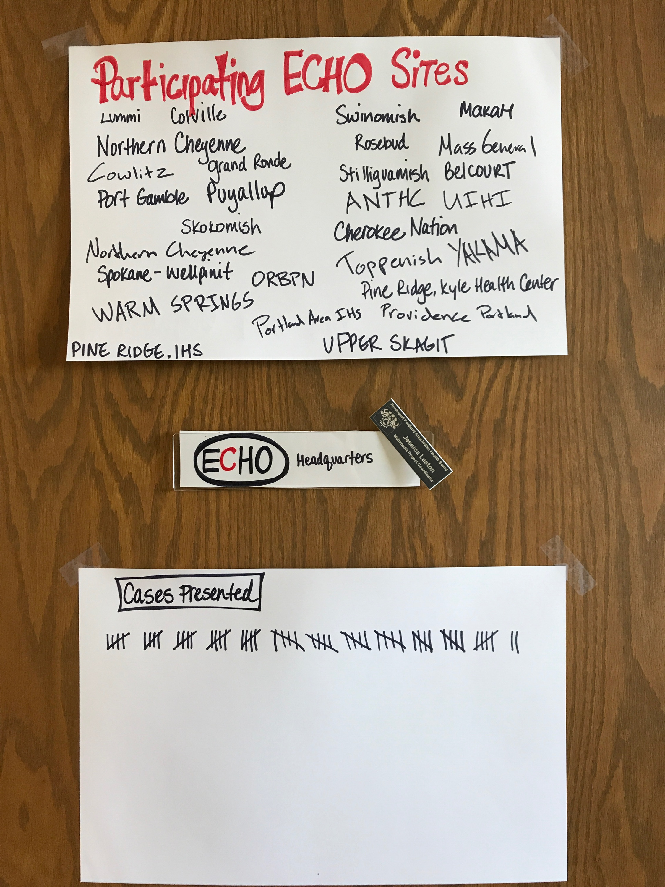
So far….
30 sites have joined
75+ people have participated
62 cases have been presented
Panel over 3,000 patients
Notes:
62 cases
29+ sites
75+ people

Slide 20
Why is HCV a problem? What are the solutions? What is our BIG GOAL?
Outline

Slide 21
HCV Elimination - Is it Possible in Indian Country?

Slide 22
HCV Elimination
Definition:
Reduction to zero of the incidence of infection caused by a specific agent in a defined geographical area as a result of deliberate efforts; continued measures to prevent re- establishment of transmission are required. Example: measles, poliomyelitis¹.
Goal:
Eliminate viral hepatitis as a major public health threat by 2030²
Miller M. et al. In Disease Control Priorities in Developing Countries: 2nd Edition 2006
National Academies of Sciences, Engineering and Medicine, 2016

Slide 23
Why is HCV Elimination Needed in Indian Country?
It is a recommendation from the National Academies of Medicine, 2016
The incidence of acute hepatitis C in AI/AN is higher than the U.S. population. (Estimated > twice the national prevalence.)
National Notifiable Disease Surveillance System
AI/AN have highest rates of HCV-related mortality of any race/ethnicity.
CDC National Hepatitis Surveillance 2015
At the present time we can deliver curative treatment to >90% of patients
Notes:
Highlight – present time
Citation

Slide 24
Learning from Example CNHS HCV Elimination Program Goals
Secure political commitment
Reduce prevalence by expanding
Screening
Linkage to care
Treatment
Cure
Reduce the incidence of new HCV infections
Notes:
These goals were pre-implementation goals from over 1 year ago and they still hold true today.

Slide 25
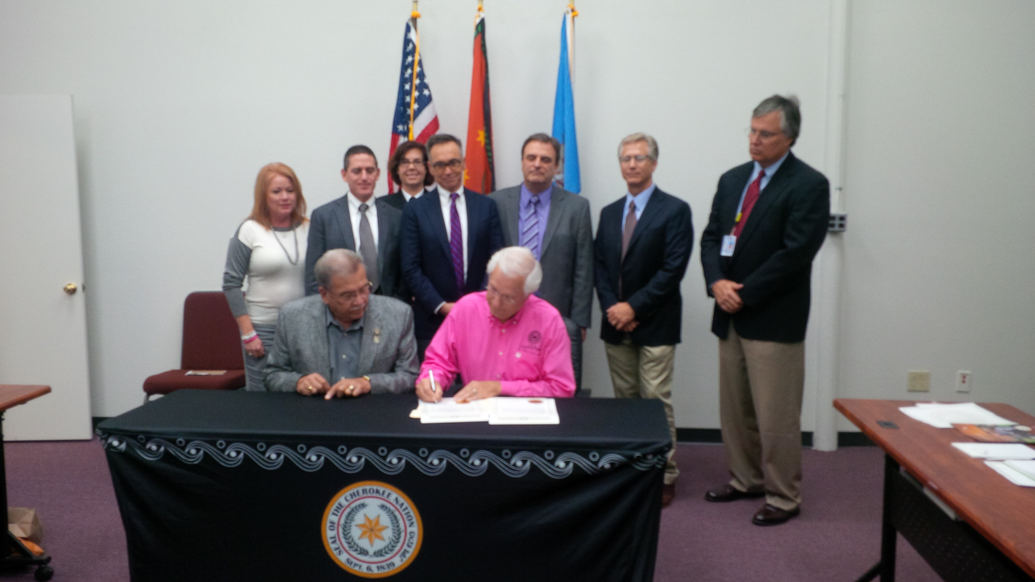
Goal #1: Political Commitment
Notes:
We knew within our tribal community that we would need public support and visible community awareness --- there would have to be tribal government officials who vocally supported our cause in order for us to build the infrastructure needed to meet our program goals.
Chief Bill John Baker

Slide 26
Goal #2: Screen, Link to Care, Treat, and Cure
Screen 85%
of Target Population
(80,828 AI/AN)
Universal Screening
(Ages 20-69)
Non-Traditional Screening Sites (ED/UC, dental, behavioral health)
New Screening Modalities
Evaluate 85%
Treat 85%
Cure 85%
Expand Clinical Capacity (ProjectECHO)
Expand Case Management Capacity
CNHS HCV Elimination Program Strategies and Goals, 8/2015-10/2018
CNHS: Cherokee Nation Health Services

Slide 27
HCV Screening in CNHS Oct 2012 – Mar 2017
MMWR Morb Mortal Wkly Rep 2016;65:461–466.
Pre-elimination Period (10/2012-7/2015) 16,772 patients screened*
Post-elimination Period (8/2015 – 3/2017) 28,824 patients screened
Primary Care
UC/ED/OB/Dental/BH
Universal Screening
Ages 20-69
Primary Care
Birth Cohort + Risk

Slide 28
HCV: Prevalence and Age Distribution during the Post Elimination Period, 8/2015 – 3/2017 (Preliminary Data)
Prevalence
Age Distribution of HCV ab (+) patients
28,824 patients screened
1,022 HCV seropositive
Overall Prevalence ~ 3.5 %
Baby boomers 3.8 % (11,700)
Non Baby Boomers 3.5 % (16,621)

Slide 29
CNHS HCV Program: Clinical Capacity Expansion1/2014 – 3/2017
HCV ProjectECHO
Introduced
HCV Elimination
Started
1 Specialist
2 Physicians
2 APRN
2 Pharmacists
7
1 Specialist
6 Physicians
5 APRN
8 Pharmacists
20
Number of patients
1 Specialist

Slide 30
Goal #3:Reduce the incidence of new HCV infections
Public and Provider Awareness
Contact Tracing
Acute HCV
PWID
Harm Reduction
Treatment as Prevention
OST
NSEP
Public Campaign
Provider Training
Notes:
In order to DECREASE INCIDENCE

Slide 31
CNHS HCV Cascade of Care* 10/2012 - 3/2017
*preliminary data
100 %
61 %
47 %
29 %
61%
62 %
90 % of patients who have completed treatment have achieved cure
Notes:
New treatments are simple, well-tolerated, and cure over 90% of patients, including in primary care settings"

Slide 32
Conclusions - elimination
Elimination of HCV in Indian country is possible but not effortless
HCV prevalence in AI/AN is higher than the overall US prevalence
Greater than 50% of the HCV seropositive patients are younger than baby boomers
The HCV elimination program should be based on
Universal screening
Robust primary care provider HCV workforce (Project ECHO)
Harm reduction
Challenges
Lack of NSEP, expanding OST program, hard to reach special populations, HCV surveillance and data collection

Slide 33
Conclusions
HCV is a problem in prevalence and mortality; and impact to our public health system and communities.
There are existing solutions out there that are working in Indian Country – in a variety of settings, on different levels.
We need to collectively strive towards elimination of hepatitis C.

Slide 34
Notes:
Stay Connected! To get custom resources and tailored content for you and your area, you can join our text message service by texting HCV to 97779. We’ll also be sending out today’s slides via text.

