Slide 1
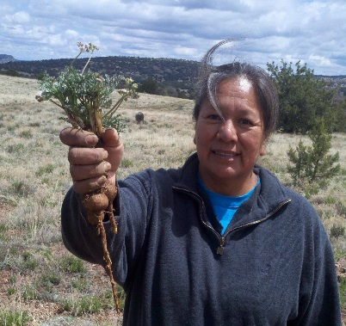
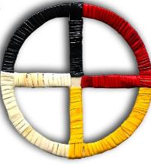
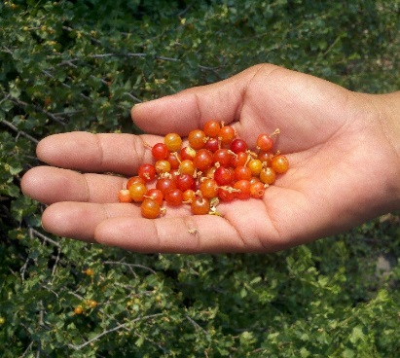
Good Health and Wellness in Indian Country
Ursula E. Bauer, PhD, MPH
Director, National Center for Chronic Disease Prevention and Health Promotion

Slide 2
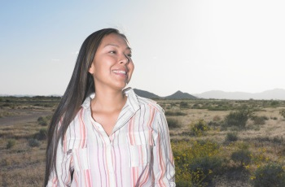
Harnessing Solutions in Indian Country
American Indians and Alaska Natives share a connection to lifeways that can sustain health and wellness.
CDC’s Tribal Advisory Committee:
Find ways to work directly with tribes and tribal organizations to build on strengths to improve health.

Slide 3
Good Health and Wellness in Indian Country
2014: 5 year, $15 million per year initiative
Funds tribes, tribal organizations and tribal epidemiology centers (TECs)
Long term goals:
  Reduce rates of death and disability from tobacco use by 5%.
  Reduce the prevalence of obesity by 3%.
  Reduce rates of death and disability from diabetes, heart disease, and stroke by 3%
Evaluation coordinated by Urban Indian Health Institute and TECs
Deep and broad reach in Indian Country
Communities of practice
Built for growth

Slide 4
Good Health and Wellness in Indian Country
Implement effective, culturally connected strategies to:
  Reduce commercial tobacco use
  Protect against secondhand tobacco smoke
  Improve nutrition
    Increase access to healthy traditional foods
    Reduce use of low nutrition foods and beverages
  Increase physical activity
    “Reclaim” traditional games
    Expand access to contemporary PA opportunities

Slide 5
Good Health and Wellness in Indian Country
Implement effective, culturally connected strategies to:
  Work with health systems to improve
    Control of high blood pressure
    Management of heart disease and diabetes
  Prevent diabetes among those at high risk
    Partnership with SDPI and DPP
    “Wrap around” nutrition and physical activity support

Slide 6
Current GHWIC Awardees and Activities
Twelve Tribes
Use community-chosen, culturally adapted policies, systems and environmental improvements to achieve GHWIC’s long-term goals
Year One Activities:
  Community Health Assessments
  Cross-sector workgroups
Year Two Activities:
  Implement programs based on assessments and funding
Eleven Tribal Organizations
Provide leadership, training, technical assistance and resource support to tribes in Area
Year One Activities:
  Assess existing infrastructure
  Support tribes (“subawardees”) to strengthen partnerships and implement strategies
Years Two - Five Activities:
  Provide TA and resources to tribes
  Provide evaluation assistance

Slide 7

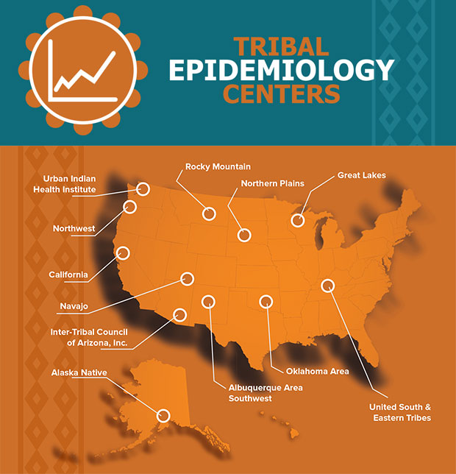
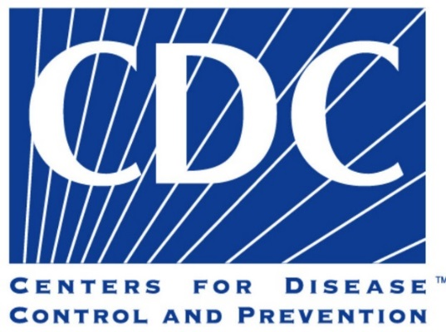

Evaluation
Eleven Tribal Epidemiology Centers (TECs) provide technical assistance to tribes and tribal organizations in area to evaluate program impact.
The Urban Indian Health Institute coordinates national evaluation of GHWIC.

Slide 8
Program Achievements
GHWIC work: coordinated, holistic tribally-driven approach to strengthen capacity to improve health of American Indians and Alaska Natives.
Examples:
CRIHB:
  Redwood Valley Rancheria adopted nutrition guidelines for Tribal activities
  Greenville Rancheria increased access to healthy foods and beverages through Living Well Program…
NPAIHB:
  Port Gamble S'Klallam Tribe implemented case-management teams to include behavioral health and social services
Notes:
The Tribal Health Program of the Greenville Rancheria, a subawardee of the California Rural Indian Health Board increased access to healthy food and beverages by introducing the Living Well Program (LWP) which offers monthly cooking and nutrition classes and educates participants on food shopping, availability, nutrition, and preparation. The program is improving LWP by starting a process where people with diabetes will be referred to the dental health clinic and physicians will be able to provide smokers with cessation resources.
The Pit River Health Service, a subawardee of the California Rural Indian Health Board, has increased access to healthy foods by coordinating a food voucher system for fruits and vegetables.
Catawba Indian Nation: Partnership with YMCA to provide CDC-recognized pre-diabetes program to tribal members
Albuquerque Area Southwest Tribal Epidemiology Center: Partner with University of New Mexico to train paraprofessionals from 27 Albuquerque tribes to prevent and manage diabetes, heart disease, stroke, risk factors. Train and mobilize up to 200 tribal professionals each year

Slide 10
Broad and deep reach into Indian Country
Through sub-awards, grantees are reaching many tribes in their areas
Sub-awardees – year 3/year 4
Sub-awardees – year 3/year 4
ANTHC: 5/5 awardees
AASTEC: 10/9
CRIHB: 25/~25
GLITC: 4/2
GPTCHB: 11/10
ITCA: 13/13 awardees
RMTLC: 2/2
NPAIHB: 11/11
SPTCHB: 13/18
UIHS: 9/9
USET: 8/8

Slide 11
Next: Expanding the model
FY2017 Omnibus Budget: $16 million additional resources to grow
  FY2017: New $8.5m Funding Opportunity out now
    Fund Tribal Epidemiology Centers
    Strengthen public health capacities
  FY2018: Additional Funding Opportunity ~$3m
    Fund tribes and urban Indian organizations
    Support tribal practices that promote health and wellness

Slide 12
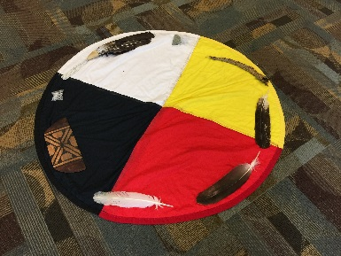
Tribal Practices – Seven Themes
Family & Community Activities That Connect Cultural Teachings To Health & Wellness
Seasonal Cultural & Traditional Practices That Support Health & Wellness
Social & Cultural Activities That Promote Community Wellness
Intertribal and NGO Collaborations That Strengthen Wellbeing
Intergenerational Learning Opportunities That Support Wellbeing & Resiliency
Cultural Teachings & Practices About Traditional Healthy Foods To Promote Health, Sustenance & Sustainability
Traditional & Contemporary Physical Activities That Strengthen Wellbeing

Slide 13
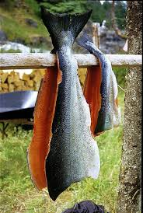
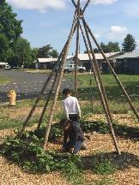
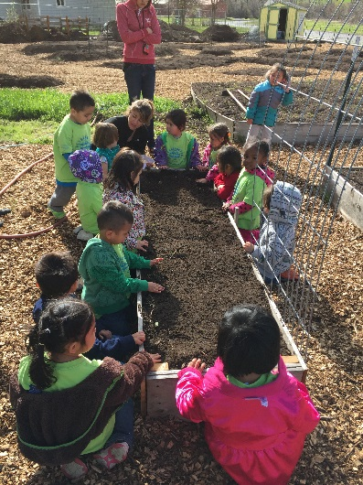
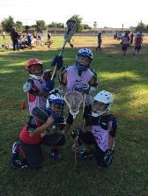
Thank you!
Questions?

