Slide 1
Dental Health Aide Therapists
Dental Health Aide Therapy in the Portland Area Update
CRIHB and NPAIHB Joint Board Meeting
July 19, 2017 11:30 AM
Christina Peters, Native Dental Therapy
Initiative Project Director
Northwest Portland Area Indian Health Board
Notes:
Hello,
My name is Christina Peters, I am the oral health project director for the Northwest Portland Area Indian Health Board and I’m really pleased to be here today to talk to you about the work we are doing in the Portland Area. I am going to start by attempting to cram about 5 hours of presentation on what the CHAP program is, the history of our work and the opportunity for economic development into about 10 minutes. So please don’t hesitate to ask questions, find me later for a deeper discussion, or google everything I say. But just remember, at the end I have an ask so please at least pay attention to that part

Slide 2
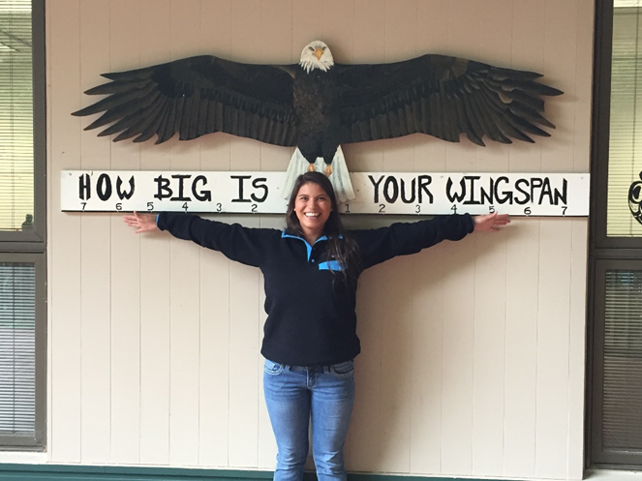
Building a 21st Century Health Team
Notes:
For a very long time, the health system has been failing native communities, not just in lack of access to care, but with low numbers of native providers. In the Portland Area we are doing exciting work based off of a system developed by the Alaska Natives, the Community Health Aide Program.

Slide 3
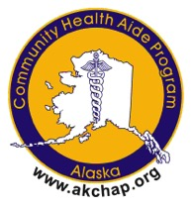
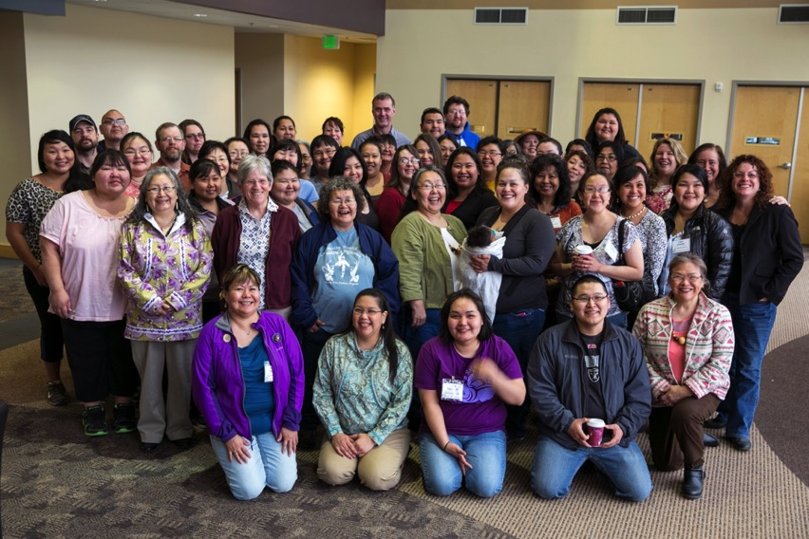
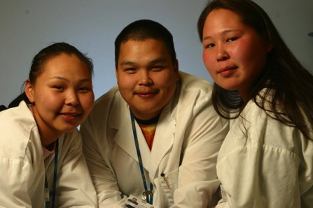
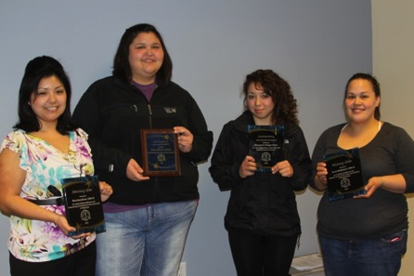
The Alaska
Community Health Aide Program
Alaska Native Tribal Health Consortium
web: www.akchap.org |www.anthc.org
Notes:
The Community Health Aide Program is a network of community health, behavioral health, and dental health providers in over 170 rural Alaska villages. Alaska Community Health aide practitioners are the frontline of healthcare in their communities.
Our most mature work in the Portland Area is the work to implement Dental Health Aide Therapy in the Portland Area. Dental Health Aide Therapists are one of many provider types available through this program.
In the Portland Area, we are exploring the possibility of implementing a full CHAP program

Slide 4
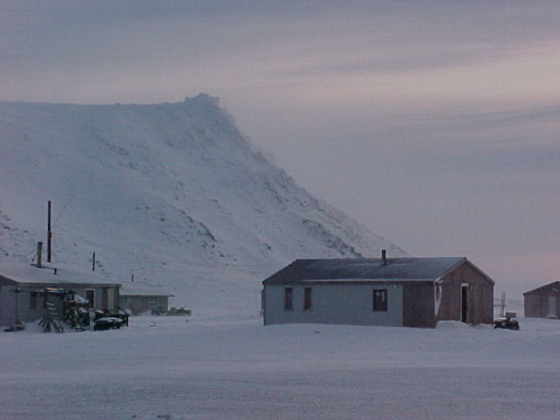
Health Aide Program Key Components
Community’s Role in Selection
Culturally Competent Care
Competency based curriculum
Team-Based Care
Gambell
Notes:
The CHAP program is different from the traditional health system because it was created by and for Native communities in Alaska. It works in tandem with the existing health system to create an accessible rung on the health providers profession ladder. This is important because American Indians and Alaska Natives are severely underrepresented in the health professions and their numbers are declining.
There is interesting work happening to better understand why fewer American Indian and Alaska Native youth are choosing the health professions, and we believe that the CHAP program is one of the many tools that we can use to both increase access to care and increase the number of native providers.

Slide 5
What is CHAP
CHAP is a system of allied health professionals that work with supervising dentists, doctors, and mental health professionals at the community level that extend the reach of those providers
CHAP providers are community members
Community Health Aides
  4 levels CHA I, II, III, IV, and CHA/P
Behavioral Health Aides
  4 levels BHA I, II, III, and BHA/P
Dental Health Aides
  5 levels PDHA I, II, EFDHA I, II, and DHAT

Slide 6
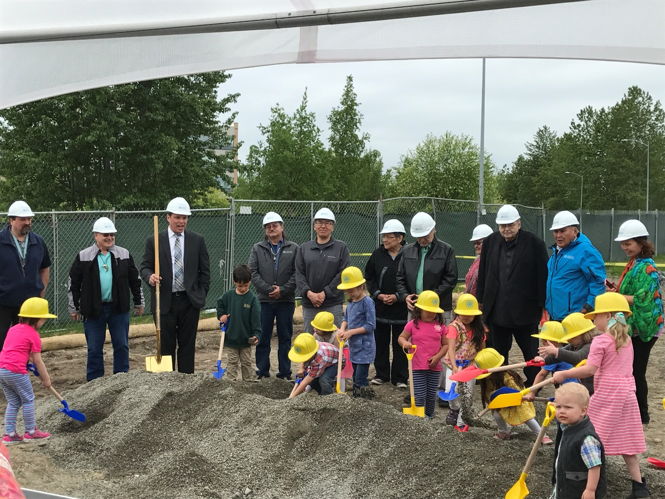
CHAP Training Program Expansion in Alaska
Notes:
Breaking ground, make jokes about child labor

Slide 7
Historical Trauma and Lack of Culturally Competent Providers
Male | 84%
Female | 16%
Native American | 0.1%
Asian/Pacific Islander | 7%
Black/African American | 3.5%
Hispanic/Latino | 3.5%
White/Caucasian | 86%
Source: American Dental Association, Bureau of Health Professions, HRSA
Notes:
We started with DHATs in the Portland Area because we had strong support from Chairman Cladoosby from Swinomish. He learned about dental therapy about 8 years ago at a meeting and a light came on. Dentistry in native communities is evolving but in many of our communities, dentistry has historically meant an itinerant dentist coming for a week or two per year to pull diseased teeth. And we all know that this historical trauma still affects tribal communities today in the health and oral health disparities in Native communities.
These lasting effects of a health system that doesn’t work for native communities requires us to support innovative initiatives that bring more native providers into the system.
There is a real lack of culturally competent providers – Native providers make up around 0.1% of dentists in the US

Slide 8
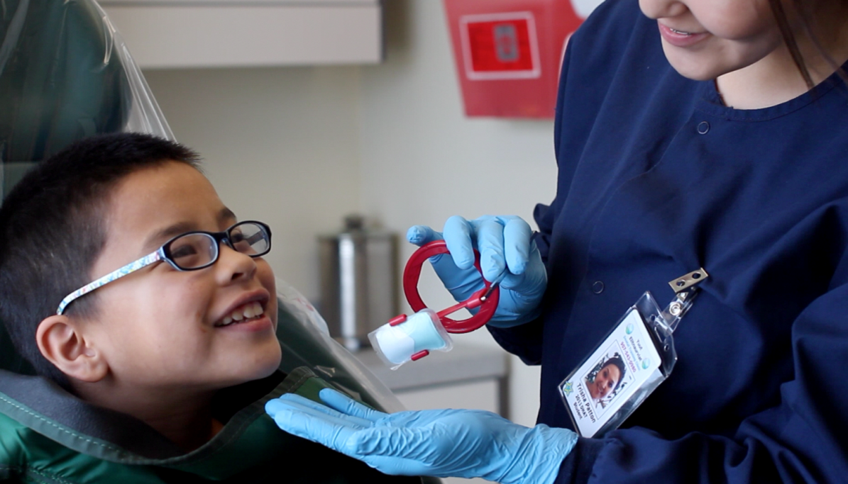
Tribal Health System Needs:
  Effective prevention efforts
  Culturally competent care
  Basic restorative services
  Locally provided
  Meeting our needs intelligently will lead to efficiencies
Trisha Patton, DHAT, taking x-rays on patient
Notes:
We don’t have to keep trying to fix a system not designed for our communities. It doesn’t have to be this way. We are all here because we believe that it doesn’t have to be this way.
And Tribes in Alaska, Washington, Idaho, and Oregon are leading the way to a new era of oral health care in tribal communities. Which works to empower and grow our tribal communities.

Slide 9
Alaska DHAT Scope of Practice and training
Dental Health Aid Therapist (DHAT)
[----]--------------------------------------
<50 Billable Procedures
DDS
[------------------------------------------]
>500 Billable Procedures
Source: Dr. Louis Fiset, BA-DDS-University of Washington
Notes:
DHATs are uniquely positioned to be recruited from, and placed back in their home communities that are often remote or lacking in sufficient access to dental providers. Tribes in the Portland Area are implementing in Dental Therapists because
The education program is also more accessible for our students. It is two years post high school with a small amount of pre requisites. Students complete the program and receive an AS degree in Dental Therapy. Dental education is notoriously competitive and expensive. DHAT education is collaborative, accessible, and really tailored to our American Indian and Alaska Native Students. It is a highly supportive environment with two primary goals of producing excellent providers and supporting students through the education process. The program has a nearly 65% graduation rate which is much higher than most 2 year community college programs (30 %).

Slide 10
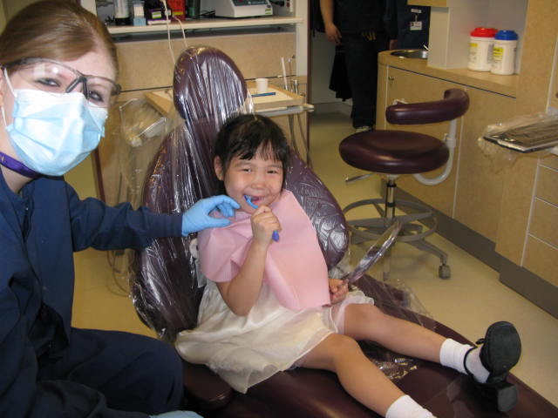
Dental Health Aide Therapy Programs
Expand access to consistent, routine, high quality oral health care in tribal communities;
Grow the number of AI/AN oral health care providers available to tribal communities;
Bring culturally competent care into tribal communities;
Create a more efficient and effective oral health team that can meet the needs of the tribal communities;
Establish cost effective solutions to oral health challenges into tribal communities;
Bring care where it is needed most.
Chelsea Shoemaker, DHAT, with Patient
Notes:
Our team at the Portland Area Board is working with our tribal communities to build oral health programs that utilize dental therapists. We believe that training our young tribal members to become health and oral health providers in their community is a strong and positive step toward breaking down barriers to care and will change the way oral health care is viewed in our communities.
The message that it sends to our next generation to see these native providers in their community is that you can do this in the future. You can go on to higher education and you can be contributing back to your community. This is a fantastic opportunity for native youth for them to get into a strong career and live at home in their communities and go to work and have the job satisfaction knowing that they are strengthening the health, oral health, and fabric their communities.

Slide 11
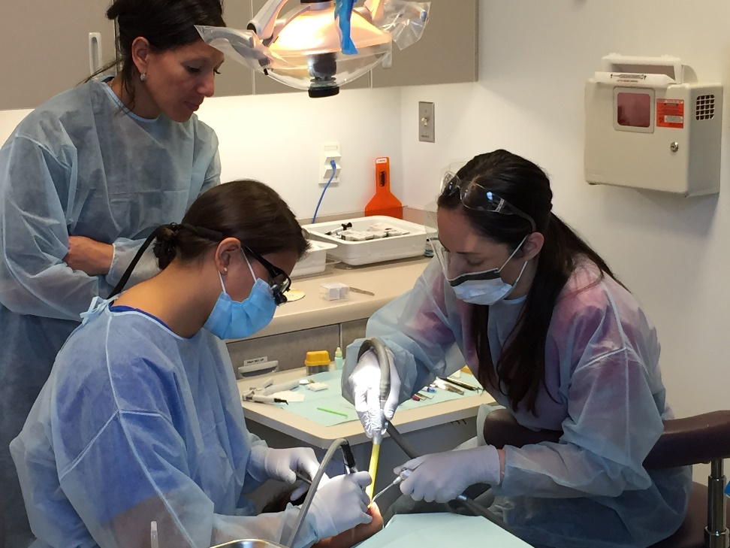
Dental Therapists in Action
Alaska’s Dental Therapists
35 dental therapists increased access to care for over 45,000 Alaska Natives
Provide culturally competent care
Produce high patient satisfaction rates
Reduce amount of emergency care
Increase preventive care
Create jobs and generate economic impact
  Created 76 full time jobs per year with total personal income of $4.4 million
  Net economic effect of program is $9.7 million in Rural Alaska
Swinomish Dentist Rachael Hogan observes DHAT Savannah Bonorden on a recent learning trip to Sitka, AK
Notes:
So why did a light come on for Chairman Cladoosby?
Because it is a good idea. . . And because it is a program built by tribal communities. It evolved in tribal communities and in the case of DHATs, the dental association is vehemently opposed to it and has spent a lot of resources fighting it because the system is working for them. . . It however is not working in many of our communities and Chairman Cladoosby has been a tireless advocate for this “disruptive technology” this systemic change to how health care is delivered in your communities.
We love that
78% of dental therapists practice in their village or region of origin;
87% of Dental Therapists are AI/AN
Retention rate: 81% over 10 years;
There is a High patient satisfaction
Educational program completion rate: 64% (US 2 year college completion rate about 30%)
Percentage of DHATs practicing in their village of origin or region of origin: 78%
Retention rate: 81% over 10 years

Slide 12
Yukon-Kuskokwim Health Corporation in Alaska
DHATs are increasing access to dental exams
DHATs are reducing costly emergency care
Notes:
And the health results are there – these are some results from a study in 2014 where you can see emergency visits going down, and preventive care going up
We looked closely at the health corporations in Alaska that were using dental therapists and for example Dental Therapists in the Yukon-Kuskokwin health corporation are increasing dental exams, particularly in the under 5 age group, reducing the need for emergency care and increasing access to preventive services.
These are the types of results we are hoping to replicate in Oregon and Washington.
(2009 Pre DHAT integration)

Slide 13

We better outcomes!
Children in communities with DHAT: 2006-2015*
D-E-F-G extractions
(front four teeth):
284% decrease
General Anesthesia:
44% decrease
Preventive care:
60% increase
*Dental Therapists and Dental Utilization
in Alaska’s YK Delta: Chi D, Lenaker D,
Mancl L, Dunbar M, Babb M
Notes:
This is what it is all about. Children keeping their teeth. Children not having to go under general anesthesia for full mouth restoration surgeries. Children getting preventive care right in their village.
This is just a teaser. Don Chi, a researcher at the University of Washington-working with colleagues including those at Yukon Kuskokwim Health Consortium--will be publishing this data soon.

Slide 14
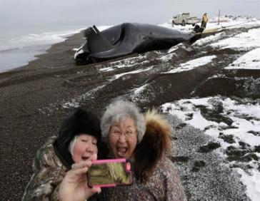
Adults: 2006-2015*
Adults in communities with DHAT: 2006-2015*
Extractions
26% decrease
Preventive Care
75% increase
The Blues & the News
*Dental Therapists and Dental Utilization
in Alaska’s YK Delta: Chi D, Lenaker D,
Mancl L, Dunbar M, Babb M
Notes:
And it isn’t just kids that are benefitting from DHAT. DHATs are caring for their whole community from babies to elders and everyone in between.

Slide 15
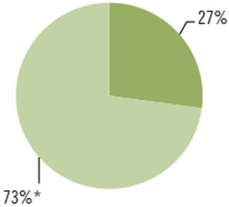
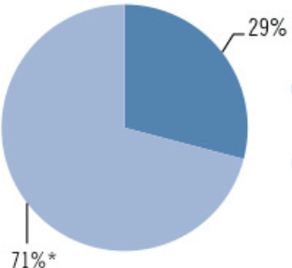
Financial Impact of Expanding the Dental Team
According to a May, 2013 Community Catalyst study on the economic viability of dental therapists in Alaska and Minnesota, dental therapists cost their employers less than 30 cents for every dollar of revenue they generate.
Total Revenue Generated by Advanced Dental Therapists and Dental Therapists in Minnesota - green
Dental Health Aide Therapists in Alaska – blue
http://www.communitycatalyst.org/doc_store/publications/economic-viability-dental-therapists.pdf;
Report conducted by Dr. Frances M. Kim, May 2013
Notes:
Not only are DHATs doing a great job providing care and reducing costly Emergency care, they are a source of revenue. For every dollar in revenue a dental therapist generated it took 27 cents to employ them in Alaska and 29 cents to employ them in Minnesota.
In Alaska, The Net revenue stream generated by the employer is $125,000-$245,000 per DHAT after costs (DHAT and dental assistant salary, benefits, travel, supplies, and other costs) Not only is dental therapy an opportunity for our youth, but they are also supporting other jobs in the community like dental assistants, front desk staff, and other clinic staff.
Swinomish did a survey of all their billings and found that a Dental Health Aide Therapist could have provided half of the services the dentist provided. They have done that analysis 3 years in a row and every year the results are consistent and growing.

Slide 16
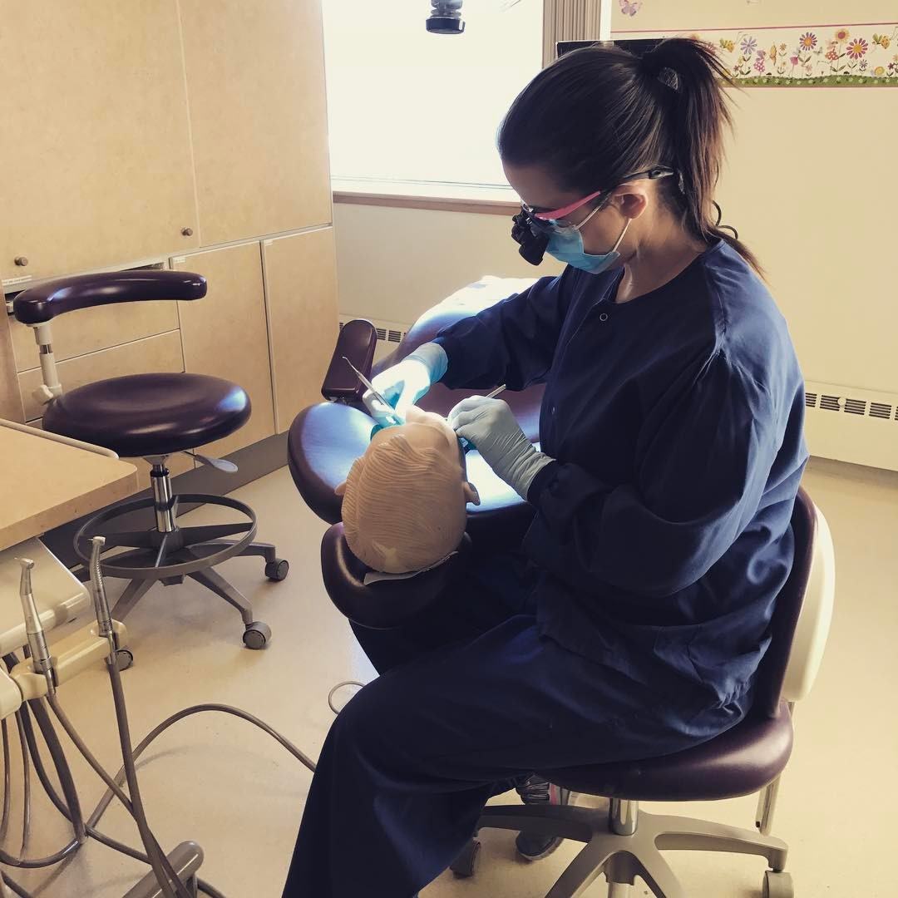
What we are working on
Develop infrastructure to support CHAP and DHAT programs
Training and Workforce Development
Ongoing Education Campaign
Evaluate DHAT project sites
Notes:
Our team at the Portland Area Board is working with our tribal communities to build oral health programs that utilize dental therapists. We believe that training our young tribal members to become health and oral health providers in their community is a strong and positive step toward breaking down barriers to care and will change the way oral health care is viewed in our communities.
The message that it sends to our next generation to see these native providers in their community is that you can do this in the future. You can go on to higher education and you can be contributing back to your community. This is a fantastic opportunity for native youth for them to get into a strong career and live at home in their communities and go to work and have the job satisfaction knowing that they are strengthening the health, oral health, and fabric their communities.

Slide 17
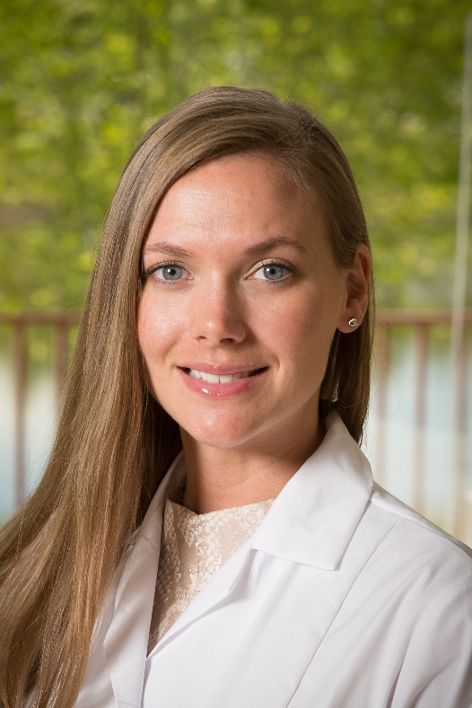
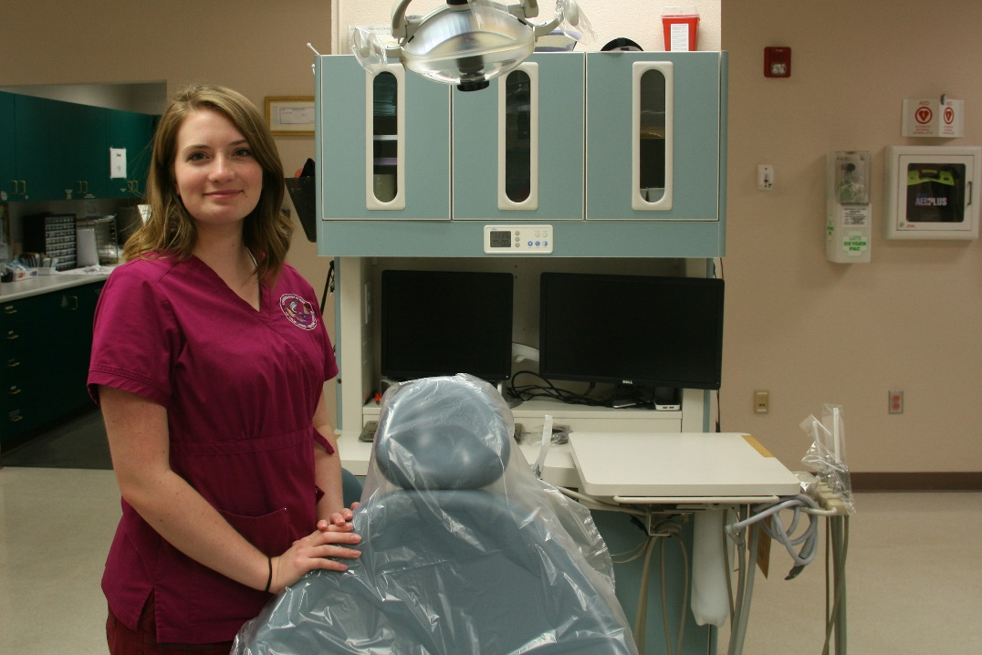
Confederated Tribes of Coos Lower Umpqua and Siuslaw Indians (OR)
Naomi Petri, Graduate 2017
Marissa Gardner,
DHAT class of 2018
Notes:
The education program is also more accessible for our students. It is two years post high school with a small amount of pre requisites. Students complete the program and receive an AS degree in Dental Therapy. Dental education is notoriously competitive and expensive. DHAT education is collaborative, accessible, and really tailored to our American Indian and Alaska Native Students. It is a highly supportive environment with two primary goals of producing excellent providers and supporting students through the education process. The program has a nearly 65% graduation rate which is much higher than most 2 year community college programs (30 %).
And now the best part, I get to introduce you to our students.
Naomi and Marissa are enrolled members of the Confederated Tribes of Coos Lower Umpqua and Siuslaw Indians. Naomi was her class highschool valedictorian and was interested in a career in dentistry. She had been working with the higher ed person at her tribe and they had landed on hygiene school until we reached out to the higher ed counselor and let her know about Dental Therapy. Naomi is our first student and will graduate this summer and go back and provide care to her community. Marissa was a couple of years out of high school and considering dental assisting. Again we worked with the higher ed counsellor at CTCLUSI and Marissa became our second student from CTCLUSI and will graduate class of 2018.
On the right side there you see Savannah Bonorden being assisted by Dr Sarah Rodgers. Savannah is a Native Alaskan from the Sitka Area that was working in construction when she went to a job fair and thought she’d give dental assisting a try. Her dentist in Sitka saw potential in her and encouraged her to become a DHAT. 6 years later, Savannah is a rising star and has started doing her pre reqs for dental school.

Slide 18
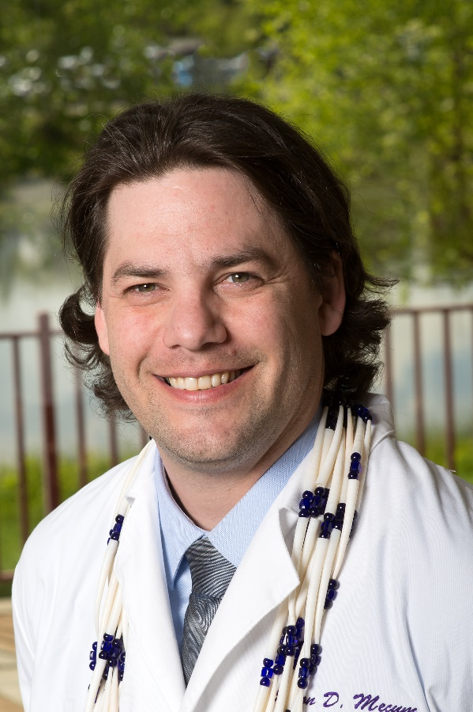
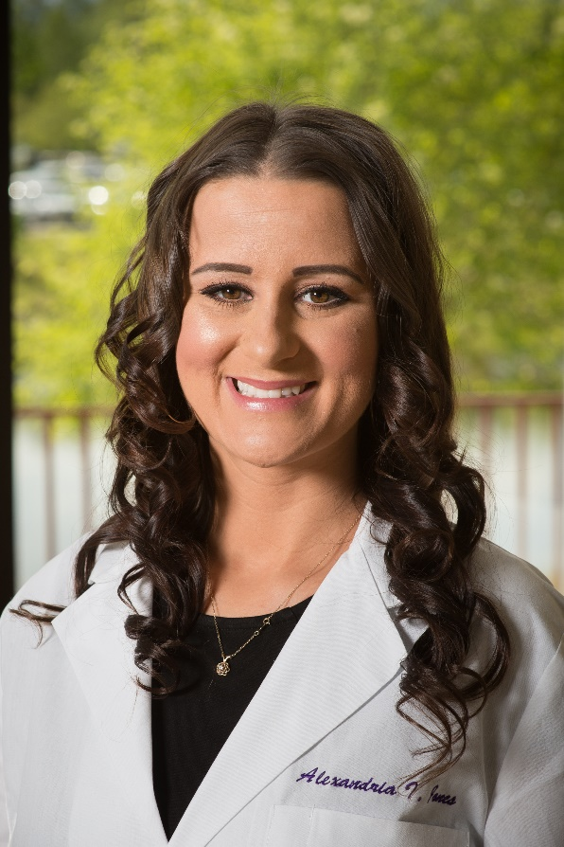
Coquille Indian Tribe (OR)
Jason Mecum,
DHAT Class of 2018
Alexandria Jones,
Class of 2018
Notes:
Central to all of our work are our students. Alexandria, a coquille tribal member former dental assistant in Medford was so excited about the possibility of being a DHAT and moving back to Coos Bay, back to where she grew up, She had read an article in the paper announcing the approval of our pilot project and saw that her tribe was involved. the day after our pilot project was approved she was on the phone to me asking how she could apply – she had also called her tribal health director and mom. Her husband and young daughter moved to Anchorage with her for the training program
Jason Mecum, also a coquille tribal member was an EMT and was considering nursing. He read about the pilot project in the Coquille community paper and decided this was an opportunity of a lifetime for him and that he should do it. When I spoke to him a couple of months ago he was telling me that at first he was worried that he couldn’t do this in the early days of the program but about half way through something clicked and he is getting more and more excited about going back and providing oral health care to his community.
They were both accepted last year to the ANTHC Dental Health Aide Therapy Training Program in Anchorage and will graduate in 2018. They have both also let me know that this “dental boot camp” has been one of the most challenging and rewarding times in their lives.

Slide 19
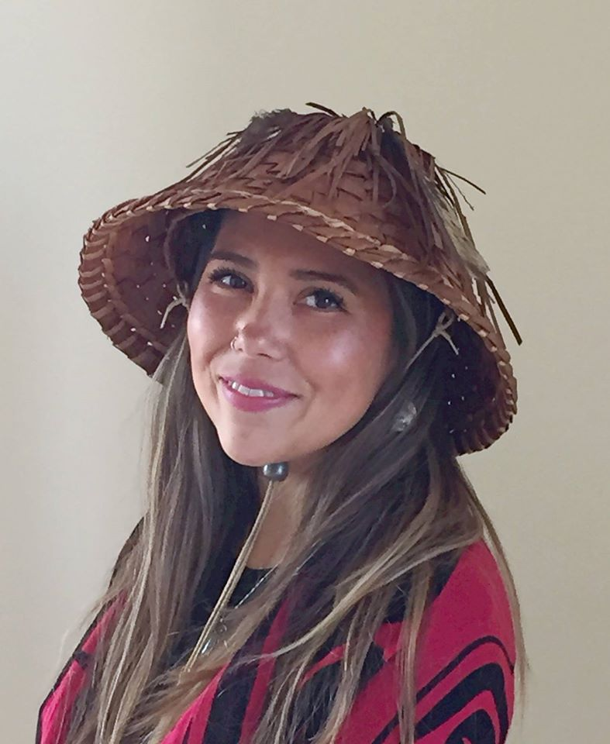
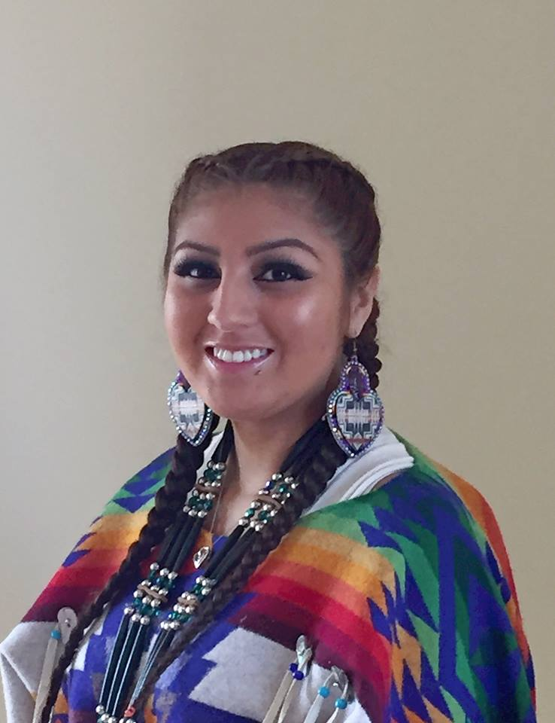
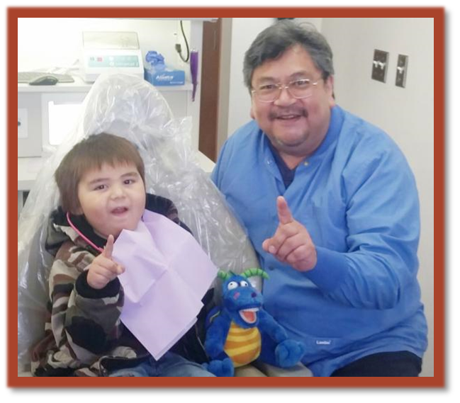
Swinomish Indian Tribal Community (WA)
The Swinomish dental team has celebrated the first anniversary of Daniel’s arrival to the clinic
Daniel Kennedy
Experienced DHAT
Sarah Chagnon,
DHAT Class of 2019
Asiah Gonzalez,
DHAT Class of 2019
Notes:
Swinomish was our first community to bring dental therapists into their dental program. Chairman Cladoosby is a tireless advocate for tribal sovereignty, youth empowerment, and dental therapy. Before we passed the bill in Washington authorizing the use of dental therapists in tribal communities in Washington state, he had already employed Daniel Kennedy there in the middle (with Brian’s Grandson).
This year Swinomish is sending two students Sarah and Asiah to the DHAT training program in Alaska. They both participated in an internship program designed by the Swinomish dental clinic to get their youth interested in dental care. These two outstanding young women are excited for their future careers as dental therapists.

Slide 20
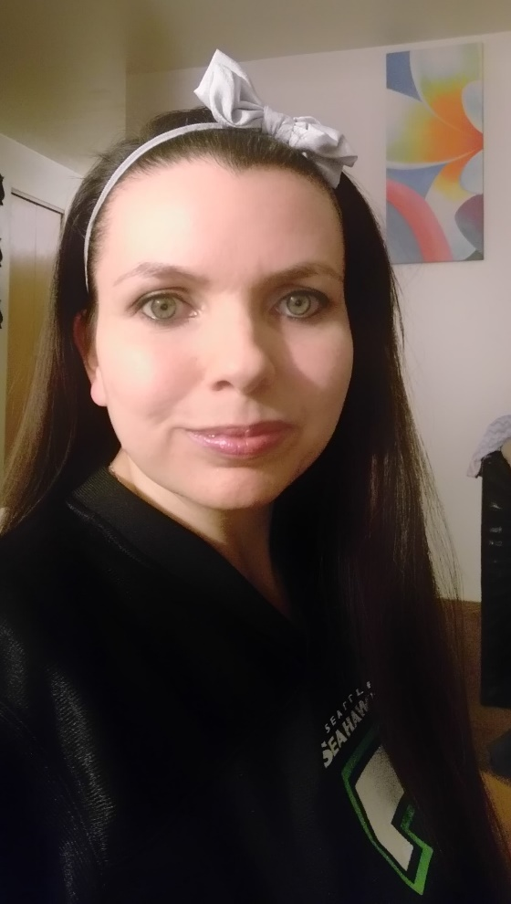
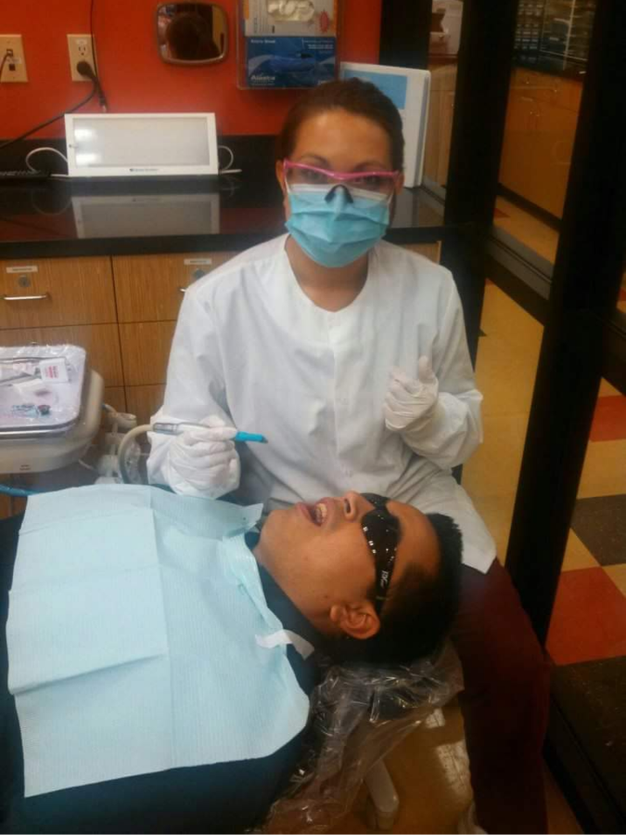
Lummi Nation (WA)
Avena Finkbonner,
DHAT Class of 2019
Angela Johnson
DHAT Class of 2019

Slide 21
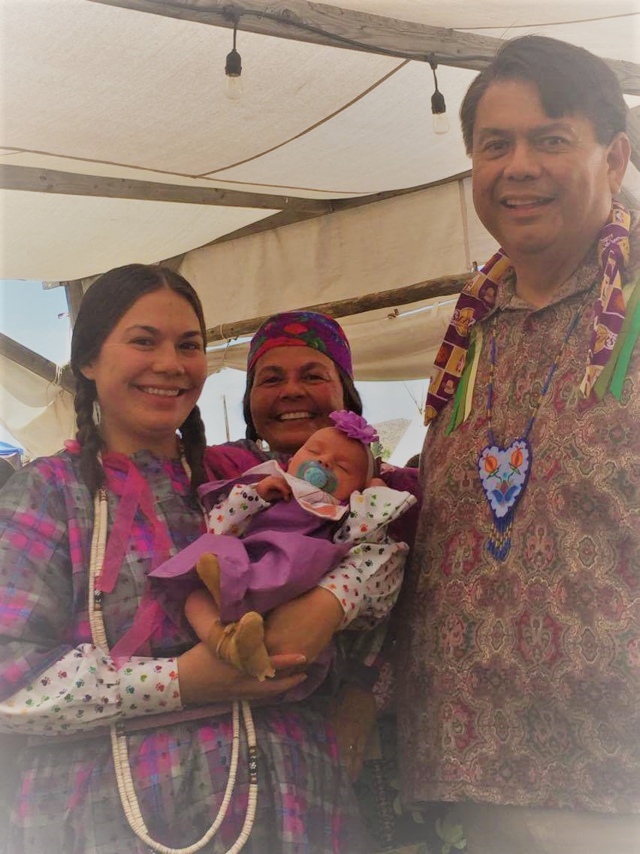
The Confederated Tribes of the Colville Reservation (WA)
Arielle Cawston
DHAT Class of 2019

Slide 22
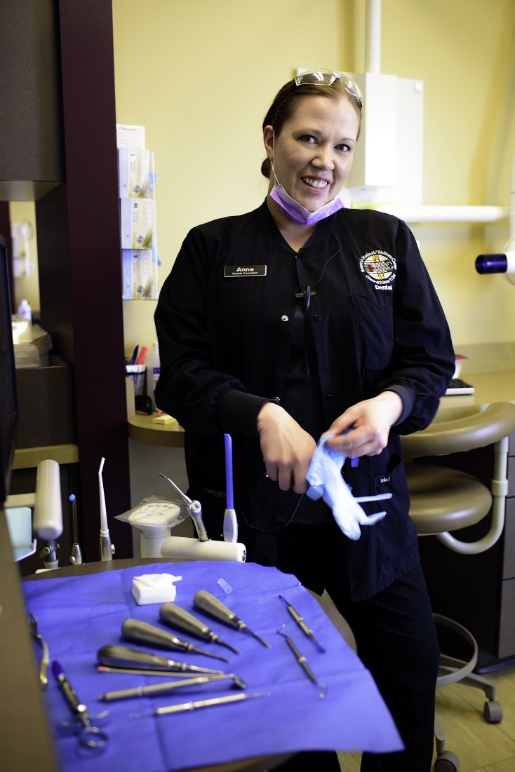
Coeur d’Alene Tribe of Indians (ID)
Anna Degraffenreid
DHAT class of 2019

Slide 23
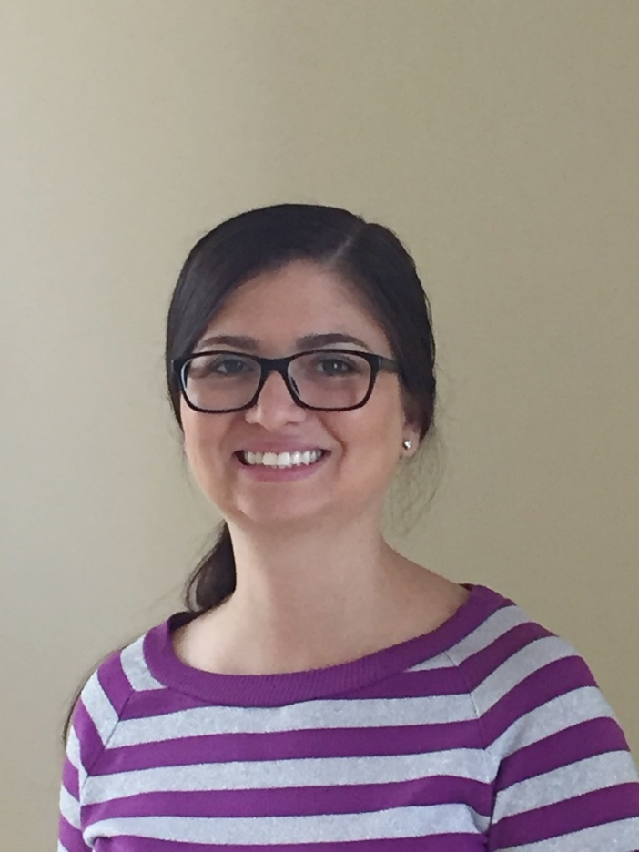
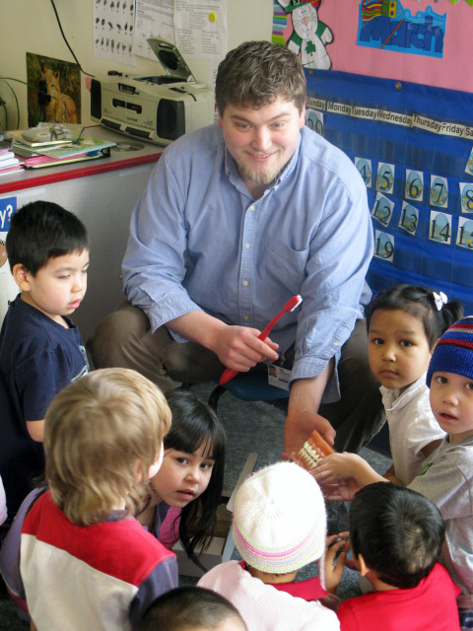
NARA Dental Clinic (OR)
Kari Douglass (Chikasaw)
DHAT Class of 2019
Ben Stewart
(Cow Creek Band of Umpqua)
Experienced DHAT

Slide 24
Swinomish Today
20% increase in patients seen
Wait time for Daniel 3-4 weeks (wait time for dentists 3 months) (Daniel can do fillings and some extractions)
Completing treatment plans faster (almost 50%)
Dentists doing more crown, bridge, and partials
More efficient “urgent” care time
Daniel is out in the community every week
Goal for 2017 is to reach out to elder population
Notes:
They have seen a 20% increase in patients seen since Daniel joined the team even though the first 2/3rds of the year he was completing his preceptorship which tends to slow clinic productivity because during that period DHATs work under direct supervision of the dentist for the duration of the preceptorship. But since he has finished his preceptorship and is now working under general supervision, productivity has increased.
Wait times
The dental team is Completing treatment plans faster and more often.
The dentists are doing more crown, bridge, and partials which I hear from them is very rewarding as they have spent their careers in public health dentistry and are usually in the trenches doing lots of extractions and large buildups and it is also very rewarding for patients who reap the benefits of much better esthetics and function
Even during their urgent care time which is Mo-Th from 8-8:45 AM, Daniel is helpful in seeing folks who have some sort of issue like “lost a filling” while the dentists can start a root canal or do a surgical extraction – making that morning hour more efficient and decrease wait time for patients with emergency and acute problems. They have on average 3-4 patients every day seeking urgent care during that 45 minute window so a high functioning dental team during that time is really important
Daniel is out in the community as I said and
Their new goal for 2017 is outreach to the elder population. Like many oral health programs kids have been the number 1 focus. While Swinomish is not shifting their focus from kids, with the expanded dental team they now have the ability to add another much needed focal point and to implement a more comprehensive plan to care for their elders oral health.

Slide 25
Swinomish Today
Dentists working at the top of their Scope
Daniel Kennedy (DHAT) out in the community
A more efficient dental team
Daniel is a natural fit to the clinic
Young Swinomish tribal members considering Dental Therapy as their future career
Notes:
Swinomish today has a more efficient dental team, a strong internship program for their native youth and exciting prospects for their young people.

Slide 26
Major Milestones
10 Students in training.
3 DHATs in practice (or soon to be) 1st graduate and 2 experienced DHATs
DHATs authorized for Tribes in Washington statewide
Pilot Project approved in Oregon for three sites in Oregon, two rural and one urban
Partner identified to begin work on Education program in Washington
Licensing infrastructure implemented at Swinomish – will serve as interim for state.

Slide 27
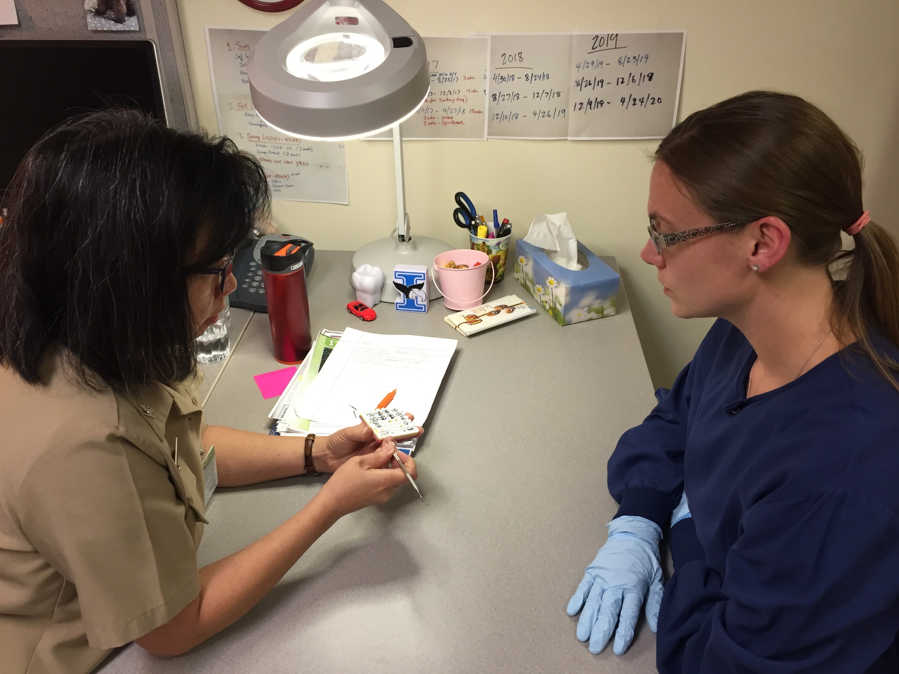
Next Steps
Convene Advisory Committee for creation of Education program for Dental Health Aide Therapy in Washington
Convene Advisory Committee for planning of implementation of full CHAP program in Portland Area
Convene Advisory Committee Behavioral Health Aide planning process
*not necessarily three separate committees

Slide 28
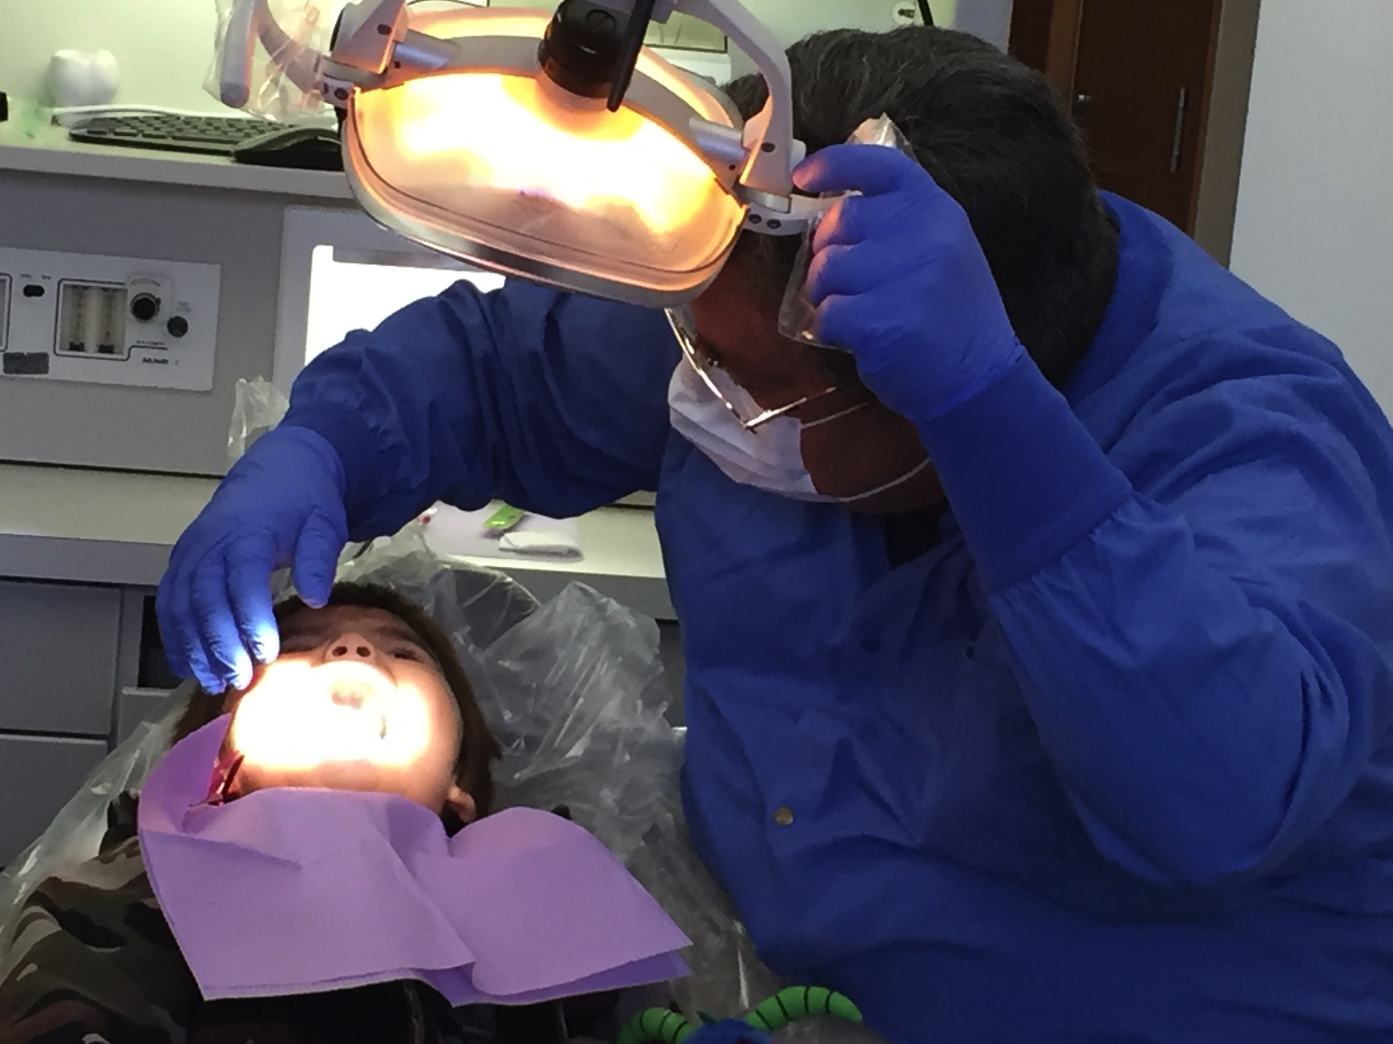
Questions?

Slide 29
Northwest Portland Area Indian Health Board
For more information please contact:
Christina Peters, Native Dental Therapy Initiative Project Director
cpeters@npaihb.org
206.349.4364
Pam Johnson, Native Dental Therapy Initiative Project Specialist
pjohnson@npaihb.org
206.755.4309
Tanya Firemoon, Native Dental Therapy Initiative Project Coordinator
tfiremoon@npaihb.org
503.228.4186
Indian Leadership for Indian Health

