Slide 1
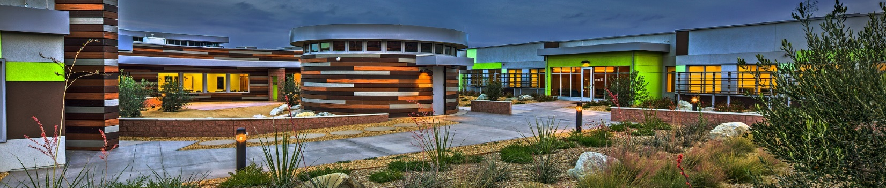


California Area Office Update
Beverly Miller, M.H.A., M.B.A.
July 19, 2017

Slide 2
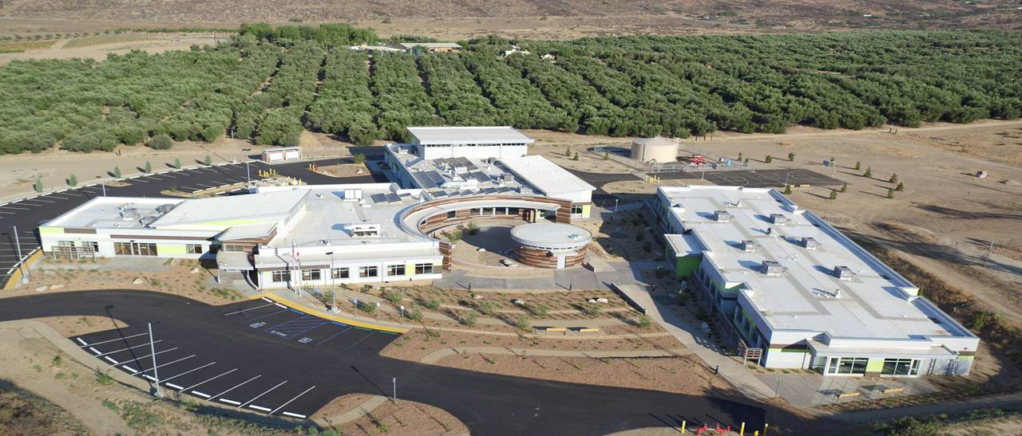
Desert Sage Youth Wellness Center – Now Open!

Slide 3
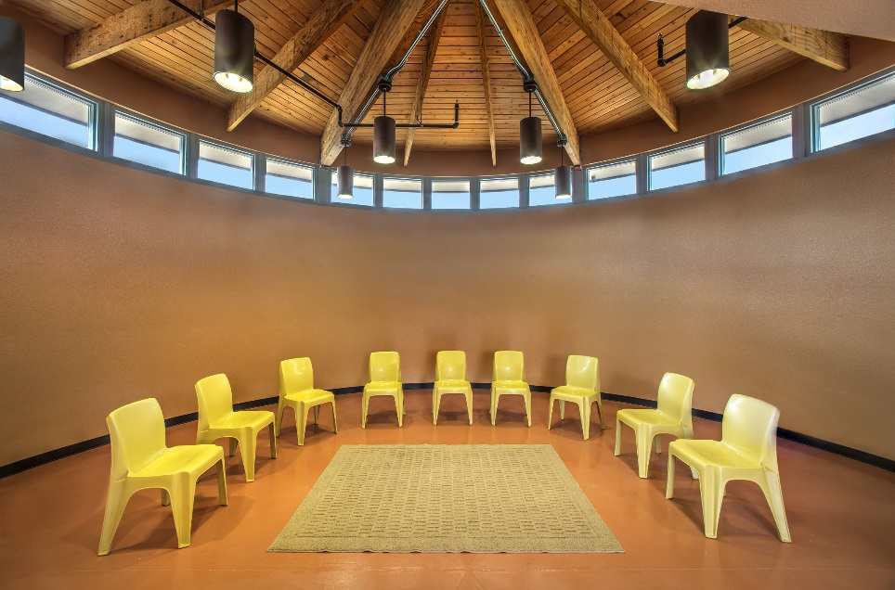
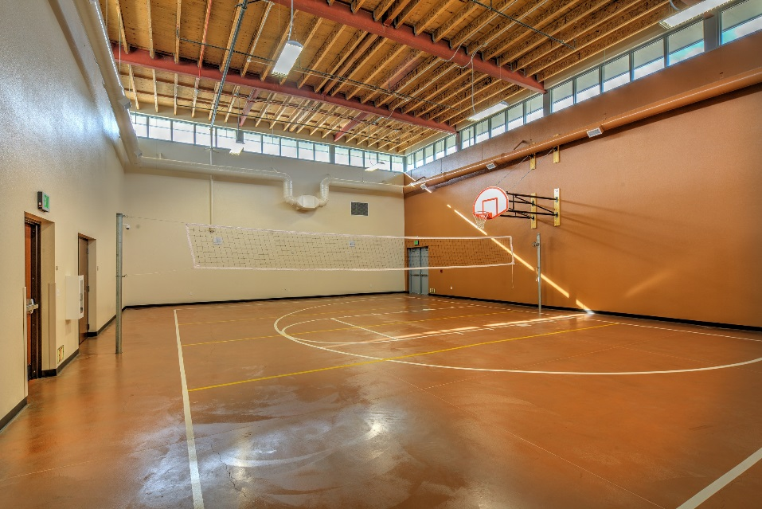
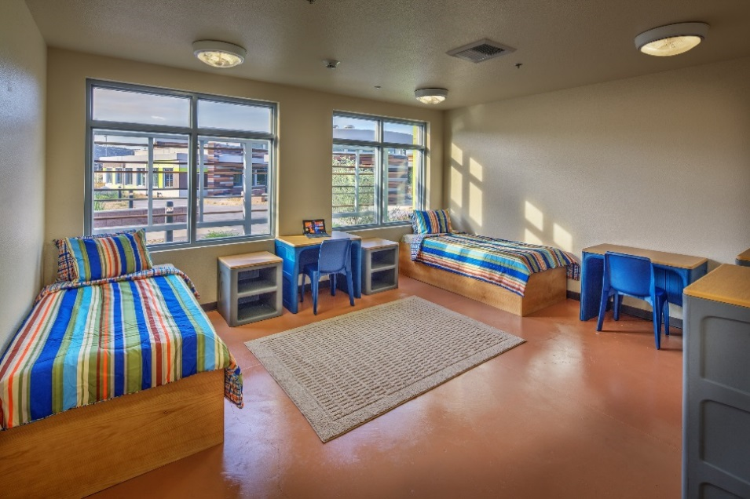
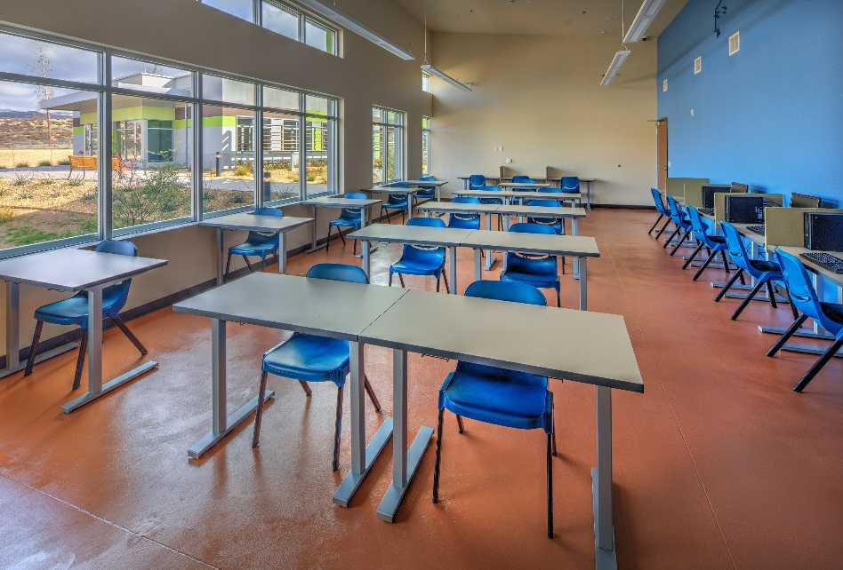
Desert Sage Youth Wellness Center
State-of-the-art amenities (kitchen and classrooms)
Fully trained and motivated staff (38% Native)
Quiet and peaceful atmosphere
Individualized education program
24-hour on-site medical care
Gym, weight room, and recreational room
5 Family suites

Slide 4
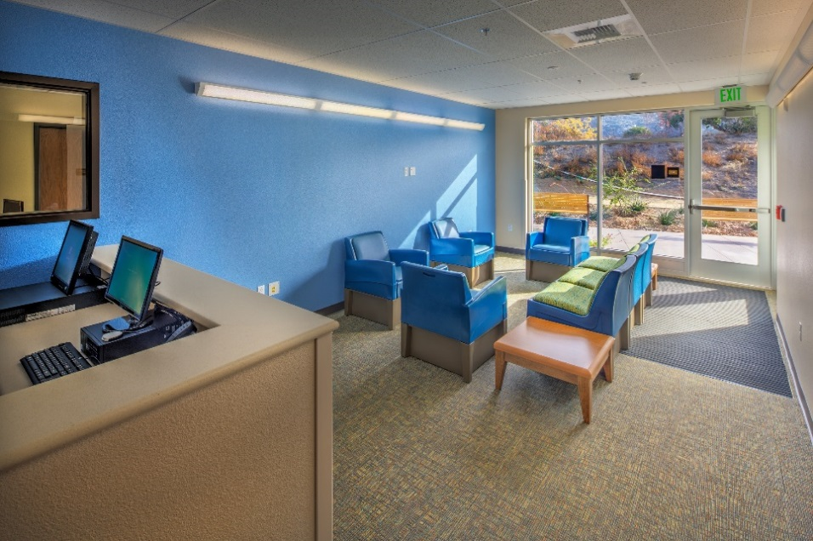
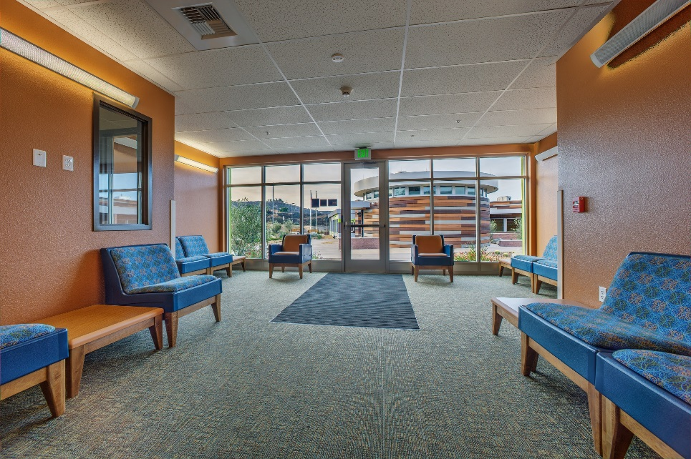
Desert Sage Youth Wellness Center
Forms and Applications are available here: https://www.ihs.gov/california/index.cfm/yrtc-project/yrtc-forms-apps/
For more information, please contact:
Mark Espinosa
Mark.Espinosa@ihs.gov
951-708-4069 ext. 4039

Slide 5
Sacred Oaks Healing Center Introduction
Request for Proposal of Selecting a Contractor
Yolo County Board of Supervisors Meeting
Project Timeline

Slide 6
Request for Proposal (RFP) of Selecting a Contractor
Currently in Phase II (of II) of the RFP process
Estimated date to award contract – September 2017
Initial RFP required a cost-saving scope of work
Bids coming in much higher than budget
Cost increases in labor rates & current construction market (we are competing for contractors, not vice versa)

Slide 7
Yolo County Board of Supervisors (BOS) Meeting
Held on June 27, 2017
Focused on:
Project Timeline
Drainage Study
Emergency Services
Broadband Connectivity
Traffic Safety Study

Slide 8
Yolo County Concerns: Traffic Improvements
Road Improvements Funding background:
The IHS initial 2012 Traffic Study did not show the need for a left-hand turn lane
Funding was appropriated by Congress in 2015 and did not include funding for County Road (CR) 31 improvements
The subsequent 2017 study showed the need for a left-hand turn lane
Associated with increased traffic on CR 31 between 2012 and 2017

Slide 9
Yolo County Concerns: Traffic Improvements
Challenges:
We are not authorized to complete work on a county road
Congressional funding was not provided
IHS legislation has provided Yolo County with multiple funding sources for our partnership to pursue
If the road safety improvements are not completed, their support the project is in question
The IHS is pursuing Tribal and County partnerships for a resolution
As a Federal agency, the IHS is prohibited from pursuing these alternate funding sources

Slide 10
In Summary
Emergency Response
Evacuation procedures need to be addressed
The IHS will address this during the operational phase of the project
Drainage/Flooding
Initial thoughts are that our project will affect the surrounding area during a flood
Flooding issues will be addressed during design/construction of the facility
Traffic Safety
A left-hand turn lane is required for the safety of our patients and staff
The funding for the left turn lane can be obtained through Tribal and County partnerships
Broadband Connectivity
The IHS has the capability of connecting to fiber optic broadband service located along CR31

Slide 11
Project Timeline
Request for Proposals (RFP) Issued: March 2017
2nd RFP Issued _{(due to overpriced proposals)}: June 2017
Estimated Date to Award Contract: September 2017
Estimated Date to Complete Design: April 2018
Estimated Date to Initiate Construction: June 2018
Estimated Construction Completion: August 2019

Slide 12
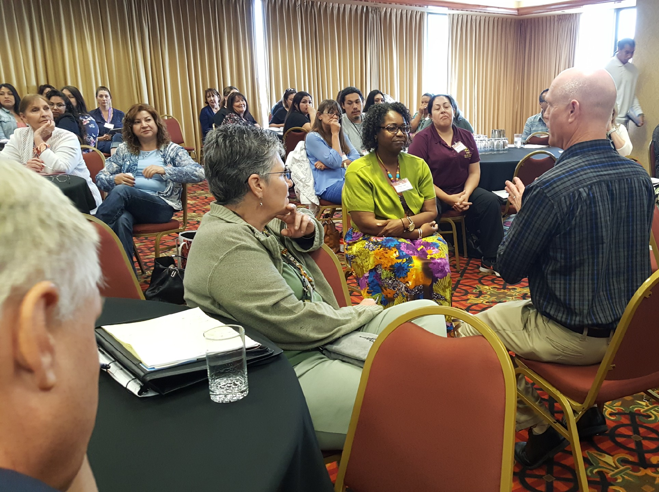
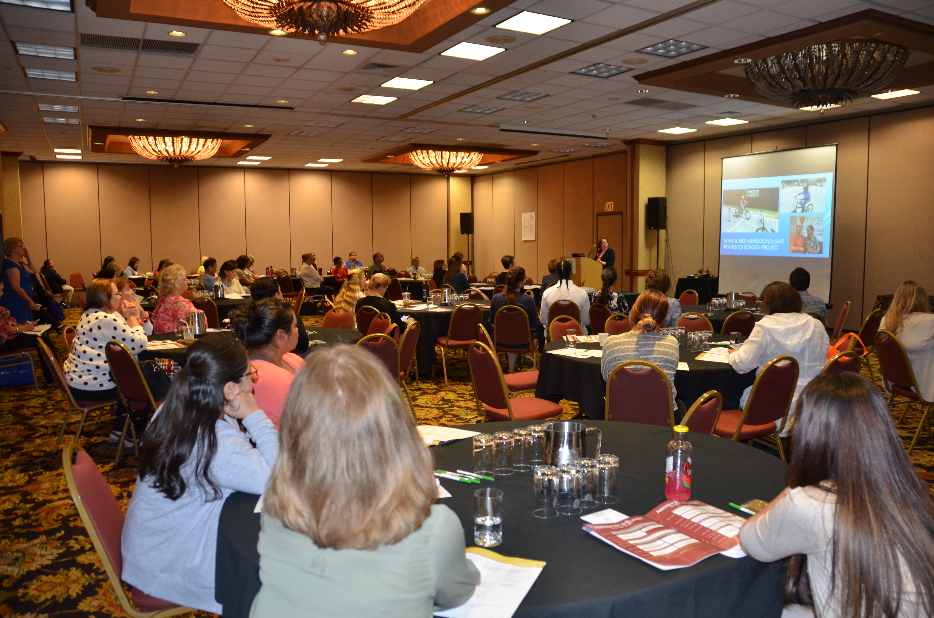
Annual California Providers’ Continuing Medical Education
The IHS/CAO and CRIHB jointly hosted the Annual California Providers’ Continuing Medical Education event on May 22-24 in Sacramento
More than 350 providers, mid-level practitioners, and clinic support staff attended, earning over 1,000 IHS-sponsored CME credits/units towards clinic licensure
An array of topics offered

Slide 13
Annual California Area Dental Continuing Education
The IHS/CAO and CRIHB jointly hosted the Annual California Area Dental Continuing Education event on May 15-18 in Sacramento
More than 400 dental staff (dentists, dental hygienists, and dental aides) attended the event and earned continuing dental education credits
An array of topics offered

Slide 14
Thank You
Beverly Miller, M.H.A., M.B.A.
Beverly.Miller@ihs.gov
916-930-3981, ext. 312

