Slide 1
Tribal Epidemiology Centers
California and Northwest
Victoria Warren-Mears, PhD, RDN, FAND
vwarrenmears@npaihb.org
Maureen Wimsatt, PhD, MSW
mwimsatt@crihb.org

Slide 2

Outline
Overview of the Tribal Epidemiology Centers
Mission and Vision of Our Tribal Epidemiology Center
Review of Capacities and Roles

Slide 3
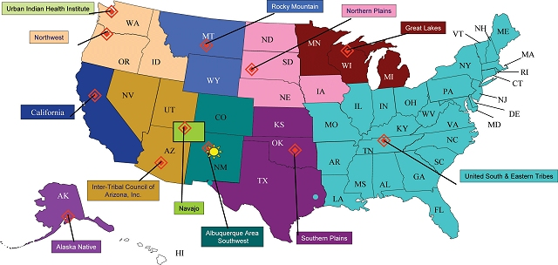
12 Tribal Epidemiology Centers

Slide 4

Celebrating 20 Years

Slide 5
Mission of the TECs
Our mission is to improve the health status of American Indians and Alaska Natives by identification and understanding of health risks and inequities, strengthening public health capacity, and assisting in disease prevention and control.

Slide 6
TEC Activities
Collect and disseminate data…
Provide analysis of health data
Area/Tribal specific health status reports…
Community Health Profiles
Maintain/provide access to surveillance databases
Conduct epidemiologic studies
Support public health emergency response
Assist Tribes in disease control and prevention
Provide training… Epidemiology, Data Collection, and Public Health
Notes:
TECs play a critical role in building public health capacity among AI/AN regions and communities.
Working with Tribal entities and urban AI/AN communities, TECs collect and disseminate data, including regional and tribal specific reports such as Community Health Profiles.
TECS also perform various surveillance activities, epidemiological studies, public health Emergency response, disease control and prevention and training.
Training includes building tribal capacity to use patient management systems such as the immunization registry and the diabetes registry.
The NPAIHB NARCH Summer Institute is an example of epidemiologic and public health training that TECs provide.
The Resource and Patient Management System (RPMS): A set of integrated computer applications designed to support the clinical and administrative functions of the IHS health care program.

Slide 7

NWTEC Projects
Immunization
Improving Data and Enhancing Access
Northwest Tribal Dental Support Center
Project Red Talon (including We R Native)
NW Comprehensive Cancer Prevention Program
Tots to Tweens

Slide 8

NWTEC Projects
THRIVE
WEAVE-NW
Injury Prevention
Tribal BRFSS
Health Priorities Survey
Public Health Emergency Preparedness Conference
Environmental Epidemiology Pilot

Slide 9

CTEC Projects
Health Priorities Survey
Injury Prevention Data Linkage
CA Behavioral Risk Factor Community Survey
IHS Epi Data Mart Studies
Summer Research Assistant Programs
TA to Tribes and Tribal Health Programs

Slide 10

CTEC Programs/Projects
GHWIC Evaluation
NIH CBPR research academy
ACF Tribal PREP Teen Pregnancy Prevention Evaluation
IHS MSPI/DVPI Evaluation TA
SAMHSA Native Connections Suicide Prevention Evaluation

Slide 11
TEC Common Programs
Program Area | CTEC | NWTEC
GHWIC Evaluation | X | X
IHS MSPI/DVPI Evaluation | X | X
TA to Tribes and Tribal Health Programs | X | X
Health Priorities Surveys | X | X
Tribal Epidemiology Center Advocacy and Coordination | X | X

Slide 12

Questions
Thank You

