Slide 1
Tribal Update Lummi Tribal Health Center
Northwest Portland Area Indian Health Board
Quarterly Board Meeting
January 18, 2017
Justin Iwasaki MD MPH
Executive Medical Director

Slide 2
Dr. Dakotah Lane
Lummi Tribal Member
Bachelors in Engineering University of Washington
Peace Corps in Malawi
Doctor of Medicine Cornell Medical School
Family Medicine Residency Daytona, Florida
Board Certified in Family Medicine

Slide 3
Quality Improvement Activities
Open Access Scheduling
Hepatitis C Treatment
Trauma Informed Primary Care

Slide 4
Open Access Scheduling

Slide 5
Open Access Scheduling
Problem to be Solved
The Walk-In Clinic Scheduling Model was a Problem
Patients
Long Wait Times. Difficult to Schedule Appointments or Hospital Discharge
Providers
Unpredictable. Difficult to Manage Chronic Disease. No Ability to Schedule Follow-Up

Slide 6
8:30 AM
9:00 AM
9:30 AM
10:00 AM
10:30 AM
LUNCH
1:00 PM WALK-IN CLINIC
8:00 AM
8:20 AM
8:40 AM
9:00AM
9:30 AM
10:00 AM
10:30 AM
11:00 AM
11:30 AM
12-1 Lunch
1:00 PM
1:20 PM
1:40 PM
2:00 PM
2:30 PM
3:00 PM
3:30 PM
4:00 PM
HELD OPEN SAME DAY APPT
WALK-IN CLINIC SCHEDULING
OPEN ACCESS
SCHEDULING
“SAVE TIME CALL FIRST”
HELD OPEN SAME DAY APPT

Slide 7
OPEN ACCESS
SCHEDULING
“SAVE TIME CALL FIRST”
8:00a
8:20a
8:40a
9:00a
9:30a
10:00a
10:30a
11:00a
11:30a
12-1 Lunch
1:00p
1:20p
1:40p
2:00p
2:30p
3:00p
3:30p
4:00p*
8:00a
8:30a
9:00a
9:20a
9:40a
10:00a
10:30a
11:00a
11:30a
12-1 Lunch
1:00p
1:30p
2:00p
2:20p
2:40p
3:00p
3:30p
4:00p*
8:00a
8:30a
9:00a
9:30a
10:00a
10:20a
10:40
11:00a
11:30a
12-1 Lunch
1:00p
1:30p
2:00p
2:30p
3:00p
3:20p
3:40p
4:00p*

Slide 8
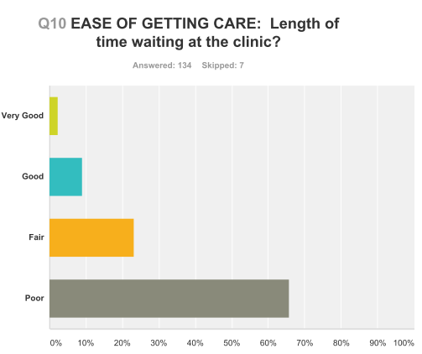
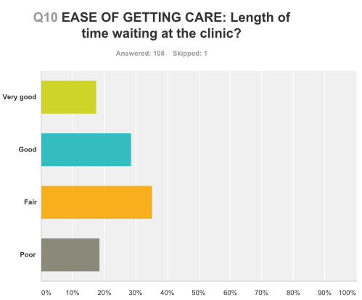
FALL 2014
SPRING 2016

Slide 9
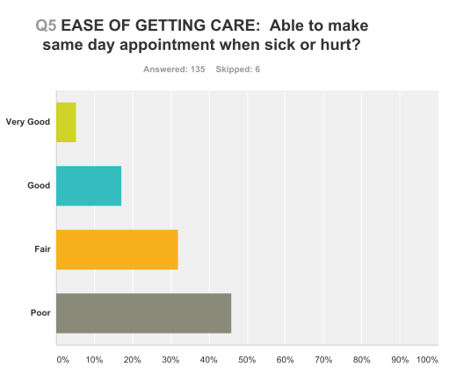
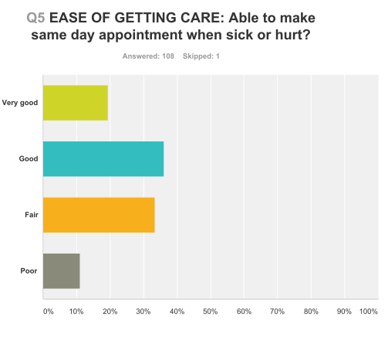
FALL 2014
SPRING 2016

Slide 10
Open Access Scheduling
Impact
Third next available appointment decreased from 5-6 weeks to zero days
Wait times decreased from 1-3 hours to less than 10 minutes
Patient forecasting and planning
Chronic disease care

Slide 11
Hepatitis C Treatment

Slide 12
Hepatitis C Treatment
Problem to be Solved
High number of community members with chronic hepatitis c virus infection. n= 200-250
High number of persons who inject drugs can spread hepatitis C infection
Treating hepatitis C infection has both individual and public health impact

Slide 13
FIRST PATIENT TREATED
FALL 2016
PHARMACY CONTRACT
PROVIDER TRAINING
HEPATITIS C COORDINATOR
NEW HEPATITIS C MEDICATIONS
WASHINGTON MEDICAID COVERS NEW MEDICATIONS
TELEMEDICINE
PROJECT ECHO

Slide 14
Hepatitis C Treatment
Clinical Model vs Public Health Model
Integrate treatment with opioid treatment program

Slide 15
Trauma Informed Primary Care

Slide 16
Trauma Informed Primary Care
14 Clinics Around the Country
Implement Trauma Screening, Assessment, and Referral to Treatment

Slide 17
Trauma Informed Primary Care
Diabetic Cohort
Initial 64 Patients
A1C >9.0
Adverse Childhood Experience Screening

Slide 18
ACE Screening
Referral to Behavioral Health
Referral to Behavioral Health and/or Support Group
Decline Referral

Slide 19
Trauma Informed Primary Care
51 Patients Made Appointment
47 ACE Screening
4 Declined
Avg Pre -A1C 10.8
Avg Post-A1c 9.0
*Statistically significant

Slide 20
Thank you.

Slide 21
IMPACT OF OPEN ACCESS SCHEDULING
VISITS

Slide 22
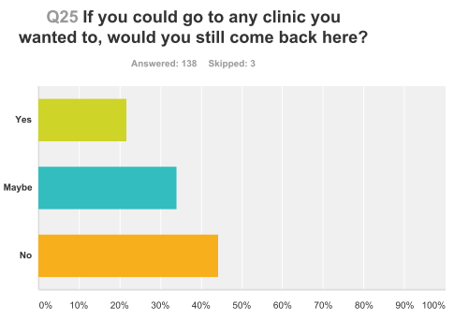
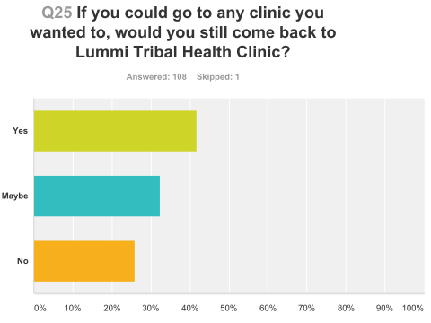
FALL 2014
SPRING 2016

