Slide 1
Northwest Portland Area Indian Health Board Quarterly Board Meeting HEALTH RESOURCES AND SERVICES ADMINISTRATION (HRSA) OVERVIEW January 18, 2017 Sharon Turner Regional Administrator Office of Regional Operations Region X – Alaska, Idaho, Oregon and Washington

Slide 2
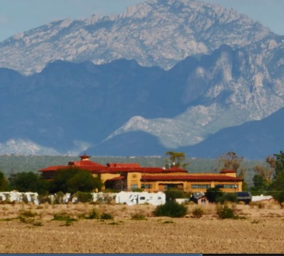
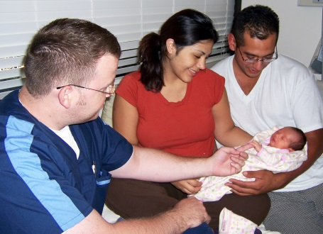
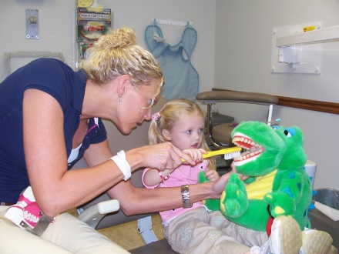
Health Resources and Services Administration Improve health and achieve health equity through access to quality services, a skilled health workforce and innovative.
Notes:
WHO WE ARE
The Health Resources and Services Administration (HRSA) is one of 11 agencies under the U.S. Department of Health and Human Services
HRSA is the primary federal agency responsible for increasing access to health care for people who are uninsured, isolated or medically vulnerable
Our $10.7 billion budget (FY17) supports states, local and community-based organizations delivering comprehensive, high‐quality preventive and primary health care to patients regardless of their ability to pay
Strategic Plan supports the mission to help provide the building blocks that Americans need to live healthy, more productive lives
The Health Resources and Services Administration (HRSA) is the primary federal agency for improving access to health care services
Awards grants to state, local, and community-based organizations to deliver health care services

Slide 3
Agency Goals
Increase Access to Quality Health Care and Services
Strengthen the Health Workforce
Improve Health Equity
Build Healthy Communities
Strengthen Program Operations
Notes:
WHAT WE DO
HRSA programs work to increase access to quality health care and services
We train and support a multi‐disciplinary clinical workforce designed to treat the whole patient through culturally‐competent, accessible, and integrated care
We build healthy communities through programs like Home Visiting, Healthy Start, rural and women’s health initiatives
HRSA programs improve health equity by working to reduce and eliminate health disparities
We are constantly strengthening our operations to maximize impact and efficiency
Now, I’ll share some key programs we administer to meet each of these objectives

Slide 4
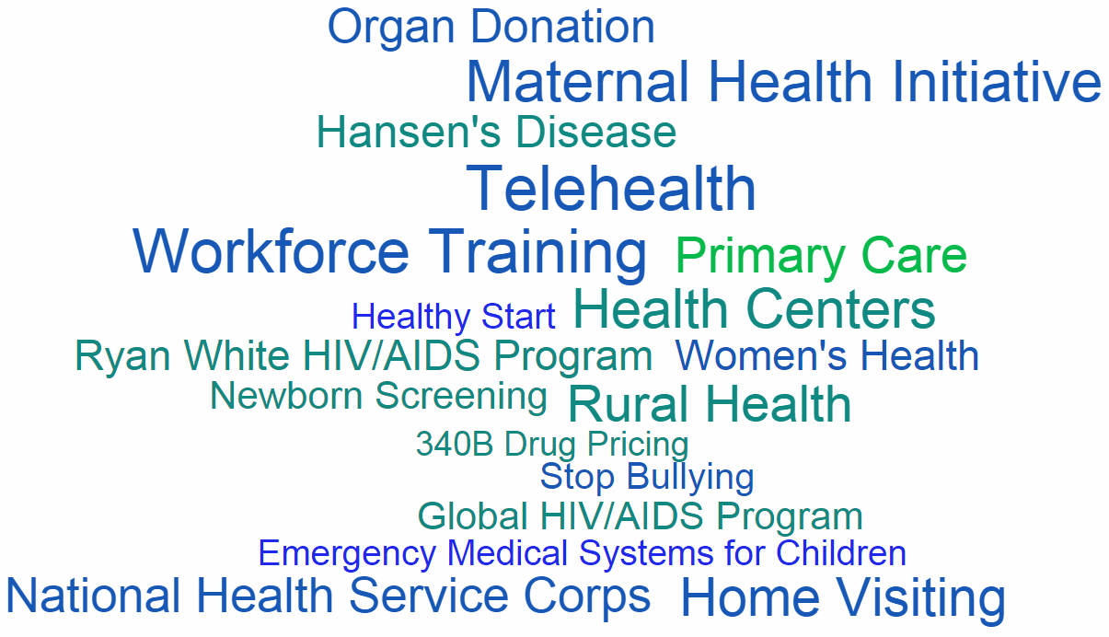
HRSA Programs
4
Notes:
Here is an example collage of some of the 90+ programs that are under HRSA
Primary Health Care is probably the most visible HRSA funded program. I will talk more about them later….

Slide 5
HRSA Major Program Areas
Primary Health Care
Health Workforce
Healthcare Systems
HIV/AIDS Care
Maternal and Child Health
Rural Health

Slide 6
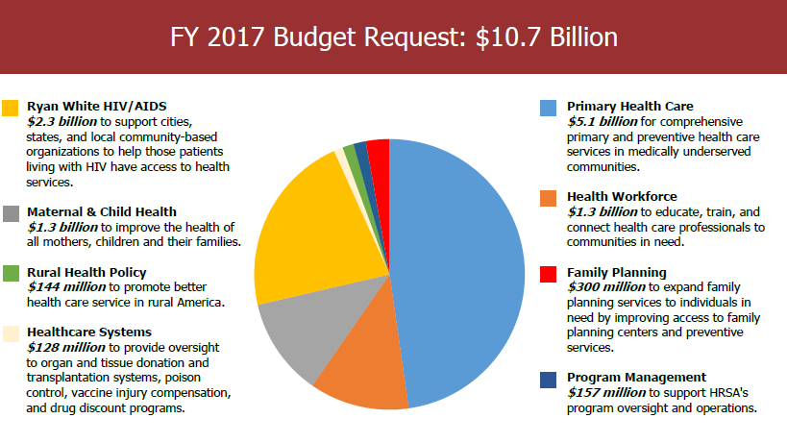
HRSA FY 2017 Budget Request
Notes:
Overview of Principal Programs
HRSA annual budget of approximately $10 billion.
HRSA operates more than 80 programs and awards more than 10,000 grants and supplements to approximately 3,000 partner organizations.
Comprised of five bureaus and ten offices, HRSA provides leadership and support to health care providers, schools for health professionals, local health systems, states, and other entities throughout the United States and its territories.
Other HRSA Programs
HRSA is responsible for the federal designation of Health Professional Shortage Areas and Medically Underserved Areas/Populations. HRSA also oversees or supports many other activities that are critical to the nation’s health and well-being. These include:
Healthy Start Program
National network of poison control centers
National organ procurement and allocation activities
National Vaccine Injury and Countermeasures Injury Compensation Programs
340B Drug Pricing Program
Maternal, Infant, and Early Childhood Home Visiting Program
Hansen’s Disease treatment, training, and research programs
National Practitioner Data Bank that helps improve healthcare quality, protect the public, and reduce healthcare fraud and abuse
Last Reviewed: March 2016

Slide 7
Increase Access to Quality Health Care and Services
One in 3 people living at or below the poverty level relies on a HRSA-supported health center for primary medical care
One in 2 people diagnosed with HIV receives care through the Ryan White HIV/AIDS Program
9.7 million people living in health professional shortage areas receive primary medical, dental or mental health care from a National Health Service Corps clinician
Notes:
How We Increase Access
Health Center Program
The Health Center program funds nearly 1,300 grantees to provide dependable, high-quality primary and preventive care at over 9,000 clinical sites. These grantees serve nearly 23 million patients regardless of their ability to pay, forming a major part of the nation’s healthcare safety net.
One in 3 people living at or below the poverty level relies on a HRSA-supported health center for primary medical care (or, one out of every 15 people living in the U.S.)
Ryan White HIV/AIDS Program
The Ryan White HIV/AIDS program supports 900 grantees in providing top-quality health care to more than half a million people living with HIV. This is nearly 60% of those living with HIV in the United States. The Ryan White HIV/AIDS program also supports access to life-saving drug treatment regimens for low-income, underinsured, and uninsured people with HIV.
National Health Service Corps
The National Health Service Corps provides scholarships and loan repayments to encourage primary care and other clinical care providers to work in underserved areas to improve access to health professionals.
More than 85% of Corps clinicians continue to serve in high-need areas after they fulfill their service commitment

Slide 8
Increase Access to Quality Health Care and Services
More than half of pregnant women and a more than a third of infants and children benefit from maternal and child health block grants
More than 700,000 rural Americans receive health services thanks to rural community-based grants
About 115,500 parents and children participate in the national Home Visiting Program
About 6,000 life-saving unrelated blood stem cell transplants facilitated annually
Notes:
How We Increase Access
Maternal and Child Health Block Grant Program
The Maternal and Child Health Block Grant program provides grants to 59 states and U.S. jurisdictions to support health systems infrastructure development, public information and education, screening and counseling, and other services (including direct care services as payer of last resort). Recipients of these grants annually reach more than 41 million women, infants, children, and children with special healthcare needs.
The federal-state partnership that exists through the Title V Block Grant Program gives states the ability to tailor services to meet the specific needs of their communities in order to achieve the national benchmarks for ensuring the health and wellbeing of mothers, children and families
Rural Health Policy Program
The Rural Health Policy program advises the Department of Health and Human Services on health policy issues impacting health care finance, workforce, and access to care in rural areas. The program also runs state- and community-based grant, technical assistance, and telehealth programs to build capacity in rural communities and help meet the health needs of rural residents. In addition, the program supports research on issues related to the delivery and financing of health care in rural America.
The Home Visiting Program serves more than 115,000 parents and children nationwide
The program employs evidence-based models proven to improve maternal and child health, prevent child abuse and neglect, encourage positive parenting, and promote child development and school readiness
79% of families had household incomes at or below the federal poverty level ($23,850 for a family of four)
34% of adult program participants had less than a high school education
27% of newly enrolled families in 2014 included a pregnant teen
67% of program participants belonged to a racial or ethnic minority
Facilitate over 6,000 life-saving unrelated blood stem cell transplants
HRSA’s C.W. Bill Young Cell Transplantation Program and National Cord Blood Inventory increase the availability of suitably matched blood stem cells, facilitating 6,253 unrelated transplants in FY 2014, helping thousands of Americans diagnosed with leukemia and other life-threatening blood and genetic disorders have a chance at finding a cure for their disease.

Slide 9
Strengthen the Health Workforce
11,400 medical, dental, and mental and behavioral health care providers in the National Health Service Corps and NURSE Corps work in health professional shortage areas
1,100 students, residents, and health providers in training receive NHSC scholarships to work in underserved communities upon graduation and licensure
Support for targeted health professions training programs focused on inter-professional care, geriatrics and autism, among others, as well as programs that increase workforce diversity
Notes:
HOW WE Strengthen the Workforce
Health Workforce Training Programs
The Health Workforce Training programs give financial support to educational institutions and healthcare delivery sites for training and curriculum development, and for scholarship and loan repayment for health professions students and faculty. The goal is to support a diverse workforce that is technically skilled, culturally appropriate, and suited for a contemporary practice environment that includes interprofessional team-based care.
11,400 medical, dental, and mental and behavioral health care providers in the National Health Service Corps and NURSE Corps work in health professional shortage areas
1,100 students, residents, and health providers in training receive NHSC scholarships to work in underserved communities upon graduation and licensure
Support for targeted health professions training programs focused on inter-professional care, geriatrics and autism, among others, as well as programs that increase workforce diversity, such as scholarships for disadvantaged students and under-represented minorities

Slide 10
Strengthen the Health Workforce
Support health centers that employ multi-disciplinary teams – 10,700+ physicians and 8,000+ nurse practitioners, physician assistants, and certified nurse midwives
Support primary care residency programs in 60 Teaching Health Centers to help train more than 550 residents annually
Trained 4,000 new mental health providers to increase access to mental health services, and make schools safer
Notes:
HOW WE Strengthen the Workforce
Health centers employ more than 10,700 physicians and more than 8,000 nurse practitioners, physician assistants, and certified nurse midwives in a multi‐disciplinary clinical workforce designed to treat the whole patient through culturally‐competent, accessible, and integrated care.
Support primary care residency programs in 60 Teaching Health Centers to help train more than 550 residents annually
Trained 4,000 new mental health providers to increase access to mental health services, and make schools safer
Also, created the Created the National Center for Health Workforce Analysis to study and collect data on health professions

Slide 11
Build Healthy Communities
Coordinate health care activities for 62 million rural Americans
Support providers in rural and isolated areas improve patient care with the use of telehealth, telemedicine and health IT
Improve perinatal health outcomes and reduce racial and ethnic disparities by using community-based service delivery through Healthy Start
Notes:
HOW WE Build Healthy Communities
Rural Health Policy Program
The Rural Health Policy program advises the Department of Health and Human Services on health policy issues impacting health care finance, workforce, and access to care in rural areas. The program also runs state- and community-based grant, technical assistance, and telehealth programs to build capacity in rural communities and help meet the health needs of rural residents. In addition, the program supports research on issues related to the delivery and financing of health care in rural America.
Coordinate health care activities for 62 million rural Americans
Support providers in rural and isolated areas improve patient care with the use of telehealth, telemedicine and health IT
Improve perinatal health outcomes and reduce racial and ethnic disparities by using community-based service delivery and facilitating access to comprehensive health and social services for women, infants and their families through the Healthy Start Program

Slide 12
Improve Health Equity
Provide linguistically appropriate enabling services (e.g., housing, food, and job support) to more than two million patients through community health centers
Ryan White HIV/AIDS clients’ viral suppression rates improved nine percent in three years – from 70% to 79% from 2010 to 2013. Viral suppression rates improved the most within disproportionally affected demographic groups, decreasing health disparities
Save qualified safety net organizations about $3.8 billion annually through the 340B Drug Pricing Program
Notes:
HOW WE IMPROVE HEALTH EQUITY
HRSA programs help improve social determinants of health through programs like Community Health Centers, Ryan White, Home Visiting, and Healthy Start
Health centers coordinate and collaborate appropriately with other health care and social service providers in their area to ensure the most effective use of limited health resources and to provide access to the most comprehensive array of services and critical assistance including housing, food, and job support. Health centers also provide a variety of supportive and enabling services that promote access and quality of care. In Calendar year (CY) 2013, enabling services were provided to 2,077,351 patients.
Research shows that FQHCs and look-alikes demonstrate equal or better performance than private practice primary care providers on select quality measures despite serving patients who have more chronic disease and socioeconomic complexity
Ryan White HIV/AIDS clients’ viral suppression rates improved nine percent in three years – from 70% to 79% from 2010 to 2013. Viral suppression rates improved the most within disproportionally affected demographic groups, decreasing health disparities
Save qualified safety net organizations about $3.8 billion annually through the 340B Drug Pricing Program

Slide 13
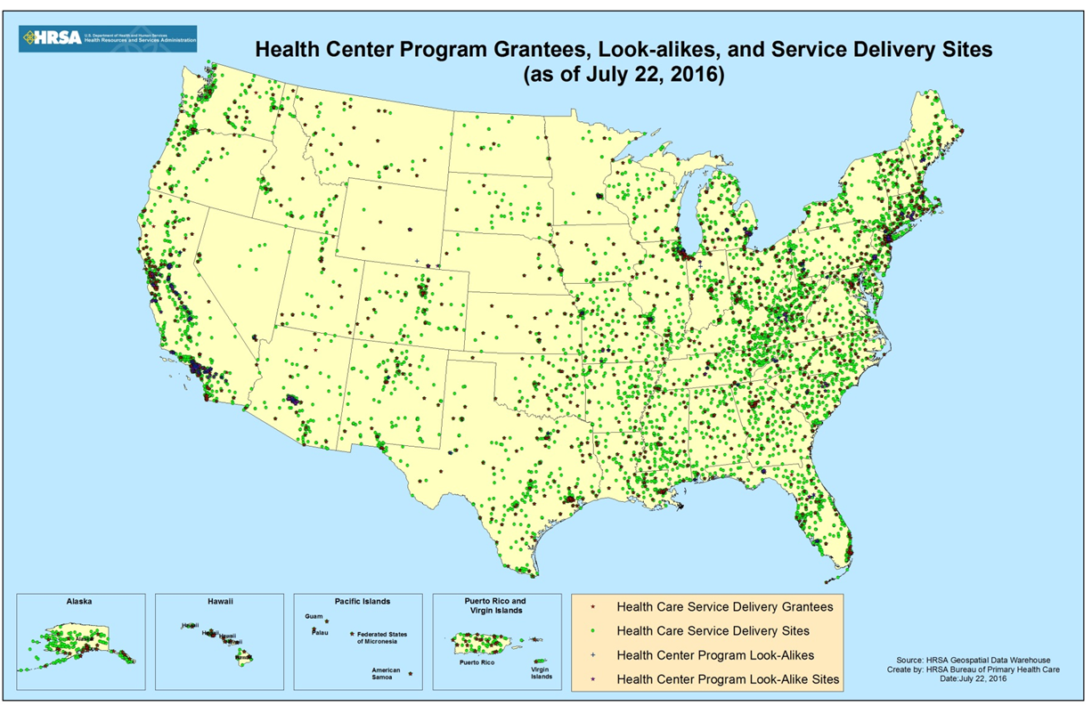
Increase Access National Presence

Slide 14
ORO Mission Statement
To improve health equity in underserved communities through on the ground outreach, education, technical assistance and partnering with local, state, and federal organizations.

Slide 15
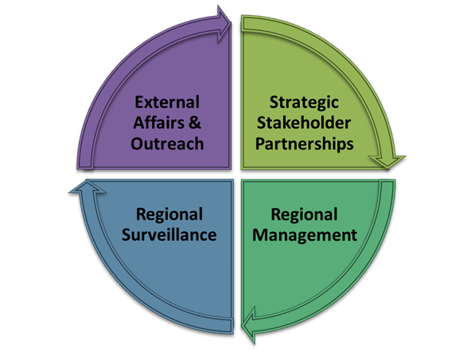
ORO Core Functions
Notes:
The Role of ORO is different than other components of HRSA. With the risk of losing your complete attention, I’ll mention that unlike most other parts of HRSA, ORO does not award or manage grants or cooperative agreements. INSTEAD, we work across all of HRSA’s program areas to extend the reach of the Bureau’s and Offices and to provide an additional touchpoint for HRSA’s stakeholders.
Our work can be categorized by these Core Functions.
External Affairs & Outreach: Agency liaison and Regional leadership
Strategic Stakeholder Partnerships: Engage partners and broker relationships
Regional Surveillance: Identify and report ground-level information
Regional Management: Ensure efficacy of HRSA Resources
Now let’s discuss each Core Function in a little more detail.

Slide 16
ORO Core Functions
External Affairs & Outreach
To effectively serve as the Agency liaison and regional leader conducting outreach, to increase knowledge about HRSA’s programs and priorities.
Represent HRSA: Affordable Care Act Events, Tribal Consultations, National and State Conferences, Ribbon Cutting Ceremonies
Notes:
External Affairs and Outreach: ORO staff oftentimes serve as the face of HRSA by attending meetings and events in the field for various HRSA program and priorities as well as share and leverage HRSA’s resources at the local level. We represent HRSA at Ribbon cuttings, at national meetings, at Tribal Consultations and most recently many, many events that support Affordable Care Act Outreach and Enrollment and Coverage to Care.

Slide 17
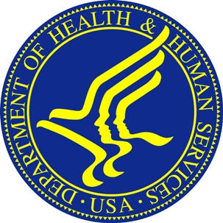
ORO Core Functions
Strategic Stakeholder Partnerships
To meaningfully engage partners at federal, state, and local levels to advance HHS/HRSA priorities.
+
Notes:
Strategic Stakeholder Partnerships: ORO routinely supports and collaborates with other HHS OpDivs and other federal departments and agencies such as the U.S. Department of Housing and Urban Development, The U.S. Department of Veterans Affairs and the Environmental Protection Agency. One of our key partners are the 10 HHS Regional Directors (“RD”) who are political appointees charged with ensuring that the Department maintains close contact with state, local, and tribal partners. ORO efforts in the regions mirror and support the RDs’ efforts on behalf of HRSA.

Slide 18
ORO Core Functions
Regional Surveillance
To proactively identify and report critical ground-level communications and information about regional/state activities to inform HRSA’s operations, decision-making, and allocation of resources.
Examples: Environmental Snapshot, Regional Director’s Report, Public Health Emergencies
Notes:
Regional Surveillance: ORO is uniquely positioned in the field, and therefore we are able to gather and assess ground-level intelligence about health care issues and trends in order to provide HRSA headquarters (HQ) with information that may impact decision making about our programs. Recently there was an outbreak of HIV/AIDS and Hep C in a very small Southeastern Indiana Rural community and ORO was the first HRSA representatives on the ground working with local, state and federal officials to respond to the outbreak.
NOTE: you may use the example bolded above or provide a regional example.
ORO R10 is a member of the Washington State-based Hepatitis B Coalition. ORO provided TA with the revision of the Coalition’s mission. Note, this group primarily serves Asian/Pacific Islanders and started in 1997 as a task force. The API population has high rates of Hepatitis B, and the coalition 1) works to educate providers and communities; 2) improve testing, care and treatment to prevent liver disease and cancer; 3) collect accurate data on transmission and diseases; 4) provide vaccine to prevent Hepatitis A & B; 5) reduce viral hepatitis caused by injection drug use; 6) protect providers and health care workers from healthcare associated viral hepatitis. Some of the needs identified during the planning meeting included:
Need for more educational events in the Cambodian, Chinese, Korean, Samoan and Vietnamese communities.
Need for more outreach to the growing East African immigrant communities in King and Pierce counties.
Need for more access to vaccines for Hepatitis A & B for uninsured immigrant adults.
Development of a provider referral and resource list for primary care, hepatitis testing and vaccine access.
Ensure that there are culturally and linguistically appropriate materials available in the 11 major languages that comprise the Asian/Pacific Islander community.
Decide whether other groups should be targeted by the coalition such as injection drug users (IDU's) and Men who have sex with Men (MSM).

Slide 19
HRSA ORO Region X Tribal Highlights

Slide 20
Regional Investments
HRSA’s Health Center Program grantees served 261,568 American Indian and Alaska Native patients in 2015. Also in 2015, Region X’s community health centers served 74,729 American Indian and Alaska Native patients.

Slide 21
Primary Care Services
HRSA’s Health Center Program grantees served over 259,000 American Indian and Alaska Native patients in CY 2013.
Region X’s community health centers served over 65,648 American Indian and Alaska Native patients in CY 2013.
10

Slide 22
FY16 HRSA Funding for Tribal Activities by HRSA Program
HRSA Program | Funding Amount (Region X)
Health Center | $47,992,398
Rural Health | $498,804
Telehealth Resource Center Grant Program | $338,425
Ryan White | $861,379
Geriatrics Workforce Enhancement Program | $842,824
Teaching Health Center | $952,580
Capacity Development for AI/AN Serving Health | $195,071
Graduate Psychology Education | $188,971
TOTAL | $51,870,452

Slide 23
FY 16 HRSA Funding for Tribal Activities by State
State | Total HRSA Funding for Tribal Activities | Total No. of Tribal Grantees
AK | $$\$41, 839, 608$$ | 44
ID | $$\$3, 126, 393$$ | 7
OR | $$\$1, 853, 335$$ | 3
WA | $$\$5,051, 116$$ | 9
Total | $51,870,452 | 63

Slide 24
National Health Service Corps (AK, ID, OR, WA)
 | Alaska | Idaho | Oregon | Washington
Total Tribal/IHS Site Approved* | 160 | 5 | 19 | 48
Total Number of NHSC Loan Repayment Program Participants* | 38 | 2 | 6 | 20
Total Number of NHSC Scholarship Program Participants* | 3 | 0 | 0 | 4
*As of 2/25/2015
9
Notes:
24

Slide 25
AI/AN Patients Served in Community Health Centers
 | AK | ID | OR | WA
Number of patients served | 46,951 | 3,971 | 7,648 | 19,006
% of total | 44.40% | 2.53% | 2.15% | 2.02%
Prenatal care patients who delivered | 661 | 51 | 56 | 233
Hypertensive patients | 5,690 | 541 | 844 | 2,167
Diabetes patients | 1,640 | 279 | 698 | 1,306
2013 UDS Report
11

Slide 26
For more information, contact:
SHARON TURNER
Regional Administrator
U.S. Department of Health and Human Services
Health Resources and Services Administration
Office of Regional Operations – Region X
(206) 615-2059
sturner@hrsa.gov

