Slide 1
Warm Springs Service Unit Update
Northwest Portland Area Indian Health Board
April 19, 2017

Slide 2
Quality Improvement Studies
Warm Springs Silver Nitrate Protocol Pilot
Lab Chemistry Analyzer

Slide 3
Warm Springs
Silver Nitrate Protocol
Pilot

Slide 4
Historical Caries (tooth decay) Experience of Warm Springs Children
>90% Head Start children had tooth decay
2010 – 2013 80 children annually required treatment for caries under general anesthesia
50% of WS Children had severe tooth decay
1000% higher than the 0.5% rate for non-Indian children in the U.S.
Notes:
Say, “Treatment of children’s tooth decay in the operating room is commonly needed in many Indian communities, but is rarely needed in many non-Indian communities. The reasons for this are complicated, but I have been in the operating room 1-2 days a week every week since I came here in 1998.”
Reducing Severe Tooth Decay in Children at Warm Springs
The best measure of the severity of tooth decay (dental caries) is the rate of children needing treatment under general anesthesia (GA)
U.S. overall rate of this severity is <0.5% (5/1000)
Over past 20 years rate of WS children requiring this drastic measure is approximately 50% (500/1000)
This represents a huge health disparity compared to U.S. children overall: more than 1000% higher.

Slide 5
What Have We Done at Warm Springs to Try to Control Caries in Children?
Historically many attempts have been made to control caries in AI/AN children.
Water system fluoridation
Oral Health Education Programs
Early & regular exams of children at Early Head Start & Head Start
Implementation of all activities of the IHS Early Childhood Caries (ECC) initiative, including the use of early access to care, Fluoride Varnish, Glass Ionomer sealants, Interim Therapeutic Restorations
Fluoride Varnish Applications – 2 to 4 times per year
Sealant application
Distribution of Xylitol products to parents and children
Outcome: No noticeable change in rate or severity of the disease
Notes:
Say, “For many years we have implemented all the recommendations to control tooth decay in children, but without success: It just didn’t work.”
Sealant application -resin done at schools and clinic
Zy-la-tol

Slide 6
Silver Nitrate Protocol Pilot
Initial aim
September 2013
Reduce the proportion of children served by Warm Springs Service Unit who develop such severe Early Childhood Caries that they require restorations and extractions under general anesthesia. This pilot aims to clinically manage 100 children in the first year, eliminating their need to go to the operating room.

Slide 7
Reducing Severe Caries in Children
A Program for treatment of tooth cavities in children with Silver Nitrate was developed and initiated in collaboration with an expert in the protocol and data collection
We wanted to clinically manage at least 100 children in the first year
Materials were developed to provide education to parents and the community on the safety of this protocol and the expected benefits.

Slide 8
Steps in Preparing to Implement Silver Nitrate Protocol
Discussion with Dental Director, CEO, consultants
Approval by the Tribal Heath & Welfare Committee
Approval by the regional IHS Chief Medical Officer
Notification to the IHS Division of Oral Health
Presentations to Head Start staff and parents
Development of a Manual of Procedures
Identified the team (EFDA & pediatric dentist)
Local radio announcements
3-part series in the local newspaper
Patient education brochure
Informed consent
Database for tracking outcomes
Regular progress reports to the CEO and community

Slide 9
Our 3-year Experience with this Model
The first children received this new non-surgical protocol in September of 2013.
As of October 14, 2016, we have enrolled 238 children.
Only a couple of parents have chosen traditional restorations over the Silver Nitrate Protocol
215 still participate in the protocol
23 dropped out of the protocol
We’ve had 1 official complaint that was quickly resolved with family of child
Parents have been consistently pleased
Children have been very easy to work with
Even the younger children are generally more cooperative after the 2nd treatment.
Notes:
Explain the ‘official complaint’:
Parents left the child with the grandmother for the weekend, and GM did not know anything about the silver nitrate protocol, and complained about dark areas on teeth when she kept the child. Now don’t start protocol until parent discusses dark spots with extended family. That was about 3 years ago.
Which is the exact opposite of what pediatric dentists usually encounter—using the standard drill and fill approach, with each additional visit for treatment, the child is more fearful and less cooperative. Other IHS dental programs that have later copied our model say the same thing – they have never before had the children be so cooperative.

Slide 10
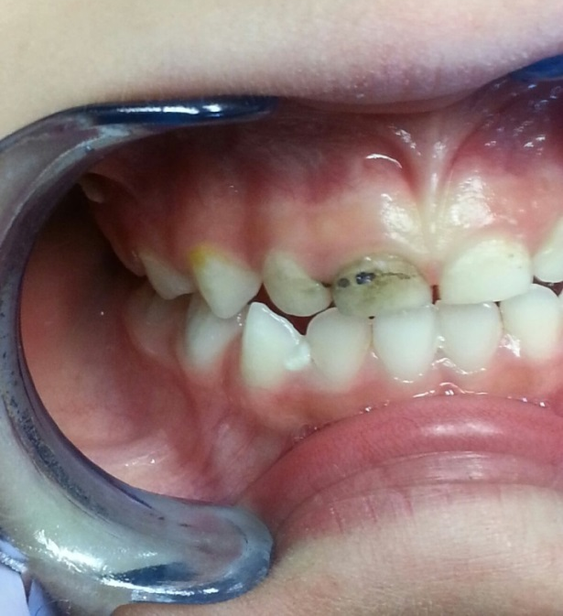
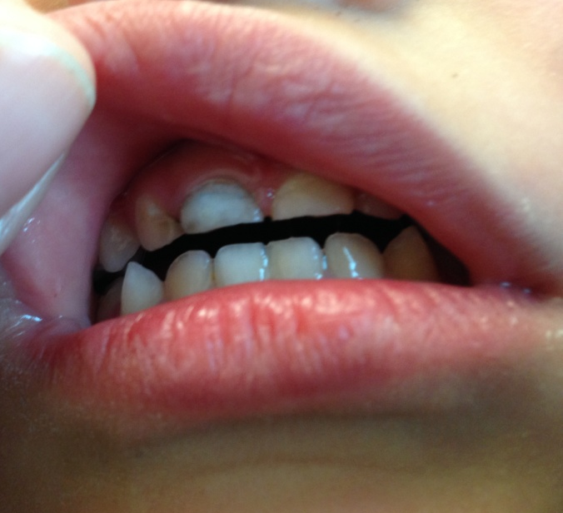
After Silver Nitrate Treatment
The caries is arrested, but a black ‘scar’ is left after an active cavity is treated.
This can be easily treated with a non-invasive restoration later

Slide 11
Results
Children requiring OR and General Anesthesia has decreased using this non-operative approach
Notes:
Not only have the hospital treatment been greatly reduced, for those children who do need to go to the hospital, the waiting time has been drastically reduced.

Slide 12
Results Head Start Screenings
Notes:
The percentage of children who had been under general anesthesia was a shocking 93 % in 2000-2001 school year. 13 years later using the IHS Early Childhood Caries prevention methods that number was down to 66% in 2013. While after just 2 years of implementing the silver nitrate protocol our numbers were reduced by almost 30% more in down to 37%
Comparing the disease level of the children in the annual Head Start screening is another good way to measure success
Rates of Children in Head Start Programs who have had or need General Anesthesia Treatment has Decreased.

Slide 13
Results
Our Goal of Decreasing treatment of children under General Anesthesia was achieved.
We are continuing with the program and continuing to collect data and monitor outcomes.
“After 35 years, I believe I finally have something that is safe, fast, easy and inexpensive to use….and it works.
I like it. The parents like it. And the children love it!” - Dr. Frank Mendoza

Slide 14
News
On March 10th, 2017, The IHS Division of Oral Health announced the release of the new Silver Ion Antimicrobial (SIA) clinical guideline.
When considering the use of SIA, it is important to communicate clearly the benefits and expected results of SIA therapy to patients, parents, and caregivers. The use of SIA agents to arrest decay (instead of using traditional restorative services) is not appropriate for all children nor will it be the choice of all parents. The IHS Division of Oral Health recommends that programs establish procedures for consent for SIA therapy.

Slide 15
Lab Chemistry Analyzer

Slide 16
Reduce Cost and Improve Turn Around Time with new Chemistry Analyzer
Problem:
New billing practices and charges by the vendor we leased 2 laboratory analyzers from was going to result in an estimated $90,000 increase in our annual lab cost.
Also, the analyzers we were leasing required significant manpower and time for maintenance and quality control runs and recalibrations.

Slide 17
Goal:
We wanted to reduce the future cost if $189,615 a year by at least 25%, and also find an analyzer that was more efficient to maintain while providing us with reliable results.
Reduce lease costs by 25%,
Projected New Rate $ 189,615
25% reduction $ 47,404
Reduce turn around time
This is influenced by frequency of calibration and quality control testing.
An average of 30 minutes is added to test run times
Find an analyzer that is more efficient to maintain while providing us with reliable results.

Slide 18
Data was collected
From RPMS by the lab staff
Finance billing records by the budget analyst
Interventions were implemented
Research replacement analyzers
Work with Purchasing Agent to request quotations for cost comparison
Review logistics support capabilities of companies bidding for the analyzer.
Finalized new lease purchase with Siemens for maximum estimated cost of $132,768

Slide 19
Results
Original quoted maximum price of $132,768 represented a minimum savings of $56,847 (30%)
The 2 analyzers were replaced with 1 unit that performed all functions
6 months of data has been analyzed and we are seeing average monthly cost of $9,723 or annual rate of $116,676
Total annual savings of $72,939 (38.5%)
Notes:
of the projected cost increase by our original lab vendor.

Slide 20
Results
Time Savings Benefits
less calibration run time
less quality control testing time
easier to maintain
Additional cost savings that we were unable to quantify include tickle down effects such as
lab staff time
provider time and patient wait times since turnaround is faster

Slide 21
Reduce Cost and Improve Turn Around Time with new Chemistry Analyzer
We will:
Reevaluate at 1 year
Continue to reevaluate annually as part of budget process
Determine how to evaluate time and cost savings related to increased turn around time.

Slide 22
Questions ?

