Slide 1
The Nez Perce Tribe

Slide 2
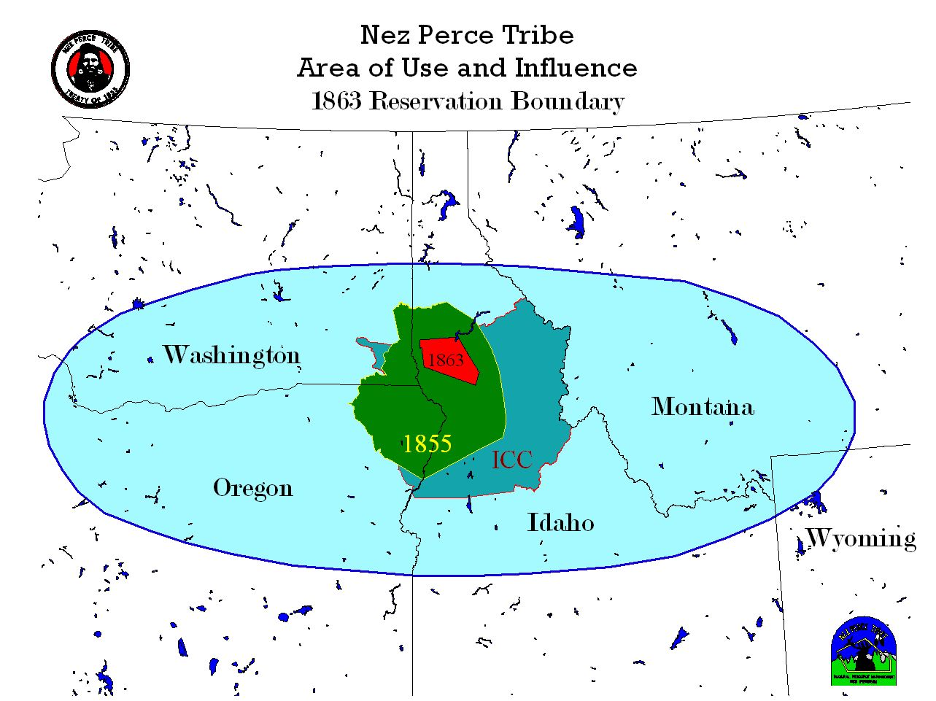
Notes:
The Nez Perce Reservation showing the original boundaries which included Oregon, Washington and Idaho.

Slide 3
History
The Nez Perce Reservation encompasses 770,000 acres which is located in central Idaho, includes counties: Nez Perce, Clearwater, Lewis and Latah.
Nez Perce ICC Territory
Nez Perce 1855 Reservation Boundary
Nez Perce 1863 Reservation Boundary

Slide 4
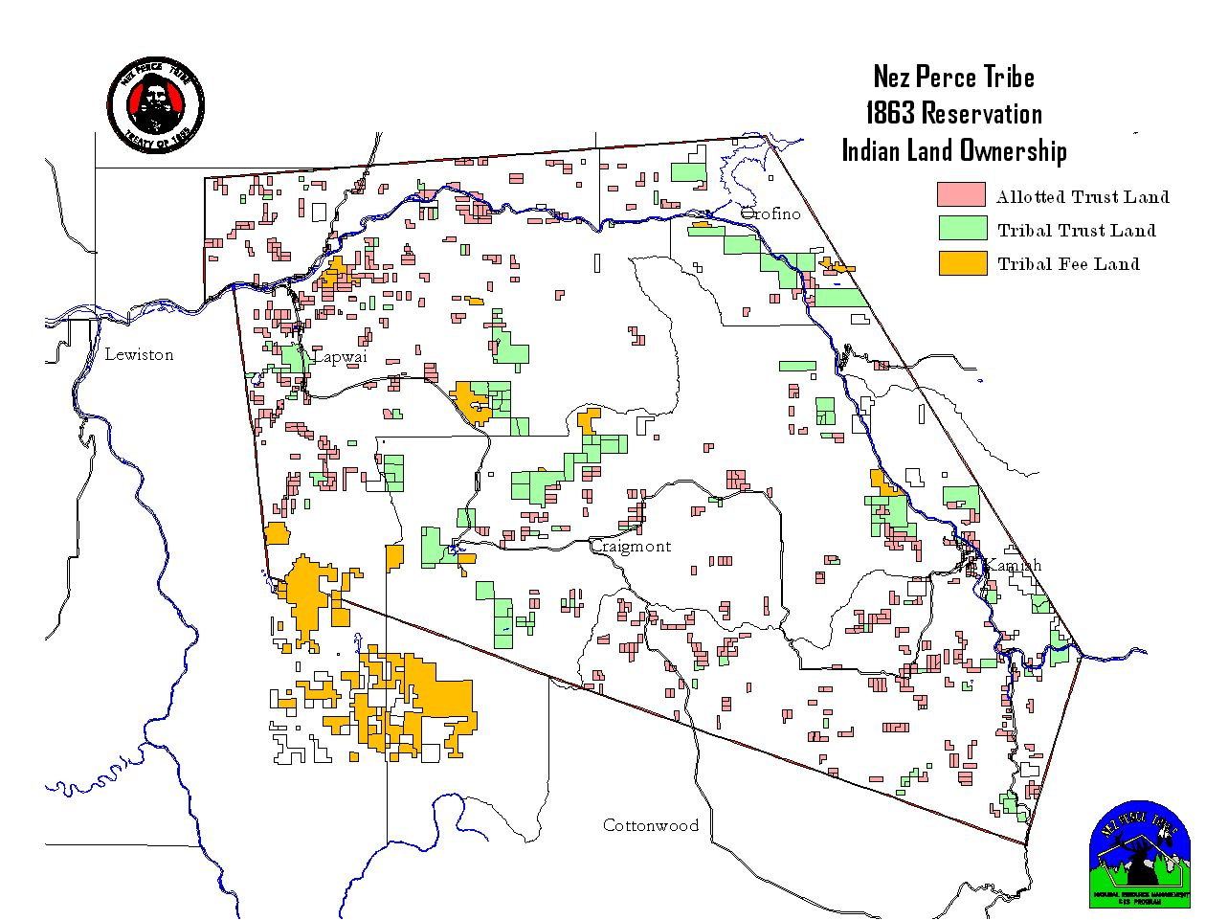
Notes:
Tribal Members and Nez Perce Tribe own approximately 107 acres within the Nez Perce Reservation. This “Checkerboard” of trust and fee land present significant jurisdictional questions for law enforcement officers.

Slide 5
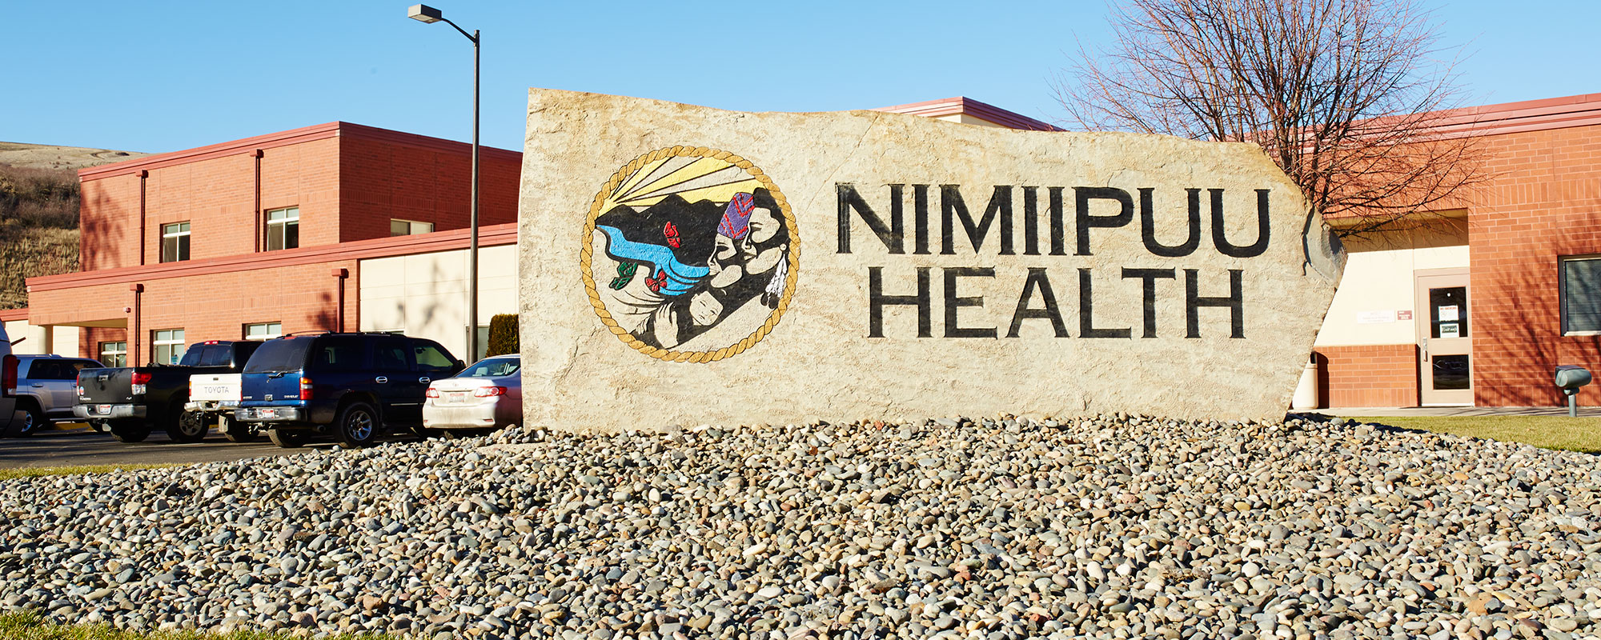
Nez Perce Tribe Nimiipuu Health
Notes:
Nimiipuu Health is an accredited organization through AAAHC (Accreditation Association for Ambulatory Health Care)……March 2016
Direct Care Services available at the clinic are:
Medical, Behavioral Health, Massage, Physical Therapy, Optometry, Drug & Alcohol Counseling, Pharmacy, Dental, Community Health Outreach, Lab, X-Ray, Diabetes Program Services, Dental Hygiene and Women’s Health. Nimiipuu Health serves approximately 4,761 patients.

Slide 6
NMPH Front View
Notes:
This is the full view of the front of the Lapwai facility.

Slide 7
Lapwai Clinic
How we started
1960
1966-67
1969
1970
1992
Notes:
In the early 1960s Health care was limited to a nurse and part time doctor.
In the Mid 1960s a one room medical clinic and a one chair dental clinic was operated in one of the old 1925 era homes in Lapwai owned by the Nez Perce Tribe. The dental clinic was operated by an I.H.S. dentist in one room in the basement of the house.
Also the medical services were operated out of a house type structure.
In 1966-67 the I.H.S. received funds for a new clinic in Lapwai, but was changed when funds were needed for another project in anther state.
Finally in 1969 I.H.S. started construction of a small cinderblock clinic building. The building was only intended to be a Health Station with one Doctor, one Nurse and one Pharmacist. In 1970 the clinic opened to provide services for the Nez Perce and Coeur d’Alene Tribes and others within the region who had the ability to drive to Lapwai.
In 1992 the Lapwai community was selected for award of a Portland Area “Ambulatory Expansion Pilot Project”. This project was a mutual partnership with the I.H.S. and the Tribe to develop an alternate initiative to provide a modern replacement comprehensive health care facility for this underserved community. The initial contract between the Tribe and I.H.S. was signed and later amended in 1993 for the completion of the full new modern facility completed and Grand Opening being August 2004. (43,000 Sq Ft)

Slide 8
Lapwai Clinic
Hours
8am-6pm Mon-Fri
1pm-6pm Weds
Notes:
This is the receptionist/main waiting room at the Lapwai Clinic. As we anticipate open access and the Medical Home Model, we have began to structure our reception/patient check-in area to reflect provider teams:
Each of the doors represent an office for the patient care coordinator (PCC), which will be associated with a team (Provider, Nurse, C.N.A.) We are planning on four provider teams.

Slide 9
Current NMPH Projects & Accomplishments
Working on IPC (Improving Patient Care) and Medical Home Model
Currently working on Policies & Procedures
Identifying Roles
Education to Staff and Community
Notes:
IPC – Improving Patient Care is very important to NMPH. We are currently working toward the Medical Home Model which provides patient-centered care. The patient is the focus, and the team provides for the patient using the team approach.

Slide 10
Telemedicine Grant
Plan to expand medical and Behavioral Health Services to our more rural communities and homebound individuals.
Provide health education to the schools
Possibly provide behavioral health services to our county jail where our membership is in need of services that are not provided by the county jail, per contract.
Notes:
NMPH has the Telemedicine patient portal installation near complete at 98%.
I.H.S. has a few more updates to do before NMPH can complete the installation.
Next, training for both staff and patients will take place.
This service will expand medical and behavioral health services to our NMPH Community.

Slide 11
NMPH Staff
Behavioral Health
Pharmacy
Notes:
Behavioral Health: A Team of 10
Services: Youth & Adult
Substance Abuse Disorder Treatment
Intake Assessments
Psychotherapy Counseling
Family and Marital Counseling
Case Management
Urgent Care/Walk-in Appointments
Pharmacy is a team of 9 Staff Members (4 Pharmacists and 5 Pharmacy Techs)
They fill up to an average of 400 prescriptions per day. They take care of the pharmacy needs for both facilities.

Slide 12
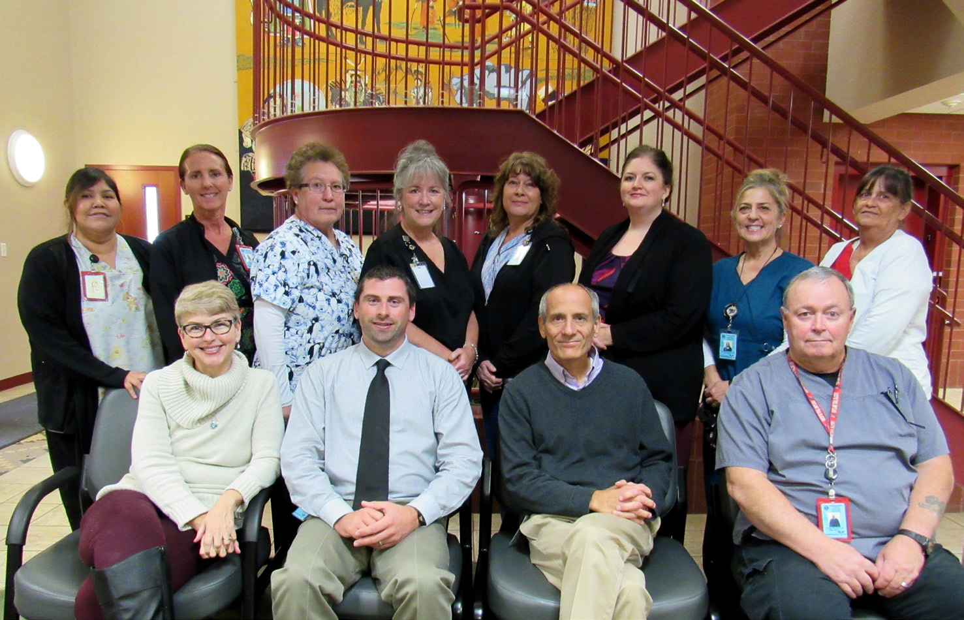
Medical Staff
Notes:
This is the Lapwai Medical Team. We have 7 Providers, including Massage and Physical Therapy, 4 Nurses, 3 C.N.A’s and 1 M.A.
We provide a full range of medical services at the Lapwai Clinic. However, there is a need for our Lapwai Clinic staff to assist with providing services to Kamiah. The Medical Doctor and OB/GYN visits once per month, Massage Therapy visits two times per month and other providers take turns two times a week to Kamiah assisting with patient care.

Slide 13
NMPH Services
Fitness Center
Dental
Notes:
The Fitness Center is a part of our Medical Services. The Fitness Team staff work in collaboration with our medical providers and Diabetes Program in addressing alternative medical needs for our patients.
Dental has 9 staff members: 2 Dentists, 2 Hygienists, 4 Dental Assistants and 1 Receptionist. They provide comprehensive dental services to meet the needs of our NMPH patients.

Slide 14
Optometry
Dr. Huh
Reception Area
Notes:
Optometry has a team of four who provide comprehensive eye exams, glasses, referrals and other optical services. Optometry has it’s own patient waiting area.

Slide 15
Community Health Services
Community Health Services
On-Site Mammograms through Lewiston’s St Joseph Medical Center –Quarterly
On-Site Blood Drive through Lewiston’s Blood Bank - Quarterly
On-Site Services
Notes:
Community Health Services schedules in the Mammogram Mobile and the Blood Mobile Unit on a quarterly basis for on site services.
Community Health also planned and organized the Women’s Wellness Day for 2017 which took place on April 18th. The focus was on “Living Smart”, being active and making good choices regarding health care and Nutrition. This year’s guest speaker spoke on the state of women’s health which focused on women and pregnancy, prenatal, family planning and tobacco. This was a very successful event.

Slide 16
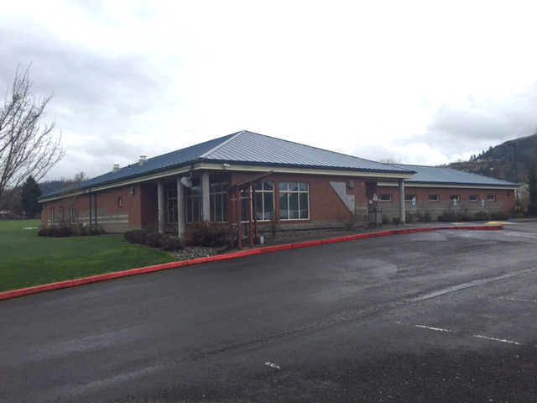
Kamiah Clinic
Notes:
Direct Care Services provided at the Kamiah Clinic are:
Medical, Dental, Behavioral Health, Pharmacy, Community Health Services.
Services traveling to Kamiah from Lapwai during the month: Massage, Dental Hygiene and Women’s Health Services.
Recently we added a specialty clinic which was podiatry once a month.

Slide 17
Kamiah Clinic
How We Started
1974-75
1994-95
2000
Notes:
In 1974-75 a DHHS community health nurse was assigned to the community due to this being a medically underserved community. The funding was continued for several years as the nurse focused efforts on MCH.
When DHHS funding sources were less than adequate to support the program staff, the support was assumed by the I.H.S. Northern Idaho Service Unit. During this time the program operated out of three rooms in the community center. The rooms were not designed to serve as a clinic, and so lacked adequate space for laboratory, examination and other health service functions.
Also during this period, the I.H.S. provided dental services in a temporary trailer. Services were provided at less than 4-5 months of the year.
In 2000 a project is funded equally by the I.H.S. and the Nez Perce Tribe who assumed operation of the health delivery program in 1996-97 under PL 93-638 Title I, with conversation to Title III in 2000. Grand Opening of the Kamiah Clinic being April 2001. (7,000 Sq Ft)
In 1994 the Tribe begin planning for a new clinic in Kamiah.

Slide 18
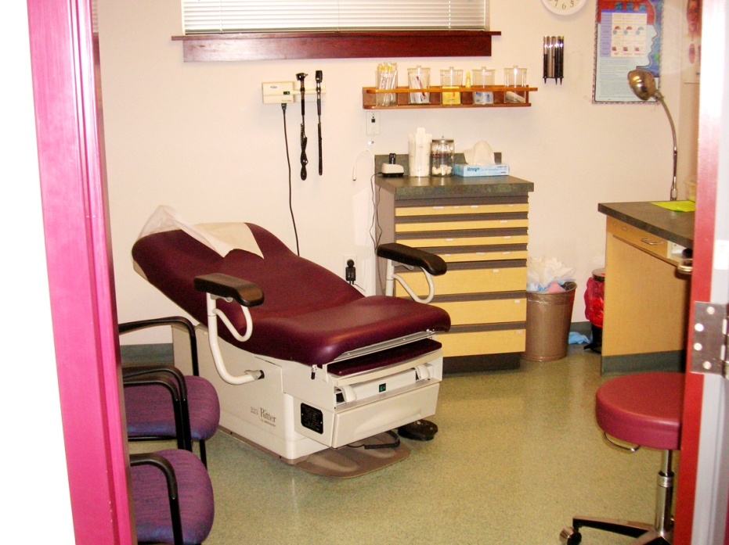
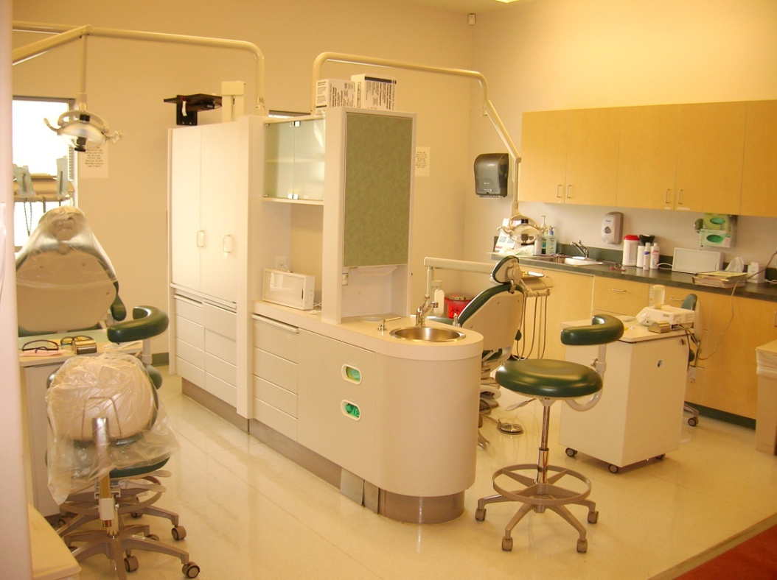
Kamiah Clinic
Hours
8am-5pm Mon-Fri
1pm-5pm Weds
Closed 12pm-1pm Daily
Notes:
This is a picture of the Kamiah Dental Clinic and one of the Medical Exam Rooms. In January 2017, the Kamiah Dental Clinic added Dental Implants Services as a “Pilot Program” offered to all eligible NMPH patients, that will eventually be offered at the Lapwai Dental Clinic.

Slide 19
Kamiah Staff
Notes:
This is the Kamiah Clinic Staff. Kamiah is a smaller clinic with a team of 12. 1 Provider, 1 Nurse, 1 C.N.A., 1 CHR, 1 Transporter, 1 Public Health Nurse, 1 Dentist, 1 Dental Assistant, 2 PCCs, 1 Pharmacy Tech and 1 Custodian.

Slide 20
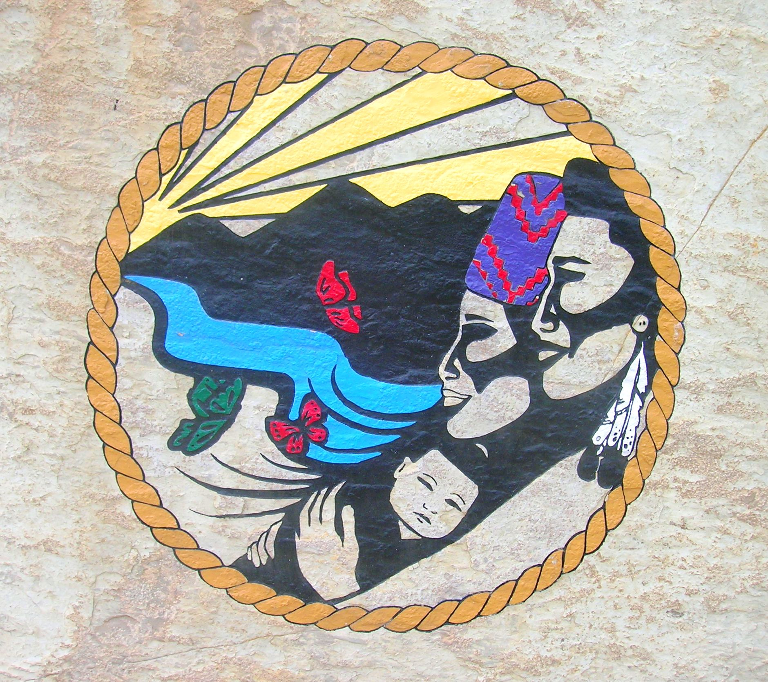
Qe’ci’yew’yew
Notes:
Qe’ci’yew’yew

