Slide 1

Hepatitis C Mortality Among American Indians and Alaska Natives in the Northwest, 2006–2012
Sarah Hatcher, PhD
Epidemic Intelligence Service Officer
Northwest Portland Area Indian Health Board
Quarterly Board Meeting
April 18, 2017

Slide 2
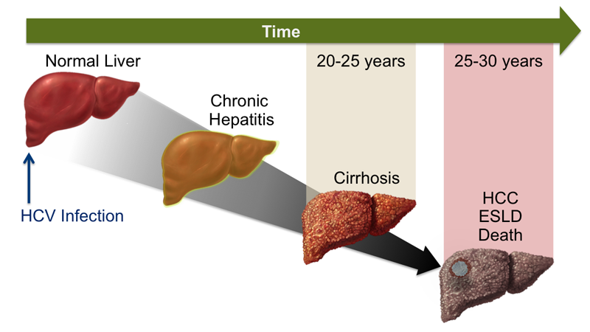
Hepatitis C Virus (HCV) Infection
Acute or chronic
Notes:
Hepatitis C virus, or HCV, infection can be acute or chronic, as seen in this graphic which shows the progression of disease over time from normal liver through hepatocellular carcinoma –HCC – and end stage liver disease – ESLD.

Slide 3
Hepatitis C Virus (HCV) Infection
75-85%
Notes:
Following acute infection, approximately 75-85% of adolescents and adults will develop a chronic infection.

Slide 4
Hepatitis C Virus (HCV) Infection
Notes:
Over time and without treatment, people who are chronically infected can develop cirrhosis, which can progress to end stage liver disease. Chronic HCV infection can also lead to hepatocellular carcinoma over time.

Slide 5
Hepatitis C Virus (HCV) Infection
Increased risk of all-cause and non-liver disease related mortality
Notes:
In addition to liver disease-related deaths, HCV infection significantly increases the risk of death from all causes and non-liver related diseases.

Slide 6
Hepatitis C Mortality is Increasing in the United States
Ly, et al. CID 2016
Notes:
In recent years the number of hepatitis C deaths has exceeded the number of deaths from 60 other infectious conditions.

Slide 7
Disparity in Hepatitis C Mortality—United States, 2010–2014
American Indian/Alaska Native (AI/AN)
Overall U.S.
non-Hispanic white
Notes:
But HCV-related mortality is not distributed equally across the population in the United States
This graph shows the HCV mortality rate from 2010-2014 for American Indians and Alaska Natives, the overall U.S. population, and non-Hispanic Whites. As you can see, the HCV-related mortality among AI/AN is roughly 2 times that of the Overall U.S. and non-Hispanic white population.
But, we know that there can be significant regional differences in AI/AN health outcomes, so regional analyses can sometimes provide more relevant information for practitioners and decision-makers.

Slide 8
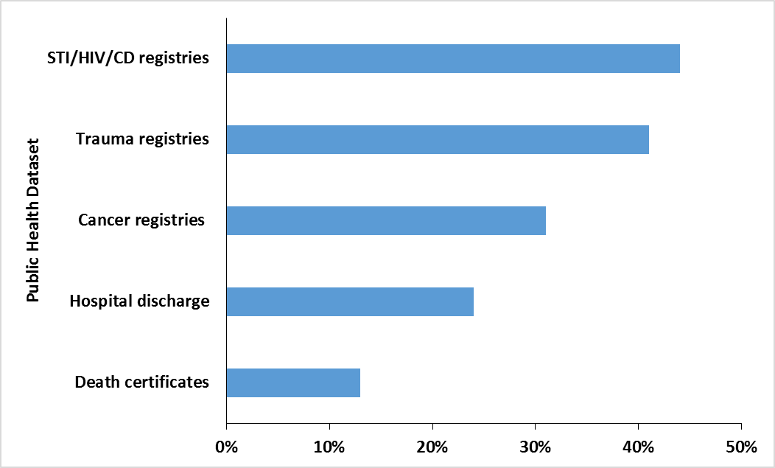
Racial misclassification
Notes:
. And most national analyses do not account for American Indian and Alaska Native racial misclassification, which, as you know, is common in Northwest public health datasets.
This bar chart demonstrates the percent misclassification for a selection of public health datasets that the Epi Center has linked with.

Slide 9
Assess the health disparity in AI/AN hepatitis C-related mortality in the Northwest
Notes:
Given the national disparity in Hepatitis C mortality for AI/AN, and the lack of racial misclassification-corrected analyses, our goal was to assess the health disparity in AI/AN hepatitis C-related mortality in the Northwest.

Slide 10
Methods
Notes:
The slide deck you all have includes more detailed information on the methods I used, but I am going to abbreviate it here to avoid putting everyone to sleep. But please feel free to ask me for more detailed methods if you have questions or concerns about it.

Slide 11
Methods
Idaho, Oregon, and Washington death certificates, 2006–2012
Notes:
HCV deaths were counted from death certificates from Idaho, Oregon, and Washington. We restricted the analysis to the years 2006-2012, the years for which data were available for all three states.

Slide 12
Methods
Idaho, Oregon, and Washington death certificates, 2006–2012
Corrected for racial misclassification using the Northwest Tribal Registry using LinkPlus v.2
Notes:
And we corrected for racial misclassification of AI/AN race in the death certificates by linking the death certificates with the Northwest Tribal Registry, using a publicly-available software called LinkPlus

Slide 13
Northwest Tribal Registry
A list of AI/AN patients in the Northwest
Northwest AI/AN Population
Tribal Health
Indian Health Service
Urban Indian Health
Notes:
As a reminder, the Northwest Tribal Registry is a list of American Indian/Alaska Native patients seen at Indian Health Service, Tribal, and Urban Indian Health clinics in the Idaho, Oregon, and Washington since the mid-1980s.
So if an individual is included in the Northwest Tribal Registry, we consider their race to be American Indian/Alaska Native.

Slide 14

Definition of AI/AN Race
A death certificate record listed as AI/AN alone or in combination in death certificate
OR
A death certificate record matched with a patient in the Northwest Tribal Registry
Photo credit: Erik Kakuska
Notes:
AI/AN race was defined as a record that was AI/AN on a death certificate or had a match in the Northwest Tribal Registry.

Slide 15
Hepatitis C-Related Death
International Classification of Diseases, 10th Revision codes
Underlying or contributing cause of death | ICD-10 code
Acute Hepatitis C | B17.1
Chronic viral Hepatitis C | B18.2
Notes:
Hepatitis C-related deaths were classified ICD-10 codes.
A hepatitis C related death was defined as a record with ICD-10 codes for acute or chronic hepatitis C in the underlying cause of death field or one of the contributing cause of death fields.

Slide 16
Mortality Rate and Rate Ratio
Age-adjusted mortality rate for AI/AN and non-Hispanic whites (NHW) separately
Rate ratio comparing AI/AN mortality rate with NHW mortality rate
AI/AN age-adjusted mortality rate
Rate Ratio (RR)=
NHW age-adjusted mortality rate
Notes:
I then calculated the HCV-mortality rate for AI/AN and NHW separately. Because the age distribution of the AI/AN and non-Hispanic White population are different, I calculated the age-adjusted mortality rate, which controls for the effect that differences in the age distribution can have on the mortality rate.
I compared the mortality rate for American Indian/Alaska Natives to the mortality rates for non-Hispanic whites by calculating the rate ratio.

Slide 17
Results

Slide 18
Age-adjusted Hepatitis C-related Mortality – Northwest, 2006–2012
Northwest
Rate Ratio (95% Confidence Interval) AI/AN : NHW | 3.33 (2.96, 3.75) | 3.22 (1.85, 5.62) | 2.52 (2.04, 3.11) | 3.88 (3.34, 4.50)
Notes:
This bar chart shows the age-adjusted Hepatitis C mortality rate for AI/AN in orange, compared with non-Hispanic Whites in grey.
In the three Northwest states overall, the HCV-related mortality rate of AI/AN was over three times that of NHW.

Slide 19
Age-adjusted Hepatitis C-related Mortality – Northwest, 2006–2012
Northwest
Rate Ratio (95% Confidence Interval) AI/AN : NHW | 3.33 (2.96, 3.75) | 3.22 (1.85, 5.62) | 2.52 (2.04, 3.11) | 3.88 (3.34, 4.50)
Notes:
This relationship held for the states of Idaho,

Slide 20
Age-adjusted Hepatitis C-related Mortality – Northwest, 2006–2012
Northwest
Rate Ratio (95% Confidence Interval) AI/AN : NHW | 3.33 (2.96, 3.75) | 3.22 (1.85, 5.62) | 2.52 (2.04, 3.11) | 3.88 (3.34, 4.50)
Notes:
Oregon

Slide 21
Age-adjusted Hepatitis C-related Mortality – Northwest, 2006–2012
Northwest
Rate Ratio (95% Confidence Interval) AI/AN : NHW | 3.33 (2.96, 3.75) | 3.22 (1.85, 5.62) | 2.52 (2.04, 3.11) | 3.88 (3.34, 4.50)
Notes:
and Washington. The disparity in HCV-related mortality was greatest in Washington, with a rate ratio of 3.88.

Slide 22
Age-Adjusted HCV-Related Mortality, 2006–2012
AI/AN
NHW
Notes:
This is a plot of age-adjusted HCV mortality rates overtime for AI/AN in orange and NHW in grey.
Over time, rates appear to remain relatively stable for NHW, and appear to increase for AI/AN, but you can see by the error bars that the rate estimates are imprecise for this population.
However, it is still evident that the disparity in age-adjusted HCV mortality between AI/AN and NHW persists over time.

Slide 23
Age-Adjusted HCV Mortality Rate, Stratified by Sex
Notes:
This bar chart shows the age-adjusted HCV mortality rate, stratified by sex, for American Indians and Alaska Natives in orange and non-Hispanic Whites in grey.

Slide 24
Age-Adjusted HCV Mortality Rate, Stratified by Sex
Notes:
Interestingly, the HCV mortality rates were greater among males [click]

Slide 25
Age-Adjusted HCV Mortality Rate, Stratified by Sex
Notes:
compared to females. And this was true for both AI/AN [CLICK]

Slide 26
Age-Adjusted HCV Mortality Rate, Stratified by Sex
Notes:
And for NHW.

Slide 27
Age-Adjusted HCV Mortality Rate, Stratified by Sex
RR: 4.55 (3.76, 5.49)
Notes:
But the disparity in HCV mortality comparing American Indians and Alaska Natives to non-Hispanic whites was greater among females [click]

Slide 28
Age-Adjusted HCV Mortality Rate, Stratified by Sex
RR: 4.55 (3.76, 5.49)
RR: 2.84 (2.44, 3.31)
Notes:
Compared to males.

Slide 29
Age-Specific Rates
 | AI/AN |  |  |  | NHW |  |  |  | AI/AN:NHW
 | n | Rate (95% CI) | Rate Ratios (95% CI) |  | n | Rate (95% CI) | Rate Ratios (95% CI) |  | Rate Ratios (95% CI)
Northwest
≤44 | 29 | 2.25 (1.51, 3.23) | Ref |  | 216 | 0.50 (0.43, 0.57) | Ref |  | 4.50 (3.05, 6.63)
45-54 | 107 | 48.6 (39.9, 58.8) | 21.6 (14.3, 32.6) |  | 1604 | 14.9 (14.1, 15.6) | 29.8 (25.9, 34.4) |  | 3.26 (2.68, 3.97)
55-64 | 108 | 72.1 (59.2, 87.1) | 32.0 (21.3, 48.3) |  | 2675 | 28.3 (27.2, 29.4) | 56.6 (49.3, 65.0) |  | 2.55 (2.10, 3.09)
≥65 | 42 | 41.7 (30.0, 56.4) | 18.5 (11.6, 29.8) |  | 863 | 8.63 (8.06, 9.22) | 17.3 (14.9, 20.0) |  | 2.25 (1.65, 3.07)
Notes:
This table shows the mortality rates for AI/AN and NHW by age group. So, these are not age adjusted but are stratified by age group.
**********************
Age-specific rates calculated by the Byar approximated Poisson method using Open Epi.

Slide 30
Age-Specific Rates
 | AI/AN |  |  |  | NHW |  |  |  | AI/AN:NHW
 | n | Rate (95% CI) | Rate Ratios (95% CI) |  | n | Rate (95% CI) | Rate Ratios (95% CI) |  | Rate Ratios (95% CI)
Northwest
≤44 | 29 | 2.25 (1.51, 3.23) | Ref |  | 216 | 0.50 (0.43, 0.57) | Ref |  | 4.50 (3.05, 6.63)
45-54 | 107 | 48.6 (39.9, 58.8) | 21.6 (14.3, 32.6) |  | 1604 | 14.9 (14.1, 15.6) | 29.8 (25.9, 34.4) |  | 3.26 (2.68, 3.97)
55-64 | 108 | 72.1 (59.2, 87.1) | 32.0 (21.3, 48.3) |  | 2675 | 28.3 (27.2, 29.4) | 56.6 (49.3, 65.0) |  | 2.55 (2.10, 3.09)
≥65 | 42 | 41.7 (30.0, 56.4) | 18.5 (11.6, 29.8) |  | 863 | 8.63 (8.06, 9.22) | 17.3 (14.9, 20.0) |  | 2.25 (1.65, 3.07)
Notes:
As you can see, the rates are highest for the age groups 45-54 and 55-64.
In addition, the rate ratio comparing the age-specific mortality rates in AI/AN to NHW is similar across most age groups, and is higher in the youngest age group – 44 years and younger.
**********************
Age-specific rates calculated by the Byar approximated Poisson method using Open Epi.

Slide 31
Age-Specific Rates
 | AI/AN |  |  |  | NHW |  |  |  | AI/AN:NHW
 | n | Rate (95% CI) | Rate Ratios (95% CI) |  | n | Rate (95% CI) | Rate Ratios (95% CI) |  | Rate Ratios (95% CI)
Northwest
≤44 | 29 | 2.25 (1.51, 3.23) | Ref |  | 216 | 0.50 (0.43, 0.57) | Ref |  | 4.50 (3.05, 6.63)
45-54 | 107 | 48.6 (39.9, 58.8) | 21.6 (14.3, 32.6) |  | 1604 | 14.9 (14.1, 15.6) | 29.8 (25.9, 34.4) |  | 3.26 (2.68, 3.97)
55-64 | 108 | 72.1 (59.2, 87.1) | 32.0 (21.3, 48.3) |  | 2675 | 28.3 (27.2, 29.4) | 56.6 (49.3, 65.0) |  | 2.55 (2.10, 3.09)
≥65 | 42 | 41.7 (30.0, 56.4) | 18.5 (11.6, 29.8) |  | 863 | 8.63 (8.06, 9.22) | 17.3 (14.9, 20.0) |  | 2.25 (1.65, 3.07)
Notes:
In addition, the rate ratio comparing the age-specific mortality rates in AI/AN to NHW is similar across most age groups, and is little higher in the youngest age group – 44 years and younger.
**********************
Age-specific rates calculated by the Byar approximated Poisson method using Open Epi.

Slide 32
Other Liver-Related HCV Outcomes
 | AI/AN |  |  | NHW |  |  | AI/AN:NHW
Cause | Count (%) | Rate |  | Count (%) | Rate |  | Rate Ratio | 95% CI
All HCV-related mortality | 286 (100) | 19.6 (17.3, 22.2) |  | 5358 (100) | 5.88 (5.73,6.05) |  | 3.33 | (2.96, 3.75)
Liver failure | 69 (24.1) | 4.53 (3.48, 5.87) |  | 1086 (20.3) | 1.18 (1.11, 1.26) |  | 3.83 | (3.00, 4.88)
Cirrhosis | 96 (33.6) | 6.52 (5.31, 8.11) |  | 1622 (30.3) | 1.76 (1.68, 1.85) |  | 3.7 | (3.01, 4.54)
Other liver disease | 23 (8.04) | 1.63 (1.00, 2.58) |  | 333 (6.21) | 0.37 (0.33, 0.41) |  | 4.4 | (2.88, 6.72)
Hepatitis B | 10 (3.5) | 0.72 (0.32, 1.46) |  | 140 (2.62) | 0.16 (0.13, 0.19) |  | 4.55 | (2.39, 8.63)
Primary Liver Cancer | 35 (12.2) | 2.40 (1.63, 3.47) |  | 936 (17.5) | 1.00 (0.93, 1.06) |  | 2.41 | (1.72, 3.38)
Other liver cancer | 2 (0.7) | 0.19 (0.02, 0.77) |  | 79 (1.47) | 0.09 (0.07, 0.11) |  | 2.17 | (0.53, 8.85)
Alcoholic Liver Disease | 81 (28.3) | 5.29 (4.15, 6.72) |  | 1297 (24.2) | 1.43 (1.35, 1.51) |  | 3.7 | (2.96, 4.64)
Notes:
This table shows the age-adjusted mortality for different liver-related causes of death, among those who died with HCV. So the top line is all of the HCV-related deaths, and the rest of the lines are sub analyses of that group, representing the number of people who had both an HCV-related cause of death AND a liver failure, cirrhosis, other liver disease, hepatitis B, primary liver cancer, other liver cancer, or alcoholic liver disease cause of death.
There are a couple of things to point out here.

Slide 33
HCV Outcomes
 | AI/AN |  |  | NHW |  |  | AI/AN:NHW
Cause | Count (%) | Rate |  | Count (%) | Rate |  | Rate Ratio | 95% CI
All HCV-related mortality | 286 (100) | 19.6 (17.3, 22.2) |  | 5358 (100) | 5.88 (5.73,6.05) |  | 3.33 | (2.96, 3.75)
Liver failure | 69 (24.1) | 4.53 (3.48, 5.87) |  | 1086 (20.3) | 1.18 (1.11, 1.26) |  | 3.83 | (3.00, 4.88)
Cirrhosis | 96 (33.6) | 6.52 (5.31, 8.11) |  | 1622 (30.3) | 1.76 (1.68, 1.85) |  | 3.7 | (3.01, 4.54)
Other liver disease | 23 (8.04) | 1.63 (1.00, 2.58) |  | 333 (6.21) | 0.37 (0.33, 0.41) |  | 4.4 | (2.88, 6.72)
Hepatitis B | 10 (3.5) | 0.72 (0.32, 1.46) |  | 140 (2.62) | 0.16 (0.13, 0.19) |  | 4.55 | (2.39, 8.63)
Primary Liver Cancer | 35 (12.2) | 2.40 (1.63, 3.47) |  | 936 (17.5) | 1.00 (0.93, 1.06) |  | 2.41 | (1.72, 3.38)
Other liver cancer | 2 (0.7) | 0.19 (0.02, 0.77) |  | 79 (1.47) | 0.09 (0.07, 0.11) |  | 2.17 | (0.53, 8.85)
Alcoholic Liver Disease | 81 (28.3) | 5.29 (4.15, 6.72) |  | 1297 (24.2) | 1.43 (1.35, 1.51) |  | 3.7 | (2.96, 4.64)
Notes:
One is that, among people who had an HCV-related cause of death, the top three liver-related causes that also appeared on the death certificate were 1) cirrhosis, 2) alcoholic liver disease, and 3) liver failure. This was true for both American Indians and Non Hispanic Whites.

Slide 34
HCV Outcomes
 | AI/AN |  |  | NHW |  |  | AI/AN:NHW
Cause | Count (%) | Rate |  | Count (%) | Rate |  | Rate Ratio | 95% CI
All HCV-related mortality | 286 (100) | 19.6 (17.3, 22.2) |  | 5358 (100) | 5.88 (5.73,6.05) |  | 3.33 | (2.96, 3.75)
Liver failure | 69 (24.1) | 4.53 (3.48, 5.87) |  | 1086 (20.3) | 1.18 (1.11, 1.26) |  | 3.83 | (3.00, 4.88)
Cirrhosis | 96 (33.6) | 6.52 (5.31, 8.11) |  | 1622 (30.3) | 1.76 (1.68, 1.85) |  | 3.7 | (3.01, 4.54)
Other liver disease | 23 (8.04) | 1.63 (1.00, 2.58) |  | 333 (6.21) | 0.37 (0.33, 0.41) |  | 4.4 | (2.88, 6.72)
Hepatitis B | 10 (3.5) | 0.72 (0.32, 1.46) |  | 140 (2.62) | 0.16 (0.13, 0.19) |  | 4.55 | (2.39, 8.63)
Primary Liver Cancer | 35 (12.2) | 2.40 (1.63, 3.47) |  | 936 (17.5) | 1.00 (0.93, 1.06) |  | 2.41 | (1.72, 3.38)
Other liver cancer | 2 (0.7) | 0.19 (0.02, 0.77) |  | 79 (1.47) | 0.09 (0.07, 0.11) |  | 2.17 | (0.53, 8.85)
Alcoholic Liver Disease | 81 (28.3) | 5.29 (4.15, 6.72) |  | 1297 (24.2) | 1.43 (1.35, 1.51) |  | 3.7 | (2.96, 4.64)
Notes:
Also, the rate ratios for these sub analyses varied, but were not statistically significantly different from the overall hcv-related mortality rate ratio.

Slide 35
Limitations
Death certificates might underestimate HCV mortality
Representativeness of Northwest Tribal Registry
Notes:
A few limitations should be mentioned. One is that death certificates might underestimate HCV mortality. Researchers have estimated that only 20% of persons with HCV who die have HCV recorded on their death certificates.
In addition, the Northwest Tribal Registry does not represent the entire Northwest AI/AN population because it only includes AI/AN patients who have sought health care services at an IHS, Tribal, or Urban Indian health clinic.
Both of these limitations would lead to and under-representation of AI/AN HCV-related mortality.

Slide 36
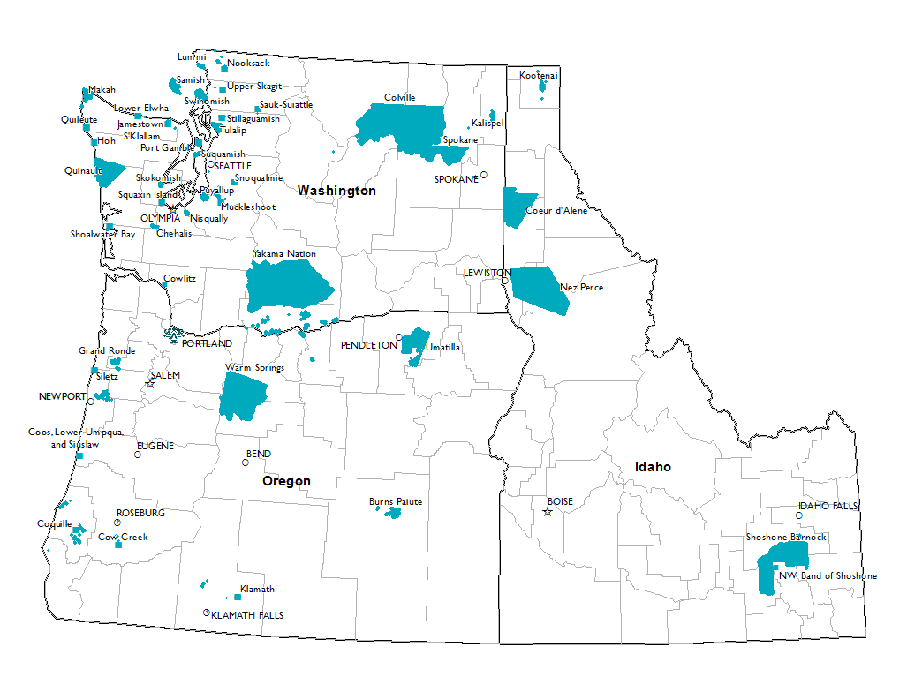
Strengths
Regional analysis
Data source
Notes:
The strengths of this study include that the regional analysis provides useful information to clinicians and public health practitioners in the Northwest, and that our analysis was conducted using a data source that corrected for AI/AN racial misclassification

Slide 37
Conclusion
HCV-related mortality is greater among AI/AN compared to NHW
Health disparity persists over time
Notes:
We demonstrated that HCV-related mortality is greater among AI/AN compared to non-Hispanic whites in the Northwest, and may exceed the disparity observed at the national level.
In addition, the analysis demonstrated that the health disparity appears to persist over time.

Slide 38
National Viral Hepatitis Action Plan 2017-2020
“Expanded access to diagnosis, treatment, and cure”
Notes:
The Department of Health and Human Services’ 2017-2020 National Viral Hepatitis Action Plan was recently released. It’s third goal addresses health disparities, explicitly stating the need for “expanded access to diagnosis, treatment, and cure.” Prevention of new viral hepatitis infections – the first goal – is also an important tenant of viral hepatitis eradication.

Slide 39

Recommendations
Prevent new HCV infection and transmission through harm reduction programs
Expand access to HCV screening and treatment for American Indians and Alaska Natives
Support providers in the Northwest in treating HCV
Photo credit: Erik Kakuska
Notes:
So, given the disparity demonstrated through this study, we recommend preventing new HCV infections through harm reduction programs, in addition to expanding access to HCV treatment for American Indians and Alaska Natives and supporting providers in the Northwest to treat their chronic HCV patients.

Slide 40
Acknowledgments
Patients and families of the Tribes of Idaho, Oregon, and Washington.
IHS
CAPT Tom Weiser, MD, MPH*
NPAIHB/NWTEC
Tom Becker, MD, PhD
Victoria Warren-Mears, PhD
Sujata Joshi, MSPH*
Jessica Leston, MPH
David Stephens, BSN, RN
*co-authors
CDC
Larry Cohen, MD, MPH
Byron Robinson, PhD
Scott Holmberg, MD, MPH
Kathleen Ly, MPH
Photo credits:
Erik Kakuska (NPAIHB)
NPAIHB
Contact:
Sarah Hatcher
shatcher@npaihb.org
The findings and conclusions in this report are those of the authors and do not necessarily represent the official position of the Centers for Disease Control and Prevention.

Slide 41

Image sources
University of Washington, Hepatitis C Online
Department of Health and Human Services: https://www.hhs.gov/about/budget/fy2017/budget-in-brief/ihs/index.html

Slide 42
HOW to expand HCV treatment for American Indian and Alaska Natives in the Northwest
Jessica Leston, MPH and David Stephens, RN
Northwest Portland Area Indian Health Board
NPAIHB QBM Meeting -April 18, 2017

Slide 44
Recommendations -
Expand access
Support providers
Themes from last CD call

Slide 45
Expand Access
“We are responsible for each other and ourselves” – Alutiiq Cultural Value, Kodiak, AK, United States.

Slide 46
CMOP

Slide 47
Provider Support
I/T/U screening, treatment and management guidelines
Flow sheets
Decision trees
Treatment Checklists
Paneling
ECHO
www.npaihb.org/hcv

Slide 48
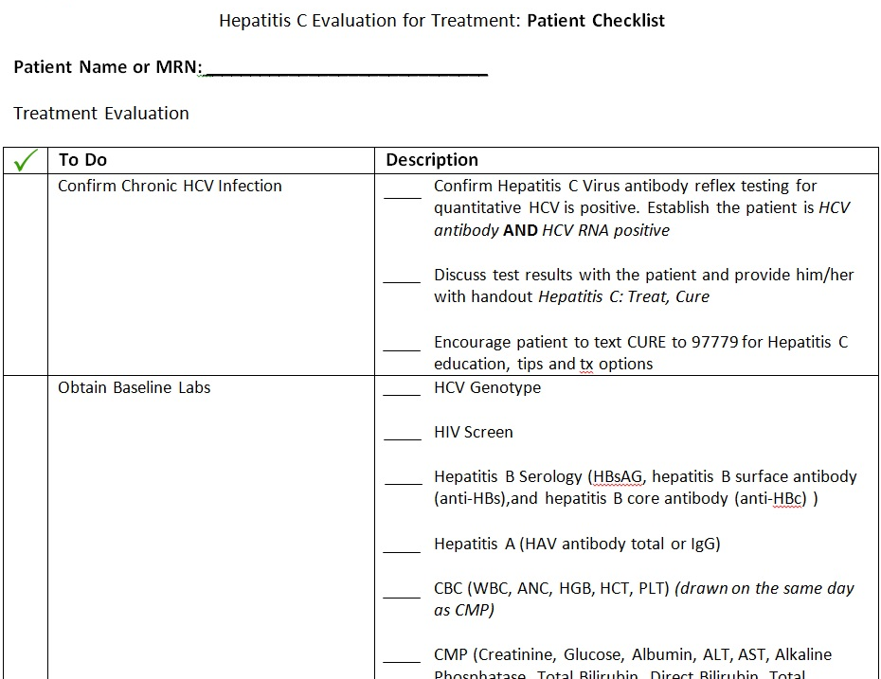

Slide 49
Notes:
Project ECHO® was created to effectively treat hepatitis C throughout New Mexico and to monitor outcomes. Once a combination of patient information is presented to the Hepatitis C Community TeleECHO Clinic, the community clinician is given a plan for treatment by the specialist. After hepatitis C treatment protocol is established, follow-ups are conducted to present the patient’s treatment status, to relay issues that may impede treatment, and to alter the treatment plan as needed to maximize the patient’s chance for a cure. Through the use of technology, best-practice protocols, and ongoing case-based learning, rural primary care clinicians deliver hepatitis C care that is as safe and effective as that given in a university clinic.
Project ECHO, the Indian Health Service (IHS) and the New Mexico AIDS Education and Training Center (NMAETC) began a collaboration in 2013, to bring HIV and hepatitis C virus (HCV) care and treatment to American Indian/Alaska Natives (AI/AN) throughout the United States. This collaboration created teleECHO clinic sessions specifically for clinicians serving these communities.

Slide 50
Notes:
Project ECHO is a lifelong learning and guided practice model that revolutionizes medical education and exponentially increases workforce capacity to provide best-practice specialty care and reduce health disparities. The heart of the ECHO model™ is its hub-and-spoke knowledge-sharing networks, led by expert teams who use multi-point videoconferencing to conduct virtual clinics with community providers. In this way, primary care doctors, nurses, and other clinicians learn to provide excellent specialty care to patients in their own communities.
Project ECHO links expert specialist teams at an academic hub with primary care clinicians in local communities. Primary care clinicians, the spokes in our model, become part of a learning community, where they receive mentoring and feedback from specialists. Together, they manage patient cases so that patients get the care they need. Although the ECHO model makes use of telecommunications technology, it is different from telemedicine.

Slide 51
IHS HCV TeleECHO Clinic Sites

Slide 52
IHS HCV TeleECHO Clinic Sites
Notes:
Need to fill gap in the NW

Slide 53
NPAIHB – Northwest HCV teleECHO
Held the 4th Wednesday of the month from 12pm-1pm PST
16 different sites have participated
30 case presentations
Notes:
During each session, clinicians present patient cases for review and consultation and receive a recommended treatment plan from a multidisciplinary panel of HIV or HCV experts. To supplement case-based learning, at each session, faculty and guest experts in the field present a 10-15 minute didactic on a wide range of topics related to the disease focus with specific emphasis on the AI/AN population. This format builds a community of learning and practice among the clinicians and increases access to high quality specialty care in areas where patients may not otherwise have access

Slide 54
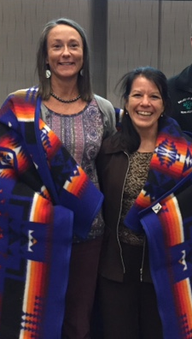
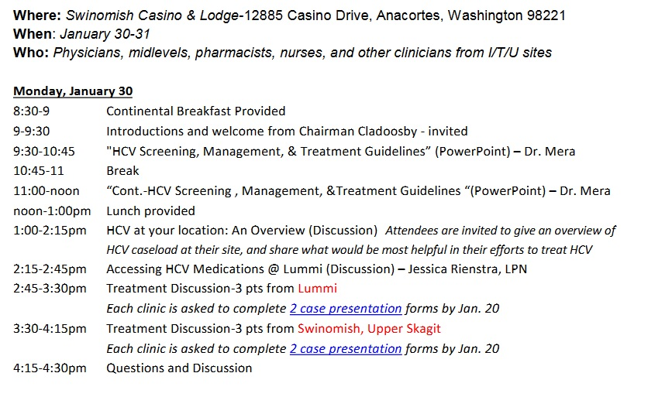
HCV Clinician Training-Fall
Free clinical training for I/T/U facilities to provide a range of HCV services at the primary care level with Dr. Jorge Mera
Host?
Notes:
Need to fill gap in the NW

Slide 55
Barriers to HCV screening – CD Discussion
Reminder gets lost among many other health maintenance/GPRA reminders
Misdiagnosed HCV patients
Unfilled nursing/MA positions that reduce capacity for ordering the test
Higher use of locums clinicians
Have we done enough to promote testing within communities?

Slide 56
Barriers to HCV screening – CD Discussion
Reminder gets lost among many other health maintenance/GPRA reminders
Misdiagnosed HCV patients
Unfilled nursing/MA positions that reduce capacity for ordering the test
Higher use of locums clinicians
Have we done enough to promote testing within communities?

Slide 57
Reminder Fatigue
Reminder Fatigue
Reduce or eliminate clinically inconsequential alerts
Tailor alerts to patient characteristics and critical integrated clusters of physiologic indicators
Tier alerts according to severity
Make only high-level (severe) alerts interruptive
Apply human factors principles when designing alerts (e.g., format, content, legibility, and color of alerts)
Delegate alerts
Notes:
The rapidly increasing computerization of health care has produced benefits for clinicians and patients. Yet the integration of technology into medicine has been anything but smooth, and as newer and more sophisticated devices have been added to the clinical environment, clinicians' workflows have been affected in unanticipated ways. These fundamental shifts have resulted in new threats to patient safety—a cruel irony given that technological solutions have been promoted for many years as the most promising solution to medical errors.
Most health care technologies—be they computerized provider order entry systems (CPOE), smart intravenous infusion pumps, or cardiac monitoring devices—provide auditory or visual warnings to clinicians to prevent or act on unsafe situations. These warnings are well intended and in isolation may be helpful. However, in the current highly computerized clinical environment, an individual clinician interacts with many different alert-generating devices—meaning that every day, clinicians are on the receiving end of a staggering number of alerts. A 2014 study found that the physiologic monitors in an academic hospital's 66 adult intensive care unit beds generated more than 2 million alerts in one month, translating to 187 warnings per patient per day. According to another study, CPOE systems generate warnings for 3%–6% of all orders that are entered, meaning that a physician could easily receive dozens of warnings each day.
The term alert fatigue describes how busy workers (in the case of health care, clinicians) become desensitized to safety alerts, and as a result ignore or fail to respond appropriately to such warnings. This phenomenon occurs because of the sheer number of alerts, and it is compounded by the fact that the vast majority of alerts generated by CPOE systems (and other health care technologies) are clinically inconsequential—meaning that in most cases, clinicians should ignore them. The problem is that clinicians then ignore both the bothersome, clinically meaningless alarms and the critical alerts that warn of impending serious patient harm. In essence, a proliferation of alerts that are intended to improve safety actually results in a paradoxical increase in the chance patients will be harmed. Although little discussed prior to the widespread use of electronic medical records, alert fatigue is now recognized as a major unintended consequence of the computerization of health care and a significant patient safety hazard.

Slide 58
Misdiagnosis – Using ICD for Hepatitis for screening
Found in every clinic
Found in every Area
Product of using a billing code for surveillance
It is – unfortunately – the best we have
Once it is “cleaned” once, it is 90% more useful
Decide on a set of codes to use for certain tests

Slide 59
Testing and Treatment Brochures

Slide 60


Slide 62
Extra slides

Slide 63
AI/AN Race
Death certificate race/ethnicity | Northwest Tribal Registry Match?
AI/AN | No
Non-AI/AN | Yes
Missing | Yes
Final Dataset Race/Ethnicity
AI/AN
AI/AN
AI/AN
Notes:
What I mean by that is demonstrated by these three scenarios:
If a record was listed as AI/AN on the death certificate, but didn’t have a match in the NTR, the record was considered AI/AN in the analytic dataset

Slide 64
AI/AN Race
Death certificate race/ethnicity | Northwest Tribal Registry Match?
AI/AN | No
Non-AI/AN | Yes
Missing | Yes
Final Dataset Race/Ethnicity
AI/AN
AI/AN
AI/AN
Notes:
If a record was coded as non-AI/AN in the death certificate, but had a match with the NTR, the record was coded as AI/AN in the analytic dataset

Slide 65
AI/AN Race
Death certificate race/ethnicity | Northwest Tribal Registry Match?
AI/AN | No
Non-AI/AN | Yes
Missing | Yes
Final Dataset Race/Ethnicity
AI/AN
AI/AN
AI/AN
Notes:
Finally, if race/ethnicity data were missing for a record in the death certificate and the record had a match in the NTR, the record was considered AI/AN in the analytic dataset

Slide 66
Age-Adjusted Mortality Rate Calculation
Numerator
HCV-related deaths
AI/AN and non-Hispanic whites (NHW)
Notes:
To calculate age-adjusted HCV mortality , I calculated the number of HCV related deaths among AI/AN and non-Hispanic Whites separately

Slide 67
Mortality Rate Calculation
Numerator
HCV-related mortality rates and 95% confidence intervals
AI/AN and non-Hispanic whites (NHW)
Denominator
National Center for Health Statistics bridged race estimates
Notes:
As a denominator, I used the National Center for Health Statistics bridged race estimates

Slide 68
Mortality Rate Calculation
Numerator
HCV-related mortality rates and 95% confidence intervals
AI/AN and non-Hispanic whites (NHW)
Denominator
National Center for Health Statistics bridged race estimates
Standardized to the U.S. 2000 standard population
2006—2012 aggregate and annual
Notes:
Mortality rates were standardized to the US 2000 standard population
I calculated both the 2006-2012 aggregate age-adjusted mortality rates and annual age-adjusted mortality rates.

Slide 69
Mortality Rate and Rate Ratio
Age-adjusted mortality rate for AI/AN and non-Hispanic whites (NHW) separately
Rate ratio comparing AI/AN mortality rate with NHW mortality rate
AI/AN age-adjusted mortality rate
Rate Ratio (RR)=
NHW age-adjusted mortality rate
Notes:
With AI/AN rates in the numerator and NHW rates in the denominator

Slide 70
Mortality Rate and Rate Ratio
Age-adjusted mortality rate for AI/AN and non-Hispanic whites (NHW) separately
Rate ratio comparing AI/AN mortality rate with NHW mortality rate
AI/AN age-adjusted mortality rate
Rate Ratio (RR)=
NHW age-adjusted mortality rate
RR > 1
Mortality rate greater among AI/AN
Notes:
So if the rate ratio is greater than one, we know the mortality rate is greater among AI/AN

Slide 71
Mortality Rate and Rate Ratio
Age-adjusted mortality rate for AI/AN and non-Hispanic whites (NHW) separately
Rate ratio comparing AI/AN mortality rate with NHW mortality rate
AI/AN age-adjusted mortality rate
Rate Ratio (RR)=
NHW age-adjusted mortality rate
RR > 1
RR < 1
Mortality rate greater among AI/AN
Mortality rate greater among NHW

Slide 72
Mortality Rate and Rate Ratio
Age-adjusted mortality rate for AI/AN and non-Hispanic whites (NHW) separately
Rate ratio comparing AI/AN mortality rate with NHW mortality rate
AI/AN age-adjusted mortality rate
Rate Ratio (RR)=
NHW age-adjusted mortality rate
RR > 1
RR < 1
RR = 1
Mortality rate greater among AI/AN
Mortality rate greater among NHW
No difference

Slide 73
Age-Specific Rates
 | AI/AN |  |  |  | NHW
 | n | Rate (95% CI) | Rate Ratios (95% CI) |  | n | Rate (95% CI) | Rate Ratios (95% CI)
Northwest
≤44 | 29 | 2.25 (1.51, 3.23) | Ref |  | 216 | 0.50 (0.43, 0.57) | Ref
45-54 | 107 | 48.6 (39.9, 58.8) | 21.6 (14.3, 32.6) |  | 1604 | 14.9 (14.1, 15.6) | 29.8 (25.9, 34.4)
55-64 | 108 | 72.1 (59.2, 87.1) | 32.0 (21.3, 48.3) |  | 2675 | 28.3 (27.2, 29.4) | 56.6 (49.3, 65.0)
≥65 | 42 | 41.7 (30.0, 56.4) | 18.5 (11.6, 29.8) |  | 863 | 8.63 (8.06, 9.22) | 17.3 (14.9, 20.0)
Oregon
≤44 | 13 | 3.25 (1.73, 5.56) | Ref |  | 19 | 0.95 (0.57, 1.49) | Ref
45-54 | 34 | 49.0 (33.9, 68.5) | 15.1 (8.0, 28.6) |  | 93 | 19.6 (15.8, 24.0) | 20.6 (12.6, 33.8)
55-64 | 33 | 68.7 (47.3, 96.5) | 21.1 (11.1, 40.2) |  | 202 | 40.5 (35.1, 46.5) | 42.6 (26.6, 68.2)
≥65 | 10 | 31.8 (15.2, 58.4) | 9.78 (4.29, 22.3) |  | 60 | 10.8 (8.25, 13.9) | 11.4 (6.8, 19.0)
Washington
≤44 | 15 | 2.03 (1.13, 3.35) | Ref |  | 10 | 0.30 (0.14, 0.55) | Ref
45-54 | 67 | 53.1 (41.2, 67.5) | 26.2 (14.9, 45.8) |  | 104 | 12.6 (10.3, 15.3) | 42.0 (22.0, 80.4)
55-64 | 71 | 83.1 (64.9, 104.9) | 40.9 (23.5, 71.5) |  | 247 | 31.7 (27.9, 36.0) | 105.7 (56.2, 198.8)
≥65 | 30 | 52.1 (35.1, 74.5) | 25.7 (13.8, 47.7) |  | 107 | 13.0 (10.7, 15.7) | 43.3 (22.7, 82.9)
Notes:
Rates calculated by the Byar approximated Poisson method using Open Epi.

Slide 74
Sex-stratified age-adjusted HCV-related mortality
Notes:
Show this in a bar graph similar to the age-adjusted mortality
Interestingly, the age adjusted HCV mortality rates were greater among males compared to females for both AI/AN [CLICK]

Slide 75
Sex-stratified age-adjusted HCV-related mortality
Notes:
and NHW.

Slide 76
Regional analysis
Espey et al.
Notes:
Other methodologies for regional analysis

Slide 77
Hepatitis C-Related Death
International Classification of Diseases, 10th Revision codes
Underlying or contributing cause of death | ICD-10 code
Acute Hepatitis C | B17.1
Chronic viral Hepatitis C | B18.2
Notes:
The underlying cause of death is defined as the disease or injury that initiated the train of morbid events leading directly to death or the circumstances of the accident or violence that produced the fatal injury.

Slide 78
Hepatitis C-Related Death
International Classification of Diseases, 10th Revision codes
Underlying or contributing cause of death | ICD-10 code
Acute Hepatitis C | B17.1
Chronic viral Hepatitis C | B18.2
Notes:
The contributing causes of death are defined as diseases or injuries that contributed to the fatal outcome.

Slide 79
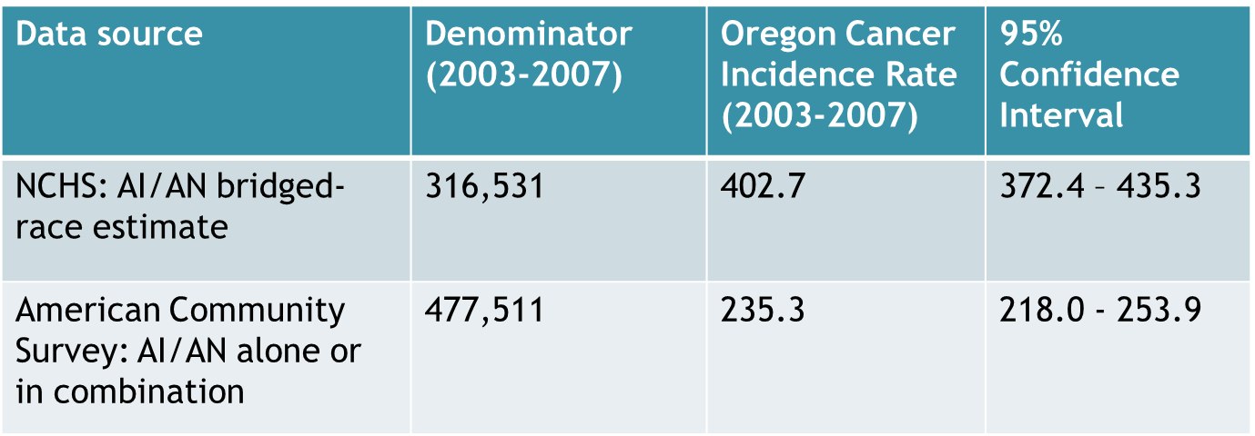
Population denominators
Notes:
Choice in population denominators and effect on incidence rates – from a different study of Oregon cancer incidence

