Slide 1
Indian Health Service Portland Area Director’s Update
Dean M Seyler - Area Director
April 18, 2017
Quinault Beach Resort
NPAIHB Quarterly Board Meeting

Slide 2
Indian Health Service
Portland Area
Current IHS Headquarters Senior Leadership
RADM Chris Buchanan – Acting Director
Elizabeth A. Fowler – Deputy Director for Management Operations
CAPT Michael Toedt, M.D. – Acting Chief Medical Officer
Jonathan Merrell – Acting Deputy Director for Quality Health Care
P. Benjamin Smith – Deputy Director for Intergovernmental Affairs
RADM Kevin Meeks – Acting Deputy Director of Field Operations
RADM Kelly M. Taylor – Acting Chief of Staff
https://www.ihs.gov/aboutihs/keyleaders/
Current IHS Headquarters Senior Leadership
Chief Contracting Officer - Elida Monroe
Contract Support Cost (CSC)/Indian Self Determination (ISDEAA) Specialist position

Slide 3
Indian Health Service Portland Area
People
Partnerships
Quality
Resources
People
Partnerships
Quality
Resources

Slide 4
Indian Health Service
Portland Area
Funds Distribution Workgroup
Met March 14, 2017 at Portland Area Office
Discussed Area-wide CHSDA Proposal
A proposed CHSDA expansion pilot project for Tribes to opt into a secondary layer of coverage that would allow them to expand their individual CHSDA’s throughout Portland Area (OR, WA & ID) in order to access Medicare Like and PRC Rates.
Under Review
FY17 CHEF
$115,904 submitted for Portland Area
100% reimbursement rate to date
Current balance: $46,801,410.

Slide 5
Indian Health Service Portland Area
2017 Tribal Self Governance Annual Conference
Date: April 25 - 26
Location: Spokane, WA
Direct Service Tribe Advisory Committee Quarterly meeting
May 3-4, 2017
Portland, OR
Location: Radisson Hotel – Portland Airport

Slide 6
Indian Health Service Portland Area
2017 Portland Area Director’s Recognition of Excellence
Date: May 12, 2017
Location: Portland – Embassy Suites – downtown Portland, Oregon
Tribal Leaders, Recipients and Supervisors notified
2015 & 2016 IHS Directors Award Ceremony
Date: July 28, 2017
Location: Rockville, MD
Both Fiscal Year Recipients will be recognized (FY15 & FY16)
IHS Direct Service Tribes National Meeting
Date: July 26-27
Location: Boston, MA

Slide 7
Indian Health Service Portland Area
P.L. 93-638 Orientation
When: August 2-3, 2017
Location: Portland, OR – Embassy Suites Portland Airport
Who Should Attend:
Tribal Leaders
Tribal Administrators and staff
Area & Service Unit staff involved with P.L. 92-638 process
Oregon YRTC Contract With NARA Update
Facilities update:
Construction is on-going in all phases
Building is projected to be complete and permit sign-off mid-May.
Delay will be with electrical service to the building from PGE.
Temporary Occupancy permit is being requested before power service.

Slide 8
Indian Health Service Portland Area
Oregon YRTC Contract Update
16 bed facility at opening with an option to expand to 24 beds
Hired YRTC Manager and Youth Tribal Liaison
Interviews are in process for Milieu therapists, tutor, Youth A & D Counselors, cook, and others
Planning is on-going for:
Medical services
School services
Treatment curriculum is developed – 2 months to 3 months anticipated treatment length of stay depending on the youth’s progression through treatment

Slide 9
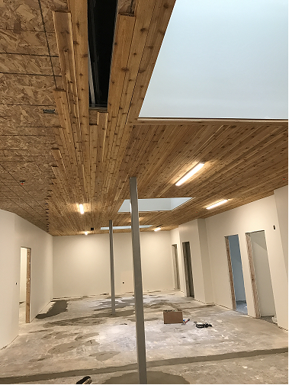
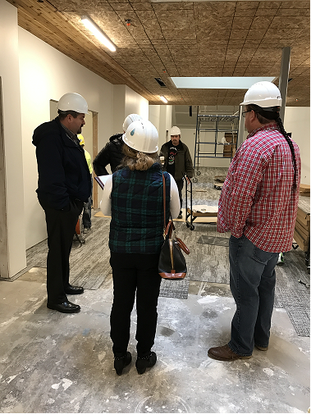

Slide 10
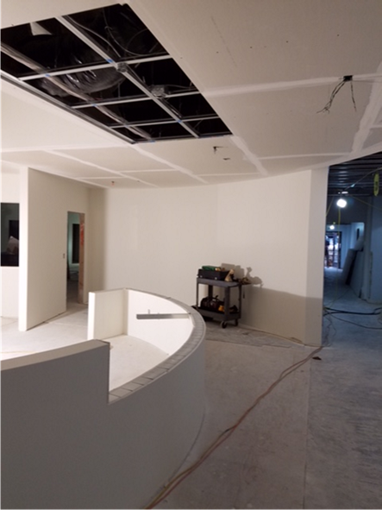
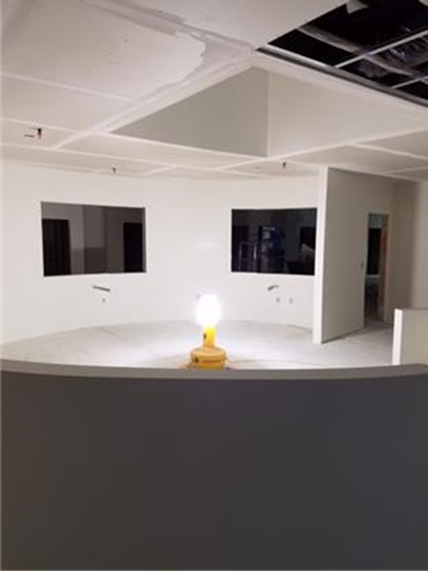

Slide 11
Indian Health Service Portland Area

Slide 12
Indian Health Service Portland Area

Slide 13
Indian Health Service Portland Area
IHS Program Maximum Supportable Space (MSS) – Update from October 2016
Approved IHS Program Space is Used to Determine Allocation of Maintenance & Improvement (M&I) and Equipment (EQ.) Funds.
Funds Are Not Allocated for Program Space Above the Maximum Supportable Space (MSS).
Health Facilities Engineering (DHFE) Analyzed all Tribal Programs with Retained Shares and Determined Six Tribal Programs Would Benefit From Recalculating MSS.
Area Director Notified These Tribes in November 2016.
Three Tribal Programs Responded and Worked With DHFE Resulting in Supported Program Space Increases of 41%, 21%, and 8%. The Increased Space Will be Considered in Future Year Allocations.
In FY 2018, Subject to Workload and Resource Availability, There May Be Buy-Back Opportunities for Tribes Who Have Taken Their Shares to Follow This Process.

Slide 14
Indian Health Service Portland Area
Grant Opportunity
American Cancer Society/Walgreens
Will award five (5) grants in amounts up to $100,000 ($50,000/year for 2 years) to eligible tribal health organizations and organizations serving the health needs of AI/AN communities to support the implementation of colorectal cancer screening projects.
Information has been shared with all Portland Area I/T/U Clinical Directors. Contact Dr. Rudd for a copy of the grant announcement.
Deadline for grant applications: May 17, 2017.
Assistance:
Oregon- 503-295-6422
Washington- 206-283-1153
Idaho- 208-343-4609

Slide 15
Indian Health Service Portland Area
Federal Register Notice Published
Proposed re-designation of Service Delivery Area
Tolowa Dee-ni’ Nation
Consultation with two Oregon Tribes
Open for comments until May 01, 2017
https://www.federalregister.gov/documents/2017/03/31/2017-06383/proposed-re-designations-of-service-delivery-areas-tolowa-dee-ni-nation-smith-river-rancheria
Perception of Significant Amount of IHS Funds Returned
IHS is not returning a significant amount of funds
Dear Tribal Leaders Letter dated March 28, 2017
https://www.ihs.gov/newsroom/includes/themes/newihstheme/display_objects/documents/2017_Letters/57343-1_DTLL_UIOLL_FundsReturnedTreasury_03282017.pdf

Slide 16
Questions or Comments
Our Mission... to raise the physical, mental, social, and spiritual health of American Indians and Alaska Natives to the highest level.
Our Goal... to assure that comprehensive, culturally acceptable personal and public health services are available and accessible to American Indian and Alaska Native people.
Our Foundation... to uphold the Federal Government's obligation to promote healthy American Indian and Alaska Native people, communities, and cultures and to honor and protect the inherent sovereign rights of Tribes.

