Slide 1
Community Health Aide Program: An Introduction
Northwest Portland Area Indian Health Board Native Dental Therapy Initiative
QBM October 18, 2016

Slide 2
A CHAP History Timeline
1950s Chemotherapy Aides (Volunteers)-Direct Observed Therapy for TB patients
1960s Formal Training/Federal Funding 1968
1976 Indian Health Care Improvement Act (IHCIA) (PL 94-437)
1992 IHCIA amended to add § 119 that provided for the Alaska Community Health Aide Program under authority of the 25 U.S.C. § 13 popularly known as the Snyder Act and require a Certification Board (PL 102-573)
1959 Alaska becomes a State
Notes:
The Community Health Aide Program was a program developed in Alaska in response to a number of health concerns, including: the tuberculosis epidemic, high infant mortality and high rates of injury in rural Alaska.
The idea was to train local people to provide services to their community between visits from physicians. Because the physicians couldn’t be there to monitor chronic illness, in the 50s, that was a tuberculosis epidemic, as well as the ongoing care necessary to improve infant mortality and care after injury.
The first example of this was from the 1950, even before. Alaska became a state in 1959
In the 60s, there were pilot programs to test out this village based model and in 1968, congress appropriated funding to support 185 health aide positions in 157 villages. That being the official beginning of the funded Community Health Aide Program.
In 1976, the Indian Health Care Improvement Act further laid out congressional intent for the use of paraprofessionals to increase the number of Indians entering the health professions and securing the supply of health professionals for the IHS
In 1992, the Indian Health Care Improvement Act was amended to add section 119 that codified the Community Health Aide Program, required the creation of a certification board and set the foundation for the CHAP program that we know today.

Slide 3
More CHAP History
1998 CHAP Certification Board Established
2002 Standards amended to address dental health aides (including therapists).
2005 First Dental Health Aides Certified
2008 Standards amended to address behavioral health aides/practitioners
2009 First Behavioral Health Aides Certified
Notes:
The federally authorized Community Health Aide Program Certification Board (CHAPCB) was established and charged with formalizing the process for maintaining Community Health Aide/Practitioner training and practice standards and procedures. 1998 Alaska Area Director (Like Medicaid, the IHS is divided up into Areas, for example, Washington, Oregon, and Idaho make up the “Portland Area”. Alaska is it’s own Area, the Alaska Area). Alaska Area Native Health Area Director supervised the establishment of an eleven person board which first convened in July of 1998.
That board worked with the Alaska Native Tribal Health Consortium to create the standards and procedures for the CHAP program and once those were adopted, Community Health Aides could be formally certified.

Slide 4
CHAP Certification Board
  Established in 1998
  Federal Authority, 12 members
Standards and Procedures
      Individuals, Training Centers, Curricula
489 individuals certified
      405 Community Health Aides
      52 Dental Health Aides
      32 Behavioral Health Aides
Notes:
The CHAP certification board is the keystone of the Community Health Aide Program legal structure and ensures for the quality and safety of care through the chap program. The CHAP Certification board is a continually active board that is responsible for the certification of the individuals, training centers, and curricula for the different health aides. This board is continually updating the curricula to better meet the needs of the communities it serves and to ensure that CHAP providers are providing the best care available.
Amendments to add 6 Dental Health Aide providers
Dental Health Representative added to the Board
2005 First DHAs certified
Amendments to add 4 Behavioral Health Aide providers
Behavioral Health Representative added to the Board
2009 First BHAs certified

Slide 5
CHAPCB Membership
12 Positions, representing:
Each region with a CHA Training Center (4)
CHA Training Centers (1)
CHAP Directors’ Association (1)
CHA Association (1)
Medical Director (1)
Federal [Alaska Area Native Health Service] (1)
State of Alaska (1)
Dental Health (1)
Behavioral Health (1)
Notes:
Today there are 12 positions, and you can see here (read slide)

Slide 6
CHAPCB Operations
Ongoing review of applications & granting provisional certification
Maintain database and applicant files
Facilitate 3 Board meetings per year
Travel and support for Board Members
Billing, budget projection & reconciliation
Correspondence, newsletter & website
Notes:
As I said, it is a continually active board that meets regularly (3 times a year) to review applications and grant certification, fine tune or update the curricula for the three disciplines of community health aides to better meet the needs of the tribal communities served by the CHAp program. Any changes to the federal CHAP standards and procedures must be approved by the CHAP Certification Board.
Additional Board meetings may be held as needed and
Certification period is 2 years. Fee is $500 for any action on application in that time period.

Slide 7

Total Certified - August 2016
Notes:
These are the most current numbers of certified CHAP providers. As you can see, in Alaska it is a robust network of providers. I will now explain the different providers in the Community Health Aide Program.

Slide 8


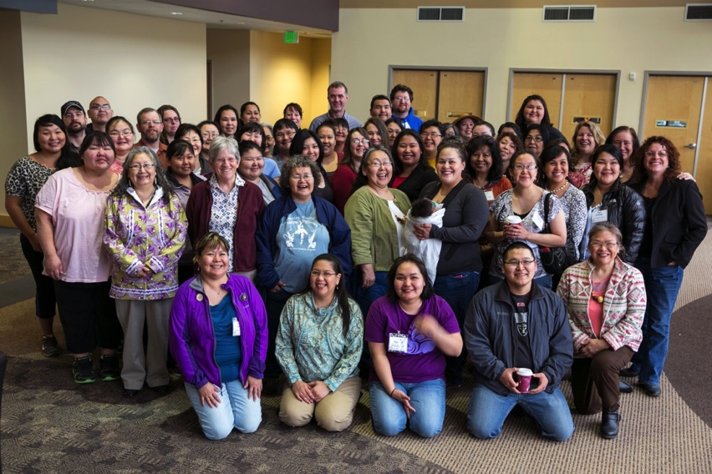
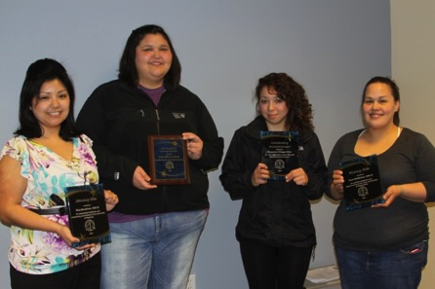
The Alaska
Community Health Aide Program
Alaska Native Tribal Health Consortium
web: www.akchap.org |www.anthc.org
Notes:
I would also encourage you to check out the Alaska Native Tribal Health Consortium CHAP website www.akchap.org for more in depth information and remind you all that Dr. Onders, the director of the CHAP program for ANTHC will be joining the webinar to provide answers to questions. He is currently on an airplane. . .

Slide 9
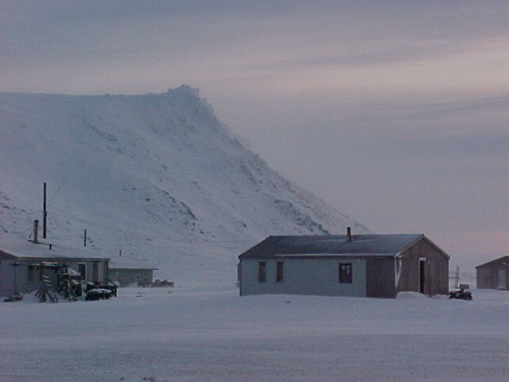
CHAP Key Components
Community’s Role in Selection
Culturally Competent Care
Competency based curriculum
Team-Based Care
Gambel
Notes:
It is important to understand the key components of CHAP that set it apart from other health programs aimed at improving the health of Native people. The Community Health Aide program is deeply rooted in the community and was developed to meet the specific needs of the Alaska native and American Indian Communities. The current health care system is failing native populations and Alaska has spent the last 60 years shaping their health care delivery system – everything from how providers are educated and who is delivering care to how care is delivered – to break down the specific barriers to health that Native populations faced. The success of the CHAP program in Alaska has been to understand the role of the village-based communities and its recognition to build on these strengths to develop the program. The role of the tribal community is critical to meeting the unique health needs and addressing health disparities for each of the Tribes involved. At the heart of the Community Health Aide program is the community’s role in the selection of providers, because it is not just about bringing more providers to Indian country, but changing the current system for training health professionals to make it more accessible to native people. To ensure culturally competent care. It should not be a privilege to be seen by a provider that looks like you and understands your culture, your language, history, and community (it should be the norm). The curriculum is competency based and the approach to health care is team based.

Slide 10
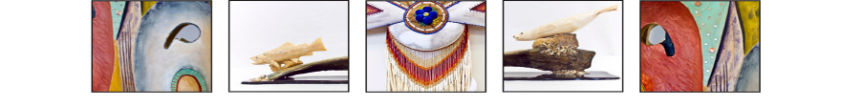
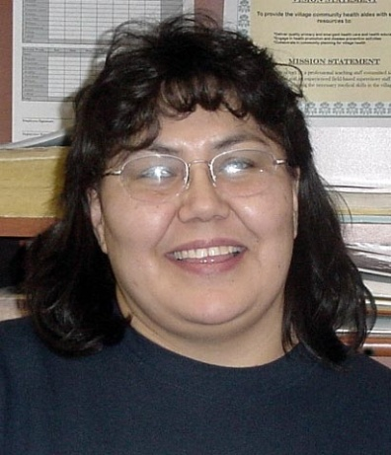
Role of CHA/P
  Emergency Medical Response
  Front office manager/receptionist
  Admissions and registration clerk
  Medical records clerk
  Nurse
  Provider
  Lab technician
  Pharmacy technician
  Travel clerk
  Medical supply officer
Agnes Silas CHP, Minto, AK
“Stronger Together
for the Next 100 Years”
Notes:
Not an AIDE – a health care provider!
What makes them different is they are treating family and friends, they know patients on a different level, as people. They know your baseline normal and therefore often can notice before an itinerant providers who isn’t based in the community when something just isn’t right.
It is an Enormous job, not just anyone can do the job
There are 5 levels of community health aides, 4 levels of dental health aides, and 4 levels of behavioral health aides.
As you can see from the slide, Community Health Aides play significant roles in the health care delivery systems of their communities.

Slide 11
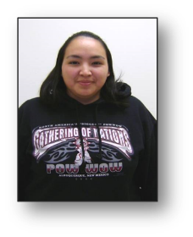
CHA/P Training
ETT/EMT every 2 years
Pre-session: Intro to CHAM/CHA
Session I: 4 weeks → 60 hours in village clinic
Session II: 4 weeks → 200 hours in village clinic
Session III: 3 weeks → 200 hours in village clinic
Session IV: 4 weeks → 200 hours in village clinic or Session IV Blended
Preceptorship: 1 week
CME: 48 hr/2 yrs
Eligible for University Credit
Mary Malemute, CHP, Koyukuk, AK
“Stronger Together
for the Next 100 Years”
Notes:
As I said there are 5 levels of community health aides and the training builds upon itself.
The 4 week didactic training sessions are done only at certified training center (certified by chap board)
Again, they are Competency based and after the didiactic portion of the education, the students spend one on one time with the training physician or midlevel (such as a physicians assistant or nurse practitioner) to complete that particular level of training.
The training sessions are not done back to back.
Each session is followed with time in their home clinic seeing patients and being mentored by our program trainers

Slide 12
Community Health Aide Training Sessions
Sessions I & II
Body Systems approach
Focus on medical history & basic exams-problem specific & complete history and physical
Intro to basic anatomy, physiology, and function
Skills including blood draw, urine dip, lab testing, suturing, wound care, IV therapy, splinting, med administration
ETT review, mental health, substance abuse
Session III
Women’s Health, STI, prenatal visits, emergency delivery
Well child
Mental health, substance abuse
ETT review
Session IV
Focuses on follow-up of patients with chronic illness (COPD, DM, CAD, seizures, CVA)
Elders
Tobacco cessation, mental health, substance abuse prevention
ETT review

Slide 13
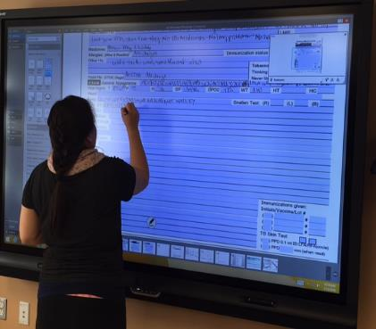
Supervision and Mentoring
Referral physician
  EVERY CHA/P MUST HAVE A REFERRAL PHYSICIAN
  Medical Traffic
  Standing Orders
Coordinator or Supervisor Instructors
  Resource of daily questions
  Documentation review
  Skills training
Documentation practice on smart board
“Stronger Together
for the Next 100 Years”
Notes:
Physician
EVERY CHA works under a physicians license
daily consult of patients, called daily medical traffic
can sign standing orders permitting the cha/p to treat without consulting physician
Coordinator/Supervisor Instructor
Daily contact and support, someone with 4 weeks of training is going to have questions (supplies, how to interact with the Tribal Council, immunizations – you name it)
Monthly review of at least 5 visits
Training
Skills, patient volume
DOCUMENT DOCUMENT DOCUMENT
CHAM

Slide 14

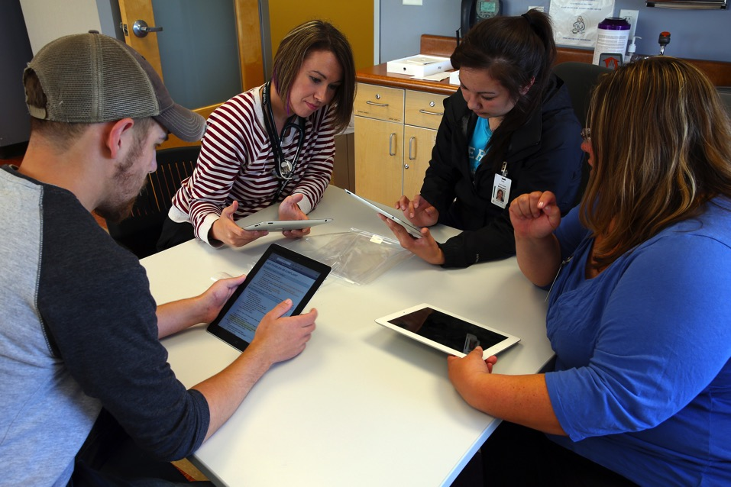
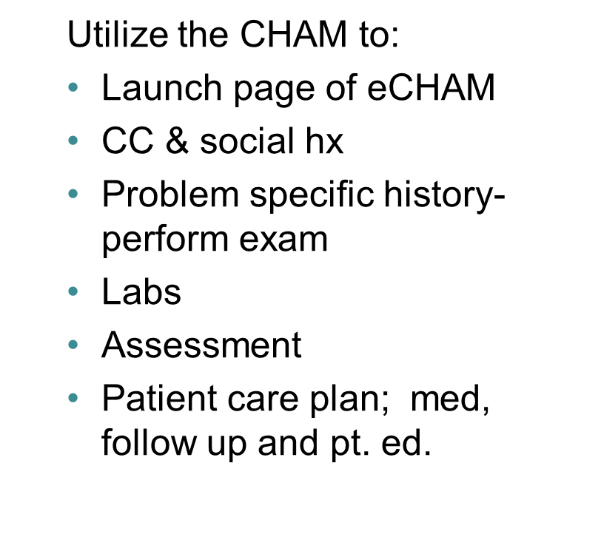
Alaska Community Health Aide/Practitioner Manual
eCHAM training
“Stronger Together
for the Next 100 Years”
Notes:
No longer the 14 pound, 4 volume book that Lincoln referred to yesterday
Yep, it is an app!
Offline versions require initial Internet access.
A guide to the CHA/P for every patient encounter
Identifies specific section to guide exam and assessment and determine plan
Online: eCHAM Website
Offline: iCHAM (iPad app)
Backups: ePub and PDF
Personalization features (bookmarks, comments, highlights)

Slide 15
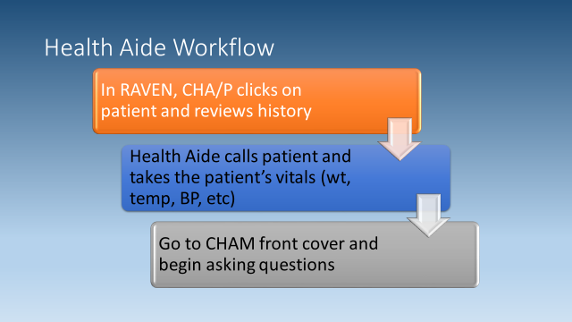

Slide 16
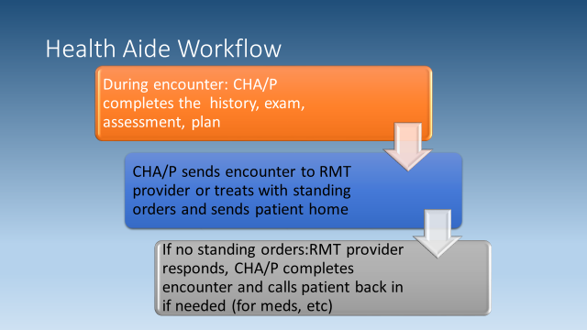

Slide 17
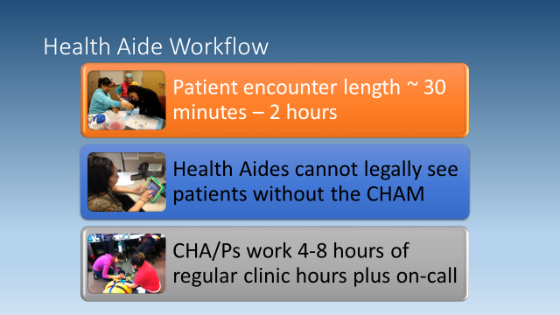

Slide 18

Hiring a CHA/P
Positions open and advertised several months prior to scheduled Pre-session
Applications received
  SI travels to the village
  Test for Adult Basic Education (TABE)
  Interview with tribal council
    Tribal council gives top 3 choices
  CHA selected and hired

Slide 19
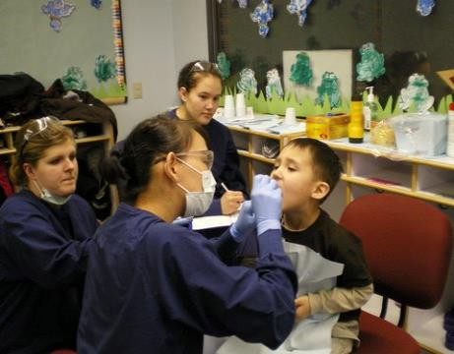
Types of Dental Health Aides (DHA)
Primary DHA (CDHC)
  Oral Health Educators
Expanded Function DHA
  Restorations, cleanings, temporary fillings
DHA Hygienist
  Local anesthesia
DHA Therapist (DHAT)
  Prevention, operative, urgent
Chelsea Shoemaker, Bonnie Johnson, Corrina Cadzow (DHAT students) providing fluoride varnish treatment for a Head Start student.
Supervised providers
Teams led by Licensed Dentists

Slide 20
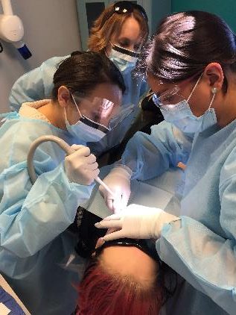
Dental Therapists: A Definition
Primary oral health care professionals
Basic clinical dental treatment and preventive services
Multidisciplinary team members
Advocate for the needs of clients
Refer for services beyond the scope of the dental therapist’s practice.*
*SASKATCHEWAN DENTAL THERAPISTS ASSOCIATION

Slide 21
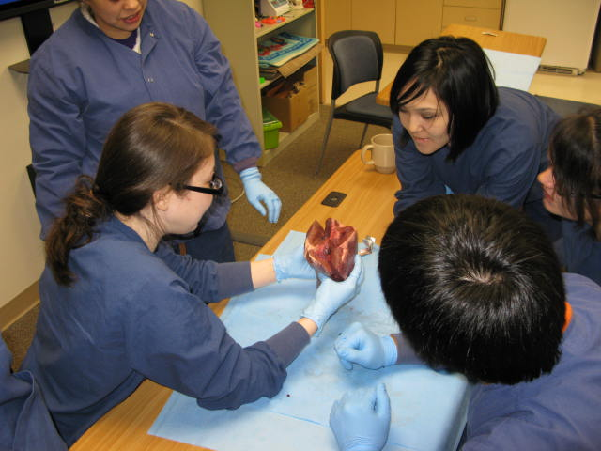
DHAT Curriculum
Year 1: basic health sciences, basic dental concepts, professional role development, introduction to clinic, patient and facilities management.
Year 2: clinical year, expansion of concepts learned in first year, extractions, community project, village dental rotations
DHAT Students Kate Kohl, Trisha Patton dissecting a cow heart

Slide 22
Alaska DHAT Scope of Practice and Training
Dental Health Aid Therapist (DHAT)
[----]--------------------------------------
<50 Billable Procedures
DDS
[------------------------------------------]
>500 Billable Procedures
Source: Dr. Louis Fiset, BA-DDS-University of Washington

Slide 23
Different Providers
Different Education
DHAT
Limited scope, 46 procedures
DENTIST
NEED to know+ nice to know
Large scope, 500+
Supervised
Prevention oriented team approach
Accessible to students in target populations
Culturally competent
Patient centered
Team leader
Surgically oriented
Minorities underrepresented in dentistry
Struggling to address cultural competency
Practice centered
NEED TO KNOW

Slide 24
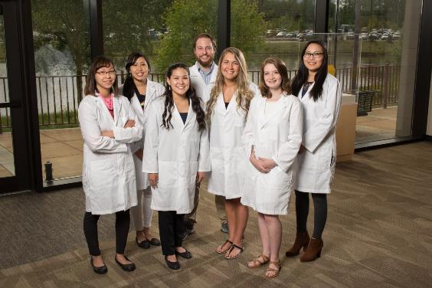
DHA Success
52 certified DHA
DHAT in 80+ communities
  40,000+ access to direct care
Continuity of care
  Higher level of care
  Working to full extent of licensure
2016 Transitioning Class of DHAT. Includes first student from Oregon who will return to work for her tribe in
SW Oregon.

Slide 25

Behavioral Health Aide Program
Village-based counselors to provide culturally-informed, community-based, clinical services
Provide behavioral health prevention,
intervention, aftercare, and postvention
Training and practicum requirements
On-the-job training
Four levels of certification BHA I, II, III and BHP

Slide 26
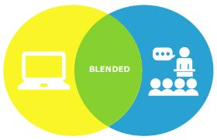
BHA-I Training
General Orientation (28)
Orientation to Village-based BH Services (8)
Ethics & Consent (6)
Confidentiality & Privacy (6)
Intro to Behavioral Health (24)
Intro to Counseling (12)
Intro to Documentation (12)
Survey of Community Resources & Case Management (8)
Working with Diverse Populations (12)
Intro to Group Counseling (8)
Crisis Intervention (16)
HIV/AIDS & Blood-Borne Pathogens (8)
Community Approach to Promoting Behavioral Health (8)
Family Systems I (16)
Recovery, Health, Wellness, & Balance (8)
Notes:
Blended learning approach (online, in person, on the job)
Training partners
local substance abuse training organization,
university program focused on rural human services,
online learning management system,
annual BHA forum

Slide 27
BHA-II Training
Psycho-physiology & Behavioral Health (16)
Intro to Co-Occurring Disorders (8)
Tobacco Dependency Treatment (8)
DSM Practice Application (12)
Advance Interviewing Skills (16)
ASAM Practice Application (12)
Case Studies & Clinical Case Management (8)
Traditional Health Based Practices (8)
Intermediate Therapeutic Groups Counseling (16)
Applied Crisis Management (8)
Community Development Approach to Prevention (12)
Family Systems II (16)

Slide 28
BHA-III
BHP
Treatment of Co-Occurring Disorders (12)
Advanced Behavioral Health Clinical Care (40)
Documentation & Quality Assurance (16)
Intro to Case Management Supervision (16)
Applied Case Studies in Alaska Native Culture Based Issues (8)
Behavioral Health Clinical Team Building (12)
Intro to Supervision (8)
Issues In Village-Based Behavioral Health Care (40)
Special Issues in Behavioral Health Services (16)
Competencies for Village-Based Supervision (16)
Principals & Practice of Clinical Supervision (40)

Slide 29
BHA Scope of practice
BHA-I
Screening
Initial intake process
Case management
Community education, prevention, early intervention
BHA-II
Substance abuse assessment and treatment
BHA-III
Rehabilitative services for clients with co-occurring disorders
Quality assurance case reviews
BHP
Team leadership
Mentor/support BHA-I, II,
and III

Slide 30
QUESTIONS
CHAP Website – www.akchap.org
Dr. Robert Onders, - Overall questions related to the three Tribal Community Provider programs operated by ANTHC rponders@anthc.org
Mary E Williard mewilliard@anthc.org DHA specific questions
Baez, Laura lbaez@anthc.org BHA specific questions
Victorie Heart (Torie) vheart@anthc.org CHA specific questions
Christina Peters
Native Dental Therapy Initiative Project Director
Northwest Portland Area Indian Health Board
cpeters@npaihb.org 206.349.4364

Slide 31


