Slide 1
Zika Virus Update
CAPT Thomas Weiser, MD, MPH
Medical Epidemiologist
Portland Area Indian Health Service
Northwest Tribal Epidemiology center

Slide 2
Background
What is Zika virus? How is it transmitted?
What are the health effects of Zika virus infection?
What precautions should we take in the Pacific Northwest?

Slide 3
What is Zika Virus?
Flavivirus- similar to dengue, yellow fever and West Nile virus
Vector-borne disease- Aedes egypti and Aedes albopictus mosquitos are the primary vectors

Slide 4
Non-Mosquito Transmission of Zika Virus
Mother to fetus
Sexual transmission- more information is being learned about sexual transmission of the virus
Transmission primarily from men to women or other men
1 documented case of transmission from woman to man
The virus was cultured from semen as long as 90 days after infection
The virus has also been found in vaginal mucous in primates
Other body fluids- blood, urine, amniotic fluid, cerebrospinal fluid

Slide 5
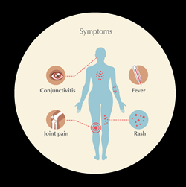
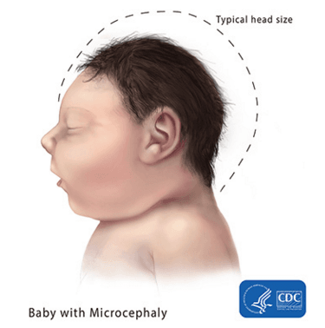
Health Effects of Zika Virus Infection
Acute Zika virus infection: fever, rash, joint pain, or conjunctivitis; less common: muscle pain, headache
Guillain-Barré Syndrome: post-infectious autoimmune disorder characterized by bilateral flaccid limb weakness attributable to peripheral nerve damage
Congenital Zika Syndrome: microcephaly, intracranial calcifications or other brain anomalies, or eye anomalies

Slide 6
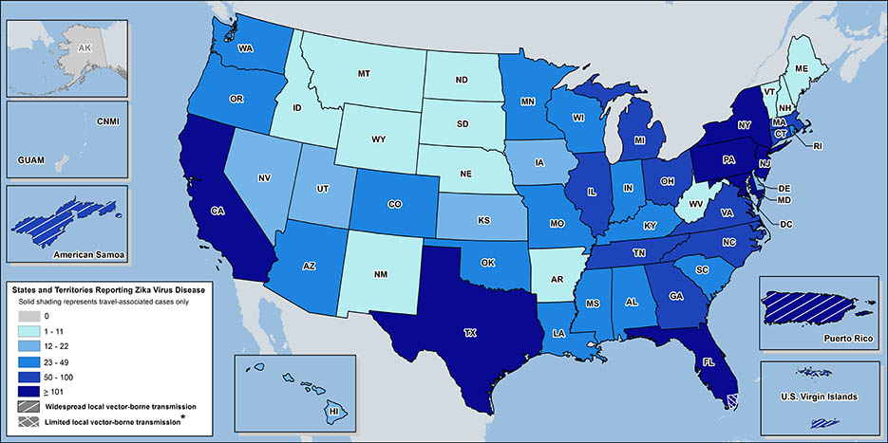
Zika Cases Reported in the United States
Laboratory-confirmed Zika virus disease cases reported to ArboNET
by state or territory (as of October 5, 2016)

Slide 7
Prevention Steps
Mosquito transmission of Zika virus has not been documented in the Pacific Northwest. The following prevention recommendations are only for those who travel to areas with known Zika virus transmission or those who have contact with someone who has traveled in these areas:
Prevent exposure to mosquitos
CDC recommends the use of window screens, bed nets and EPA-registered mosquito repellents
Mosquito larvacide to treat standing water and reduce mosquito burden near homes
Permethrin spray to treat bed nets, clothing
Prevent exposure through sexual contact
Condoms to prevent exposure
Prevent pregnancy if exposed
Long-acting reversible contraception to prevent pregnancy if exposure is likely to occur or have already occurred

Slide 8
Recommendations
CDC recommends Zika virus testing for potentially exposed persons with signs or symptoms consistent with Zika virus disease, and recommends that health care providers offer testing to asymptomatic pregnant women within 12 weeks of exposure.
For couples planning to conceive who do not live in areas with active Zika virus transmission:
Couples in which the female partner may have been exposed to Zika virus should wait at least 8 weeks before trying to conceive
Couples in which the male partner may have been exposed to Zika virus should wait at least 6 months before trying to conceive

Slide 9
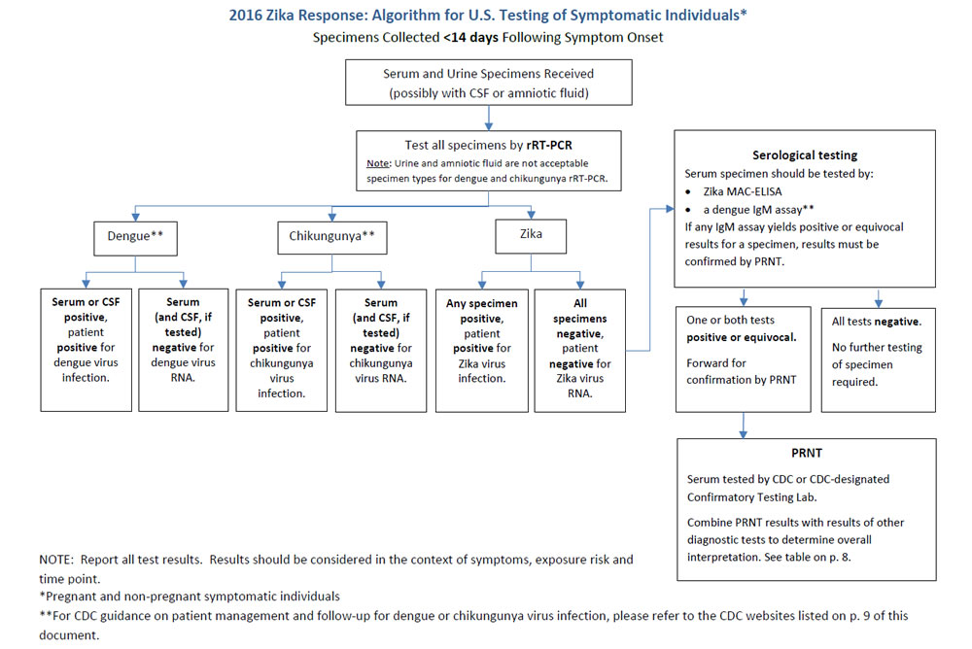

Slide 10
Thank You!

