Slide 1
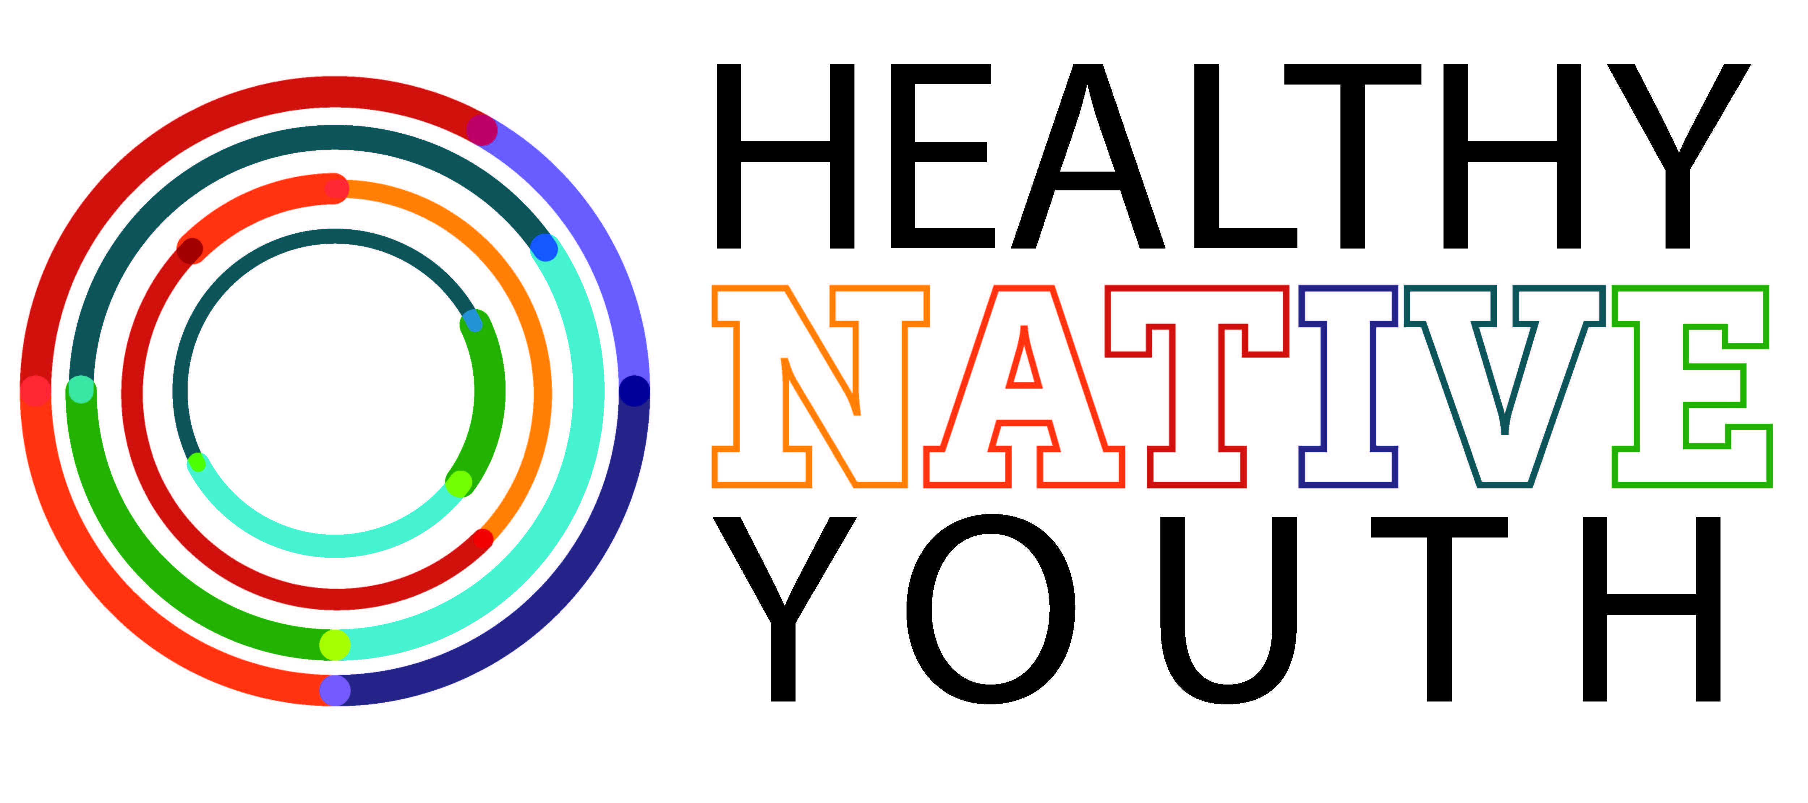
A one-stop-shop for educators who want to expand learning opportunities for AI/AN youth
October 2016
Notes:
Thank you for coming today…

Slide 2
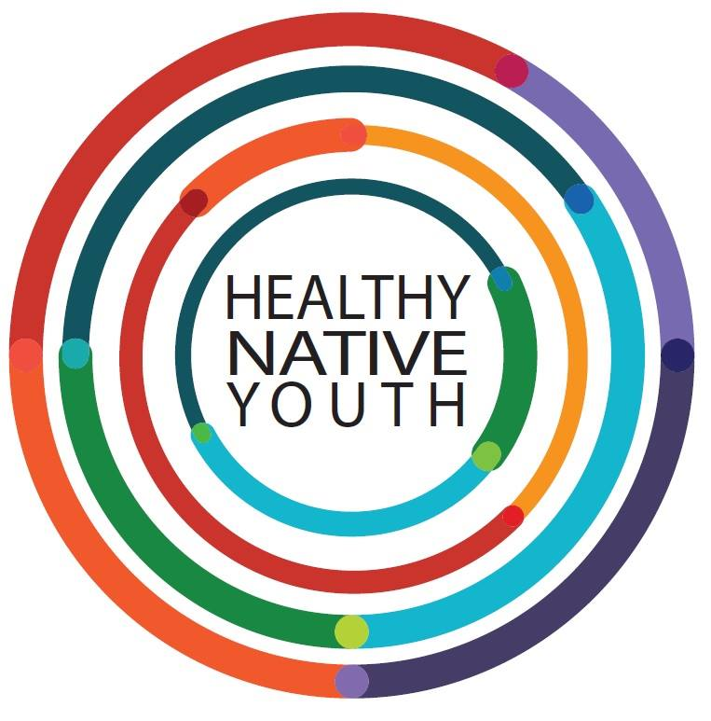
Workgroup Goal
Gain insights and connections to support the dissemination of culturally-appropriate sexual health programs to AI/AN youth.
Notes:
The Healthy Native Youth website was produced in collaboration by the Northwest Portland Area Indian Health Board, the Alaska Native Tribal Health Consortium, the Inter Tribal Council of Arizona, Inc., and the University of Texas Health Science Center at Houston.
To design the site, they teamed up with adolescent health colleagues and stakeholders across Indian Country to build connections and gain insights based on their experience. The team brainstormed strategies to support the dissemination of culturally-appropriate sexual health programs to AI/AN youth. The Healthy Native Youth website emerged from this year-long planning process.

Slide 3
Communication Strategies
Online Sexual Health Portal
Partner:
NIEA, BIE, B&G Clubs
Teachers and Educators
Social Media
Partner: UNITY, GEN-I, CNAY
Teens and Young Adults
Radio, Articles
Talking Points
Parents

Slide 4
Website Goals
Provide tribal health educators and teachers with a one-stop-shop to access to age-appropriate, culturally tailored sex education resources for AI/AN youth.
Prepare tribal health educators and teachers to deliver this content.
Measure the reach and impact of our efforts.

Slide 5
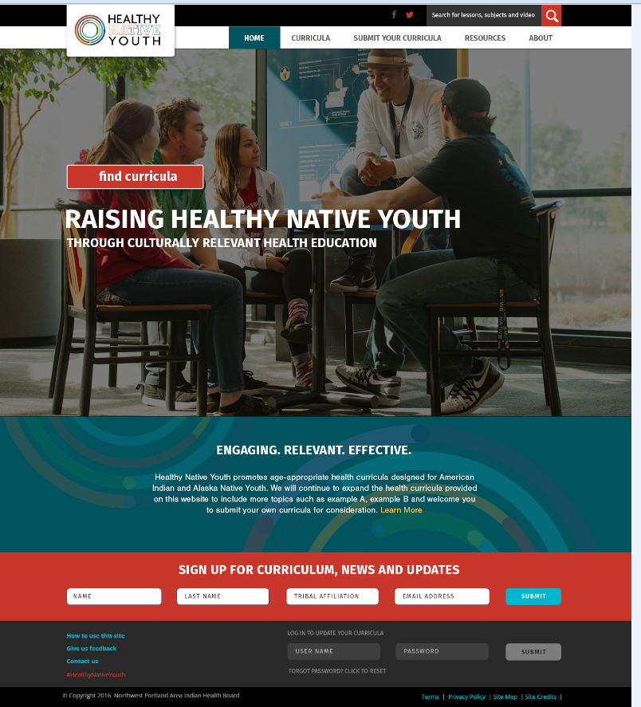
Healthy Native Youth Website
Notes:
To be effective, health curricula must be age-appropriate, culturally-relevant, and reflect the values and learning styles of the learners being taught. Finding curricula that meet these requirements for American Indian and Alaska Native youth can be challenging. Healthy Native Youth is a one-stop-shop for educators and health advocates who want to expand learning opportunities for youth.

Slide 6
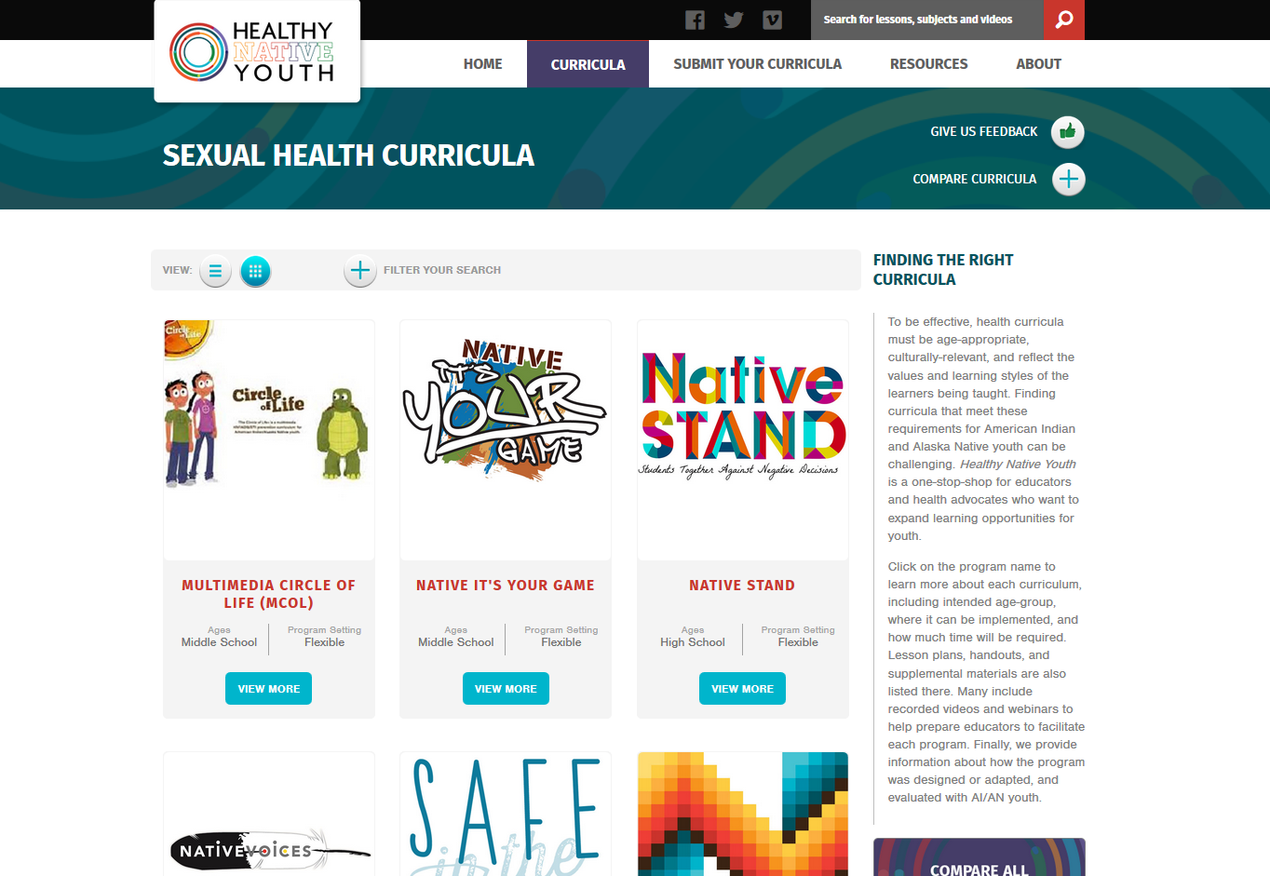
Healthy Native Youth Website
Notes:
Click on the program name to learn more about each curriculum, including intended age-group, where it can be implemented, and how much time will be required. Lesson plans, handouts, and supplemental materials are also listed there. Many include recorded videos and webinars to help prepare educators to facilitate each program. Finally, we provide information about how the program was designed or adapted, and evaluated with AI/AN youth.

Slide 7
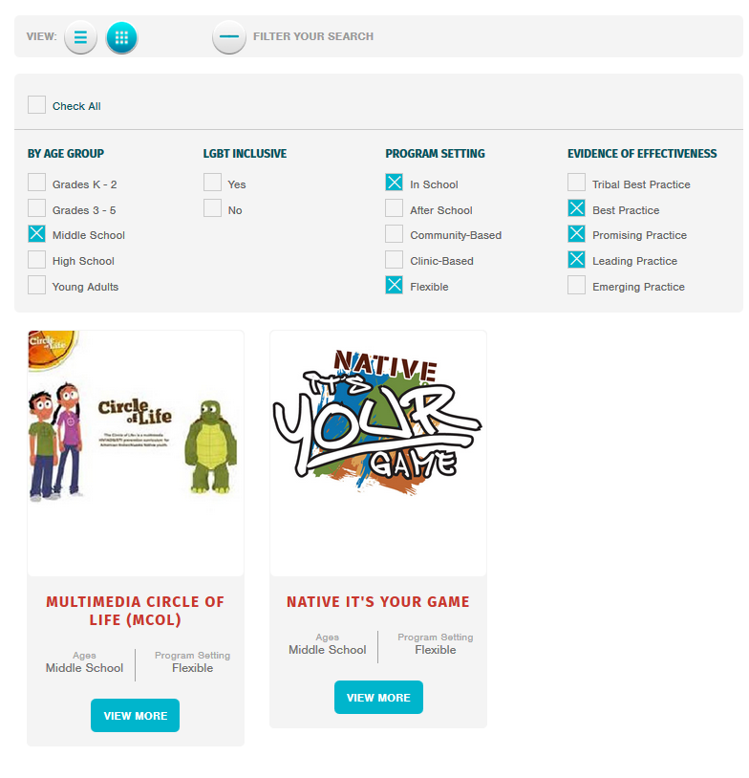

Slide 8
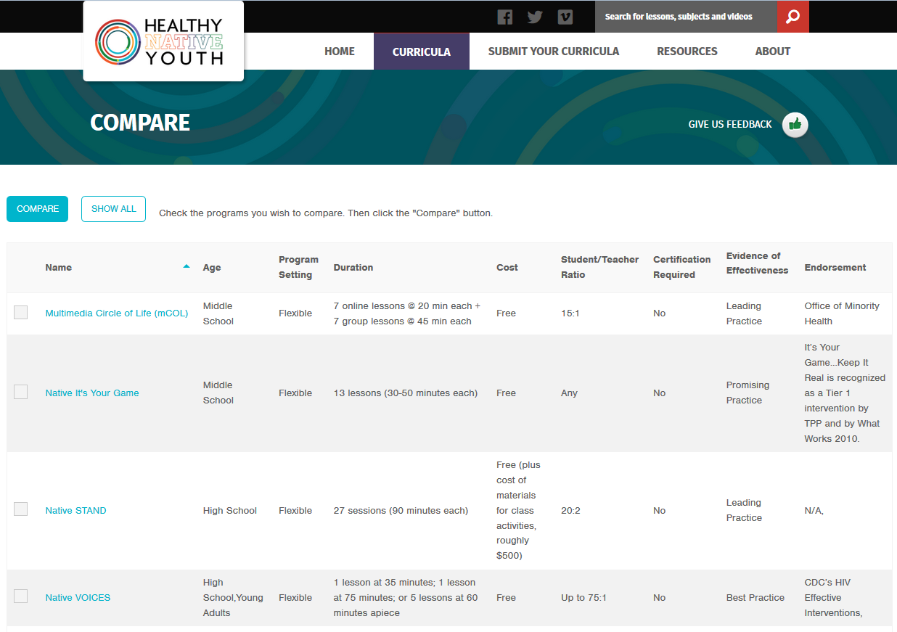

Slide 9
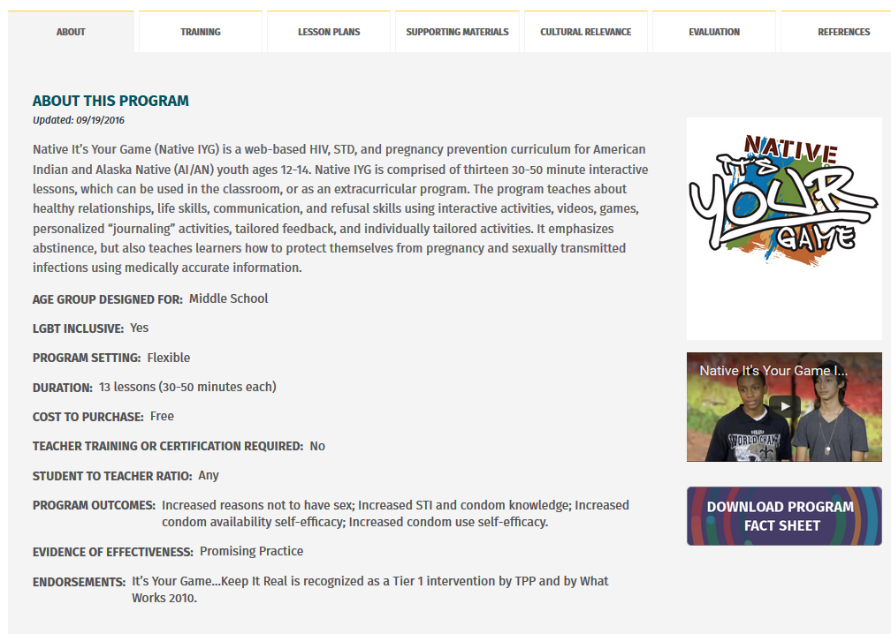

Slide 10
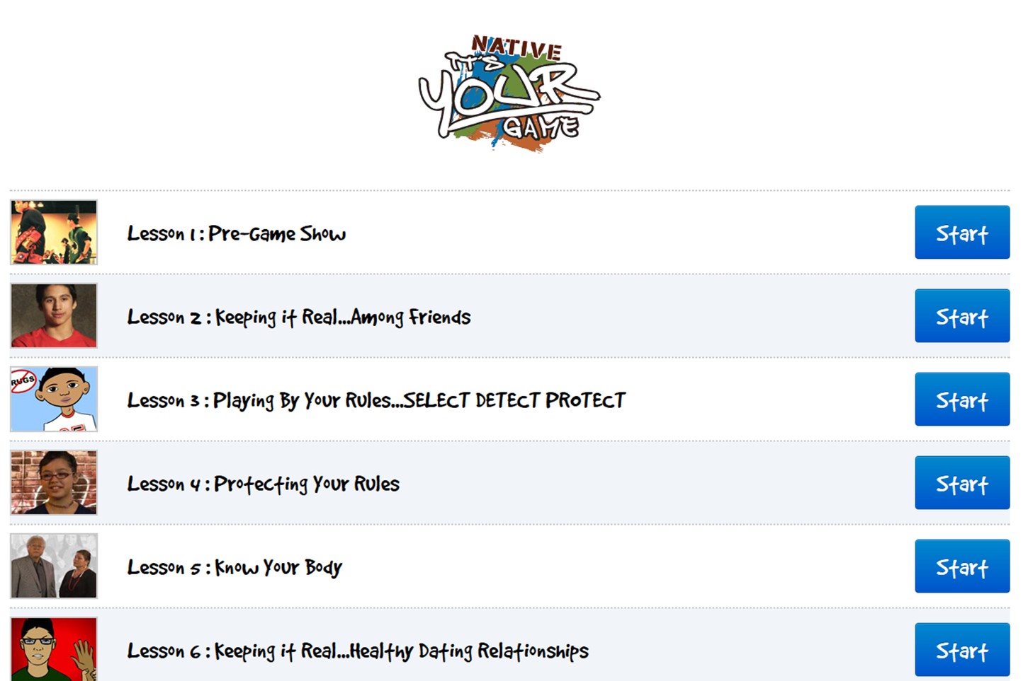
Notes:
The end product is the Native It’s Your Game program, which includes 13 internet-based lessons, each lasting 30-35 minutes. The lessons include a mix of videos, interactive activities, quizzes, animation, and journal activities.
Lessons covers healthy relationships, puberty and reproduction, HIV/STIs, pregnancy, refusal and communication skills, and contraception.

Slide 11

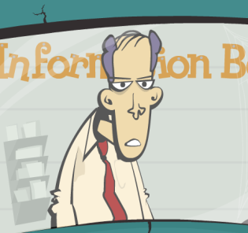
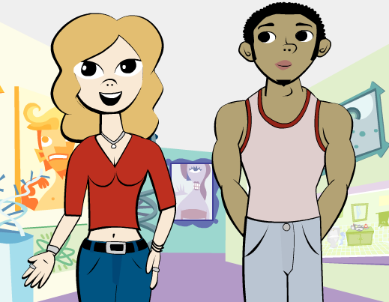
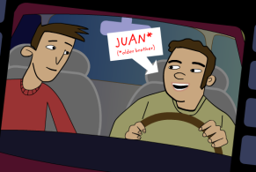
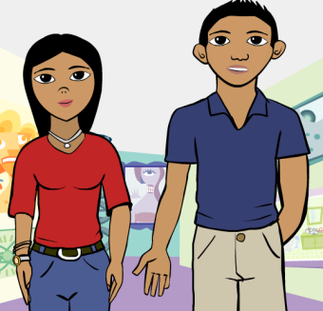
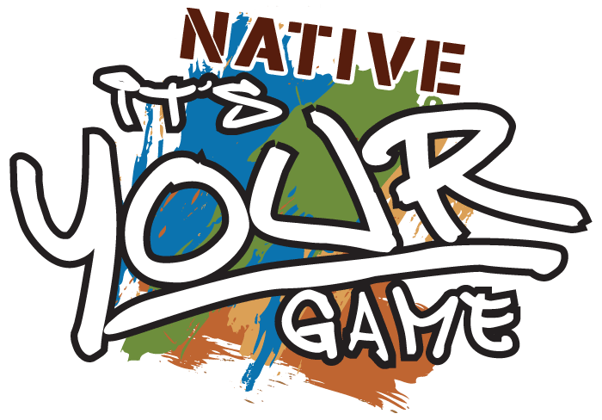
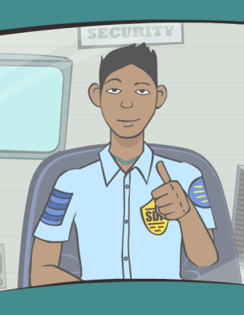
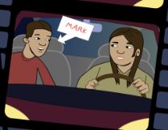
Surface level changes
Notes:
In addition to changing the intro video and program name and logo, the animated guide went from a dry, self-depreciating older character to a young, hip Native security guard. The animated youth guides were changed from being chiseled, slender, mid-drift baring animations to more conservative relatable characters.
Other small changes were made to character names, images, slang, and locations.

Slide 12
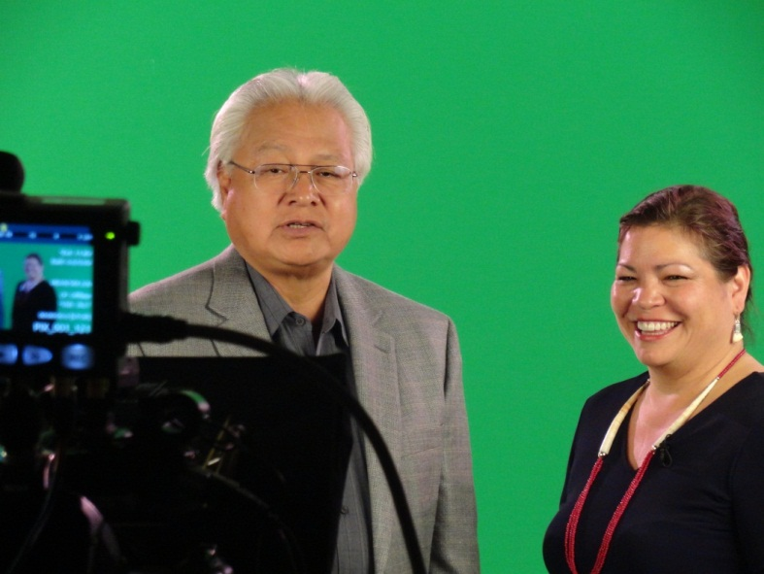
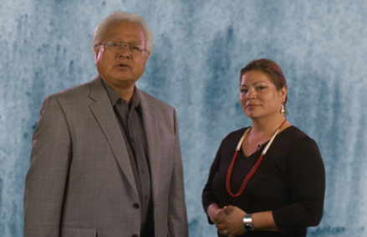
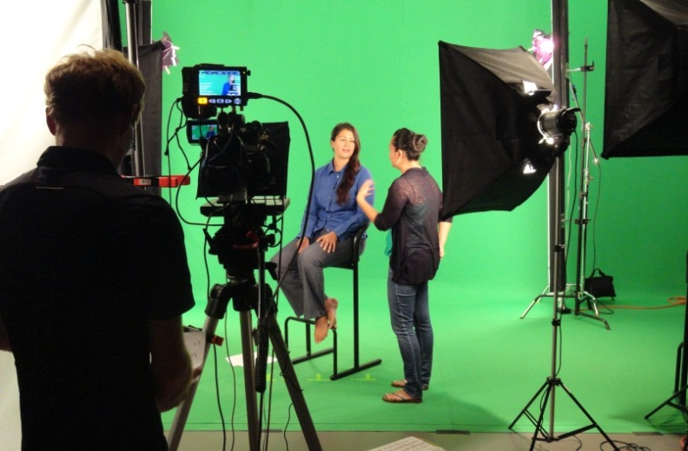
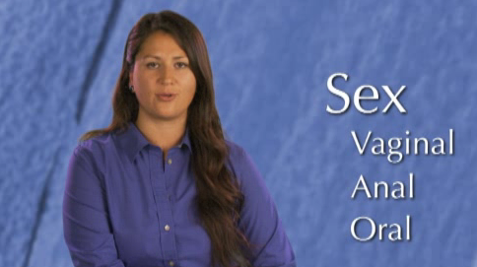
Tribal Elders & native health expert
Notes:
We also included a number of deep cultural changes include the addition of videos featuring Native youth, elders, and a health education ‘sexpert’ who reflect tribal and youth perspectives.
The elders introduce the curriculum and provide a holistic framework around sexual health that is familiar to tribal communities. They also help to provide a cultural context to sensitive topics like the anatomy and physiology, which both youth and adults had a hard time felt a bit uncomfortable with during the usability testing.

Slide 13
Effectiveness study: by the numbers
  2 study arms: Native IYG and Control
  25 Tribal Sites randomized
  3 regions: AK, NW, AZ
  574 middle school aged youth enrolled
  3 surveys: Pre, Post, 12-month follow-up
Notes:
During the 2nd phase of the study…
We recruited 25 sites representing 18 Tribes/communities to participate in the RCT. Of the 18 Tribes/communities, 11 are rural and 7 are urban, 14 sites received the Native IYG intervention and 11 received the comparison intervention. The control condition comprised five health-related computer-based programs that addressed tobacco smoking (ASPIRE), hearing (Dangerous Decibels), alcohol (N-Squad) and drugs (Reconstructors), and diet and physical activity (Quest to Lava Mountain). The control programs were delivered in a standard number of sessions (n=13) and duration (approximately 35 minutes) that approximated a comparable learning ‘time on task’ to NATIVE-IYG.
574 youth enrolled (#of youth who returned valid parental consent and youth assent forms).
We collected survey data from youth who completed the program at three different stages: baseline, immediate follow-up, and a again at 12 months.

Slide 14
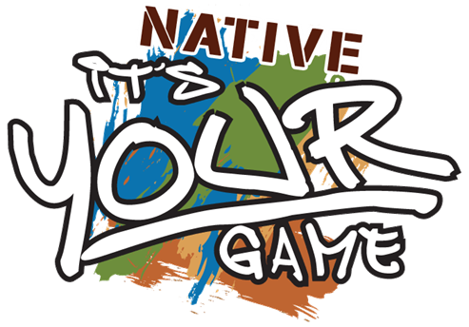
Youth who took Native IYG reported:
More reasons not to have sex
Increased STI knowledge
Increased condom knowledge
More confidence obtaining condoms
More confidence about using condoms
Notes:
The good news! From Pre-test to Post-test…
Five psychosocial variables (of 16 examined in the study) were significantly impacted by Native IYG:
Increased reasons not to have sex
Increased STI and condom knowledge
Increased condom and condom use self-efficacy (they were more confident obtaining and using condoms)

Slide 15
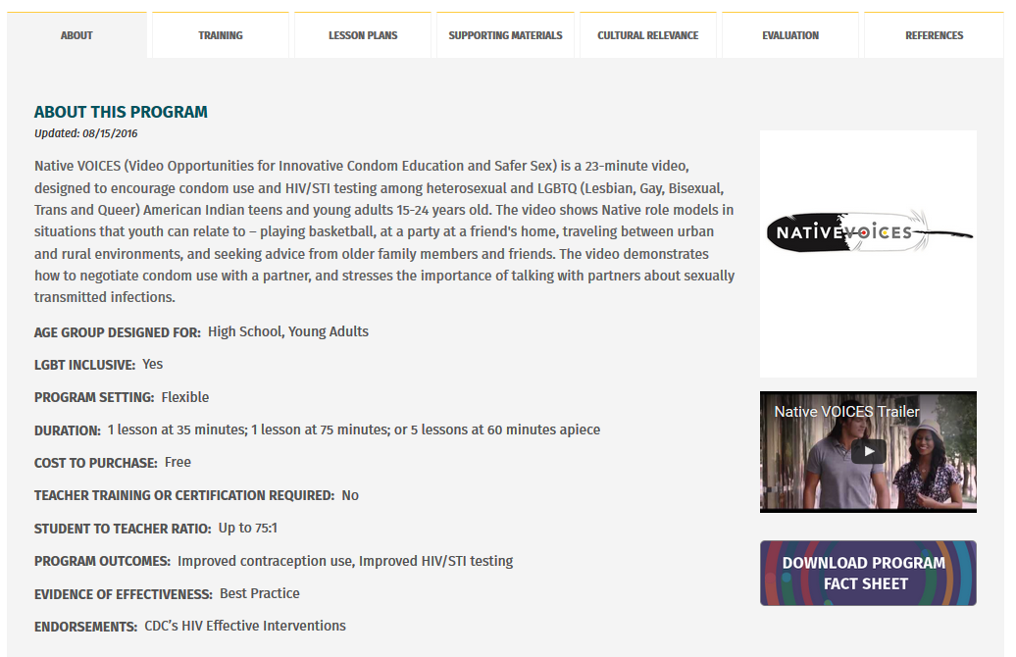
Notes:
Anyone who lives or works in Indian Country knows that discussing sex or sexual health is a difficult thing for our young people.

Slide 16
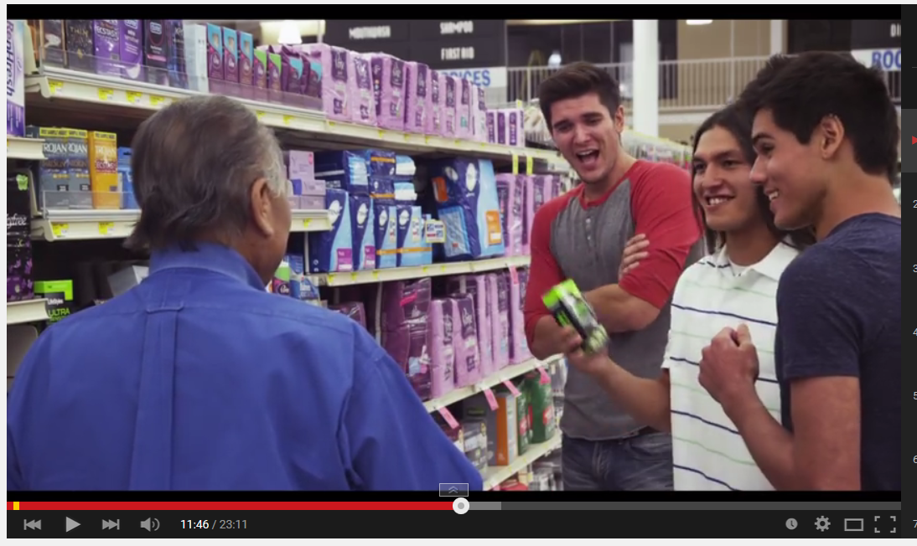
www.youtube.com
Notes:
During the third year of the project, Native teens and young adults from across the U.S. read or reenacted iterative drafts of the adapted script, and provided feedback on the characters, scenes, tone, and dialogue.
The adapted Native VOICES video was shot on location in Oklahoma City in August 2013.

Slide 17
Native VOICES Toolkit
Native VOICES video (23 minutes)
A condom demonstration video (1:40 minutes)
A dental dam demonstration video (1:08 minutes)
A selection of condoms and dental dams
A users’ guide
Notes:
To support dissemination…

Slide 18
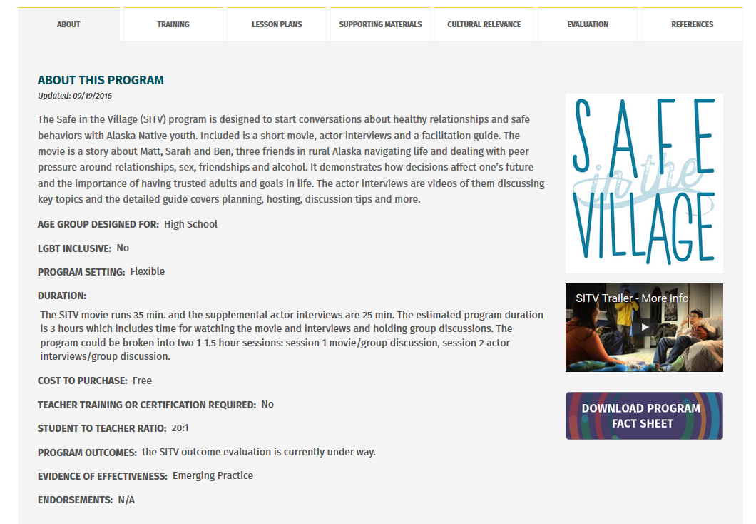
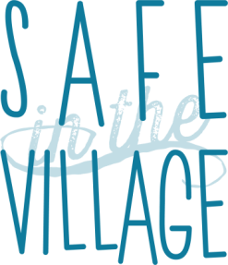
Jaclynne Richards, “Qalukisaq”, BA
HIV/STD Prevention Program, Alaska Native Tribal Health Consortium
Anchorage, Alaska, US
Funded by the Indian Health Service through the Native American Research Centers for Health (NARCH)
Notes:
Uvanga Jaclynne. Inupiaqsiniga Qalukisaq. Katyaagmiingurunga. Pangmapak kisagvingmi inuurunga. Richards kuayaagurunga. Angayuqaaka BJ Richards-lu, Arlene Richards-lu. Aasrii ataataakka Tom Richards-lu, Dorothy Richards-lu. Suli Robert Curtis-lu, Esther Curtis-lu.
My name is Jaclynne Richards. I am from Kiana, Alaska. I live in Anchorage now. My parents are Arlene Richards and the late BJ Richards. My grandparents are the late Tom and Dorothy Richards and Robert and Esther Curtis. and I am a Community Outreach Specialist for the Alaska Native Tribal Health Consortium’s HIV/STD Prevention Program in Anchorage Alaska.

Slide 19

SITV Evaluation
  September 2014 – December 2015
  5 new communities in southwestern and northwestern Alaska (n= 105) with youth ages 15-19 years old
  Implemented facilitated Safe in the Village workshops in schools and community settings
  Participants filled out surveys before and immediately after the workshop and an online follow up survey 6 months after
  Data analysis is ongoing
Notes:
Our goal was to determine the effect of the sexual health program on self-reported knowledge, attitudes, perceptions and behaviors related to key themes that were drawn from the in-depth interviews (i.e. having trusted adult to talk to, saying no to drinking etc.). We partnered with new communities for the evaluation which involved pre-post and follow-up surveys. We expected data analysis to be finalized before the end of the year.

Slide 20
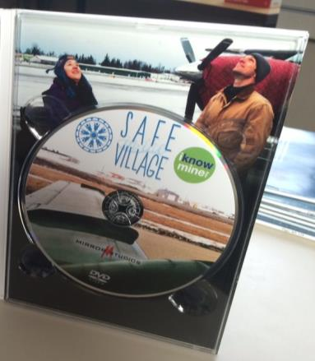
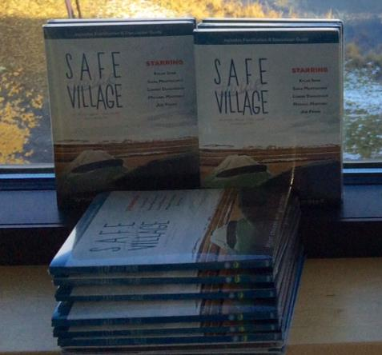
Notes:
This is our final product. If you would like to learn, more, order or talk to me…

Slide 21
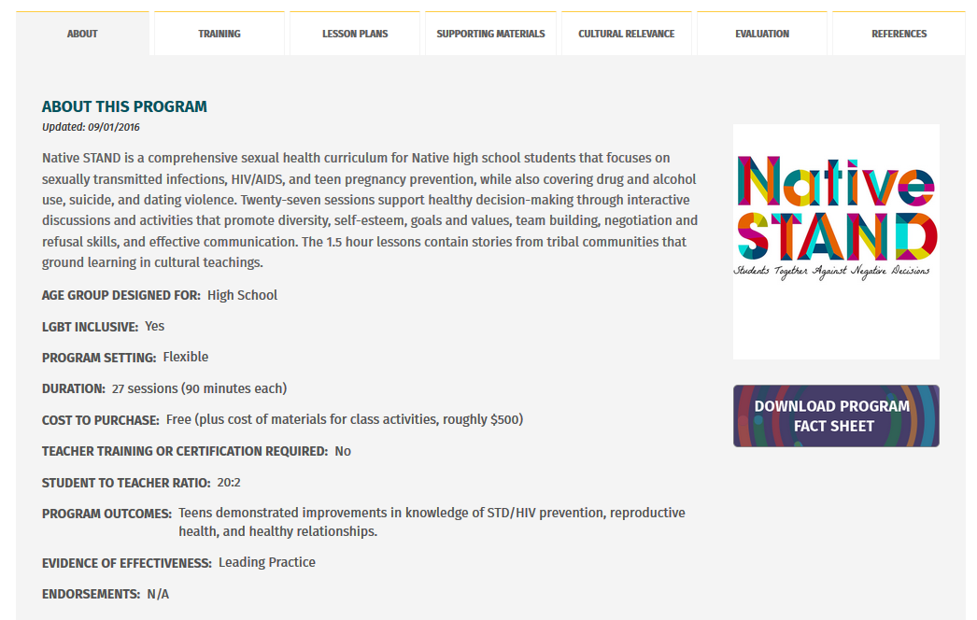
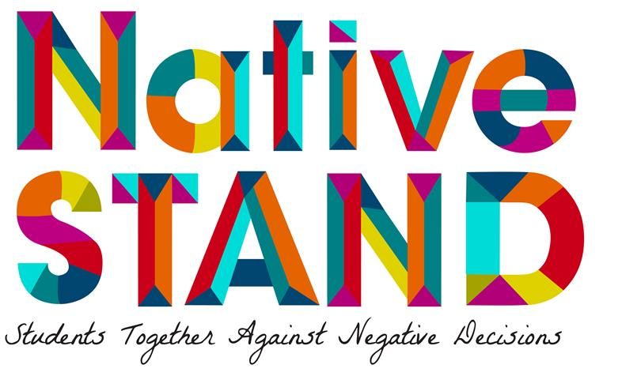

Slide 22
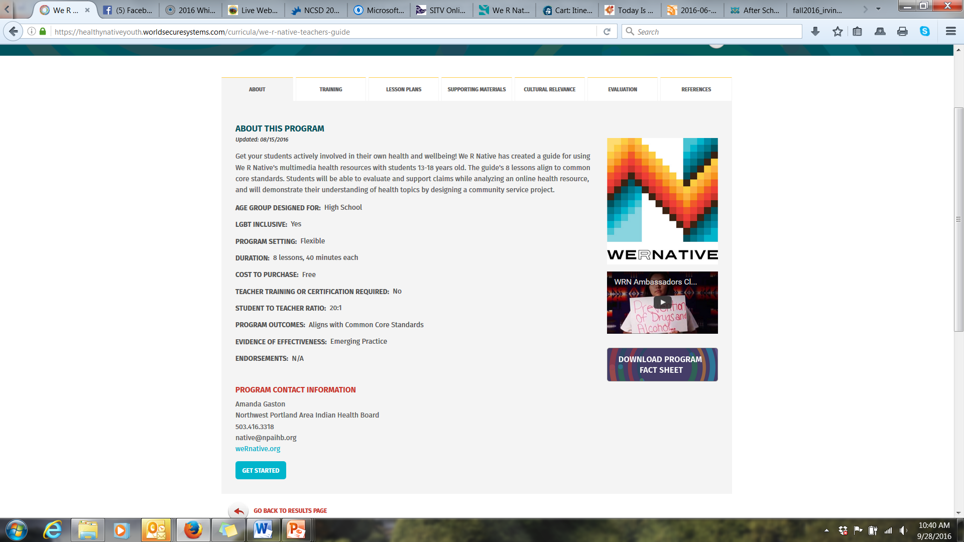

Slide 23
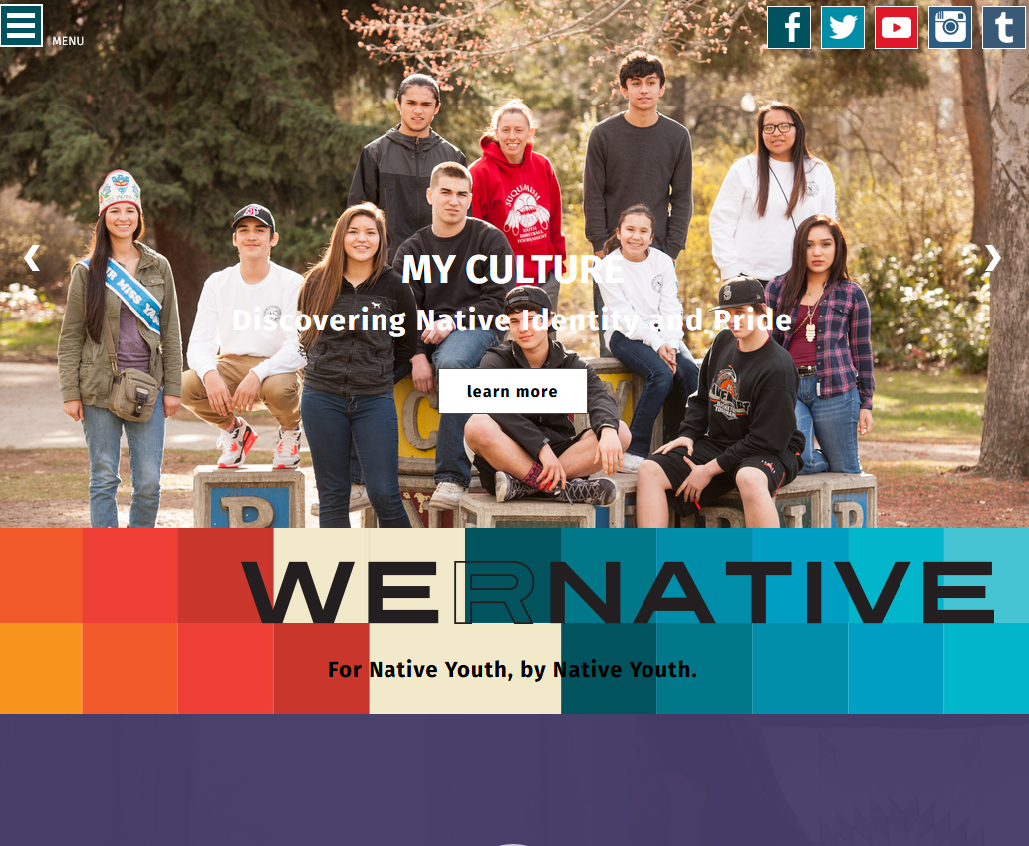
Notes:
We R Native is a multimedia health resource for Native teens and young adults.
The service was designed using behavior change theory and extensive formative research with Native youth across the U.S. We design our messages to address the social, structural, and environmental stressors that influence adolescent health. With particular focus given to the prevention of suicide, bullying, STDs, teen pregnancy, and drug and alcohol use.
The project is funded by the Indian Health Service HIV and behavioral health programs, and is heavily supported in-kind by our GLS grant.

Slide 24
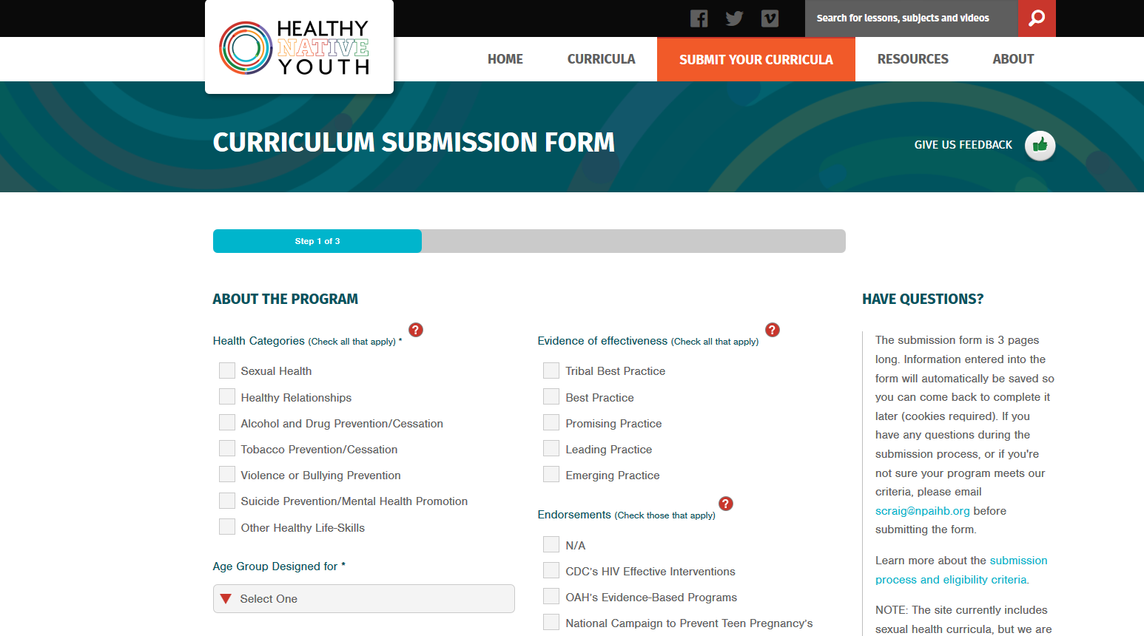
Healthy Native Youth Website
Notes:
Do you have a program that you’d like to share?
Consider housing it here! It will be made available to educators across Indian Country, and you’ll receive feedback on program uptake and reach, with the ability to update training materials and lesson plans as needed.

Slide 25
Any oTher Health Topics That You Think we should Add?

Slide 26
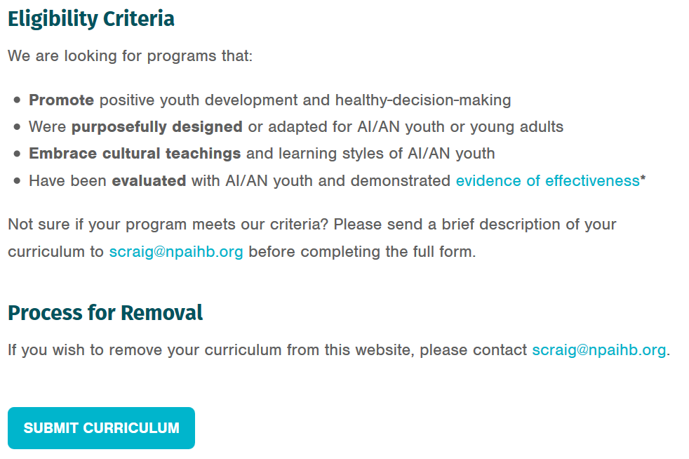

Slide 27
Do you know of oTher Culturally relevant Health Curricula that We should Reach Out To, to Add?

Slide 28
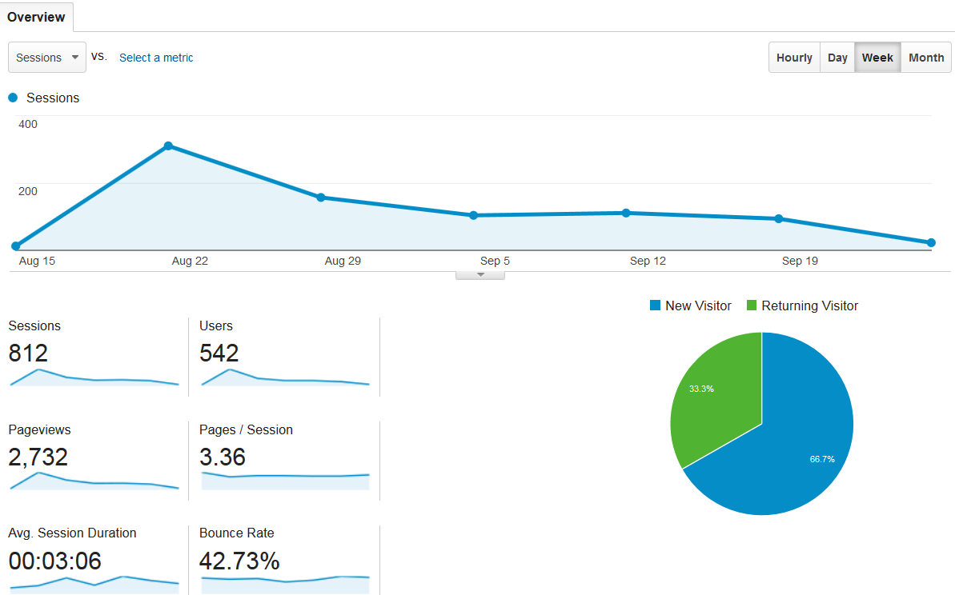
Reach

Slide 29
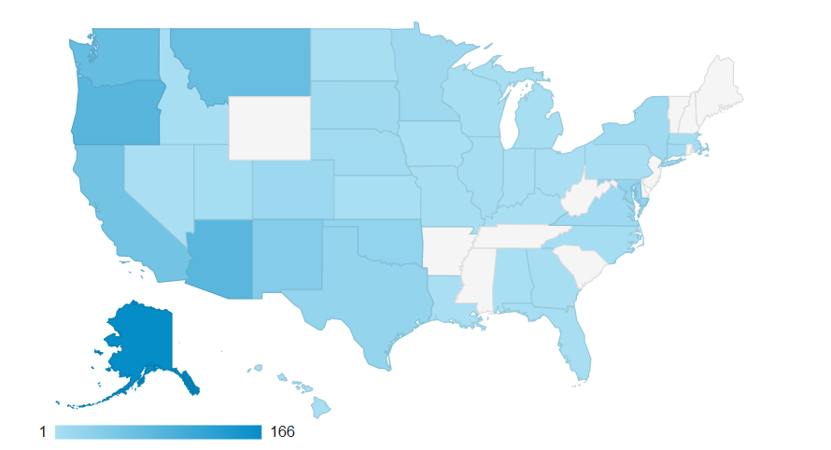
Reach

Slide 30
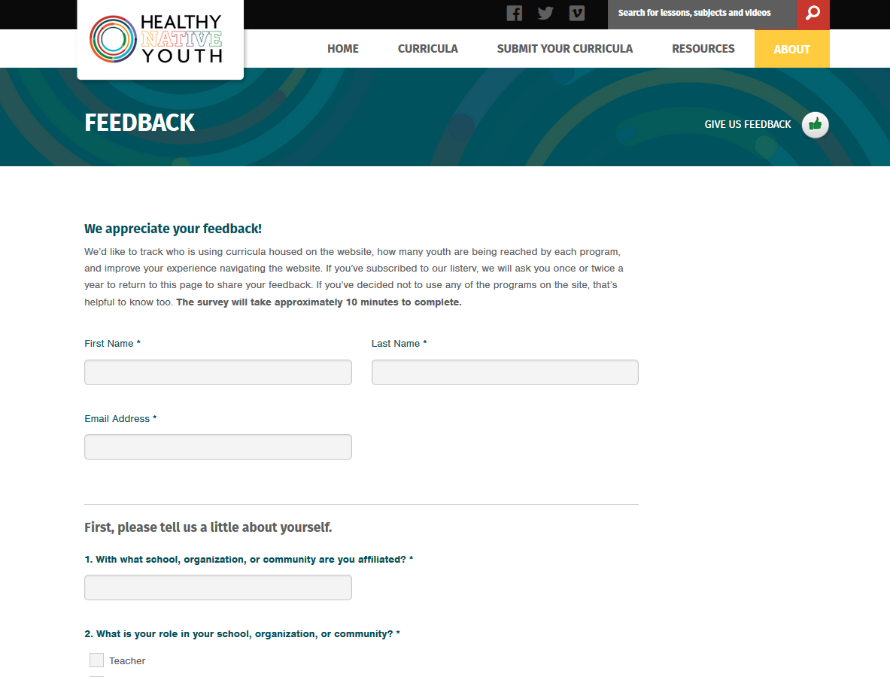

Slide 31
Concerning Posts on Social Media
We R Native and the Social Media and Adolescent Health Research Team (SMAHRT)
Tools for Youth and
Adults who work with Youth
Notes:
--Social Media and Adolescent Health Research Team and We R Native designed a study to create a resource for adults to assist youth who view concerning posts and tools to create an appropriate response plan.
--Study -- Our aim was to better understand the experiences and perspectives of Native youth when they view concerning posts on social media, barriers that prevent them from responding to such posts, and their recommendations for designing solutions. To gather this information, we held three small-group discussions with 32 Native youth 14-22 years old. 4 goals came out of these group discussions and they are the goals of the webinar:
1) that you’ll be able to identify youth who witness concerning social media posts, letting them know that they need not respond alone, all on their own
2) that everyone is aware of, and feels trained to navigate these situations
3) that you’ll be able to assess the experience of those who see concerning posts, and address their concerns, frustration, or fatigue;
4) that you’ll be able to confidently complete and implement the “viewer care plan” to support youth who post and witness concerning posts.
The discussions also told staff that:
--public disclosures on social media provide opportunities to identify youth at risk, and connect them to appropriate resources and support. Almost all adolescents use social media, and nearly a third reference depression symptom on the profiles they maintain. During conversations with Native youth, all of them said they’d viewed concerning posts online. They also mentioned that trusted adults would be people they would seek support from, including parents, mentors, and tribal health educators.
Even though this is a pretty common occurrence, when tribal health educators were polled, only 5% felt adequately prepared to respond.

Slide 32
Notes:
We R Native is a multimedia health resource for Native teens and young adults.
The service was designed using behavior change theory and extensive formative research with Native youth across the U.S. We design our messages to address the social, structural, and environmental stressors that influence adolescent health. With particular focus given to the prevention of suicide, bullying, STDs, teen pregnancy, and drug and alcohol use.
The project is funded by the Indian Health Service HIV and behavioral health programs, and is heavily supported in-kind by our GLS grant.

Slide 33
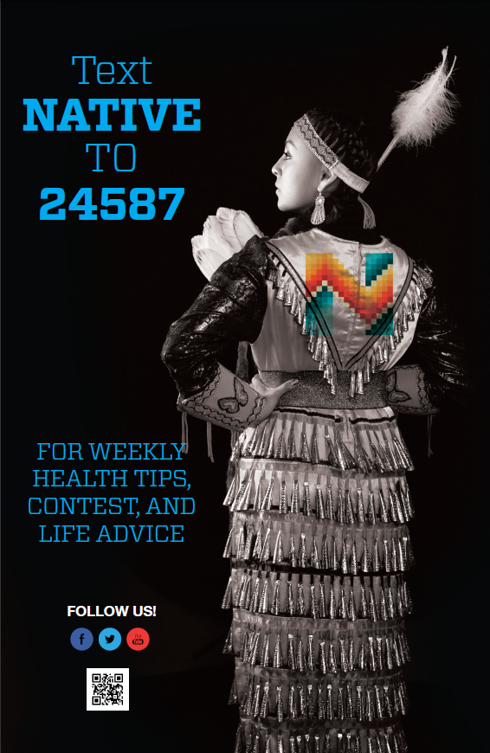
Notes:
To bring users back to the “meat and potatoes” on the website, we use monthly contests and Facebook, Instagram, and Text Message prompts.
To enroll, you just text the word NATIVE to 24587. Right now we have nearly 4,000 folks signed up for the service. It was purposefully designed as a one-way text messaging service, because we didn’t have the staffing needed for a 2-way “chat” service.

Slide 34
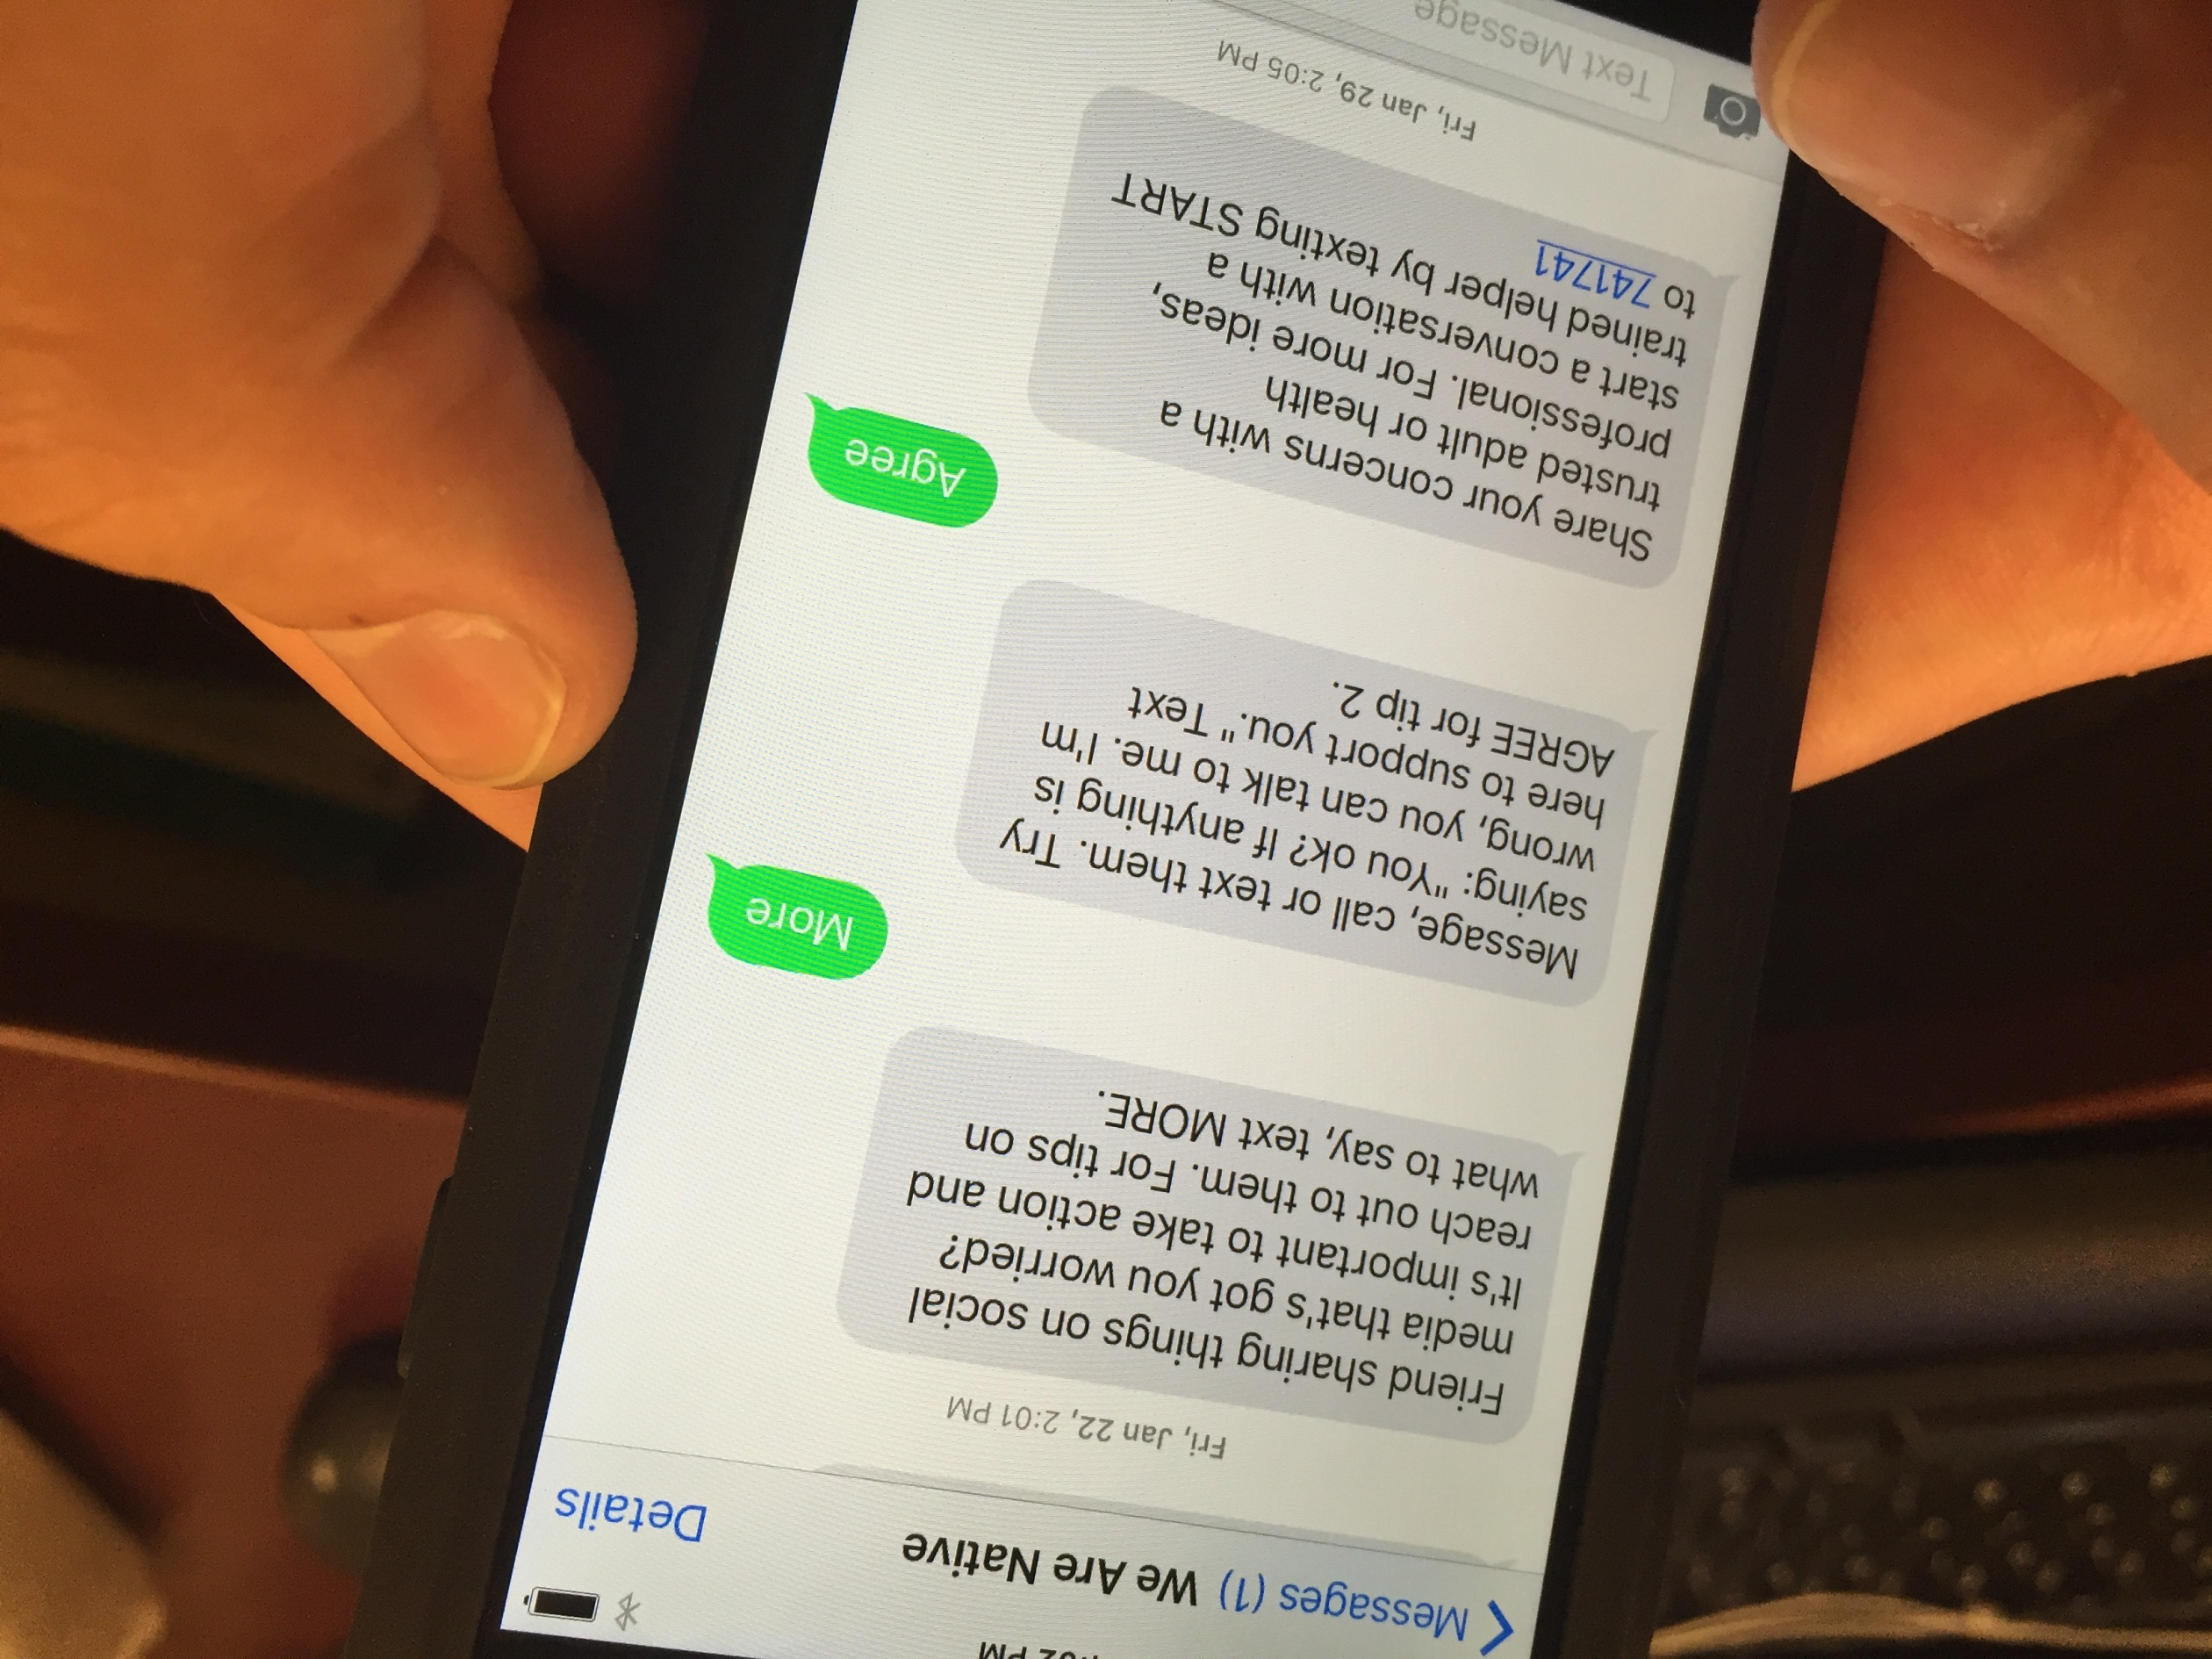
Notes:
Similarly, we posted a series of messages in January to help youth intervene if they see concerning messages from friends or family on social media – like comments about self-harm or harm to others.
This sequence started with: Friend sharing things on social media that’s got you worried? It’s important to take action and reach out to them. For tips on what to say, text MORE.
Followed by some intervention tips and the Lifeline’s chat service: 741741

Slide 35
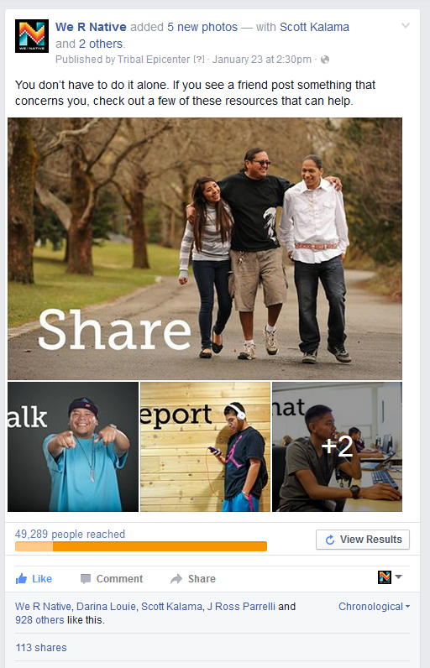
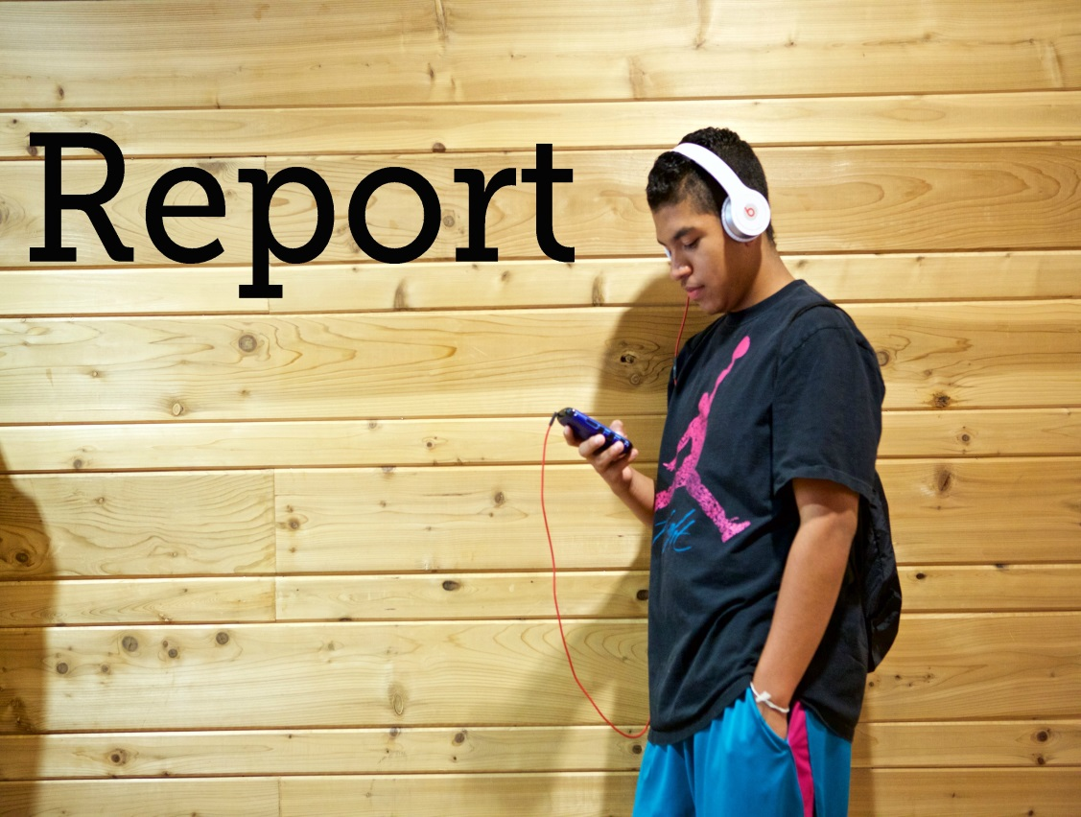
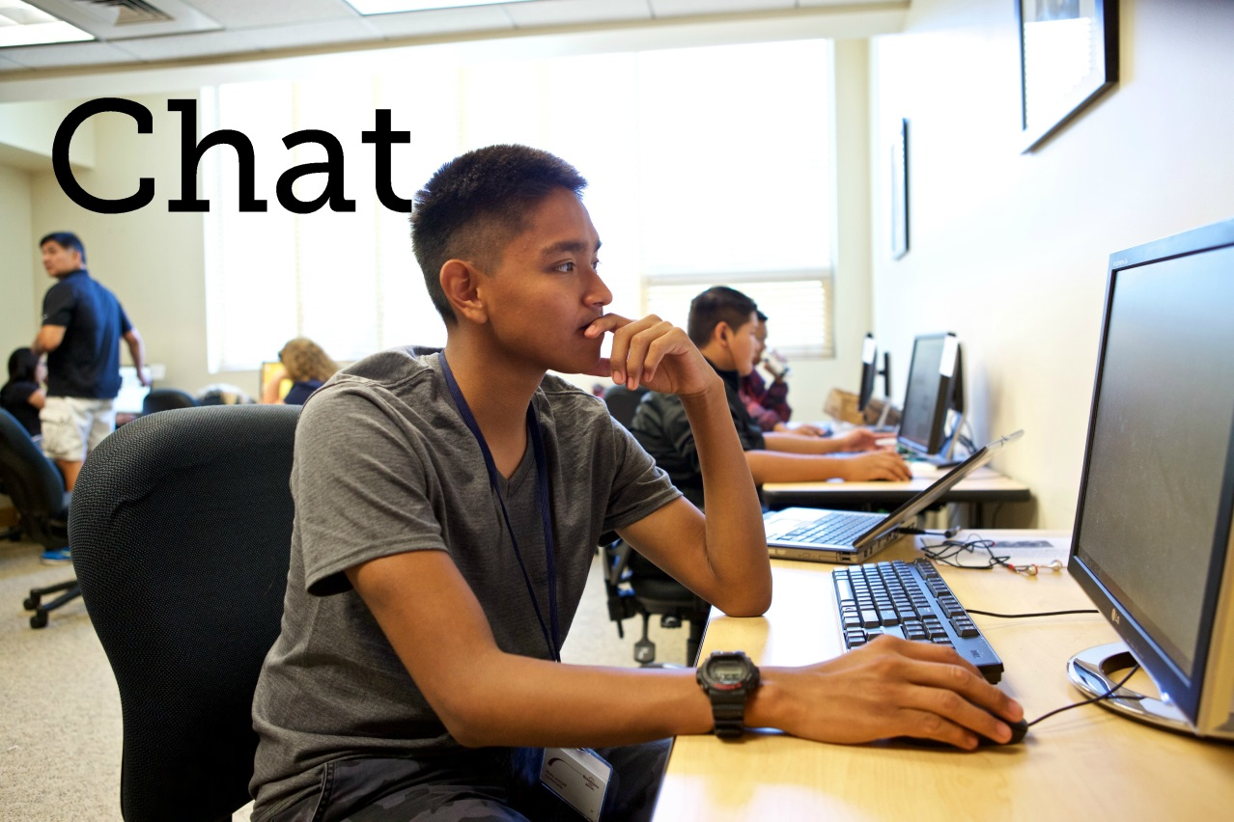
Concerning Posts?
Notes:
This series of messages and videos reached over 44,500 people per day, and had over 13,500 video views.
Reaching 178,693 viewer throughout the month!

Slide 36
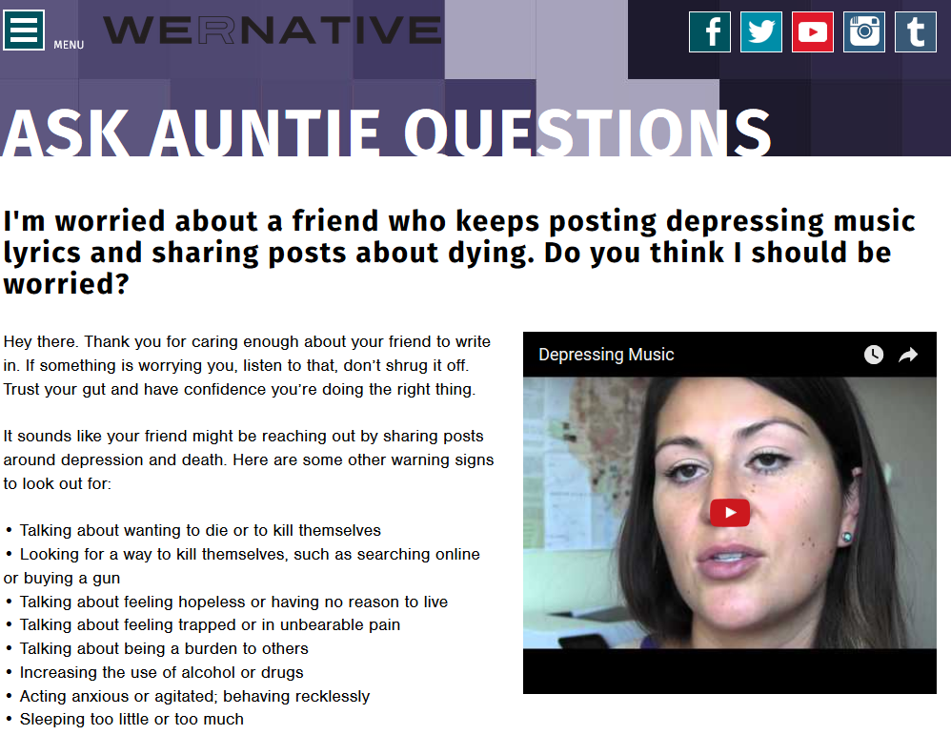
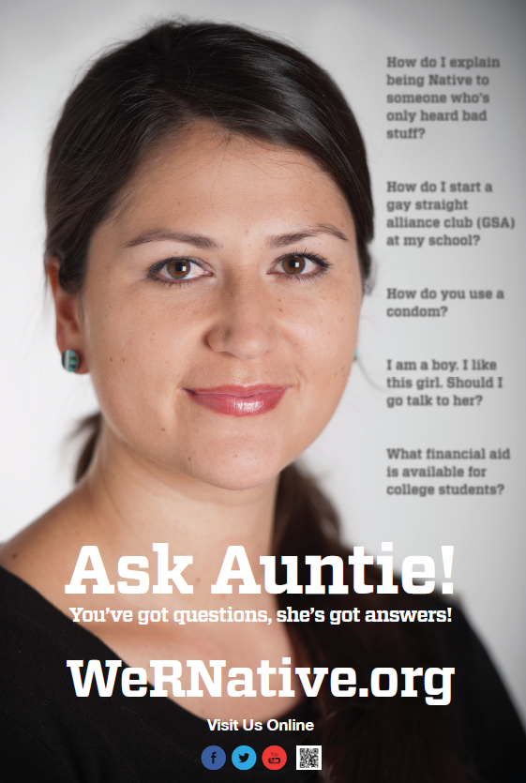
Concerning Social Media Posts
Notes:
We also encourage youth to submit questions to our anonymous “Ask Auntie” Q&A service, which offers text and video responses to questions submitted online.
It’s one of our most active sections of the website - Taking away the embarrassment youth might feel asking parents, friends, or healthcare providers.

Slide 37
Video for Adults who Work with Youth
Introduction to the topic
Real life experiences
  Suicide or self-harm posted on social media
  Responses to posts
Training Goals
Statistics
Overview of our Study and Findings
Tools for educators/adults
Resources
  QPR
  Factsheets
  Websites
  Videos

Slide 38
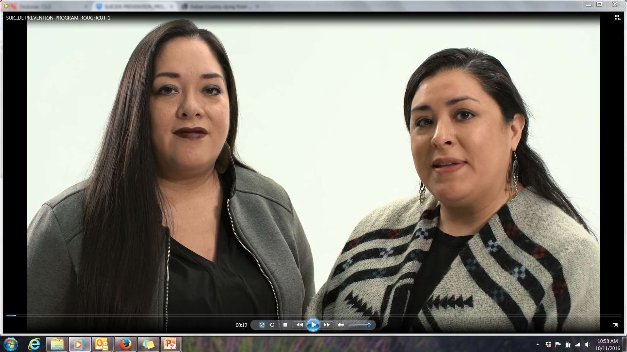

Slide 39
Video: Next Steps
Pilot evaluation of the video and accompanying tools/resources
Make any needed changes
Create a teacher's guide for placement on HealthyNativeYouth.org

Slide 40
Northwest Portland Area Indian Health Board
Stephanie Craig Rushing, PhD, MPH
Director – Project Red Talon & THRIVE
scraig@npaihb.org
Colbie Caughlan, MPH
THRIVE Project Manager
ccaughlan@npaihb.org
Celena McCray
THRIVE Coordinator
cmccray@npaihb.org
Amanda Gaston, MAT
Ask Auntie
agaston@npaihb.org
David Stephens, RN
Multimedia Project Specialist
dstephens@npaihb.org
Tommy Ghost Dog
PRT Assistant
tghostdog@npaihb.org
Jessica Leston, MPH
STD/HIV Clinical Services Manager
jleston@npaihb.org
Indian Leadership for Indian Health

