Slide 1
Npaihb - Report Yakama Service Unit
Jay M. Sampson
Chief Executive Officer
October 19, 2016

Slide 2
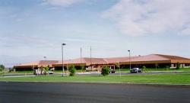
Yakama Indian Health Center
1990
Notes:
Occupied in 1990.
If you come to visit us today…you will not be able to see as open a view of the clinic. The trees have grown to forest size.

Slide 3
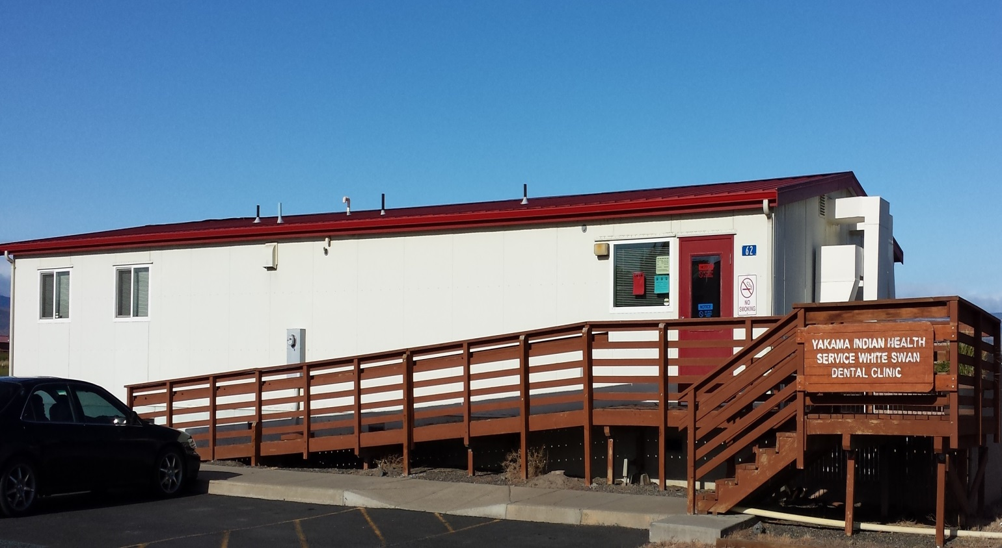
Satellite Dental Clinic – White Swan
Notes:
Change is often associated with structures or facilities.
This was the first change that occurred after the main clinic was occupied in 1990. It came about later in the 1990’s.

Slide 4
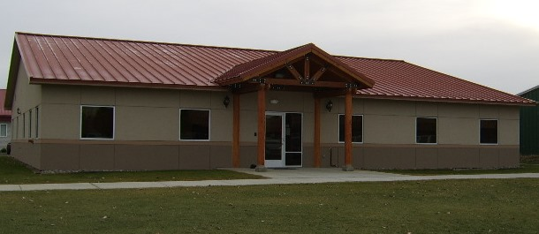
Administration Building
Notes:
This is the second change that occurred since the clinic was constructed and occupied in 1990.
It was occupied after 2011.
But did make available space in the main clinic for renovation to increase exam rooms and make the pharmacy a larger size with an improved waiting area.

Slide 5
Quality Improvement timeline
Affordable Care Act (ACA)
.........Enrollment of Patients
…………Budget impact
………….…Address Needs to Improve Care
..………………..Planning Activities
Notes:
This is post “rescission” era which was about a $500k reduction to our operating budget.
Enrollment of patients was forecasted to positively impact our budget with WA State expanding Medicaid…..the “Ed Fox model”.

Slide 6
enrolling patients
Notes:
Laura Kluever… she was named the “Top Tribal Assister” in the State of Washington for her work in enrolling patients using the Healthplanfinder and paper.
The business office was aggressive in their efforts to enroll patients.
This was contagious to other departments that quickly learned to refer patients to our benefit coordinators: Medical, Dental, PHN, Pharmacy, and PRC.

Slide 7
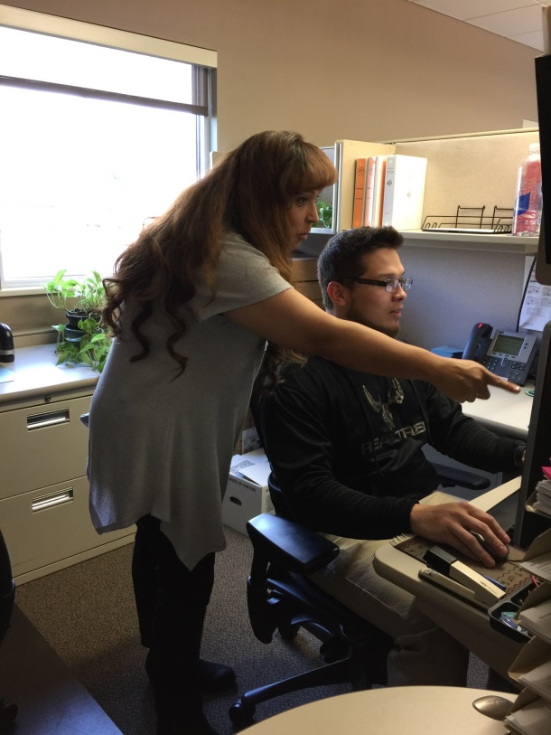
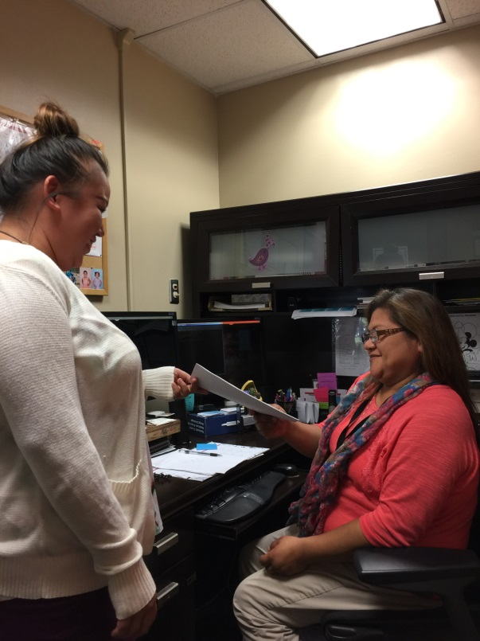
Business office processes
Biller and POS Biller
Working on Patient who have
new Medicaid Coverage
A/R Techs training a
Pathways Employee
Patient Registration working
With the Benefits Coordinator
On caseloads
Notes:
Here are a few shots of the staff that help to deliver the work from registering a patient, enrolling a patient, and finishing the revenue process.

Slide 8
83% of Active Patients have healthcare coverage.
Reimbursement revenue has exceeded $10 million.
Notes:
A recent quality improvement project presented by our Business Office provided these key items.
BOM uses the CEMU Report in the I.H.S. RPMS Billing Package. It captures all ages of uninsured patients. They want to see how to get the other 17%.
Collected revenue has exceeded $10M in the past (2) fiscal years.

Slide 9
Notes:
Patients with coverage increased: 2016 had 14,221 of 16,978 registered patients with coverage.
BOM uses the CEMU Report in the I.H.S. RPMS Billing Package. It captures all ages of uninsured patients. They want to see how to get the other 17%.
Collected revenue has exceeded $10M in the past (2) fiscal years.

Slide 10
COLLECTIONS
Notes:
Collected revenue has enabled us to recover from past budget impacts, make changes in staffing, equipment, facility, and planning.
Historically hovered around $5.5 M.

Slide 11
PEDIATRIC SPECIFIC POSITIONS
Pediatrician
Pediatric Dentist
Special Needs Public Health Nurse
Notes:
We have been able to start the process to reinstitute pediatric specific care at our facility.
Have hired a pediatirican this past summer, and are recruiting for the pediatric dentist. Will be recruiting for the PHN position.
Will also hire the supporting nursing staff to be teamed with the providers.

Slide 12
Other Staff Changes
- Pharmacy Technician (Point of Sale)
- Patient Registration
- Coder
- Custodian
Initial plan for working within current facility.
Notes:
We have hired the Pharmacy POS technician. It is a position to compliment our Business Office POS technician.
We will be recruiting for the: patient registration, coder, and custodial positions.

Slide 13
OTHER CHANGE
Equipment
Facility
Notes:
We have hired the Pharmacy POS technician. It is a position to compliment our Business Office POS technician.
We will be recruiting for the: patient registration, coder, and custodial positions.

Slide 14
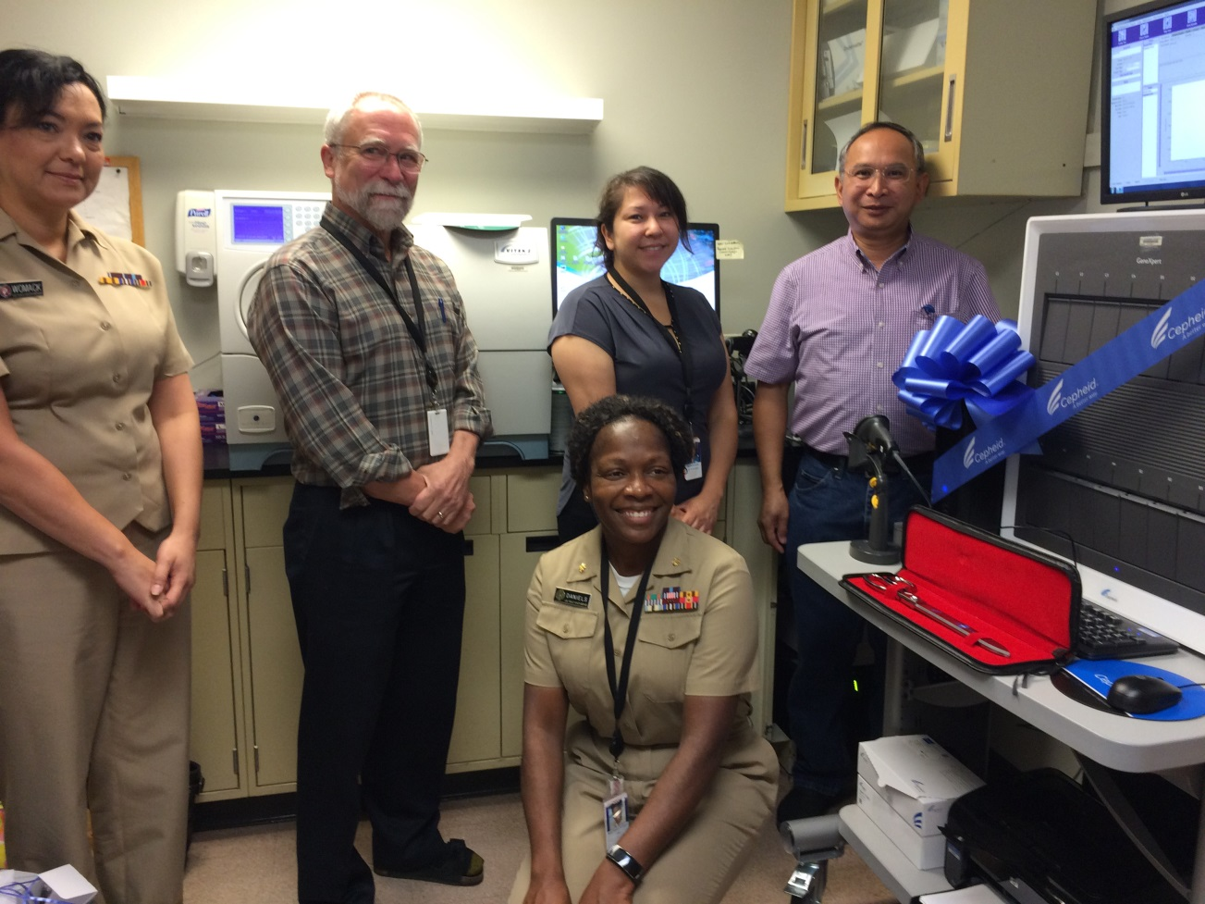
Gc Analyzer
Notes:
CD, Lab Director, Lab Supervisor, Lab Technologists
Brings this form of testing in-house as we are currently a moderate complex lab. Analyzer will enable quicker results to providers and lead to cost savings.
Projection is a cost savings of approximately $40k annually. Estimated payback period is roughly 2 years.
We are also updating our Siemens Chemistry analyzer. A replacement and not an addition.
I am told it is the latest and greatest in this analyzer technology.

Slide 15
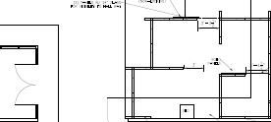
Facility changes
Notes:
Improve the area for patient registration…for the patients and the employees of the main entryway to the clinic. Solution is by systems furniture.
A consultative finding of a AAAHC survey. Installation is to be initiated in November 2016.

Slide 16
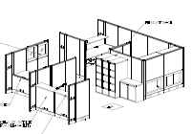
Facility changes
Notes:
Improve the area for patient registration…for the patients and the employees of the main entryway to the clinic. Solution is by systems furniture.
A consultative finding of a AAAHC survey. Installation is to be initiated in November 2016.

Slide 17
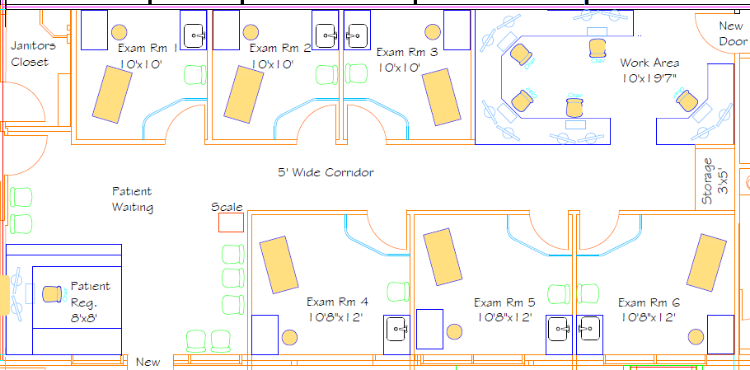
Facility changes
Notes:
Provide 6 additional exam rooms: increase ratio of exam rooms to PCP Team, and add another Medical Team.

Slide 18
Change FOR IMPROVEMENT
Provide (6) additional exam rooms.
Provide capability for bariatric equipment needs and an isolation area in event of an outbreak or other need.
Improve the patient panel size for each medical team.
Increase access for patients to primary care services.
Notes:
It is to be defined.
But the efforts of the clinic staff both care positions and administrative positions have put us in a position to plan for an improved picture.
We will continue with the facility changes, and planning for making new what is old, and staffing where service is needed.

Slide 19
PLanning
Goal: Continue to improve access for services.
Dental Facility: separate, larger, more efficient layout.
New facility makes available space in clinic to evaluate:
Optometry Department expansion,
Renovate space for increasing nurses for medical teams,
Renovate space to address referral needs.
Work with Tribal programs on possible alternate building location.
Notes:
We will continue with the planning of facility changes, making new what is old, and addressing staffing where service is needed.
As a large service area there are opportunities at other communities in the future.
We are starting from the center and working outward toward those opportunities.

Slide 20
PICTURE Of FUTURE
Notes:
It is to be defined. Or, in facility terms…it is “under construction”.
But the efforts of the clinic staff both care positions and administrative positions have put us in a position to plan for an improved picture.
We will continue with the facility changes, and planning for making new what is old, and staffing where service is needed.
We had an unscheduled AAAHC survey in the past year, and completed our 3 year AAAHC survey this past fall.

