Slide 1
Reports and the EHR Reports Tab
CDR Katie Johnson, Pharm D
NPAIHB Integrated Care Coordinator

Slide 2
Objectives
Familiarize CACs with some of the available reports in RPMS that may help with common troubleshooting or requests from various departments in your clinic
Explore EHR Reports Tab
Learn how to add reports to the EHR Reports Tab
Indentify some useful reports on EHR Reports Tab

Slide 3
Reports
HIM Reports
  These reports will help keep the medical record accurate and complete
  See Excel spreadsheet for a more detailed list

Slide 4
Common HIM Reports
Often asked to find notes and addendums of various status
  Unsigned Notes
  Uncosigned Notes
  Notes awaiting additional signatures
  Unsigned/Cosigned Addendums

Slide 5
*****************************************
* INDIAN HEALTH SERVICE *
* TIU MEDICAL RECORDS MENU *
* VERSION 1.0, NOV 10,2004 *
*****************************************
DEMO HOSPITAL
ADD Review unsigned additional signatures
HIMS Special HIMS TIU Reports ...
IPD Individual Patient Document
LAD List of Active Document Titles
MPD Multiple Patient Documents
PDM Print Documents Menu ...
SIG Awaiting Signature Listing
SSD Search for Selected Documents
STR Statistical Reports ...
TMM TIU Maintenance Menu ...
UNS Unsigned/Uncosigned Report
UPL TIU Upload Menu ...
VUA View a User's Alerts

Slide 6
ADD Review Unsigned Additional Signers
Please specify an Entry Date Range:
Start Entry Date: T-30 (JAN 13, 2014)
Ending Entry Date: T (FEB 13, 2014)
Select service: ALL//
Select one of the following:
F FULL
S SUMMARY

Slide 7
HIMS Special HIMS TIU Reports ...
1 Missing Text Report
2 Missing Text Cleanup
3 Reassignment Document Report
COS Missing Expected Cosigner Report
ID Mismatched ID Notes
PN Signed/unsigned PN report and update
SURR Mark Document as 'Signed by Surrogate'
UNK UNKNOWN Addenda Cleanup

Slide 8
COS Missing Expected Cosigner Report
START WITH REFERENCE DATE: Jan 01, 2003// (JAN 01, 2003)
GO TO REFERENCE DATE: Feb 13, 2014// (FEB 13, 2014)
Please select an output format from the following:
1 - 80 column standard print [STANDARD]
2 - 132 column standard print
3 - Table without headers (export to another application)
Enter response: 1// 80 column
DEVICE: HOME// VT
NOTES WITH 'UNCOSIGNED' STATUS THAT DON'T HAVE AN EXPECTED COSIGNER
Patient Entry Date/Time Title Author Note IEN
------- --------------- ----- ------ --------
XX12345 DEC 03, 2008@12:06:27 PC NOTE ADULT MOSELY,ELVIRA ~463
XX12345 JUL 17, 2012@16:36:34 Discharge Summa USER,FSTUDENT ~859

Slide 9
HIM Reports
Search for Selected Documents
  This can be a very helpful way of finding notes for various reasons
  Allows searching by
    Select Status: UNVERIFIED// ?
    1 undictated 5 unsigned 9 purged
    2 untranscribed 6 uncosigned 10 deleted
    3 unreleased 7 completed 11 retracted
    4 unverified 8 amended

Slide 10
SSD
All types of documents
  Select CLINICAL DOCUMENTS Type(s): Progress Notes// ?
  1 Progress Notes 7 Advance Directive
  Addendum 8 Tier II
  Discharge Summaries 9 Surgical Reports
  Clinical Procedures
  Laboratory Reports
  Tier 1

Slide 11
SSD
Search Categories:
All Categories 6 Patient 11 Transcriptionist
Author 7 Problem 12 Treating Specialty
3 Division 8 Service 13 Visit
Expected Cosigner 9 Subject
Hospital Location 10 Title
And Date Range

Slide 12
UNS Unsigned/Uncosigned Report
Start Entry Date: T-30 (JAN 13, 2014)
Ending Entry Date: T (FEB 13, 2014)
Select service: ALL//
Select one of the following:
F FULL
S SUMMARY

Slide 13
User Alerts
A word on Alerts and Notifications
  All Notifications are Alerts, but not all Alerts are Notifications
  Various reports available to track how well users are managing their notifications
  It is possible to track down the details of a notification such as when it first displayed to a user and when it was deleted
    However, those “scheduled” notifications that you can send to yourself or other users can’t be tracked like Alerts can.

Slide 14
VUA View a User's Alerts
Using this menu option, you can simply view the CURRENT alerts a user is seeing
One user at a time
For a broader picture, use the menu on the next slide

Slide 15
ALRT Report Menu for Alerts ...
Critical Alerts Count Report
List Alerts for a user from a specified date
Patient Alert List for specified date
User Alerts Count Report
View data for Alert Tracking file entry

Slide 16
Report Menu For Alerts
This menu is ‘read-only’ and so is safe to deploy to end users
It is called [XQAL REPORTS MENU] and I like to ask that it have the
  A good mnemonic is ALR

Slide 17
View data for Alert Tracking file entry
A little bit more on this one…
Select Report Menu for Alerts Option: VIEW data for Alert Tracking file entry
Internal Entry number in Alert Tracking File: (186252-197449): 186252
Another Internal Entry number in Alert Tracking File: (186252-197449):
DEVICE: HOME// VT Right Margin: 80//
NUMBER: 186252 NAME: OR,24989,57;1723;3080415.113438
DATE CREATED: APR 15, 2008@11:34:38 PKG ID: OR,57
PATIENT: DEMO,Patient Boy GENERATED BY: USER,BSTUDENT
GENERATED WHILE QUEUED: YES RETENTION DATE: MAR 28, 2083
DISPLAY TEXT: DEMO,PAT (A1468): Critical labs - [CBC]
ROUTINE TAG: RPTLAB ROUTINE FOR PROCESSING: ORB3FUP2
DATA FOR PROCESSING: 405719@OR|40491;3080415;2;CH;6919583.886666@LRCH
RECIPIENT: MOSELY,ELVIRA AUTO DELETED: MAY 07, 2008@09:32:55
RECIPIENT TYPE: INITIAL RECIPIENT ALERT DATE/TIME: APR 15, 2008@11:34:38

Slide 18
How to Use Alert Tracking
First, find the IEN of the alert in question
  Use the List Alerts for user or Patient Alert List menu options
  Selected Alerts for User GOSNEY,KIMI (DFN=1888)for dates Jan 01, 2014
  through Feb 11, 2014
  Selected alerts containing: LAB
  DEMO,PATI (D9999): Labs resulted - [CALCIUM]
  01/06/2014@12:25:51 [ROU] ien=193320

Slide 19
View Data for Alert Tracking file entry
Use that IEN you just found
  NUMBER: 193320 NAME: OR,25141,3;1888;3140106.122551
  DATE CREATED: JAN 06, 2014@12:25:51 PKG ID: OR,3
  PATIENT: DEMO,PATIENT WILLIAM GENERATED BY: GOSNEY,KIMI
  GENERATED WHILE QUEUED: YES RETENTION DATE: JAN 06, 2015
  DISPLAY TEXT: DEMO,PATI (D9999): Labs resulted - [CALCIUM]
  ROUTINE TAG: RPTLAB ROUTINE FOR PROCESSING: ORB3FUP2
  DATA FOR PROCESSING: 406877@OR|62637;3131212;10;CH;6859892.877473@LRCH
  RECIPIENT: GOSNEY,KIMI
  ALERT FIRST DISPLAYED: JAN 06, 2014@12:27:41
  PROCESSED ALERT: FEB 11, 2014@09:42:04
  DELETED ON: FEB 11, 2014@09:42:04
  RECIPIENT TYPE: INITIAL RECIPIENT-SURROGATE
  ACTING AS SURROGATE: YES ALERT DATE/TIME: JAN 06, 2014@12:25:51
  SURROGATE FOR: DOCTOR,GSTUDENT G
  DATE/TIME - SURROGATE FOR: JAN 06, 2014@12:25:51
  RECIPIENT: DOCTOR,GSTUDENT G
  RECIPIENT TYPE: INITIAL RECIPIENT SENT TO SURROGATE: GOSNEY,KIMI
  ALERT DATE/TIME: JAN 06, 2014@12:25:51

Slide 20
Details of file entry
Notice all the great information
This can be invaluable when figuring out where an alert “disappeared” to
ALERT FIRST DISPLAYED: JAN 06, 2014@12:27:41
PROCESSED ALERT: FEB 11, 2014@09:42:04
DELETED ON: FEB 11, 2014@09:42:04
RECIPIENT TYPE: INITIAL RECIPIENT-SURROGATE
ACTING AS SURROGATE: YES ALERT DATE/TIME: JAN 06, 2014@12:25:51
SURROGATE FOR: DOCTOR,GSTUDENT G
DATE/TIME - SURROGATE FOR: JAN 06, 2014@12:25:51

Slide 21
Retention Time
Note: You can set the retention time for EACH individual notification
For most, 30 days is sufficient
Lab Results should be set to 27375 days (75 years) per IHS Standards of Practice
  Generally do only “Lab results” for this long because the “Abnormal lab result” depends on result flagging and not all lab tests have result flagging

Slide 22
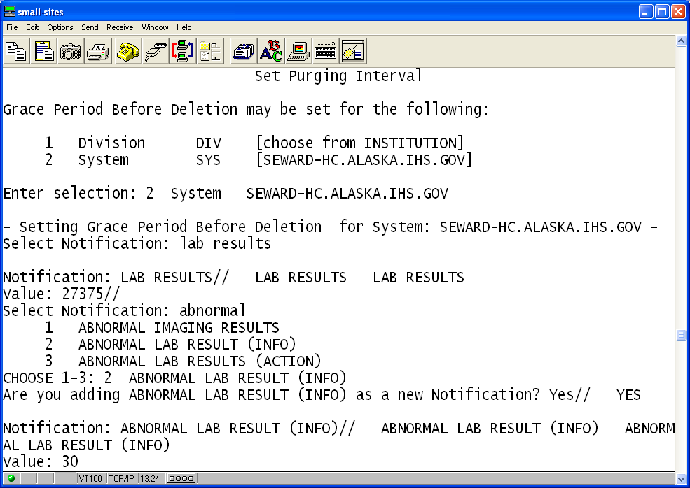
Retention Time
EHR | BEH | NOT | PAR | PRG
  PRG Set Purging Interval

Slide 23
Coding Reports
Uncoded problems and Uncoded POV
  Need to be cleaned up before EHRp13 (Spring/Summer 2014)

Slide 24
Reports to find Uncoded Items
*************************************************
** PCC Data Entry Module **
** Fix UNCODED ICD9 Diagnoses/Operation Codes **
*************************************************
IHS PCC Suite Version 2.0
DEMO HOSPITAL
POV Fix Uncoded Purpose of Visit Diagnoses
PRB Fix Uncoded PROBLEM File Diagnoses
PER Fix Uncoded PERSONAL HISTORY Diagnoses
FAM Fix Uncoded FAMILY HISTORY Diagnoses
OPS Fix Uncoded V PROCEDURE Operation Codes
PPV Print a list of all Uncoded Diagnoses/Operations

Slide 25
Uncoded POV
Uncoded POV - (May be done in Coding Queue.)
DEU | SUP | ICD | POV
  Data Entry Utilities… | Data Entry SUPERVISORY Options and Utilities… | Fix Uncoded ICD9 Diagnoses/Operations… | Fix Uncoded Purpose of Visit Diagnoses

Slide 26
Uncoded Problems
Uncoded Problems
DEU | SUP | ICD | PRB
  Data Entry Utilities… | Data Entry SUPERVISORY Options and Utilities… | Fix Uncoded ICD9 Diagnoses/Operations… | Fix Uncoded PROBLEM File Diagnoses

Slide 27
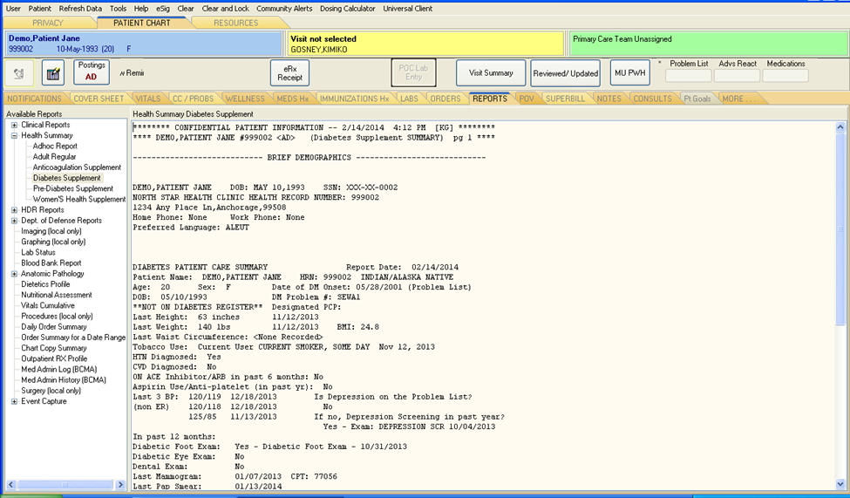
EHR Reports Tab

Slide 28
EHR Reports Tab
From your EHR – BEH Menu in RPMS
Choose
  RPT Report Configuration ...

Slide 29
RPT Report Configuration…
RPMS-EHR Management
Report Configuration
FMT Print Formats
HSM Health Summary Configuration ...
PAR Report Parameters ...
SYS System Display Parameters
USR User Display Parameters

Slide 30
PAR Report Parameters…
ALL Default Time and Occurrence Limits for All Reports
RPT Default Time and Occurrence Limits by Report
Time & Occurrence limits for all: T-7;T;10//
Format: Start Date;End Date;Occurrence limit (T-100;T;200)
So, we have a date range of T-100 to Today and will show 200 occurences of the item in this example

Slide 31
SYS System Display Parameters
DEMO HOSPITAL RPMS-EHR Management Version 1.1
System Display Parameters
GUI Reports - System for System: DEMO-HO.IHS.GOV
------------------------------------------------------------------------------
List of reports 1 ORRP ADHOC HEALTH SUMMARY
2 ORRPW REPORT CATEGORIES
3 ORRP HEALTH SUMMARY
4 ORRP LAB STATUS
5 ORRP IMAGING
8 ORRPW REPORT CATEGORIES
9 ORRP DAILY ORDER SUMMARY
10 ORRP ORDER SUM FOR A DATE RNG
11 ORRP CHART COPY SUMMARY
12 ORRP OUTPATIENT RX PROFILE
25 BEHOEN VISIT SUMMARY1
30 BEHOEN VISIT SUMMARY2
35 ORRPW DOD VITALS
40 1142
50 ORRPW ORDERS CURRENT
List of lab reports
------------------------------------------------------------------------------

Slide 32
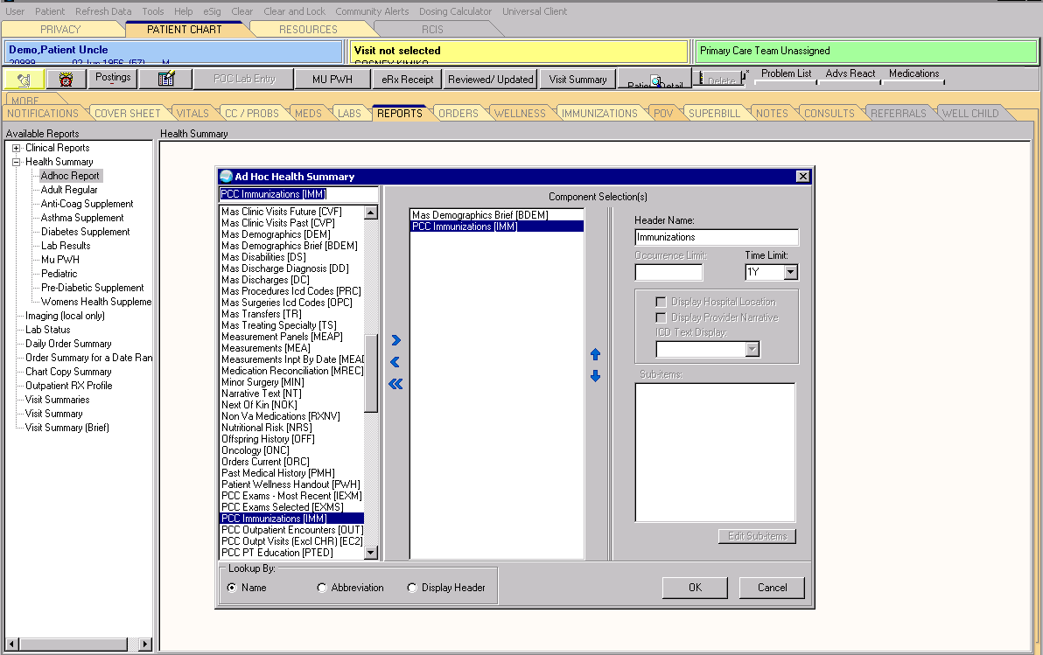
Useful Reports
Ad Hoc

Slide 33
Useful Reports
Health Summaries
Inpatient
  Order Summaries
Pharmacy
  All Meds – help look far back into med history of patient

Slide 34

Questions?

