Slide 1
Cow Creek Health & Wellness Center
SDPI Community Grant Program
Bre Syron, RD, LD, Chef
Diabetes Program Coordinator
Notes:
Introduce self and topic

Slide 2
Diabetes Program Overview
Goals:
See every active diabetic patient that uses our clinic at least once a year with ultimate goal of quarterly diabetic visits.
Have every patient meet their standards of care.
Increase our patient’s confidence in their ability to self manage their diabetes.
Encourage our patients with diabetes to become leaders within our tribe and help others through the process.

Slide 4
How to Meet Our Goals
Develop a Diabetes Team
Case management
Opportunities for patients to learn what our clinic has available for them.
Implement the best practices from Community Directed Grant Program that will help us meet the standards of care.
Physical Activity
Diabetes Self Management Education

Slide 5
Case Management
Currently have 4 medical teams
Each team is responsible for case managing their patients.
Registered Dietitian and Diabetes Program Coordinator assists all four teams in managing their diabetic patients.
Rely heavily on the Diabetes Management System (DMS) and iCare to run reports that aid in case management.
Call and send letters to patients reminding them what standards of care are due and ask them to make an appointment.
RD works closely with each team’s RN and CMA to ensure patients are being followed up with and seen.

Slide 6
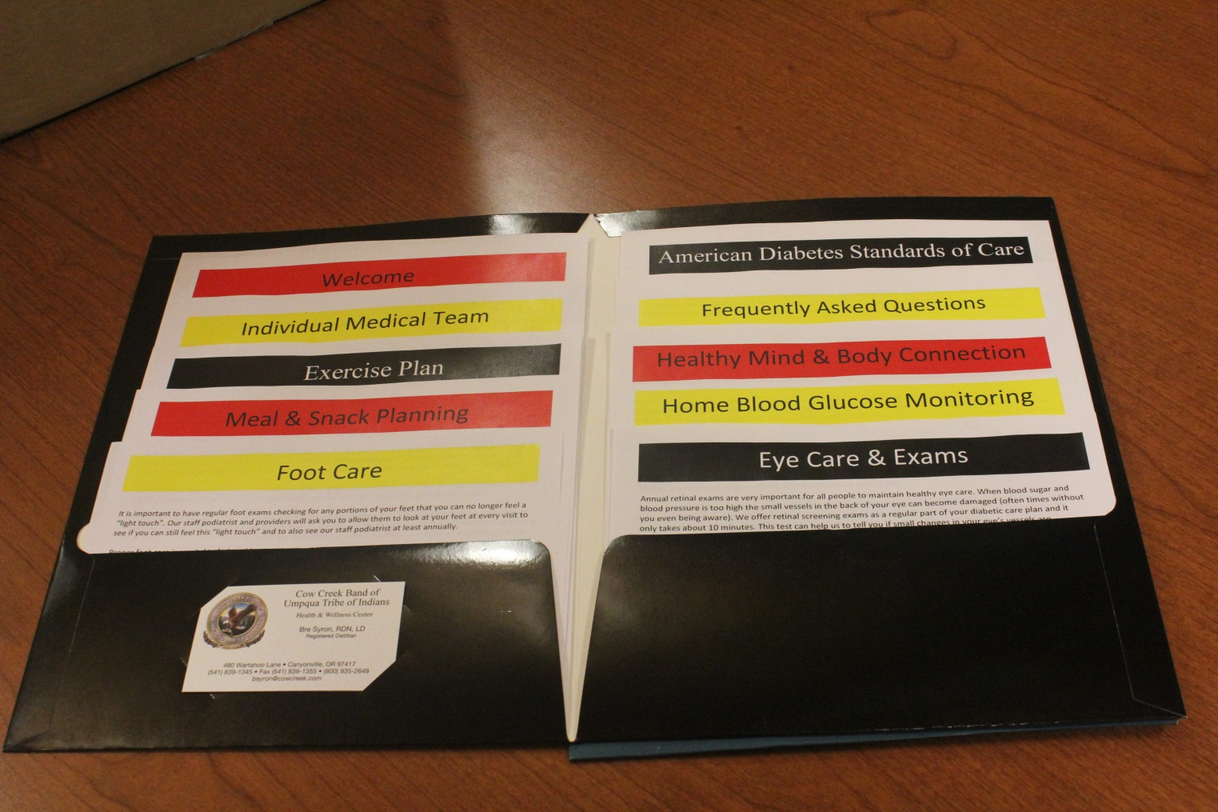
Welcome Packet

Slide 7
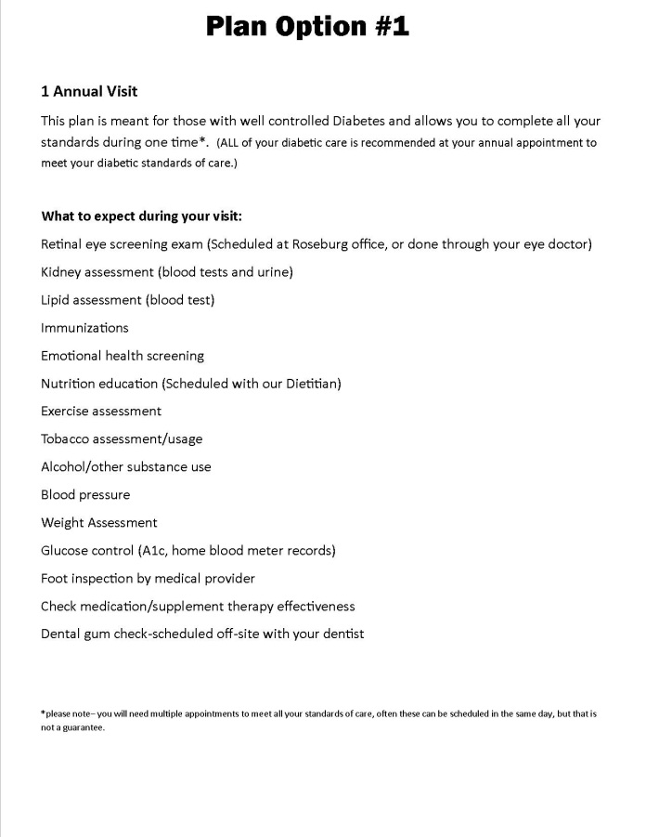
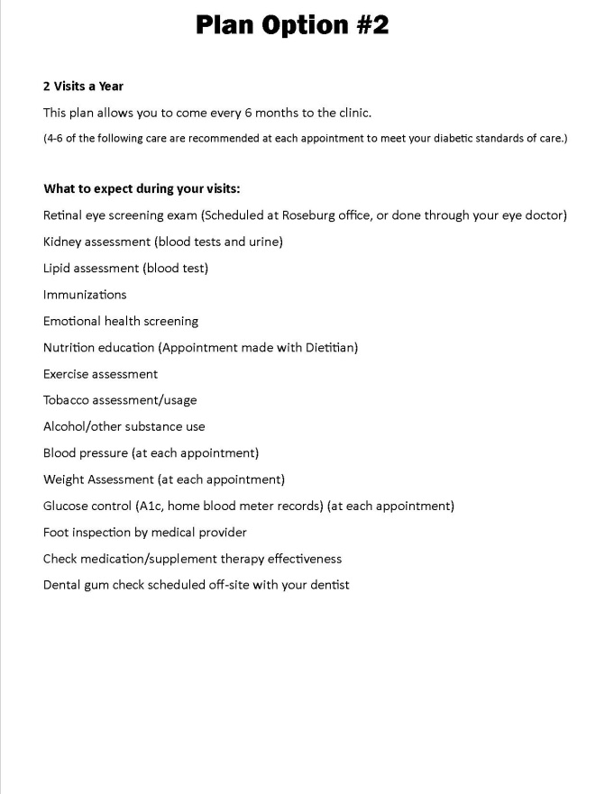
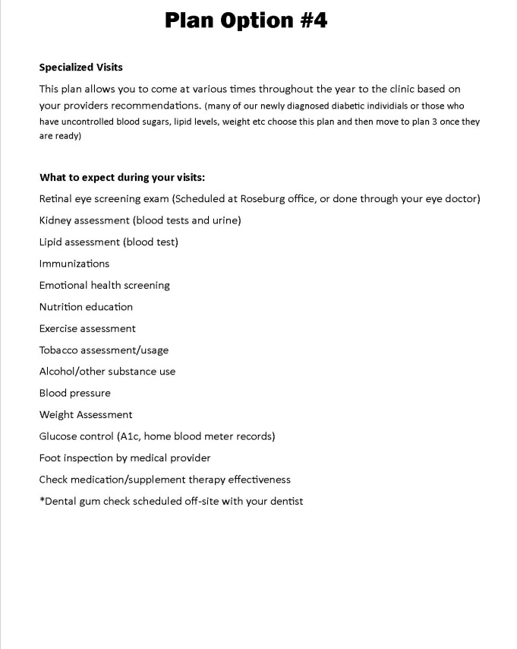
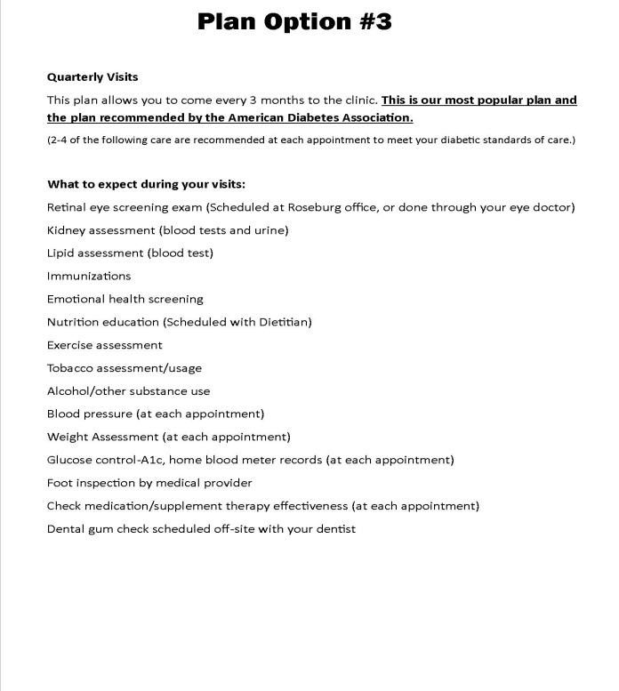

Slide 8
What Now?
So….we have them on a plan, we are meeting their medical standards of care (A1c, lipid panel, medication management etc.) what else do we need to do……

Slide 9
Diabetes Self Management Education (DSME)
Diabetes management takes a team approach, but it is argued that one of the most important parts of the disease management is teaching the patient how to care for themselves.
DSME is an ongoing process to facilitate a person’s knowledge, skill, and ability for self-care. This process incorporates the needs, goals, and life experiences of the person with the diabetes and is guided by evidence based standards.
DSME involves health care providers in activities that help people with diabetes to implement and sustain ongoing behaviors needed to manage their diabetes. This includes behavioral health, nutrition, and clinical support.

Slide 10
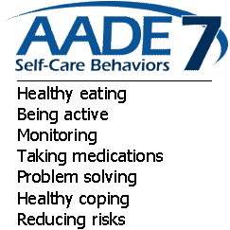
AADE 7 Self-Care Behaviors
Healthy Eating
Being Active
Monitoring
Taking Medication
Problem Solving
Healthy Coping
Reducing Risks
In our clinic-Registered Dietitians work with patients in achieving their 7 Self care behavior goals. Use scale of 1-10 to evaluate a patient's confidence in each area.
Utilize the AADE-7 curriculum and highly recommend their text, The Art and Science of DSME Desk Reference.

Slide 11
Implementation
Patients come see our RD’s who will guide the patient through their DSME self-care behaviors.
RD focuses on: healthy eating, being active, monitoring, problem solving and reducing risks.
Refer patient to behavioral health for Healthy Coping and work with them for reducing risks such as smoking cessation.
Work with medical teams for medication management.
Hold events to help patients with their diabetes control. These include:
Cooking demos
Grocery store tours
Support groups
Exercise opportunities
Tutorials/training on self monitoring and carb counting

Slide 12
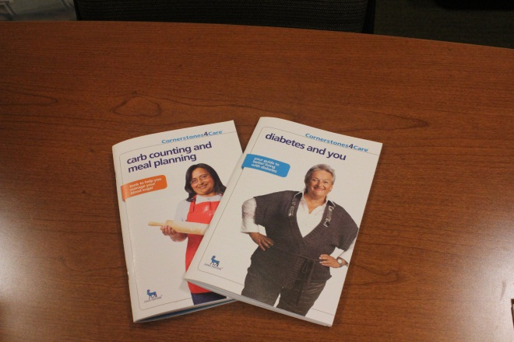
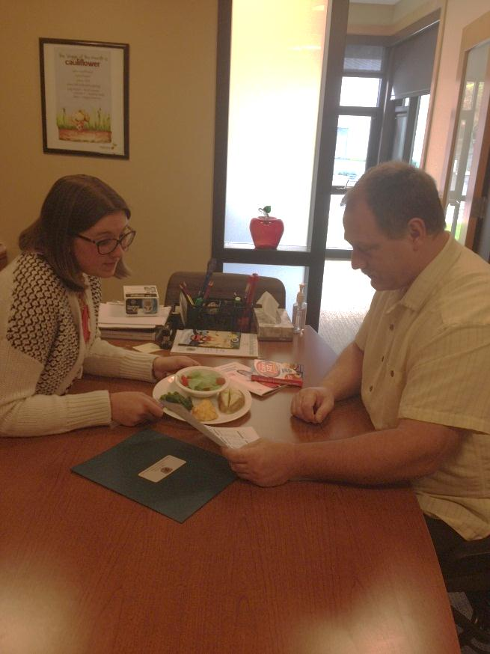
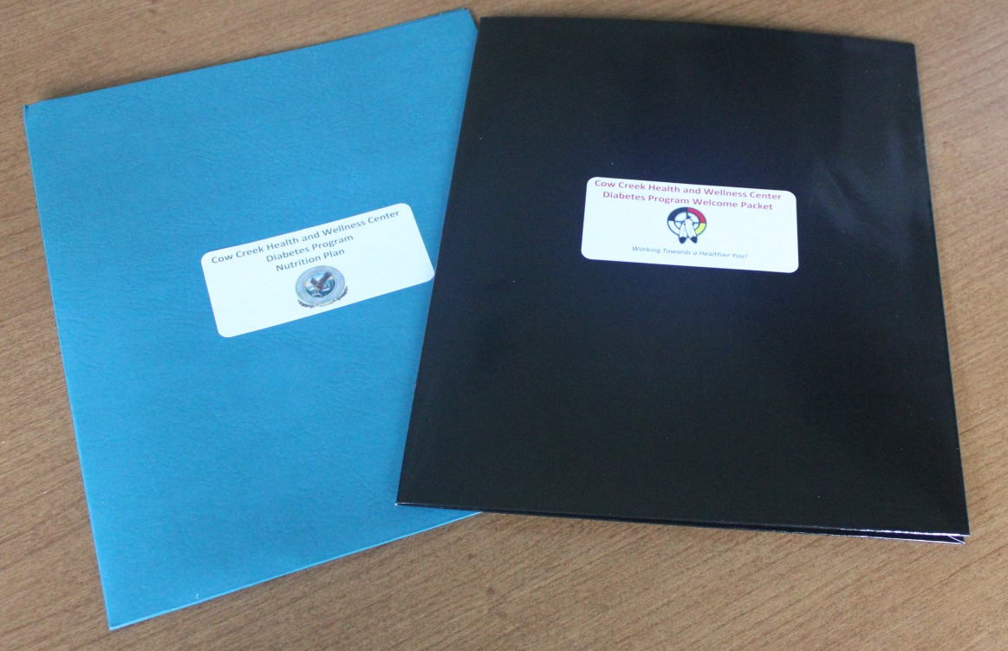
In addition to the welcome packet each patient who comes to see the RD receives a Nutrition Program Packet that includes information on diet, exercise, self monitoring, reducing risks and recipes.
Goal is to have each diabetic patient meet with an RD 1 time a year to review their self-management goals.

Slide 13
In the Nutrition Packet
Customized nutrition plan that the RD creates for that patient.
Utilize the Plate Method first and then introduce basic carbohydrate counting.
Focus on portion sizes and timing of meals first.
Ask patient to check blood glucose on a regular basis until numbers are under control. These plans are also customized.
Follow curriculum from Type 2 Diabetes Basics 4th Ed. By International Diabetes Center.

Slide 14
We have no off limit foods, bad foods, or never foods. Instead we focus on portion control, foods to eat less often, and being realistic.
Also give patients plenty of recipes that are healthy, balanced and diabetic friendly. This is important when asking a person to change how they have been eating for some time.
Goal for exercise is ultimately 150 minutes per week. However we start wherever the patient is able to start.
Band exercises
Chair exercises
Walking programs
Fitness program at North Clinic

Slide 15
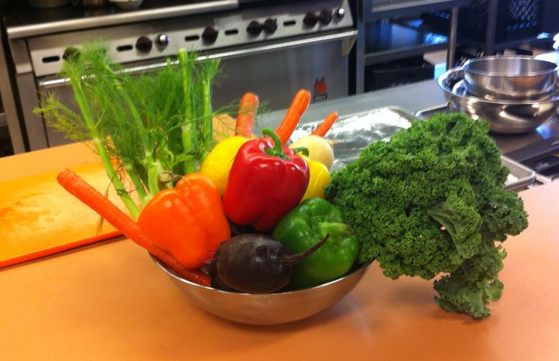
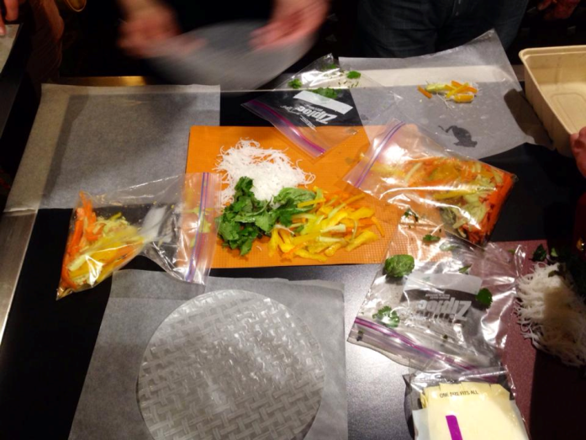
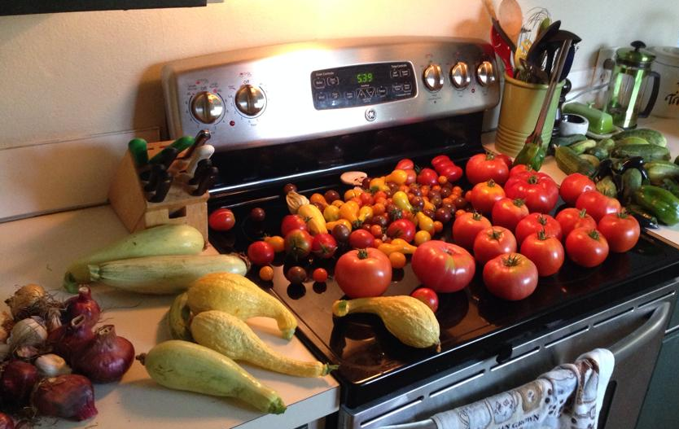
Cooking Demos & Grocery Store Tours

Slide 17
Recipe Recommendations
Diabetic Living website: http://www.diabeticlivingonline.com/
Eating on a budget: http://www.choosemyplate.gov/budget/sampletwoweekmenus.html
Good and Cheap by Leanne Brown: https://8b862ca0073972f0472b704e2c0c21d0480f50d3.googledrive.com/host/0Bxd6wdCBD_2tdUdtM0d4WTJmclU/good-and-cheap.pdf
Sample diet by kcals: http://www.xenical.com/xenical/hcp-7_samplediets.do
Diabetes Menus: http://spock.fcs.uga.edu/ext/pubs/food.php?category=Diabetes
Low Literacy Education materials:
http://www.learningaboutdiabetes.org/

Slide 18
Questions?

