Slide 1
THE TRIBAL RESEARCH MODEL: CAPTURING THE HELICOPTER
DR. TOM BALL, Ph.D
RESEARCH COORDINATOR
x̌smr̓imstn : COLVILLE NARCH

Slide 2
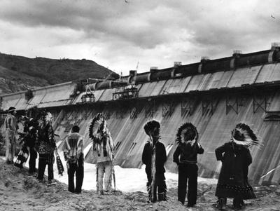
Helicopter Research in Action
Part I: The Project Begins…

Slide 3
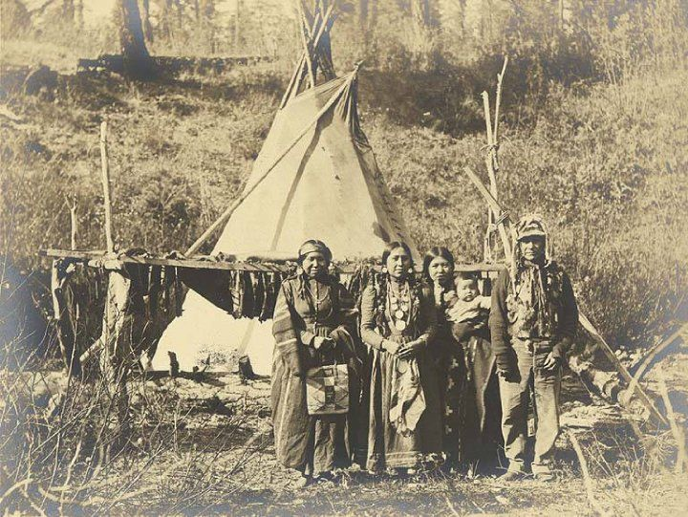
Helicopter Research continued
Part 2: The Project Ends…
Problems with sustainability and adherence

Slide 4
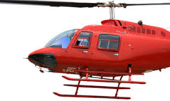
NARCH Mission: Capture the Helicopter
Be the first Tribe that is conducting their own research from the reservation.

Slide 5
The Community Empowerment Model: Tom Ball, Alison Ball, Phil Fisher
Phase I Phase II Phase III Phase IV Phase V Phase VI Phase VII
Indian Community
Research Community

Slide 6
The Academic Model: All Control in Research Community, None in Indian Community
x̌smr̓imstn Colville Research Center
Research
Community
Phase 1
Phase 2
Phase 3
Phase 4
Phase 5
Phase 6
Problem Identified by academic community
Research Community Recruited by academic community
Data Collected from Indian Subjects by academic community
Data Analyzed by academic community
Data Published and Presented by academic community
Resources brought in by academic community

Slide 7
The Tribal Model: All Control in Indian Country
Tribal Research Center
Research
Community
Phase 1
Phase 2
Phase 3
Phase 4
Phase 5
Phase 6
Problem Identified by Tribe
Research Community Recruited by Tribe
Data Collected from Indian Subjects by Tribe
Data Analyzed by Tribe
Data Published and Presented by Tribe
Resources brought in by Tribe

Slide 8
x̌smr̓imstn : How are we Implementing Tribal Research?
Admin Core: Building capacity for future research
Capacity Building Core: Building capacity for programs to mine their own data
Research
Pilot Project:
Men’s Diabetes Study: two tribal members hired to work on project

Slide 9
Administrative Core
Facilitating Research by building into the administration
processes that will continue to support research activities for the tribe.

Slide 10
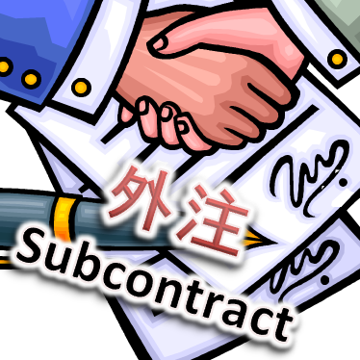
continued…..
Sub-contracting with outside organizations to provide technical assistance in specialized capacities such as curriculum development, epidemiology, or biostatistics.

Slide 11
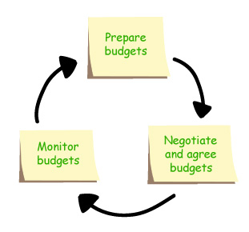
Continued…
Budgeting
Tribal budgets vs. Federal budgets

Slide 12
Administrative Core continues..
Tribal Scientific Board is made up of Tribal Council, Office of Reservation Attorneys, Program Managers from Environmental Trust, History & Archeology, CFO, Traditional leaders.
Quarterly all day meetings
IRB processes
Data Sharing Agreements
Research Agenda’s
Policy & Procedures
Finance

Slide 13
Capacity Core
Building sustainability, data capacity in Health Programs to organize, collect, and analyze data

Slide 14
Why Collect Data?
Grant Applications
Program Improvement
Resource Allocation
Tribal Council
Data Mining
Data Analysis
Study Patterns of Health & Disease

Slide 15
How are we doing it?
Meet with individual programs.
Is the data collected currently answering the questions program managers, directors, CBC?
Customize data collection.
Assist in developing ways to collect data, Excel, Access, etc.
Collect data sets from programs.
Determine how the datasets will be shared, email,
secure server, USB, etc.

Slide 16
Shifting the Research Paradigm
Political
Tribal Research Code Established Use of Community Experts Goal of research is Healing social change Resources brought into Community
Mental
Data Data presented
Collected to tribe and published
Economical
Cultural
Physical
Data Identify
Analyzed Problem
Spiritual
Emotional
Social

Slide 17
Building Your Own
Colville Tribe has 16 Ph.D.'s
Need to have a place to do research
Student research academy – cohort model 10 weeks
Research methodology
Research project
Present at conferences
Follow up with support; future summer placements, mentoring, small research grants

Slide 18
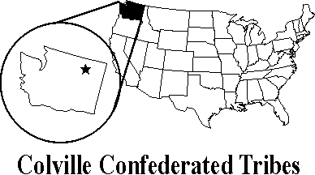
Building Your Own Cont.
Training:
GIS (Geographic Information Systems)
ArcGIS I: Introduction to GIS
ArcGIS II: Essential Workflows
Microsoft SQL Server
Querying Microsoft SQL Server
Administering SQL Server Databases
Implementing Data Warehouse with SQL Server

Slide 19
Cont...
Excel:
Excel 2013 Parts 2 & 3
Intermediate to Data Mining
Microsoft Access
Beginning & Advanced
Human Subjects
Grants Management & Financial Accountability

Slide 20
Negative Perception of Research
Annual Colville Research Conference
We’ve been researched to death
We never hear back from researchers
See Tribal students/family members reporting back to community their research findings.
See the potential for research to help the people when research is controlled by the people.
Data ownership: Sovereignty issue. It is your data.
Measure attitude change.

Slide 21
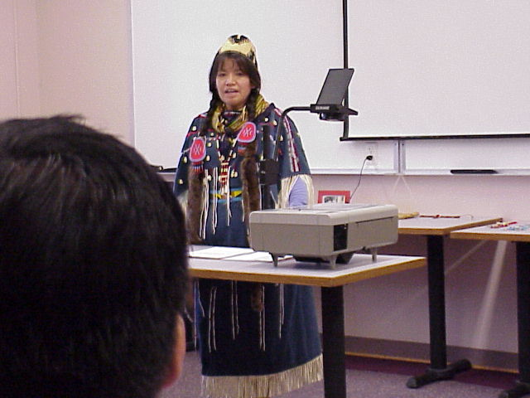

Slide 22
The NARCH Mission
Capture the Helicopter
Tribal Research Model
Colville Researchers doing Colville Research
Limlimt.

