Slide 1
2021 Policy Priorities
Presented by: Elizabeth J. Coronado and Candice Jimenez

Slide 2
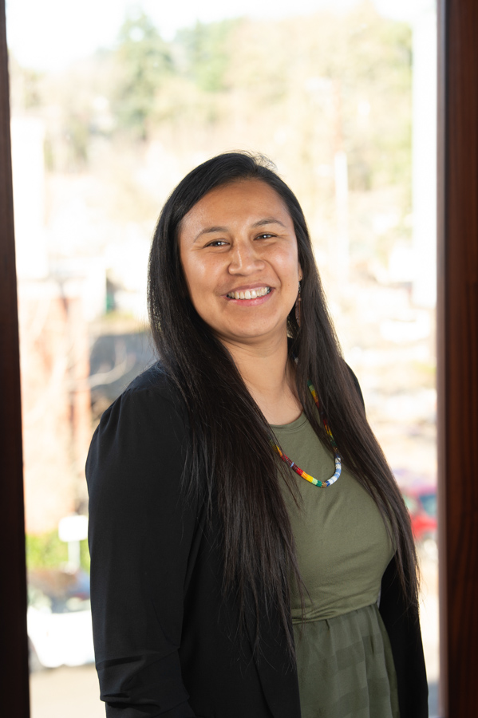
NPAIHB Health Policy Team
New Staff Introduction
Elizabeth J. Coronado, JD Candice B. Jimenez, MPH
Chukchansi Confederated Tribes of Warm Springs

Slide 3
Legislative and Policy Committee

Slide 4
Indian Health Service
Fully fund the IHS. This was requested to be at the top of any document and high priority.
Establish a separate and indefinite discretionary appropriation for 105(l) lease funding. This request was accomplished, but needs to be mandatory.
Provide mandatory funding for IHS
Amend IHCIA to authorize advance appropriations for IHS. Huge Priority.
For Purchased and Referred Care, move access to care factor from category 3 to category 2 in funding formula. This will increase PRC funding to Portland Area.
Tribes need to advocate for COVID-19 Response and Relief 2021.

Slide 5
Health Care Facility Funding
Request GAO to issue a report on IHS Health Care Facilities Construction Priority System.
Create equitable health care facilities funding opportunities for all IHS areas.
Fund Regional Referral Specialty Care Demonstration Project in the Portland Area.
Increase funding for small ambulatory programs and joint venture projects.
Bill HR 2 reintroduced in Congress with health care facility funding.
Funding for long term care, assisted living, hospice care under IHCIA. NPAIHB needs to look at the IHCIA to determine if it includes facilities.

Slide 6
IHS IT Modernization
For FY 2021, fund $25 million for planning and phased in maintenance of RPMS.
Conduct tribal consultation in each IHS area on any efforts to modernize or replacement of RPMS.
Provide ample transition period, training, and TA.
Consider the many tribal facilities that have purchased commercial off the shelf systems. Consult with the tribes that have purchased COTS and are using tribal resources for upgrades, technical support and maintenance in order to guarantee interoperability. Reimbursement for the tribes who have purchased COTS and funding for maintenance, TA, replacement.
10 year transition period to a new EHR is unacceptable, tribes will have be forced to move away from RPMS to continue operations.
All hospitals in NW are on EPIC.

Slide 7
Workforce Development
Establish HRSA TAC in FY 2021.
Expand Title 38 authorities to ensure that IHS and tribal facilities can be competitive in the current job market.
Fund IHCIA 112, 132, and 134 for additional resources to address recruitment and training programs.
Fully fund IHS Indian Health Professionals scholarships and support Loan Repayment Program. This is a priority that IHCP scholarships are fully funded to support AI/AN workforce. Need to look at expanding the type of professions that qualify for the scholarships. Recommendation to look at the needs in Indian County for health professionals (IT, administration, etc.).

Slide 8
SDPI
Permanently authorize SDPI at $200 million per year with medical inflation rate increases annually. (NPAIHB Res. No. 19-04-12)
Create options for tribes to receive SDPI funds through Title I or Title V compacts or contracts.
Allow areas to reallocate data infrastructure funds to Tribal Epi Centers to assist tribes in managing their SDPI data.

Slide 9
Patient Protection and Affordable Care Act / IHCIA
Congress must protect ACA and IHCIA.
Fully fund IHCIA, including long term care, recruitment and retention, and behavioral health.
Fund Tribal Epi Centers to fulfill their role as a Public Health Authority. (TA, capacity building, evaluation, public health surveillance)

Slide 10
Medicaid/CHIP
Protect 100% FMAP.
Protect FFS (not subject to managed care or value based payments).
Support legislation that:
Extends Medicaid eligibility for all AI/AN with household income up to 138% of the federal poverty level.
Authorizes IHCPs in all states to receive Medicaid reimbursement for health care services delivered to AI/ANs
Extend full federal funding through 100% FMAP to states for Medicaid services furnished by urban Indian providers
Removes the limitation on billing by IHCPs for services provided outside the 4 walls of a tribal clinic

Slide 11
Elders Committee

Slide 12
Elders and Long Term Care
Congress must fund long term care services, assisting living services, hospice care and home/community-based services (all authorized under IHCIA for AI/AN people)
HHS/CMS/IHS must create an encounter rate (or enhanced rate) for tribal nursing homes
Congress must increase funding to IHS or ACL for elder access to no-cost eyeglasses
No changes at this time.

Slide 13
Behavioral Health Committee

Slide 14
Behavioral Health (Mental Health & Substance Use)
Strengthen partnerships for integrated care between behavioral health and medical care teams (top priority)
SAMHSA –
Accessible funding: prevention, training for mid-level SUD providers, data waiver trainings for SUD providers, training & development of peer counselors
Support funding for the IHS Fully fund a Behavioral Health Programs for Indians with option for tribal shares and non-competitive funding for direct service tribes (NPAIHB Res. No. 19-04-09)
Increase support for AI/AN youth inpatient and outpatient mental health and substance use services
Address 42 CFR part 2 restrictions and align it with HIPAA to allow for integrated care for AI/Ans with Substance Use Disorder (SUD)

Slide 15
Behavioral Health (Mental Health & Substance Use)
Fully fund IHCIA provisions for increases to Behavioral Health
Provide inpatient treatment, training for mental health techs, tele-mental health expansion and demonstration grants and crisis intervention training
For IHS to ensure that all BH initiatives create option for tribes to receive funding through contracts and compacts
For SAMSHA to acknowledge and support the development and implementation of Tribal Best Practices, traditional Indigenous knowledge and cultural practices in prevention and interventions
Reduce restrictions of federal housing programs for tribal members in recovery; acknowledge houselessness as PH crisis and COVID-19
Provide telehealth/telemedicine resources to increase accessibility

Slide 16
Community Health Aide & Oral Health Committee

Slide 17
Community Health Aide Program Nationalization & Dental Health Aide Therapists
Support continued funding for Community Health Aide Program (CHAP) & Community Health Representative (CHR) program expansion in FY 2022
Support unification of national CHAP program by removing state authorization requirements for the use of DHATs as part of a CHAP program
Implement nationalization of CHAP in the Portland IHS Area (NPAIHB/CRIHB Joint Res No. 17-04-09)
Support tribes to authorize/license/certify CHAP providers
Creation of permanent series and classification of position descriptions CHA/Ps in federally-operated facilities (for DHA/Ts)

Slide 18
Public Health Committee Note: Consideration that this section should include health factors that predispose community members to chronic and communicable disease – how can we uplift the multitude of needs, resources and challenges as voiced by NW tribal communities.
Public Health –
Infrastructure development
Events of international importance incl. COVID-19
Capacity development
Emergency preparedness
Overall, a focus on Tribal practices that guide each of these areas.

Slide 19
COVID-19 (Vaccine)
COVID-19 Pandemic has laid bare the structural inequities that lead to health disparities, including inadequate public health infrastructure.
Hold agencies accountable to conduct ongoing and meaningful tribal consultation on all COVID-19 vaccine policies and plans
Ensure access to all 3 options to receive vaccine: federal, state and local
Ensure that tribes have resources needed to receive and store vaccine
Honor tribes’ authority to determine service & priority populations
HHS and IHS must provide funding and infrastructure support to tribes for vaccine reporting

Slide 20
HCV & HIV Treatment and Funding
For HCV, ensure that all AI/AN patients with HCV at I/T/U facilities have access to treatment
Ensure that Indian Country is included in Ending the HIV Epidemic Funds
IHS to support creation of a funding mechanism to receive Minority AIDS Initiative (MAI) funding for distribution via the Office of Infectious Disease and HIV/AIDS Policy
For State Medicaid Agencies, make HCV treatment a clinical priority and ensure access to medications to all persons with medical need
as determined per American Association for the Study of Liver Diseases (AASLD) guidelines (NPAIHB Res No. 18-02-03)
Ensure Administration’s National Plan for HIV Elimination is inclusive of tribes and AI/AN communities

Slide 21
Public Health
Appropriate funding directly to tribes for tribal public health infrastructure; tribally-determined
Develop Tribal Public Health capacity; equitable access to services & gradual capacity improvement; equity reflected in all areas, not just funding – an equity based framework
Authorize Public Health Emergency Fund established through the Secretary of HHS that tribes can access for tribally-declared public health emergencies
analogous to tribal disaster declarations to access FEMA funding
Fund Tribal EpiCenters to fulfill their role as a Public Health Authority
Outlined in IHCIA for activities such as technical assistance, capacity building, evaluation, public health surveillance, etc.
Provide targeted funding through CDC for tribes to increase asthma treatment programs
Education and remediation of environmental triggers associated with poor asthma control and housing-related environmental hazards; a leading causes of illness and early mortality
Support Good Health and Wellness in Indian Country (GHWIC) and Tribal Practices for Wellness in Indian Country (TPWIC) expansion
Ensure equity in funding to address social and economic factors that impact health (SDoH)
Invest in Maternal Child Health (MCH) programs that address tribal priorities

Slide 22
Veterans Committee

Slide 23
Veterans
On Reimbursement agreements:
Pass legislation to preserve and strengthen VA reimbursement agreements
Ensure reimbursement at the OMB encounter rate & allow VA reimbursement of Purchased and Referred Care (PRC) dollars for specialist care to AI/AN veterans
Streamline and improve process for establishing reimbursement agreements between the VA and tribal health programs
Increase outreach & advocacy resources to ensure all AI/AN veterans are eligible for health care benefits available in their community including veterans’ care coordination and mental health care needs
Support and improved interoperability of the EHR for IHS, VA, and DOD
Pass legislation creating VA Tribal Advisory Committee (NPAIHB Res No 19-04-11)
Passed! See HR 7105 (Sec. 7002) and HR 6237 (Amends IHCIA for Proper/Reimbursed care)

Slide 24
Youth Committee

Slide 25
Youth
Fund initiatives that provide for AI/AN adolescents & young adults:
Fund tribes/IHS/Tribal Epi Centers to invest in safe and secure environments; places to live, learn and play; improve tribal capacity to support youth
Brainstorm ways to continue supportive funding; sustainability w/o funding source
Prepare AI/AN youth in taking active role in their health and wellbeing
Engage youth, tribal youth councils – connect tribes to establish rapport and culture sharing across youth councils
Uplift youth delegates as future leaders; policy coordinators meet with youth and connect priority areas with adolescent youth action plan
Maintain opportunities for youth engagement/skill building alongside education

Slide 26
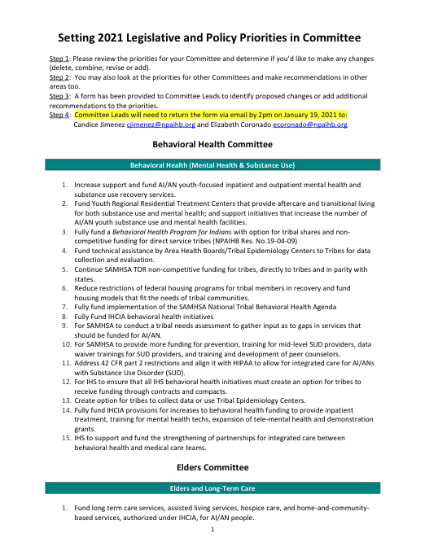
2021 Policy Priorities – Moving Forward
Policy Team Follow-up
Review 2021 Leg & Policy requests
and Biden transition priorities
Compile in draft form for tribal delegates; ‘
this is not a ‘final draft’
Liz/Candice will follow-up for continuous feedback

Slide 27
Mich gayis / Tai itukdi – Thank you!
ecoronado@npaihb.org cjimenez@npaihb.org
Elizabeth J. Coronado, JD Candice B. Jimenez, MPH
Chukchansi Confederated Tribes of Warm Springs

